Slide 1
Debug & Patch
——By M4x

Slide 2
Debug Tools：
Linux
  gdb(peda, pwndbg, gef....)
  pdb
  IDA
Windows
  Ollydbg, Windbg
  IDA
  IDE
Patch Tools:
010editor, winhex, C32Asm
IDA(keypatch), Ollydbg, Windbg
gdb
some github repo

Slide 3
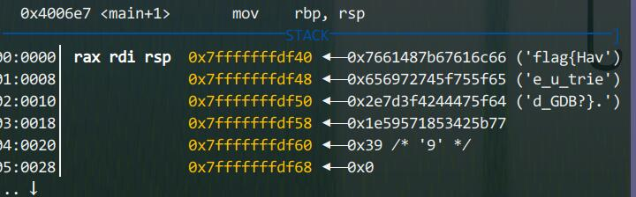
Why dynamic debugging?
watch memory(stack, heap and register)
clarify program flow
for better patch

Slide 4
How dynamic debugging?

