Slide 1
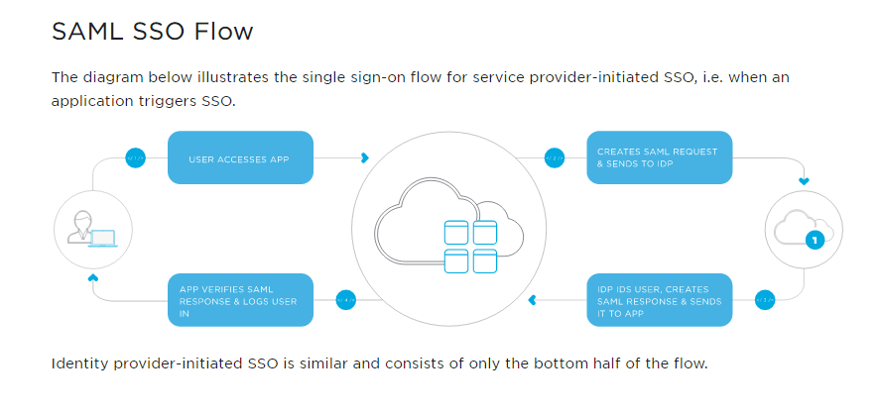
The main elements of a web-based SSO system are:
Web Browser - represents the user within the SSO process
Resource - contains restricted access content that the user wants
Identity Provider (IdP) - authenticates the user
Service Provider (SP) - performs the SSO process for the resource
How SAML SSO Works (Explanation 1)
SAML SSO works by transferring the user’s identity from one place (the identity provider) to another (the service provider). This is done through an exchange of digitally signed XML documents.
Consider the following scenario: A user is logged into a system that acts as an identity provider. The user wants to log in to a remote application, such as a support or accounting application (the service provider). The following happens:
The user accesses the remote application using a link on an intranet, a bookmark, or similar and the application loads.
The application identifies the user’s origin (by application subdomain, user IP address, or similar) and redirects the user back to the identity provider, asking for authentication. This is the authentication request.
The user either has an existing active browser session with the identity provider or establishes one by logging into the identity provider.
The identity provider builds the authentication response in the form of an XML-document containing the user’s username or email address, signs it using an X.509 certificate, and posts this information to the service provider.
The service provider, which already knows the identity provider and has a certificate fingerprint, retrieves the authentication response and validates it using the certificate fingerprint.
The identity of the user is established and the user is provided with app access.

Slide 2
Another way of describing how SAML SSO Works
Step 1: User accesses the Resource
The user starts by attempting to access the protected resource. The resource monitor determines if the user has an active session and, discovering that they do not, directs them to the service provider in order to start the SSO process.
Step 2: Service Provider issues Authentication Request
The user arrives at the Service Provider which prepares an authentication request and sends it and the user to the Identity Provider. The Service Provider software is generally installed on the same server as the resource.
Step 3: User Authenticated at Identity Provider
When the user arrives at the Identity Provider it checks to see if the user has an existing session. If they do, they proceed to the next step. If not, the Identity Provider authenticates them (e.g. by prompting for, and checking, a username and password) and the user proceeds to the next step.
Step 4: Identity Provider issues Authentication Response
After identifying the user, the Identity Provider prepares an authentication response and sends it and the user back to the Service Provider.
Step 5: Service Provider checks Authentication Response
When the user arrives with the response from the Identity Provider, the Service Provider will validate the response, create a session for the user, and make some information retrieved from the response (e.g. the user's identifier) available to the protected resource. After this, the user is sent to the resource.
Step 6: Resource returns Content
As in Step 1, the user is now trying again to access the protected resource, but this time the user has a session and the resource knows who they are. With this information the resource will service the user's request and send back the requested data.

Slide 3
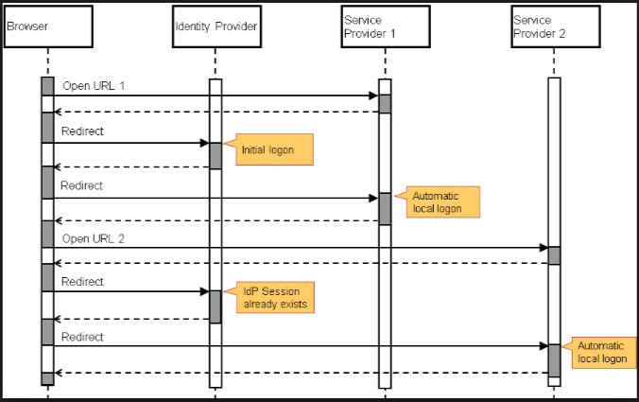
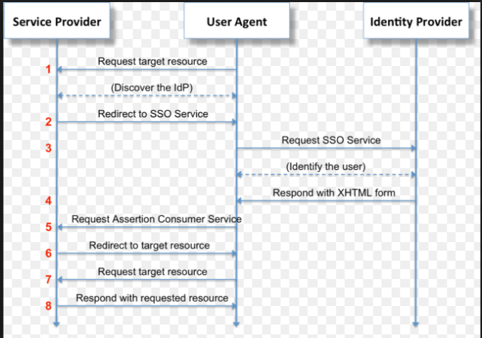
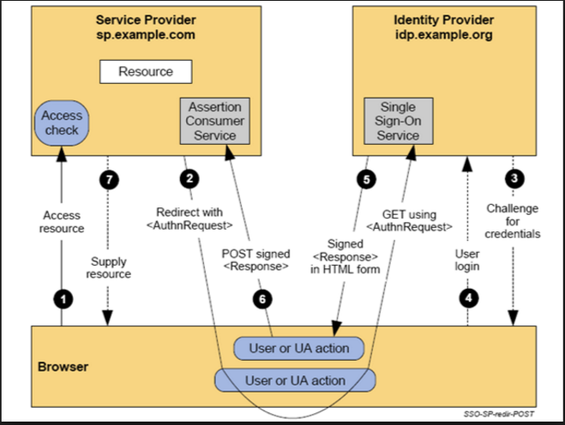
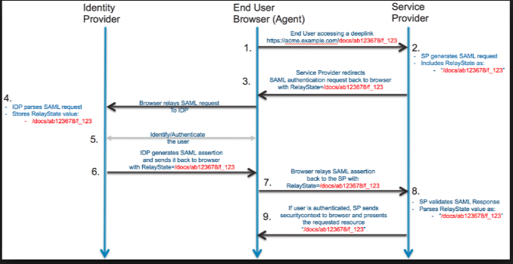

Slide 4
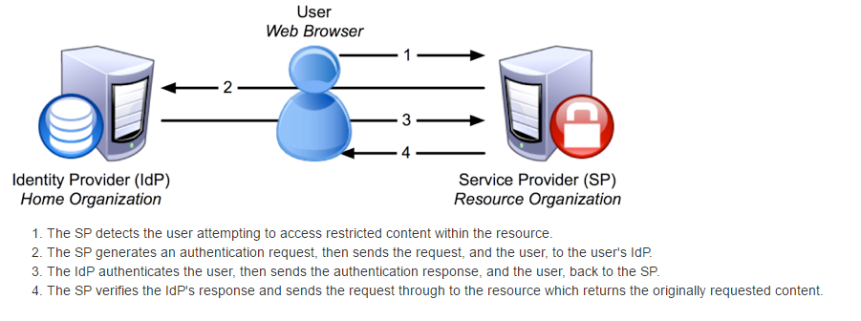
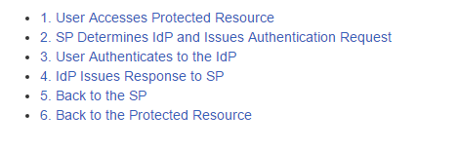
Protected Resource
Httpd.conf
Shibboleth2.xml
<RequestMap>
SessionInitiator
SAML Metadata
Idp Discovery
Relying-party.xml
Attribute Resolver
Attribute Filter
Signing with IDP’s key
Encrypting with SP’s key
Assertion Consumer Service
Attribute Filter
Signing with IDP’s key
Encrypting with SP’s key
SP’s attribute extractor
SP’s session cache

Slide 5
User Accesses Protected Resource
A user tries to access a protected resource, causing the SP to intercept the request.
The resource locations to protect can be defined in the web server configuration itself, such as httpd.conf, or in shibboleth2.xml (or a separate file) using the <RequestMap>
SP Determines IdP and issues Authentication Request
The SP will select a SessionInitiator to use based on this protection configuration, which in turn is responsible for determining which IdP the user will be referred to and what protocol to use. The providers signal their profile preferences to one another through the exchange of SAML metadata.
The process of determining the IdP to use is called IdP Discovery and can include a combination of configuration options, various web-based interactions, cookies, and other techniques. A SessionInitiator might supply a text entry box, refer the user to a locally or remotely deployed discovery service (DS), or select a fixed IdP based on the resource requested.
In some legacy configurations, the SP may use an older-style discovery mechanism called a "WAYF" service. In this case, the request for authentication is assumed to be a legacy Shibboleth 1.x request and is issued to the WAYF itself, which then relays the request to the IdP once the selection is made. This approach is limited to SAML 1.x use, does not interoperate with most other SAML implementations, and is not recommended for new installations.
An authentication request is issued by the SP to the IdP as a result of the previous step
The format of this request depends on the protocol and binding/profile selected by the SP.
The authentication request is passed through the browser, and the client is redirected (via GET or POST) to an endpoint at the IdP typically called a "Single Sign-On Service".
The IdP examines the request and decides how it would like to authenticate the user based on rules established for the SP in relying-party.xml and authentication in general in <LoginHandler> and login.config.
The user is redirected to the selected login handler, authenticates (or tries to) using the method selected, and eventually control passes back to the profile handler with their username set.

Slide 6
IDP issues response to SP
The IdP now uses the principal's name, the SP, and the protocol and binding/profile selected to decide what information to send the SP and how to package it.
First, the IdP gathers a set of attributes for the user using the attribute resolver. It collects user data from all the backend sources, transforms it if necessary, and attaches encoders to each attribute.
These attributes are passed through the attribute filter, which may pare down the information to be included in the response. The set of attributes released most often depends on the SP and the principal. This protects the user's privacy. The resulting information could be as little as "someone authenticated successfully", or reveal any attribute you can imagine.
The user's information is packaged into a form suitable for the eventual response using the encoders attached earlier, typically in a SAML assertion. This assertion may be signed with the IdP's key and, in the case of a SAML 2.0 assertion, encrypted with the SP's key for security and privacy. The assertion (or a reference to it called an artifact) is placed into a response that is passed through the client browser for delivery back to the SP to an endpoint called an Assertion Consumer Service.
The browser delivers the response from the IdP to an Assertion Consumer Service endpoint at the SP. The ACS implementation decodes the message, decrypts the assertion if necessary, and performs a variety of security checks. If everything is in order, then the SP will create a new user session after extracting attributes and other information from the message. Attributes are translated into a cacheable form using the SP's AttributeExtractor, passed through an AttributeFilter, and cached in the new session along with other relevant information.
In the final step, the browser is redirected to the protected resource accessed in Step 1, but this time the access occurs in the context of a session stored within the SP's SessionCache. Assuming the session is recognized and validated by the SP, any applicable AccessControl plugins will be enforced, and assuming access is granted, the request will proceed, with any cached attributes attached to the request.

