Slide 1
Cryptography
The Basics

Slide 2
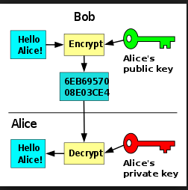
Unencrypted data (plain text, machine readable, decipherable) is encrypted
using an encryption algorithm (“Cipher”) and an encryption key.
This process generates CipherText
The diagram shows public and private key
These are asymmetric keys
In symmetric cryptography, the same keys are used
For encryption and decryption

