Slide 1

大学物理（热学）
1) Maxwell-Boltzmann
Distribution
2) Phase transition
2006-11-06

Slide 2

Maxwell-Boltzmann分布率

Slide 3
1866年，Maxwell承认他1860年的推导“may
他又给出了另一个推导.
appear precarious” .
现在他考虑的是两个粒子碰撞的速度，而不
是一个粒子的不同速度分量，存在统计的独
立性.这就意味着
F(v ,v ) = f (v ) f (v )
1 2
1
2
接着，他指出平衡态的达到，只有在初始态
(v ,v )
碰到末态
○ 
(v ,v ) 的碰撞数等于反过
1 2
1 2
来的逆过程的碰撞数时才能发生. 这样

Slide 4

○ 
F(v ,v ) = F(v ,v )
1 2
1 2
即
○ 
f (v ) f (v ) = f (v ) f (v )
1
2
1
2
同时
1
2
1
1
1
² +
² =
○
○
² +
2
2 2
m v m v m v m v
1 1
2
2 2
2
1 1
2
类似于前面的推导，他得到

Slide 5

N
³³ ²
f =
(v)
− ²  ²
exp( v )
其中
2k_{B}T
 ² =
m
1868年，Boltzmann将这种考虑推广到存在
V(x)
外力的情况，即在势函数 的情况 这时能
.
量守恒的条件应该是
1
2
1
1
1
² = ² +  + ²
² + +
m v V(x ) m v m v V(x ) m v
1 1
1
2
2 2
2
1 1
1
2
2 2

Slide 6

然后Boltzmann采用Maxwell的推导方式，得
到


1

✓
2
f (v) = cexp − h mv +V(x)

⬇

☒

2
✗
☑
其中
1
h =
k T
B
这就是著名的Maxwell-Boltzmann分布率.

Slide 7
Temperature Dependence
of C h emical Reactions

Slide 8
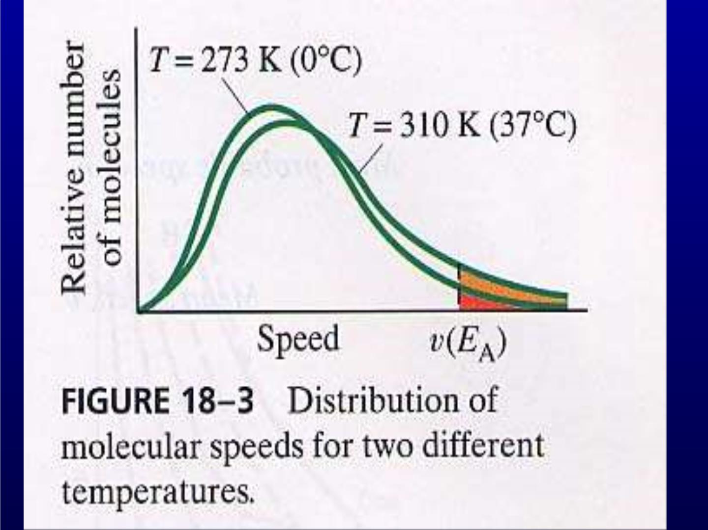

Slide 9
Phase Transition

Slide 10
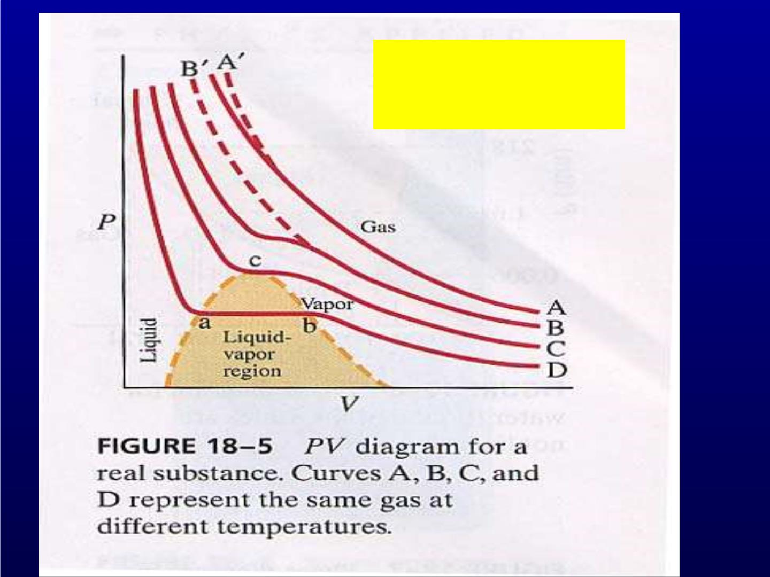
PV=Nk_{B}T
P – low, T –high

Slide 11
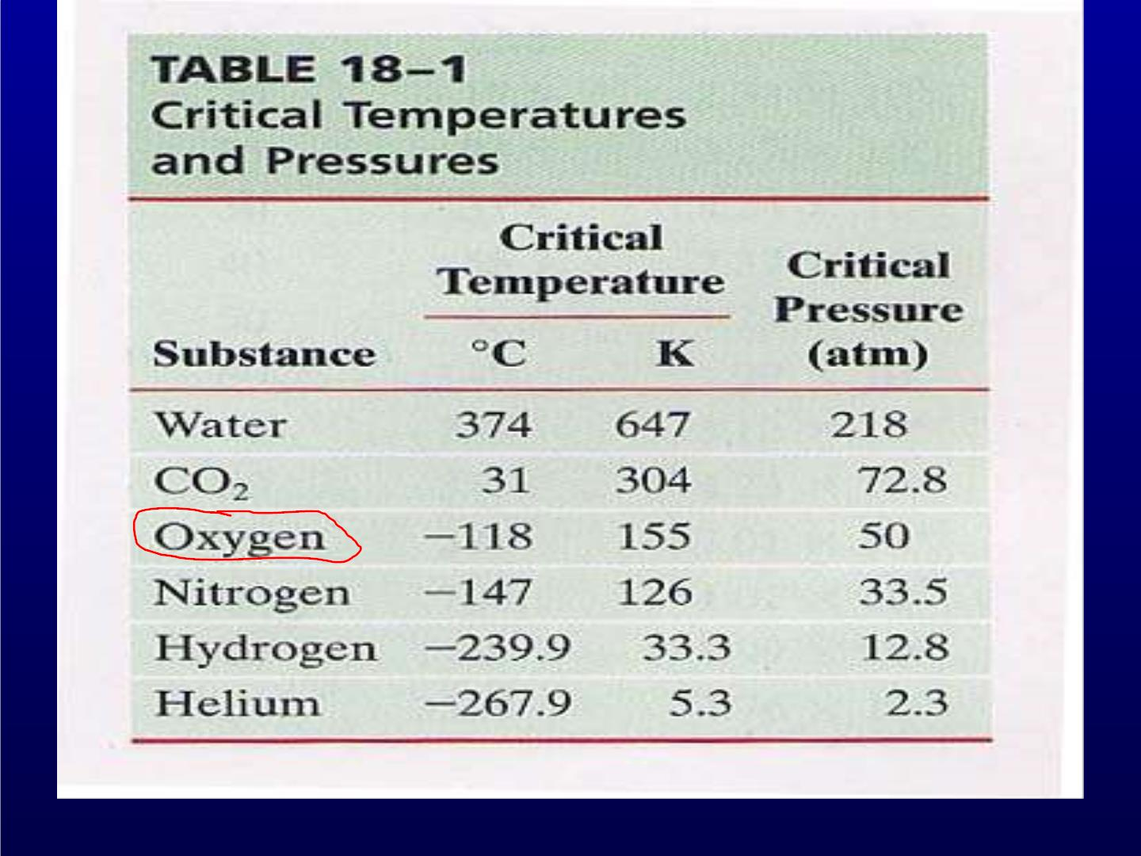

Slide 12
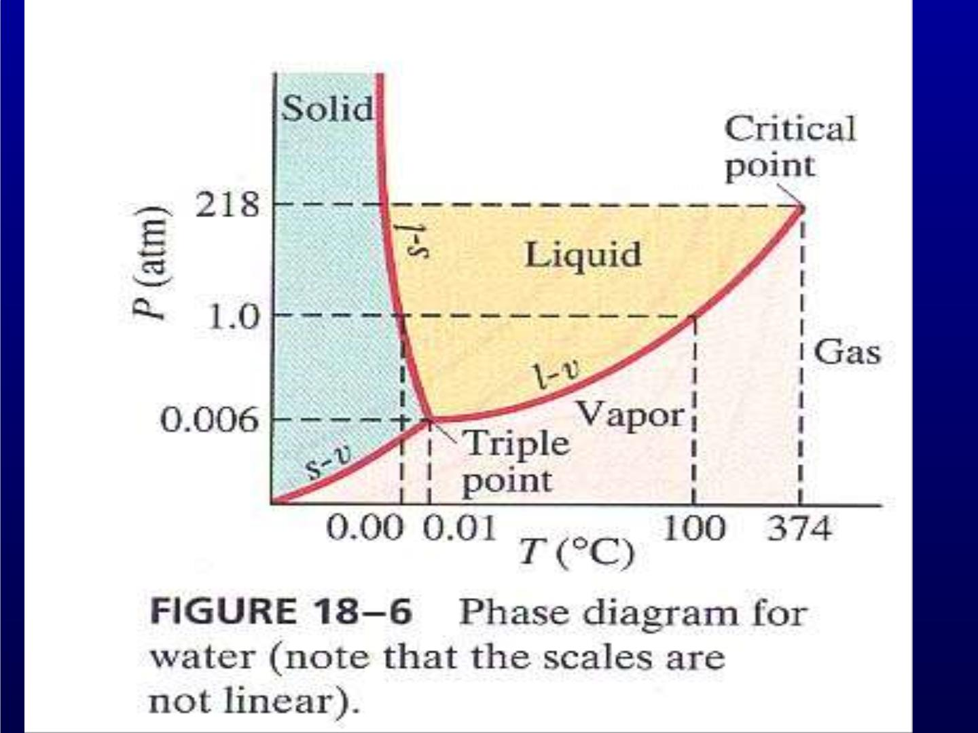

Slide 13
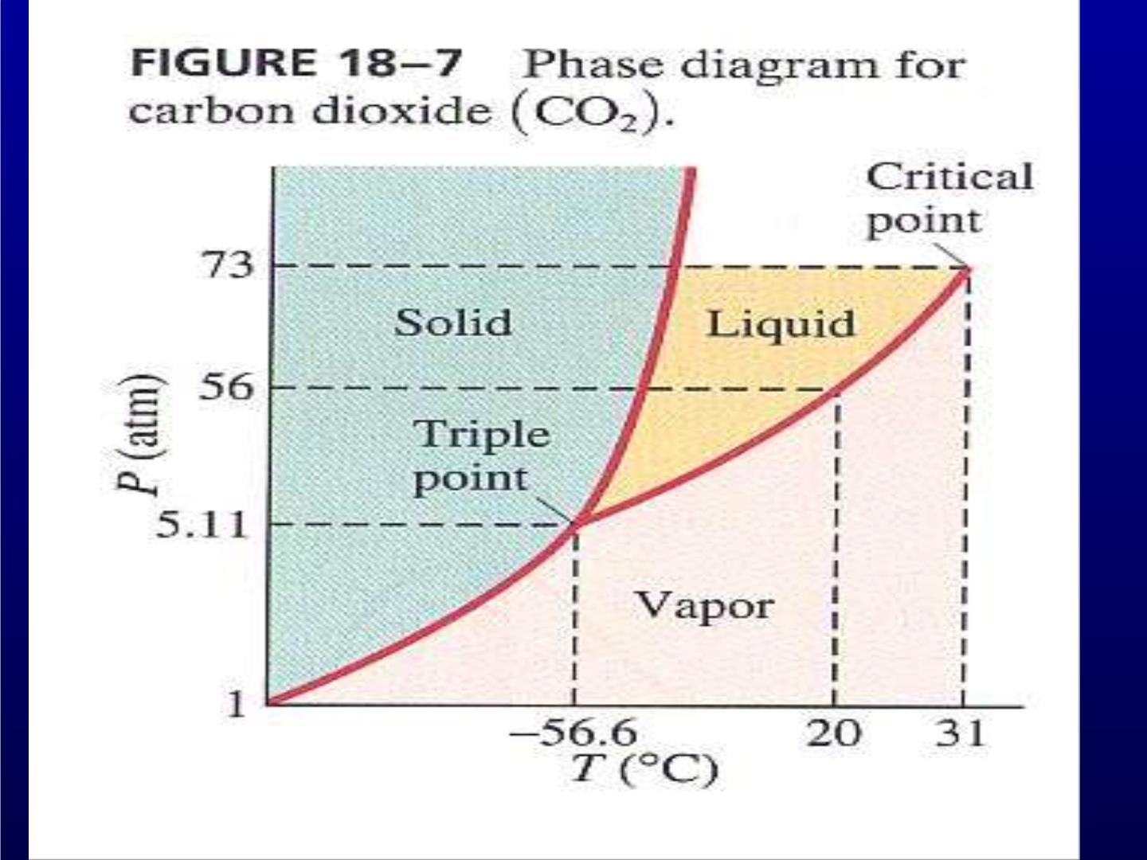

Slide 14
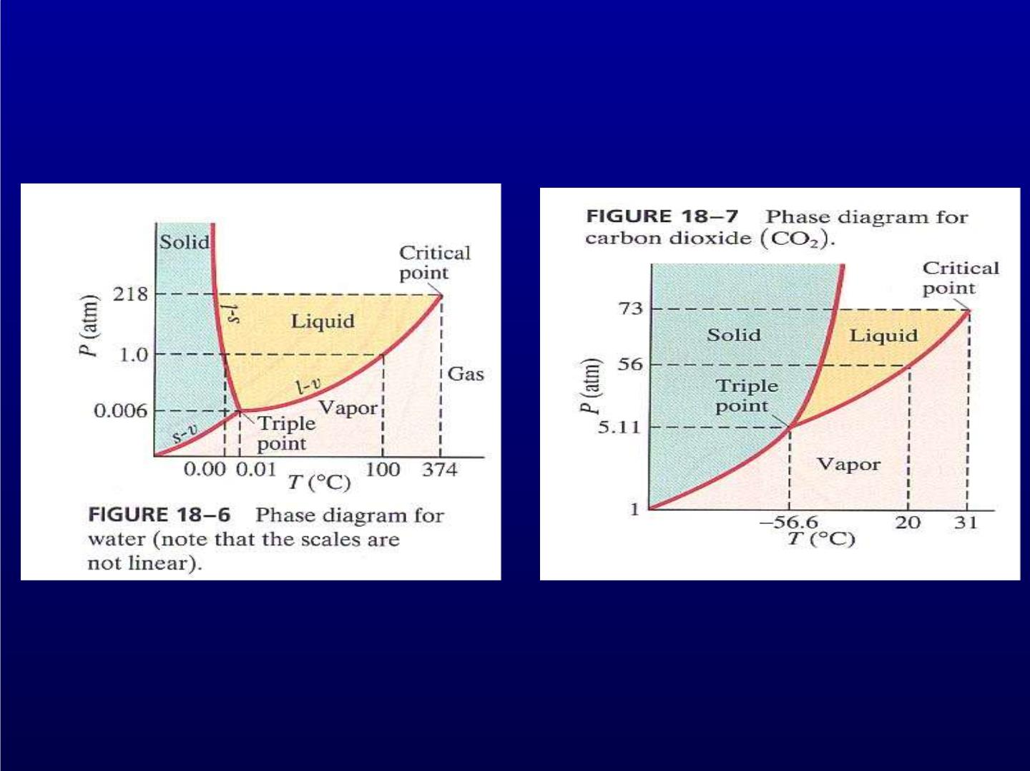

Slide 15
Evaporation

Slide 16
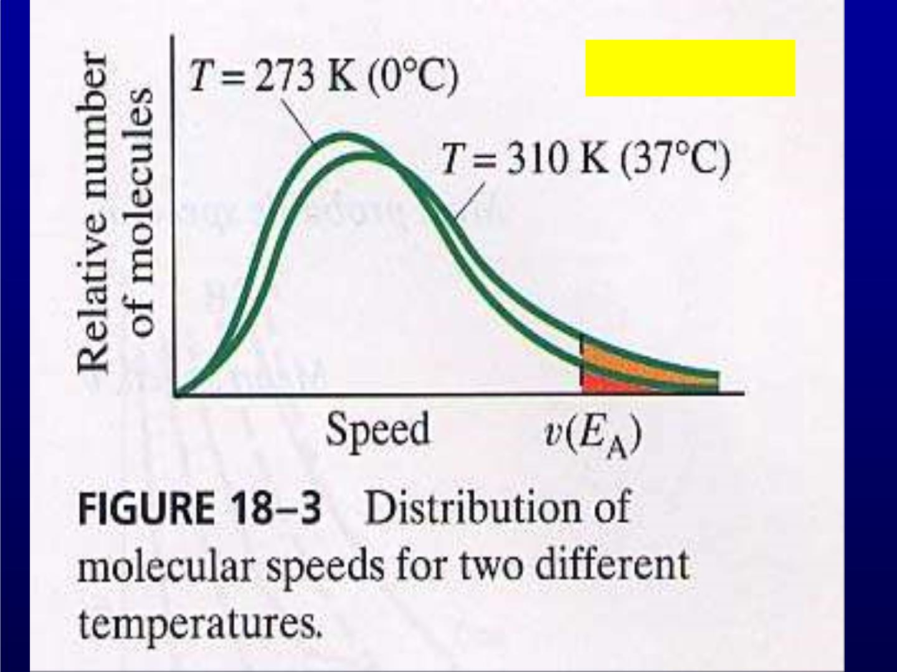
In a Liquid

Slide 17
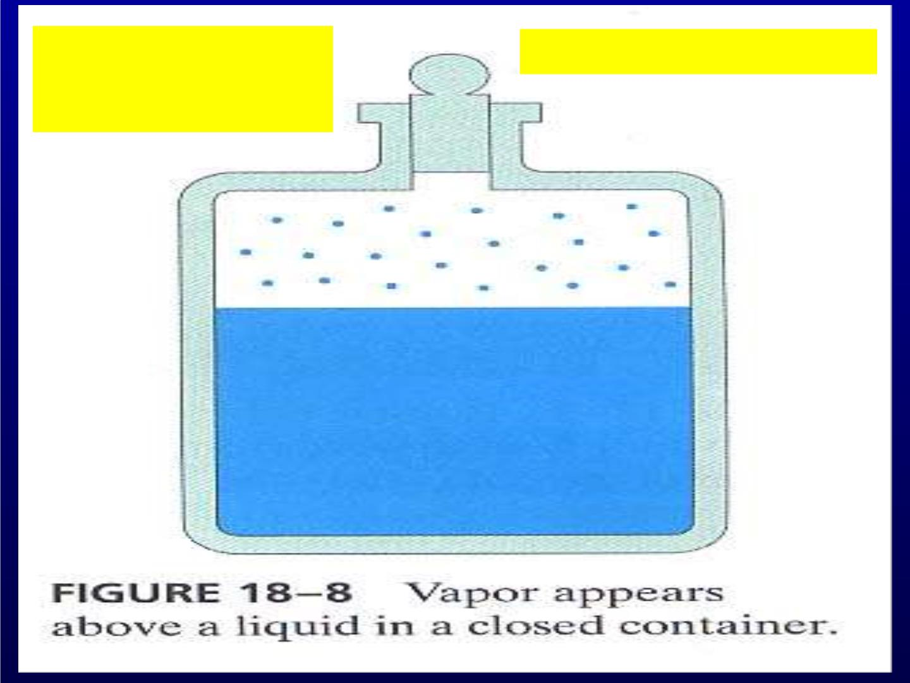
1)Evaporation
Saturated Vapor Pressure
2) Condensation

Slide 18
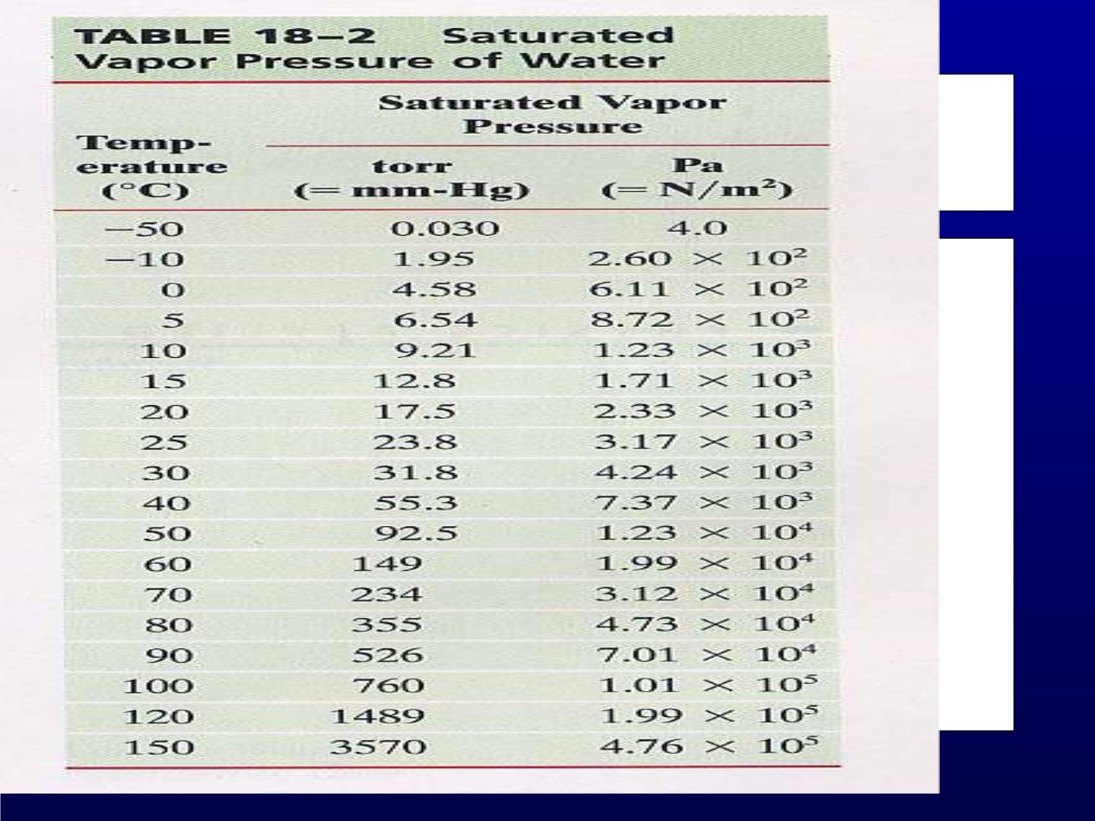

Slide 19
Boiling

Slide 20
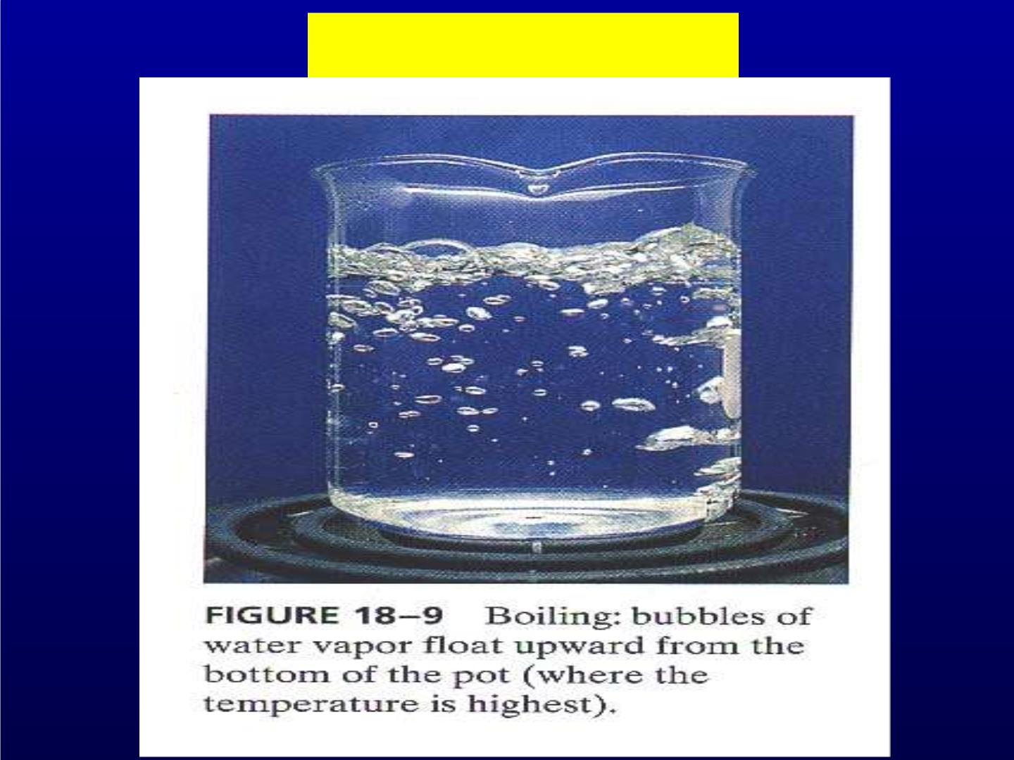
Boiling: P_{SVP}=P_{External}

Slide 21
Humidity

Slide 22

Partial Pressure
Humidity
Partial− P −of − H2O
Relative− Hum idity=
100%
SVP −of − H2O
For: 30ºC, PP of water in the air 21.0
torr, then
2 1.0to rr
RH =
100% = 66%
3 1.8to rr

Slide 23
Supersaturation
For: 30ºC, PP of water in the air 21.0 torr,
if T falls to 20ºC (SVP=17.5 torr), then
RH would exceed 100%,
What would happen ?
Dew or Fog or Rain might appear !
Dew point – as a measure of RH.

Slide 24
Van der Waals
Equation of State

Slide 25
Van der Waals in 1873:
1) Finite size of molecules
2) Attractive forces between molecules
What would happen ?

Slide 26
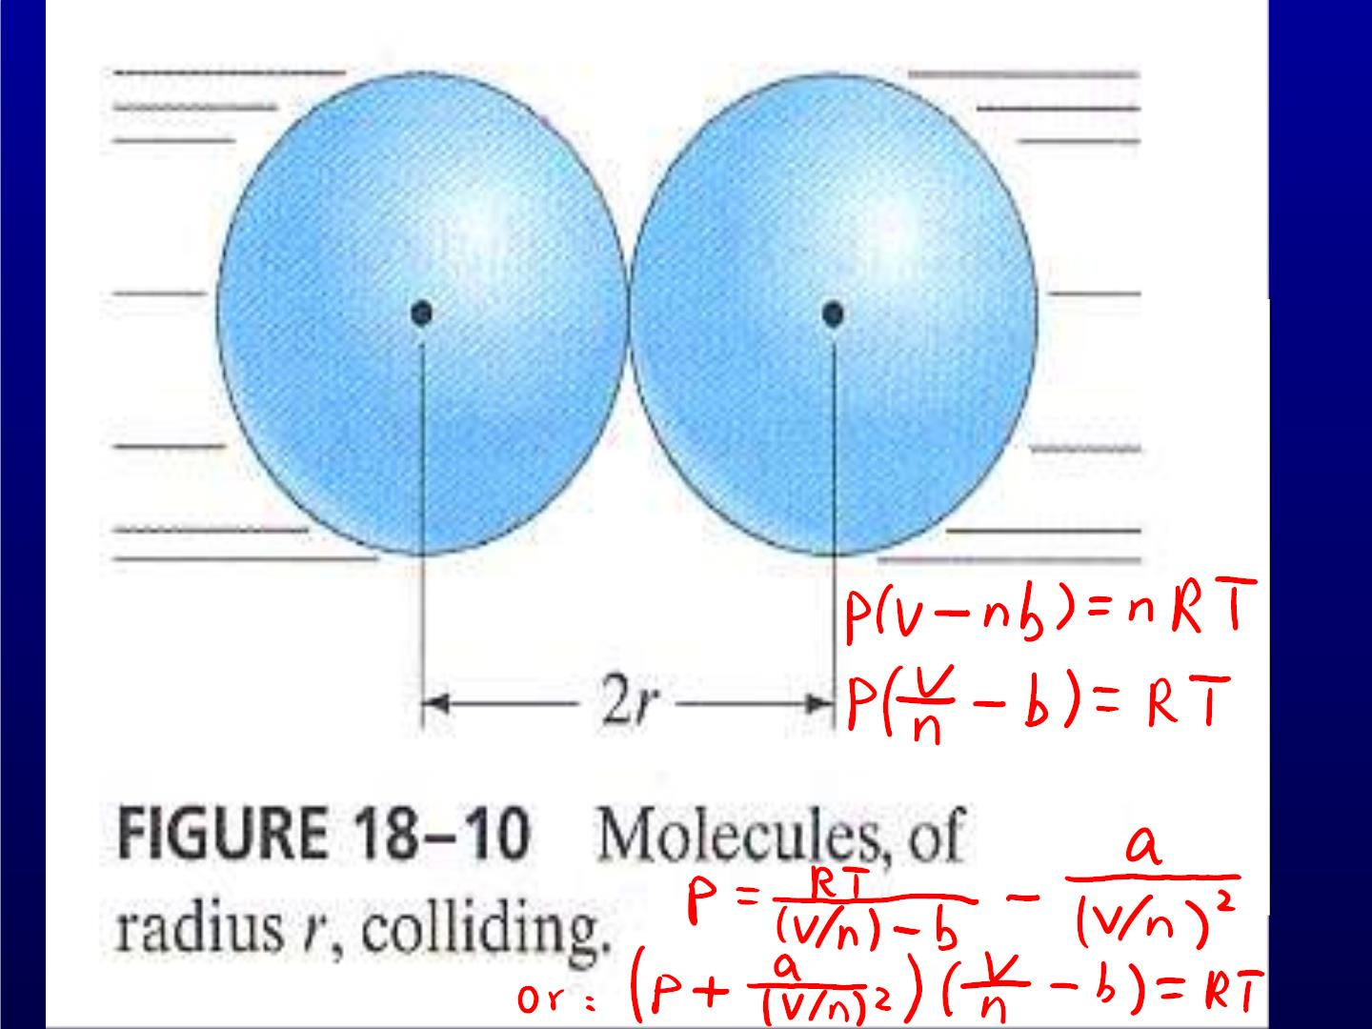

Slide 27
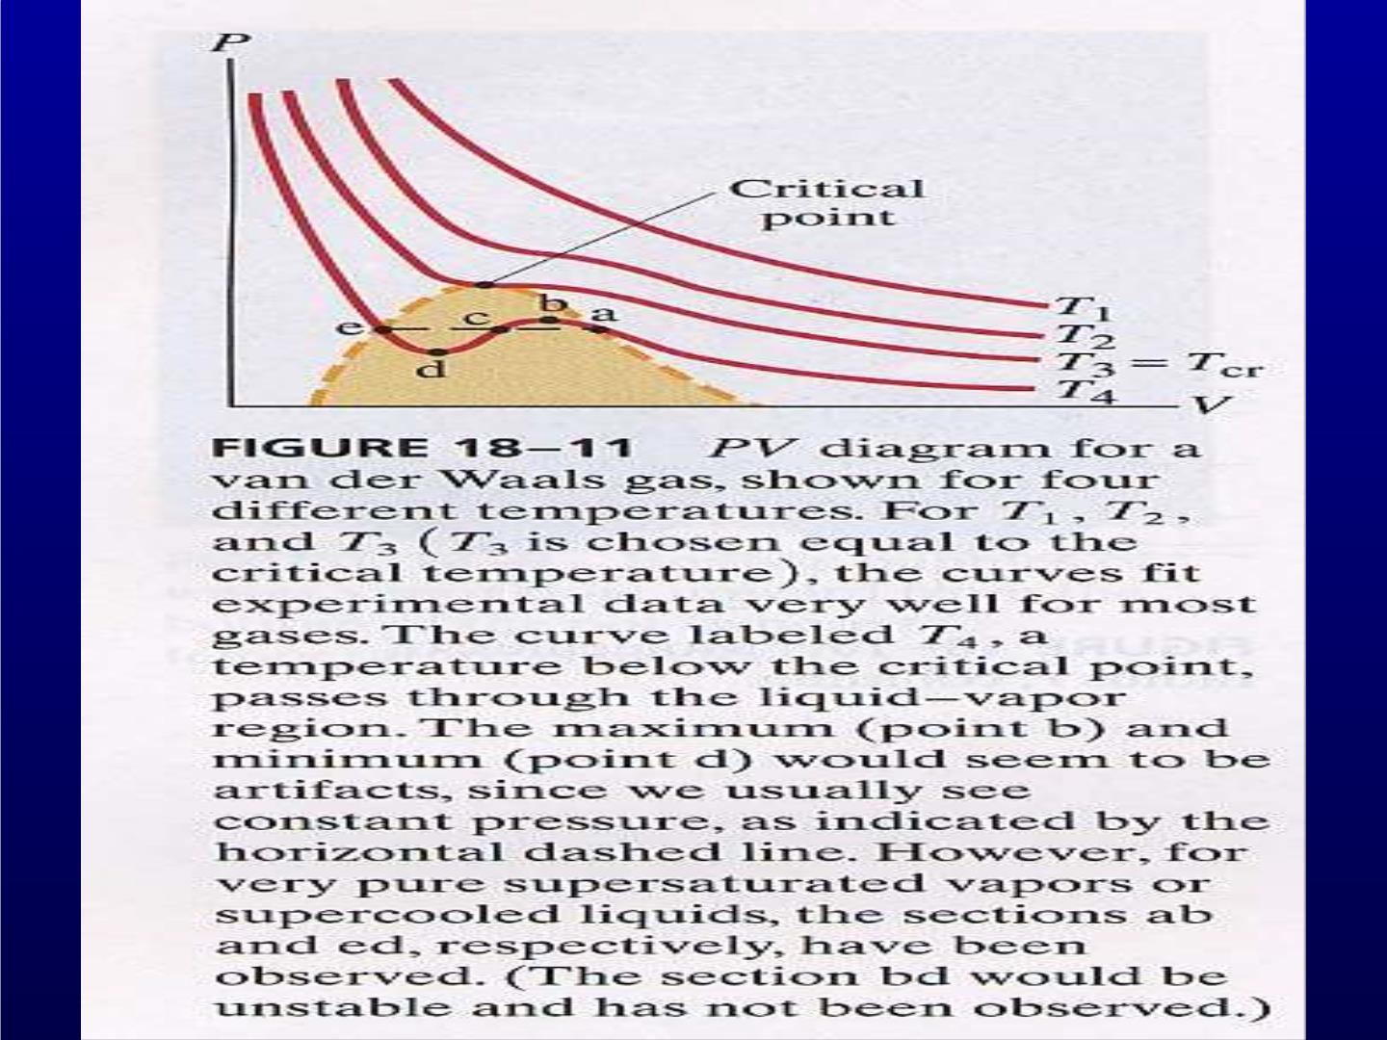

Slide 28
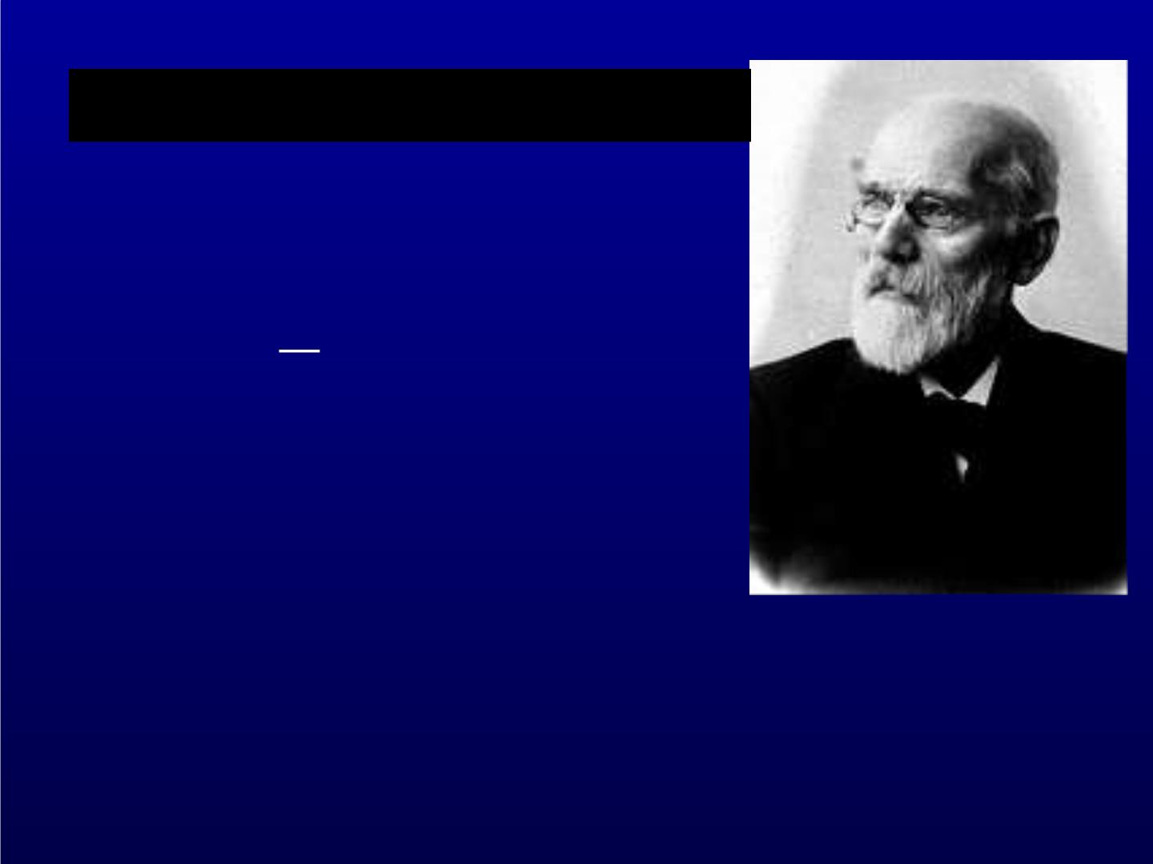
Va n der Waals: 126 000 items
14.1 Van der Waals’ equation
(1873)

 n ²
V 

( )
p a    V − nb = nRT
+




Johannes Diderik Va n der Waals
(1837-1923)
The Nobel Prize in Physics 1910
"for his work on the equation of state for gases
and liquids"

Slide 29

Virial expansion


−1
2
−1
   
a n
n
pV = nRT +
1−
 
p V   V 
   
1
b








a n
= nRT 1+ b −
+☹





 RT V


Slide 30
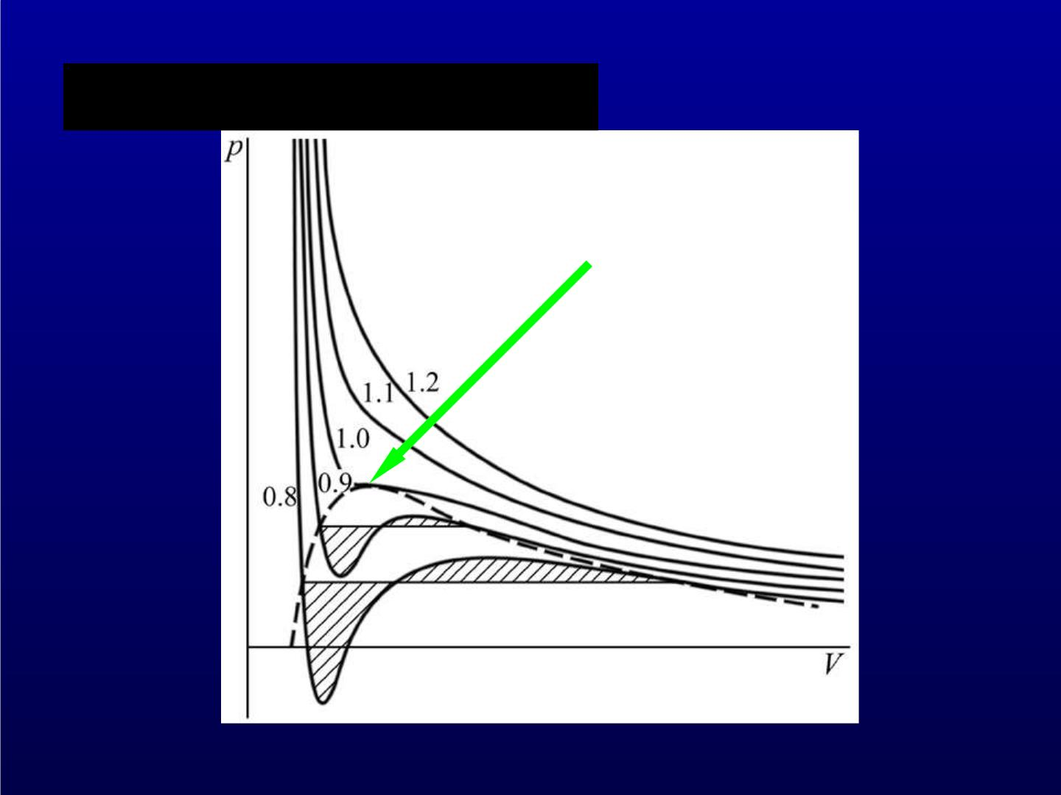
Va n der Waals isotherms
Critical point

Slide 31
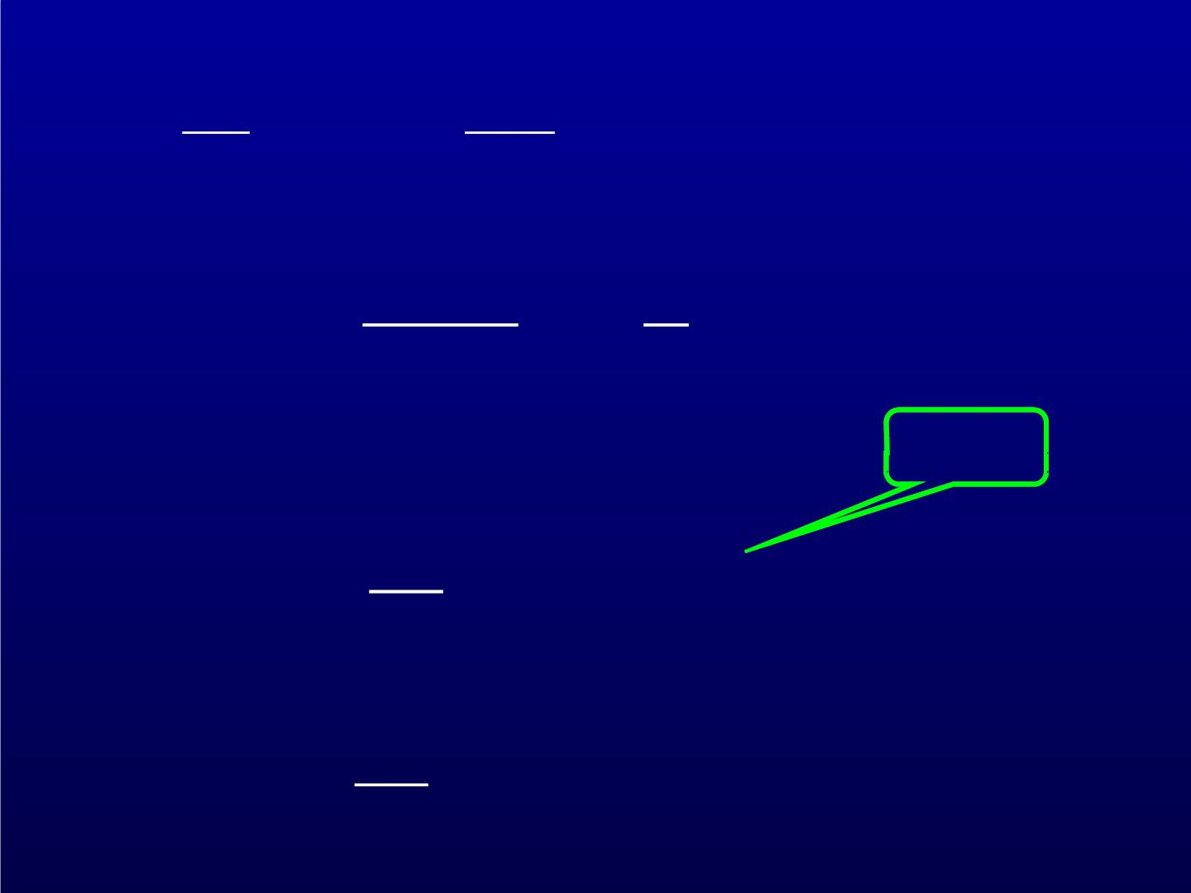
p
 
 
 
² p
 
V
= 0,
 
= 0
p , V , T
 
C C C
✰ ²
V
 
T
T
nRT  n 
− a
2
p =
 
V − nb V
☹
 
tilde
Dimensionless version:
 3  ~
~
~
( )
 p  3V −1 = 8T
+
~
2
 V 
where
~
p
p  , ☹
p
C

Slide 32
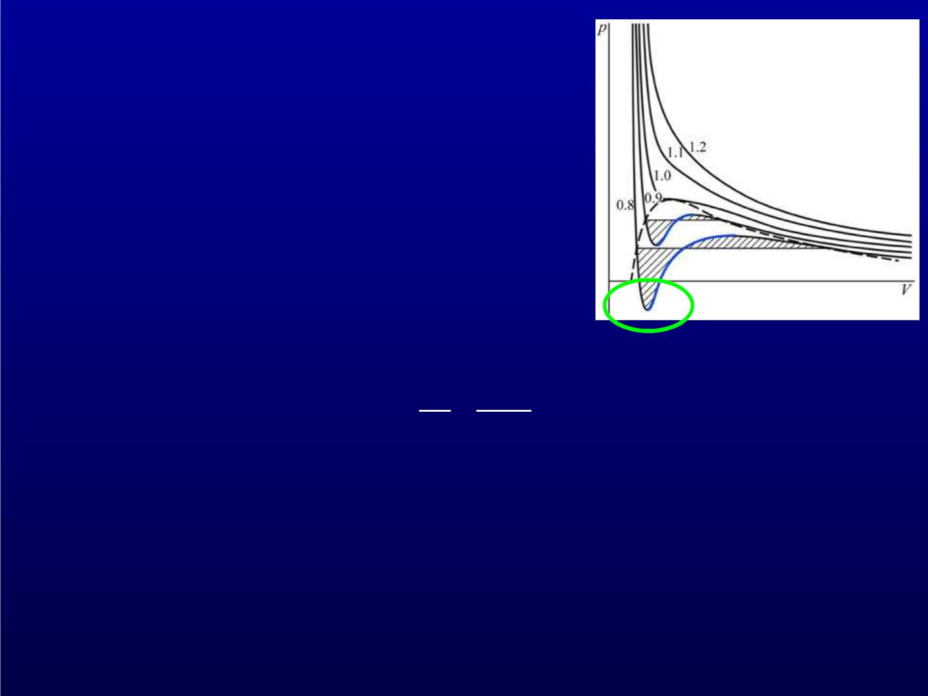
Problems:
1. non-physical part (p < 0)
2. There is no solid phase.
3. Stability requires
  
1 V
 = −    0
 
V p
T
 
T
Positive slope part is not stable.

