Slide 1

大学物理（热学）
1) Review
2) Applications
2006-12-6
2021/9/5
1

Slide 2
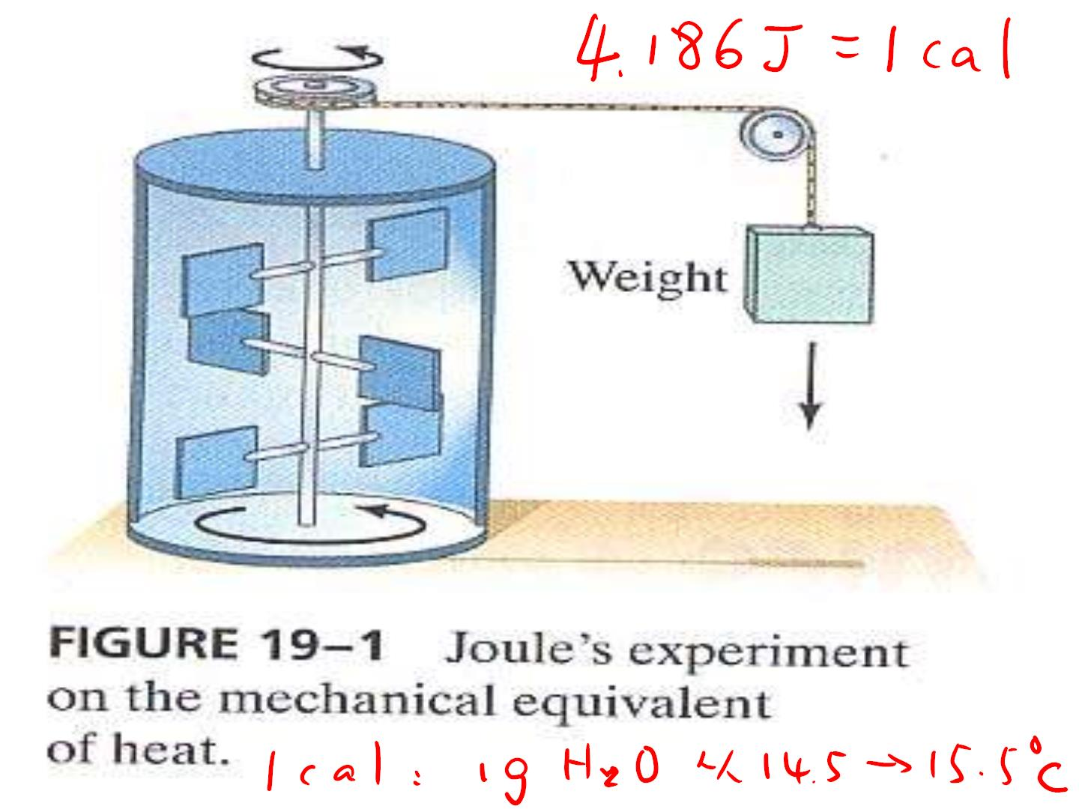

Slide 3

• Heat is energy that is
transferred from one body
to another because of a
difference in temperature.

Slide 4
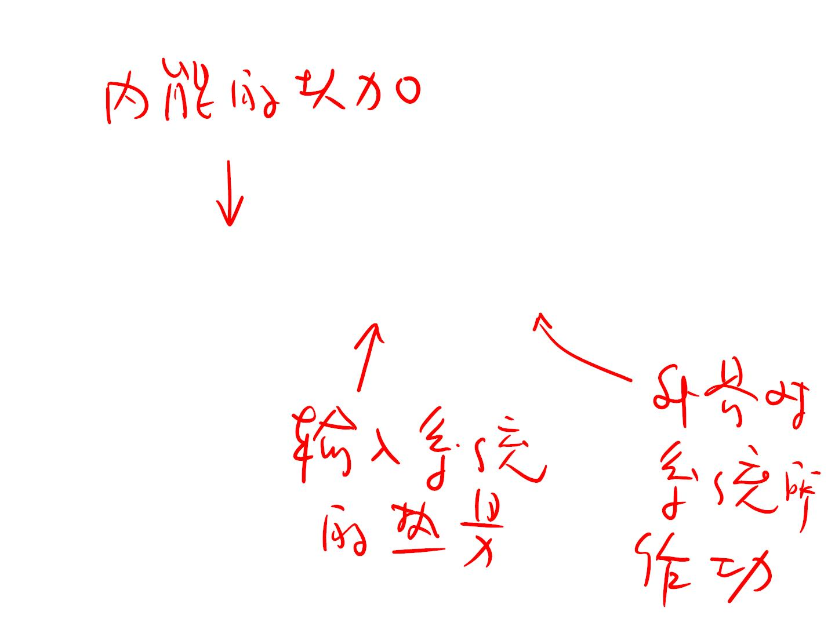
•dU=dQ+dW

Slide 5
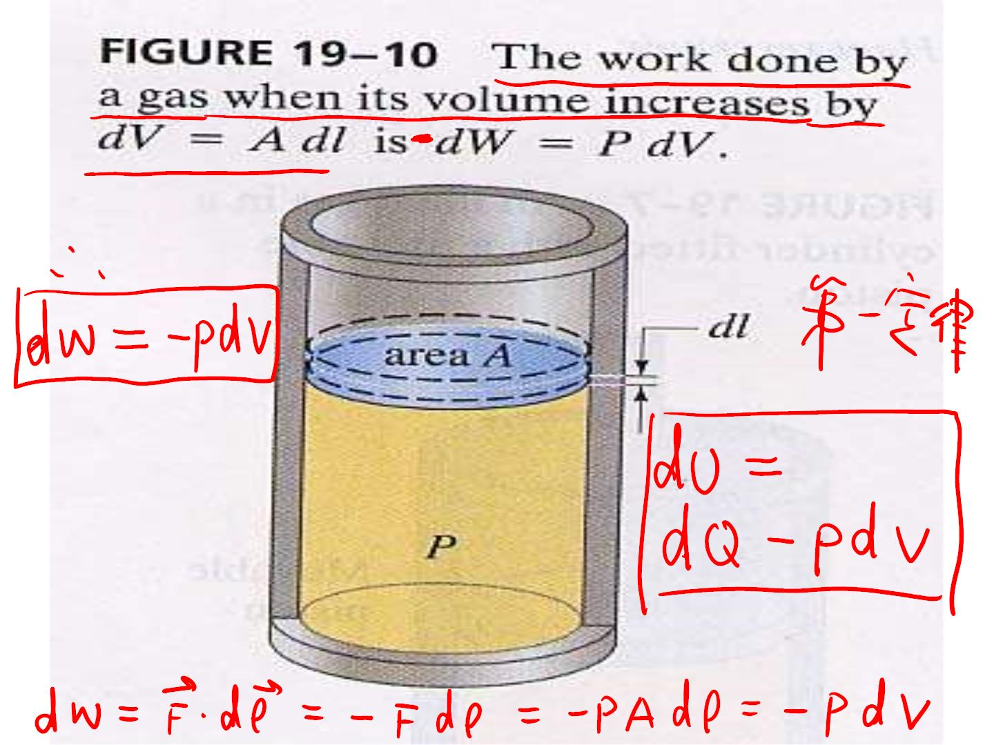

Slide 6
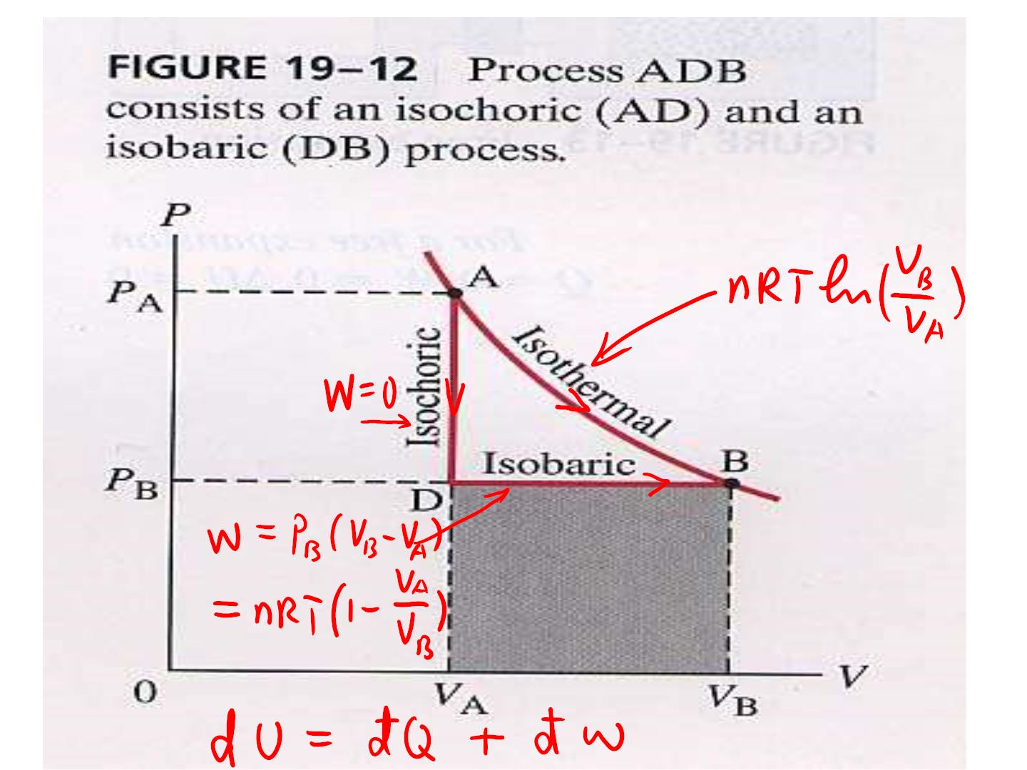

Slide 7
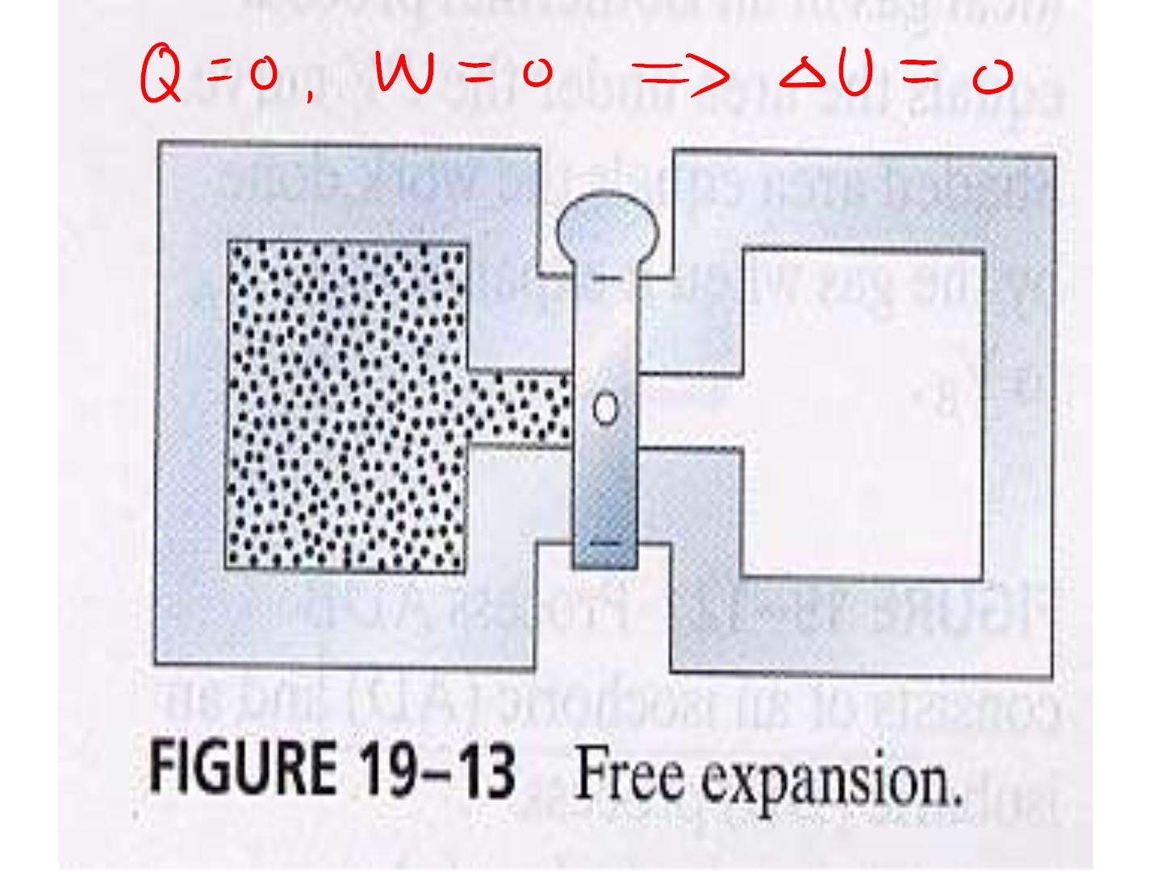

Slide 8

•Molar Specific Heats
•Q=nC ⊿T (C =mc /n)
v
v v
•Q=nC ⊿T (C =mc /n)
p
p p

Slide 9
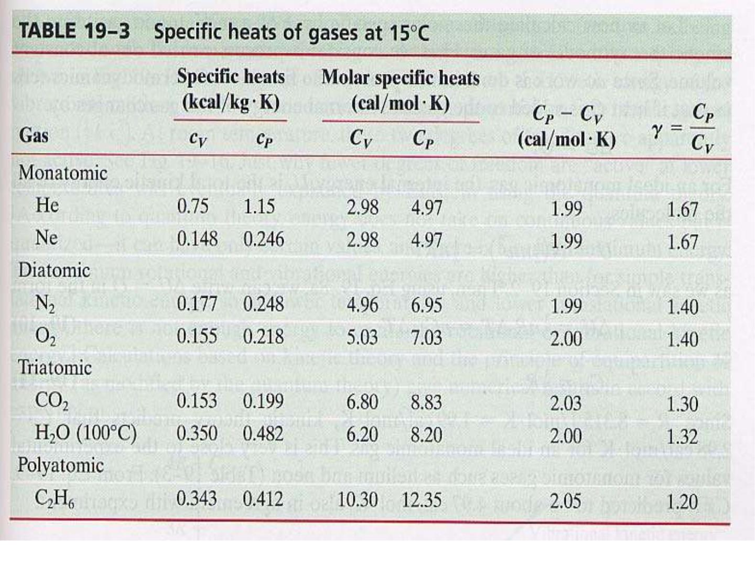

Slide 10
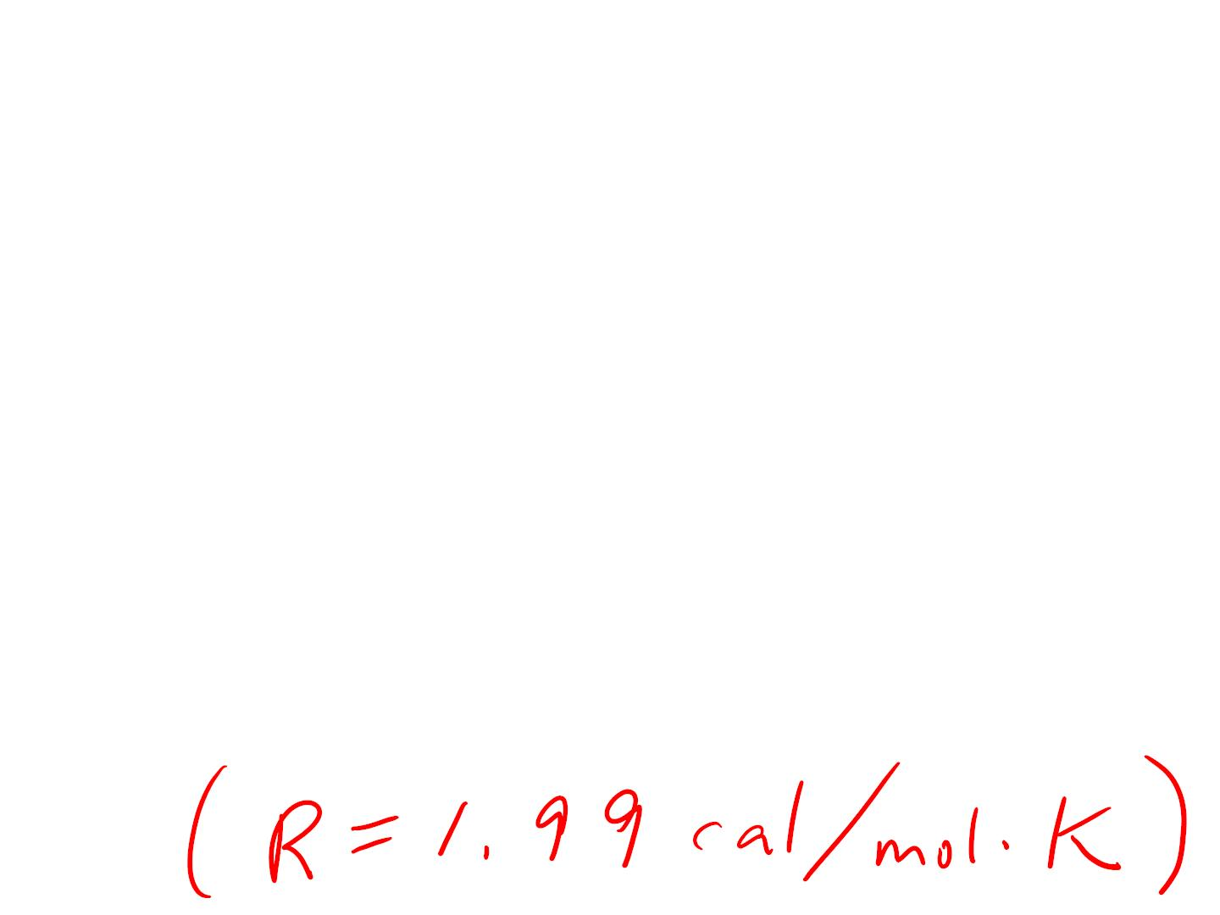
for the same ⊿T:
Q_{v}=⊿U (dU=dQ-PdV)
Q_{p}=⊿U+P⊿V
Q -Q =P⊿V
p v
nC ⊿T-nC ⊿T=P(nR ⊿T/P)
p
v
C -C =R
p v

Slide 11

an ideal monatomic gas:
Q_{v}=⊿U
Because: U=3nRT/2
Thus: ⊿U=3nR⊿T/2=nCv⊿T
Or: Cv=3R/2

Slide 12
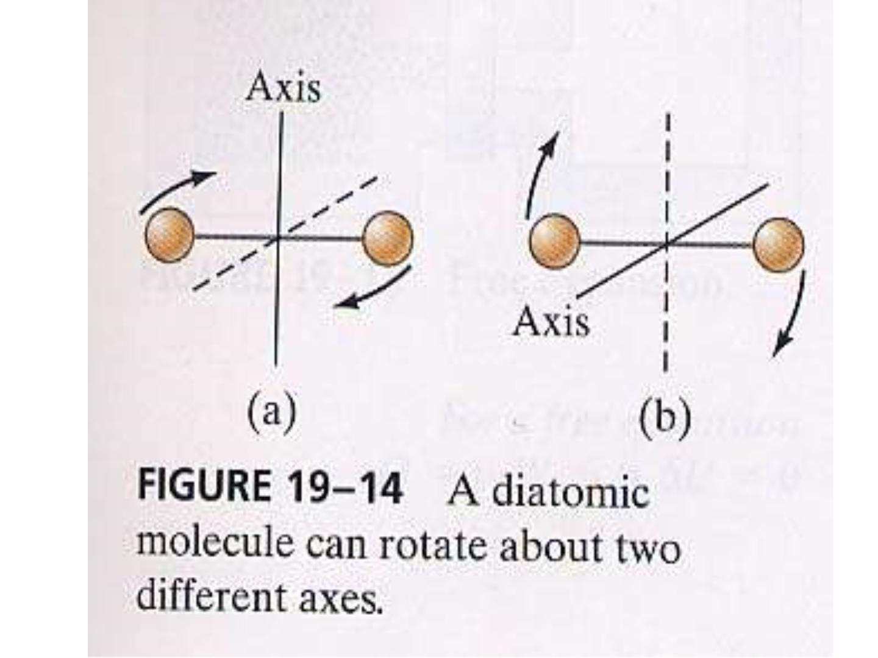

Slide 13
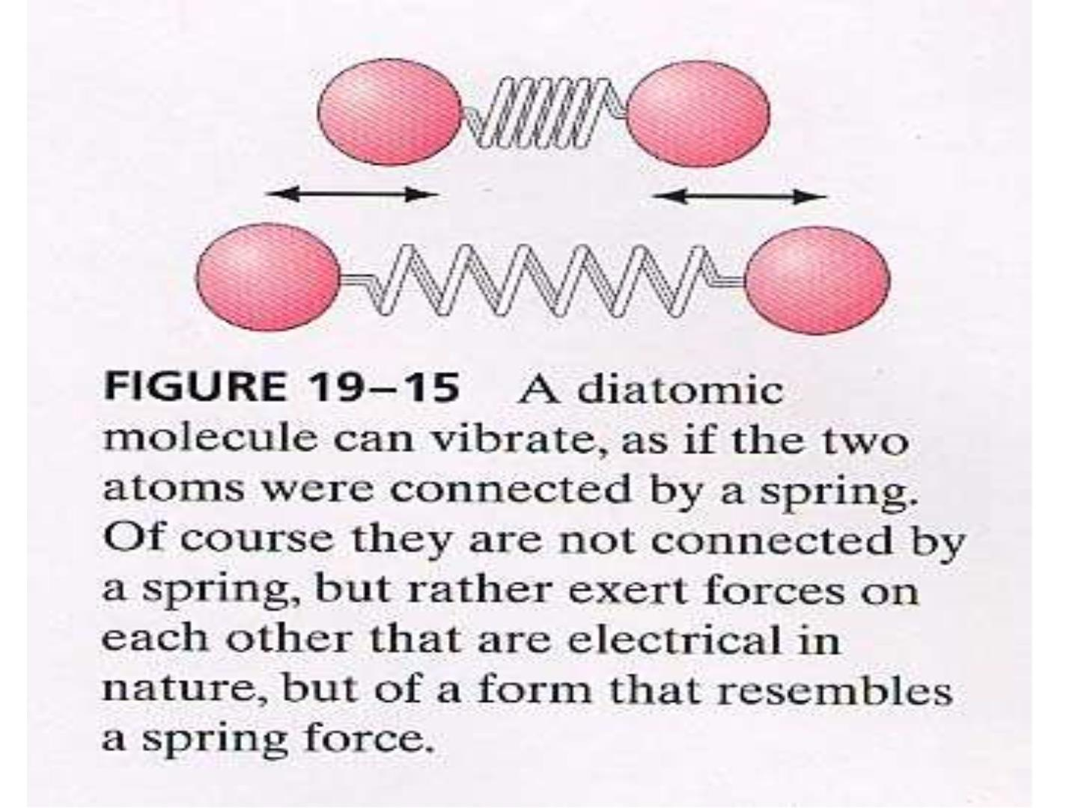

Slide 14
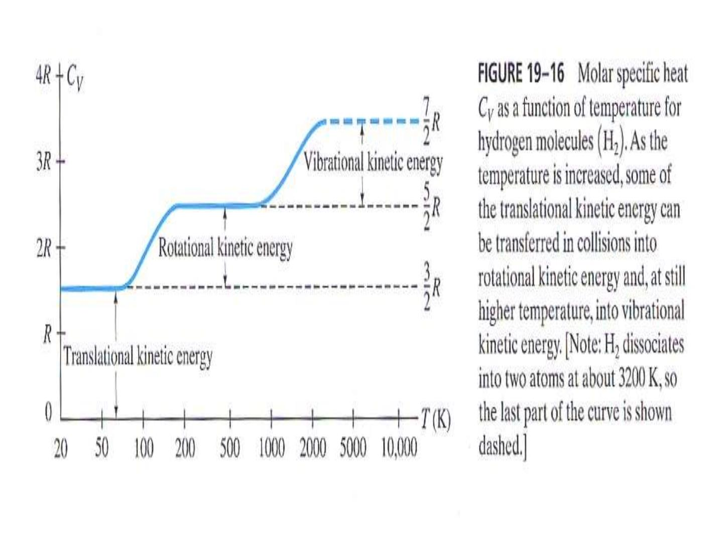

Slide 15
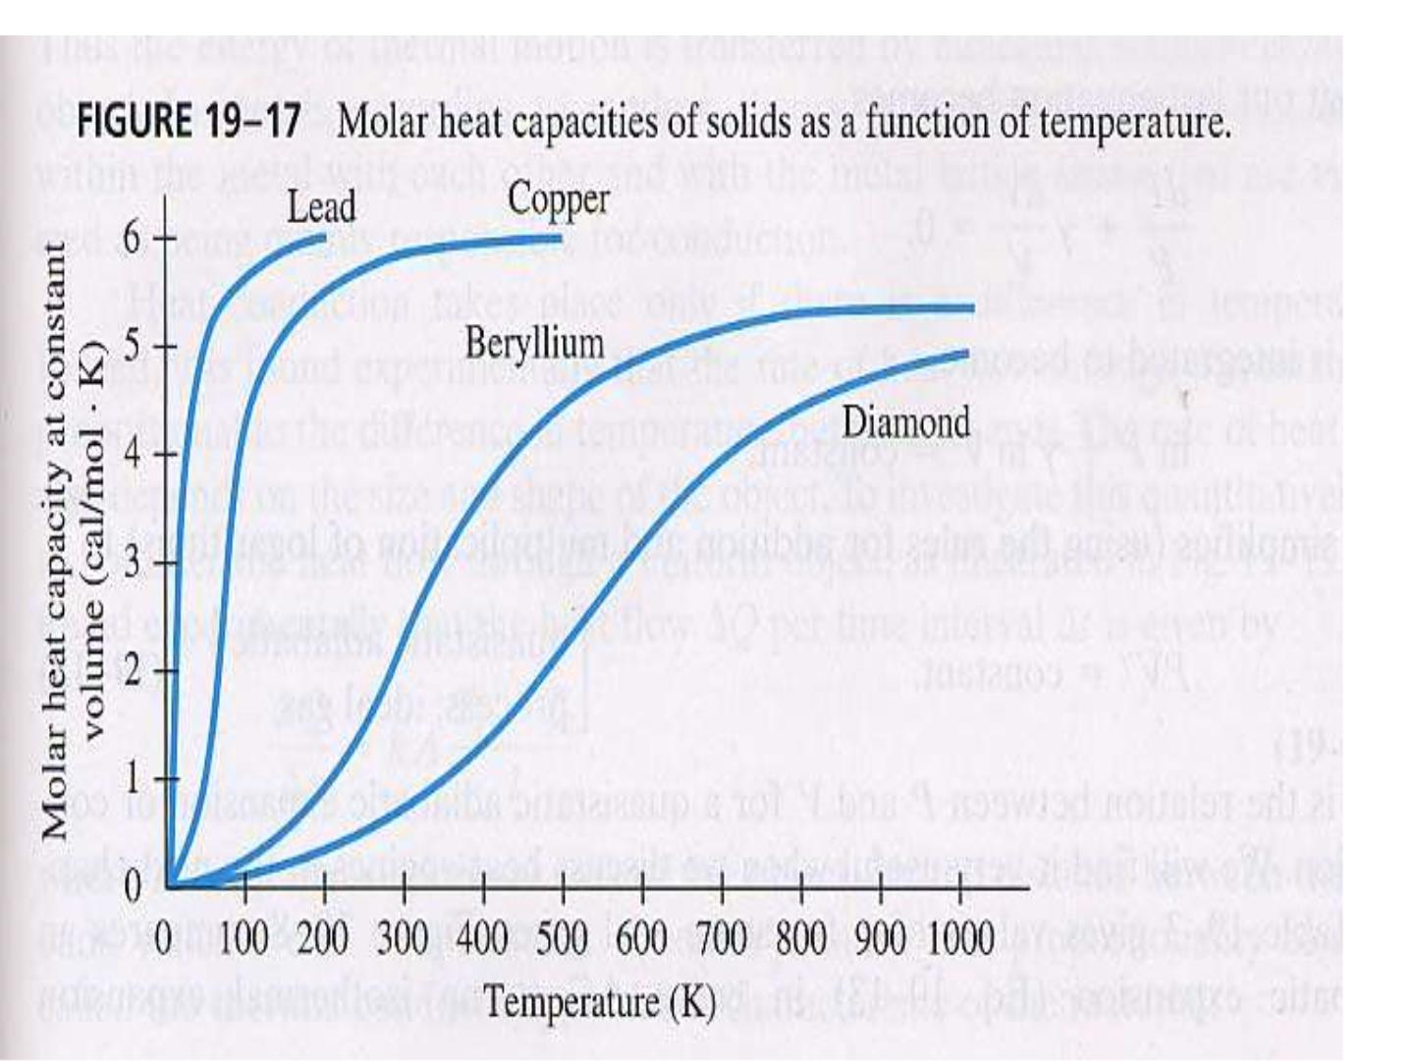

Slide 16
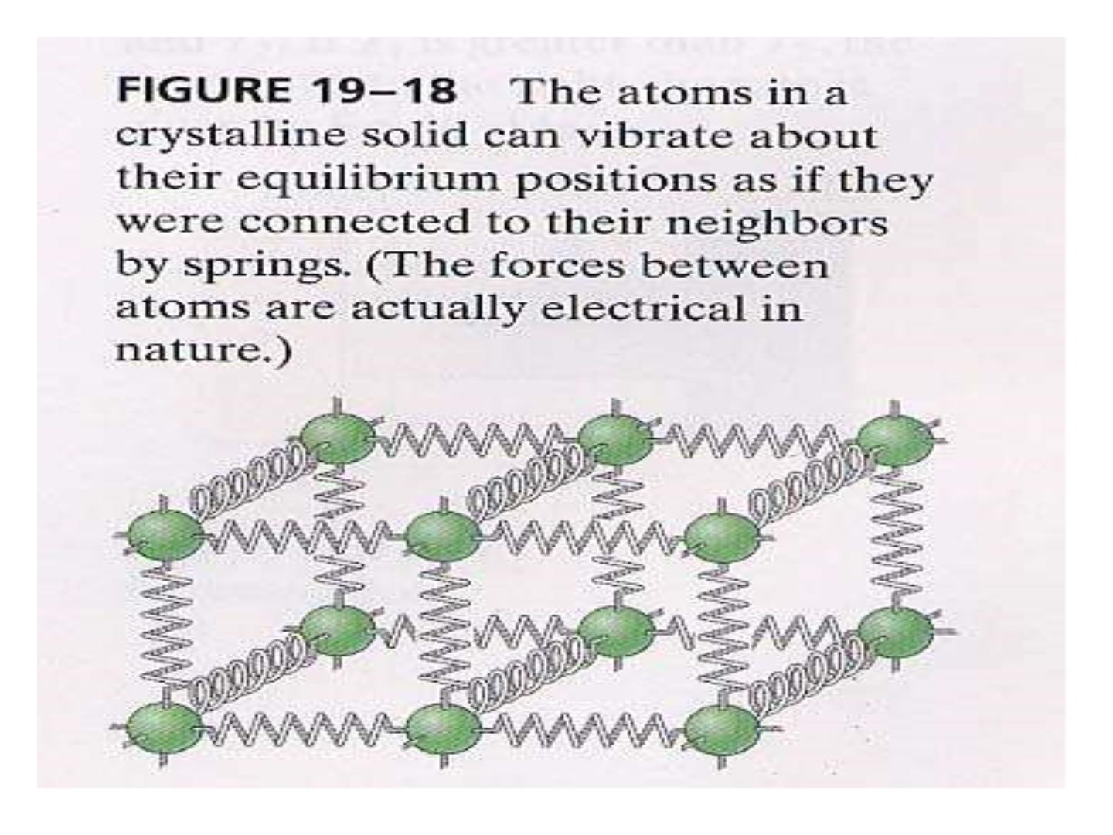

Slide 17
Adiabatic expansion:
dU=dQ-PdV=-PdV (since dQ=0)
on the other hand: dU=nC_{v}⊿T
so: nC_{v}⊿T+ PdV=0
From PV=nRT,
we have: PdV+VdP=nRdT
and: nC_{v}(PdV+VdP)/nR +PdV=0
or: (C +R)PdV+C VdP=0
v
v

Slide 18
Since C =C +R
p v
So: C PdV+C VdP=0
p
v
Or: (C_{p}/C_{v})PdV+VdP=0
Define: = C /C
p v
dP/P+ dV/V=0
lnP+ lnV=C
Therefore: PV =C


Slide 19
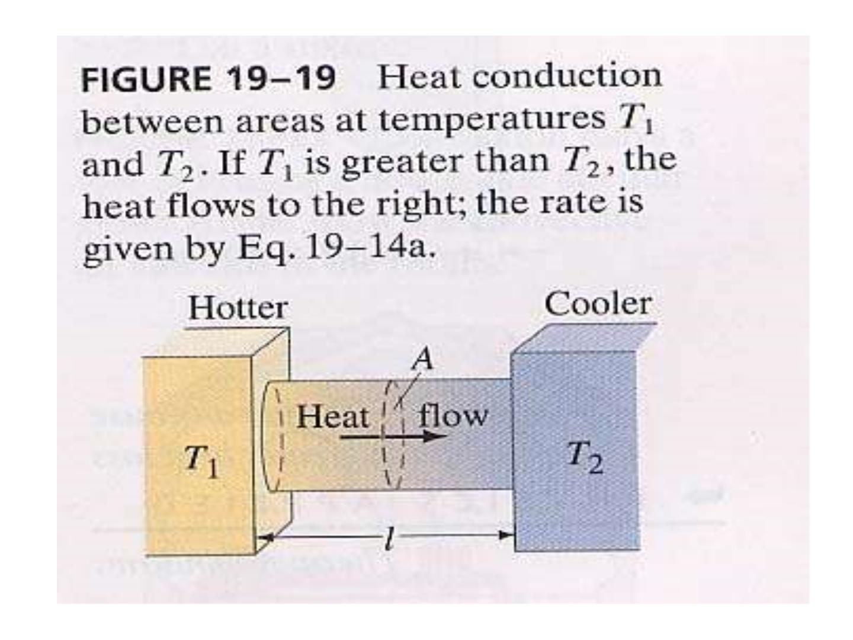

Slide 20
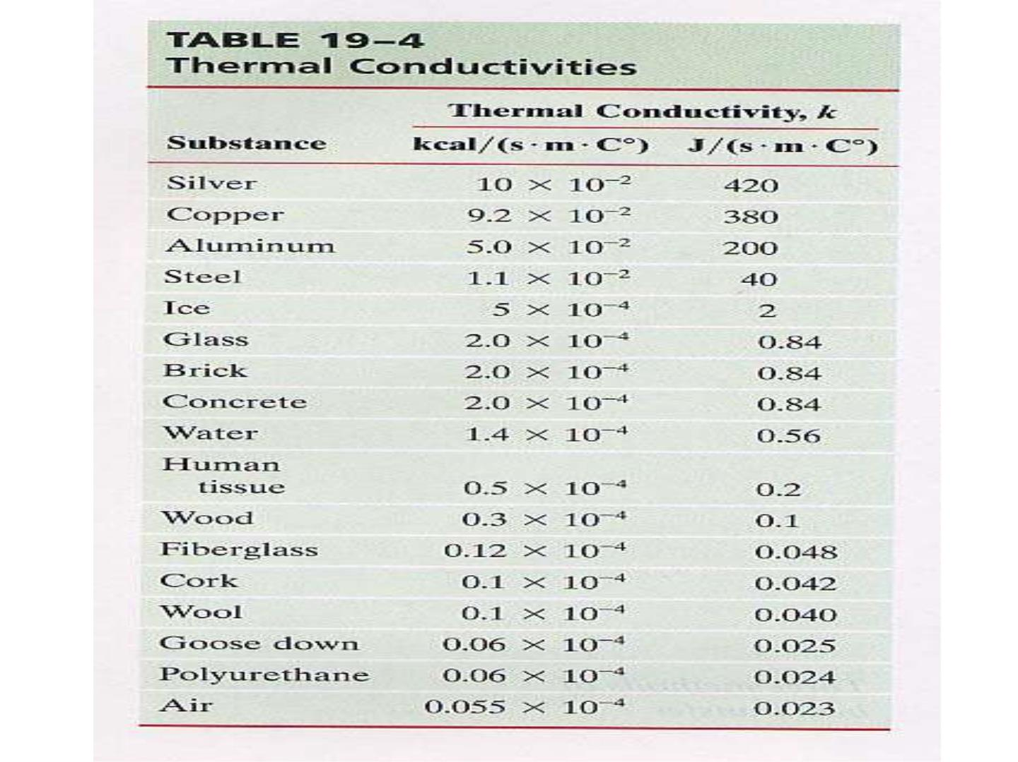

Slide 21
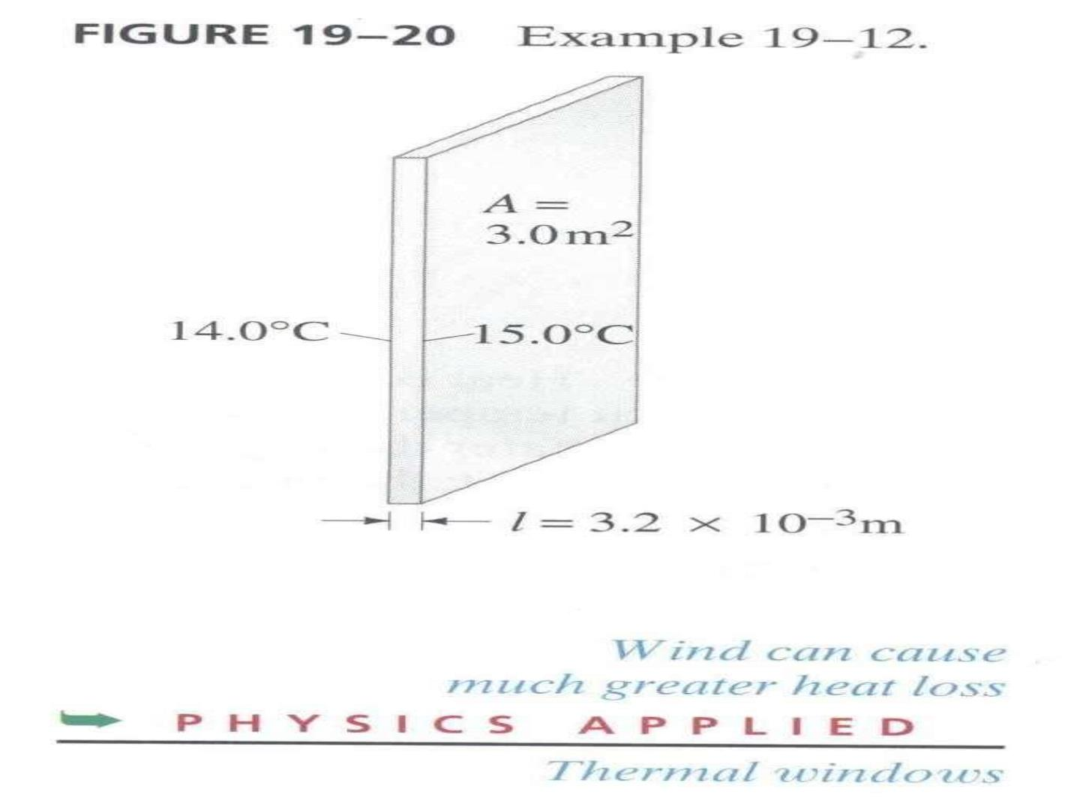

Slide 22
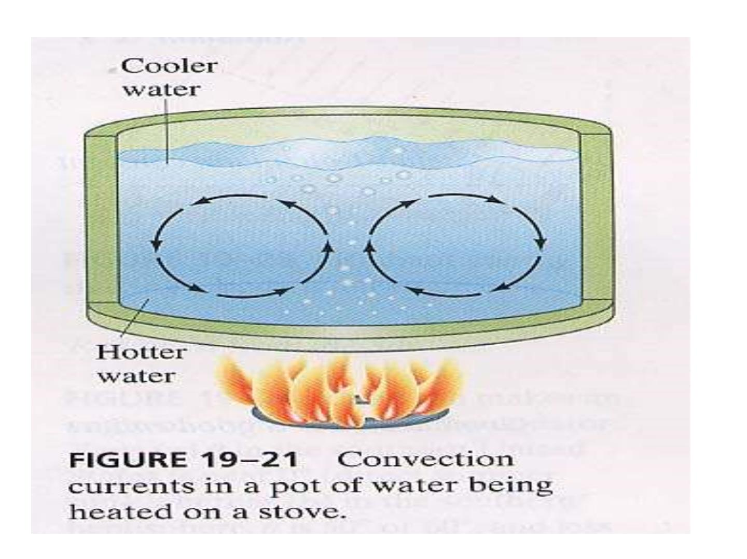

Slide 23
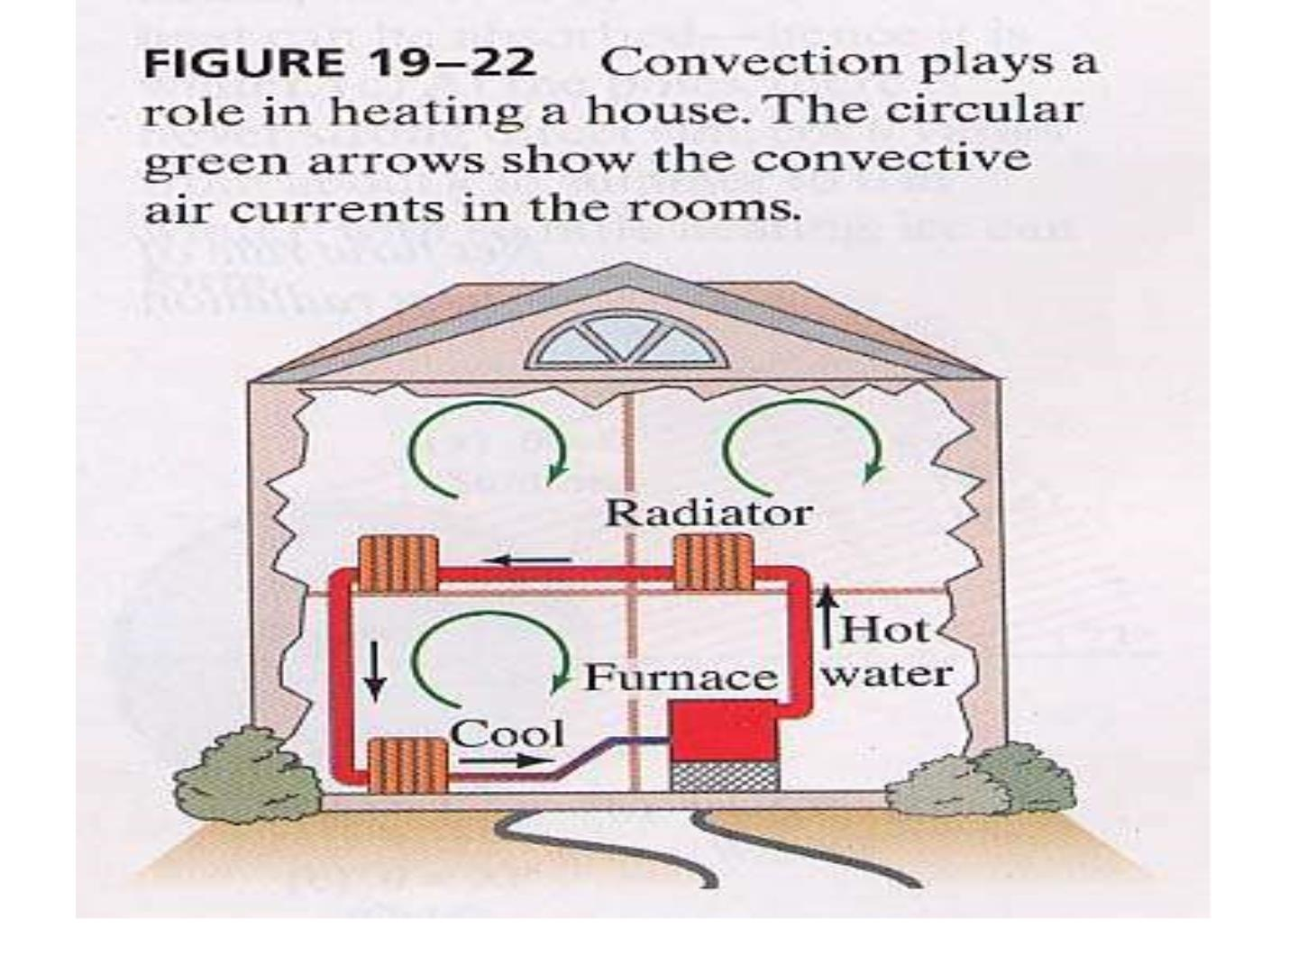

Slide 24
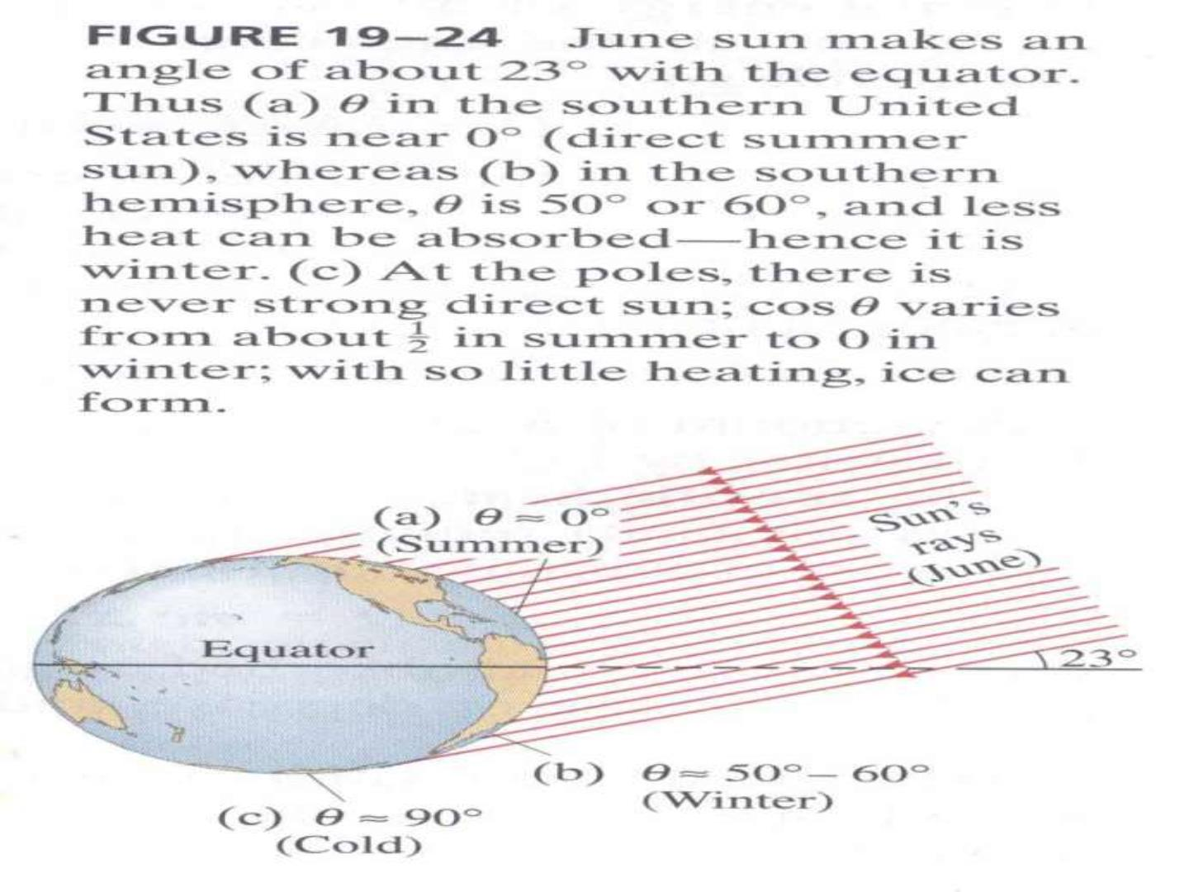

Slide 25
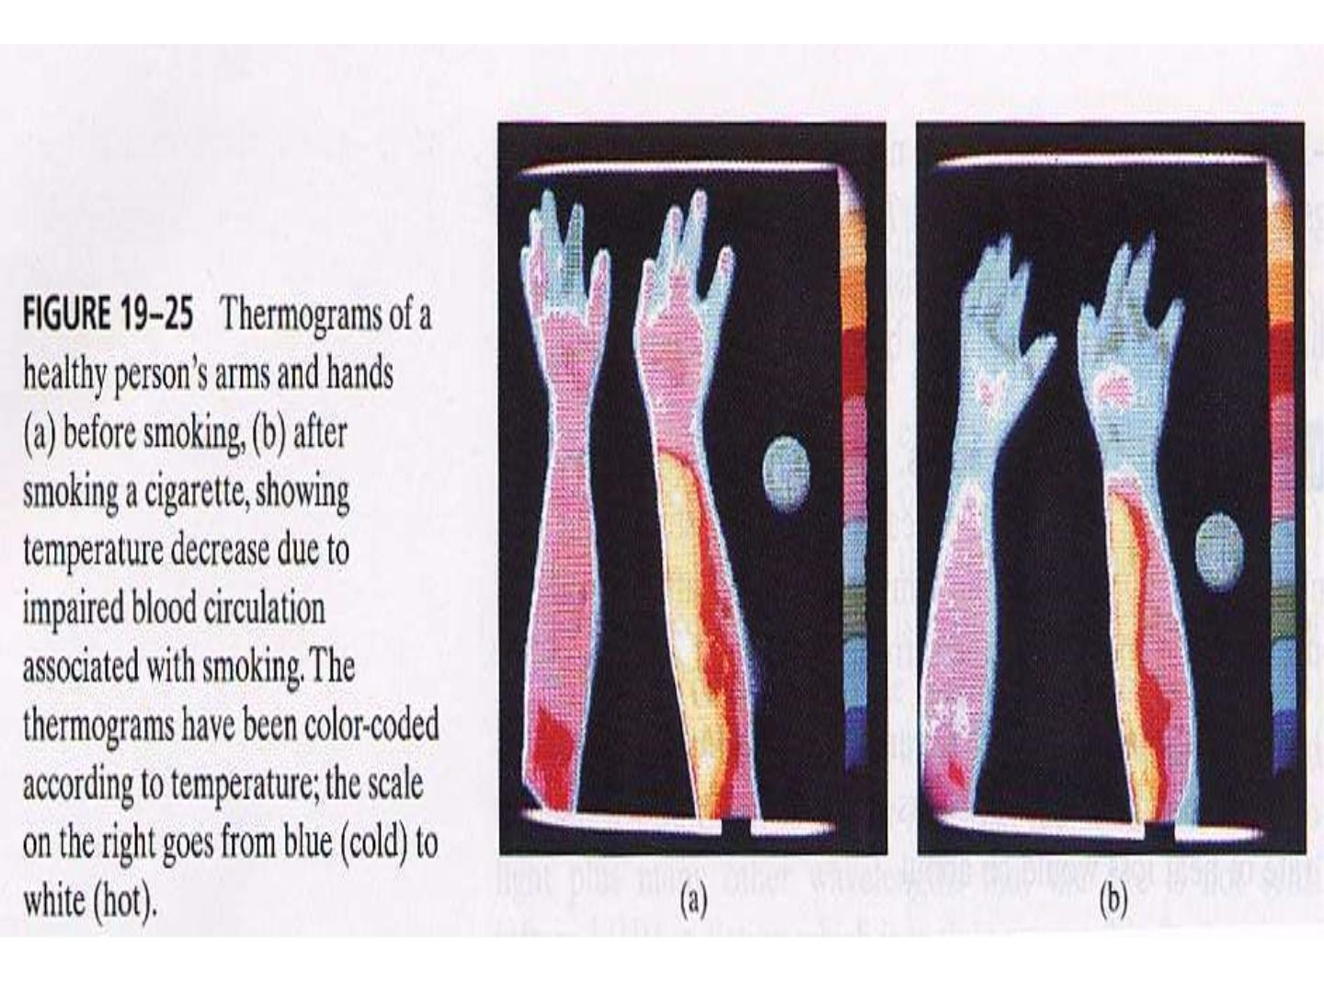

Slide 26


