Slide 1

大学物理（热学）
1) Review
2) Carnot’s Ideas
3) The Second Law
4) Carnot’s cycle
2006-12-13
2021/9/5
1

Slide 2
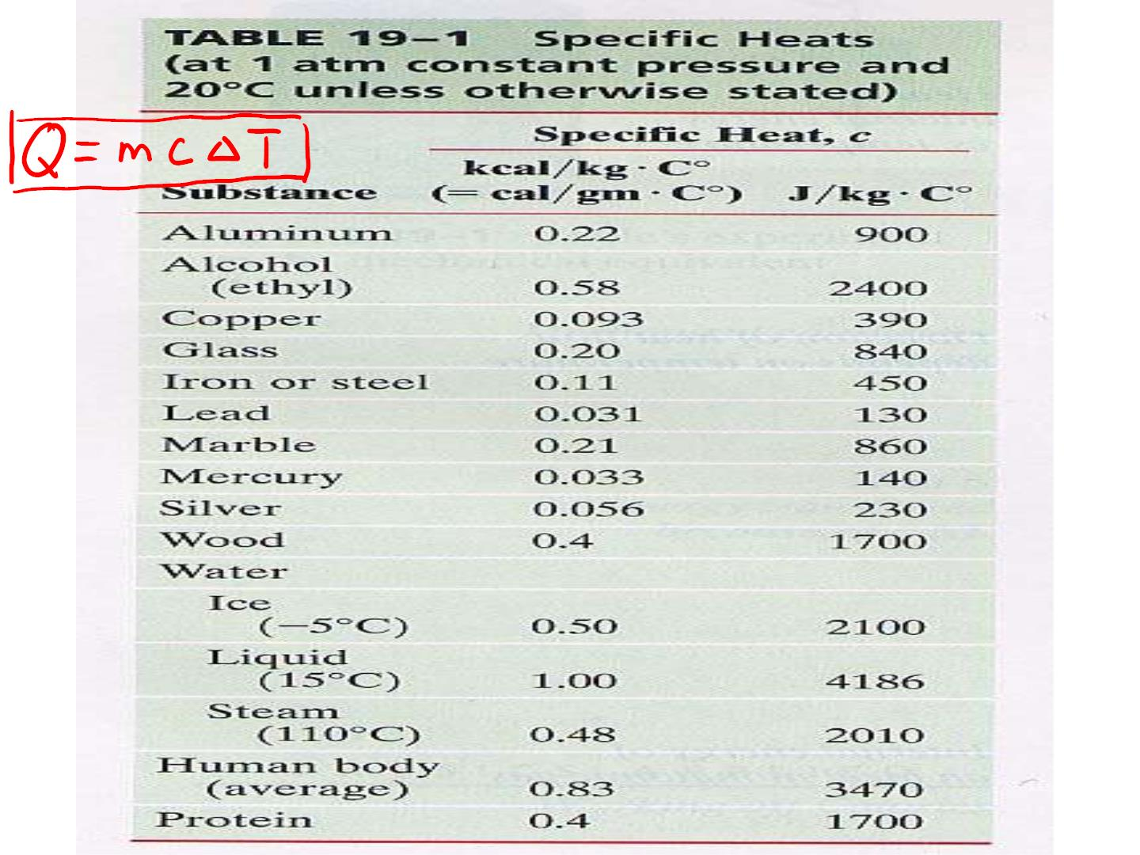

Slide 3
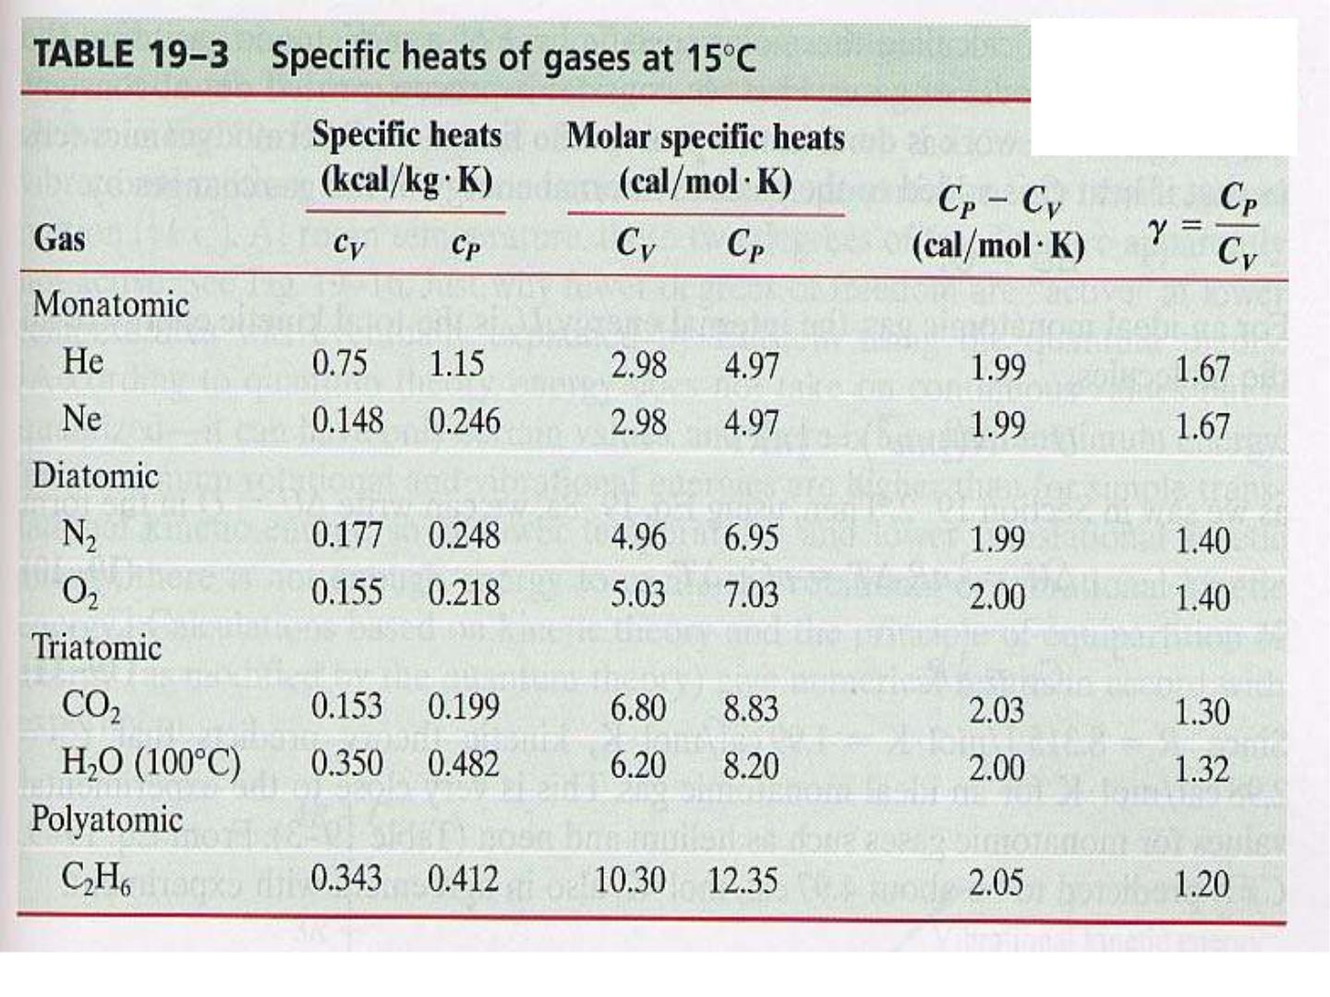
Q=nC ⊿T
v
Q=nC ⊿T
p

Slide 4
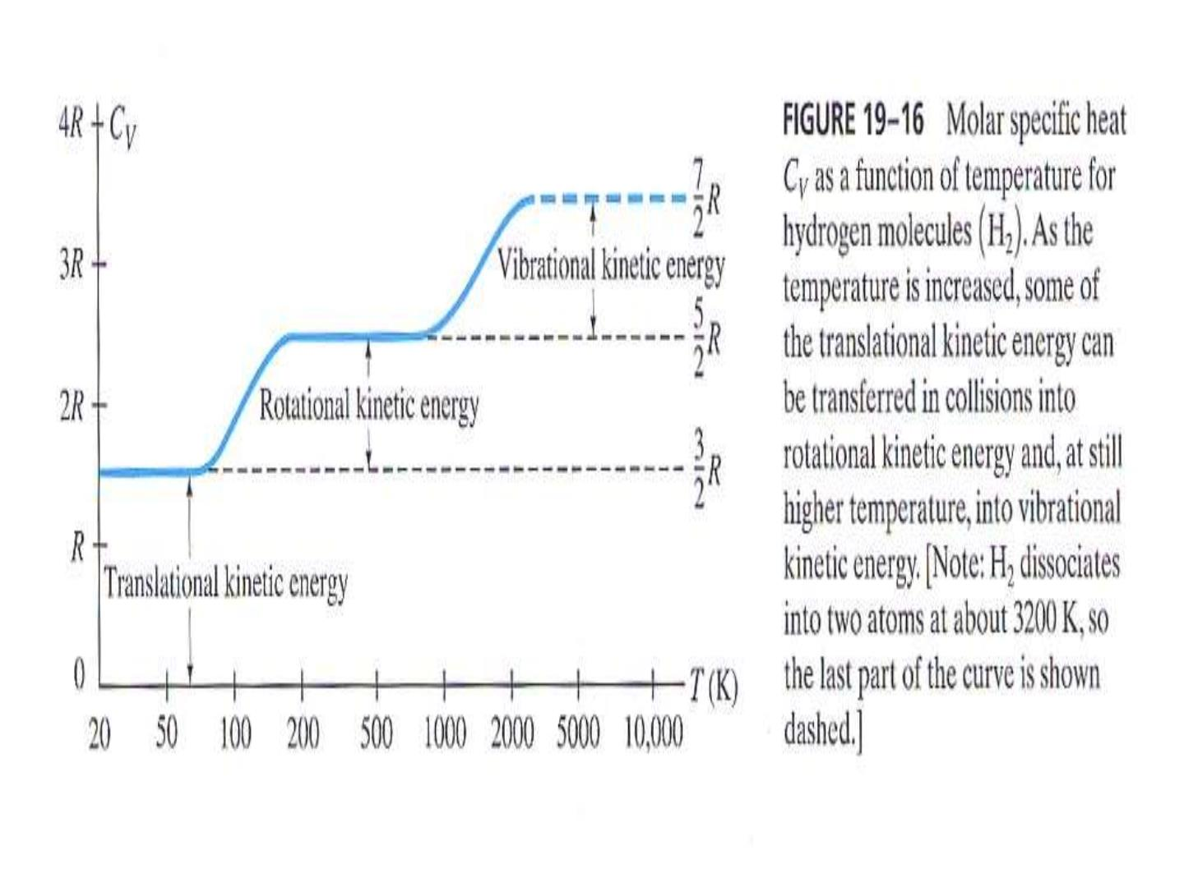

Slide 5
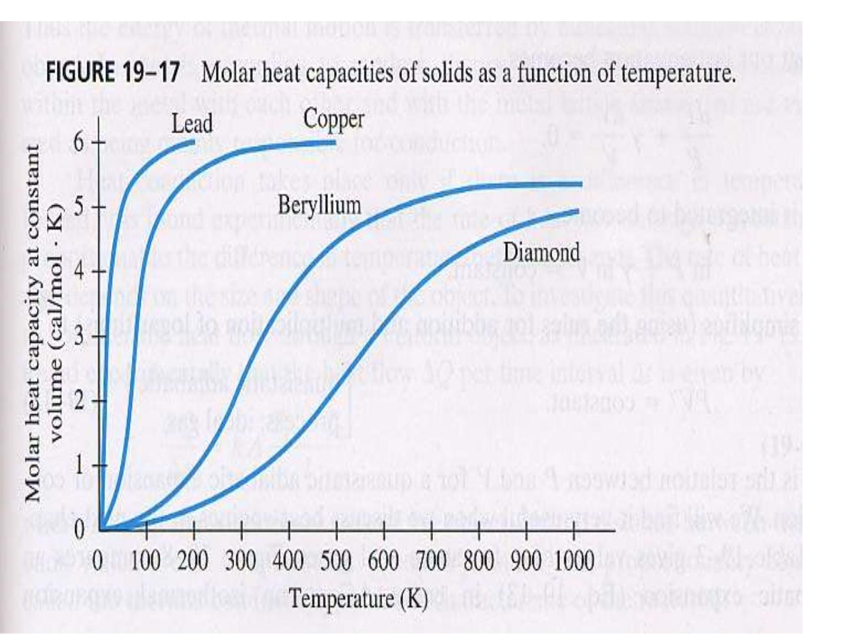

Slide 6
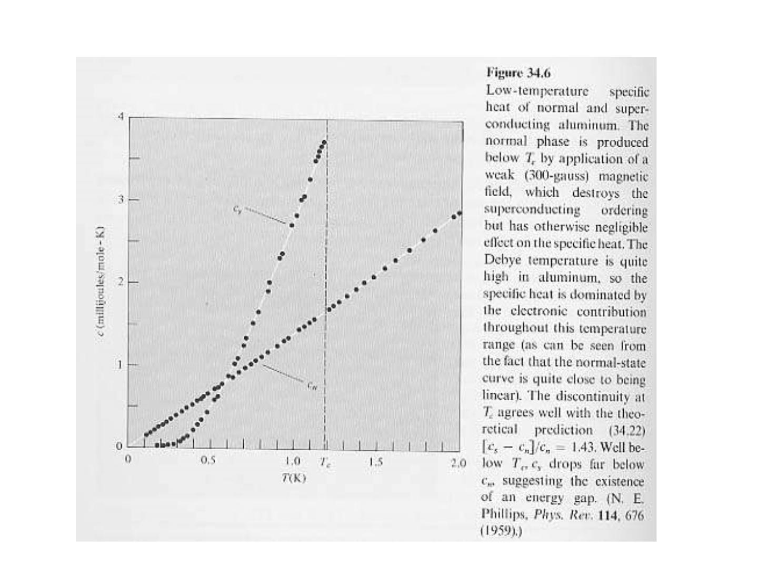

Slide 7
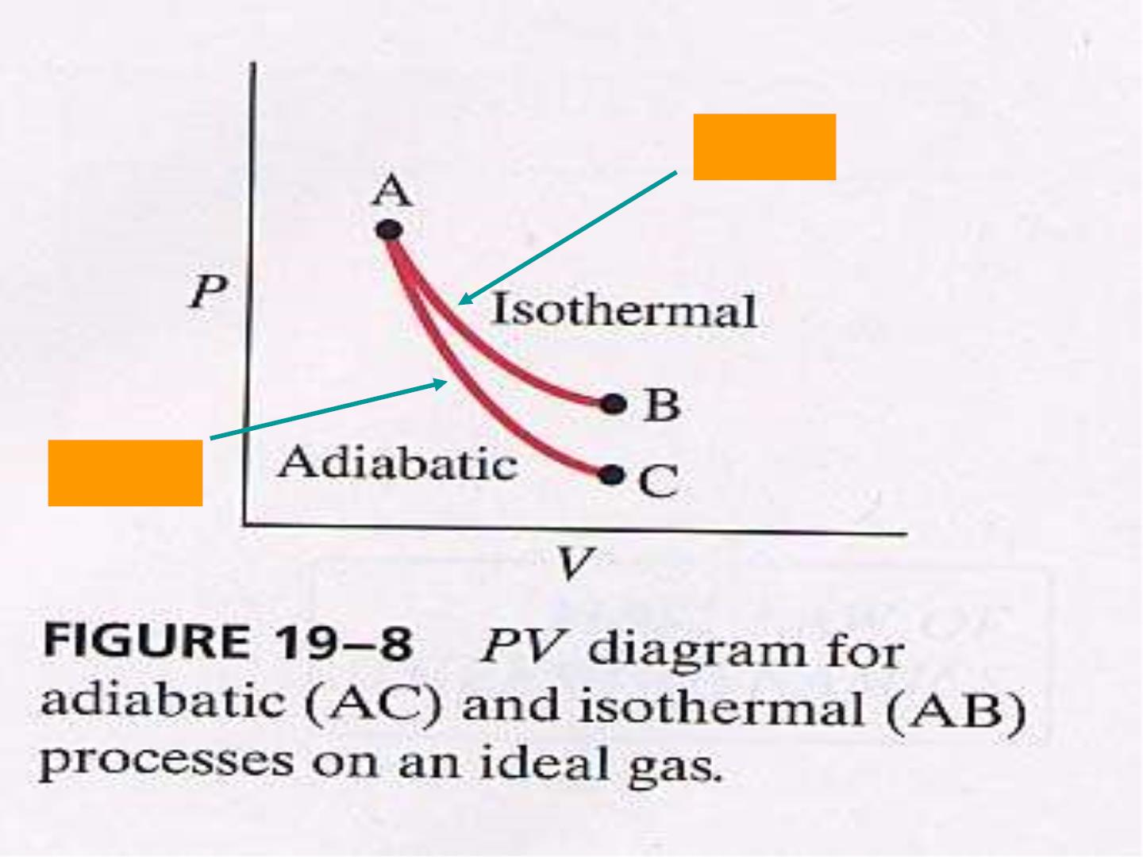
PV=C
PV=C

Slide 8
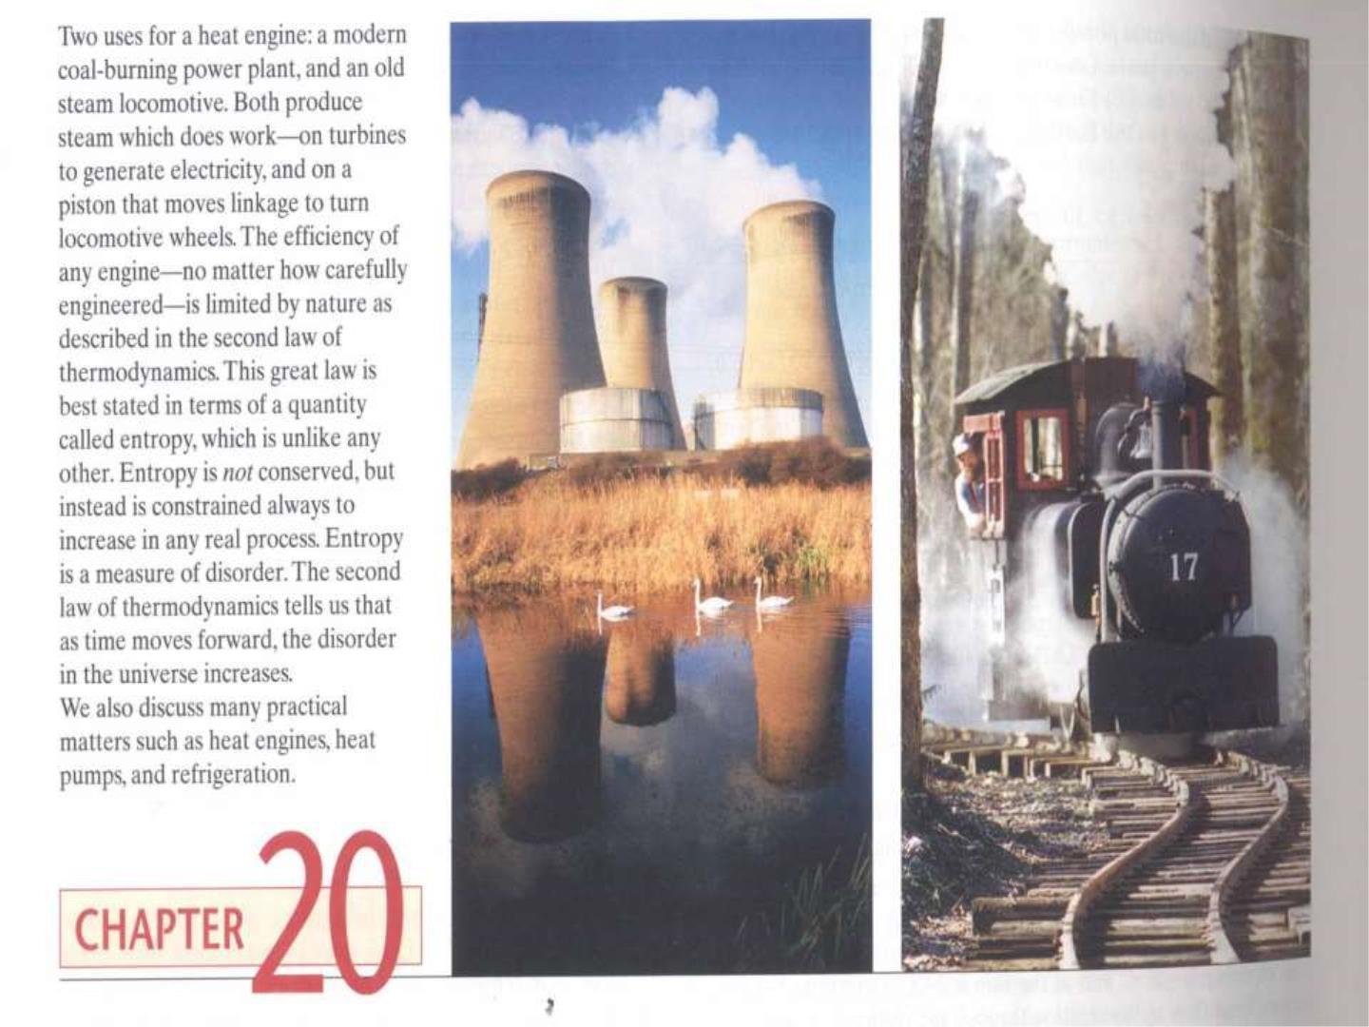

Slide 9
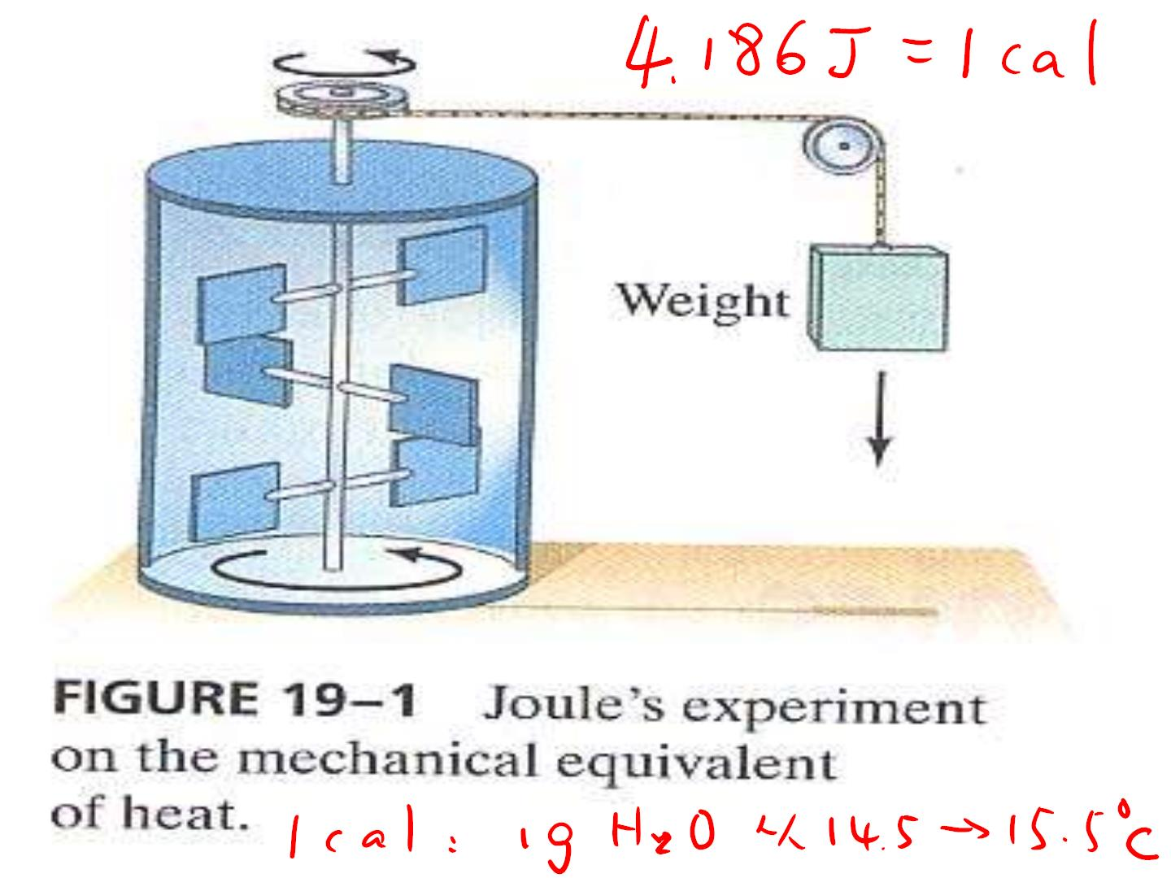

Slide 10
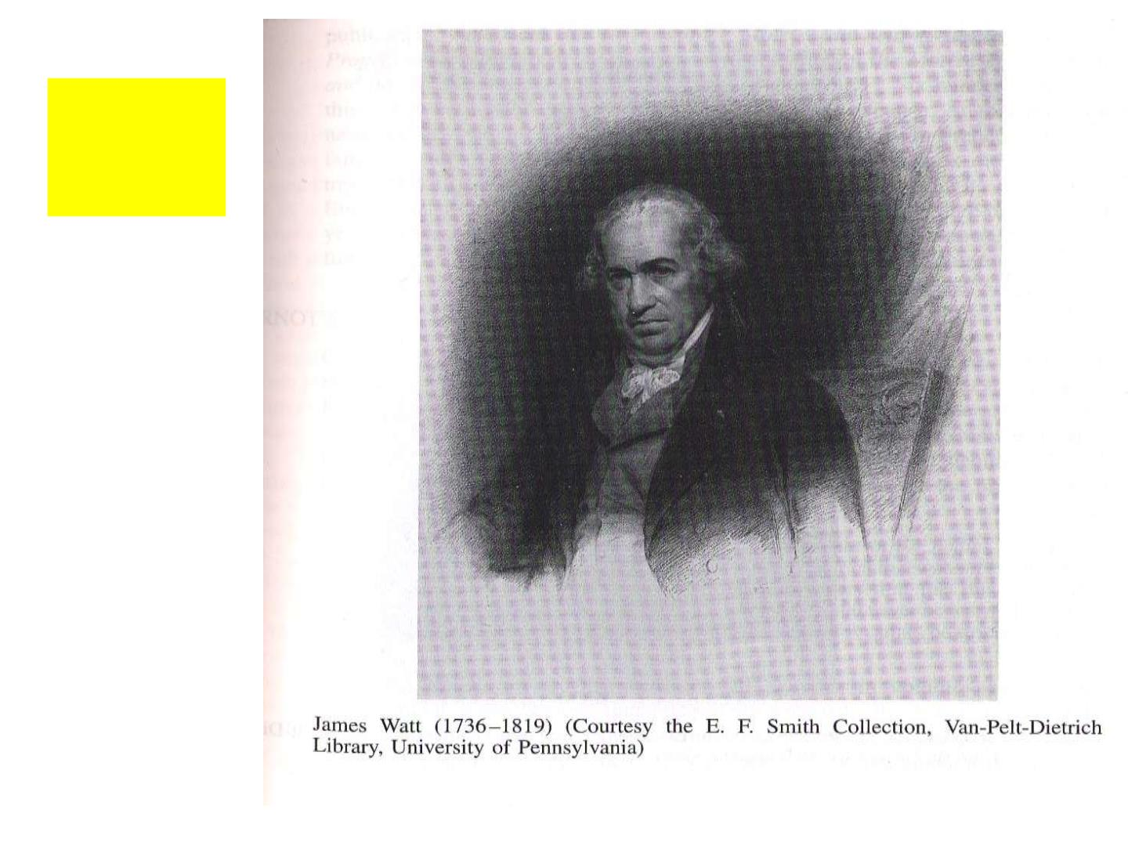
瓦特
J. Watt
蒸汽机

Slide 11
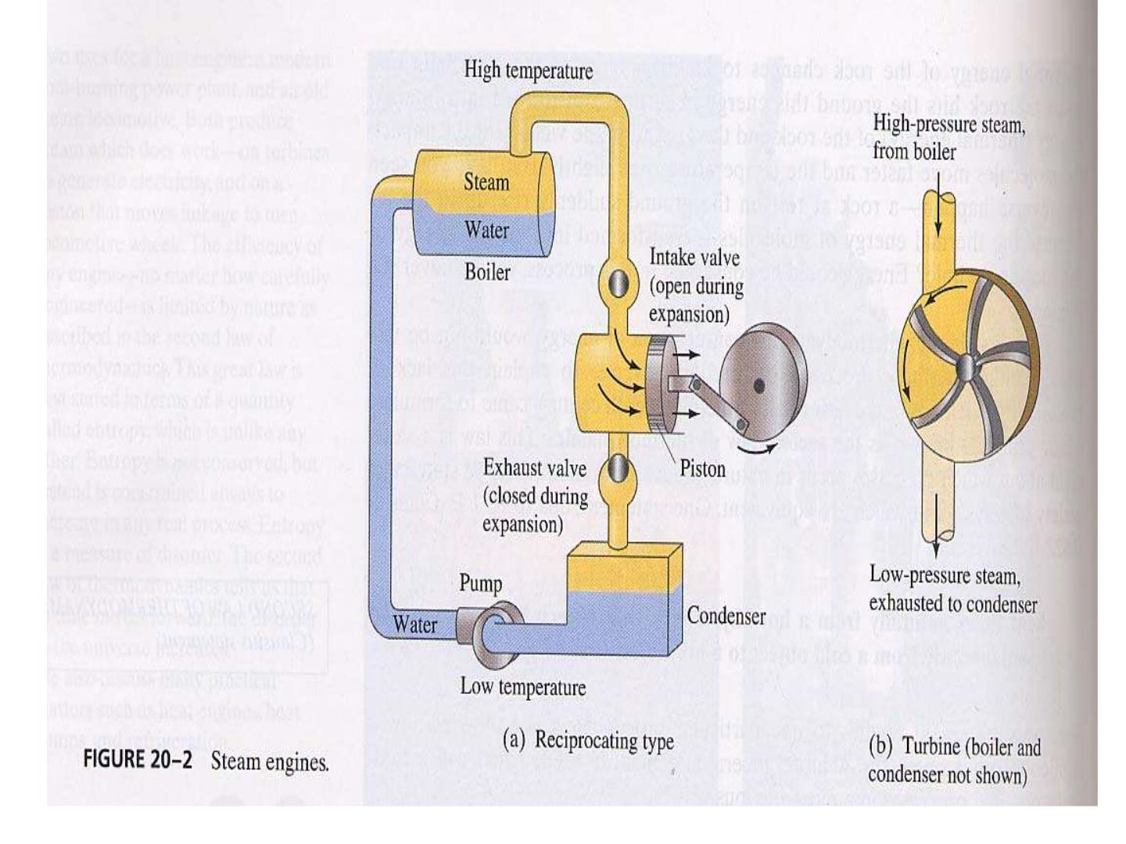

Slide 12
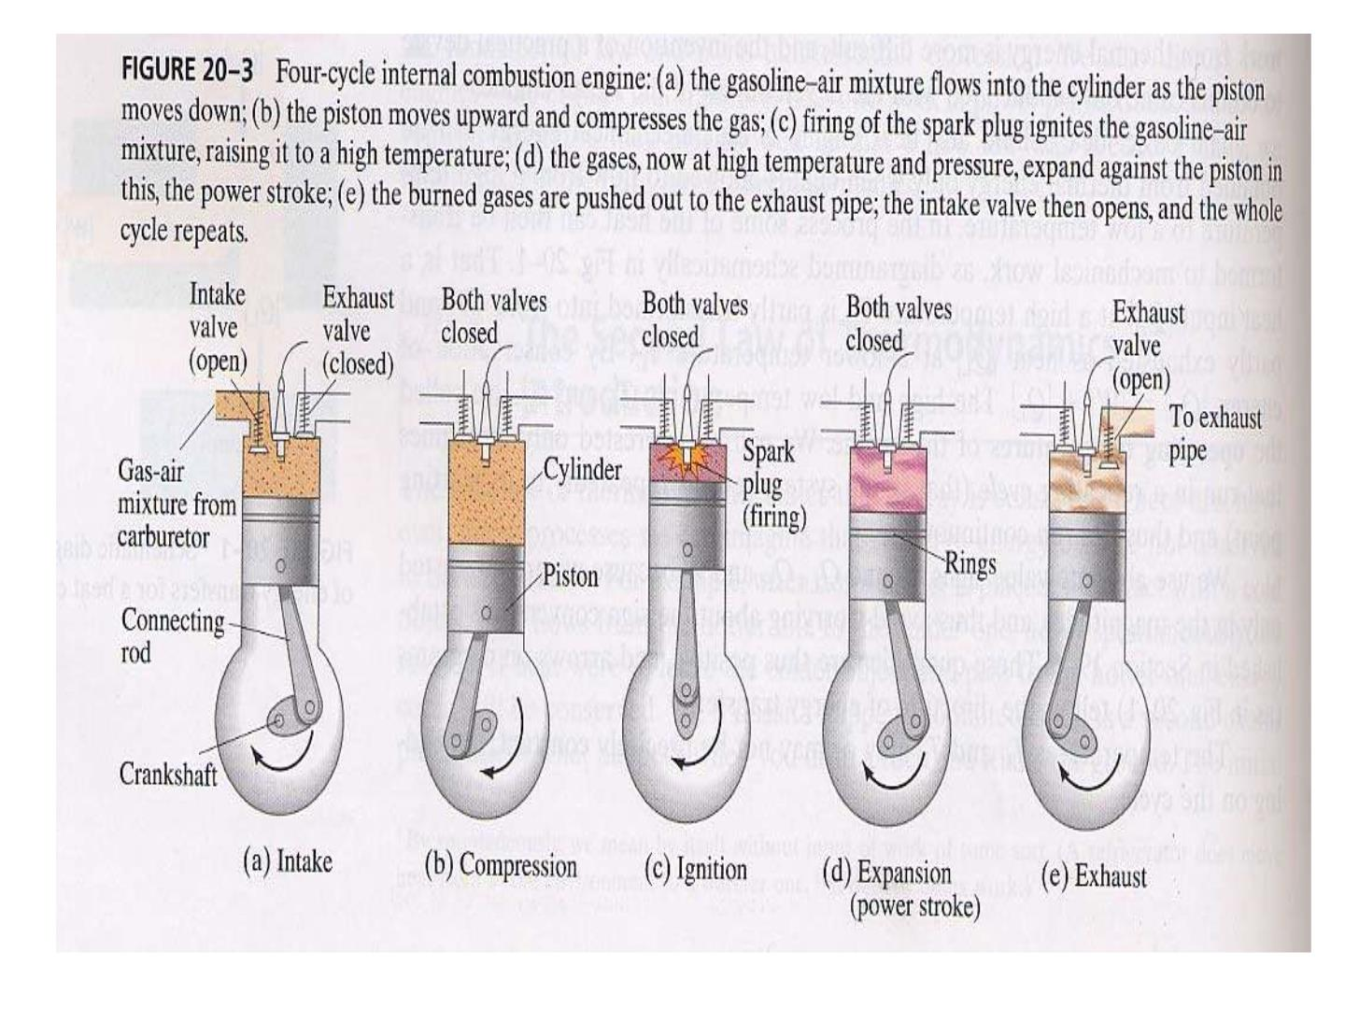

Slide 13

用热做功——存在限制否？

Slide 14
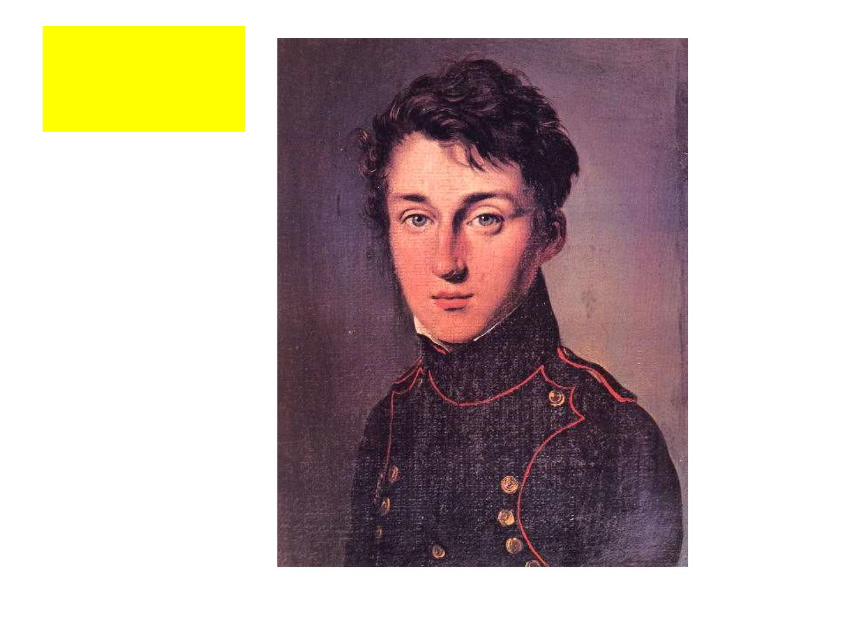
卡 诺
Sadi
Carnot
卡诺循环

Slide 15
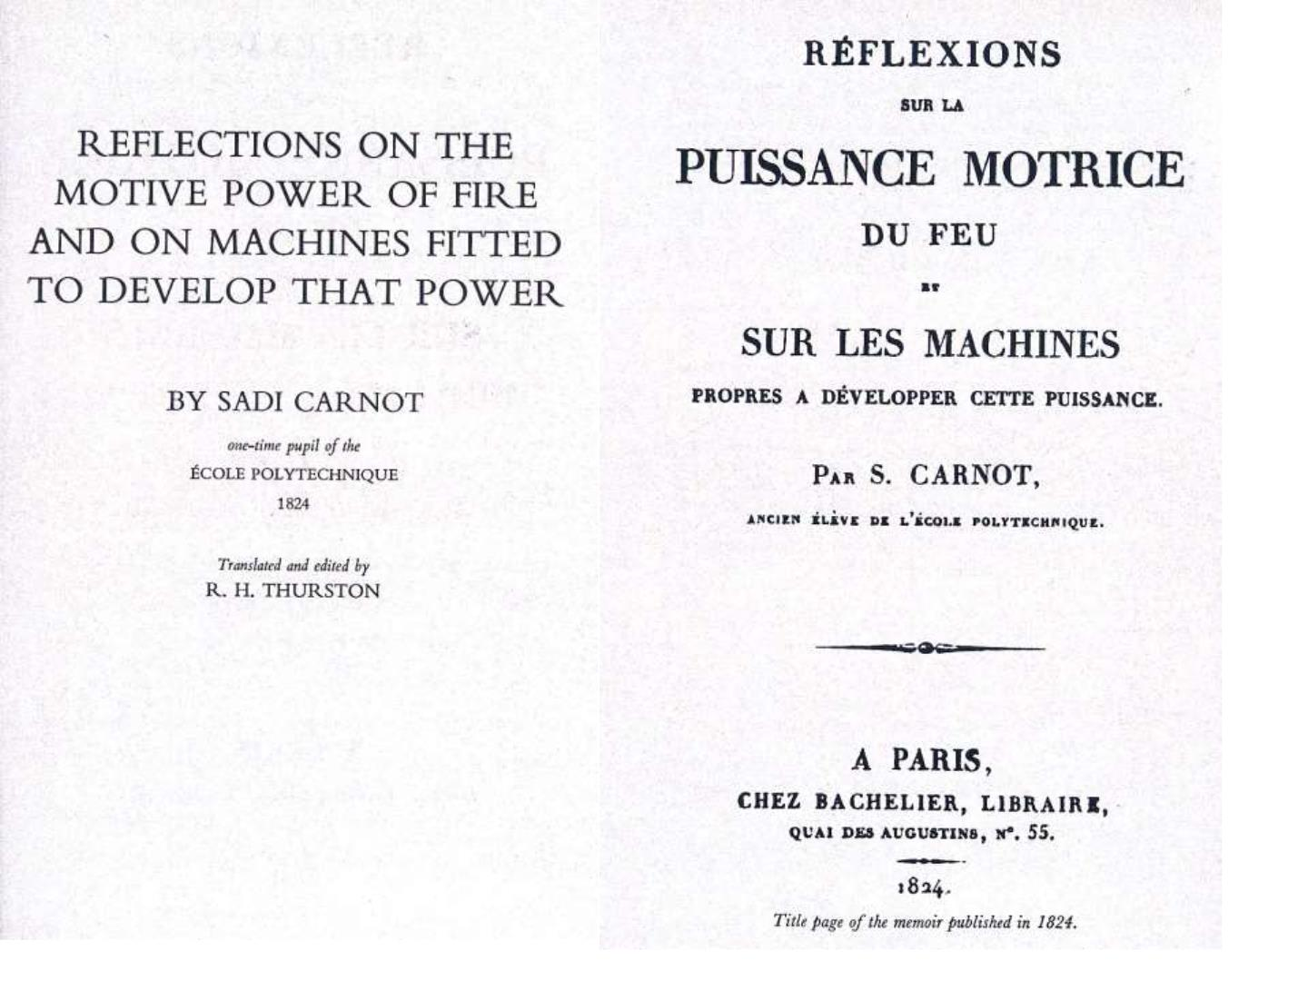
(1824)

Slide 16

Carnot’s ideas
“The production of motive power is
then due in steam-engines not to an actual
consumption of caloric, but to its
transportation from a warm body to a cold
body, that is, to its re-establishment of
equilibrium - an equilibrium considered as
destroyed by any cause whatever, by
chemical action such as combustion, or by
any other.”

Slide 17
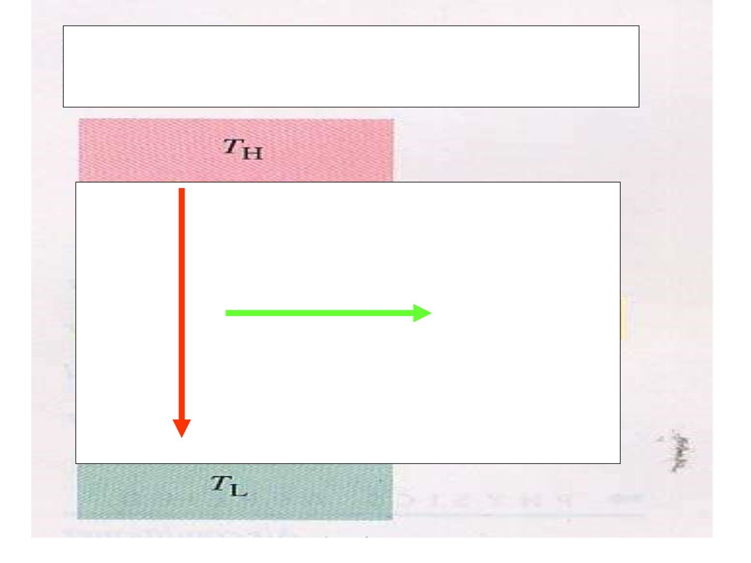
Carnot’s ideas
Q
W

Slide 18

Carnot’s ideas
“According to this principle,
the production of heat alone is not
sufficient to give birth to the
impelling power: it is necessary
that there should also be cold;
without it, the heat would be
useless.”

Slide 19

Carnot’s ideas
“The necessary condition of the
m aximum is, then, th at in the bodies
emp lo yed by realize the motive
power of heat there sh ould not occur
any change of temperature which
may not due to a change of volum e.”

Slide 20
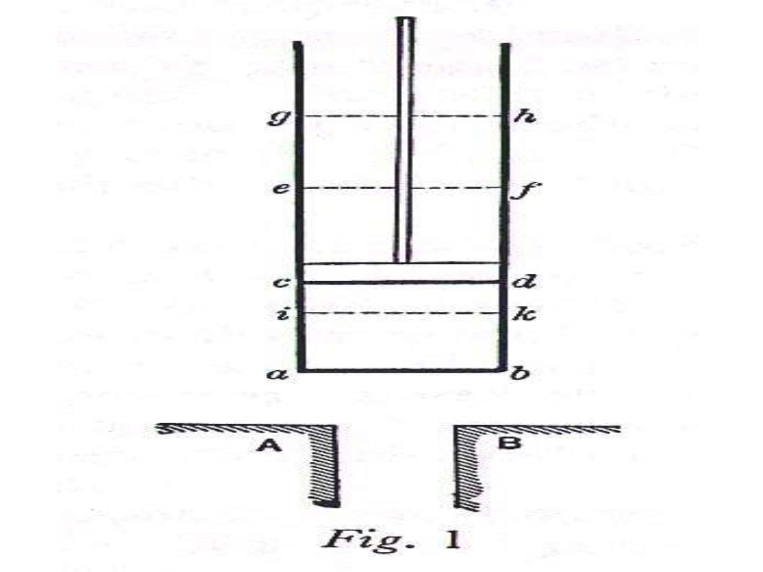

Slide 21
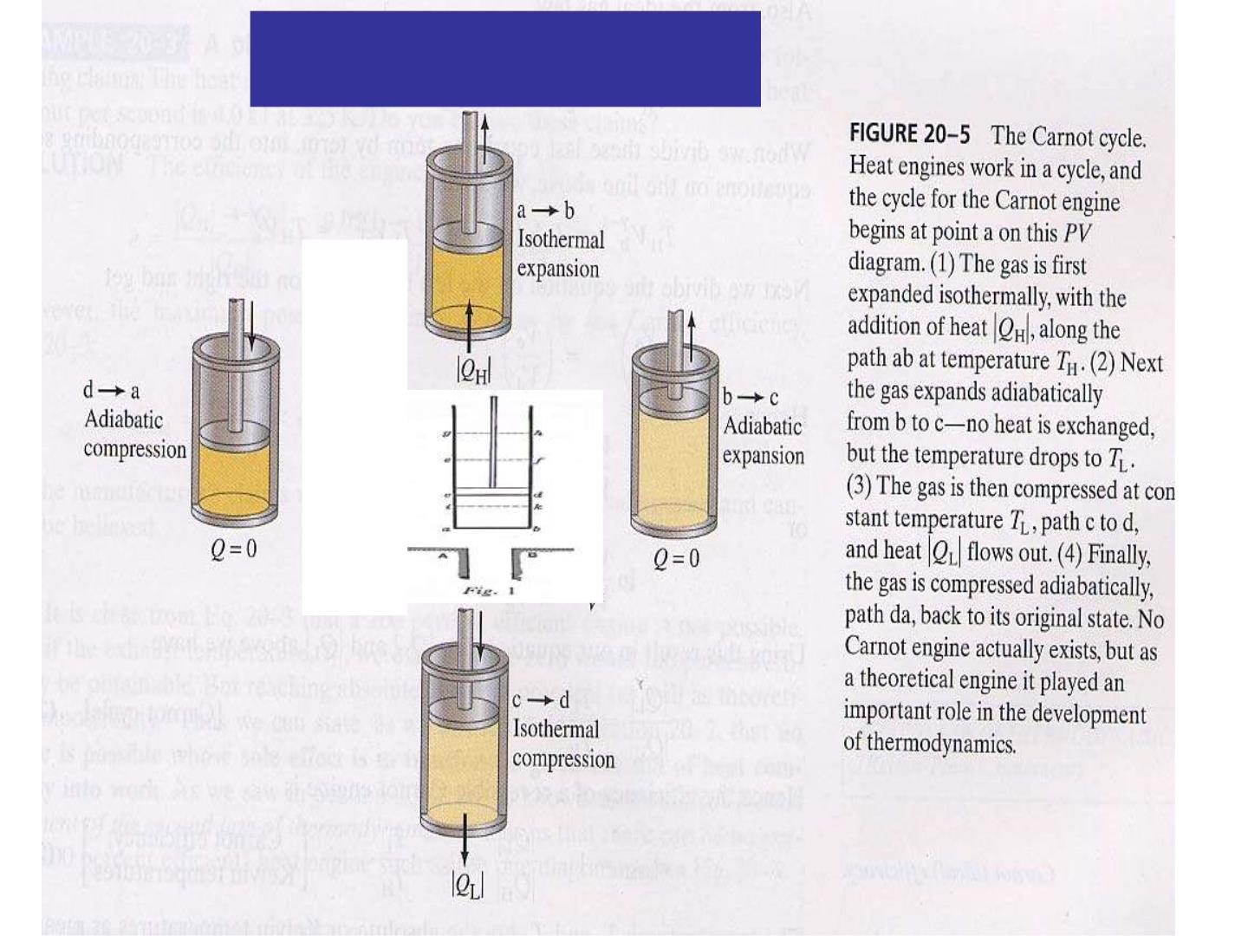
Carnot’s Cycle

Slide 22

Carnot’s theorem
“All reversible engines operating
between the same two constant
temperatures T and T have the sa me
H
L
efficiency.
Any irreversible engine operating
between the same two fixed temperatures
will have an efficiency less than this.”

Slide 23
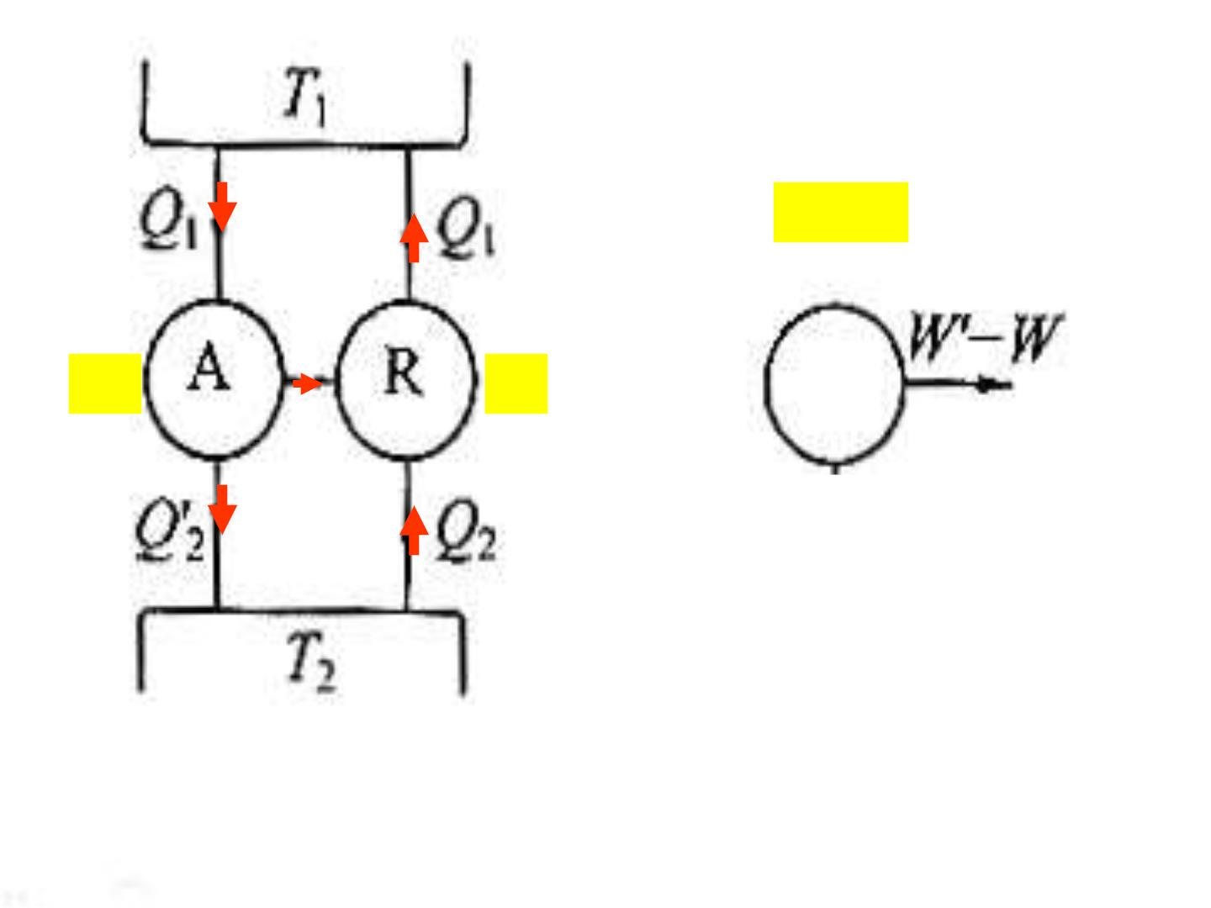
W’>W
W’
W
Q₁
Q₁
Original proof of Carnot’s theorem

Slide 24
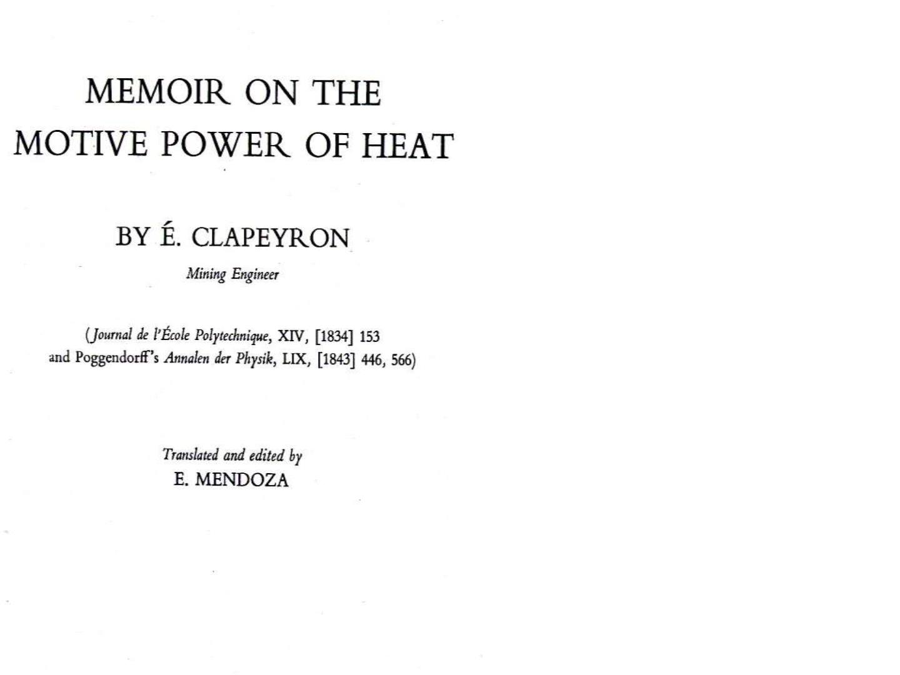
(1834)

Slide 25
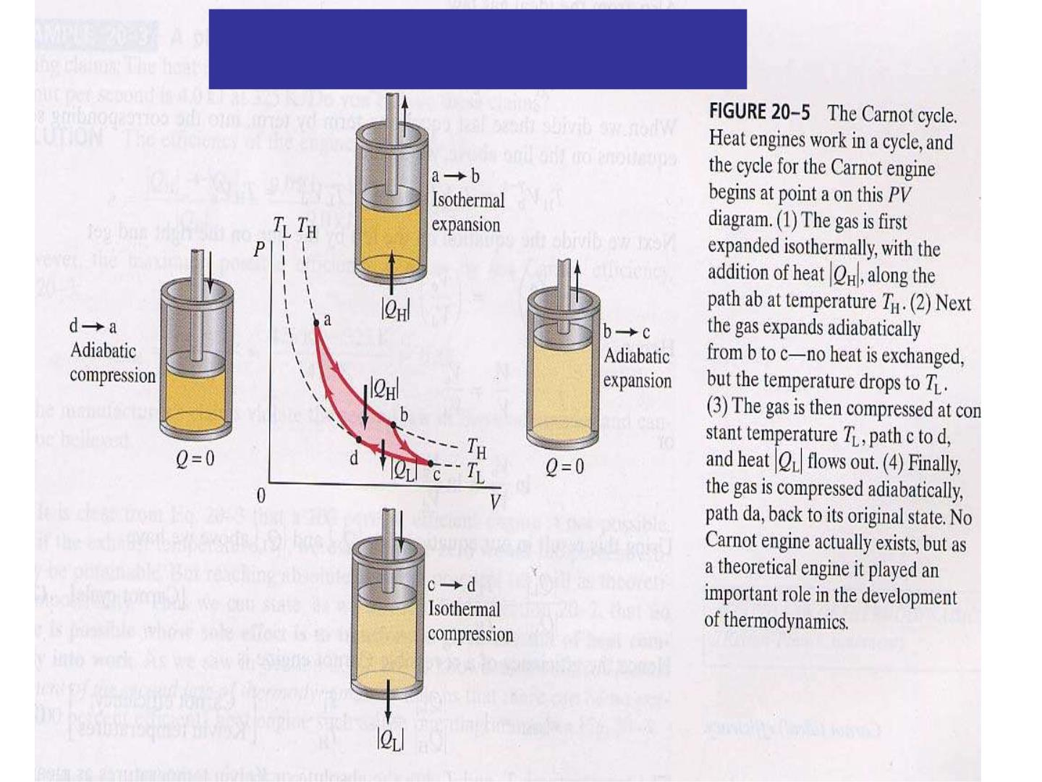
Clapeyron’s Graph

Slide 26
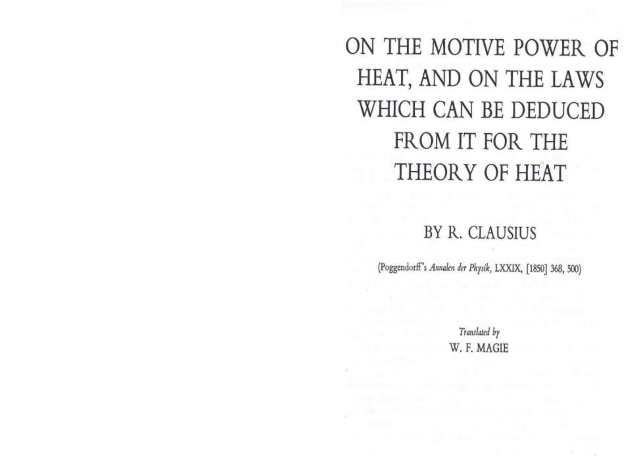
(1850)

Slide 27

Clausius’ ideas
A careful examination shows that the new
method does not stand in contradiction to the
essential principle of Carnot, but only to the
subsidiar y statement that no heat is lost, since
in the production of work it may ver y well be
the case that at the same time a certain quantit y
of heat is consumed and another quantit y
transferred from a hotter to a co ld er bod y, and
both quantities of heat stand in a definite
relation to the work that is done.

Slide 28
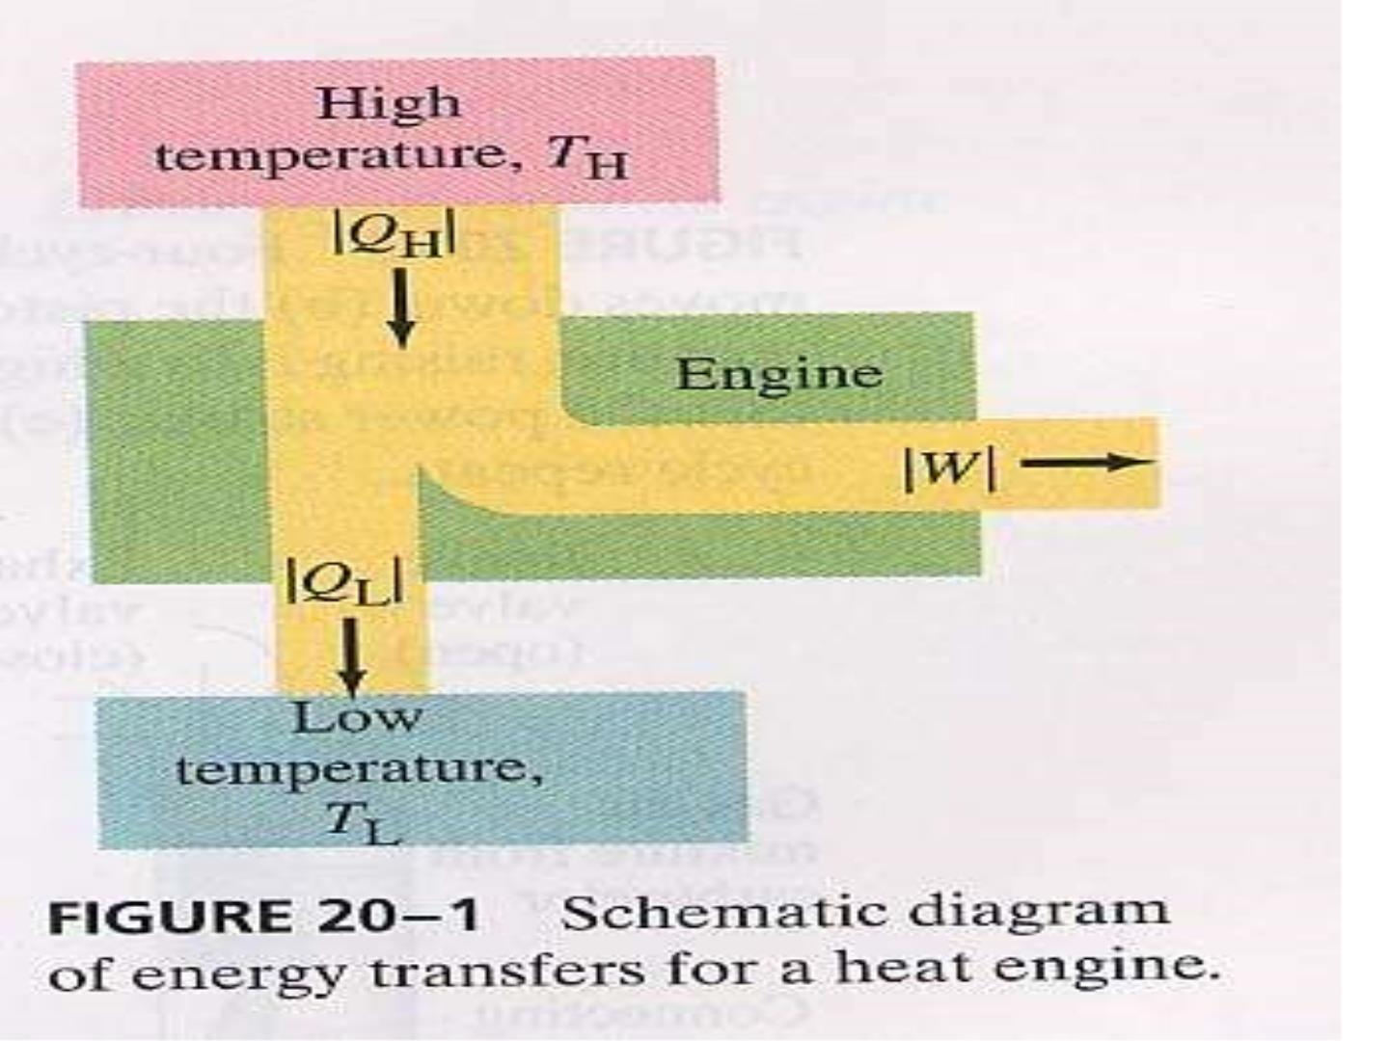

Slide 29
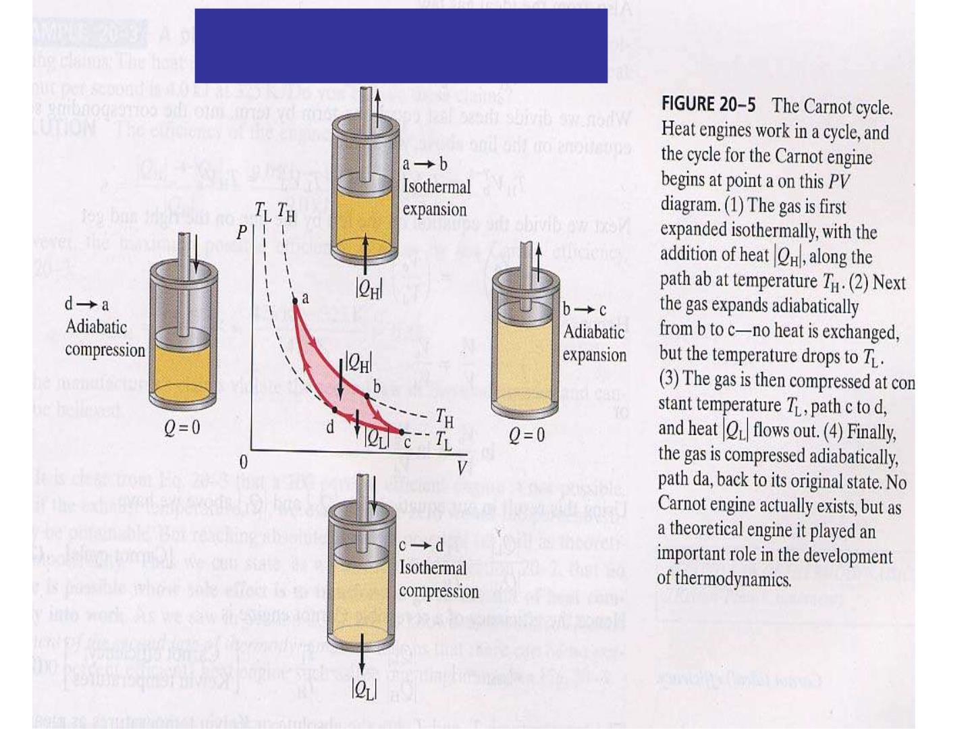
Clausius’ ideas

Slide 30
Carnot’s theorem
“All reversible engines operating
between the same two constant
temperatures TH and TL have the same
efficiency.
Any irreversible engine operating
between the same two fixed temperatures
will have an efficiency less than this.”

Slide 31
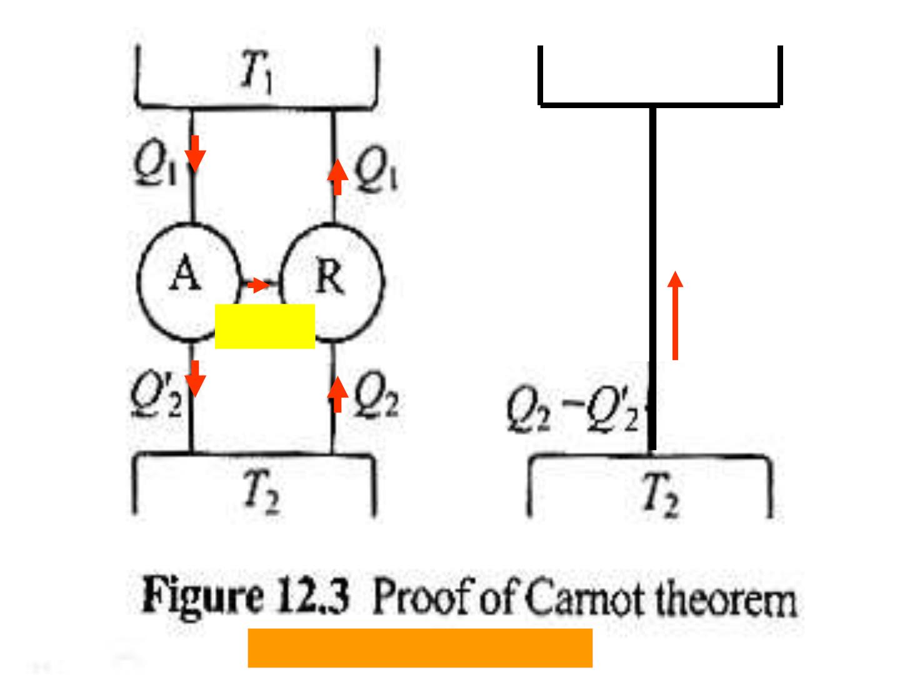
T₁
Q – Q ’
’
1
1
W’=W
在热力学第一定律的基础上：

Slide 32
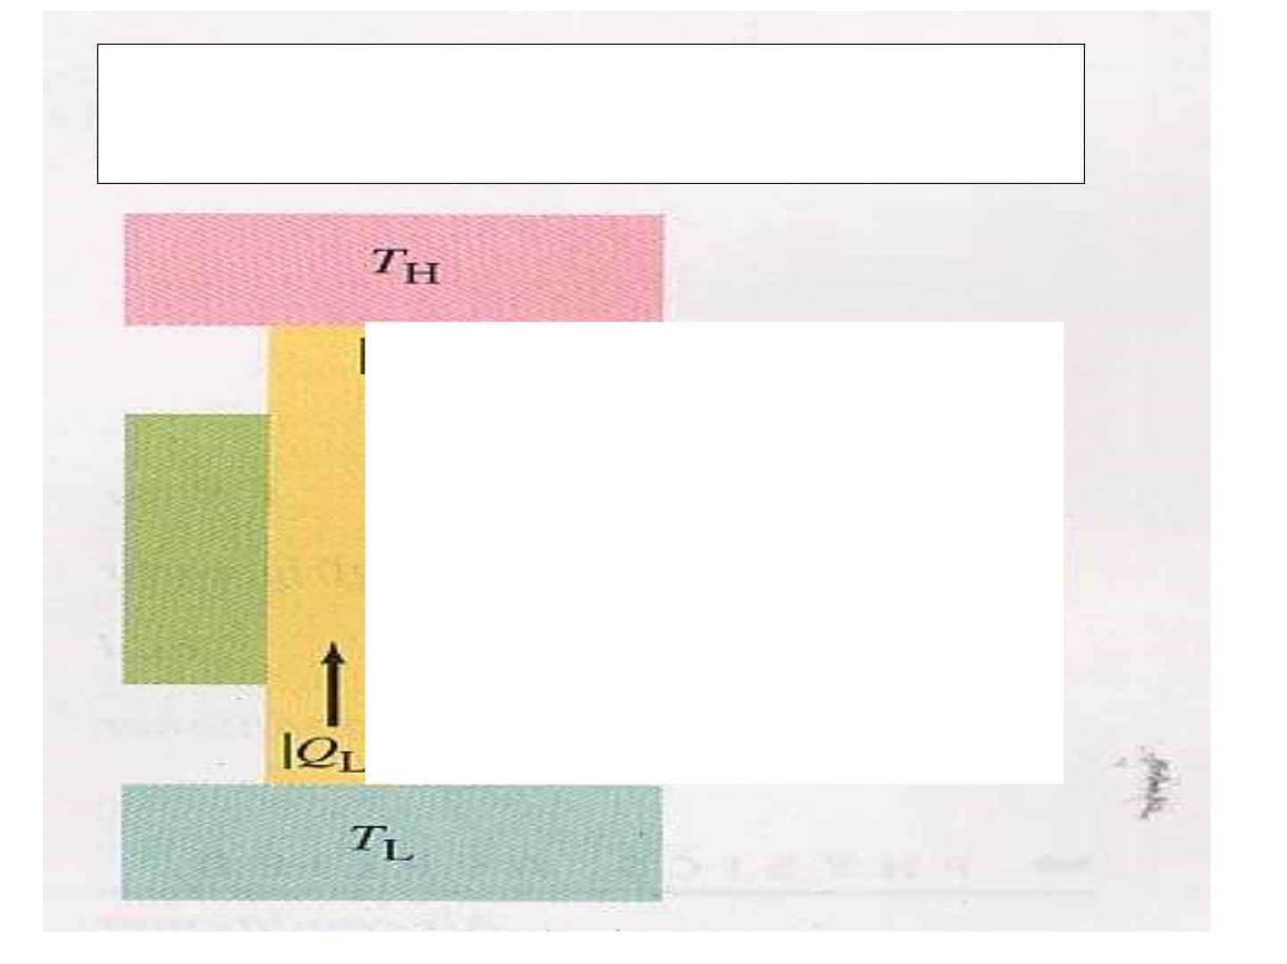
Clausuis statem ent
Not possible

Slide 33
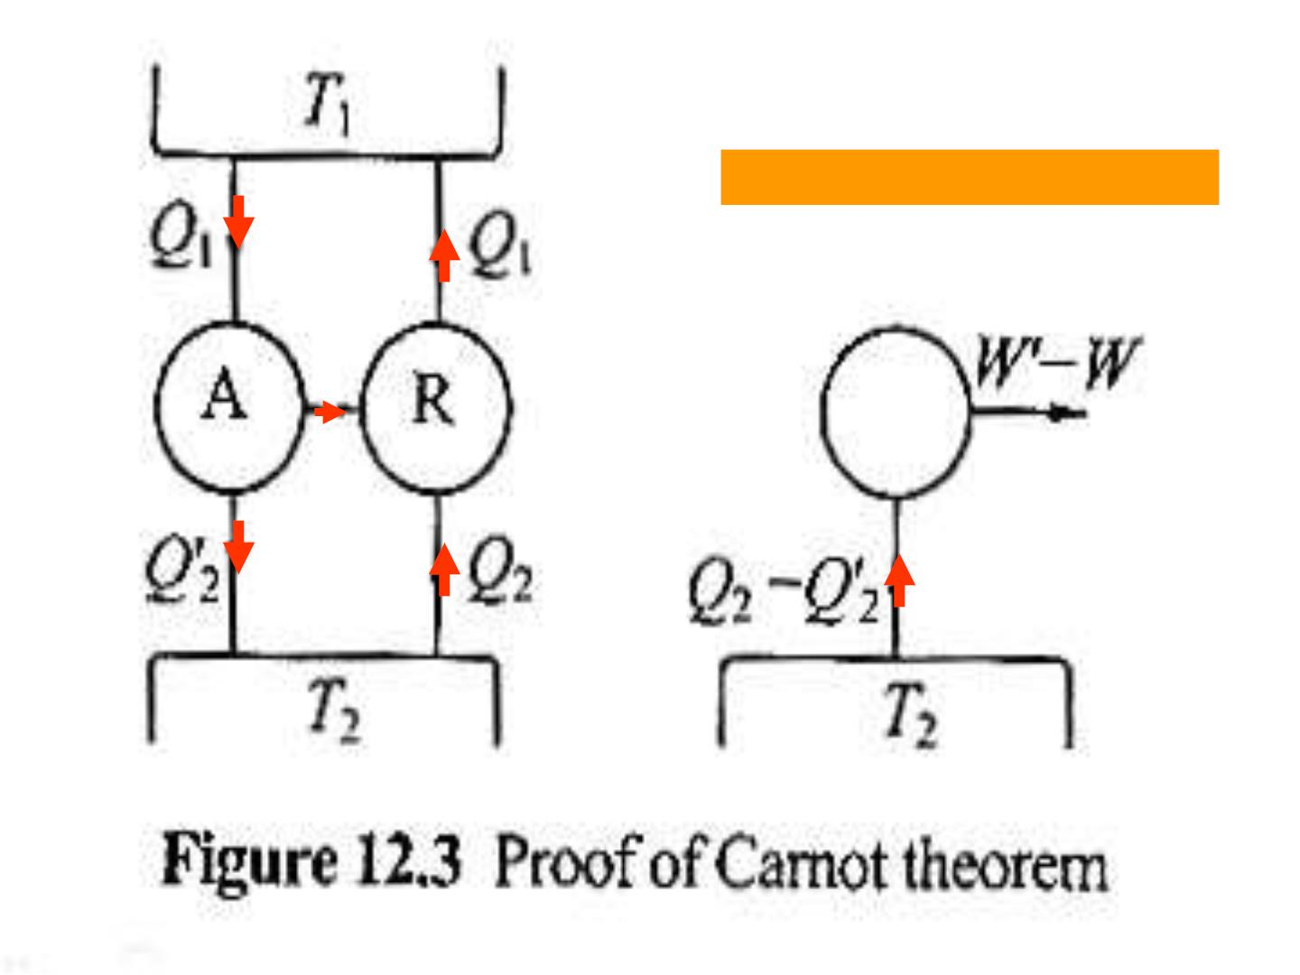
在热力学第一定律的基础上：

Slide 34
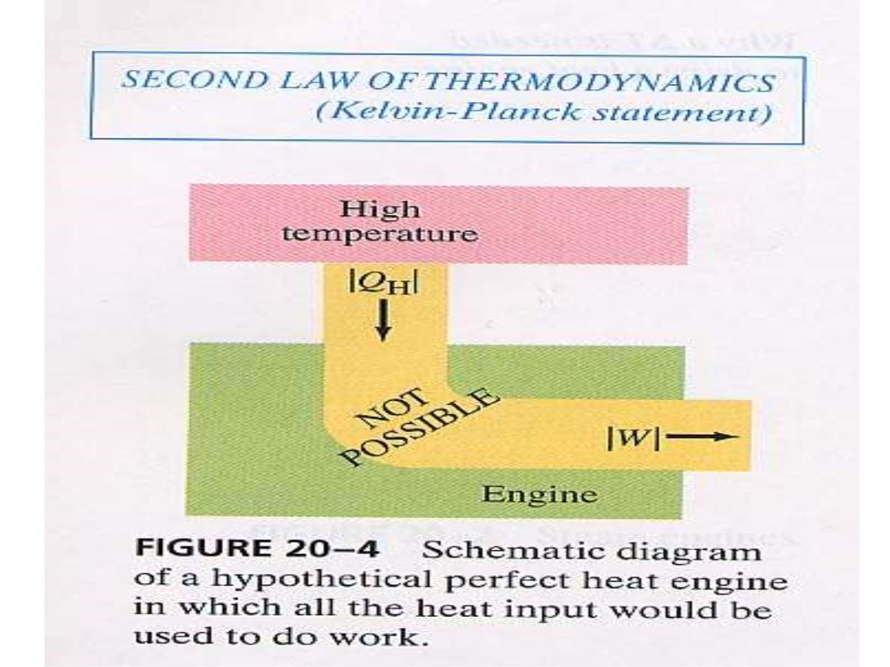

Slide 35
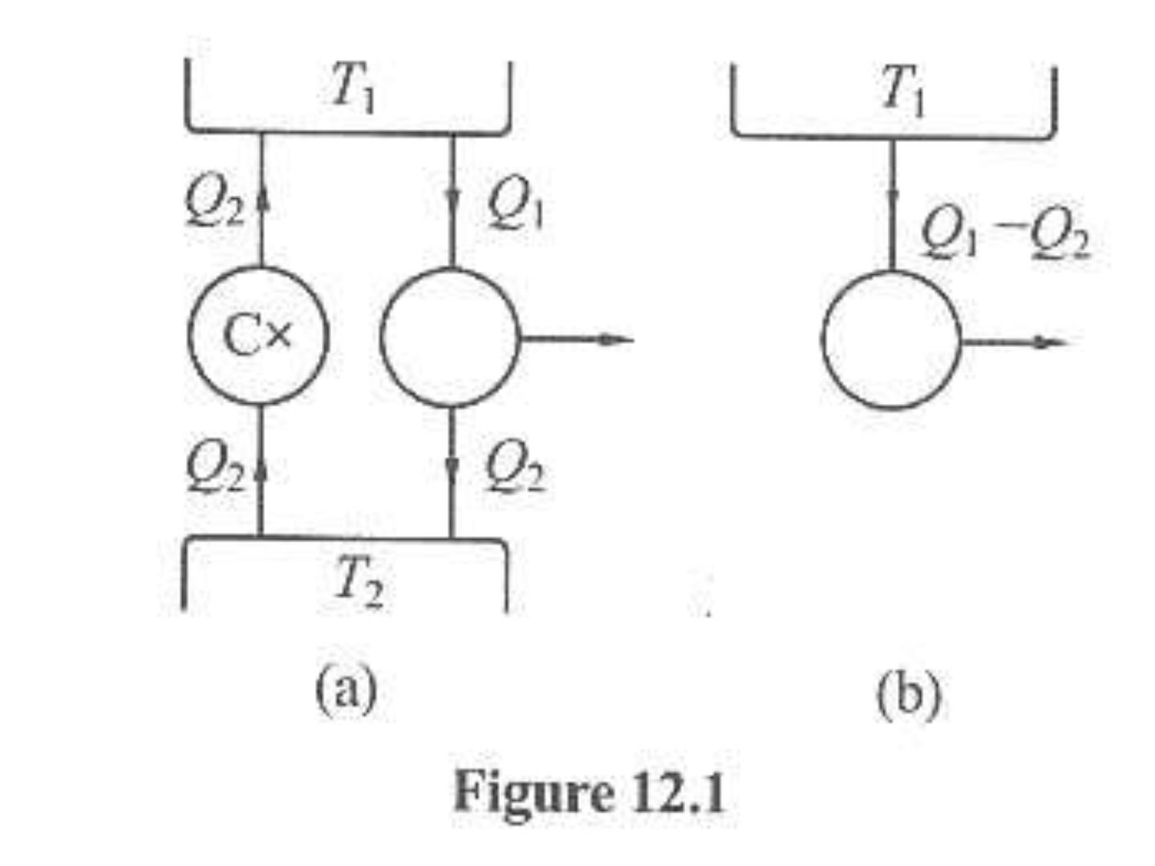

Slide 36
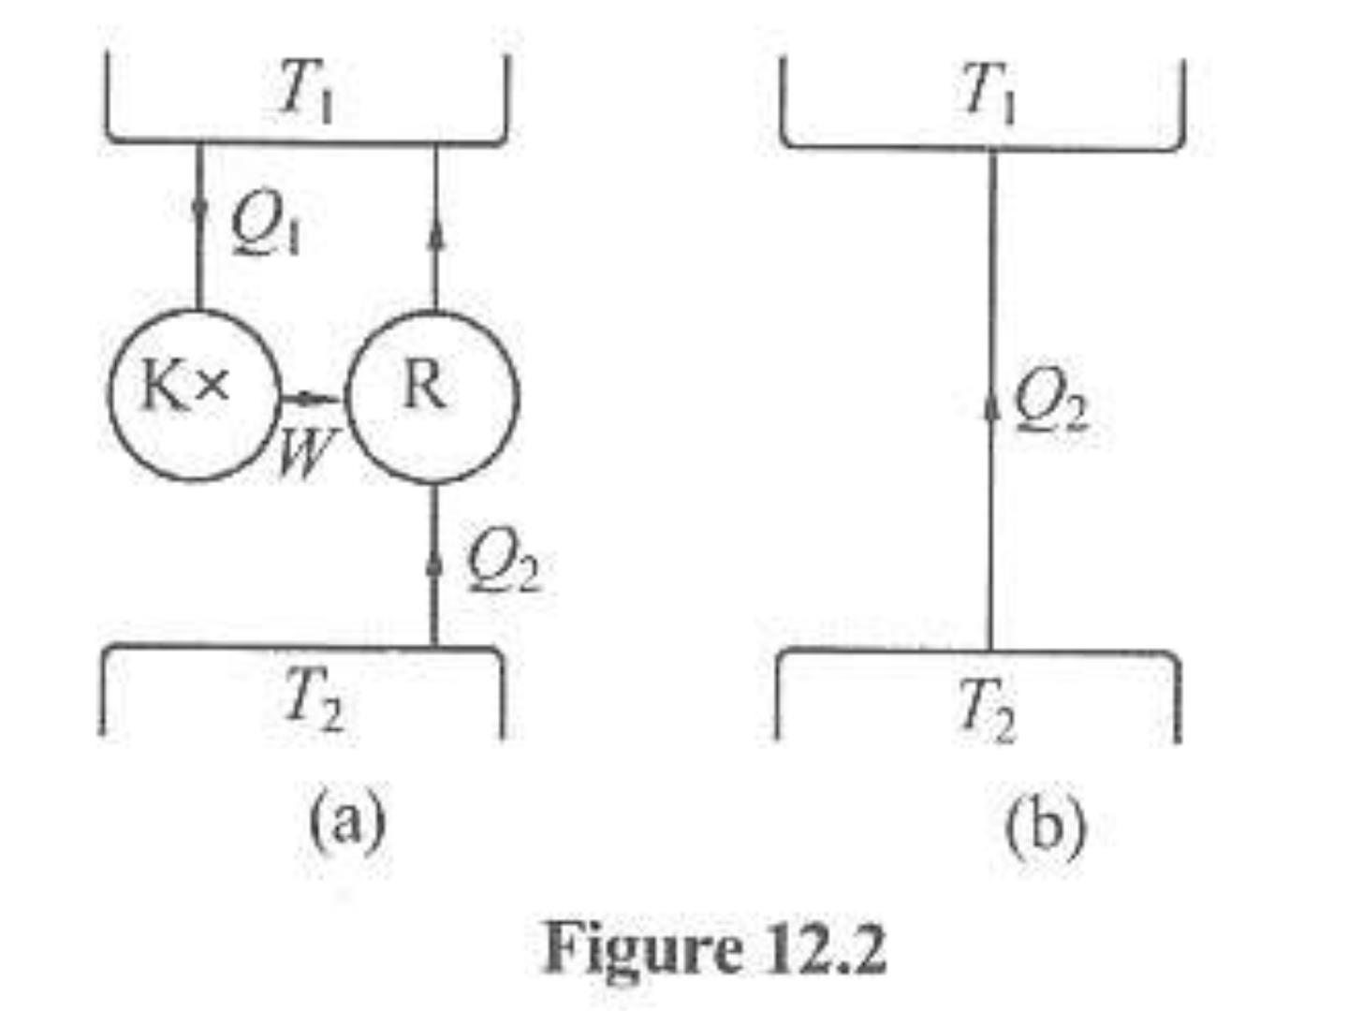
Q₂ + Q₁

Slide 37
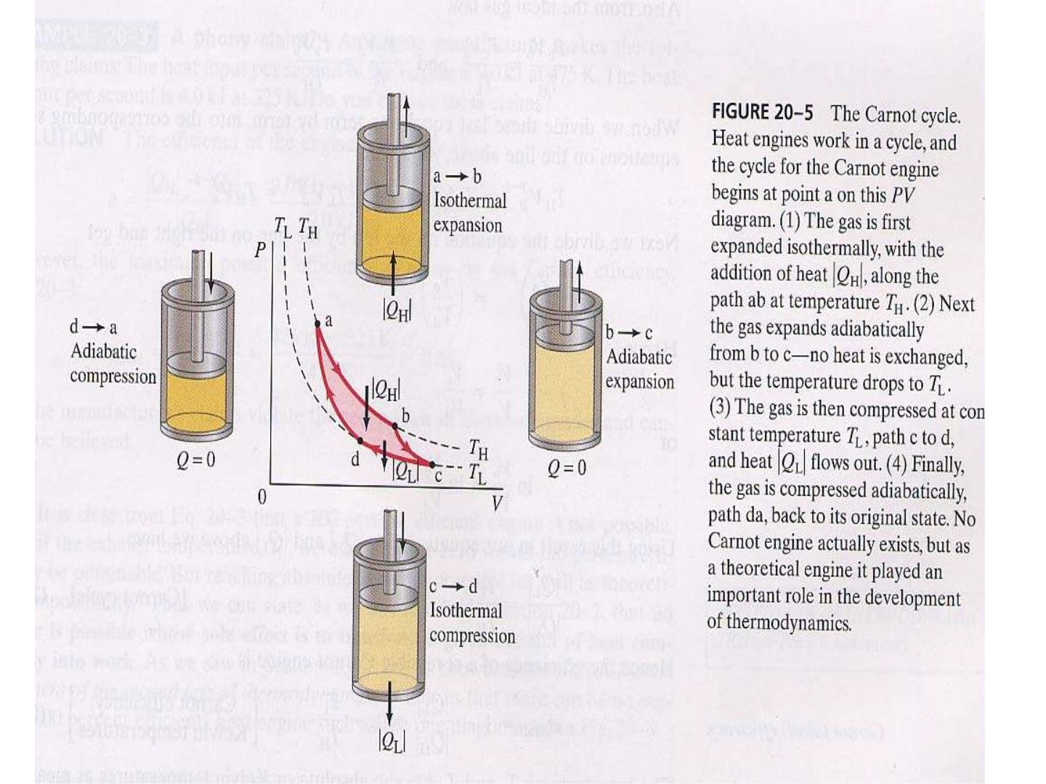
e=1-T /T
L H

Slide 38
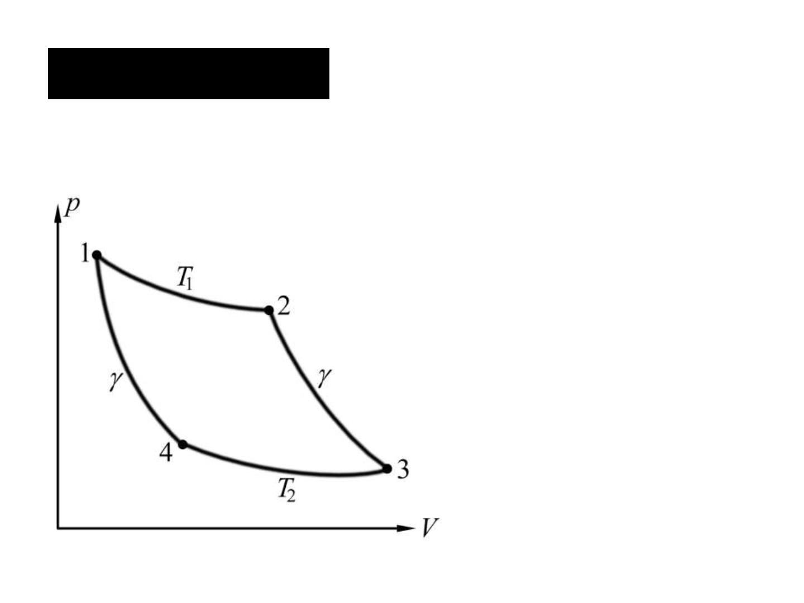
11.6 Carnot cycle Carnot heat engine
⇩
W = pdV done by engine
=
T , U U(T )
1
1
V →V W  0
1
2
1
Q  Q  0
12
1
T , Q  0
2
34
− Q₃₄  Q₂

Slide 39
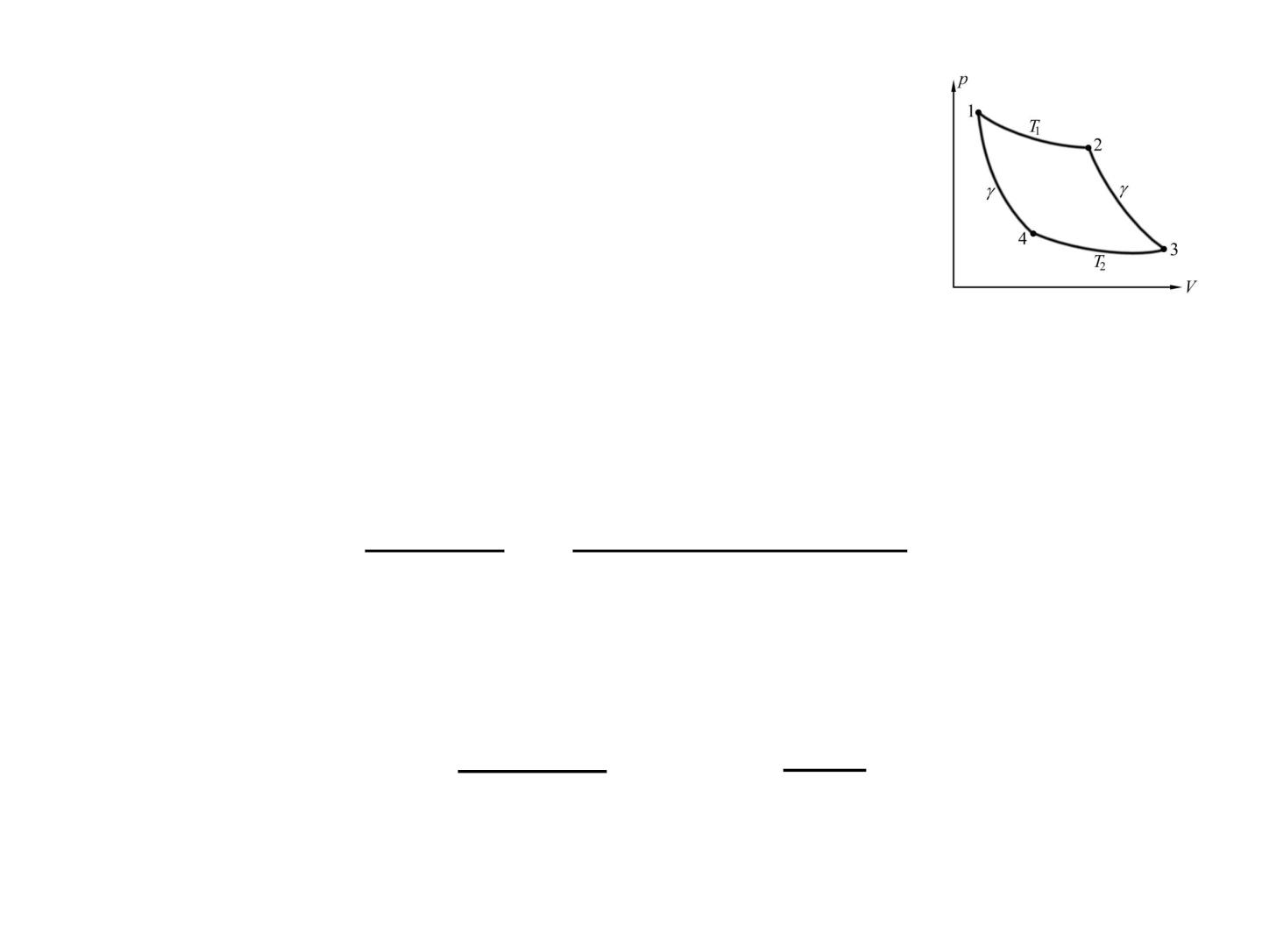
For a complete cycle
U = 0
Q + Q − W = 0
12
34
Efficiency is
W Q + Q
 = =
Q
12
Q₁₂
34
12
Q
Q
= +  −
1
34 1 2
Q
Q
12
1

Slide 40
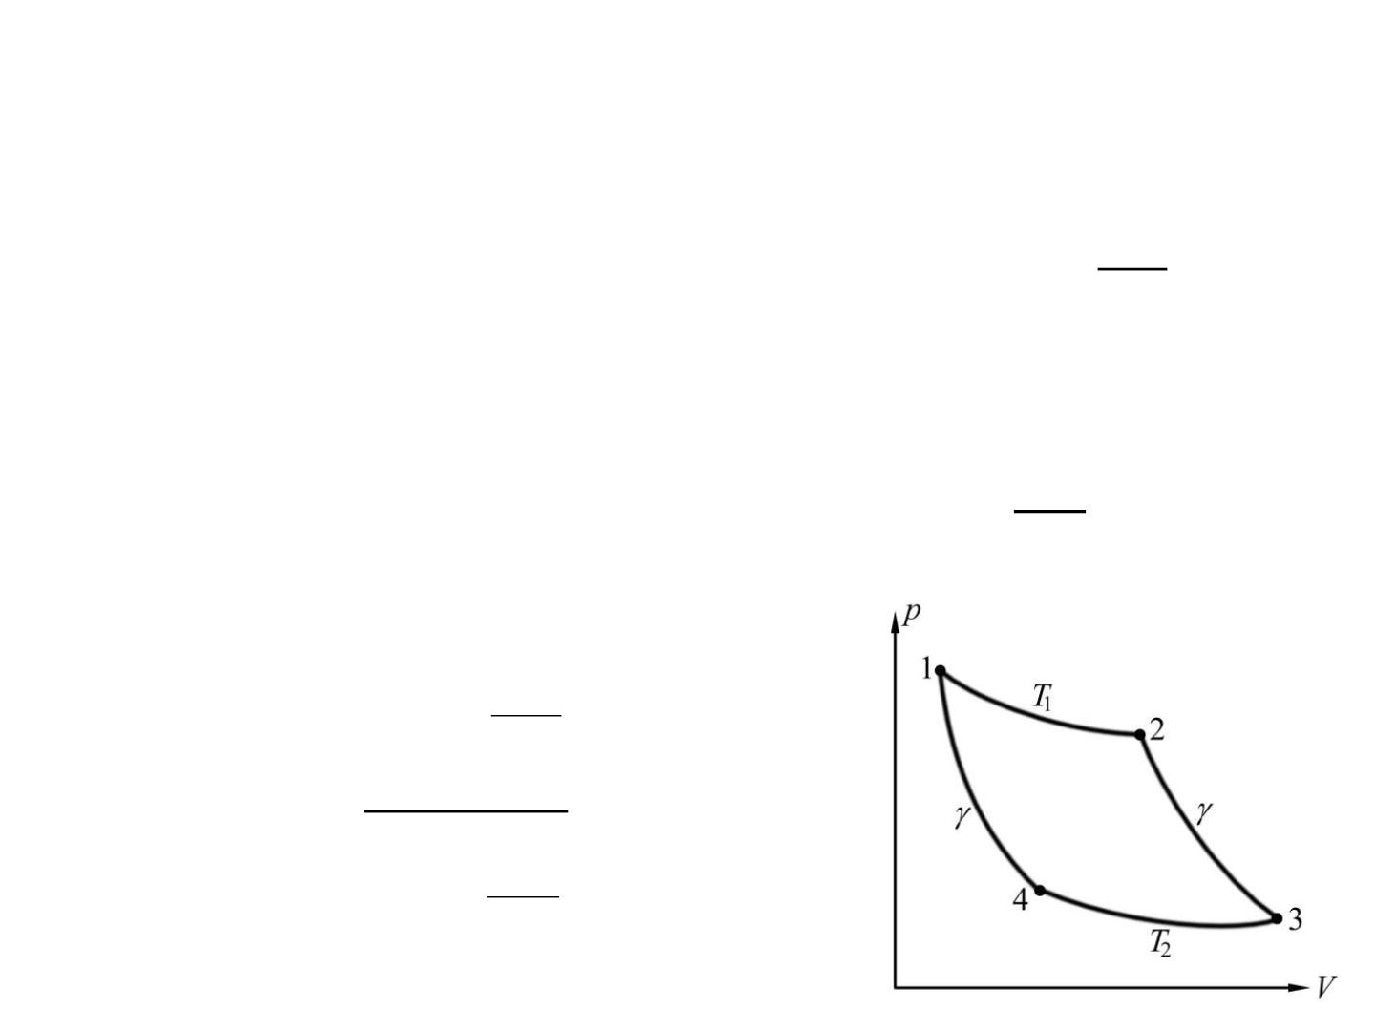
U =
Along isotherm
T , 0
1
V
V₂
V₁
2
⇩
  =  = =
Q Q W pdV nRT ln
1
12
12
1
V
Similarly
1
V
V₃
V₄
4
⇩
Q Q pdV nR T ln
= − = − =
2
34
2
V
3
V
T ln ³
2
V
V
 = −
4
1
T ln ²
1
V
1

Slide 41
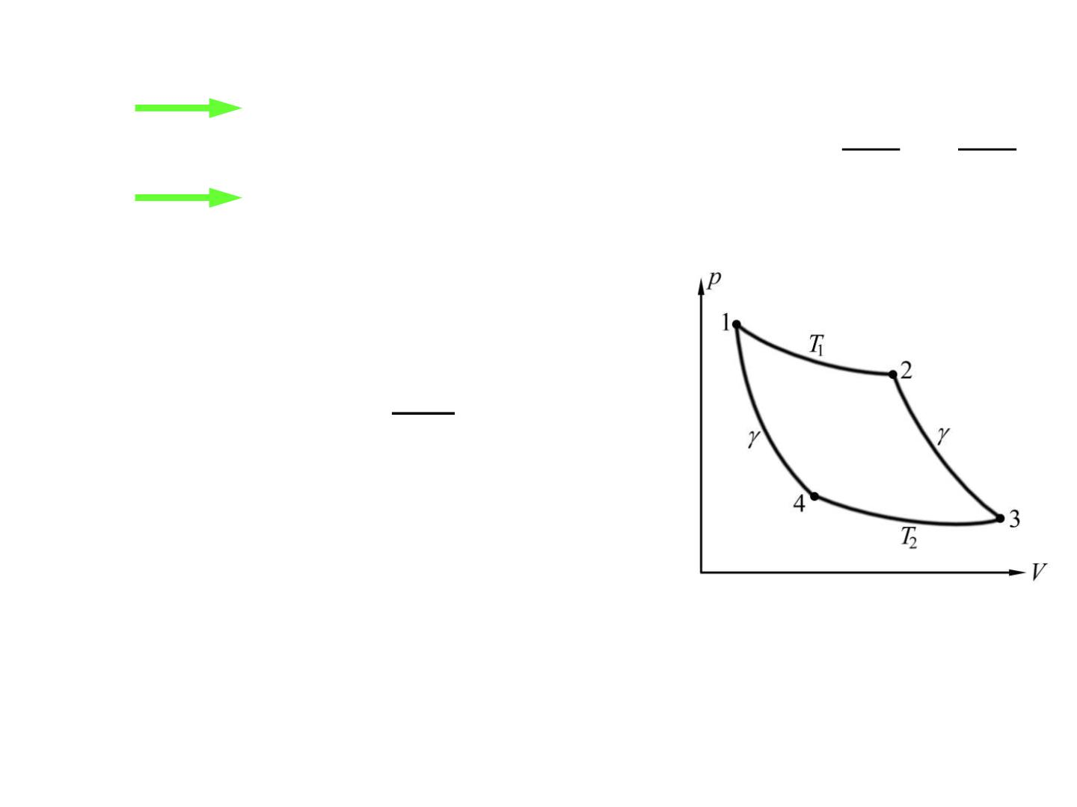
 −1
1 2
 −1
2 3
2 3
T V = T V V V
2
=
3
 −1
 −1
2 4
V V
4 1 T V = T V
1 1
1
4
T
 = −
2
1
T
1

