Slide 1

大学物理（热学）
1) Review
2) Carnot’s cycle
3) Entropy
2006-12-21
2021/9/5
1

Slide 2
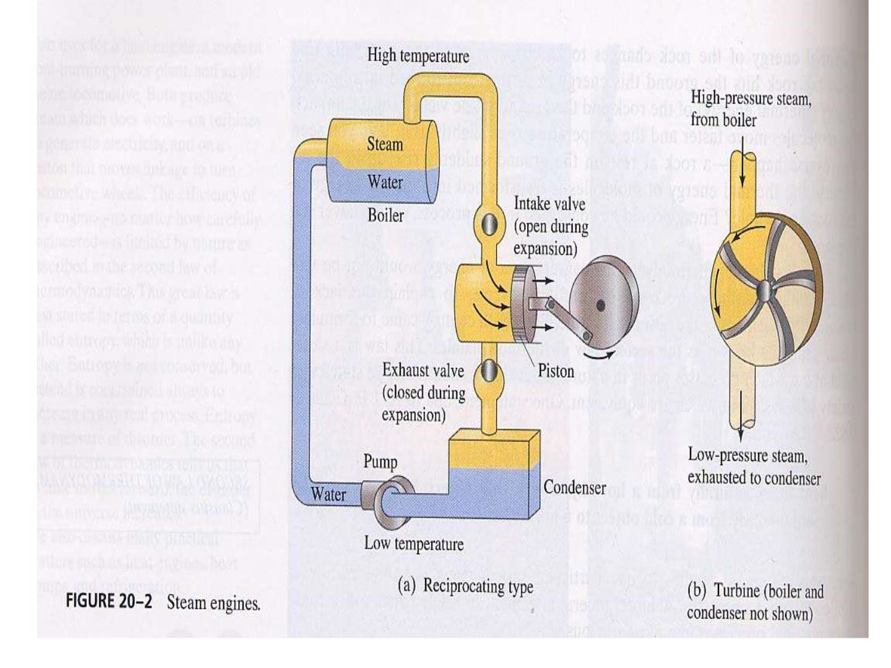

Slide 3
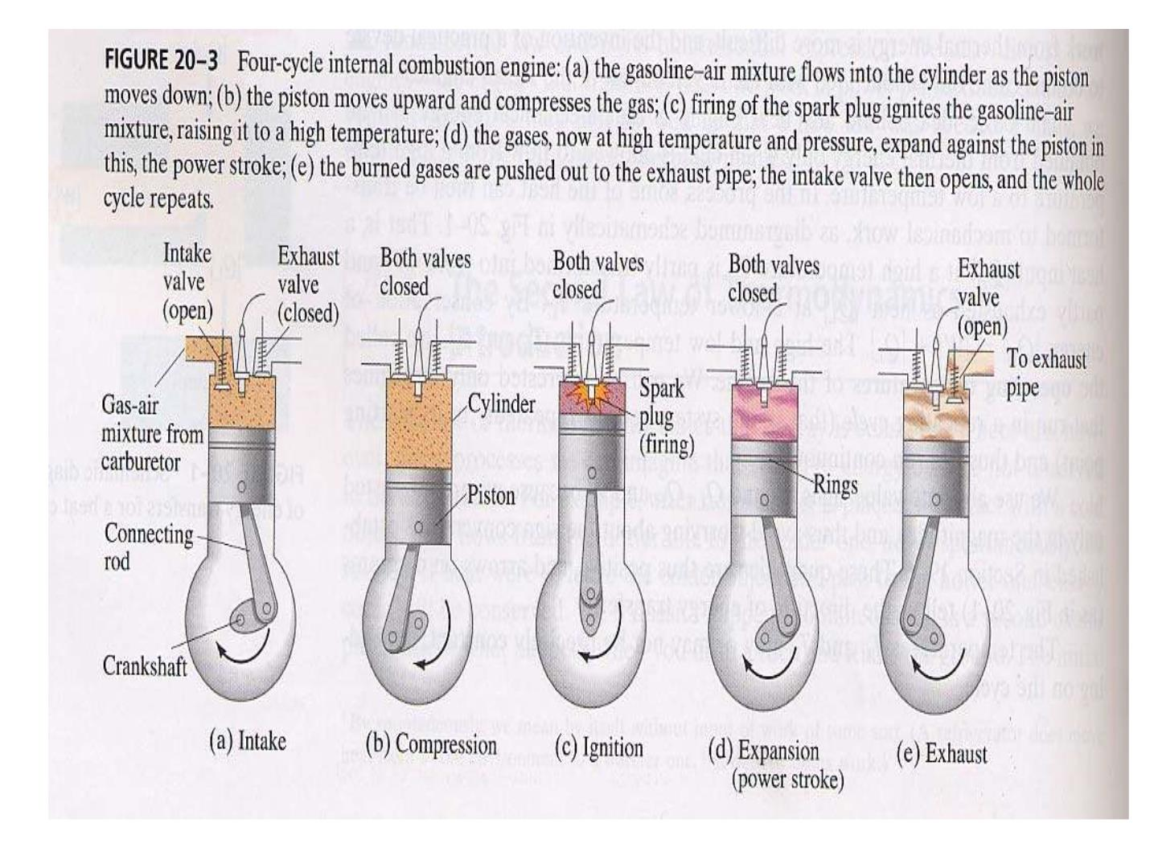

Slide 4

用热做功——存在限制否？

Slide 5
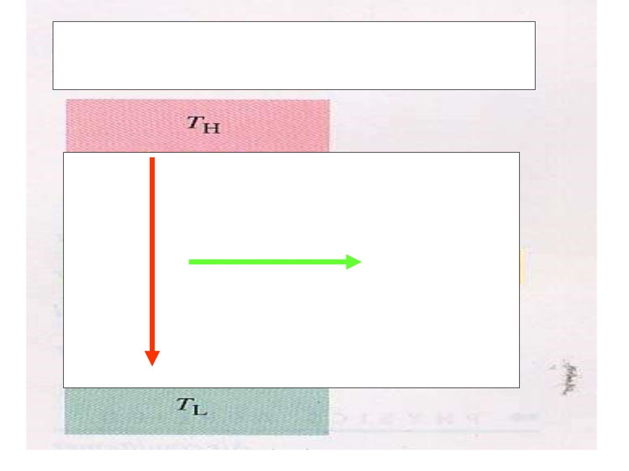
Carnot’s ideas
Q
W

Slide 6

Carnot’s ideas
“The necessary condition of the
m aximum is, then, th at in the bodies
emp lo yed by realize the motive
power of heat there sh ould not occur
any change of temperature which
may not due to a change of volum e.”

Slide 7
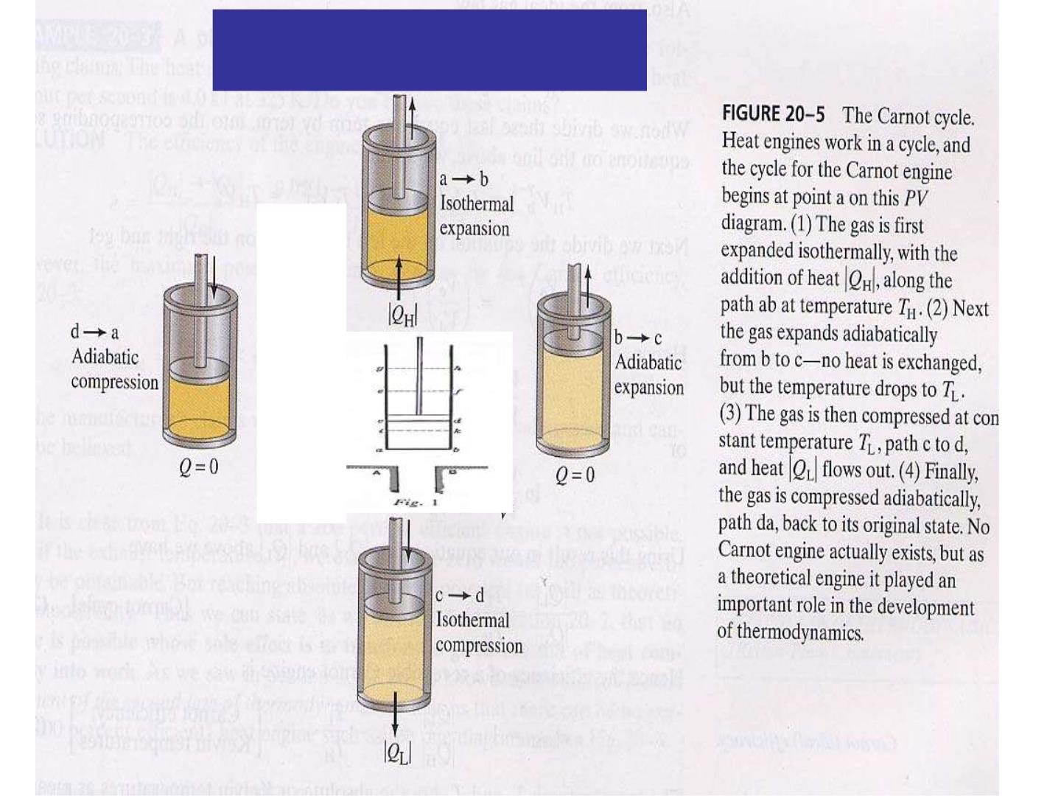
Carnot’s Cycle

Slide 8
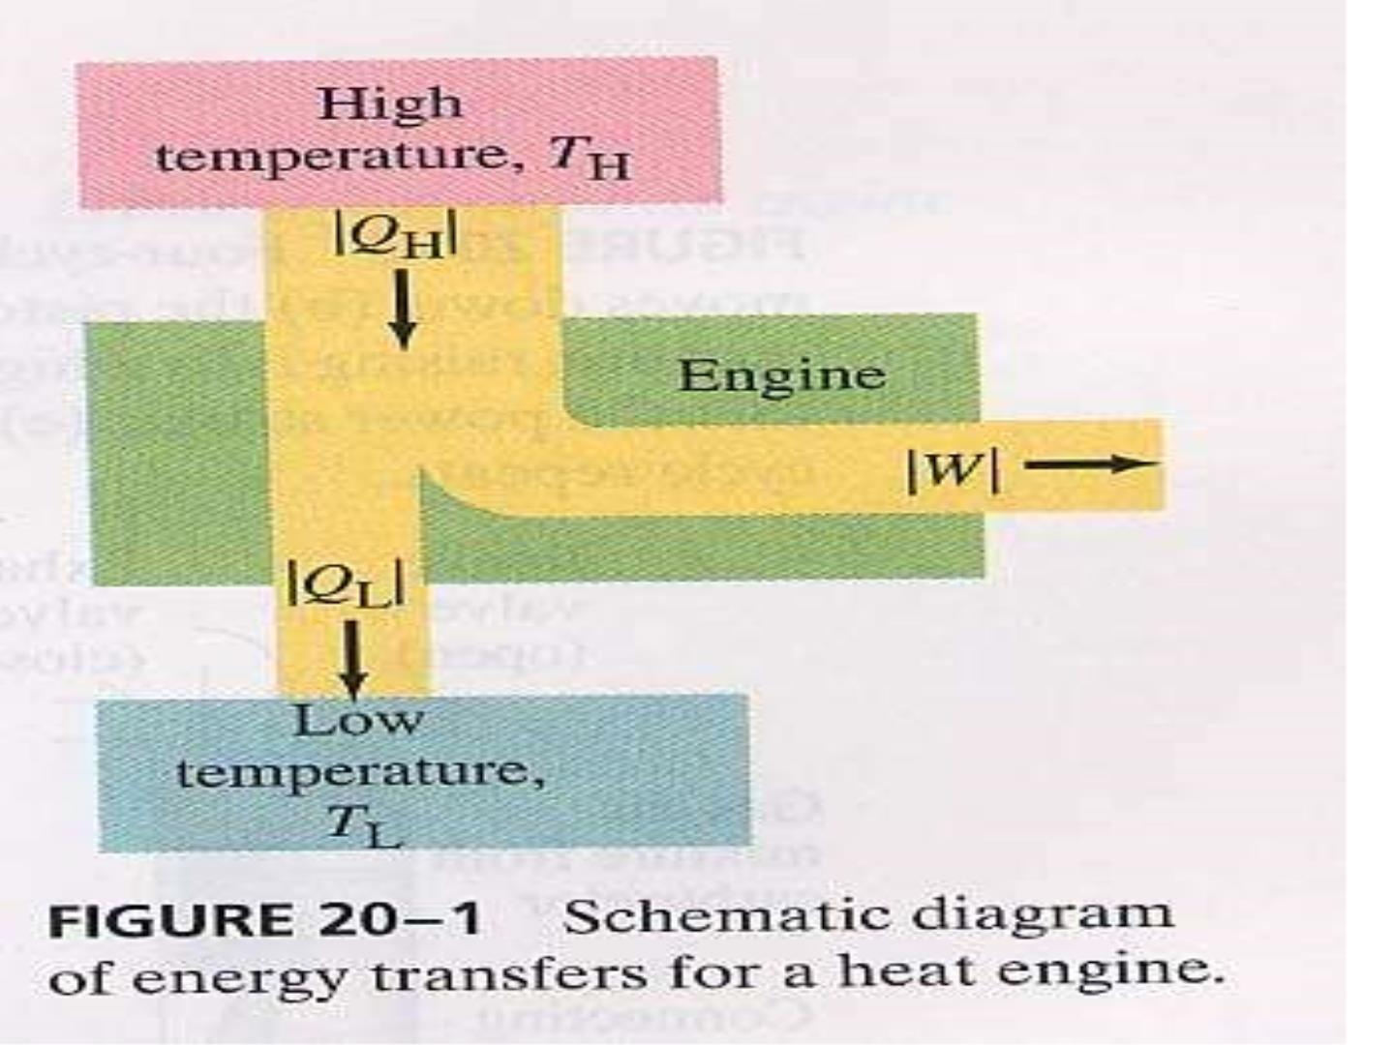

Slide 9

Carnot’s theorem
“All reversible engines operating
between the same two constant
temperatures TH and TL have the same
efficiency.
Any irreversible engine operating
between the same two fixed temperatures
will have an efficiency less than this.”

Slide 10
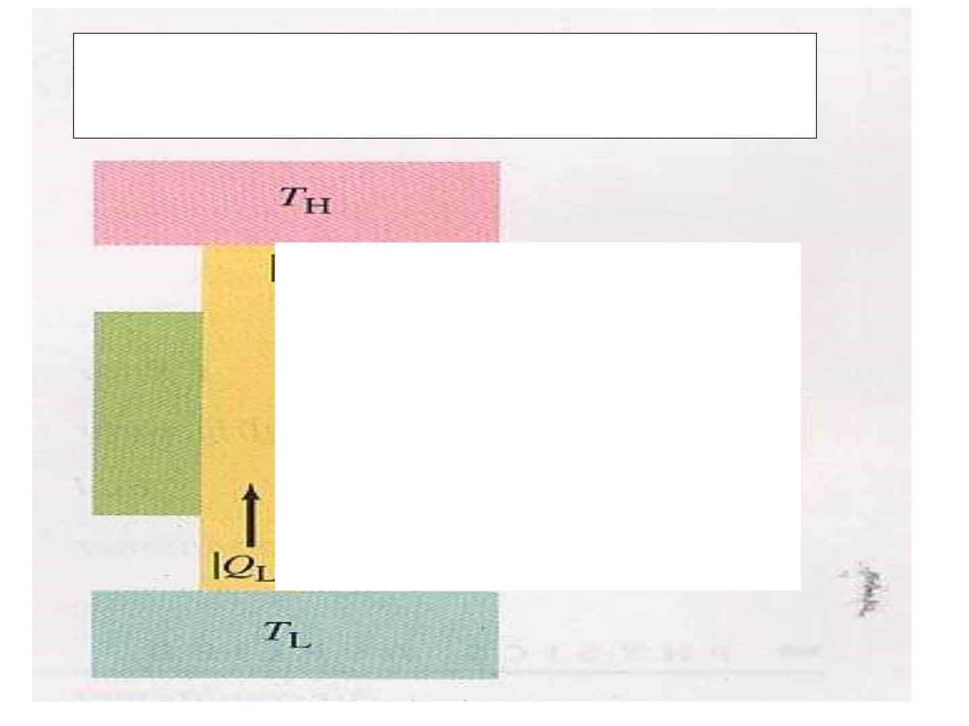
Clausuis statem ent
Not possible

Slide 11
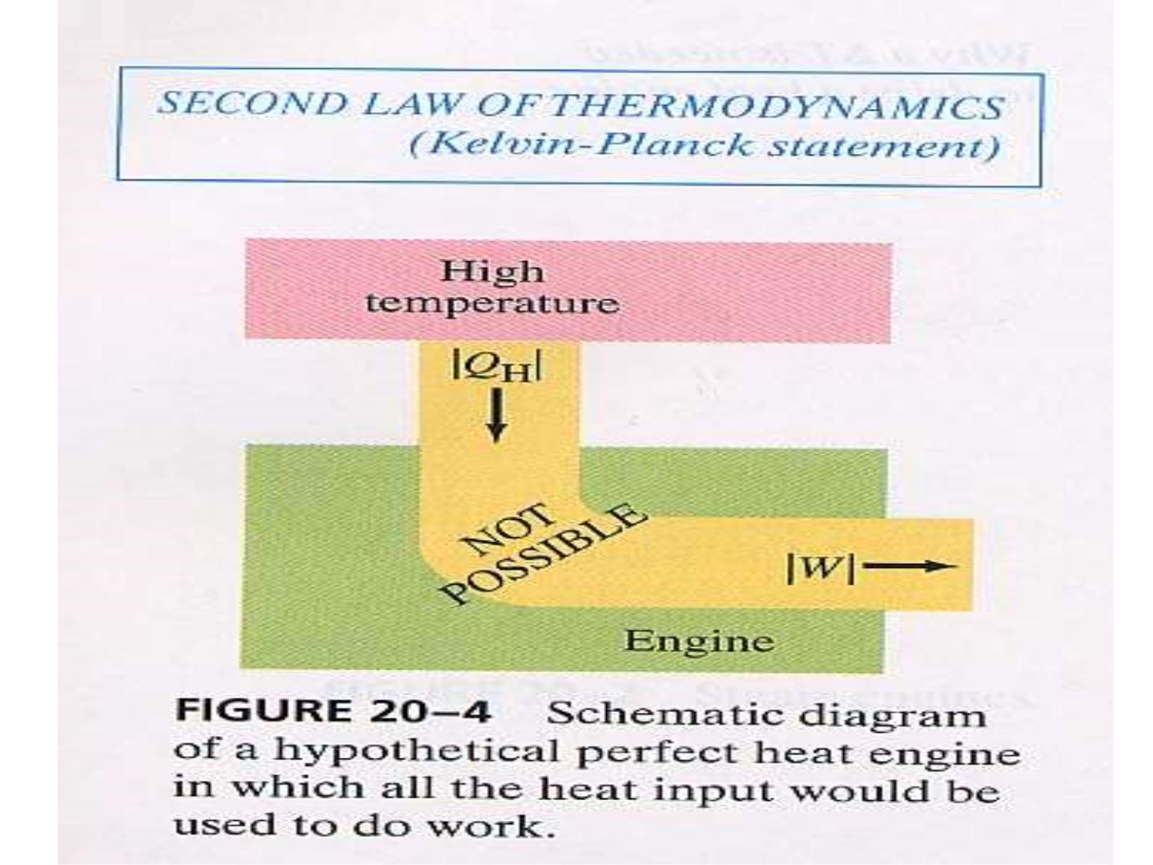

Slide 12
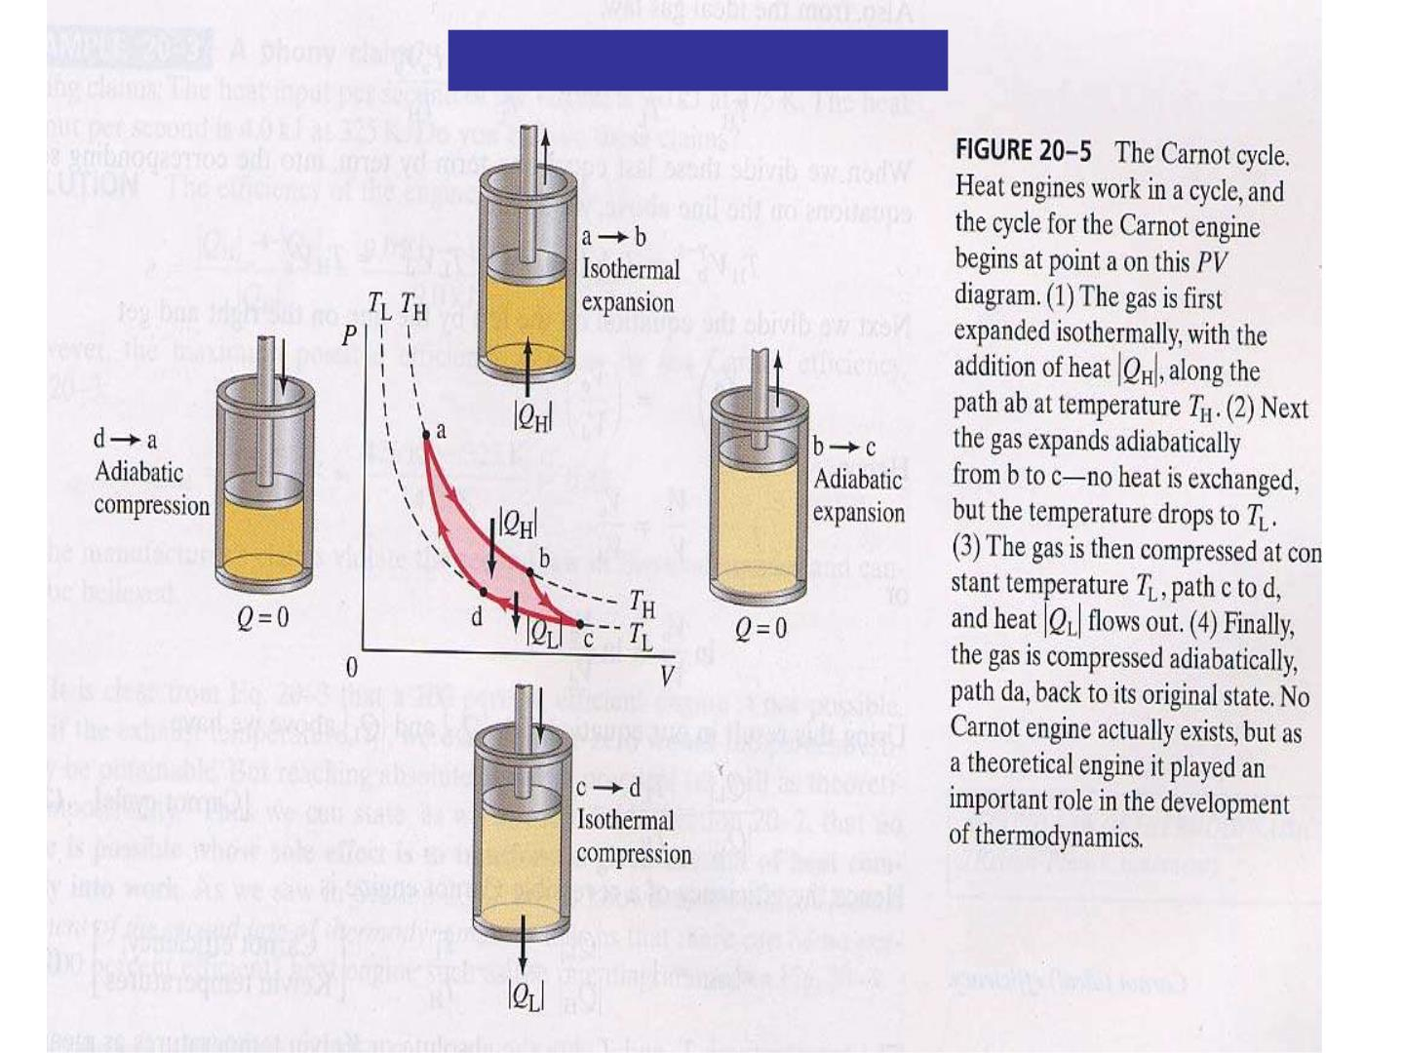
Clapeyron’s Graph (1834)

Slide 14
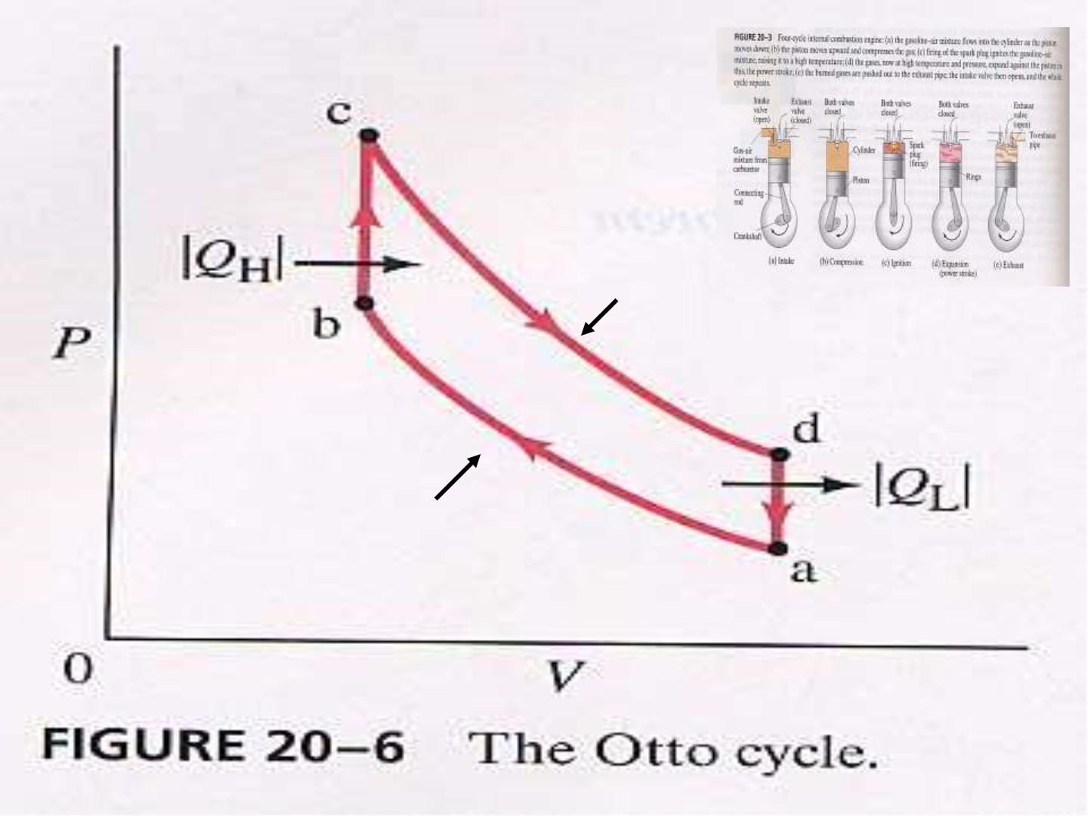
绝热
绝热

Slide 15
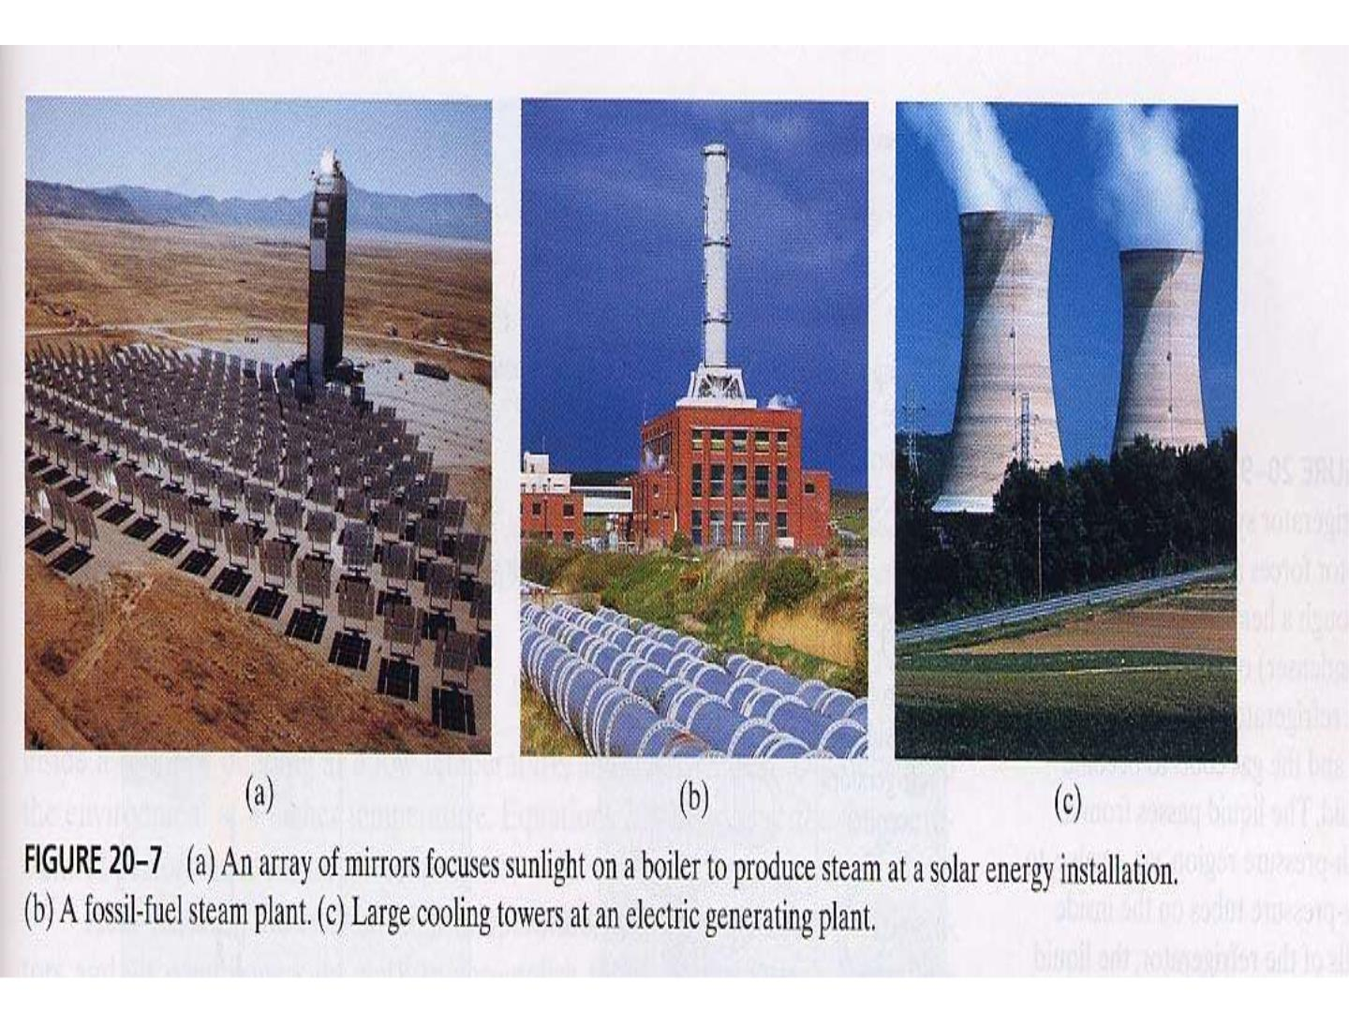

Slide 16
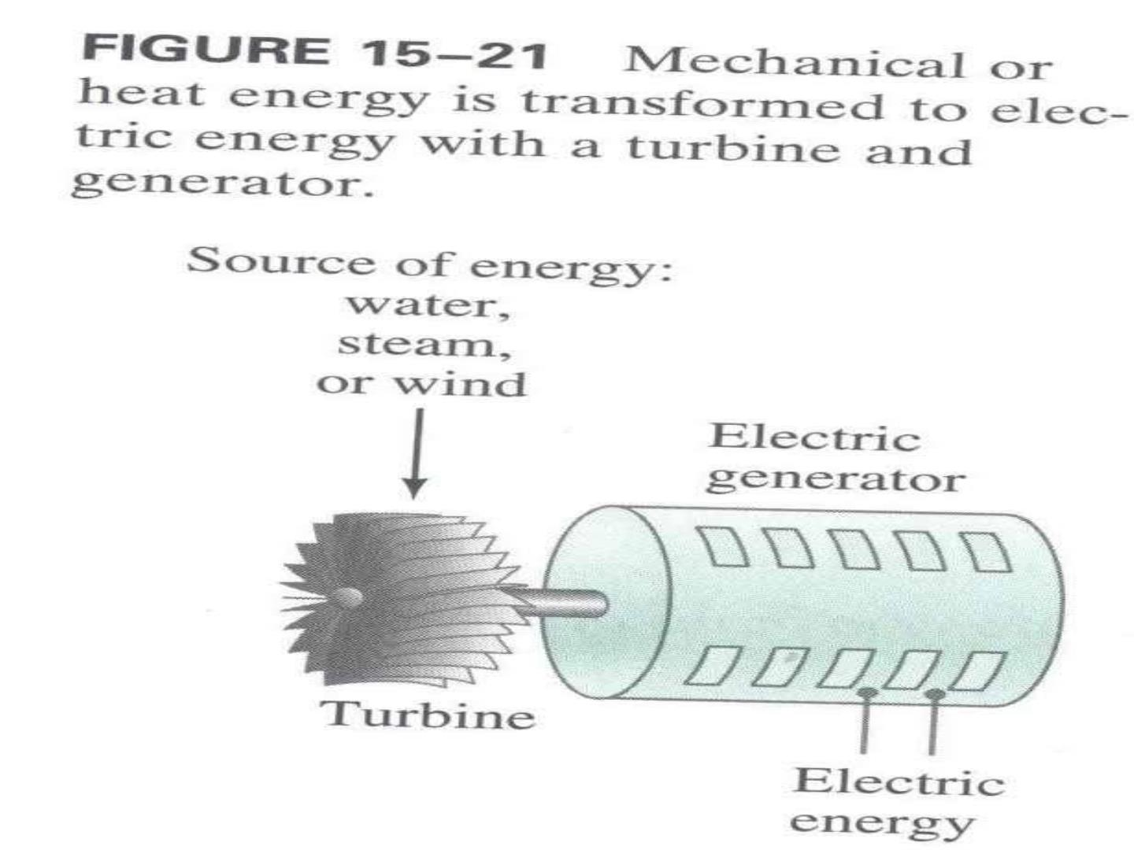

Slide 17
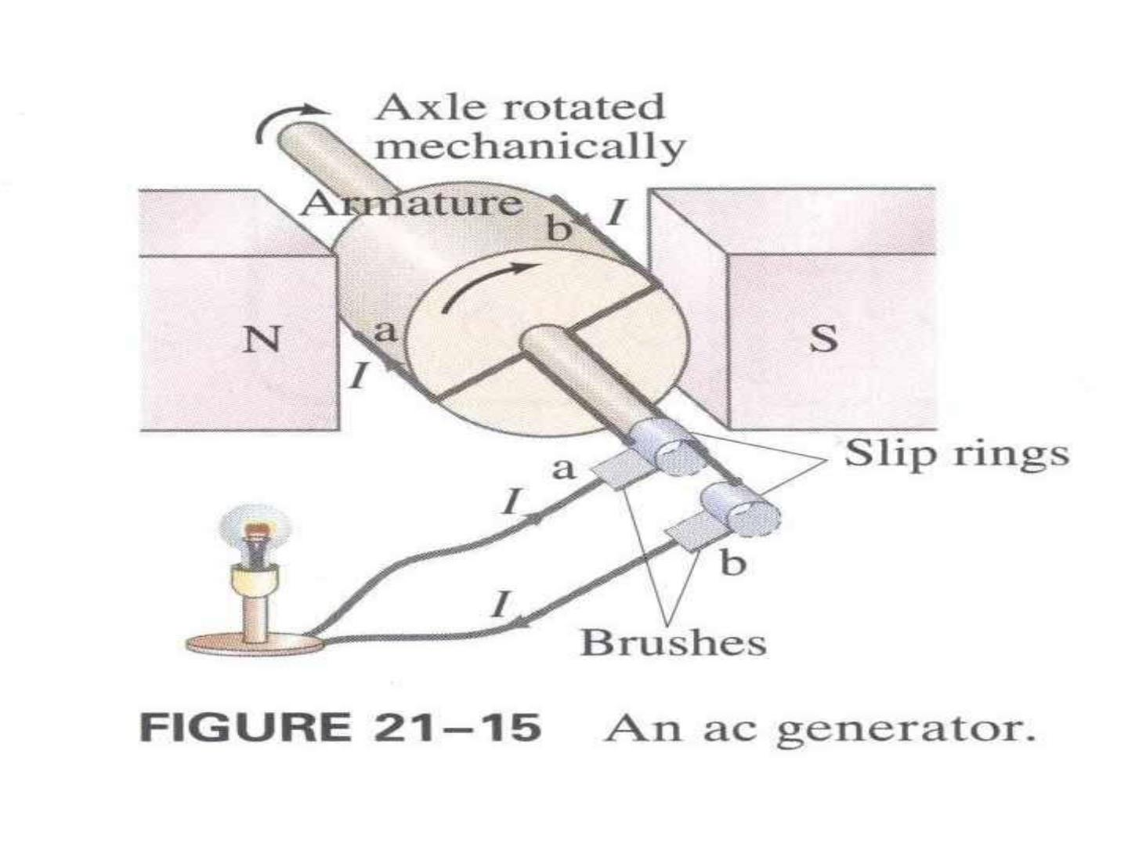

Slide 18
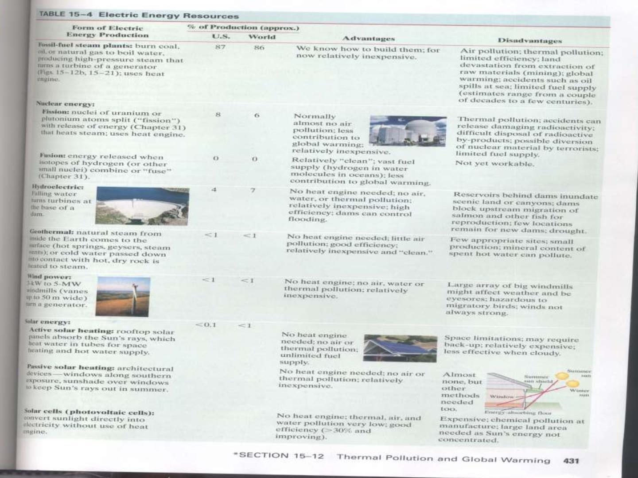

Slide 19
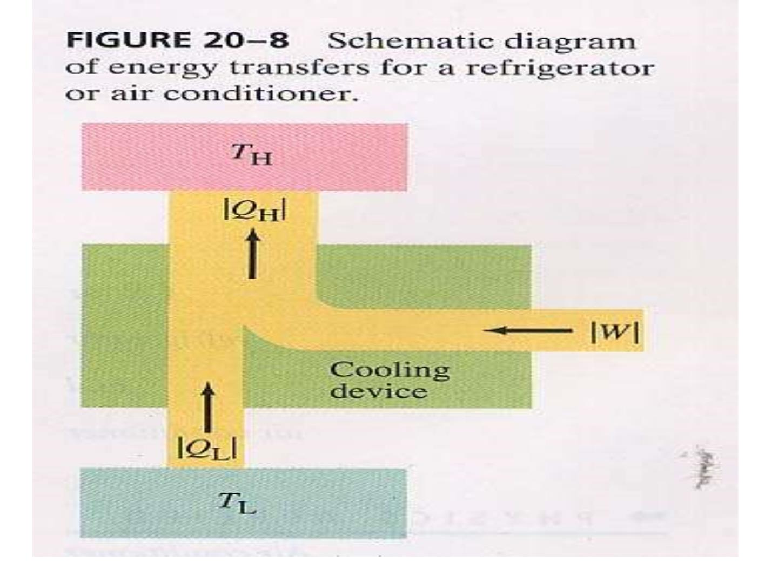

Slide 20
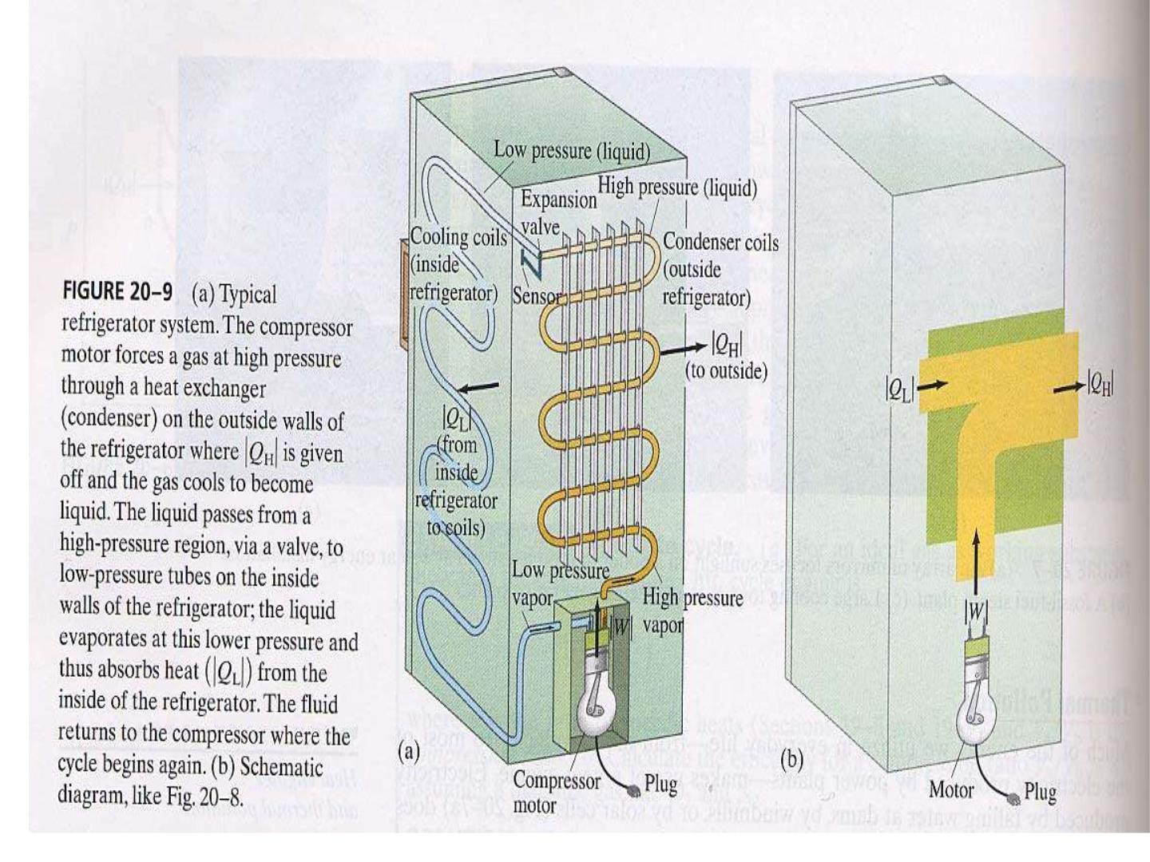

Slide 21
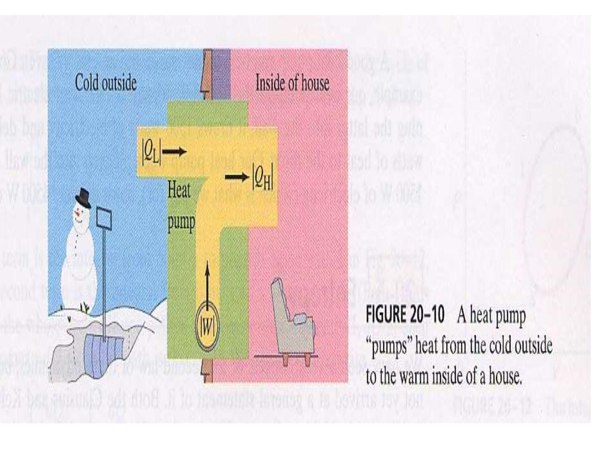

Slide 22
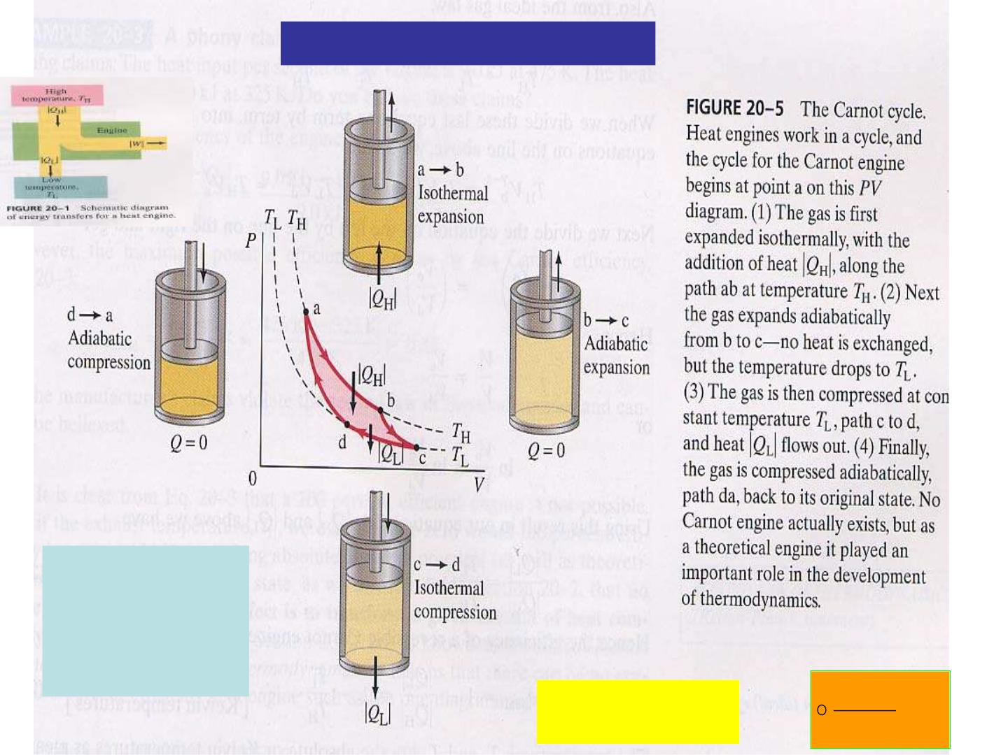
Clausius’ deduction (1865)
e= W/ Q_{H}
= 1-Q /Q
L H
Q / T =Q /T Q / T -Q /T =0
=1-T /T
L
L
H
H,
H
H
L
L
L H
dQrev
(Q/T)=0 
= 0
T

Slide 23
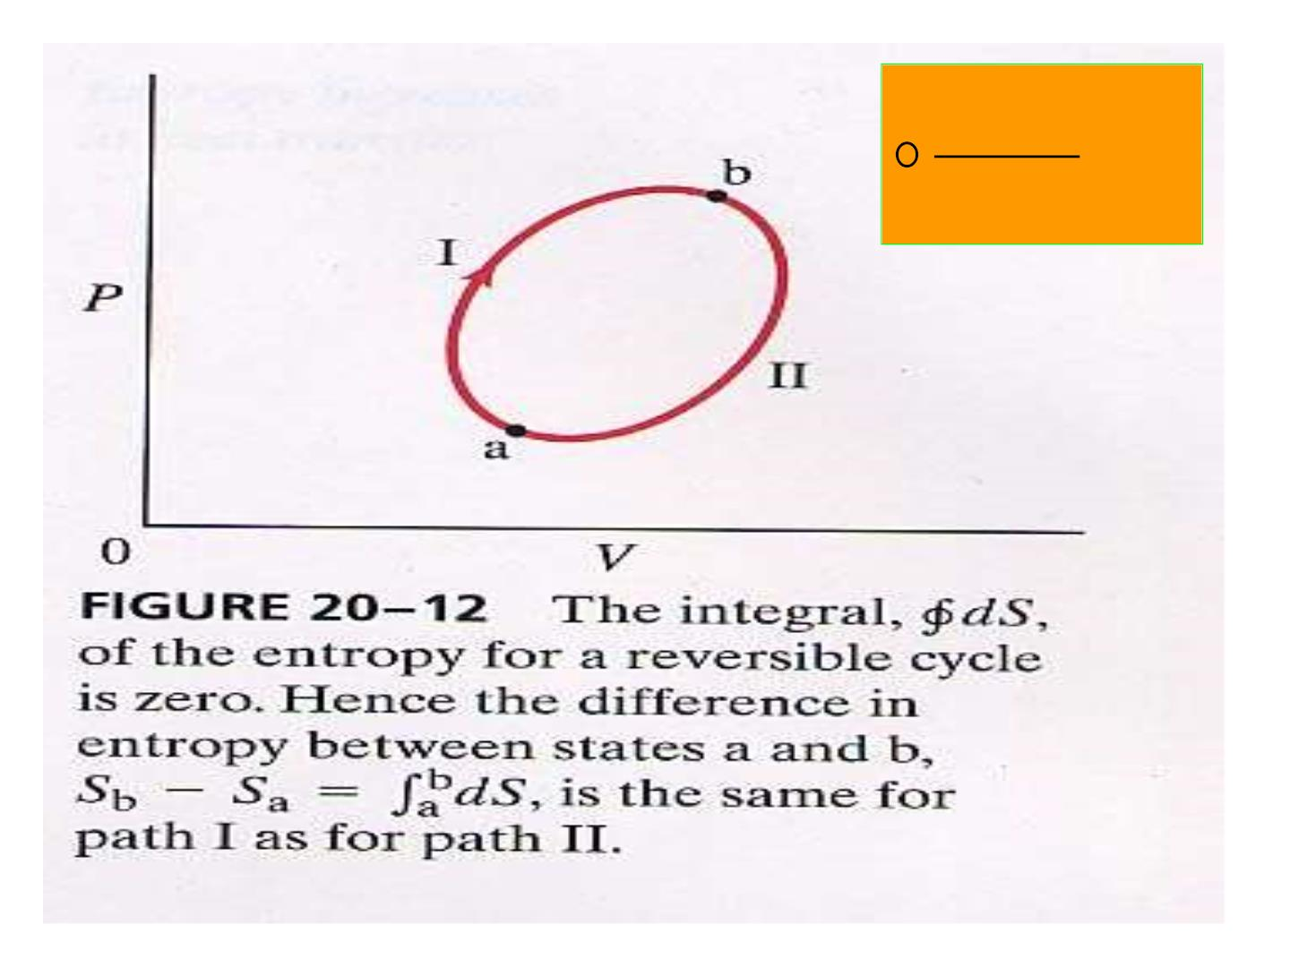
dQrev
⇩
= ?
T

Slide 24
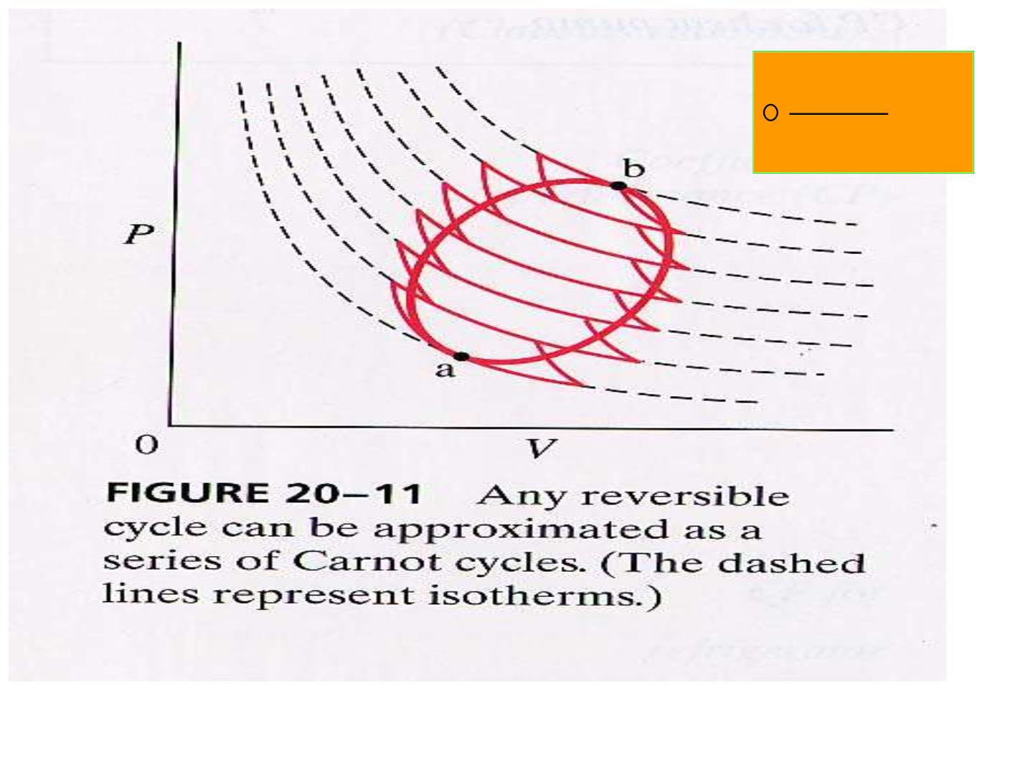
dQr ev
⇩
= 0
T
T₁
T₂
T₃
T₄
T₅
T₆
T₇
(Q / T +Q /T )+(-Q /T +Q /T )+…+ (-Q /T +Q /T )=0
1
1
2
2
2
2
3
3
6
6
7
7

Slide 25
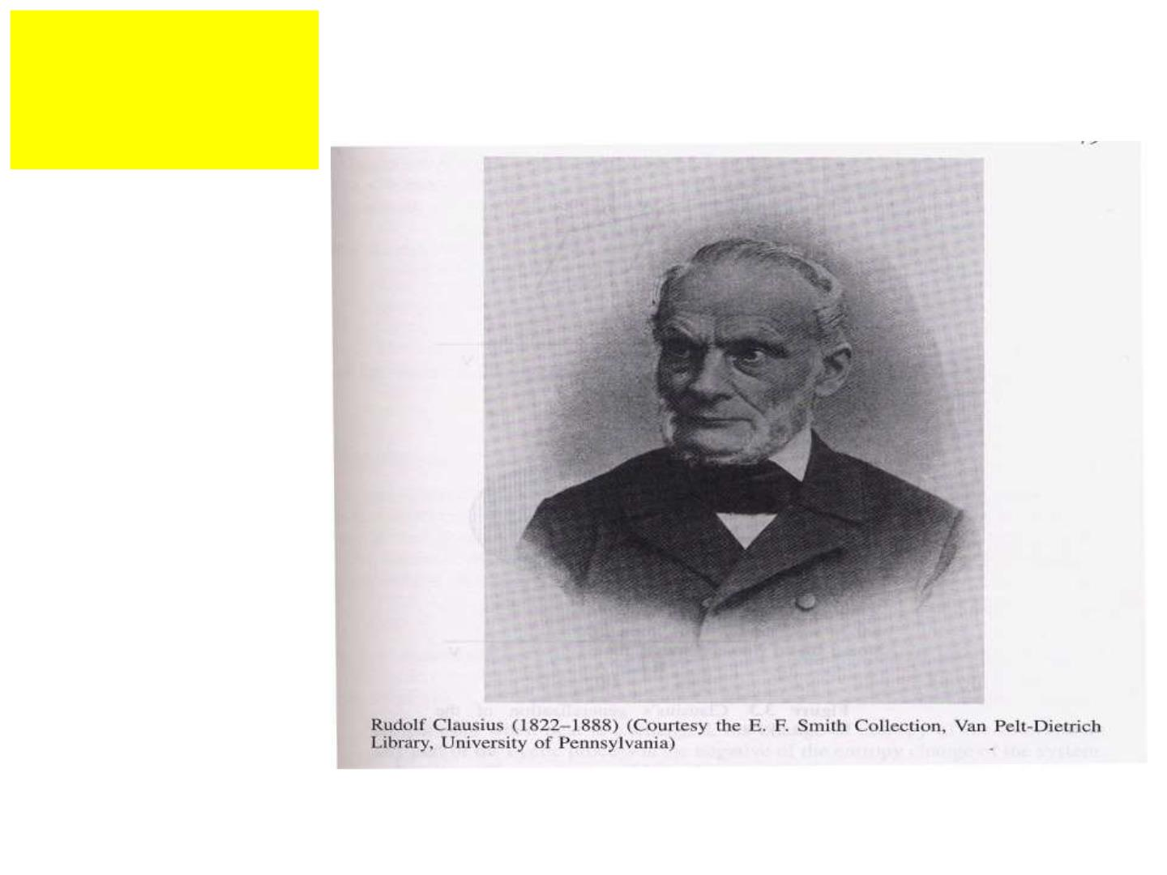
克劳修斯
R. Clausius
熵的引入

Slide 26
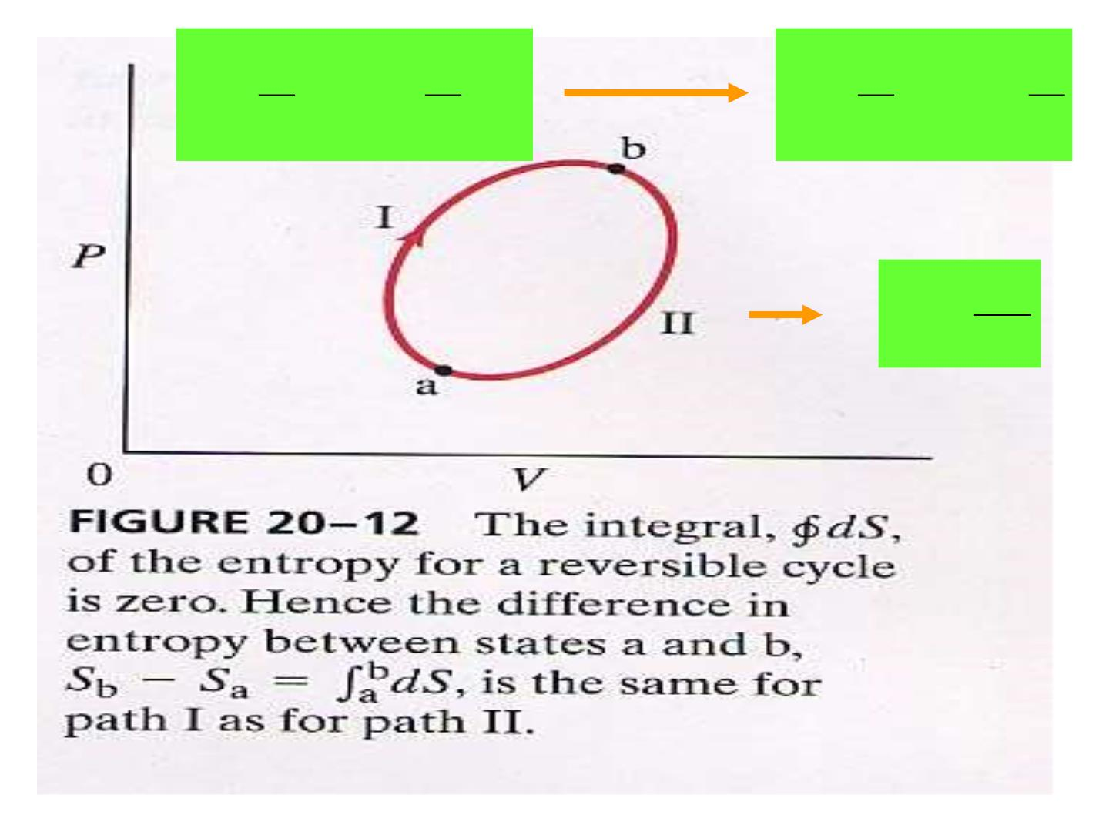
b
a
b
b
b
a
⇩ 
⇩ 
dQ
T
+
dQ
T
=
(I)
dQ
T
=
(II)
dQ
T
(I) (II)
0
a
a
dQ
T
dS =

Slide 27
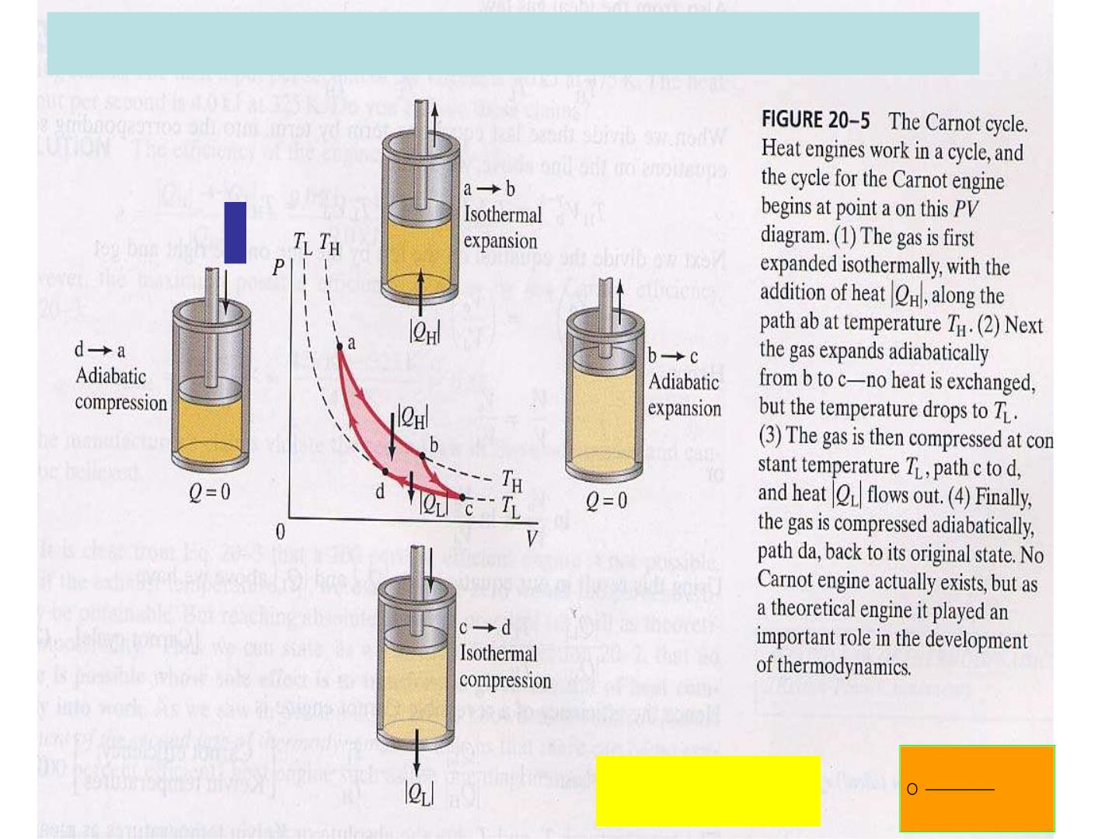
Irreversible: e= W/ Q = 1-Q /Q < 1-T /T
H
L H
L H
Q / T >Q /T
L L
H H
(Q/T)<0 
dQrev
 0
T

Slide 28
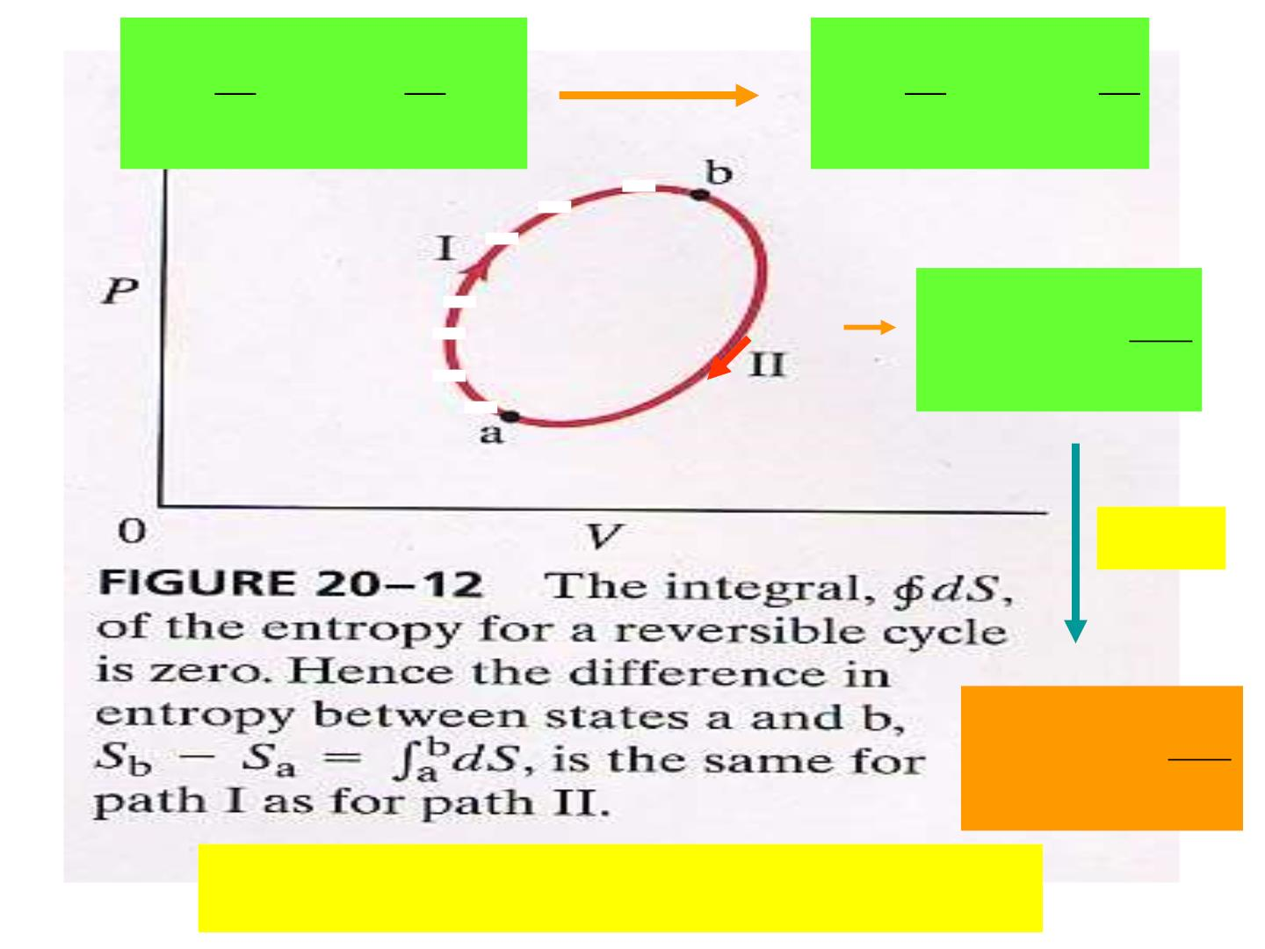
b
a
b
b
a
⇩ 
⇩ 
(I) + (II)  0
dQ
T

dQ
T
dQ
T
dQ
T
(I)
(II)
a
b
a
B
dQ
T
S
B
− SA

⇩
A
R&IR
B
dQ
T
S
− SA

⇩
B
A
For isolated system: S  0

Slide 29

Clausius’ Statement
“The energy of the universe is a
constant. The entropy of the universe
approaches a maximum.”

