Slide 1

大学物理（热学）
1) Review
2) Examples
3) Order and Disorder
2006-12-27
2021/9/5
1

Slide 2
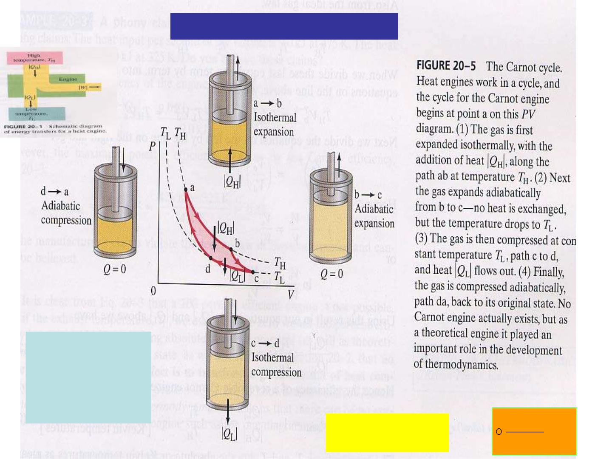
Clausius’ deduction (1865)
e= W/ Q_{H}
= 1-Q /Q
L H
Q / T =Q /T Q / T -Q /T =0
=1-T /T
L
L
H
H,
H
H
L
L
L H
dQrev
(Q/T)=0 
= 0
T

Slide 3
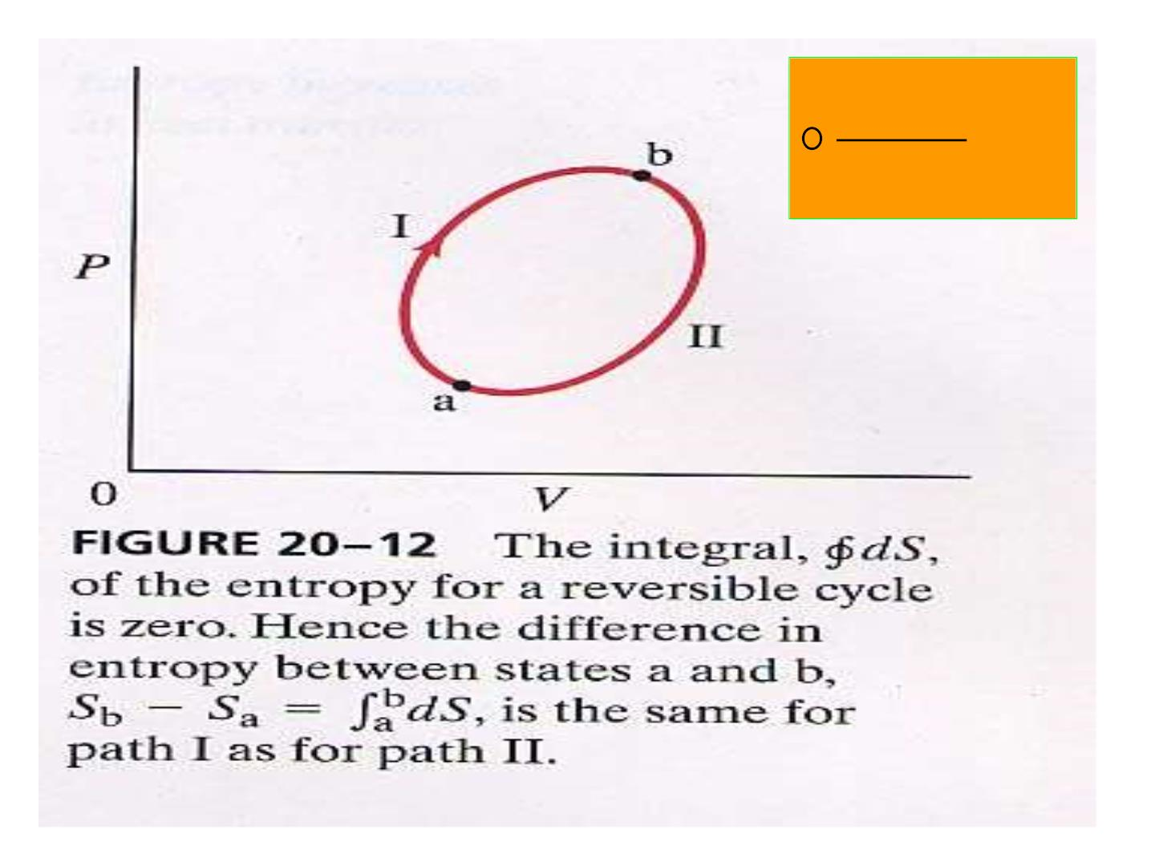
dQrev
⇩
= ?
T

Slide 4
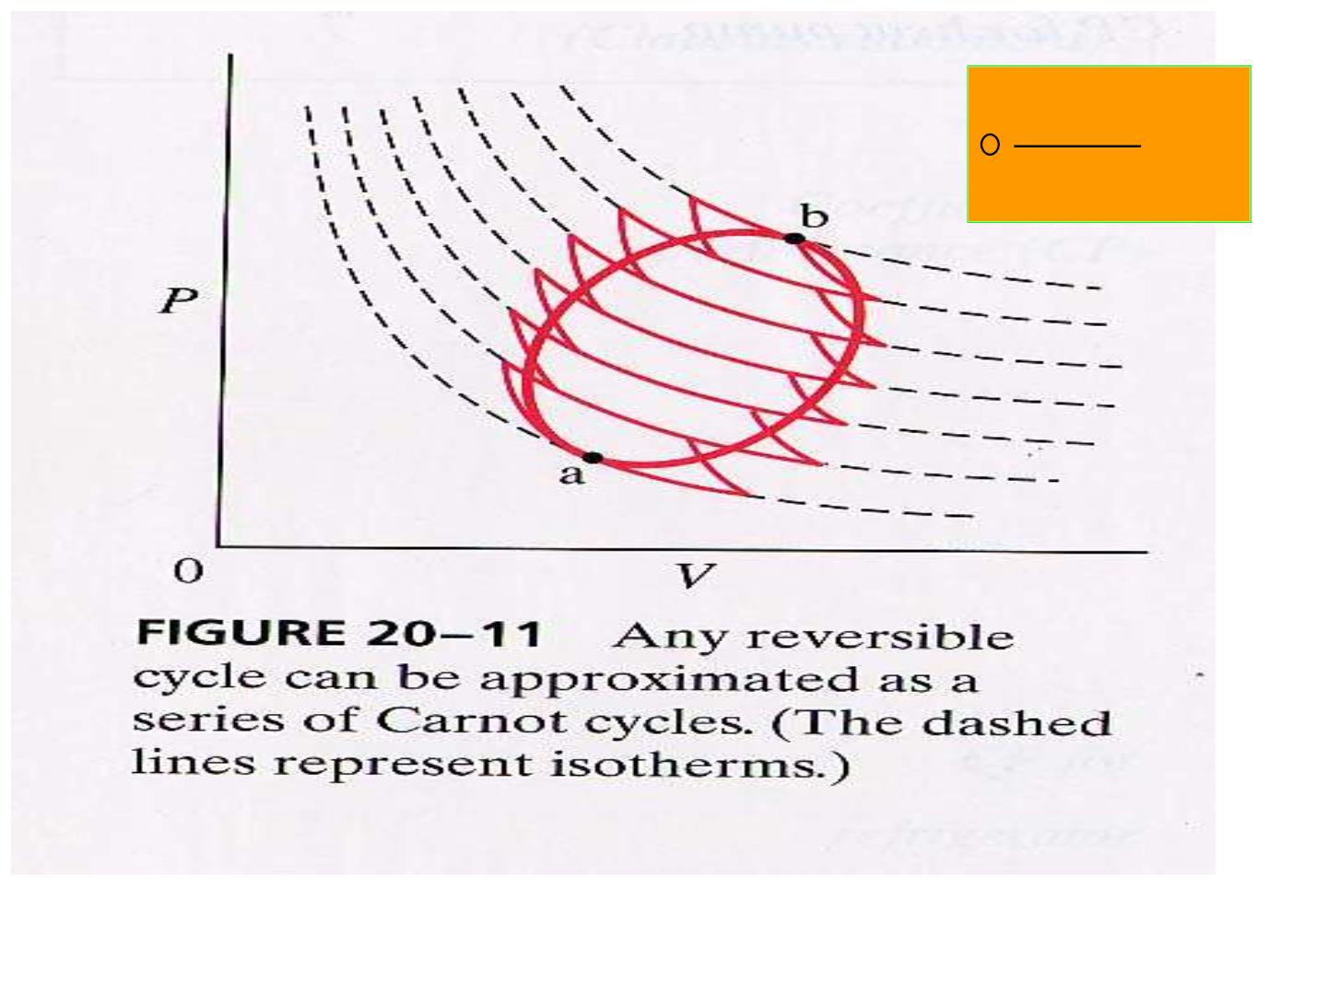
dQr ev
⇩
= 0
T
T₁
T₂
T₃
T₄
T₅
T₆
T₇
(Q / T +Q /T )+(-Q /T +Q /T )+…+ (-Q /T +Q /T )=0
1
1
2
2
2
2
3
3
6
6
7
7

Slide 5
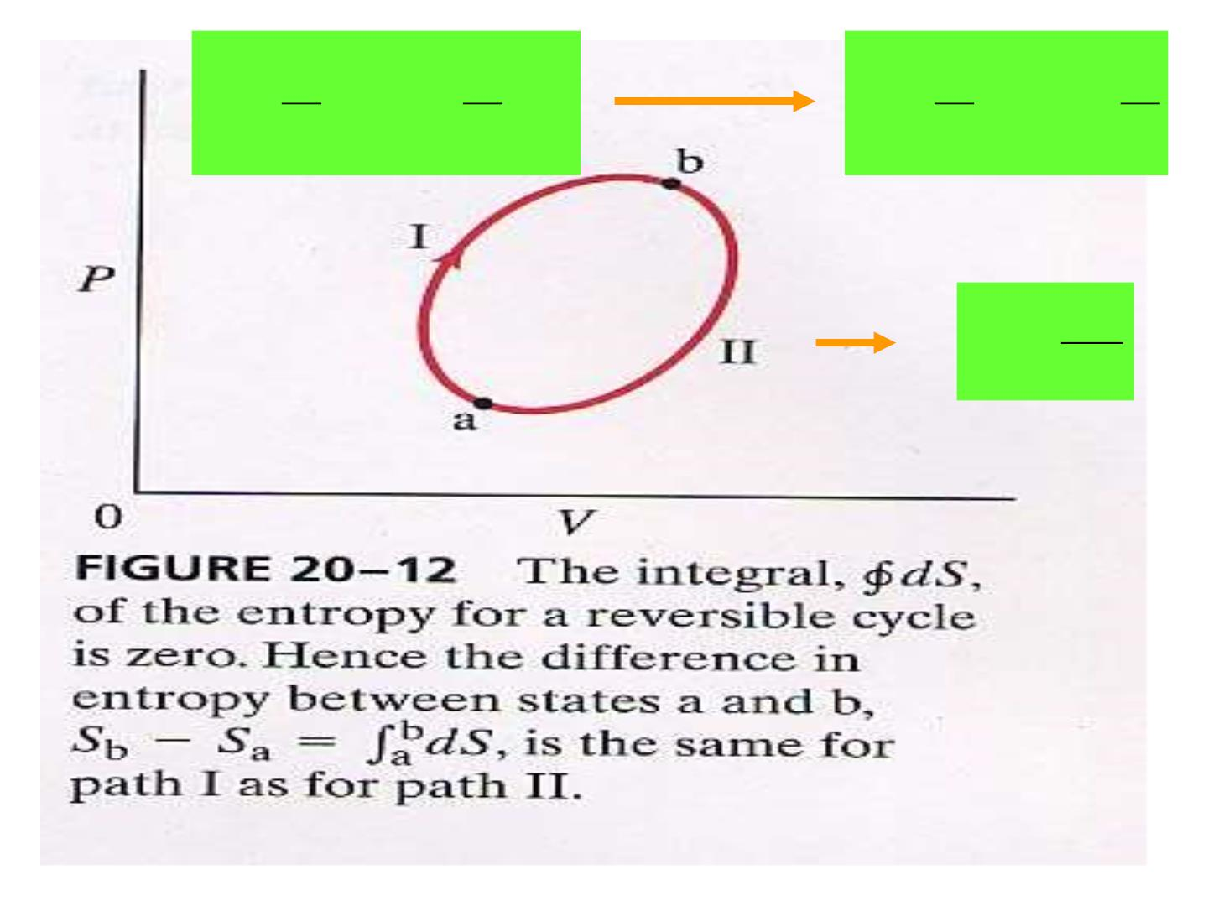
b
a
b
b
b
a
⇩ 
⇩ 
dQ
T
+
dQ
T
=
(I)
dQ
T
=
(II)
dQ
T
(I) (II)
0
a
a
dQ
T
dS =

Slide 6
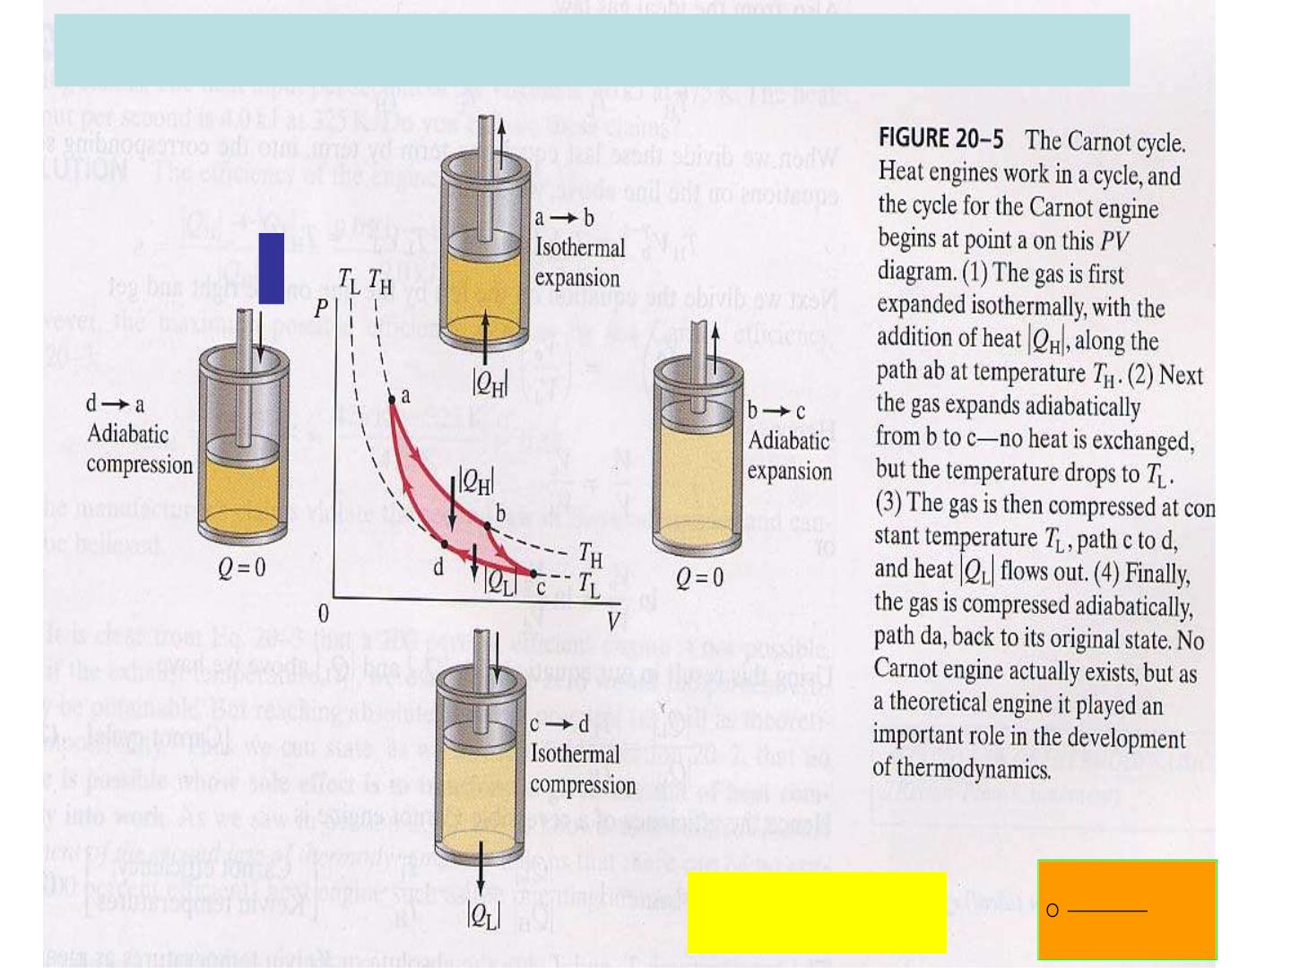
Irreversible: e= W/ Q = 1-Q /Q < 1-T /T
H
L H
L H
Q / T >Q /T
L L
H H
(Q/T)<0 
dQrev
 0
T

Slide 7
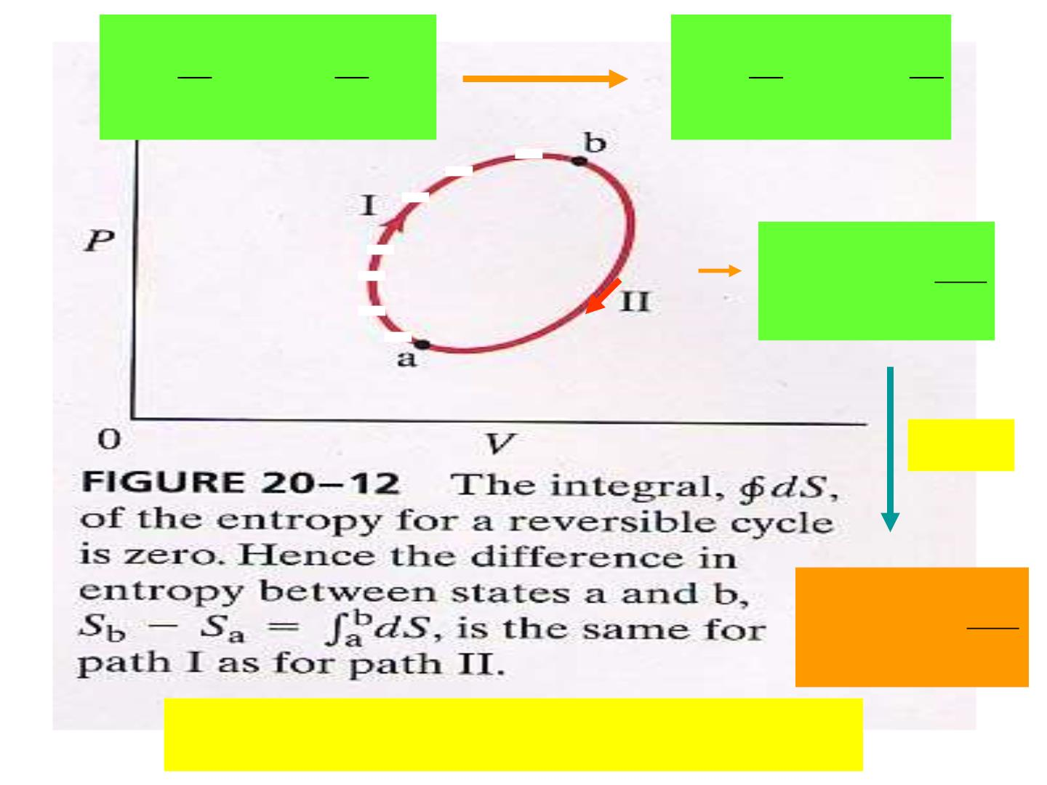
b
a
b
b
a
⇩ 
⇩ 
(I) + (II)  0
dQ
T

dQ
T
dQ
T
dQ
T
(I)
(II)
a
b
a
B
dQ
T
S
B
− SA

⇩
A
R&IR
B
dQ
T
S
− SA

⇩
B
A
For isolated system: S  0

Slide 8

Clausius’ Statement
“The energy of the universe is a
constant. The entropy of the universe
approaches a maximum.”

Slide 9

Example 20-6
Entropy change in melting. A
1.00-kg piece of ice at 0ºC melts
very slo wly to water at 0ºC. Assume
the ice in contact with a heat
reservoir whose temperature is only
infinitesimally greater than 0ºC.
Determine the entropy change of (a)
the ice cube and (b) the heat
reserv oir.

Slide 10
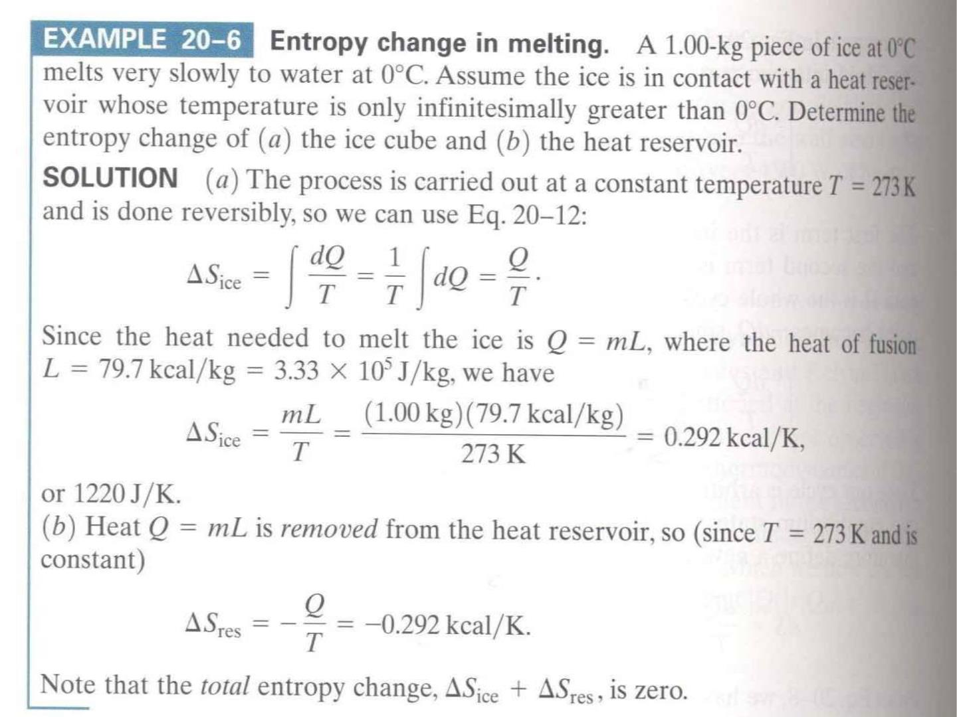

Slide 11

Example 20-7
Entropy change w hen mixing
water. A sample of 50.0 kg of wa ter
at 20.0ºC is mixed with 50.0 kg of
wa ter at 24.0ºC. Estimate the
change in entropy without using
calculus.

Slide 12
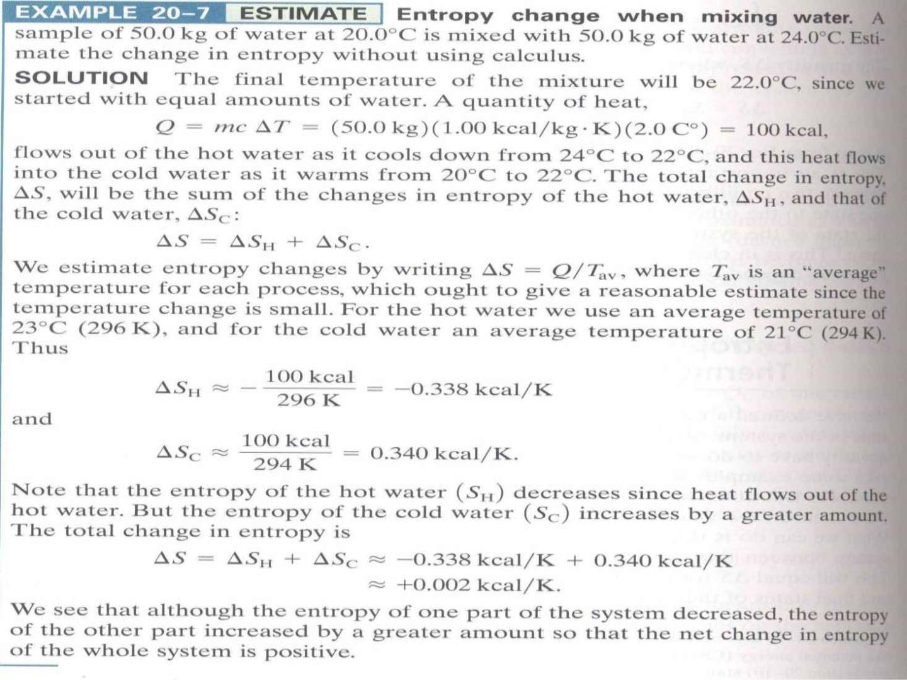

Slide 13

Example 20-8
Entropy changes in a free expansion.
Consider the adiabatic free expansion
of n moles of an ideal gas from volume
V to volume V , where V > V .
1
2
2
1
Calculate the change in entropy (a) of
the gas and (b) of the surrounding
environment. (c) Evaluate S for 1.00
mole, with V = 2.00 V .
2
1

Slide 14
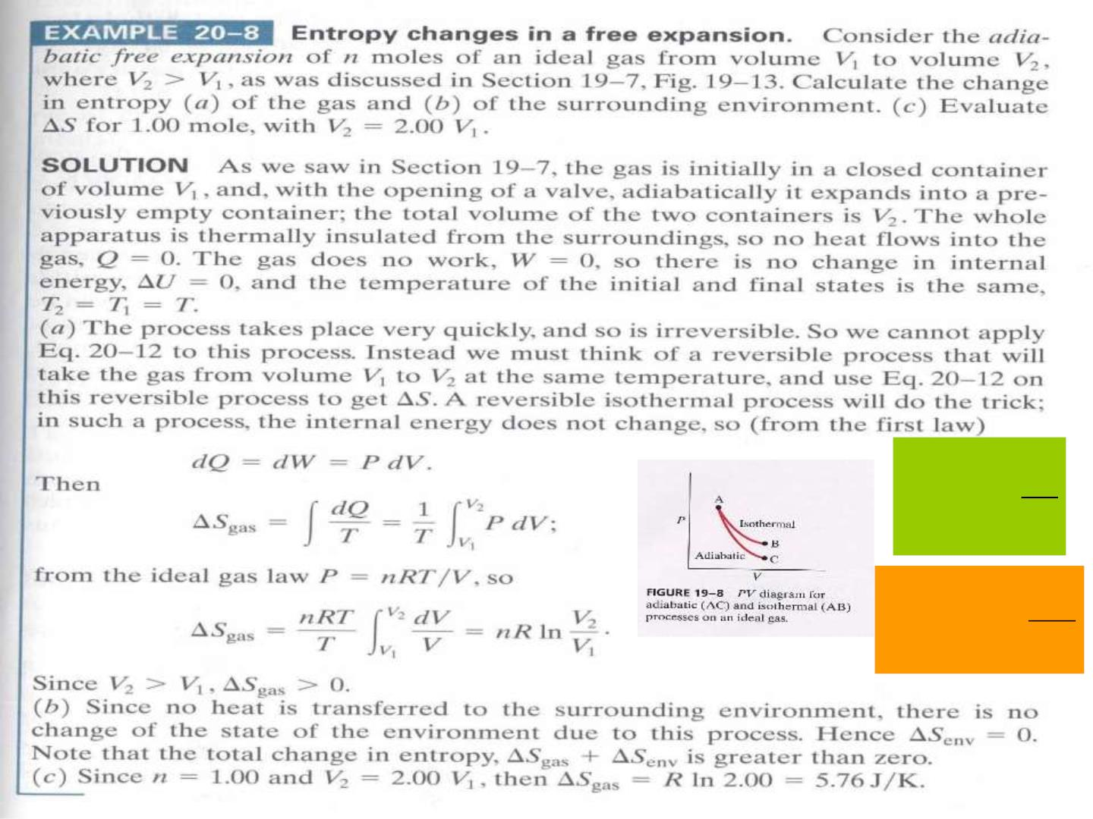
B
SB − SA =
⇩
dQ
T
A
B
dQ
T
S
− SA

⇩
B
A

Slide 15
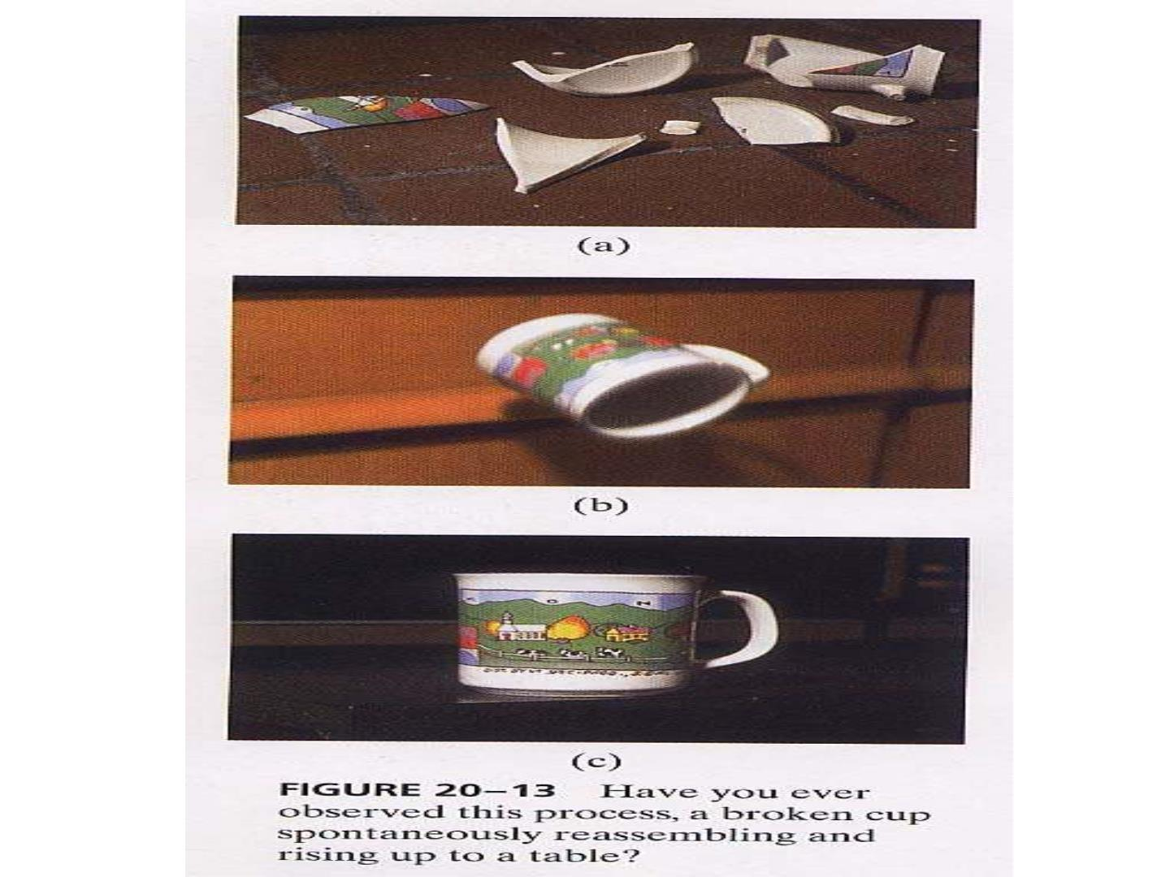

Slide 16

Second Law
“Natural processes tend to m ove
toward a state of greater disorder.”

Slide 17
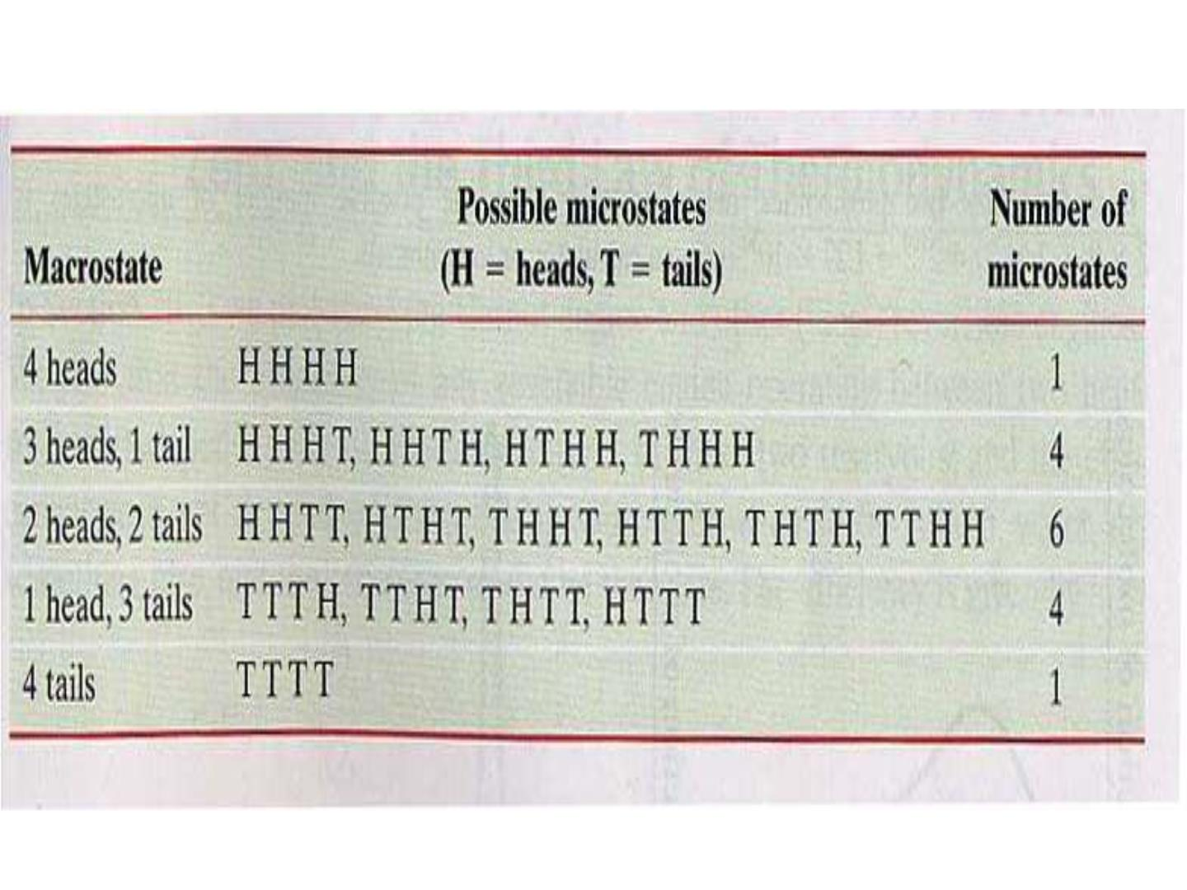
等几率假定

Slide 18
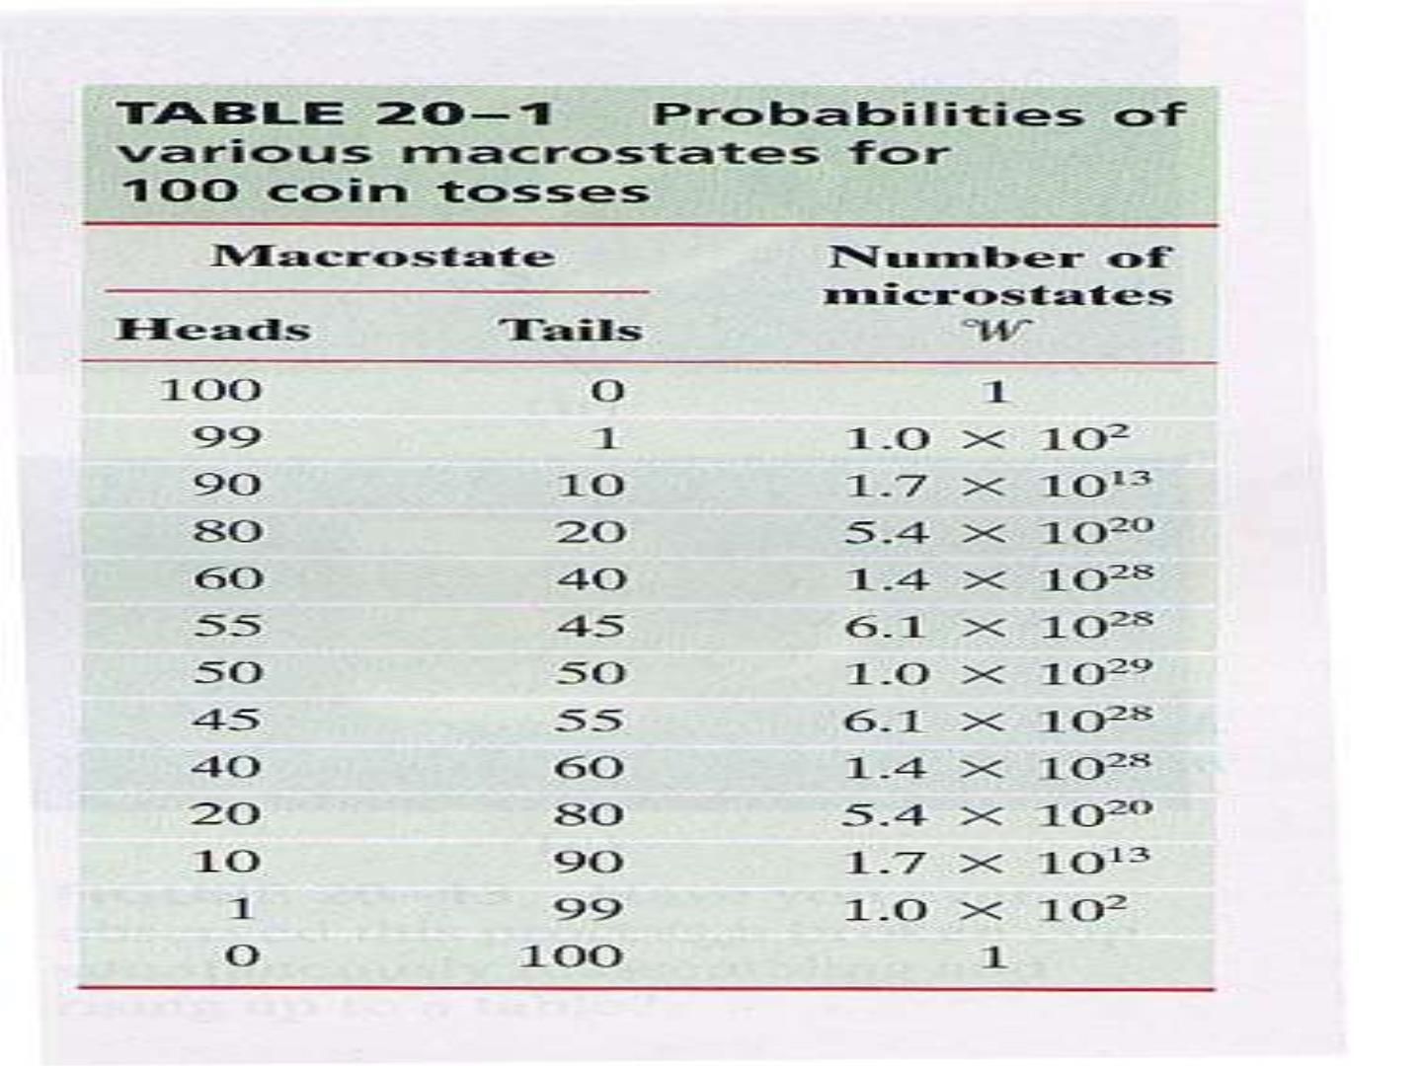

Slide 19
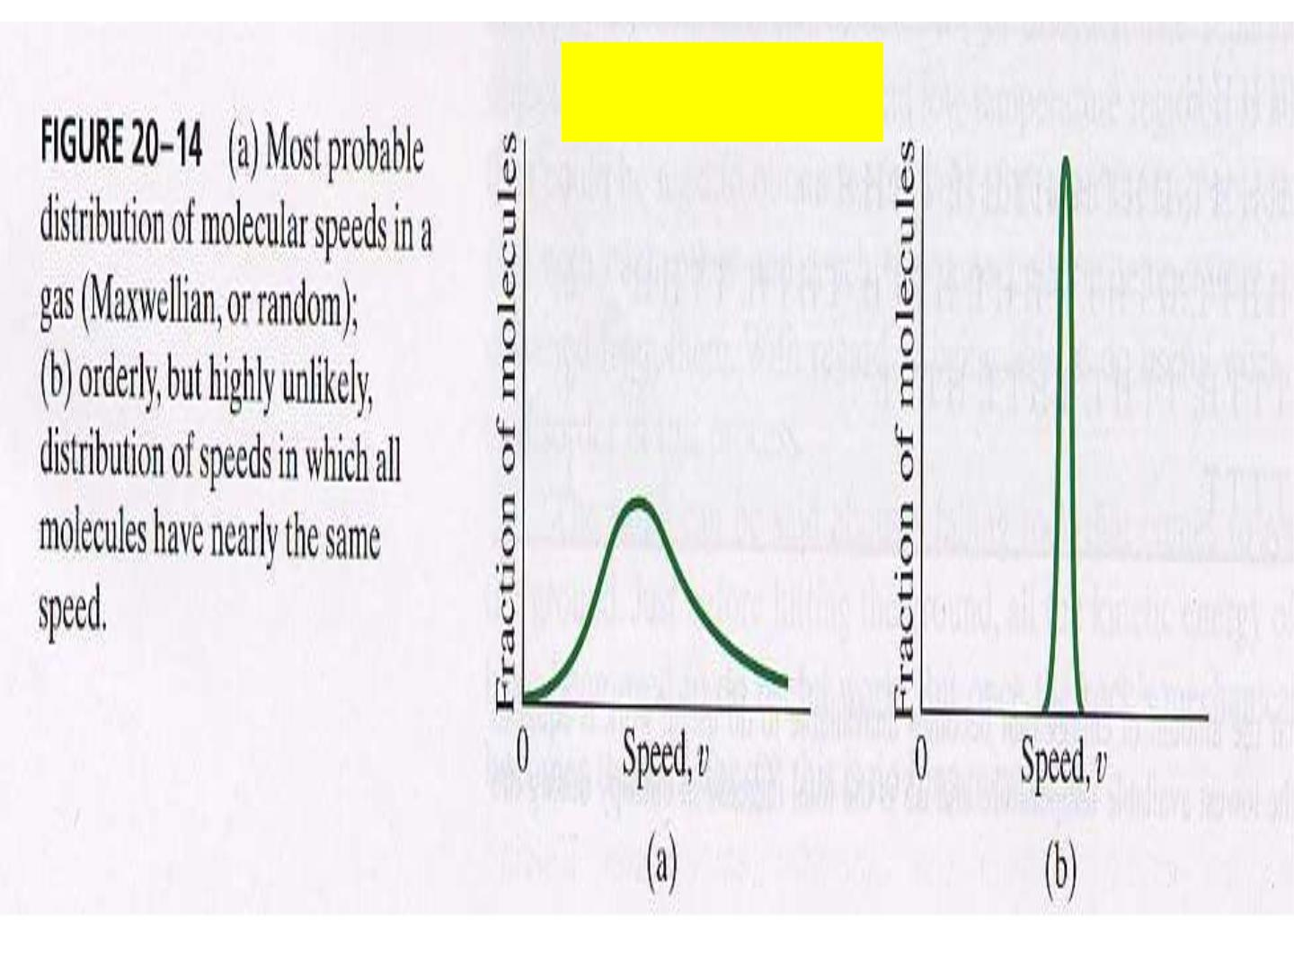
S=k_{B}lnW

