Slide 1

大学物理（热学）
金晓峰
复旦大学物理系
xfjin@fudan.edu.cn
2006-9-12
2021/9/5
1

Slide 2
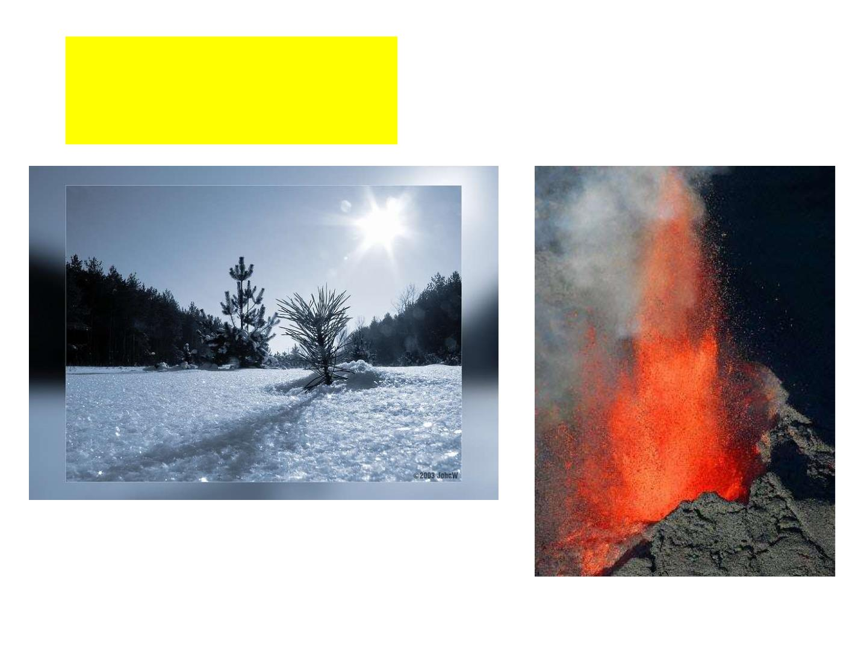
冷热的感觉

Slide 3
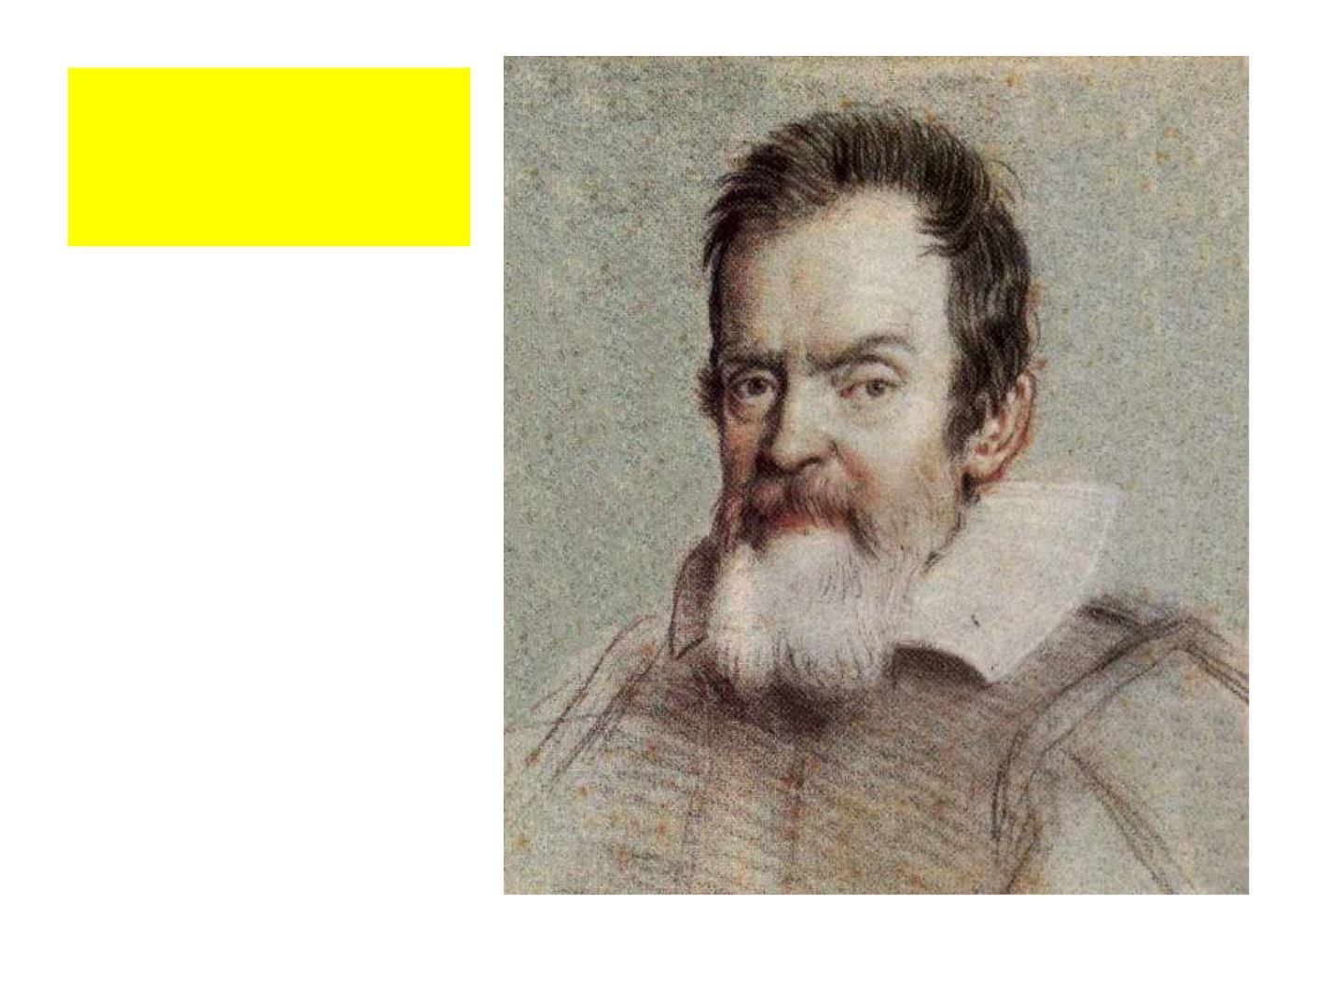
伽利略
Galileo Galilei
温度计的发明

Slide 4
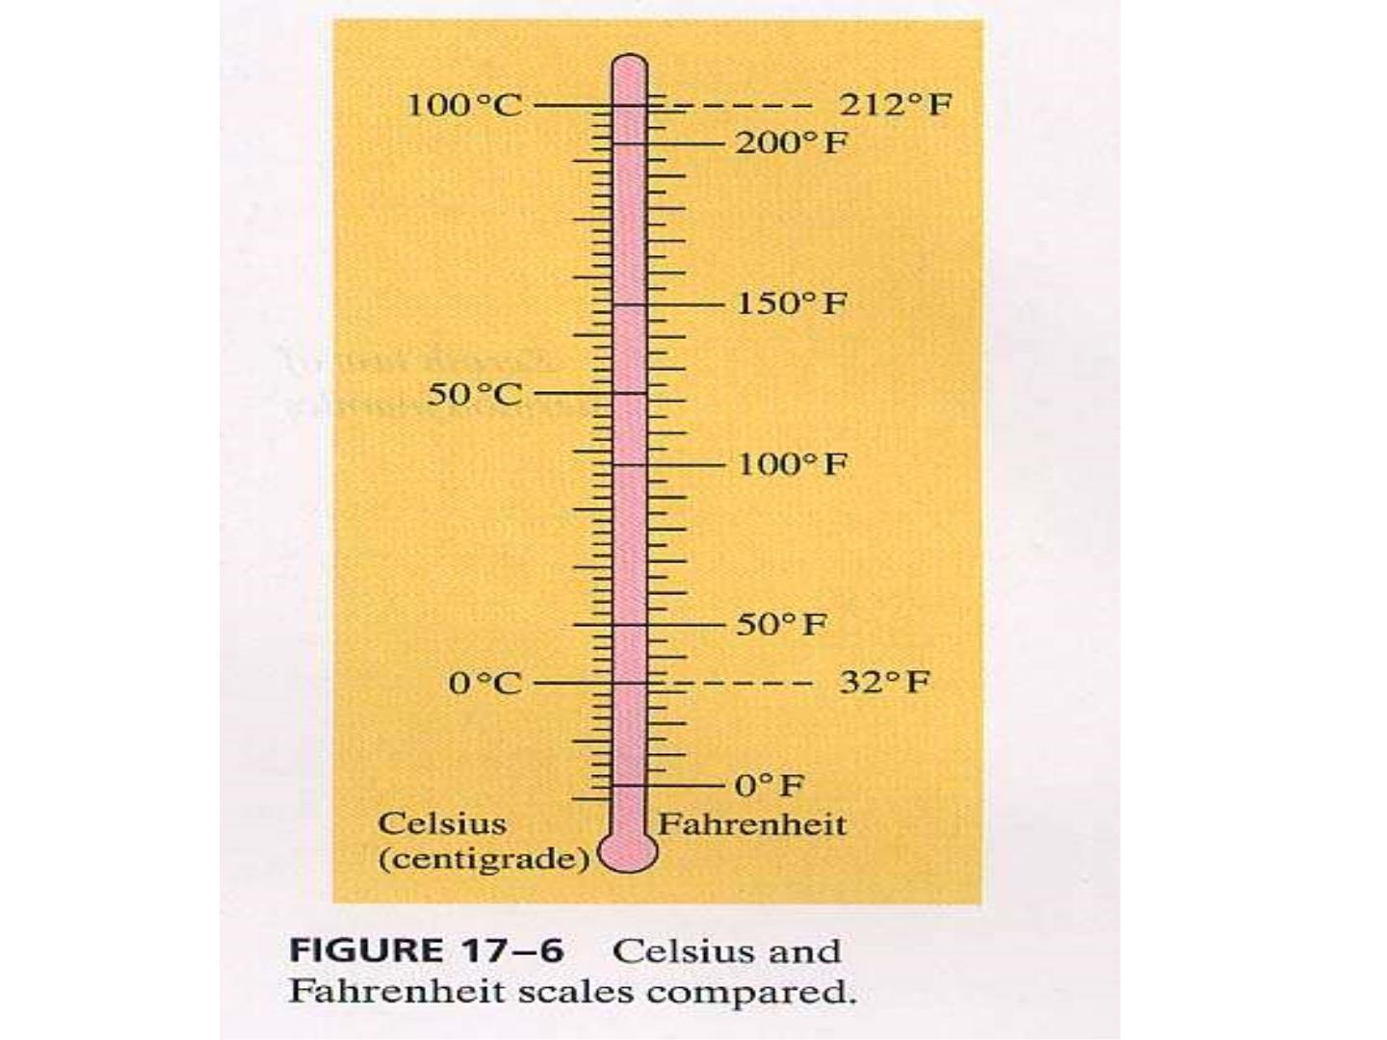

Slide 5

Black（1728—1799)
“By the use of t hese instr ume nts we have
learned, t hat if we ta ke 1000 or more
different ki nds of matter, such as metals,
stones, salts, woods, cor k, feathers, wool ,
water and a variety of ot her fl uids ,
althoug h t hey be at first of different
heats, let the m be placed toget her in t he
same room wi t hout a fire,

Slide 6
and into whic h the sun does not shine,
the heat will be communicated fro m
the hotter of t hese bodies to the col der ,
duri ng some hours per haps, or the
course at a da y, at the end of whic h
time, if we apply a ther mometer to
the m all in s uccession, it will poi nt
precisely to the same degree.”

Slide 7
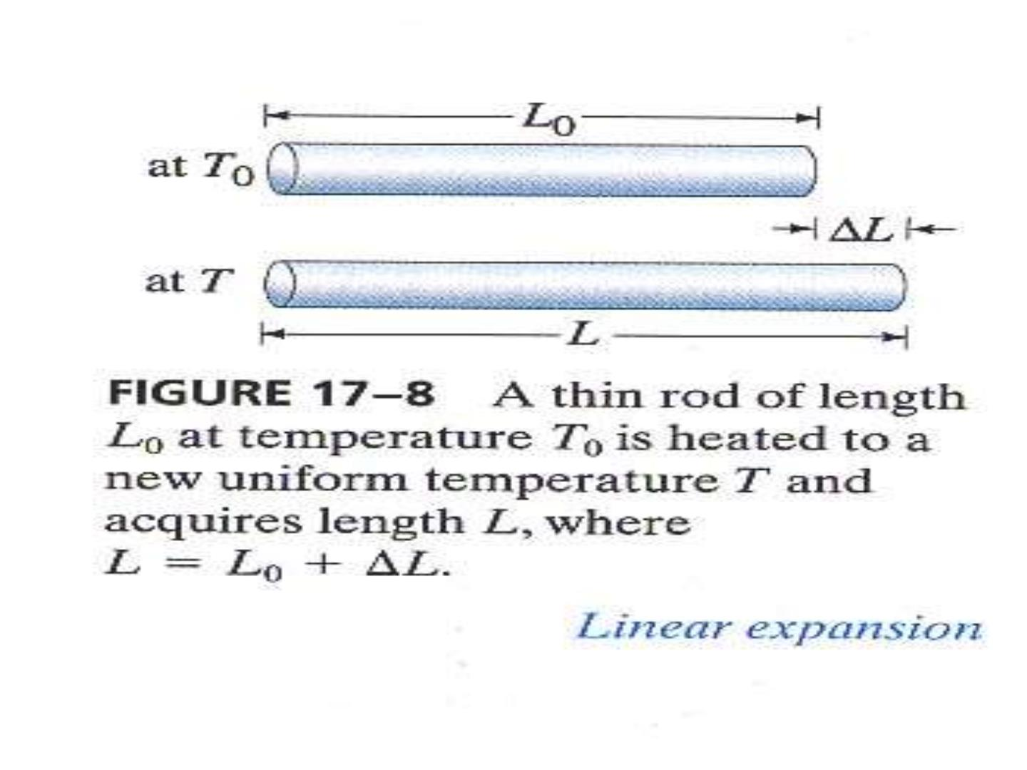

Slide 8
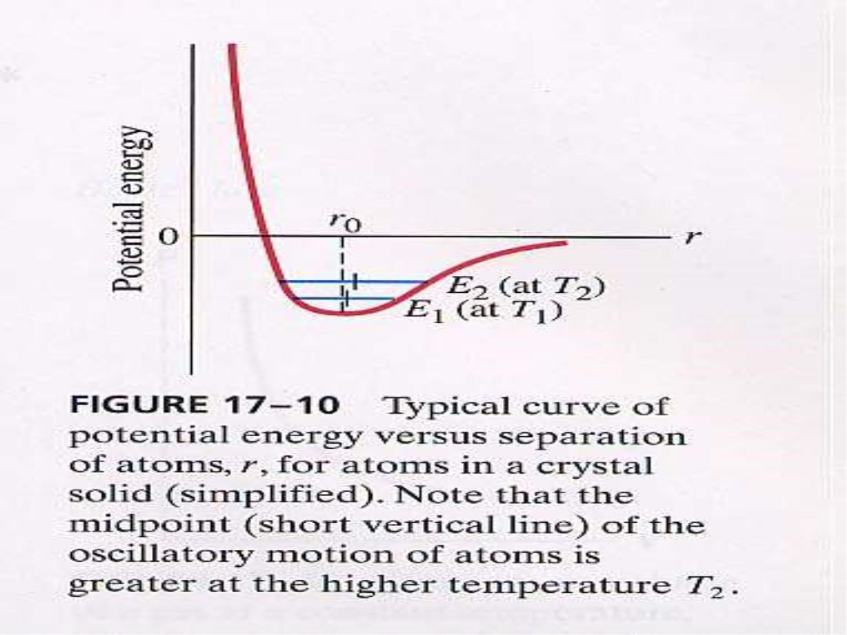

Slide 9
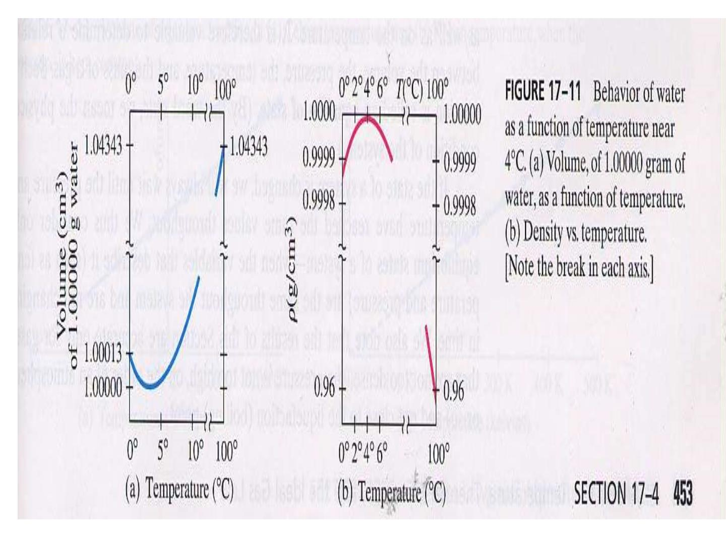

Slide 10
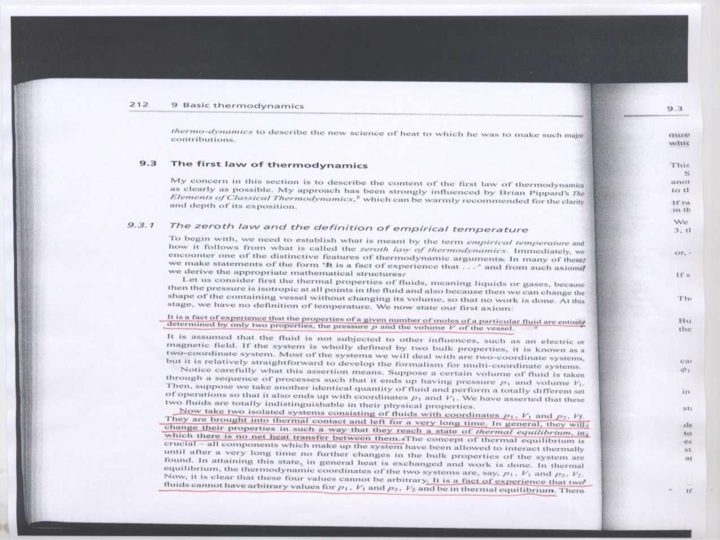

Slide 11
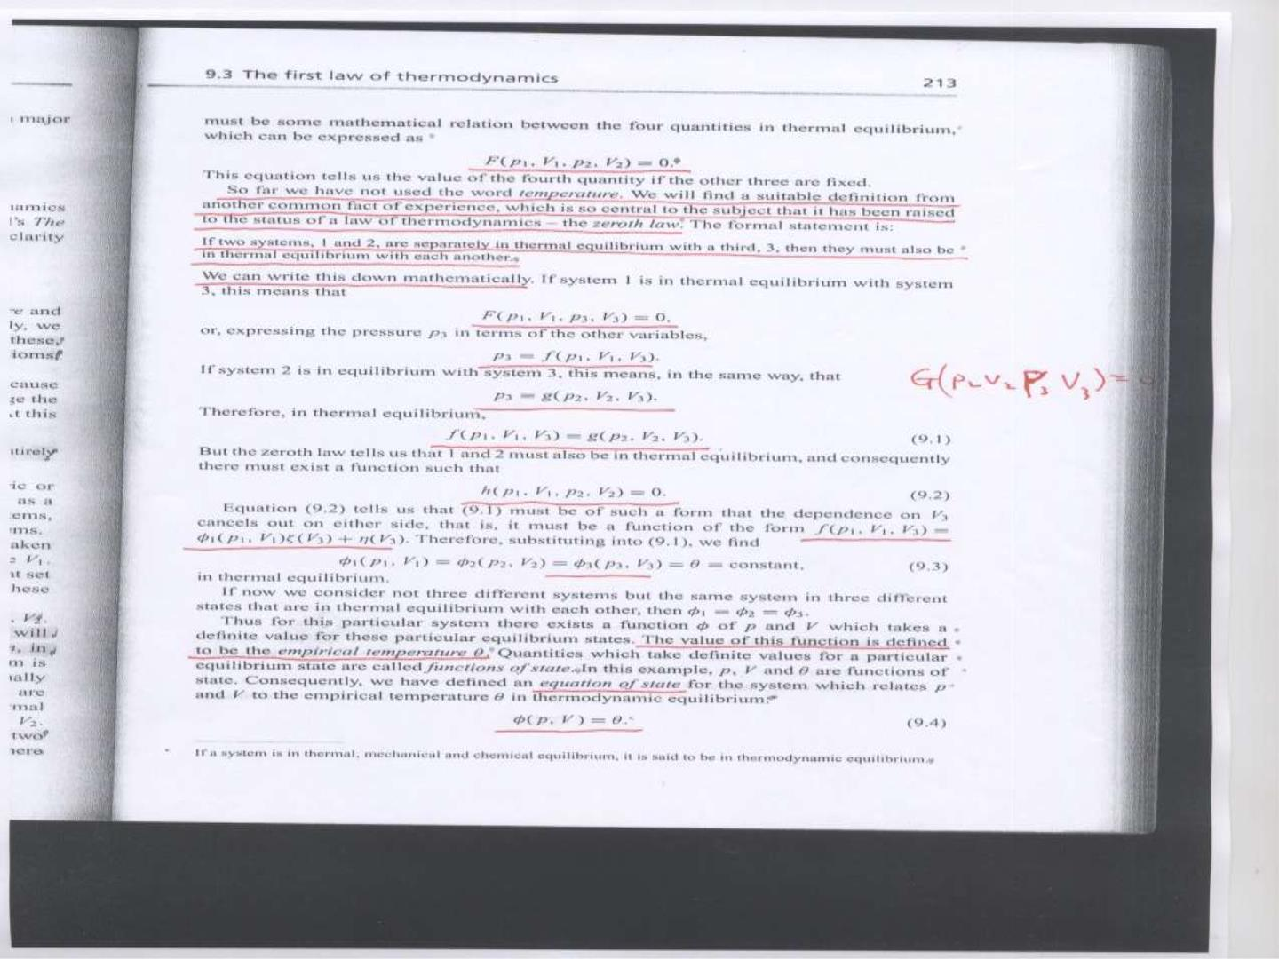

Slide 12


