Slide 1

大学物理（热学）
金晓峰
复旦大学物理系
xfjin@fudan.edu.cn
ftp://10.45.88.88/大学物理06xfjin
2006-9-30
2021/9/5
1

Slide 2

1913, Planck, Nernst, Rubens, and Warburg
proposed Einstein for Prussian Academy:
“… That he may sometimes have missed
the target in his speculations, as for
example, in his hypothesis of light q uanta ,
cannot really be held too much against
him , for it is not possible to int roduc e
fundamentally new ideas, even in the most
exact sciences, without occasionally taking
a risk. ”

Slide 3
James Clark Maxwell
It is of great advantage to
the student of any subject
t o r e a d t h e o r i g i n a l
memoirs on that subject,
for science is always most
completely assimilated when
it is in the nascent state.

Slide 4
James Clark Maxwell
对任何领域的学生来说，
阅读相关的原始文献都是极
有益处的，因为处在雏形中
的科学最容易被消化。

Slide 5
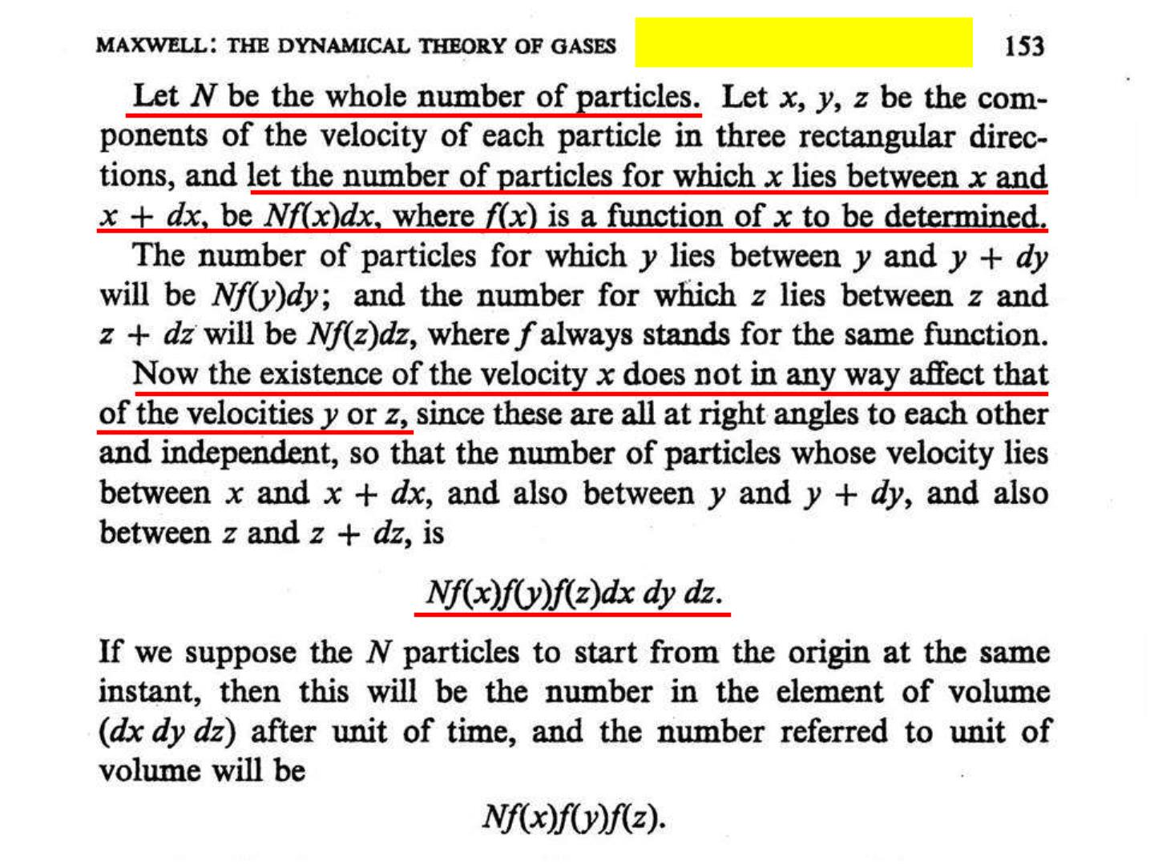
Phil. Mag. 19 (1860) 19

Slide 6
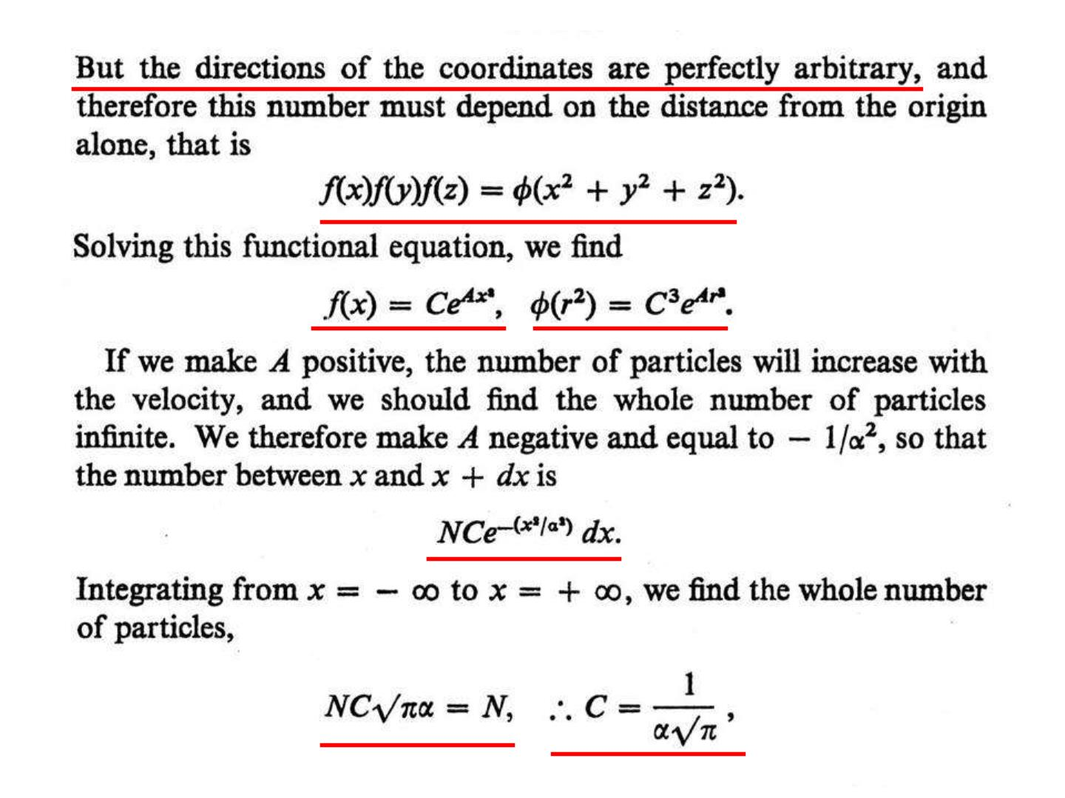

Slide 7
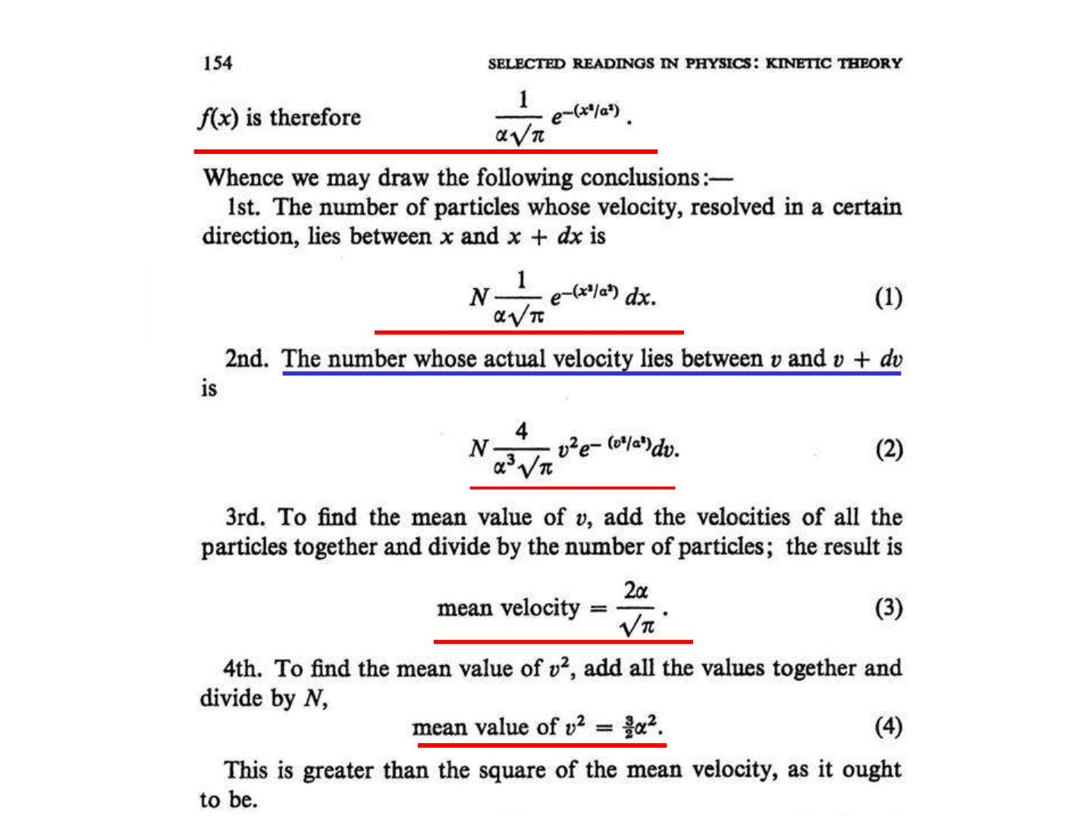

Slide 8
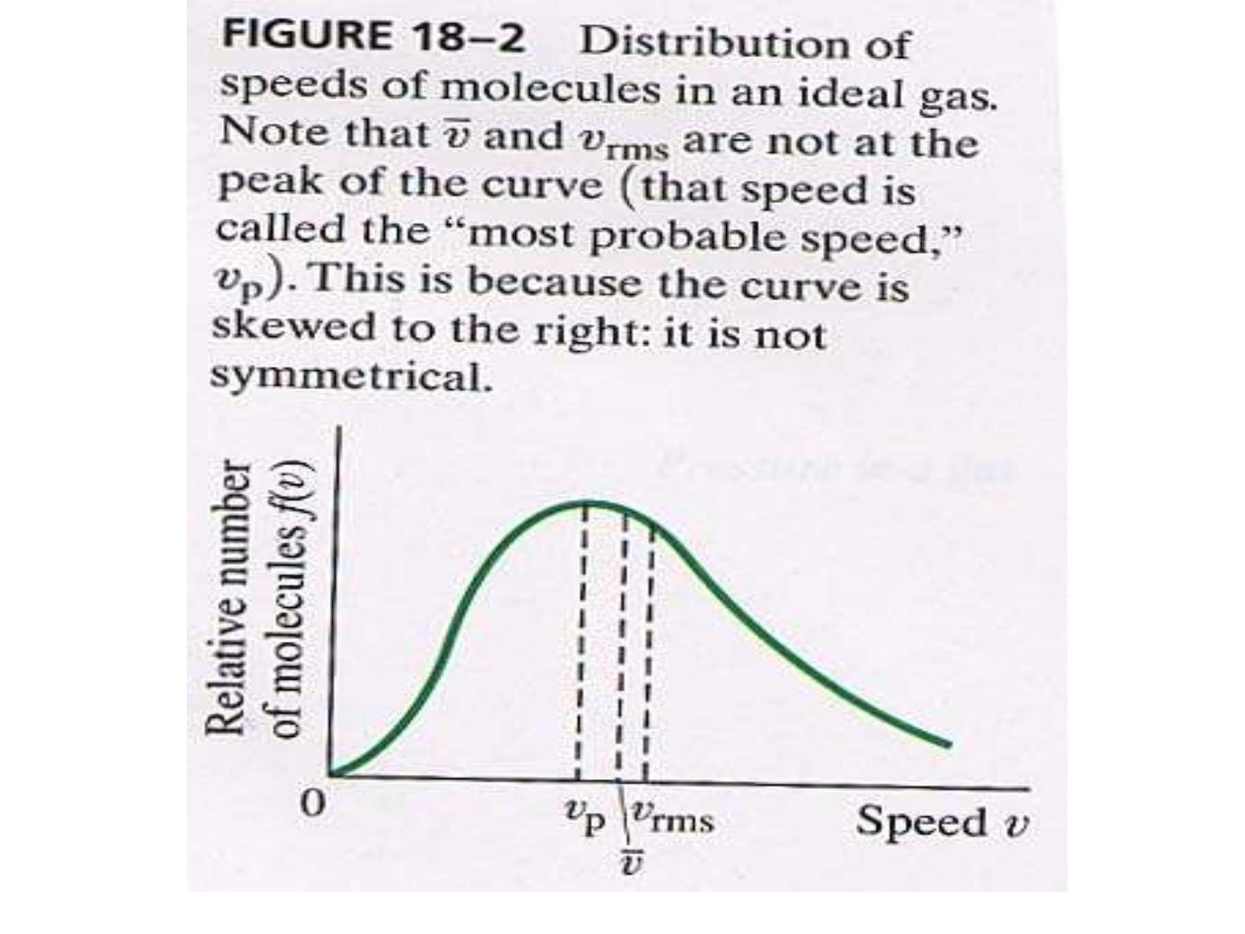

Slide 9
麦克斯韦分布演示
• 程序

Slide 10
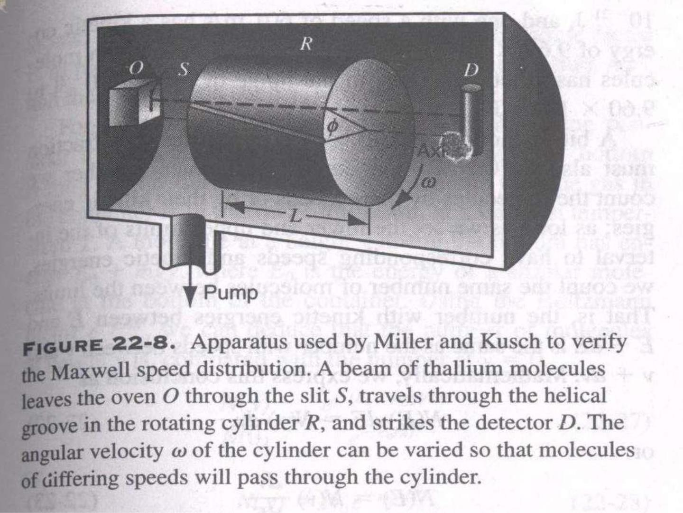

Slide 11
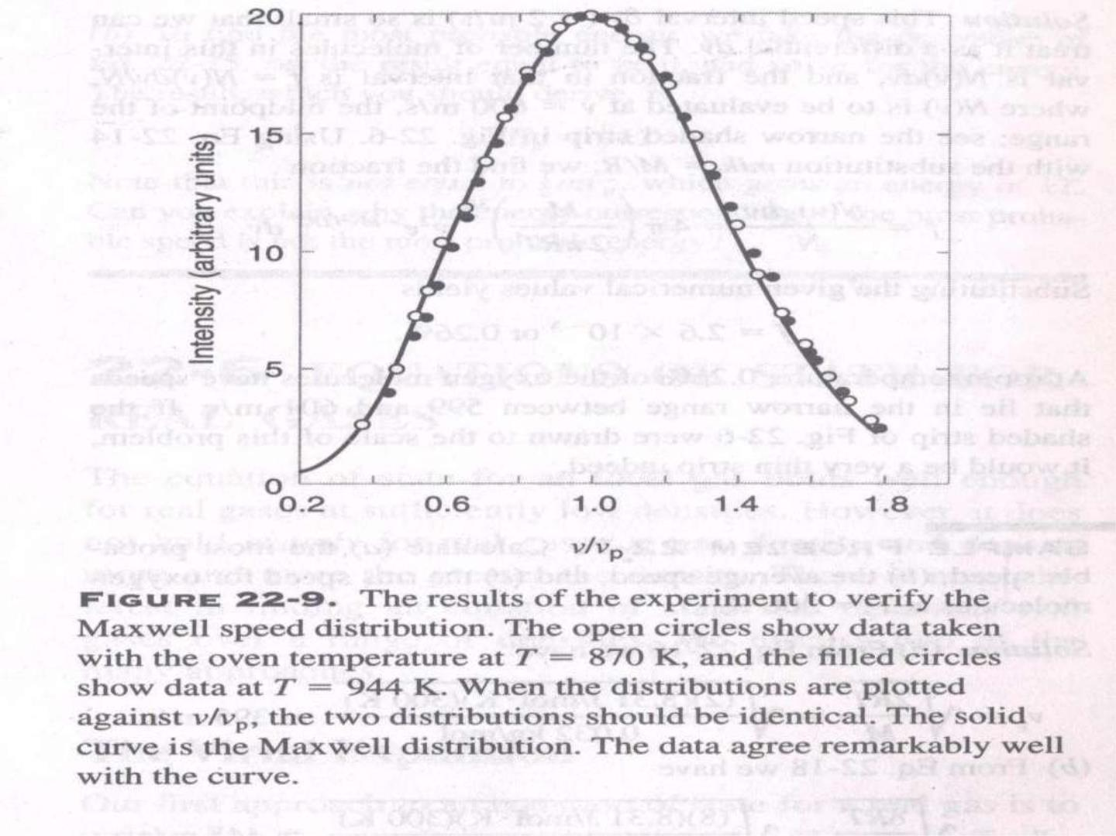

Slide 12
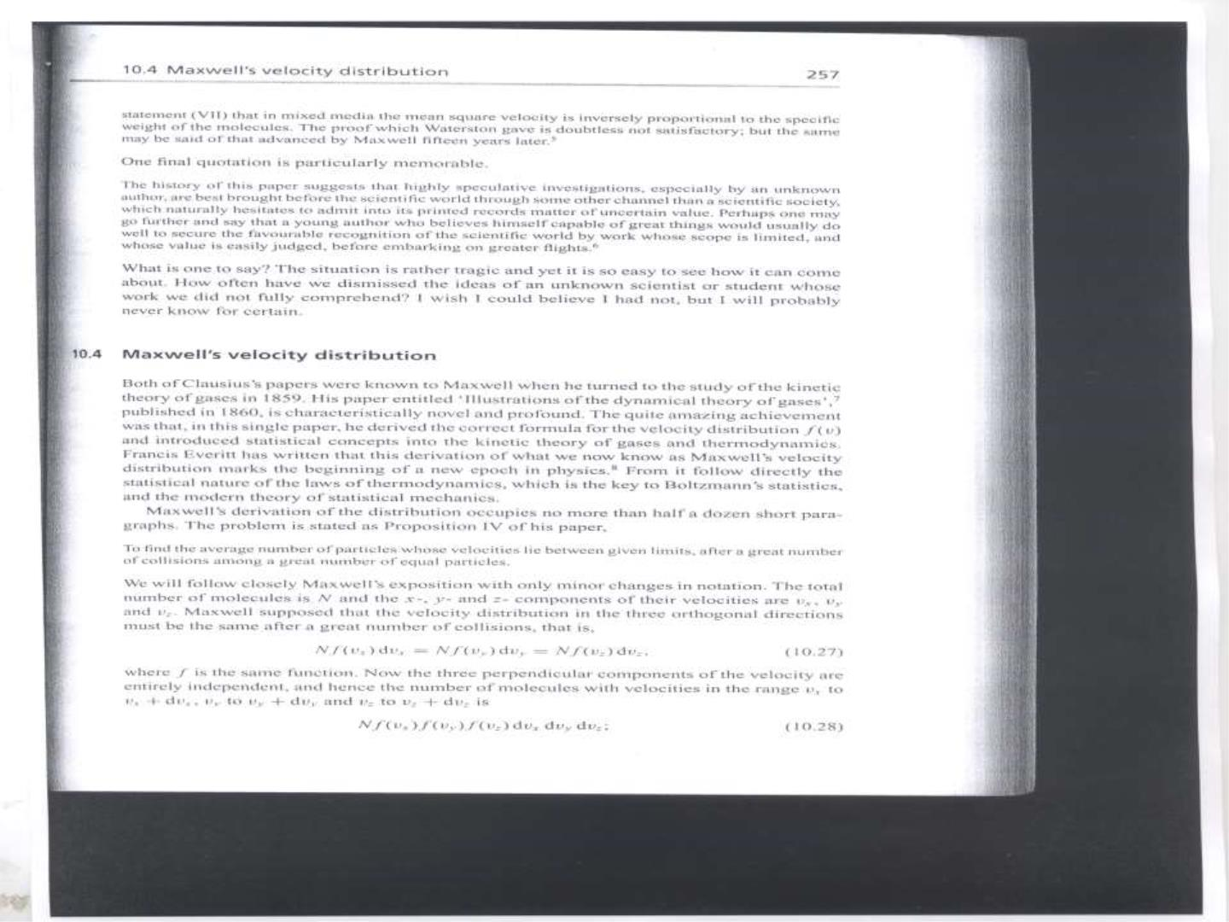

Slide 13
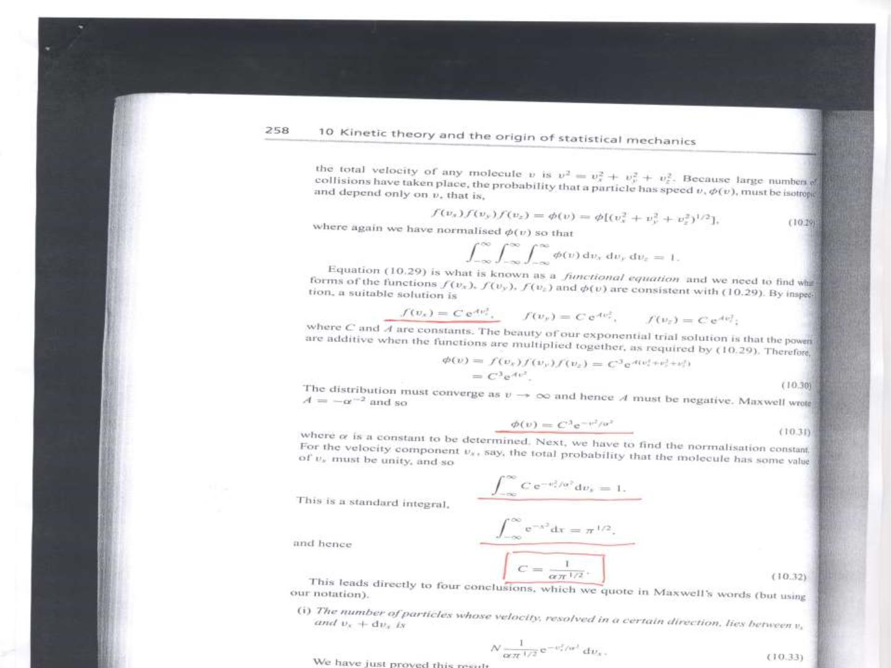

Slide 14
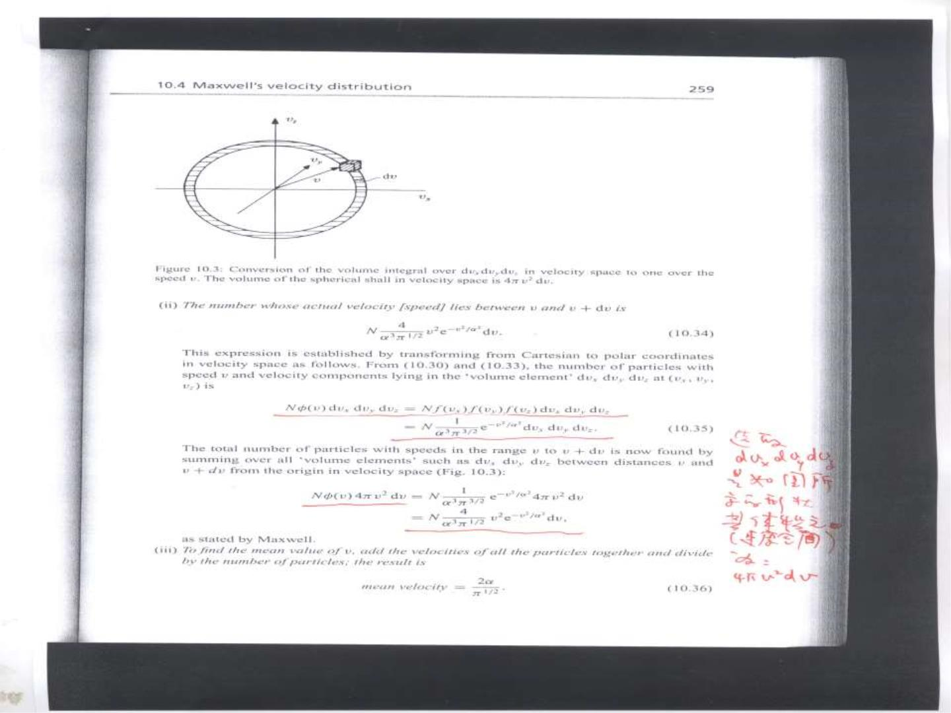

Slide 15
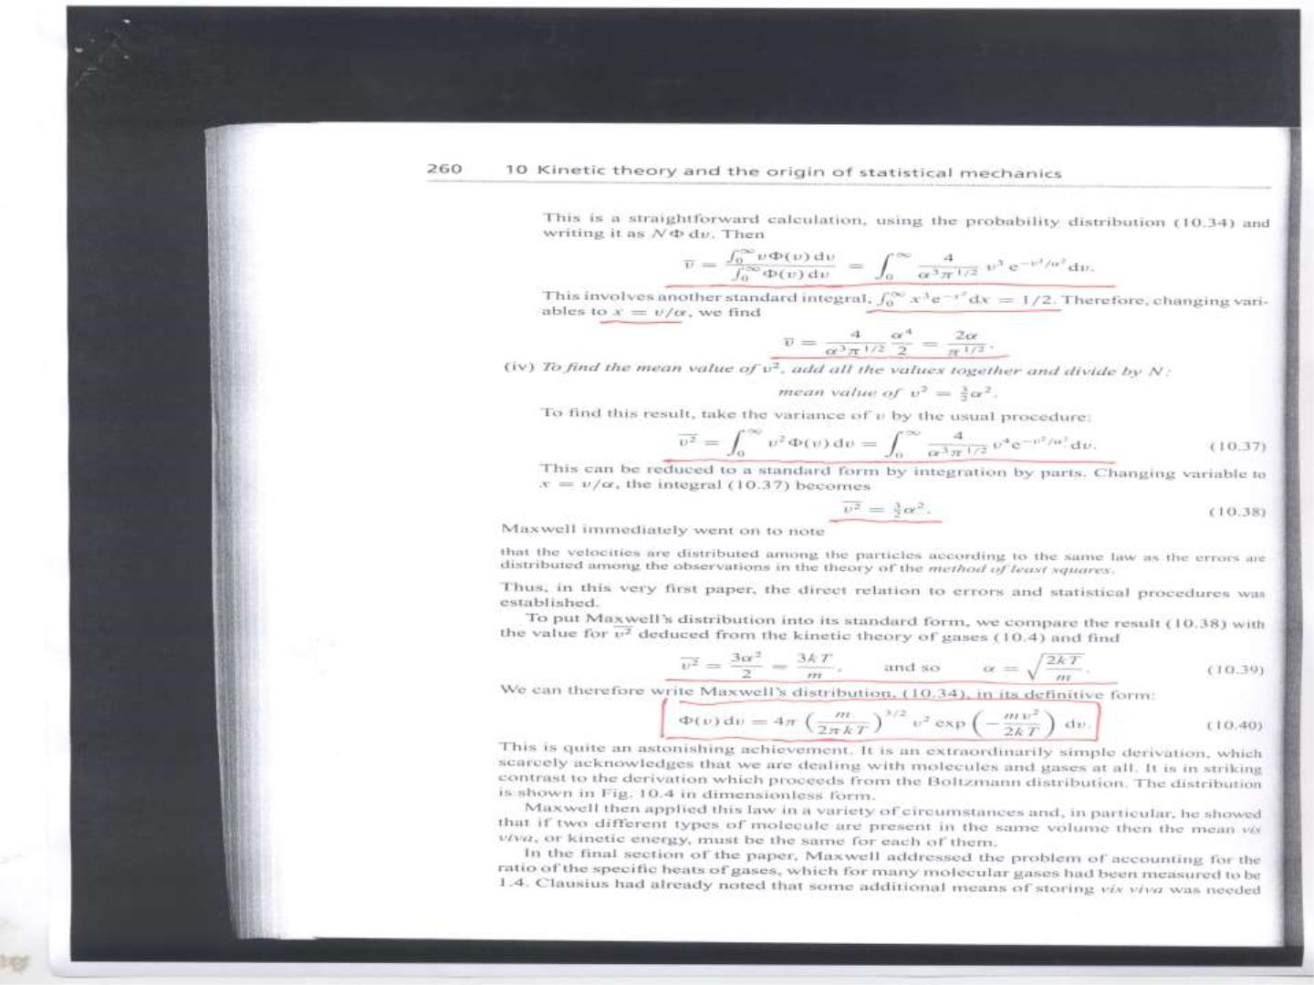

Slide 16


