Slide 1

大学物理（热学）
1) Mean F ree Path
2) Diffusion, Thermal conductivity,
and Viscosity
2006-10-12

Slide 2

Equilibrium distribution
○ 
² +
² +
² + ² + + ² n v n v ☹
v v ☹ v
_{v}² =
1
2
N
= ¹ ¹
2 2
N
N

 
n


dn
= v
²
i → v
2
 

i
 N 
N
i
○
n_{i} ⎯ the number of molecules of v_{i}
dn is the number of molecules in
near v
v → v + dv
x
x
x
→
v v + dv
y
y
y
v → v + dv
z
z
z

Slide 3
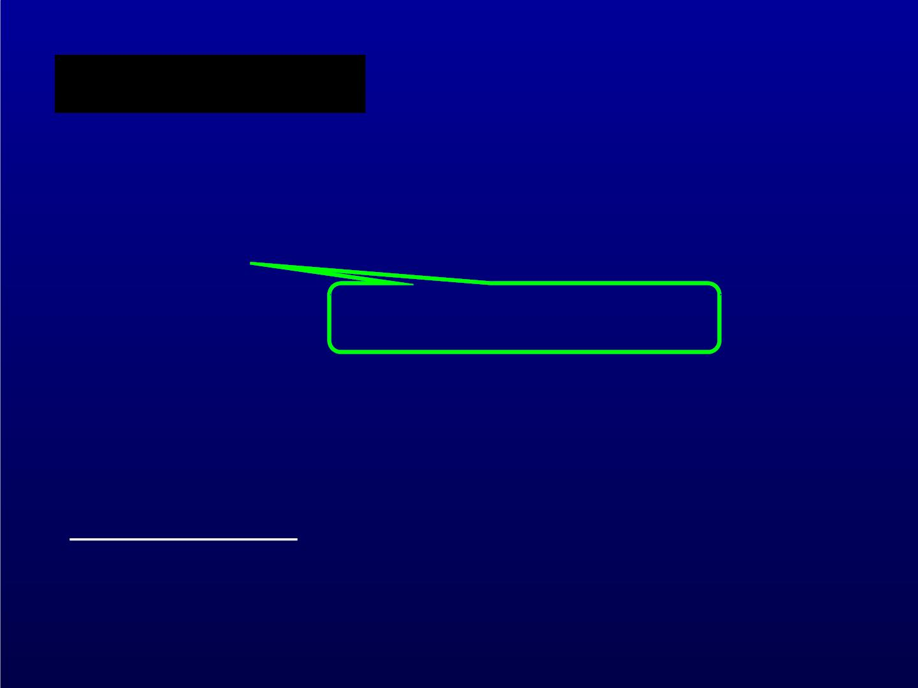
Meaning of dn/N
among N molecules, how many are near v
probability that one molecule is near v
proportional to dv_{x} ...
( )
f v dv
x
x
dn(v ,v ,v )
x y z
( ) ( ) ( )
= f v dv  f v dv  f v dv
N
x
x
y
y
z
z

Slide 4

Isotropic assumption
( ) ( ) ( ) ( ) ( )
= ² = ² + ² + ²
f v f v f v v v v v
x
y
z
x
y
z
The solution is
( ) ( )
= − ² ²
f v Cexp v
x
x
The probability should be normalized


dn
1=

N

Slide 5
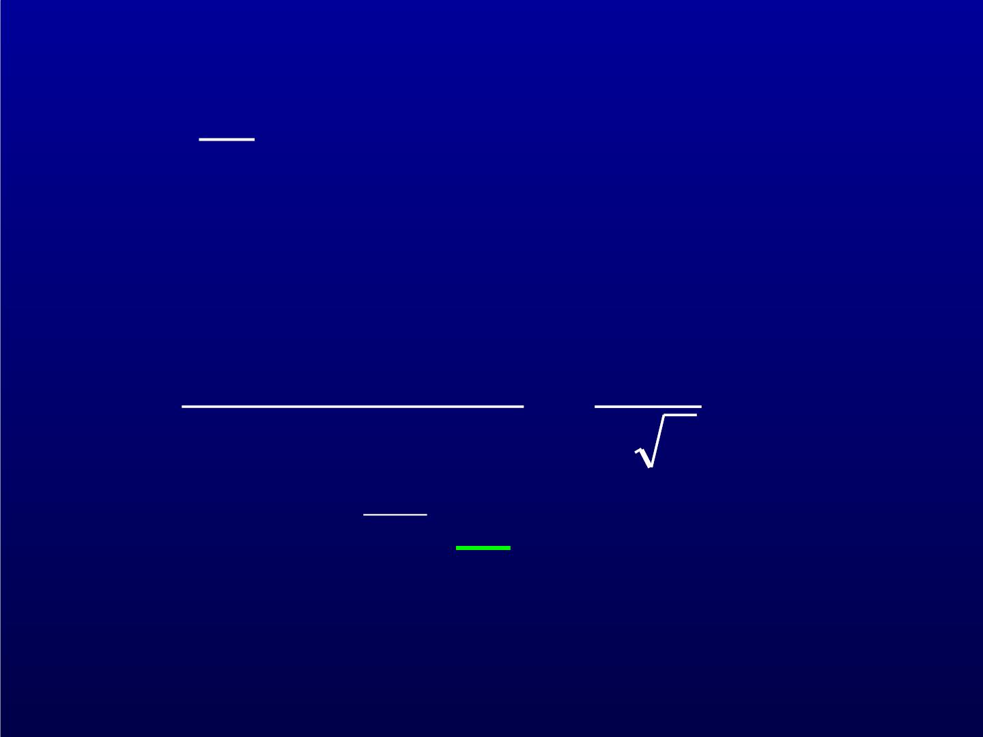


dn
 
⇩
( )
3
1
exp
= = C³ − v²  ² v

d
N
x
x
⇩
( )
²  ²
1= C exp − v dv each normalized
x
x
1
1
C =
=
◎
 
  
v
2
x
 
 exp − dv

 
 ²
  
x

−
12

Slide 6
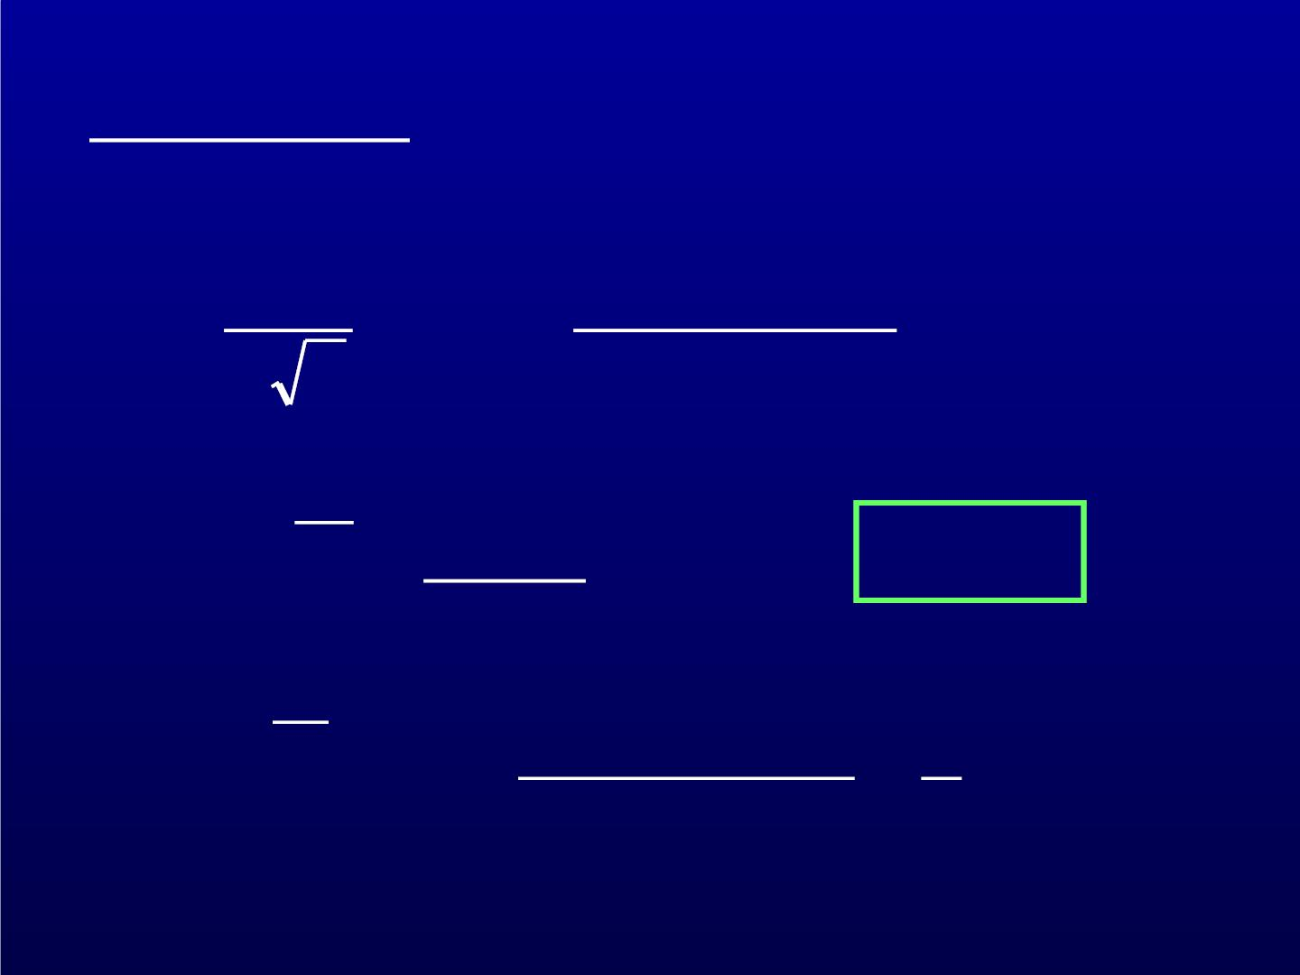
dn(v ,v ,v )
x y z
N
3

( )

 
² + ² + ²
1
v v v
=
 
exp
−
x
y
z

dv dv dv
 
x
y
z
 
 

 ²



3k_{B} T
 = ?
Known
while
_{v}² =
m


dn(v ,v ,v )
3
² = 2
x y z
=  ²
v v

N
2

Slide 7

( )
dn v ,v ,v
x y z
N
3 2 
( )


² + ² + ²

m
2k_{B}T
m v v v
=


−

x
y
z

dv dv dv

exp
 

x y z


2k_{B}T


For unit volume
( )
dn v ,v ,v
x y z
3 2 
( )


² + ² + ²

m
2k_{B}T
m v v v
=
n


−

x
y
z

dv dv dv

exp
 
0

x y z


2k_{B}T


Maxwell velocity distribution

Slide 8


1
2


2




3 2
mv
m
=

 
−

❐ ²
4 v dv
dn(v) n

exp
0
❐



2 k T

k T
B

B 



❐ ²
n f (v)4 v dv
0
Maxwell speed distribution
Most probable speed
For one molecule, wha t speed is most possible?
Among N molecules, wha t is the speed most
molecules have in unit interval?

Slide 9
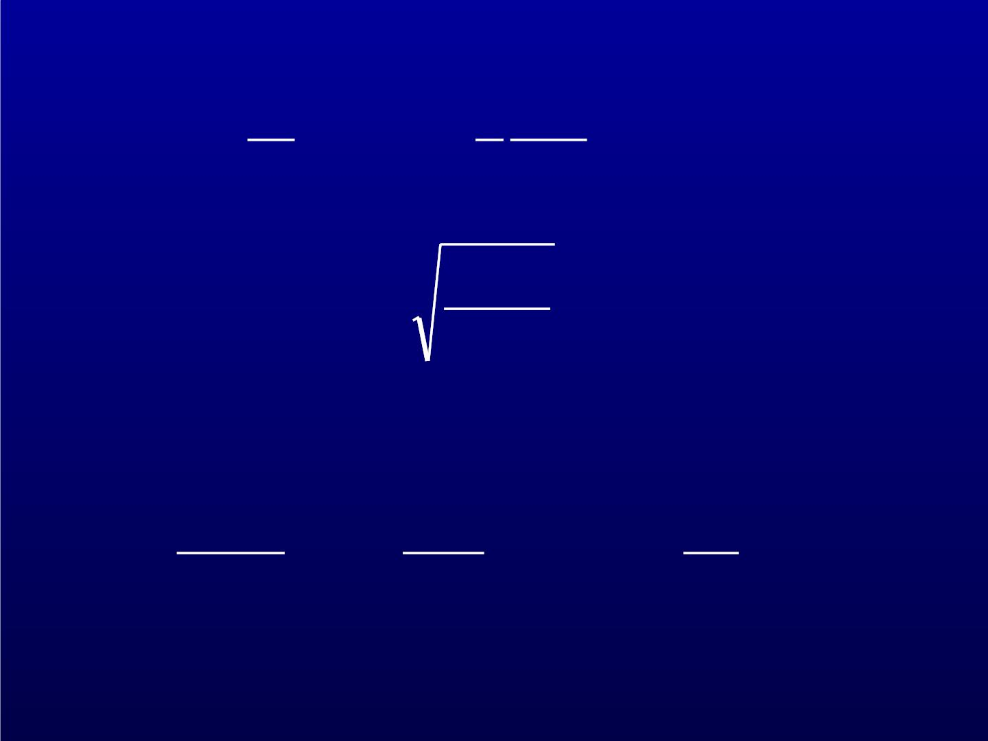


1 mv²
2 k_{B}T


d



2 −

=
v exp
0


dv






2k_{B}T
^{v}m
=
m
Maxwellian can be written as
3 2
   
dn(v)
1
v
2
   
= 
v²dv
4
−
exp
   
❐ ²
N
v
v
2
m
   
m

Slide 10

The average speed
3 2
◎
 
1
⇩
( )
 
v 4
− ² 2 2
= 
 
❐ ²
vexp v v v dv
v
m
 
m
◎
0
4
⇩
2
=
3 −x
v x e dx
❐
m
0
8k_{B}T
m
=

Slide 11
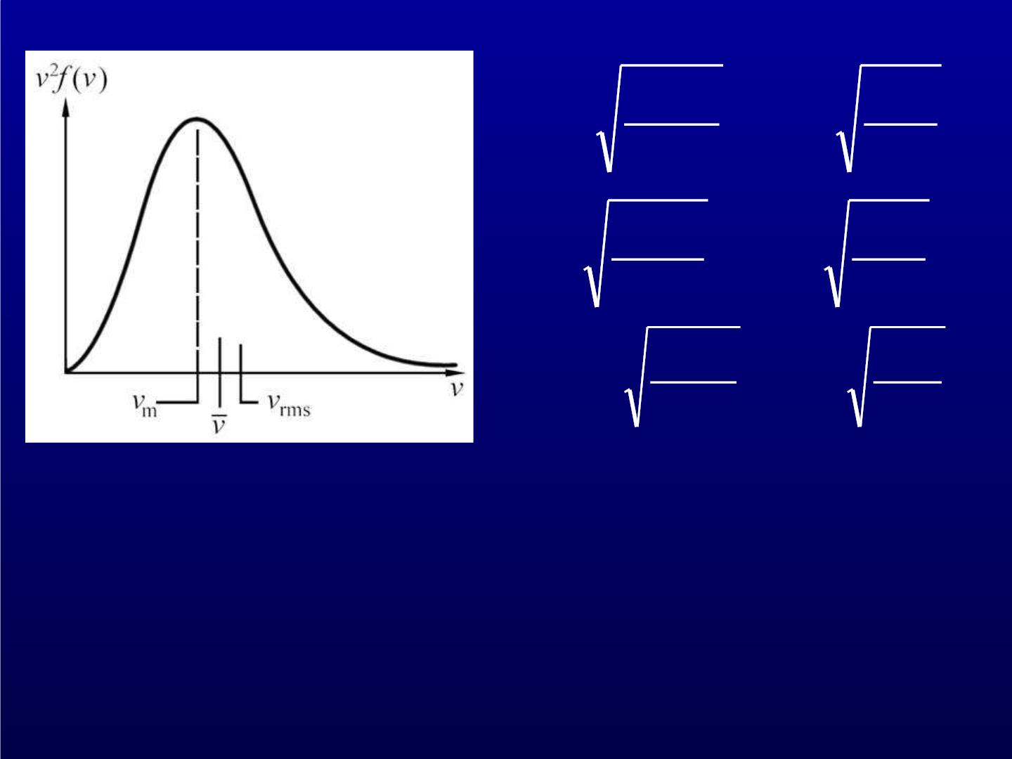
2k T
k T
v_{m}
v
=
B =
1.41
B
m
m
8k T
k T
=
B =
1.59
B
m
m
3k T
k T
v_{rms}
=
B =
1.73
B
m
m

Slide 12
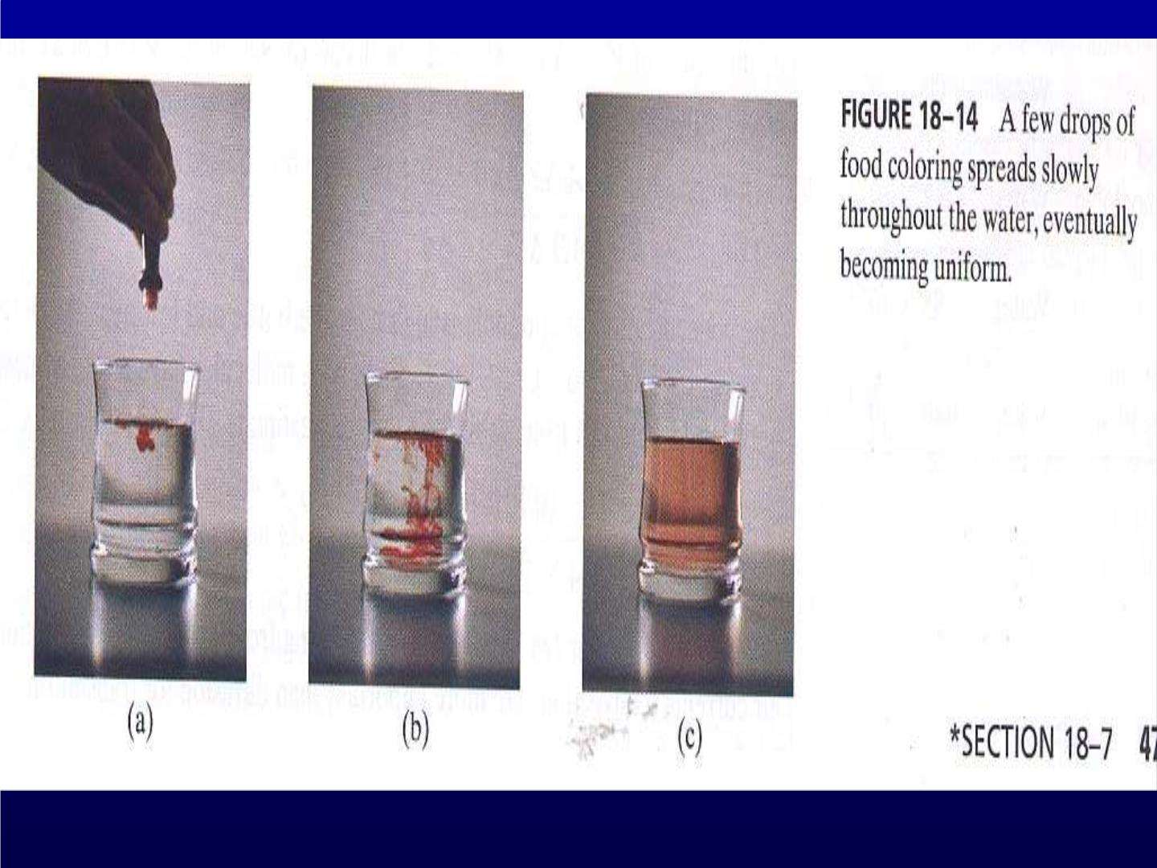

Slide 13
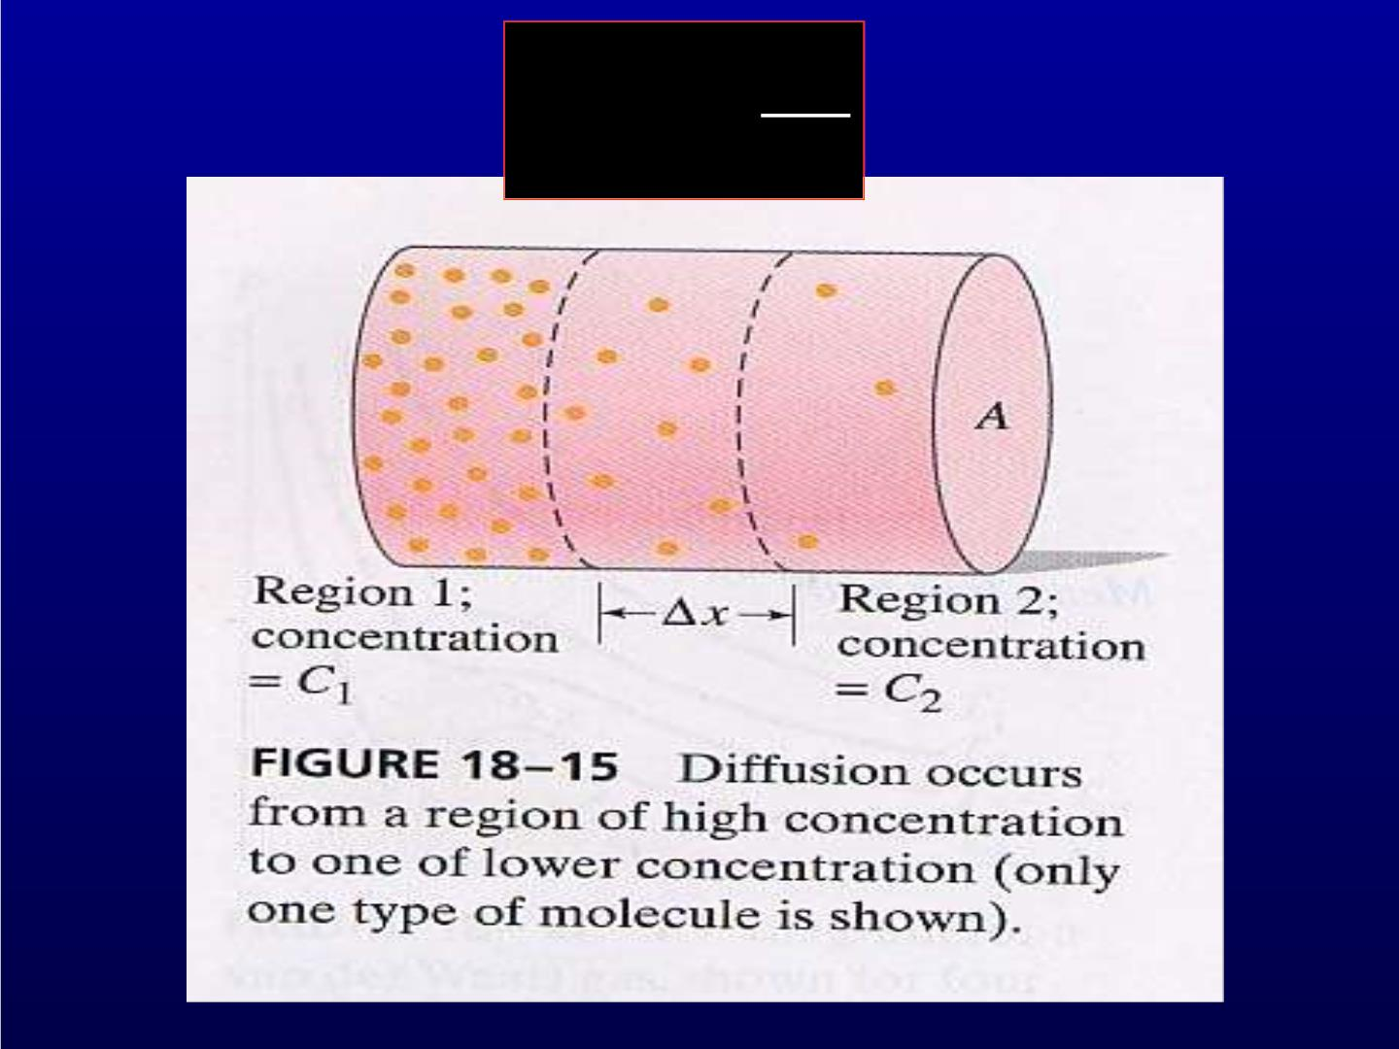

J_{m} = −D
x

Slide 14
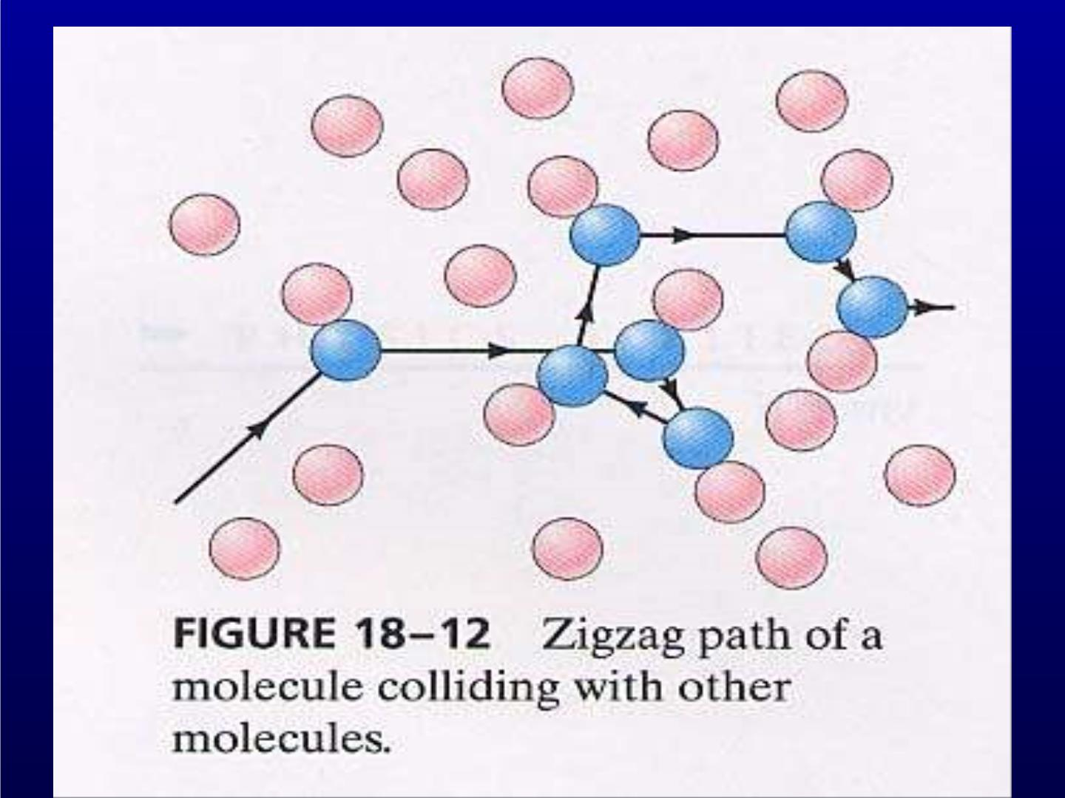

Slide 15
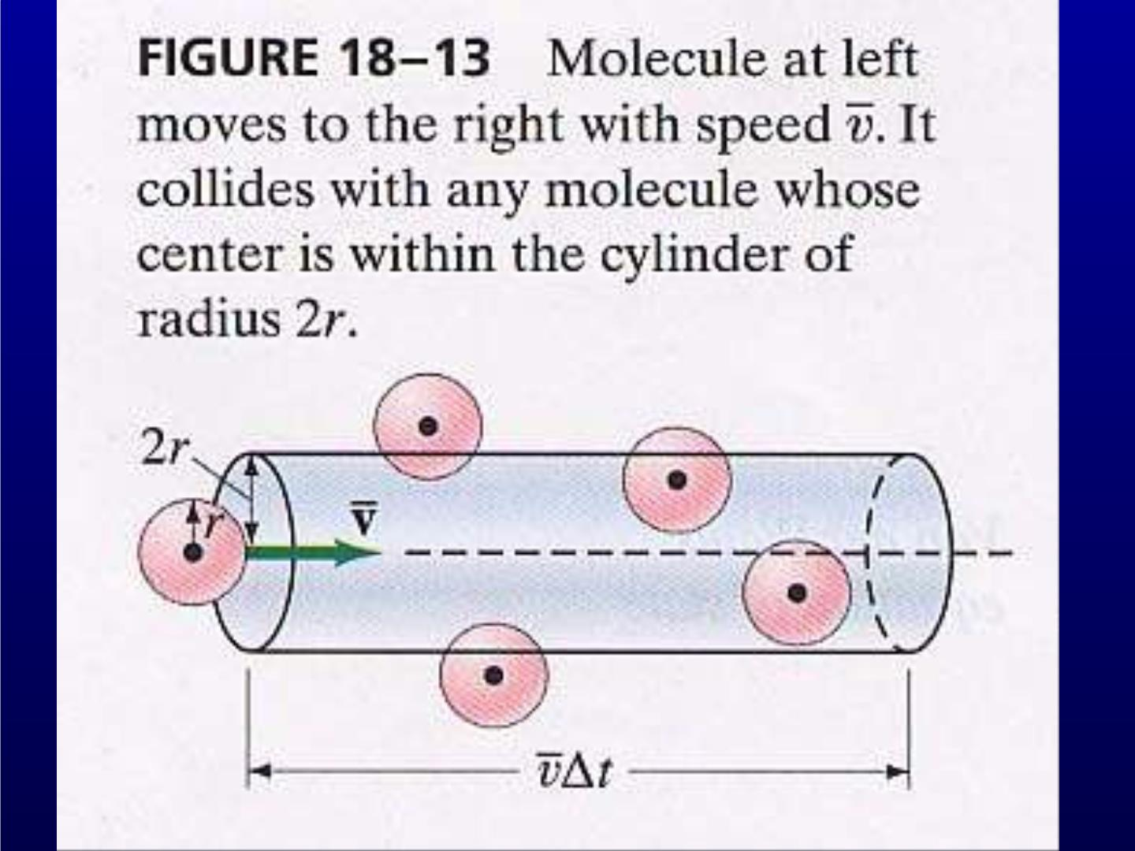

Slide 16
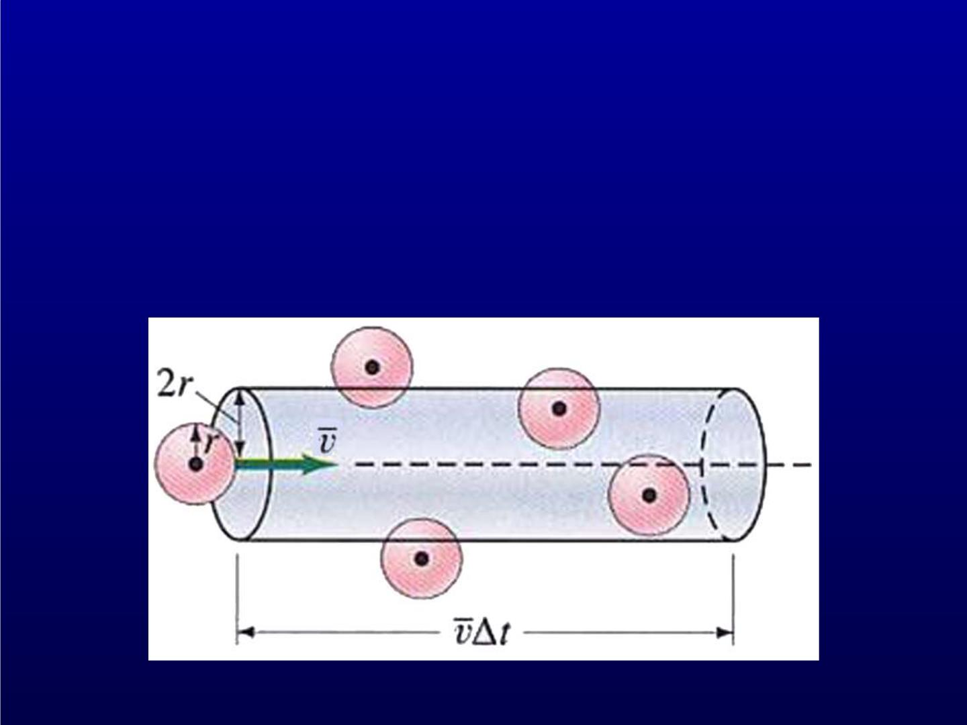
In an interval of t, number of collisions is
 =  v
2
N d ( t) n

Slide 17

Then mean free path is
^{L}cyl
● =
=
N_{cyl}
1
❐
n d
2

Slide 18

^{L}cyl
● =
=
N_{cyl}
vt
❐ v 
2
d t n
r
where the mean relative speed is
v = v − v
r
1
2

Slide 19
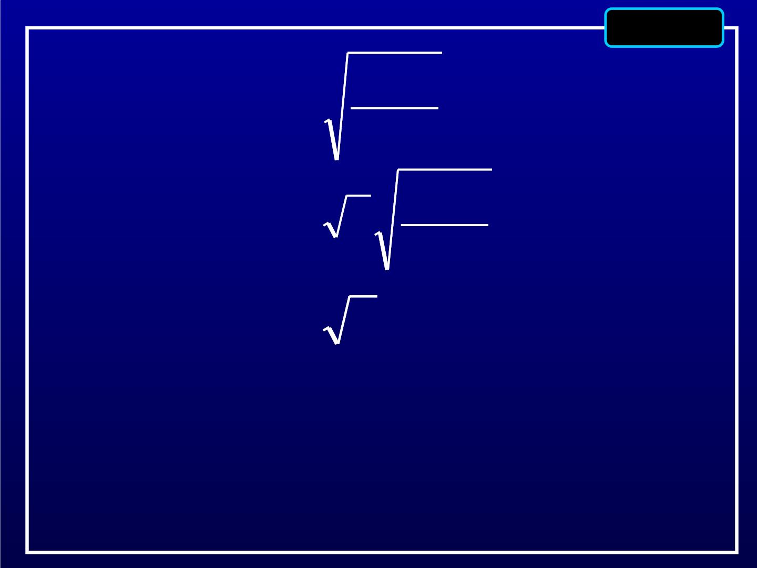
optional
8k_{B}T
v_{r} =

8k_{B}T
= 2
m
= 2v
Reference
L. E. Reichl, A Mordern Course in Statistical Physics.
University of Texa s Press, Austin 1980 pp458

Slide 20
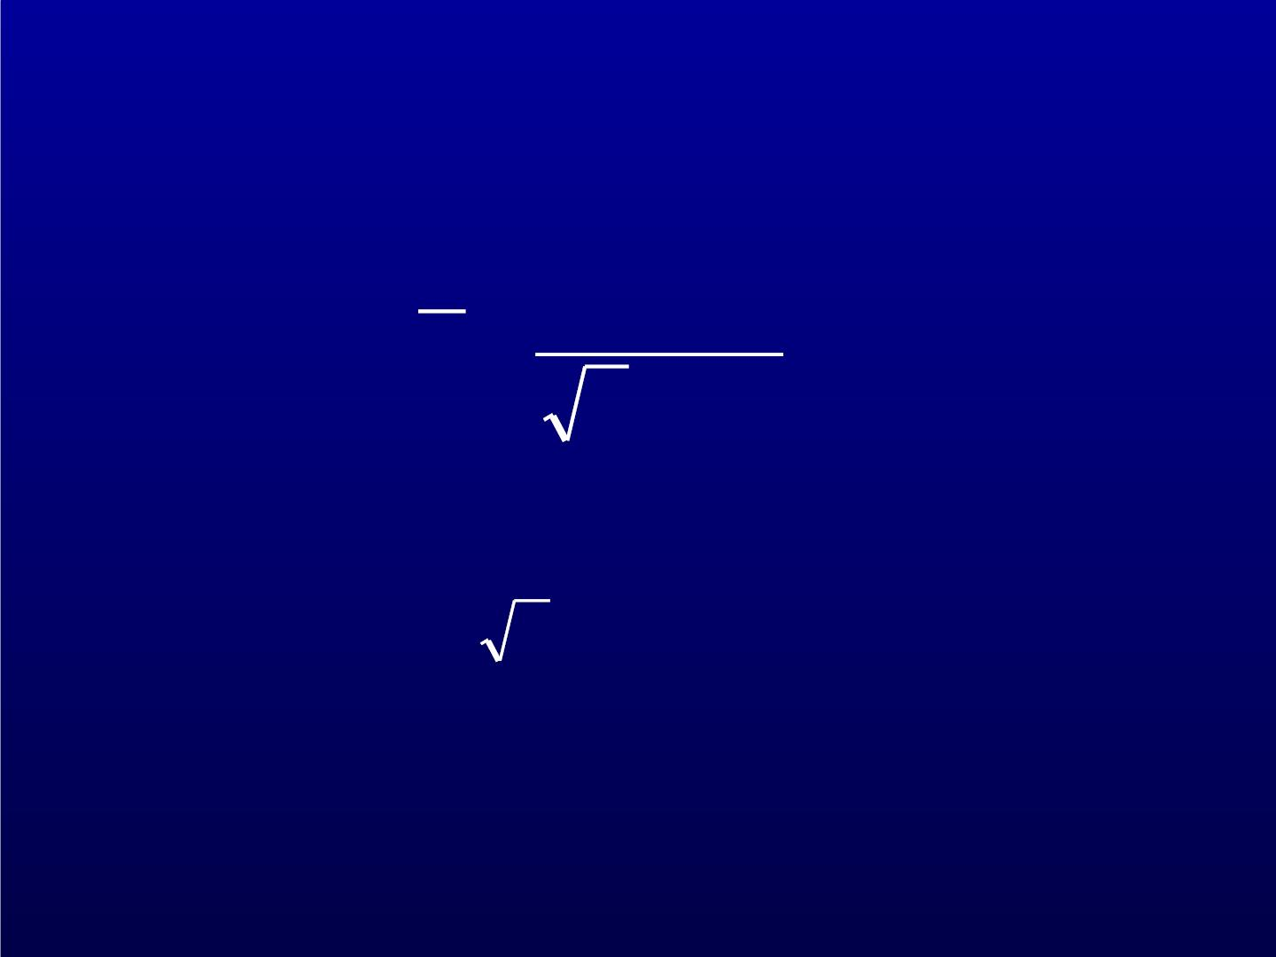
Then mean free path is
1
● =
❐ ²
2n d
Only a factor 2 different from dimension
analysis result.

Slide 21

Transport phenomena
Heat transfer : conduction
convection
thermal radiation
diffusion
viscosity
Conduction
thermal conductivity
T
x
J_{Q} = −
Fourier ’s law

Slide 22
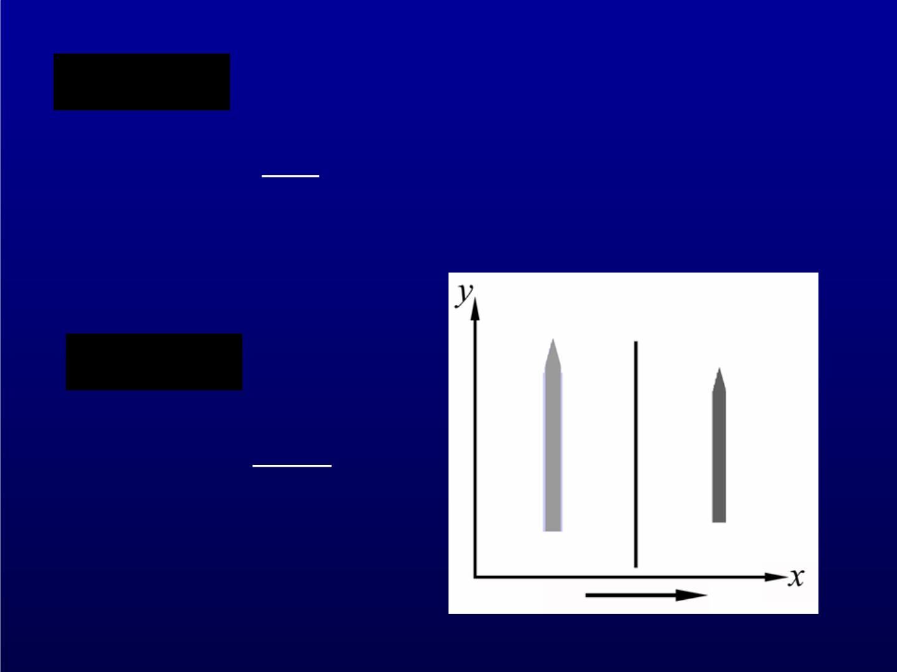
Diffusion

x
J_{m} = −D
Fick’s law
Viscosity
v_{y}
x
J _{p} = −
6

Slide 23
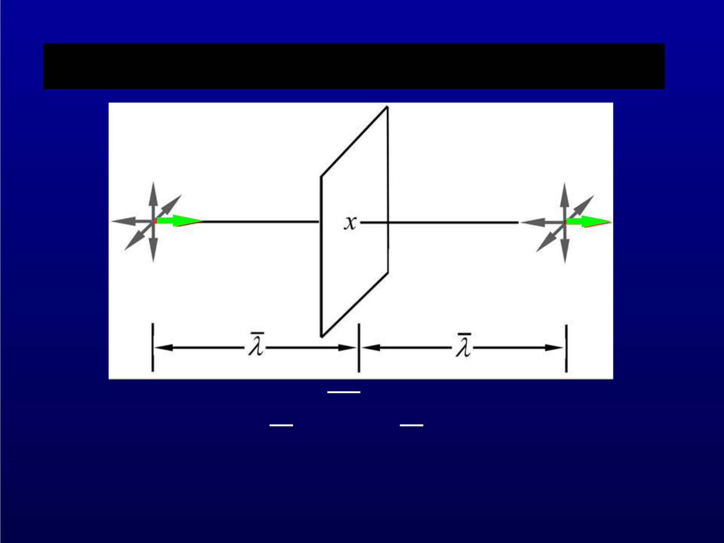
Microscopic theory of transport coefficients
1 3
 =
² =
m, mv k T, mv
2 2
 = M, Q,
B
y
p

Slide 24

mn = 
For mass transport,
1
 ( ) ( )
dM = dAvdt mn x −  − mn x + 
6
1



x


= dAvdt − 2


6
In general:
1


d = dAvdt n(x −  )(x −  ) − n(x +  )(x +  )
6

Slide 25
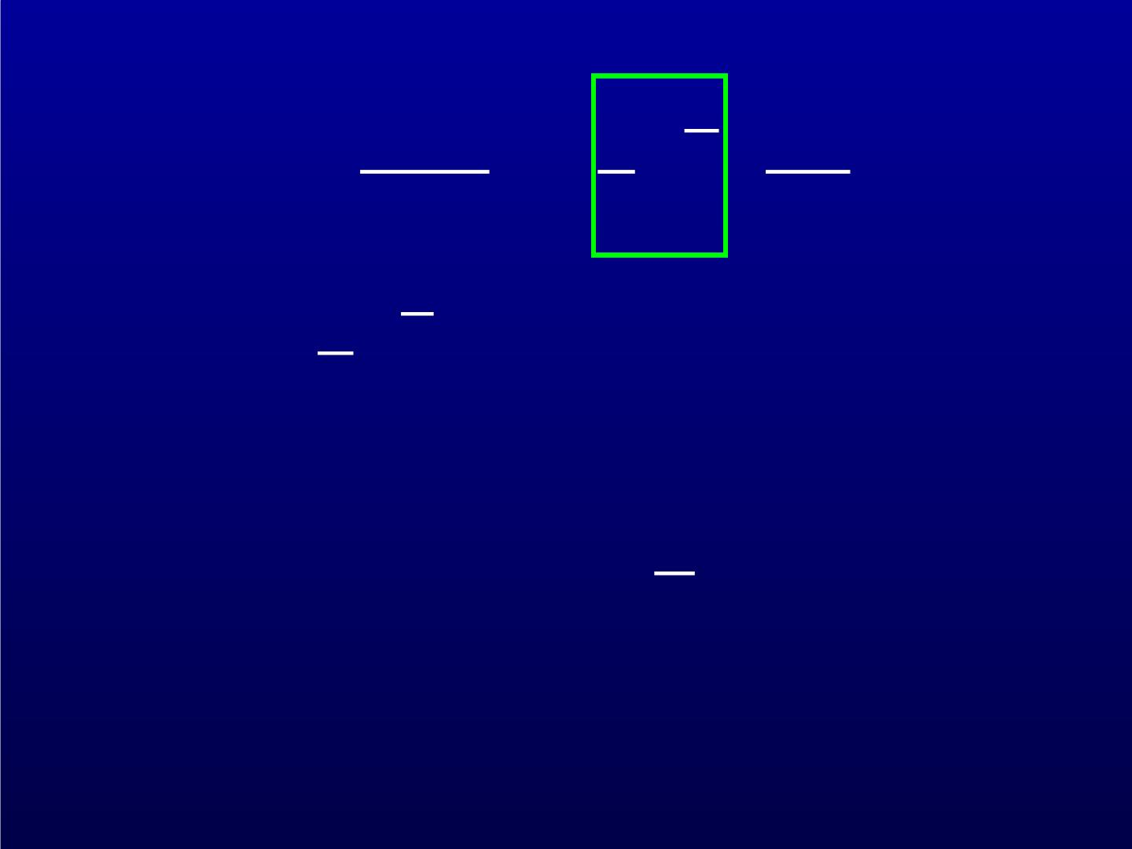
dM 1 
 
J  = − v
 
M
dAdt 3 x
 
1
D = v
3
Similarly

3

 = DC n k T = C T


V
 2
B
V

 = D

Slide 26
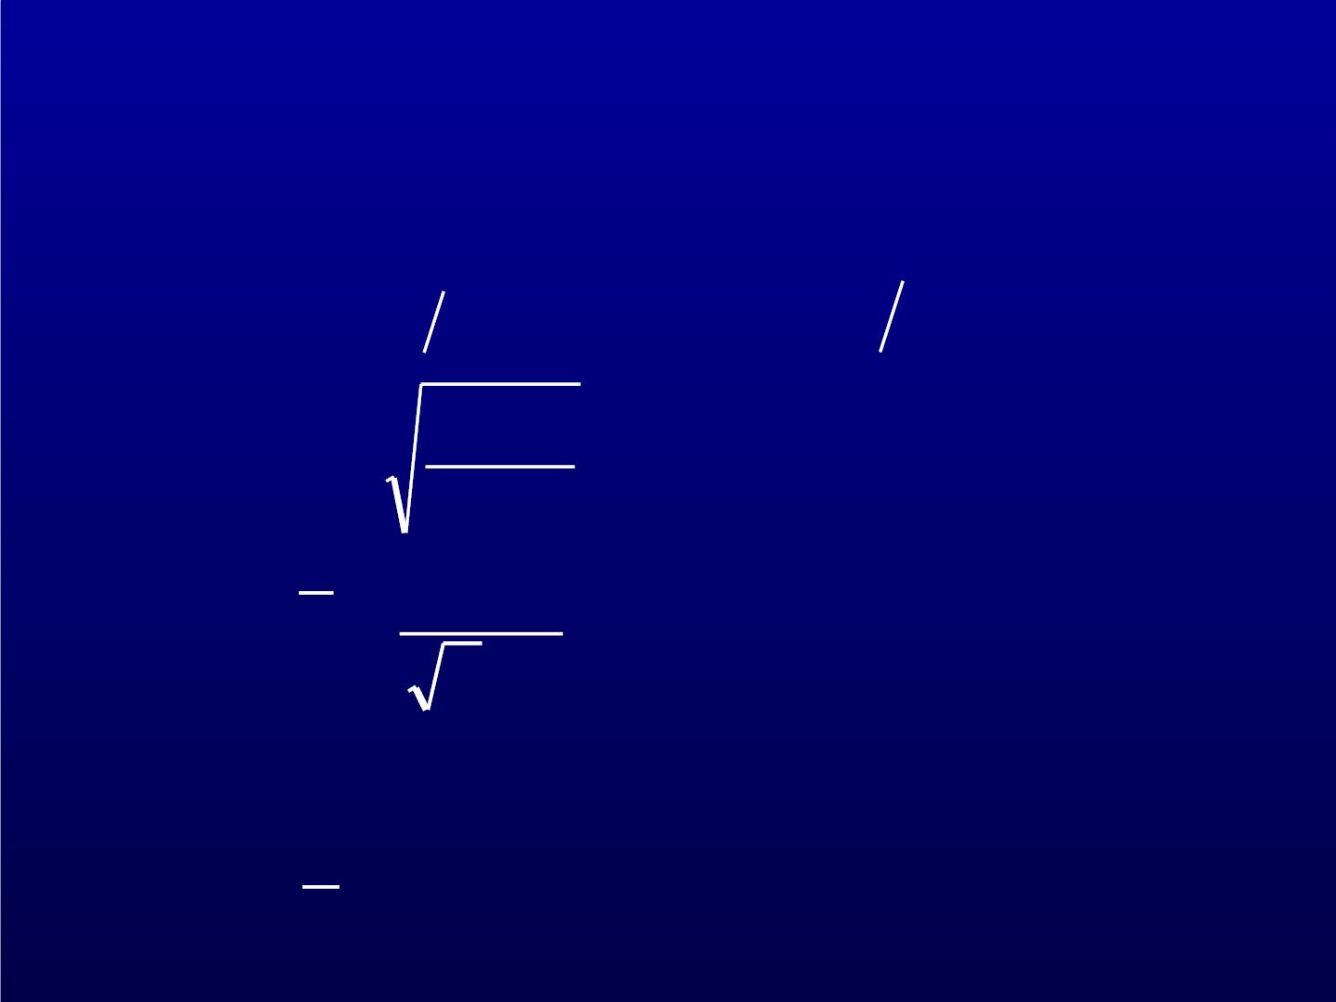
Hydrogen under STP
−
m =  27
3.33 10 kg
n = p k T =  25
_{2.68 10 m}3
B
8k_{B} T
m
1
v =
1.69 10 m s
=  3
● =
2n
⬧  2
~ (2r)
r = 1.12×10⁻¹⁰m
● =1.6710⁻⁷ m

Slide 27

−
9.42 10 m s ,
D =  5 2
 = 8.7110⁻² W (m K)
Experimental results:
−5 2
D = 1.2810 m s
−
  2
⋅
= 1.68 10 W (m K)

