Slide 1

Chapter 0 Preface
➢ Introduction to Physics
➢ Introduction to Vectors
➢ Introduction to Calculus(微积分)

Slide 2
Chapter 0 Preface
➢ Introduction to Physics
(See 动画库\力学夹\绪论. exe)
1) Objects studied in physics
2) Methodology for studying physics
3) Some other key points

Slide 3

Chapter 0 Preface
➢ Introduction to Vectors
A scalar is a simple physical quantity that
does not depend on direction.
mass, temperature, vo lu me, work…
A vector is a concept characterized by a
magnitude and a direction.
force, displacement, veloc it y…

Slide 4
Chapter 0 Preface
1) Representation of vectors
(See 动画库\力学夹\0-4矢量运算. exe)
2) Addition and subtraction of vectors
(See 动画库\力学夹\0-4矢量运算. exe)
3) Dot and cross products

Slide 5
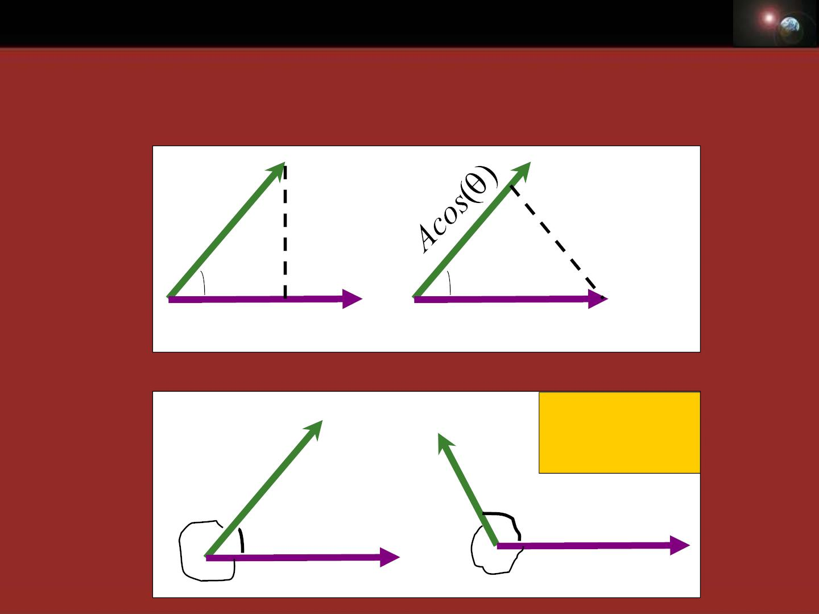
Chapter 0 Preface
❖   
A B =| A|| B | cos(θ)
3.1) Dot product:
❖
❖
B
B
❖
❖
θ
A
θ
A
Bcos()
❖
❖
B
B
No problem，
if
θ  
θ
❖
?
❖
A
θ
A
?

Slide 6
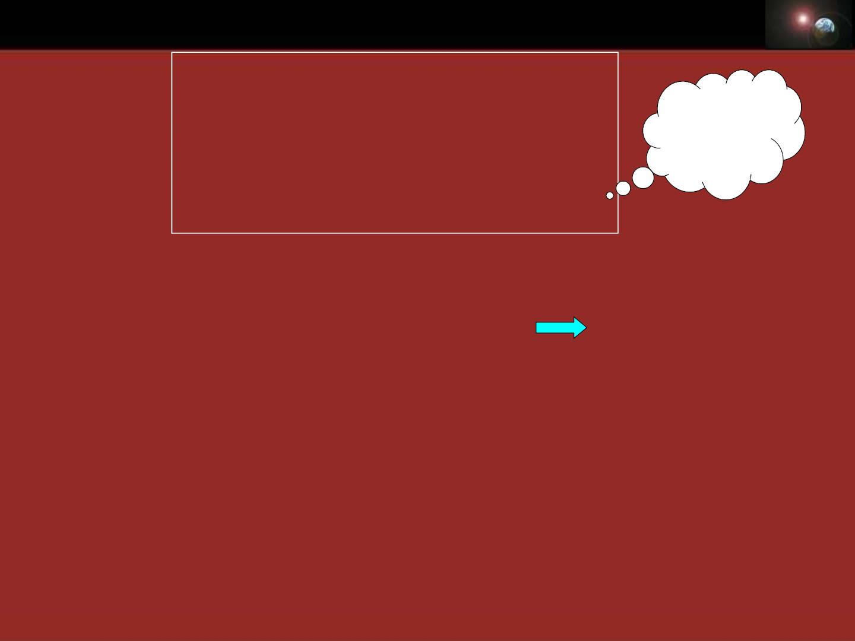
Chapter 0 Preface
❖   
AB = B A
❖  
⋅ =|
2
=
2
Prove it?
A A A| A
❖      
A(B +C) = AB + AC
❖
❖
❖ 
❖
A = A i + A j + A k
❖ 

x
❖
y
❖
z
❖  =
A B ?
❖
B = B i + B j + B k
❖ 
x
❖
y
❖
z
❖ 
❖
AB = (A i + A j + A k)(B i + B j + B k)
x
y
z
x
y
z
= A B + A B + A B
x x
y y
z z
❖ 
AB = A B + A B + A B
x x
y y
z z

Slide 7
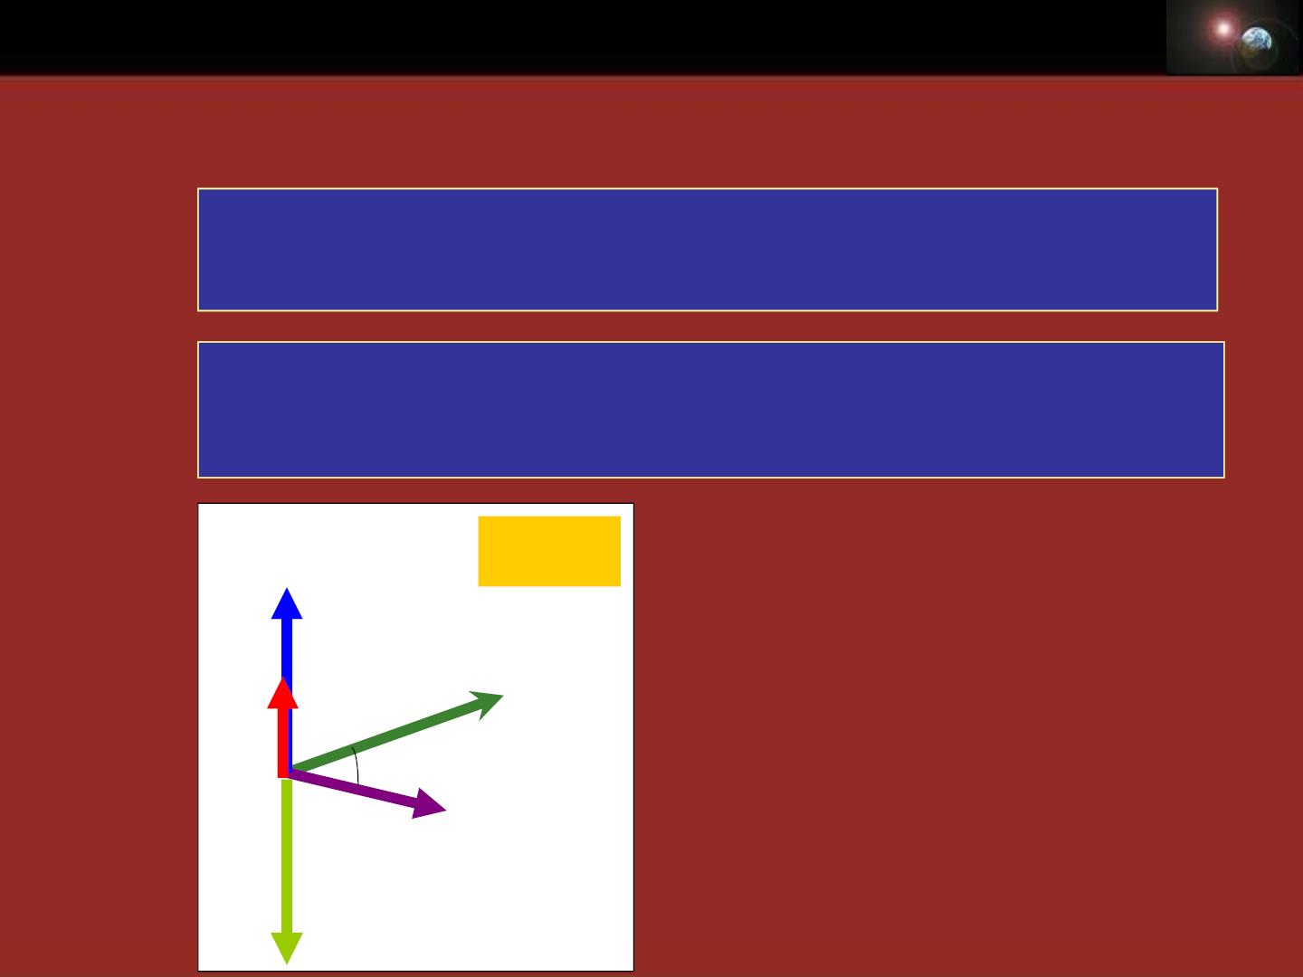
Chapter 0 Preface
❖ 
A B = ABsin()n
❖
3.2) Cross product:
❖
❖
A B
The length of × can be interpreted as the
area of the par all el ogram h aving A an d B as sides.
❖
❖ 
A B
❖
❖
n
A B
is a unit vector perpendicular to both and .
❖
n
, , and also becomes a right handed system.
❖ 
A B
θ  
❖   
If A// B, A B = 0
❖
❖   
❖
B
If A ⊥ B,| A B|= AB
n
❑
❖
Scalar triple product:
A
❖  
❖   
B A = -AB
( ) ?
A BC =

Slide 8
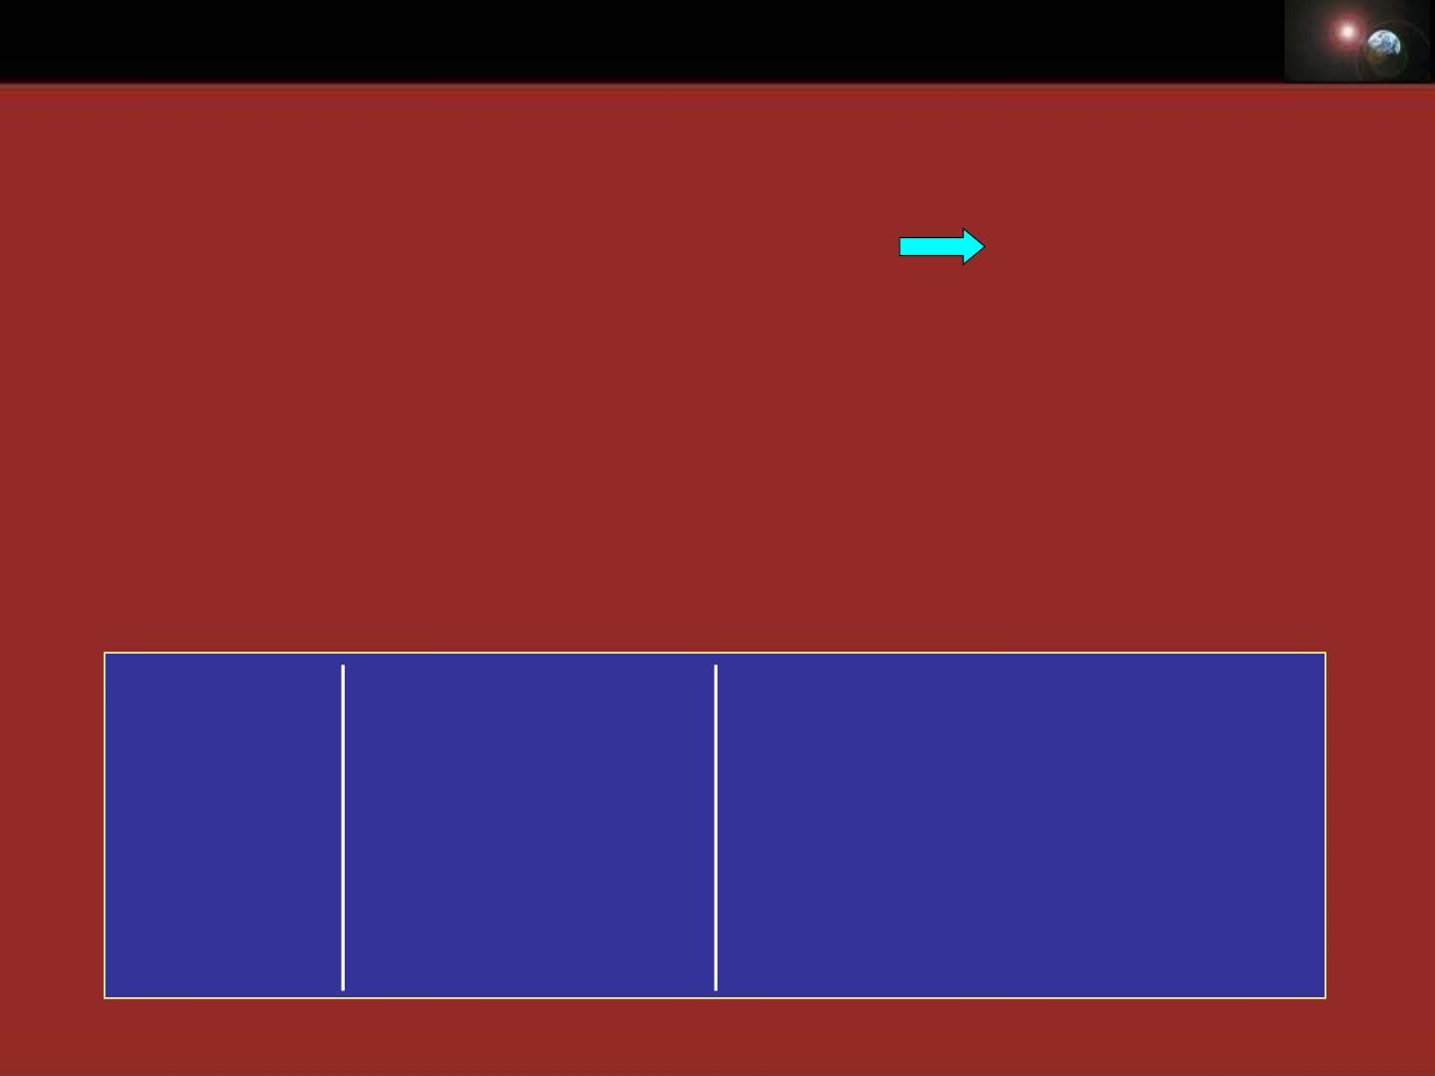
Chapter 0 Preface
❖
❖ 
❖
A = A i + A j + A k
❖ 

❖
x
❖
y
❖
z
❖  =
A B ?
B = B i + B j + B k
❖ 
x
y
❖
❖
❖ 
z
❖ 
AB = (A i + A j + A k)(B i + B j + B k)
x
y
❖
❖
z
x
y
z
= (A B − A B )i + (A B − A B ) j
y z
z y
❖
z x
x z
+(A B − A B )k
x y
y x
❖
❖ 
i j k
❖
= (A B − A B )i
+(A B − A B ) j
+ −
B B B (A B A B )k
❖ 
A B = A A A
y z
z y
❖
x
y
z
z x
x z
❖
x
y
z
x y
y x

Slide 9

Chapter 0 Preface
➢ Introduction to Calculus(微积分)
1) L imit of a function
lim f (x) = L
ƒ(x) can be made to be as
close to L as desired by
making x sufficiently close to c.
x→c
“The limit of ƒ of x, as x approaches c, is L."
Note that this statement can be true
even if
f (c)  Lor ƒ(x) is not defined at c.
x 1
² −
x −1
Example:
f (x) =
lim f (x) = x +1| = 2
x=1
x→1

Slide 10
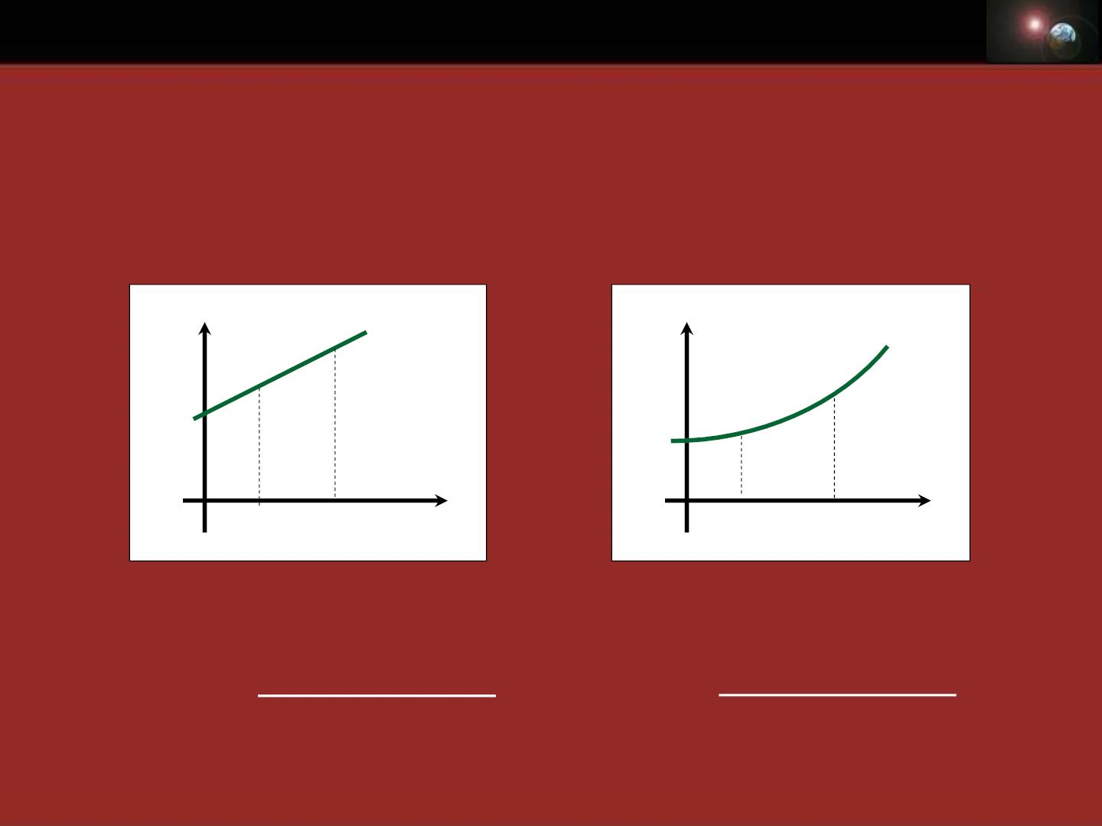
Chapter 0 Preface
2) Derivat iv e of a function(函数的导数)
• Motion with constant • Motion with changing
veloc it y
speed
s
s
t t
1 2
t
^{t}1 ^{t}
2
t
s(t ) − s(t )
−
s(t ) s(t )
v(t)
= 2
1
v(t)
= 2
1
?
t −t
t −t
2 1
2 1

Slide 11
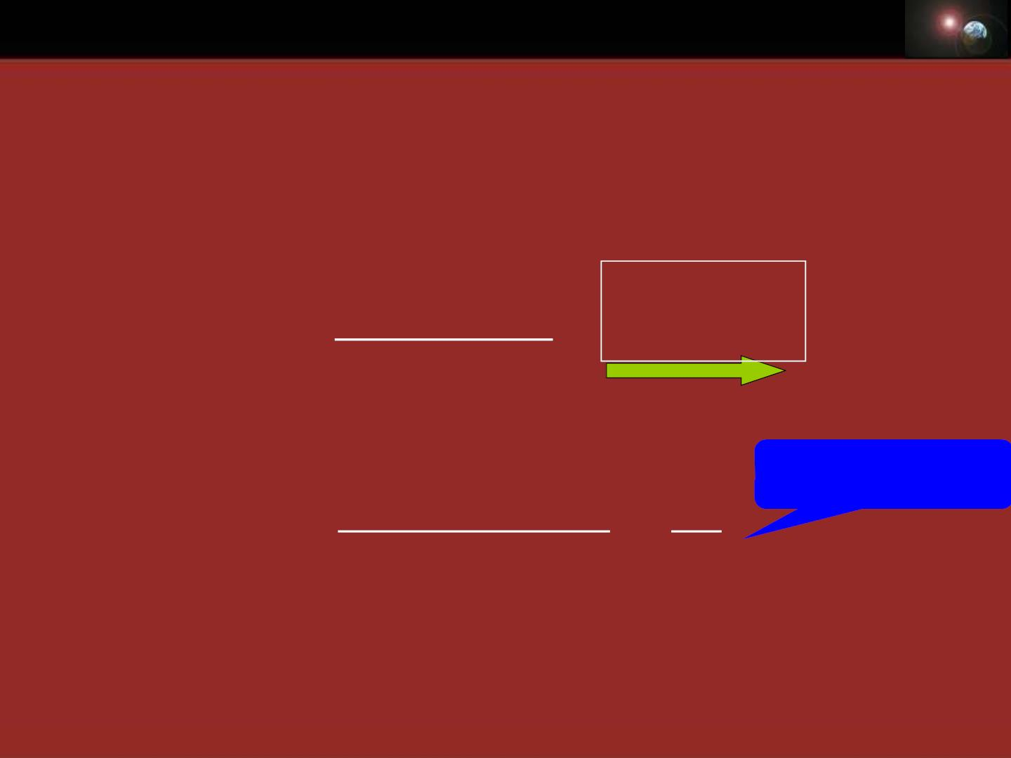
Chapter 0 Preface
• Motion with changing speed
How to find the instantaneous speed at t₁?
t = t
s(t ) − s(t ) 1
=
2
= + 
1 t t t
v(t ) lim
1
t −t
2
t →t
2
1
2 1
s(t + t) − s(t) ds
Derivative of s
v(t) = lim
=
t→0
t
dt

Slide 12
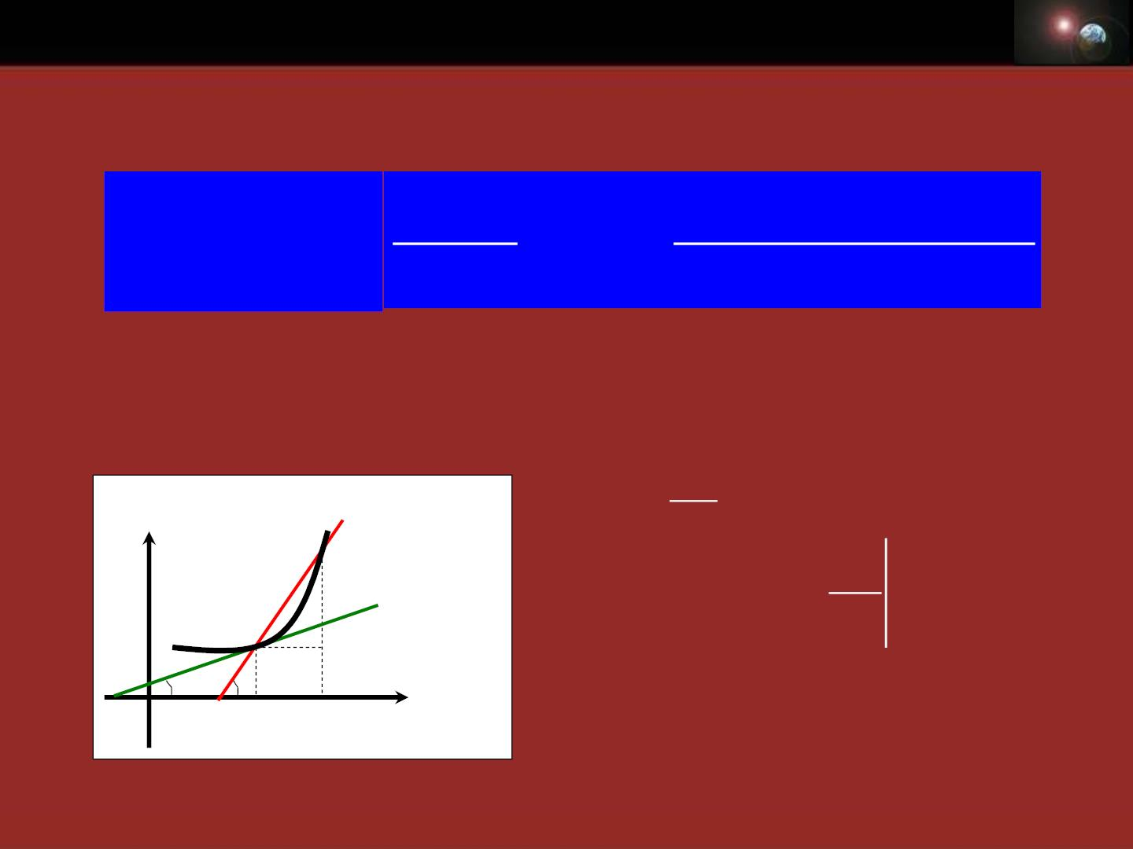
Chapter 0 Preface
For general function, its derivative is def ined as:
df (x)
f '(x)  y' = lim
dx
f (x + x) − f (x)
x
x→0
The meaning of derivative of a function:
y
x
A' → A
f(x)
tan  =
A’
y

f '(x )
tan
=

1
tangent lim tan β lim
A

A'→A
x→0
x = 
x
1

x x
x
^{ f '(x}1^{) = tan}
1 2

Slide 13
x →0

x
is infinitesimal.
How big is an infinitesimal?...

Slide 14
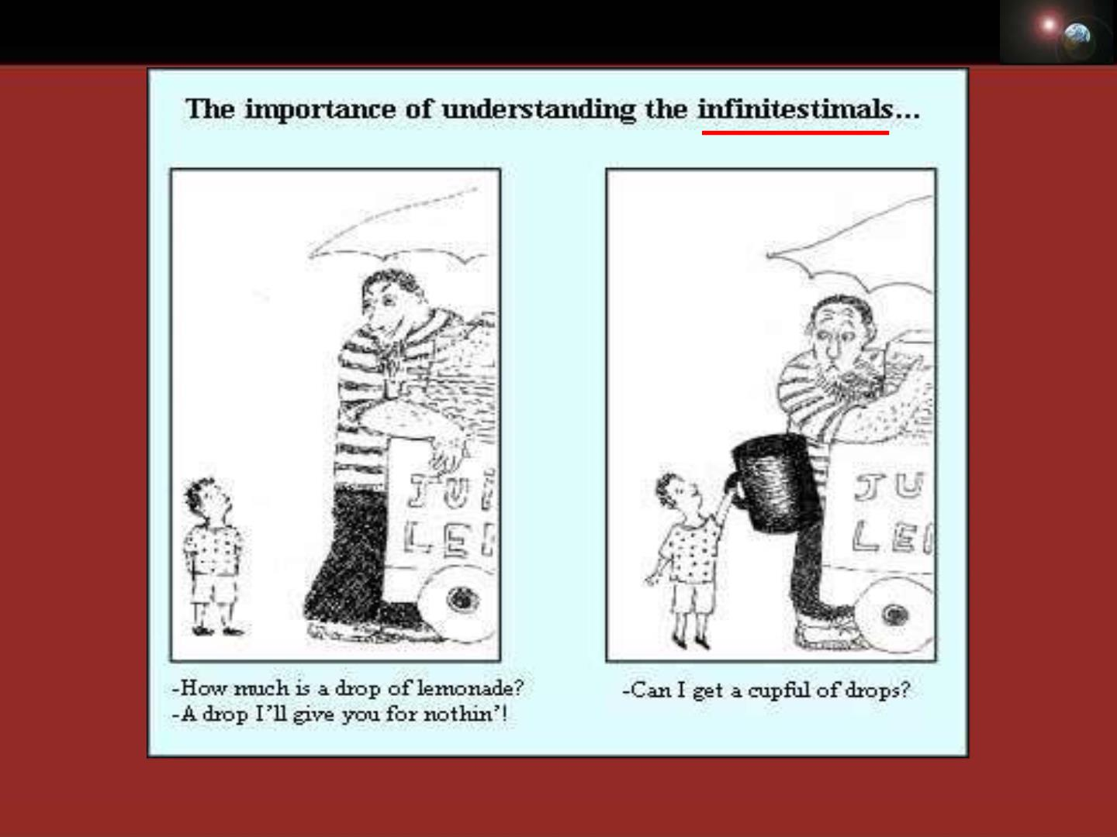
Chapter 0 Preface

Slide 15

Chapter 0 Preface
Example: y x
= ²
f (x + x) − f (x)
y'= lim
x→0
x
+  ² − ²
2x x x
 +  ²
x
(x x) x
= lim
= lim
= 2x
x→0
x
x→0
Some basic formulae:
(c') = 0
= −
(cos x)' s in x

−1
1
(x )'=x
(ln x)'=
( is a real number)
x
(sin x)'= cos x
^{x} = ^{x}
(e )' e

Slide 16
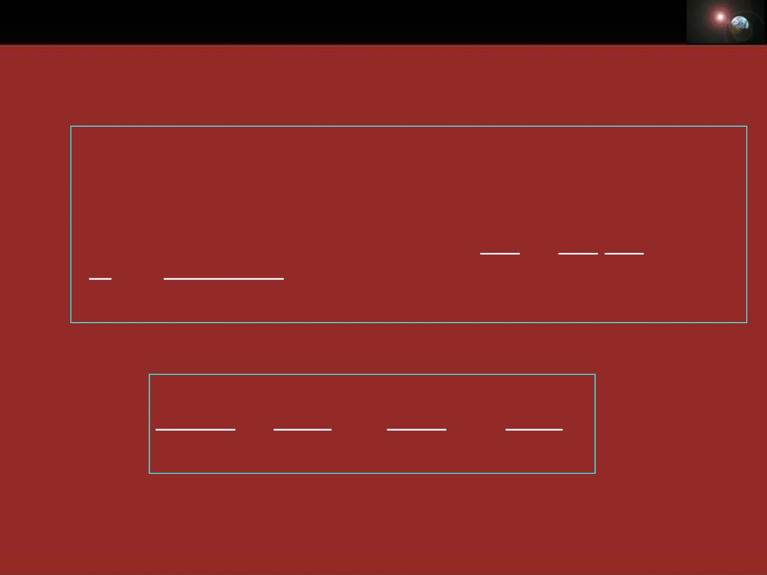
Chapter 0 Preface
Some basic rules:
(u v)'= u'v'
(uv)'= u'v +uv'
y = f (v),v = (x) 
y'(x) = f '(v)v'(x)
(Cu)'= Cu'
,C is a const.
dy dy dv
u u'v −uv'
( )'=
or =
(v  0)
dx dv dx
v
v²
For a vector:
❖
dA(t) dA
❖ dA 
dA
❖
y
= x + + z
i
j k
dt dt dt dt

Slide 17

Chapter 0 Preface
3) Differential of a function (函数的微分)
If f(x) has its derivat ive at point x, then f ’(x)dx is
its differential at that point.
dy = f '(x)dx

Differential of the function
Differential of the variable
dx
dy
dx
So f ’(x)
=
is also called differential quotient (微商)

Slide 18
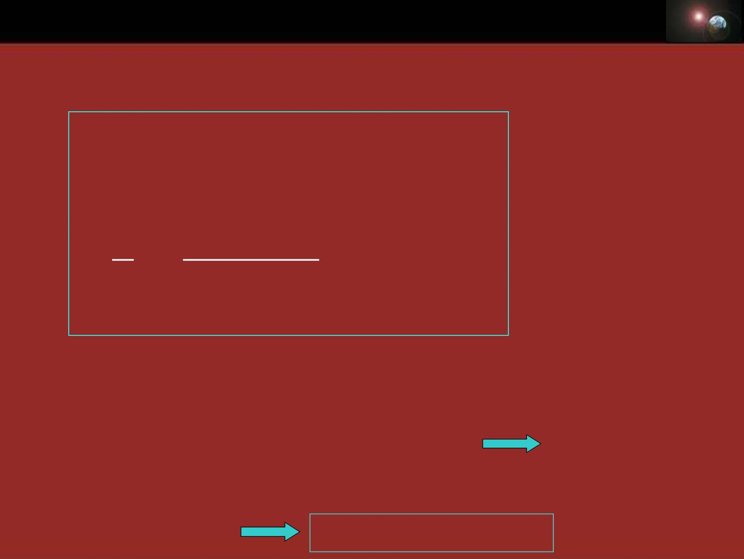
Chapter 0 Preface
Operation rule is the same as that for derivat ive:
d(u v) = du  dv
d(uv) = vdu+udv
d(Cu) = Cdu
,C is a const.
u vdu−udv
d( ) =
(v  0)
v
v²
One application of d ifferen t ia l
if x → x₀
y = f (x) − f (x )  f '(x )(x − x )
0
0
0
f (x)  f (x )+ f '(x )(x − x )
0
0
0
When x₀ = 0
 +
f (x) f (0) f ' (0)x

Slide 19

Chapter 0 Preface
f (x)  f (0) + f ' (0)x
Example:
s in( x)  s in( 0)+(sin x)'|_{x=0} x = cos(0)x = x, x →0
Following approximate formulae often used
x →
in physic s ( 0 ) :
s in( x)  x
x x
ln(1+ ) 
ta n( x)  x
1
1+ x 1+ x
2
^{x}  +
e 1 x
(1+ )^{N} 1+
x
Nx

Slide 20
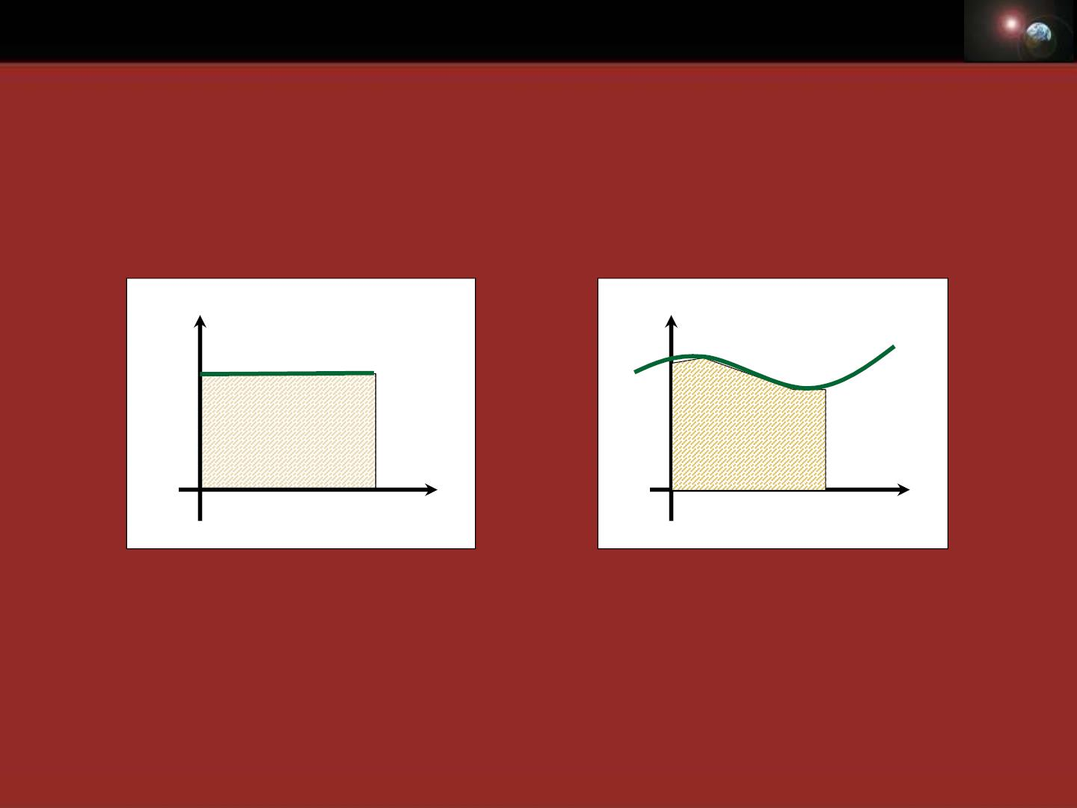
Chapter 0 Preface
4) Integrals(积分)
• Motion with constant • Motion with changing
veloc it y
speed
v
v
S
S
0
^{t}0
t
0
t₀
t
S = vt₀
How to find S?

Slide 21
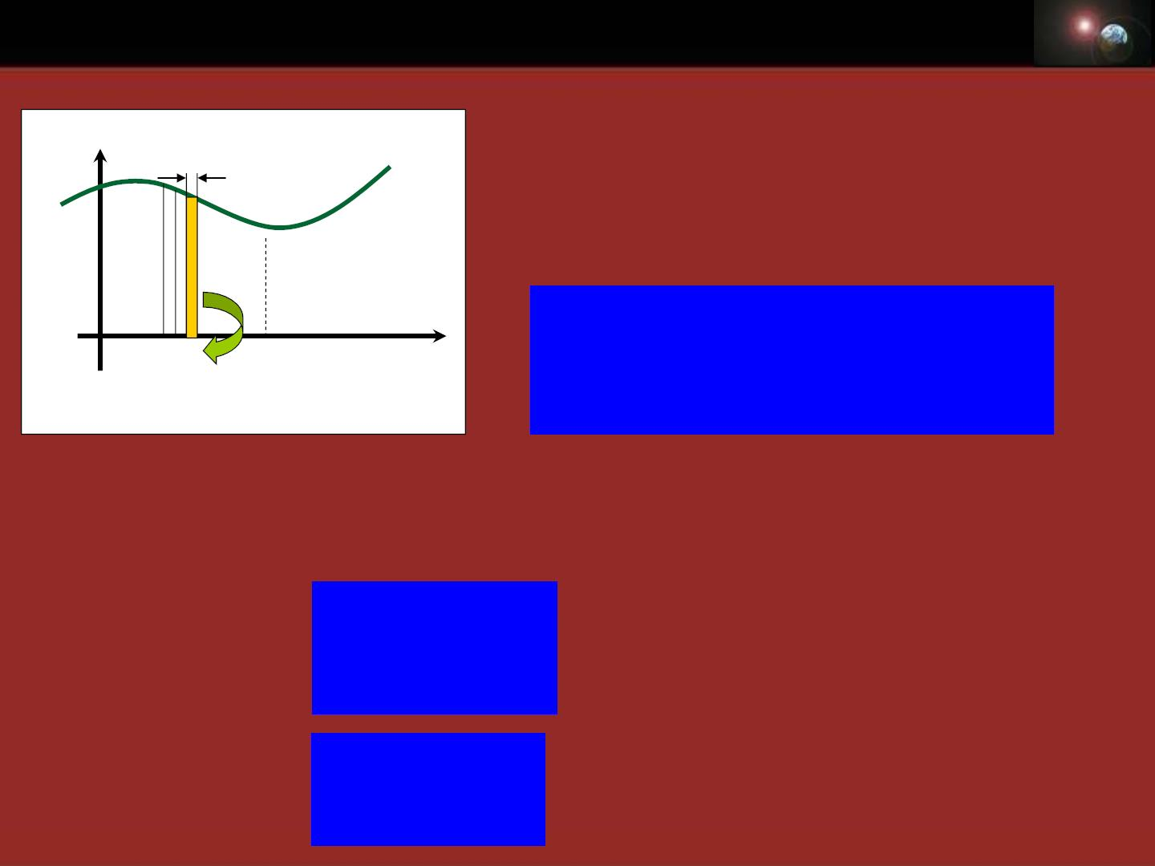
Chapter 0 Preface
v
S  v(t )t +v(t )t +......v(t )t
t
1
2
N
N

i=1
= v(t )t, if t → 0, N → 
… …
i
N
t

⇩
S = lim v(t )t  v(t)dt
0
0
i t₀ t
i
t→0
0
N→
i=1
In general, the integral f rom a to b of f(x) with respect
to x is expr essed as:
⇩
⇩
b
f (x)dx
f (x)dx
definite integral
a
indefinite integral

Slide 22

Chapter 0 Preface
How to find an integral of a function?
If function f(x) is continuous on the interval [a, b]
and if
'(x) = f (x
)on the in terva l (a, b), then
b
b
b
d(x)
⇩  
f (x)dx = '(x)dx =
dx
a
a
a
dx
b
⇩
= d(x) =(b)−(a)
a
b
⇩
f (x)dx =(b) −(a), '(x) = f (x)
a
⇩
f (x)dx =(x) +C, '(x) = f (x)

Slide 23

Chapter 0 Preface
2
1
Example:
⇩
dx =
?
1
x
1
( ln x)'=
(x) ln x
 =
x
2
1
⇩
 dx = x ² =
ln | ln 2
1
x
1
Basic integral formulae:
k,C: const.
⇩
⇩
⇩
x
x
dx = x +C
e dx = e +C
⇩
kdx = kx+C
1
dx = ln x + C
⇩
x
cos xdx = s in x +C
^{sin xdx = −cos x +C}
x
a+1
⇩
a
x dx = + C a  −
a +1 ,( 1)

