Slide 1

Chapter 10 Angular
momentum

Slide 2
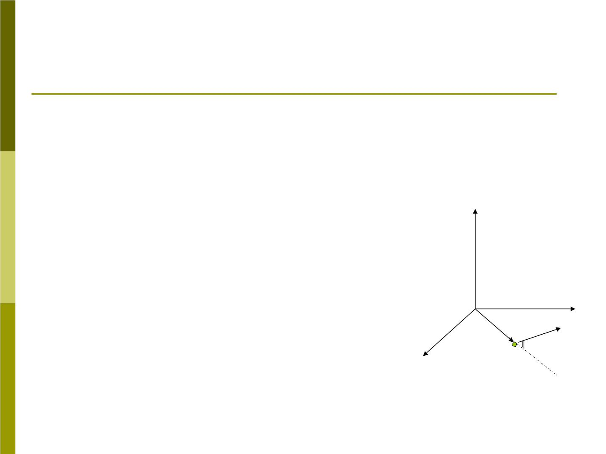
10-1 Angular momentum of a particle
1. Definition
Consider a particle of mass m and
→
→
linear momentum at a position
r
P
relative to the origin o of an inertial
frame we define the “angular
→
z
momentum” of the particle with
L
respect to the origin o to be
y
→
→ →
→
P
L = r P
(10-1)
→
r
❑
x
m

Slide 3

Its magnitude is
L = rp sin 
(10-2)
→
where  is the smaller angle between and
r
→
, we also can write it as
P
L = pr = rp
⊥
⊥
→
→
P
Note that , for convenience and are in
r
xy plane.

Slide 4

2. The relation between torque and angular
momentum
Differentiating Eq(10-1) we obtain
→
→
→
d L d r → → d P
→

→
→
(10-6)
=  P+ r = r F = 
dt dt
dt
→
→
d r
dt
→
d r
→
→ →
Here
= v
, the
 P = v P =
0
→
dt
d P
dt

→
and
= F
Eq(10-6) states that “the net torque
acting on a particle is equal to the time
rate of change of its angular momentum.

Slide 5
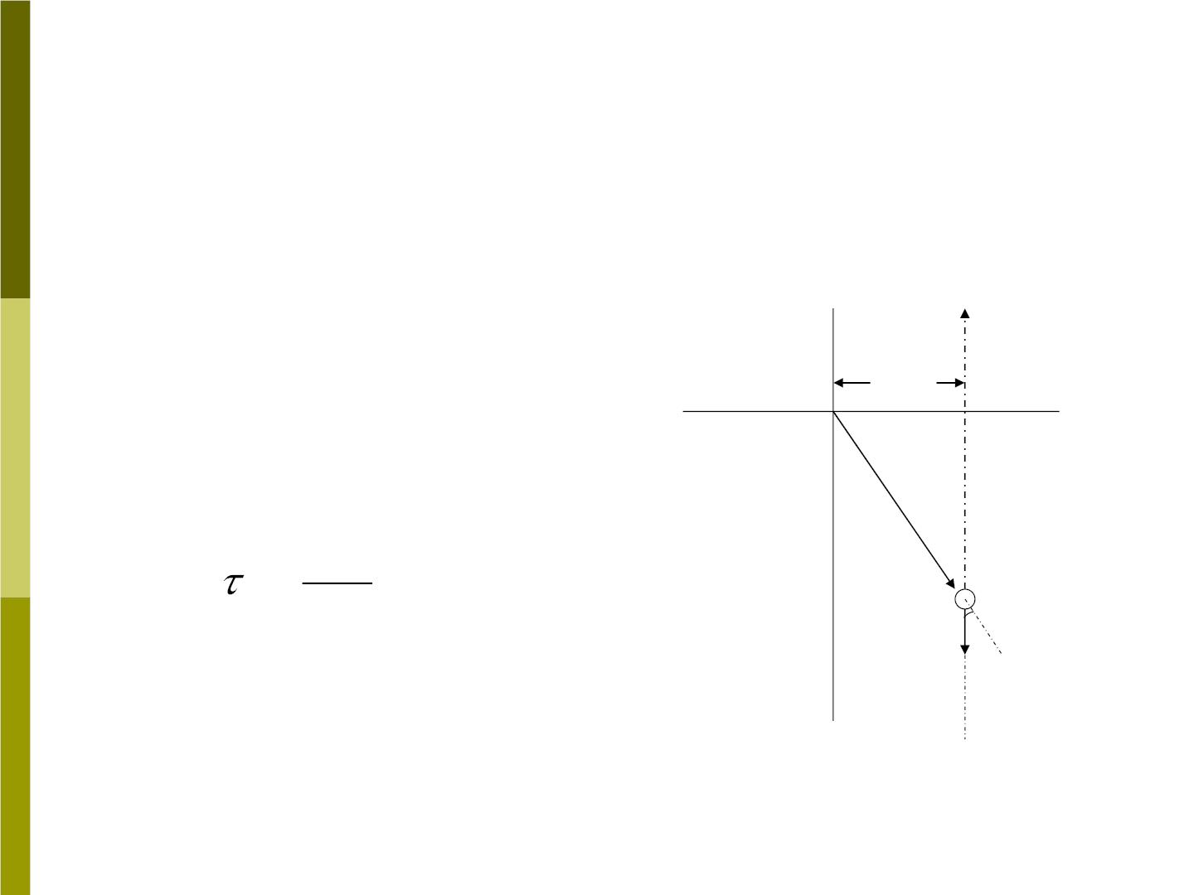
Sample problem 10-1
A particle of mass m is
released from rest at point p
(a) Find torque and angular
momentum with respect to
origin o
b
P
o
x
(b) Show that the relation
→
r
→

→
d L
dt
=
m
yield a correct result .
mg
❑
y

Slide 6

Solution:
→

(a)
= m gb z
( b is the moment arm)
0
→
→
→

L = r m v = bmgt z
0
→
d L
(b)

→
= bmg z = 
dt
0

Slide 7

10-2 Systems of particles
→
L
1.To calculate the total angular momentum of a
system of particle about a given point, we must
add vectorially the angular momenta of all the
individual particles about this point.
→
→
→
→
N →

L = L + L +  L = L
(10-8)
1
2
N
n
→
L
n=1
As time goes on, may change. That is
→
d L d
→
d
→

→
= L + L +  = 
1
2
n
dt dt dt

Slide 8

Total internal torque is zero because the torque
resulting from each internal action- reaction force
→
pair is zero. Thus
→
→
d L
dt
 
=
=
n
ext
(10-9)
That is: “the net external torque acting on a system
of particles is equal to the time rate of change of
the total angular momentum of the system.”
Note that: (1) the torque and the angular
momentum must be calculated with respect to the
same origin of an inertia reference frame.
(2) Eq(10-9) holds for any rigid body.

Slide 9
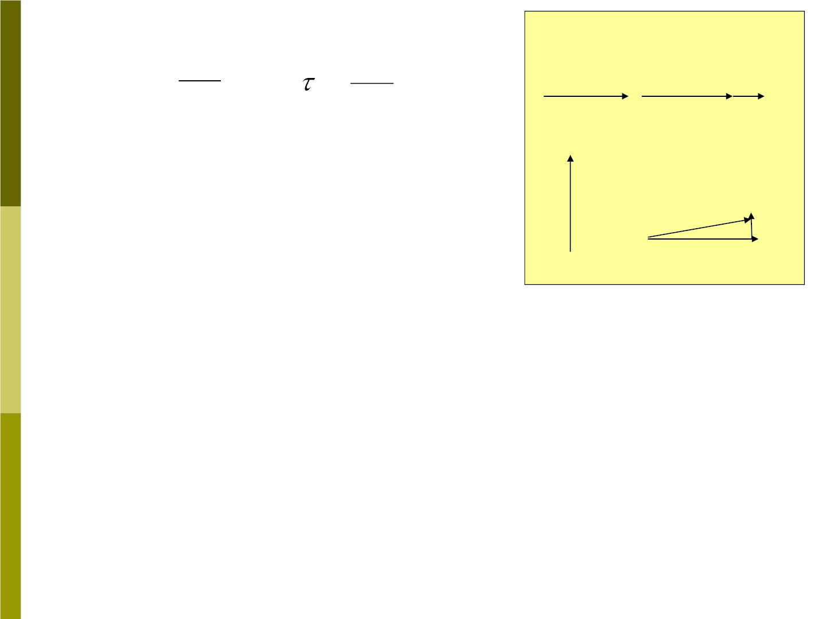
→
→
→
→
^{2.} 
→
d P
and
→
d L
dt
F
→
F =
=
P  P
//
//
dt
→
F
Suppose a force acts on a
particle which moves with
→
→
→
F
P+  P
→
→
⊥
⊥

P
momentum . We can
⊥
P
→
F
→
P
resolve into two components,
as shown in Fig 10-3:
Fig 10-3
→
→
 p
The component F gives a change in momentum ,
//
→
//
which changes the magnitude of ; on the other
P
→
F
→
hand, the gives an increment
 P
that changes
⊥
→
⊥
the direction of .
P

Slide 10
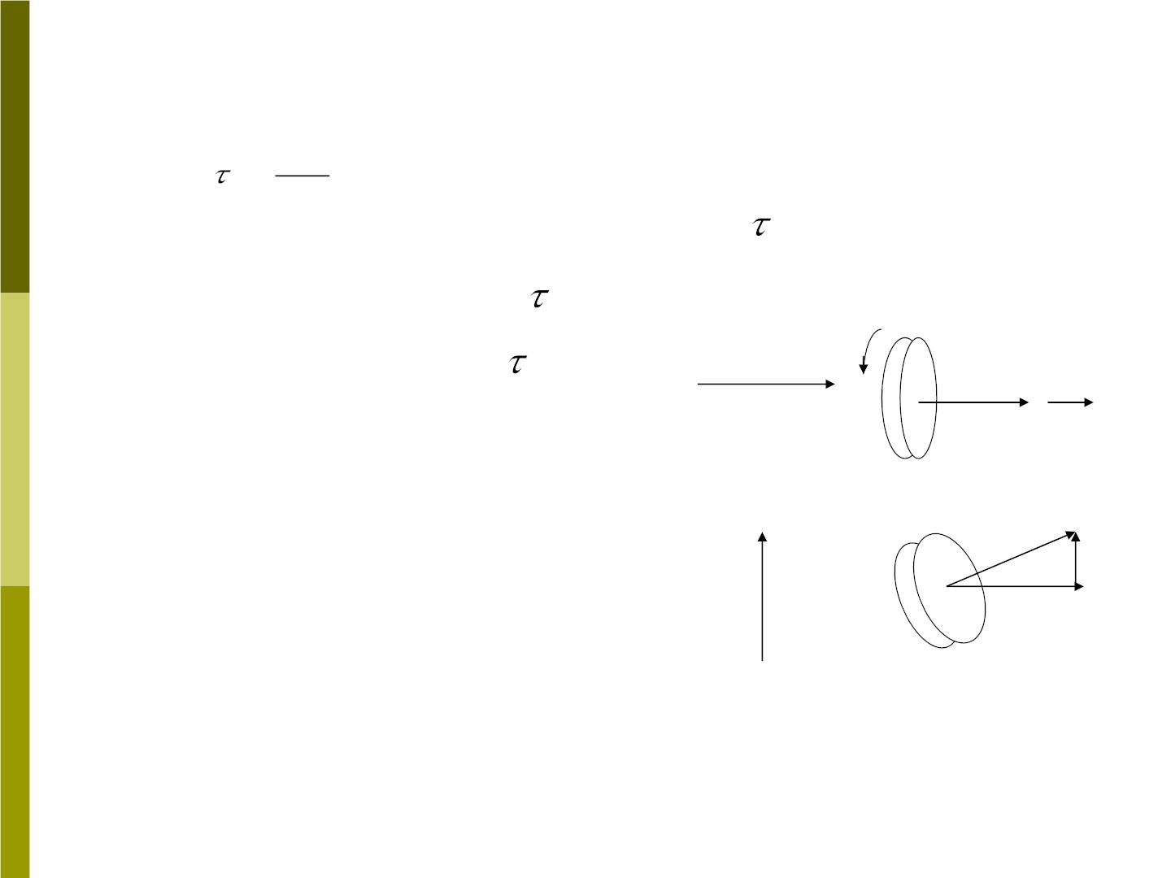
The same analysis holds for the action of a
→
torque
→
 L
, as shown in Fig 10-4. In
=

t
→
→
this case must be parallel to .
 L
→
We once again resolve
into two components
→
→
(a)
// L
→
→
//
→
and  ⊥ . The component
→
L
⧫
⧫
→
L
→
L
//
⊥
//

→
L
//
changes the in magnitude
but not in direction (Fig 10-
→
→
L+  L
→
→
⊥
→
4a ). The component
⧫
 L
→
⊥
(b)
⊥
gives an increment
→
,
⊥
→
L
L ⊥ L
⊥
which changes the direction of
→
Fig 10-4
L
but not its magnitude
(Fig10-4b).

Slide 11
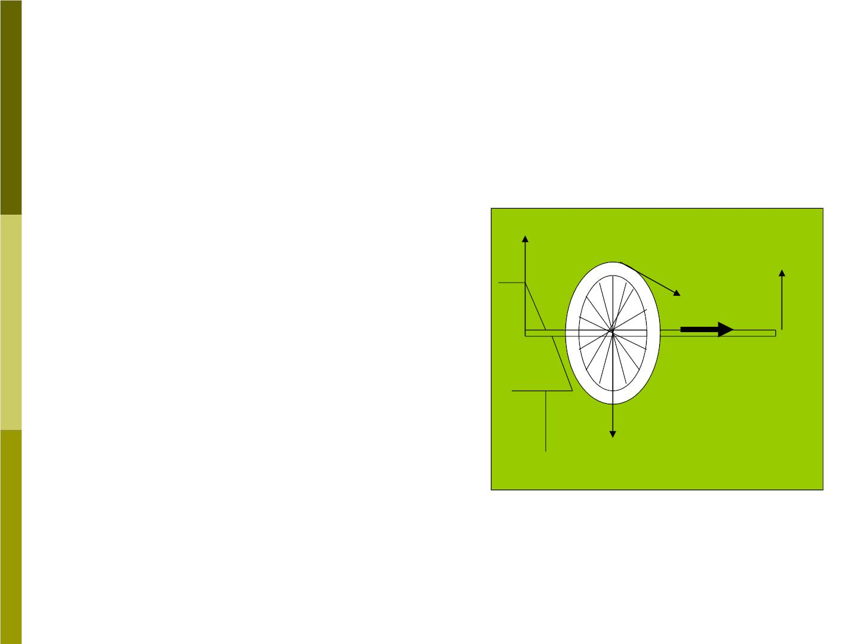
An example of the application
of Eq(10-9) for rotational
Fig 10-5a
dynamics is shown in Fig 10-5.
In Fig 10-5, a student pushes
tangentially on the wheel with a
N
→
f
F
r
→
o
force at its rim, in order to make
f
→
→
L
⧫
→
L
it spin faster. {The (// ) due to
→
f
→
L
increases the magnitude of .}
mg

Slide 12
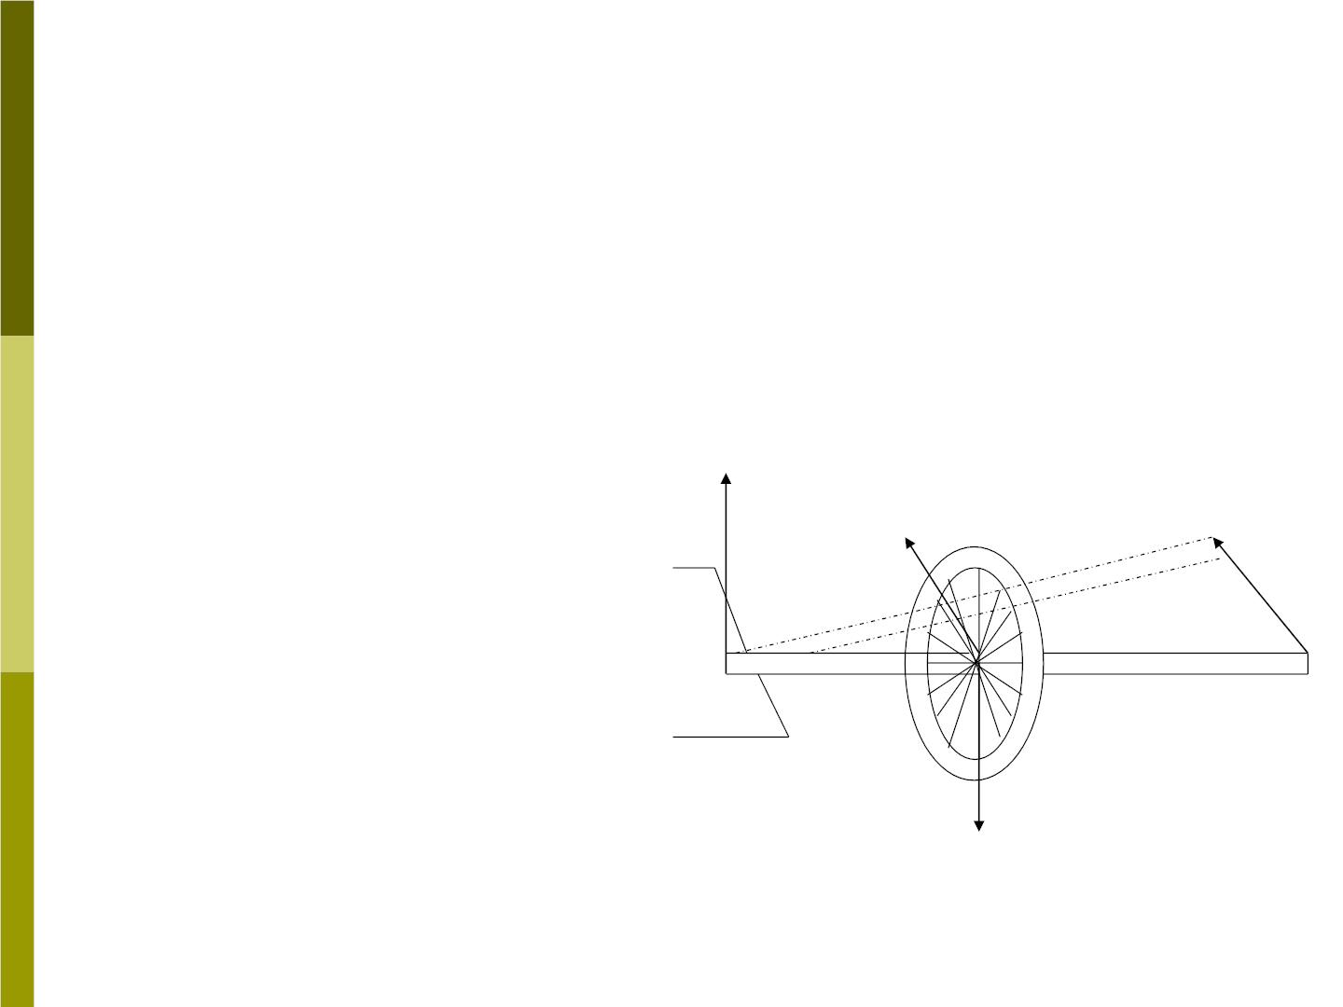
In Fig 10-5b, we have
release one support of
the axis. There are two
Fig 10-5b
forces acting: a normal
→
N
→
'
force at the supporting
→
'
N
⧫
point o, which gives no

→
L
torque about o, and the
wheel’s weight acting
downward at the Cm.
O’
→
L
mg

Slide 13
→
The torque about point o due to the weight is
⧫
→
perpendicular to and its effect is to change the
→
L
direction of .
L
Note that:
→
→
L
(1).Eq(10-9) holds when  and are measured
with respect to the origin of an inertial reference
frame.
(2). Eq(10-9) would not apply to an arbitrary point
which is moving in complicated way. However if
the reference point is chosen to be the Cm of the
system, even though this point may be accelerating,
then Eq(10-9) does hold.

Slide 14
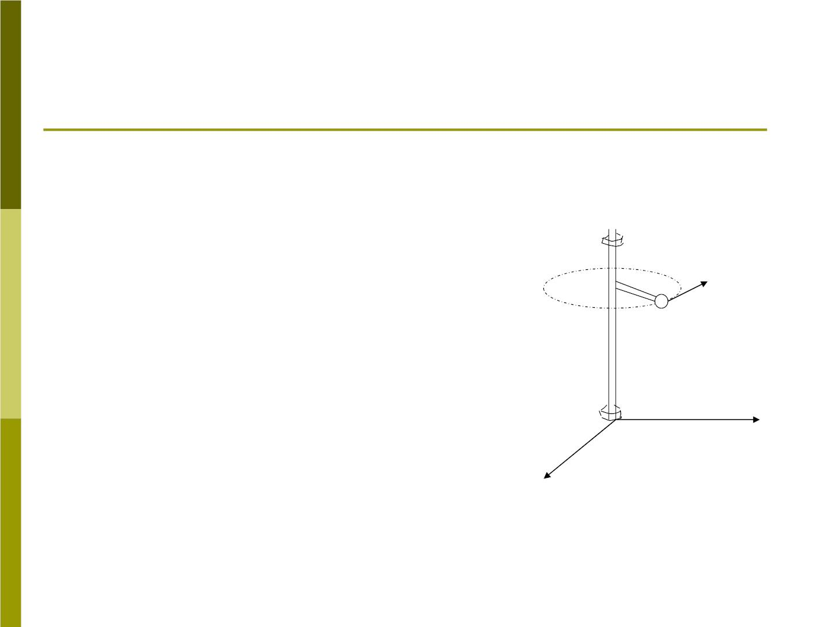
10-3 Angular momentum and angular
velocity
1.Angular momentum and angular
velocity
Fig 10-6a
Fig10-6a shows a single particle
of mass m attached to a rigid
→
r
'
V
massless shaft by a rigid,
m
massless arm of length
r
'
perpendicular to the shaft. The
particle moves at constant speed
v in a circle of radius r' .
x
y

Slide 15
We imagine the experiment to be done in a region
of negligible gravity, so that the only force acting
on the particle is centripetal force exerted by the
arm r' .
The shaft is confined to the z axis by two thin
ideal bearings (frictionless). Let the lower bearing
define the origin o of our coordinate system. The
upper bearing prevent the shaft from wobbling
about the z axis.

Slide 16
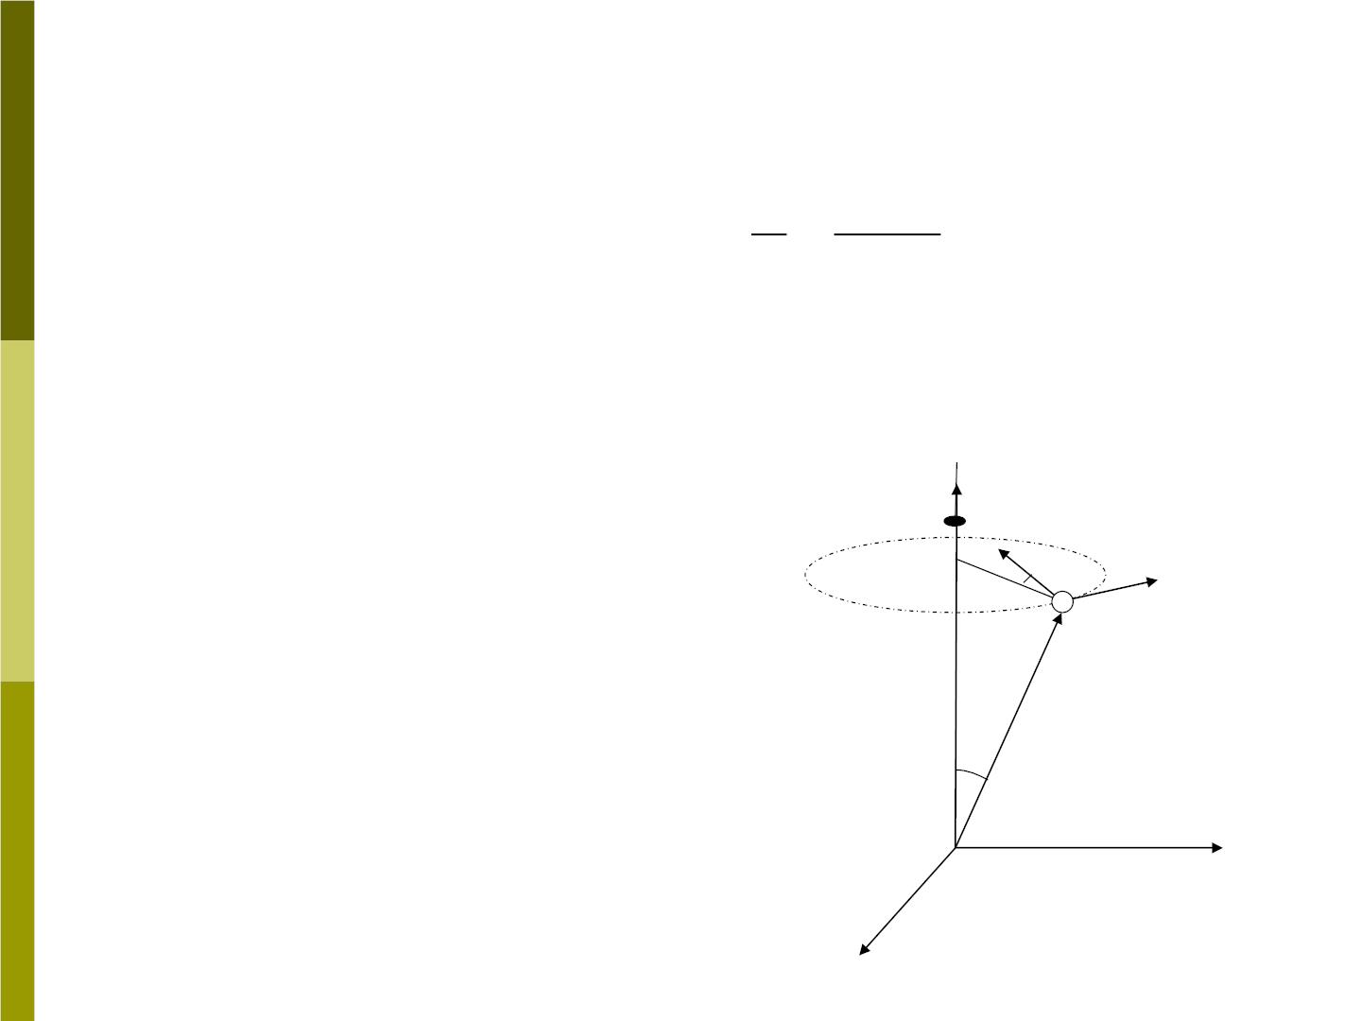
→
The angular velocity of the particle upward
⬥
along the z axis no matter where the origin is
chosen along the z axis.
v
v
⬥ = =
r
' r sin 
→
L
The angular momentum of the particle with
respect to the origin o is (shown in Fig 10-6b)
→
→ →
→
L = rP
⬥
→
, not parallel to .
⬥
→
→
❑
L
If we choose the origin o
to lie in the plane of the
L
→
P
'
r
circulating particle, then
→
→
→
❑
L = L //
→
r
z
otherwise, it is not.
o
y
x
Fig 10-6b

Slide 17
L_{z} = Lsin = rpsin = rmvsin = r'mv = mr^{'2}
(10-10)
2
'
mr
Now is the rotational inertial I of the particle
about z axis. Thus
L = I
Note that the vector relation
(10-11)
is not
z
→
→
L = I 
correct in this case.

Slide 18
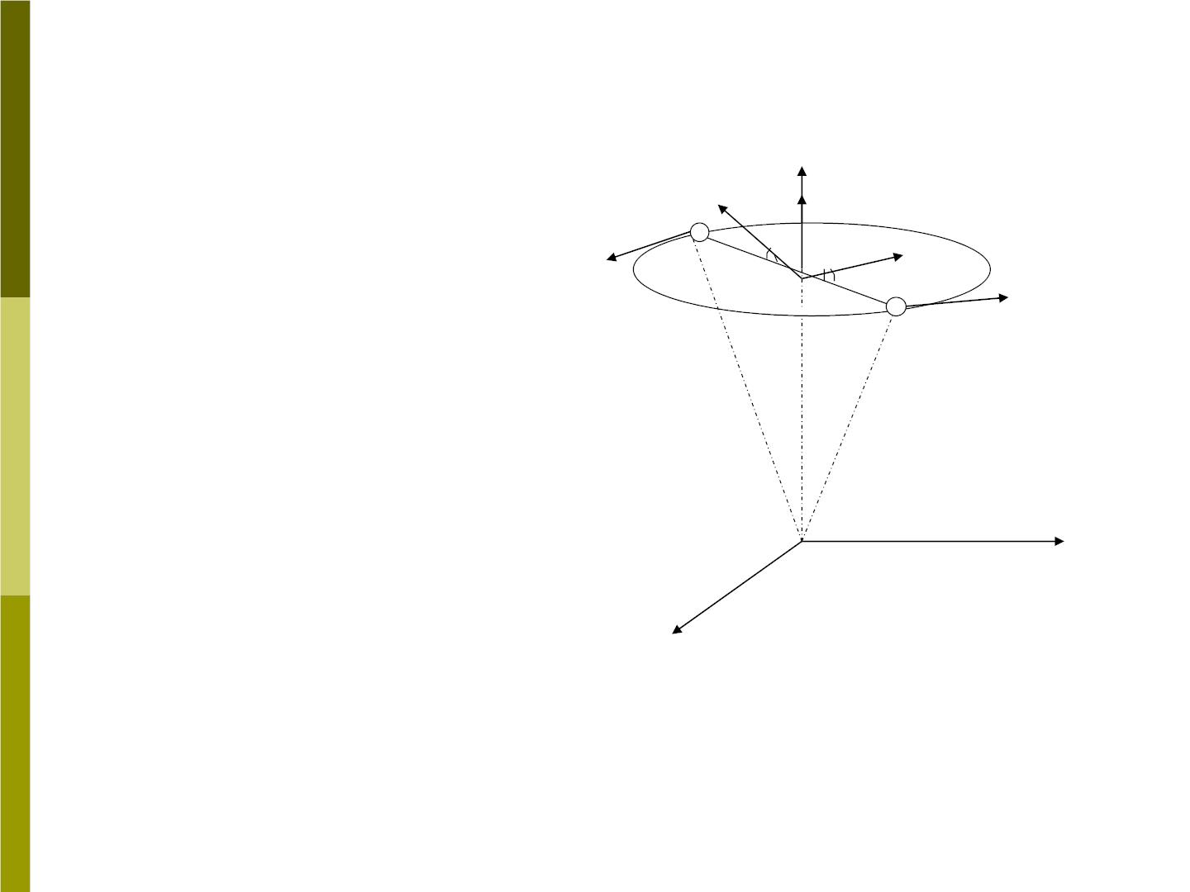
2. Under what
circumstance will and
→
⬥
→
L
→
L₁
❑
m₂
→
L
→
^{L}2
→
point in the same
⬥
direction? Let us add
another particle of the
same mass at same
→
❑
→
P
P
1
2
m₁
m
location as the (first) ,
but in the opposite
direction.
❑
❑
1
o
Fig 10-7

Slide 19

→
The component due to this second particle
L
⊥
will be equal and opposite to that of the first one,
→
and the two vectors sum to zero. The
→
L
⊥
two I vectors in the same direction. Thus for
z
→
→
this two-particles system, L//
We can extend our system to a rigid body,
made up of many particles. If the body is
symmetric about the axis of rotation, which is
→
→
⬥
called “axial symmetry”, and are parallel then
L
→
→
L = I 
(10-12)

Slide 20
→
L
→
(1). If stands for the vector component , then
L
z
Eq(10-12) holds for any rigid body, symmetrical or
not.
(2). For symmetrical bodies, the upper bearing
(Fig(10-6)) may be removed, and the shaft will
remain parallel to the z axis. Any small asymmetry
in the subject requires the second bearing to keep
the shaft in a fixed direction, the bearing must
exert a torque on the shaft, otherwise the shaft
would wobble as the object rotates.

Slide 21
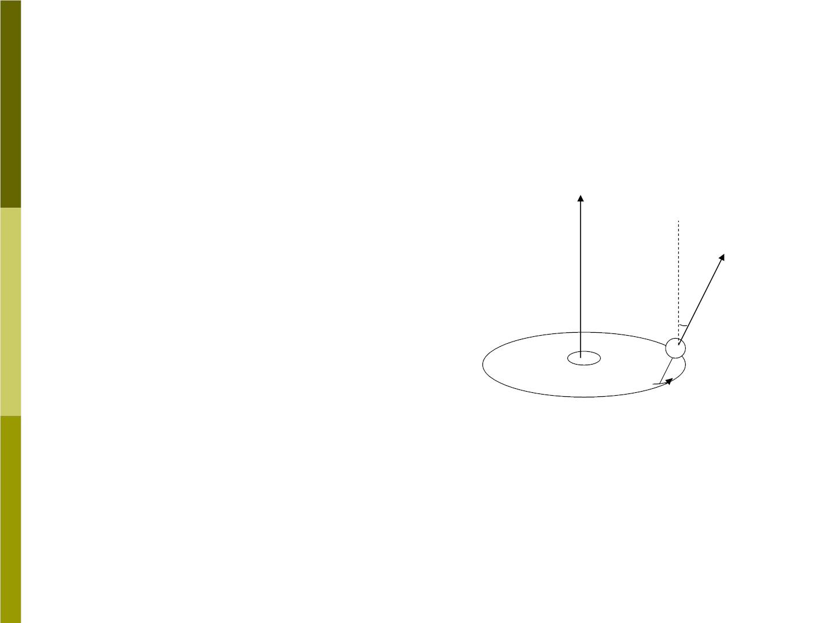
Sample problem 10-2
Which has greater
magnitude, the angular
momentum of the Earth
about its center or
angular momentum
about the center of its
orbit.
→
L
orb
23.5□
→
L
rot
Earth
Sun
Fig 10-8

Slide 22
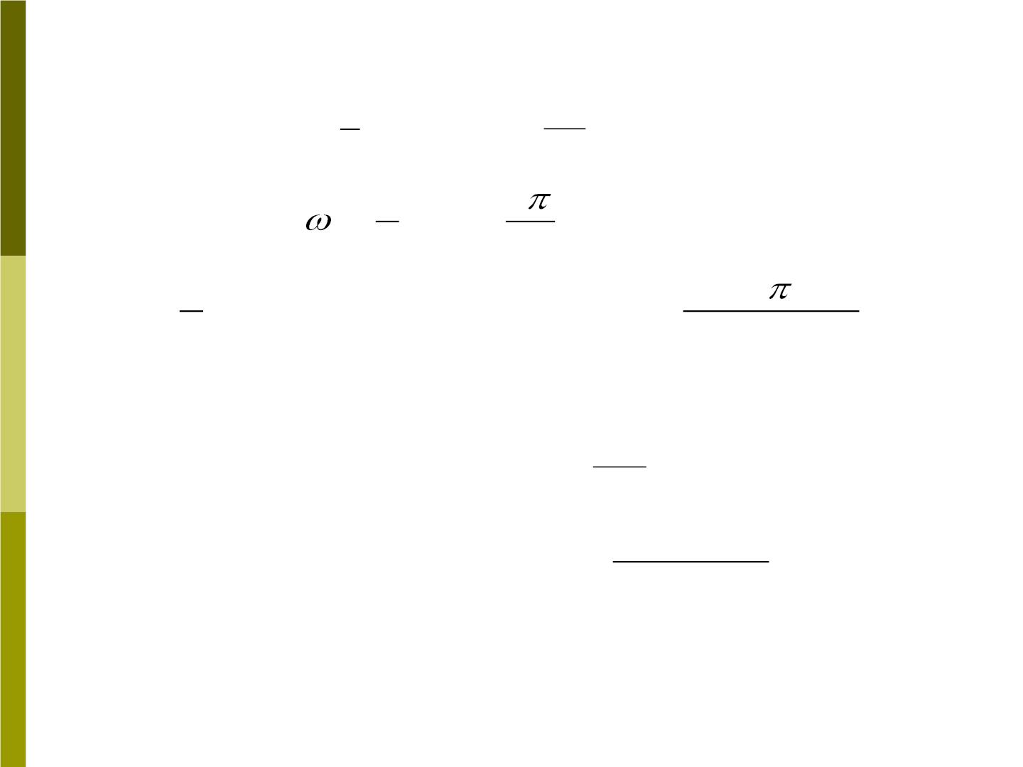
Solution:
2
5
2
=
2
⬥ =
= = 
T 24h 8.64 10 s
I
MR_{E}
4
spin
T
2
5
2
T
=
=
2
L I
MR_{E}
rot
spin
2
5
2
= (5.98 10²⁴ kg)  (6.37 10⁶ m)

8.64 10⁴
s
= 7.06 10³³ kg  m² / s
2
^{L}orb
=
=  =
R P I
MR_{orb}²
orb
orb orb
^{T}orb
2
3.16 10⁷ s
= (5.9810²⁴ kg)  (1.5010¹¹ m)²
= 2.67 10⁴⁰ kg  m² / s

Slide 23
The orbital angular momentum is far greater
L
orb
then the rotational angular momentum L .
→
rot
The points at right angles to the plane of the
Earth ‘s orbit, while is inclined at an angle of
L
orb
→
L
rot
23.5
□ to the normal to the plane. ( neglecting the
very slow precession ).

Slide 24
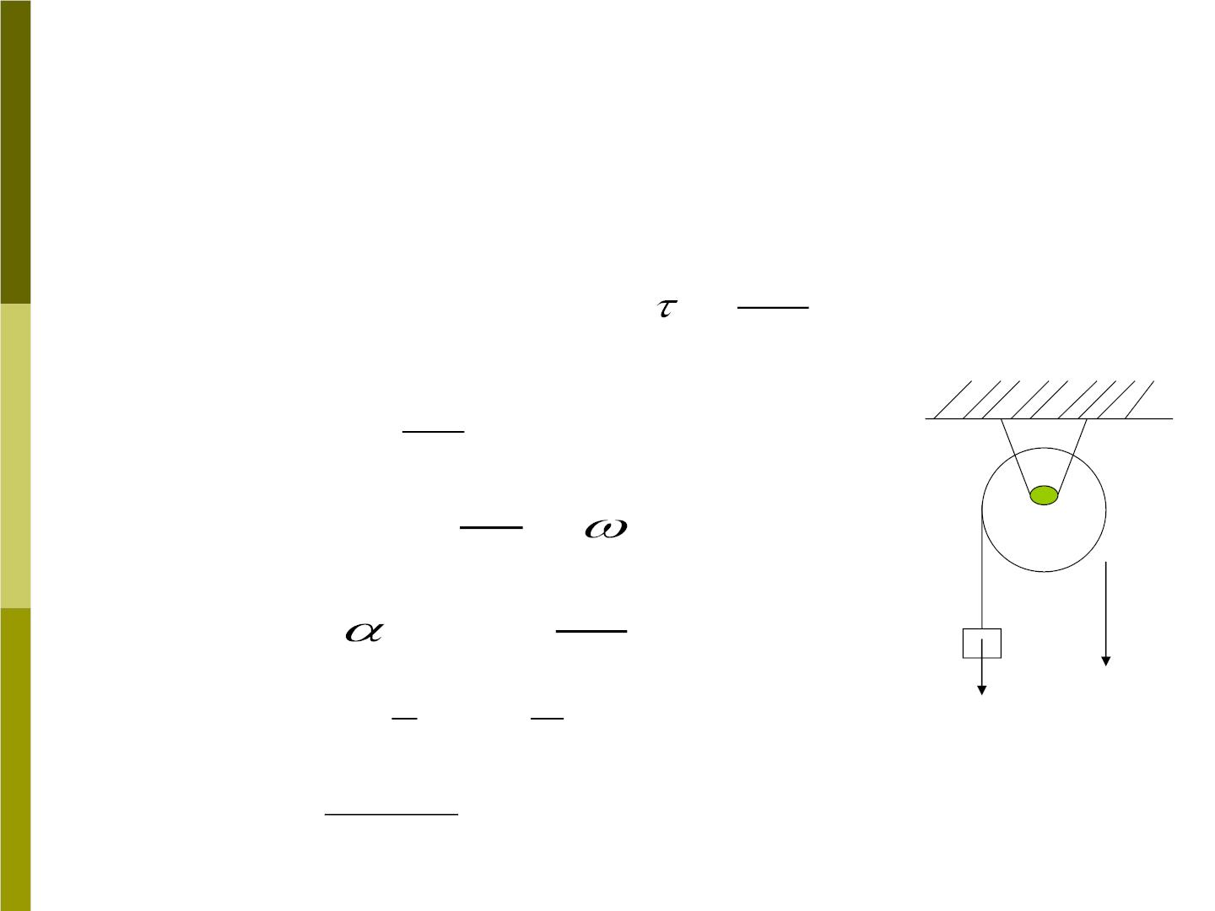
Sample problem 10-3
Solve the sample problem 9-10 by direct
→

→
d L
dt
application of Eq(10-9). (
=
)
=  +
Solution: L I mvR
z
dL
Applying

→
yields
⧫ =
z
dt
z
M
y
d
o
m gR = ( I + m v R)
dt
dv
dt
= I + m R
m
1
a
mg
mgR = ( MR ) + mRa
2
2
2mg
M + 2m
R
a =

Slide 25

10-4 Conser vation of angular
momentum
→

→ d L
1. From  = (Eq (10-9)) , if
ext
dt

→
→
⧫ = 0
=
then
L cons tan t
ext
→
→
(10-5)
L = L
i
f
Eq(10-15) is the mathematical statement of the
principle of conservation of angular momentum:
“if the net external torque acting on a system is
zero, the total vector angular momentum of the
system remains constant”

Slide 26
❐ This is a general result that is valid for a wide
range of system. It holds true in both the
relativistic limit and in the quantum limit.
❐ Eq(10-9) is a vector equation and is equivalent
to three one-dimensional equations. Any
component of the angular momentum will be
constant if the corresponding component of the
torque is zero.

Slide 27
Examples
(1).The spinning skater
A spinning ice skater pulls her arms close to her
body to spin faster and extends them to spin
slower.
(2).The springboard diver
(3). The rotating bicycle wheel and the spinning top
(Section 10-5)

Slide 28
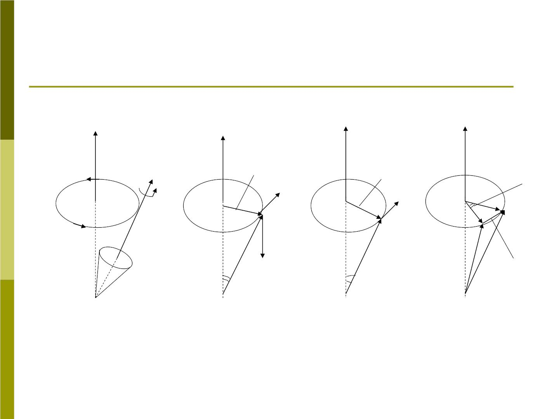
10-5 Spinning top
z
z
z
z
→
L
rs in
❑
Ls in 
→
d

⧫
→
⧫
M
precession
circle
→
→
mg
→
L
L
→
d L
❑
r
❑
the
top
o
o
o
o
a
b
c
d
Fig 10-18

Slide 29
Fig 10-18a shows a top spinning about its axis.
The bottom point of the top is fixed at origin o. The
axis of this spinning top will moves slowly about
the vertical axis oz. This motion is called
precession, and it arises from the configuration
illustrated in Fig 10-4b, with gravity supplying the
external torque.
In fig 10-18b, the gravitational force Mg acting at
the top’s Cm gives a torque about O of magnitude

Slide 30
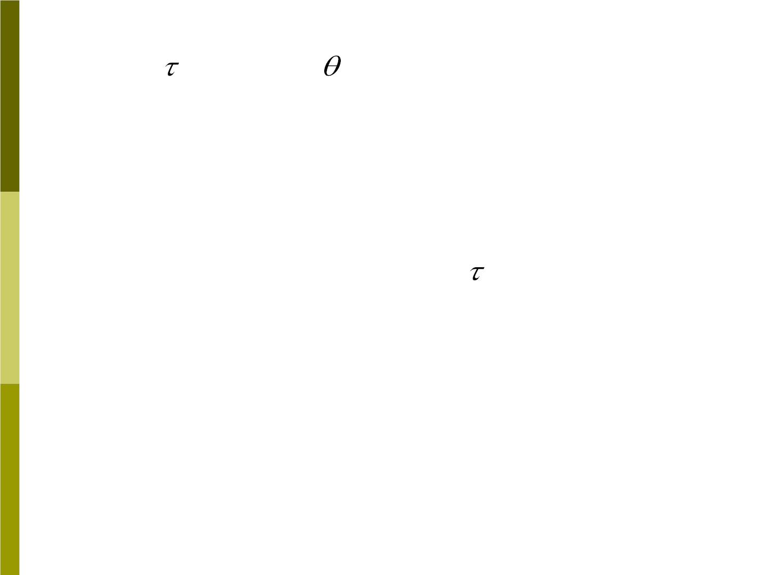
= Mgr sin
(10-18)
which is perpendicular to the axis of the top and
→
therefore perpendicular to (Fig(10-18c). The
L
→
torque can change the direction of but not its
L
magnitude.
→
→
d L =  dt
(10-19)
→
d L
→
The direction of is parallel to . If the top has
axial symmetry, and if it rotates about its axis at
high speed, then the angular momentum will be

Slide 31
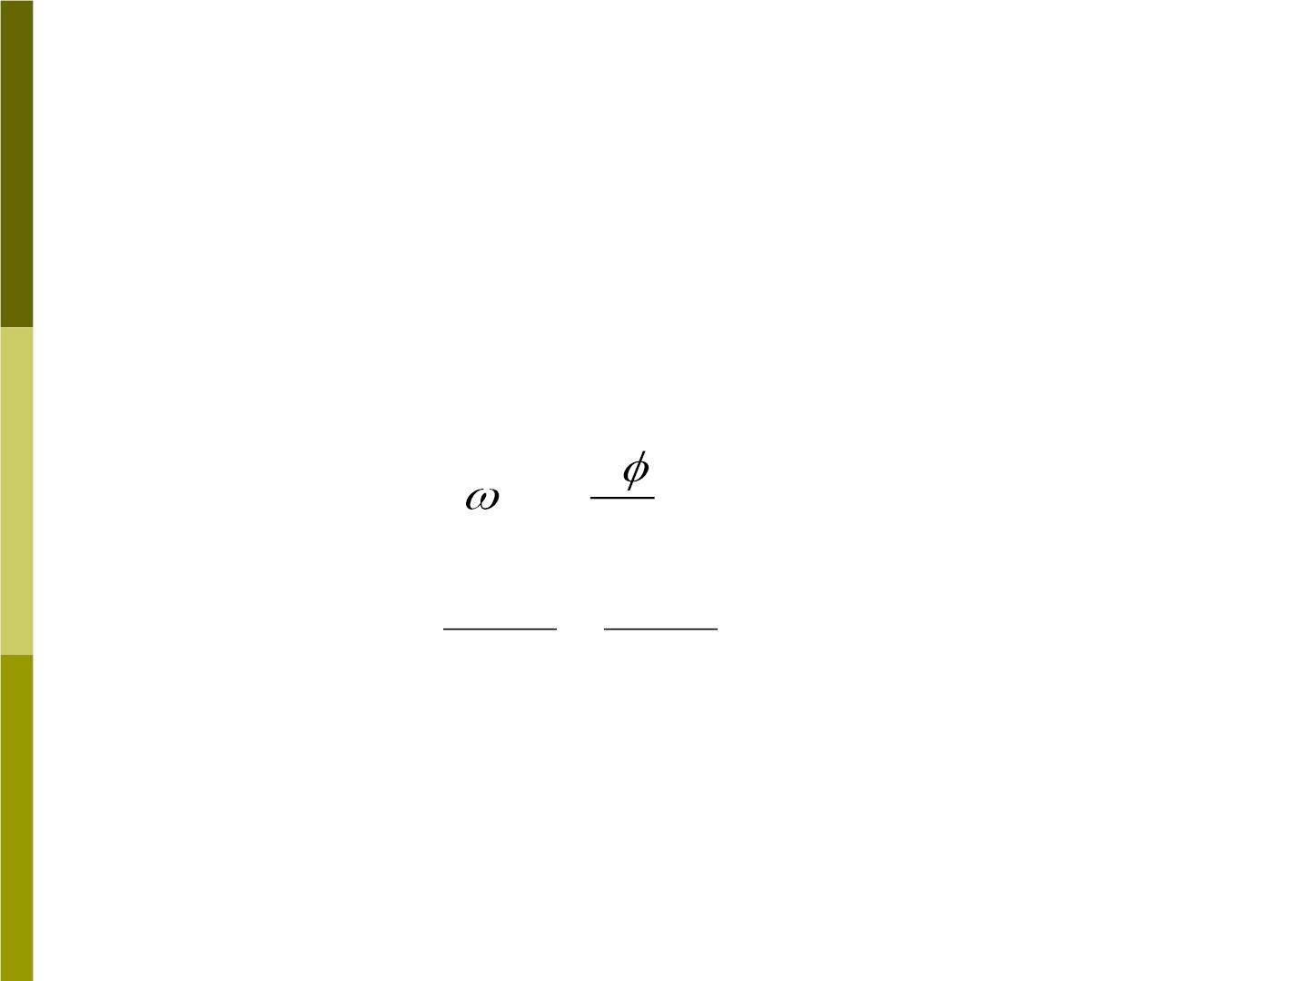
along the axis of rotation of the top.
→
→
L
When changes direction, the tip of the vector
L
and the axis of the top trace out a circle about the
z axis. This motion is the precession of the top.
In a time dt, the axis rotates through an angle
(Fig10-18d), and thus the angular speed of
d
precession_{P} is
d
=
P
dt
(10-20)
(10-21)
From Fig10-18d, we see that
dt
dL
Lsin  Lsin 
d =
=

Slide 32

d
⧫
Mgr s in  Mgr
Thus
⬥ = =
=
=
P
dt Lsin
❑
Lsin
❑
L
(10-22)
(1) The processional speed is inversely
proportional to the angular momentum; the faster
the top is spinning, the slower it will process.
Conversely, as friction slows down the rotational
angular speed, the processional angular speed
increase.
(2) The vector relationship of Eq(10-22) is
→
→
→
(10-23)
⧫ =   L
P

