Slide 1

Ch. 11 Energy I:
Work and kinetic energy
Ch.11 Energy I:
Work and kinetic energy

Slide 2
11-1 Work and energy
Example: If a person pulls an object up hill. After
some time, he becomes tired and stops.
We can analyze the forces exerted in this
problem based on Newton’s Laws, but those laws
can not explain: why the man’s ab ilit y to exert a
force to move forward becomes used up.
For this analys is , we must introduce the new
concepts of “W ork and Energy”.
Ch.11 Energy I:
Work and kinetic energy

Slide 3

Notes: 1) The “physics concept of work” is
different from the “work in daily life”;
2) The “energy” of a system is a measure
of its capacity to do work.
Ch.11 Energy I:
Work and kinetic energy

Slide 4
11-2 W ork done by a constant force
11-3 Power
1.Definition of ‘W ork’
❖
F
The work W done by a constant force that
s
mo ves a body through a displacement in the
directions of the force as the product of the
magnitudes of the force and the displacement:
❖
❖
W = Fs
(Here
s //F
) (11-1)
Ch.11 Energy I:
Work and kinetic energy

Slide 5
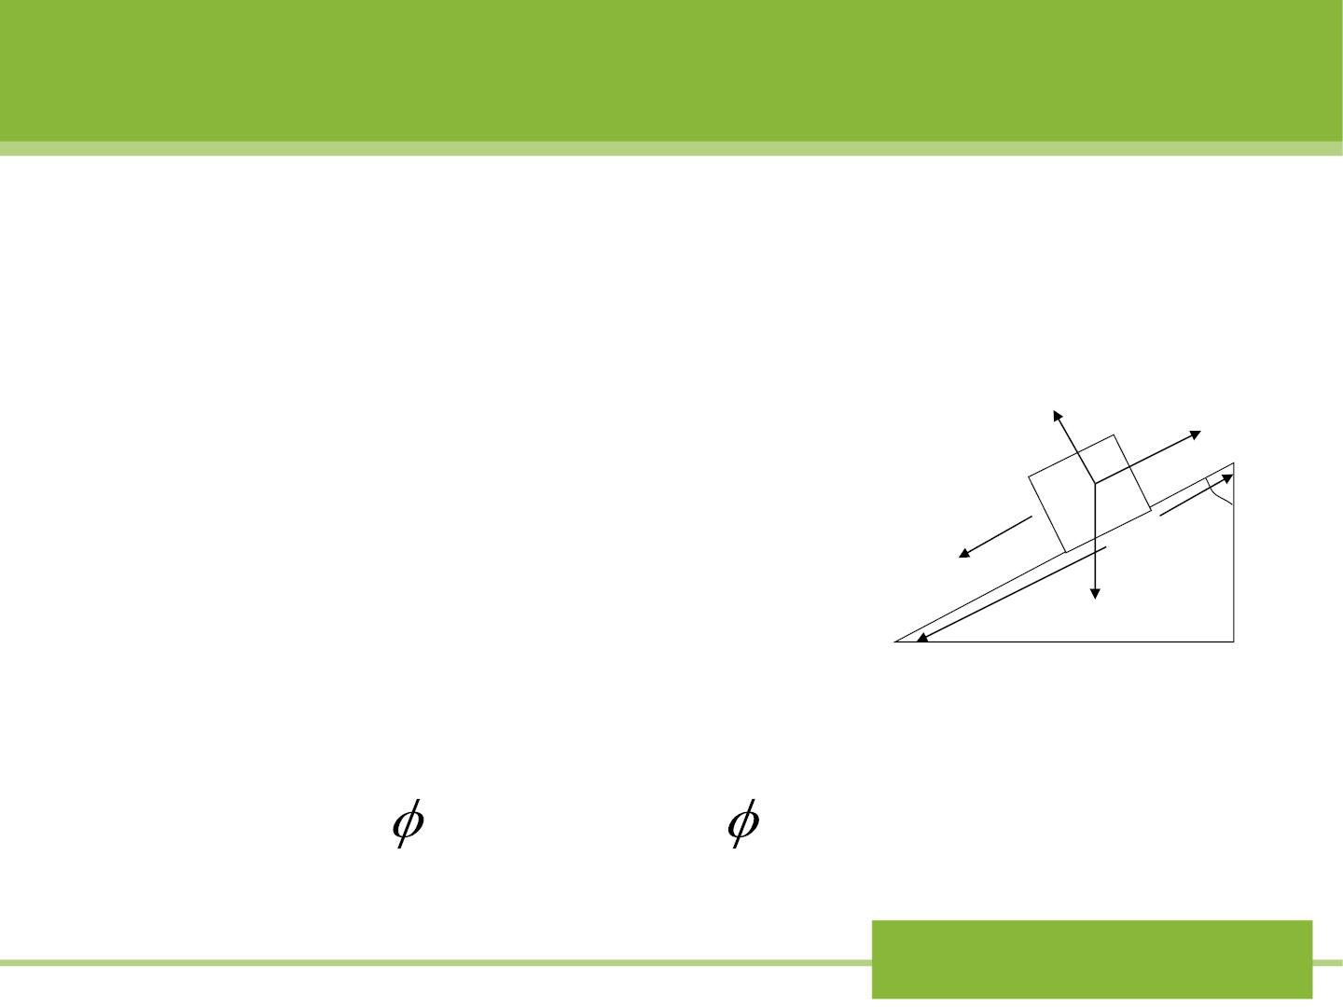
Example: In Fig11-5, a block is
slid in g down a plane.
→
N
→
N
→
f
The normal force does zero
→
work; the friction force does
f
negative work, the gravitational

v
s
→
m g
→
h
force does positive work which
m g
is
mgscos = mgh
Fig 11-5
mgscos = s(mg cos )
or
Ch.11 Energy I:
Work and kinetic energy

Slide 6


v
s
→
h
2. W ork as a dot product
m g
→
F
The work done by a force can be written as
→ →
W = F s
(11-2)
→
→
→
F
(1) If
F ⊥ s
, the work done by the is zero.
(2) Unlike mass and vo lu me, work is not an intrinsic
property of a body. It is related to the external force.
(3) Unit of work: Newton-meter (Joule)
(4) The valu e of the work depends on the
inertial reference frame of the o b server.
Ch.11 Energy I:
Work and kinetic energy

Slide 7

3. Definit ion of power:
The rate at which work is done.
If a certain force performs work Won a body in a

time t , the average power due to the force is
W

t
P =
(11-7)
av
The instantaneous power P is
dW
(11-8)
P =
dt
If the power is constant in time, then
P = P
.
av
Ch.11 Energy I:
Work and kinetic energy

Slide 8

→
If the body mo ves a displacem ent in a time dt,
d s
→
→
→
dW Fd s
P = =
dt
→
d s
→ →
= F = F v
(11-10)
dt
dt
Unit of power: joule/second (W att)
See 动画库 力学夹/ 0 变力的
功A.exe 1
Ch.11 Energy I:
Work and kinetic energy

Slide 9
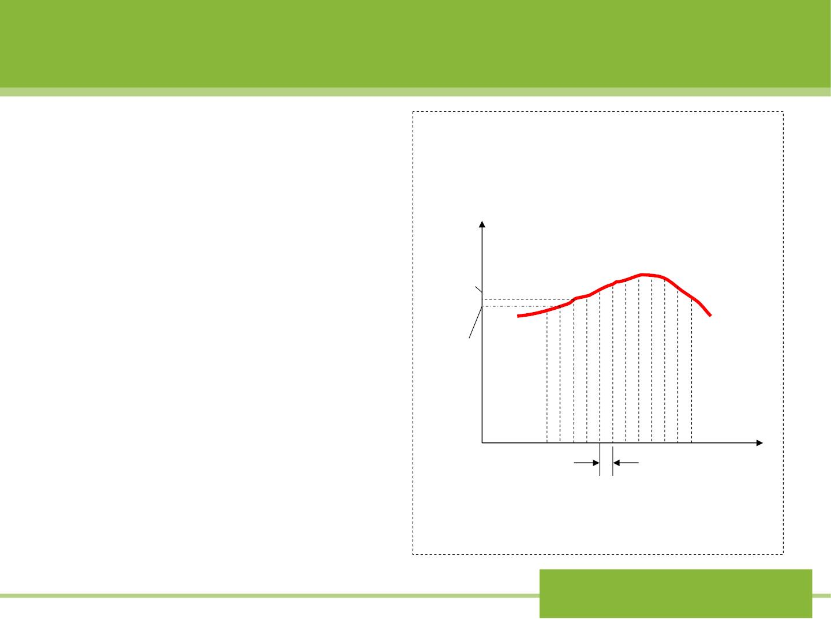
11-4
11-5
Work done by a variable force
1.One-dimensional
situation
Fig 11-12
The smooth curve in
Fig 11-12 shows an
arbitrary force F(x) that
acts on a body that
F
F₂
F_{x} (x)
F
1
x x
mo ves from to .
i
f
x_{i}
^{x} f ^{x}
x
Ch.11 Energy I:
Work and kinetic energy

Slide 10
We d ivid e the total displacemen t into a number N
of small intervals of equal width  . This interval so
x
small that the F(x) is approximately constant. Then
x
in the interval to x +dx , the work  = 
W F x
1
1
1
1
and similar  =  ……The total work is
W F x
2
2
W  W + W +... = Fx + F x +...
1
2
1
2
or
N

W  F x
(11-12)
n
n=1
Ch.11 Energy I:
Work and kinetic energy

Slide 11

To make a better approximation, we let x go to
zero and the number of intervals N go to infinit y.
Hence the exact result is
N

W = lim F x
(11-13)
(11-14)
or
x 0
 →
n
n=1
N

⇩
x
W = lim F x =
f
F (x)dx
x→0
n
x_{i}
=
n 1
Numerically, this quantity is exactly equal to the
area between the force curve and the x axis
x x
between limits and .
i
f
Ch.11 Energy I:
Work and kinetic energy

Slide 12
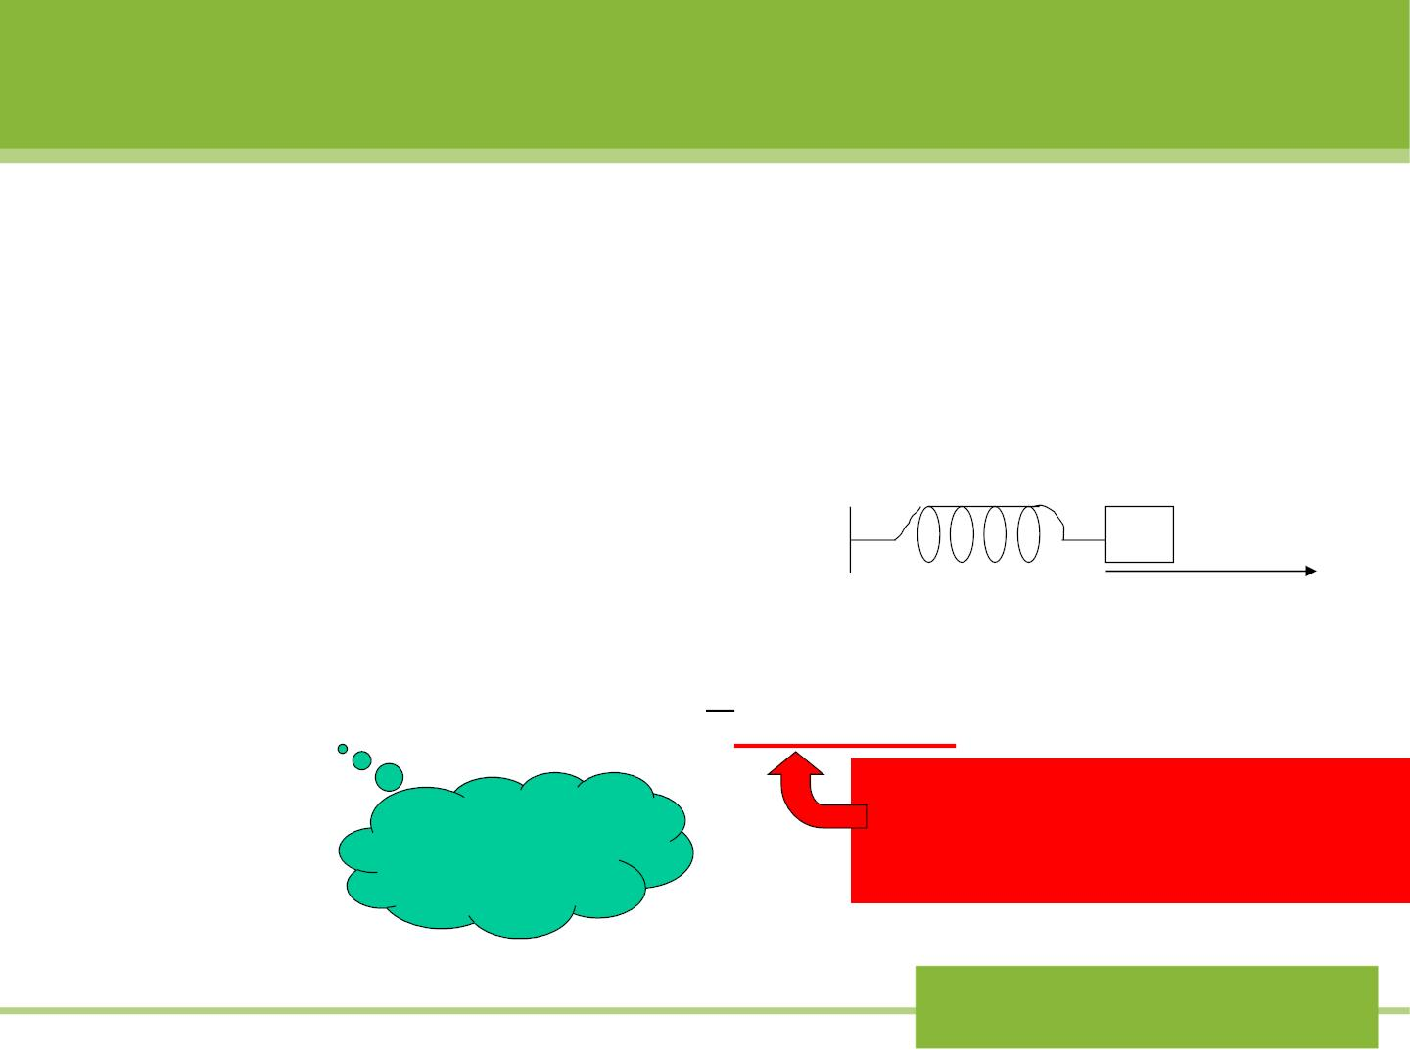
Example: W ork done by the
spring force
Fig 11-13
In Fig 11-13, the spring is in the
relaxed state, that is no force
applied, and the body is
Relaxe d length
located at x =0.
o
x
⇩ 
x
1
W_{s}
=
F dx
=
f
kxdx
− = −
² − 2
k(x x )
s
x_{i}
2
f
i
Only depend on in itia l
and final positions
F_{s} = −kx
Ch.11 Energy I:
Work and kinetic energy

Slide 13
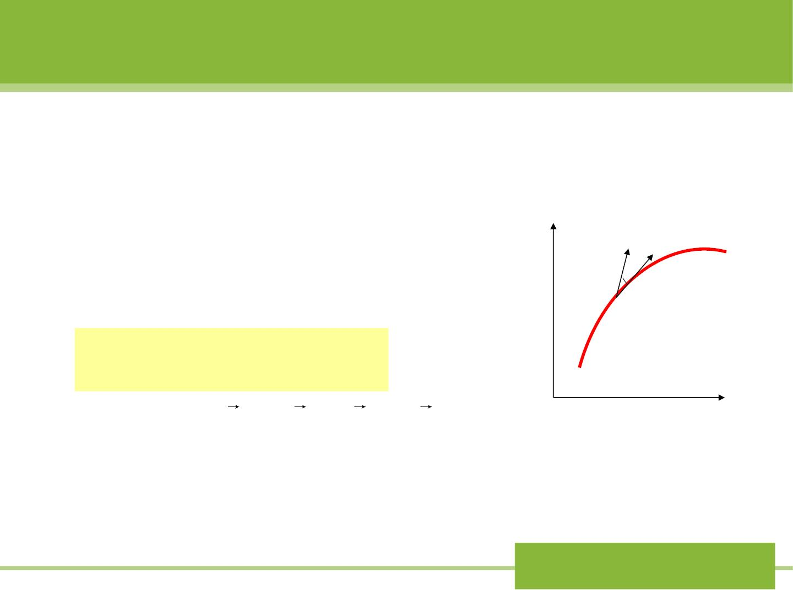
2.Two-dimensional situation
Fig 11-16 shows a particle mo ves
i
along a curve from to f . The
y
→
F
element of work
→
→

•
dW = Fd s
f
→
The total work done is
d s
f
→
→
f
(11-19)
i
⇩ 
W = F d s = F cosds
•
i
i
f
o
⇩
x
or W = (F i + F j)(dxi + dy j)
i
x
y
⇩
f
= (F dx + F dy)
(11-20)
Fig 11-16
i
x
y
Ch.11 Energy I:
Work and kinetic energy

Slide 14
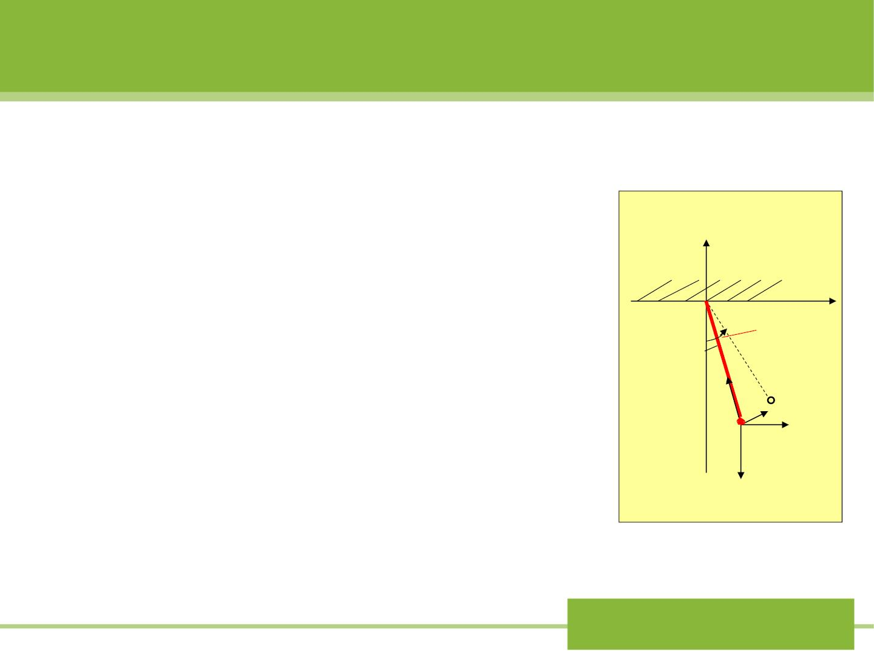
Sample problem 11 -5
A small object of mass m is
Fig 11-17
y
suspended from a string of length L.
The object is p u lled sideways by a
→
F
x
force that is always horizontal, until
the string finally makes an angle

_{m}
m

with the vertical. The displacem ent is
accomplished at a small constant
speed. Find the work done by all the
forces that act on the object.
T ds
→
F
m
mg
Ch.11 Energy I:
Work and kinetic energy

Slide 15

11-6 Kinetic energy and work -energy theorem
→ →
→
Relationsh ip between
W ork and Energy
F, a, v
1. Definit ion of kinetic energy K:
1
=
2
K mv
2
for a body of mass m moving with speed v.
2. The work-energy theorem:
1
2
1
W_{netF}
=
2
−
2
mv mv
(11-24)
f
2
i
“The net work done by the f orces acting on a body is equal
to the change in the kinetic energy of the body. ”
Ch.11 Energy I:
Work and kinetic energy

Slide 16

3. General proof of the work-energy theorem
→
For 1 D case: represents the net force acting on
F
net
the body.
dv
dv dx
^{dv}x
dx
F = ma = m ^{x} = m x = mv
net
x
dt
dx dt
x
→
The work done by is
F
net
⇩ 
^{dv}x
dx
W = F dx = mv
dx
net
net
x
v
xf
1
1
=
⇩
=
2
−
mv_{xi}²
mv dv mv
x
x
2
xf
2
v
xi
It is also true for the case in two or three
dimensional cases
Ch.11 Energy I:
Work and kinetic energy

Slide 17

Please relate a) point to
conservation of momentum
4.Notes of work-energy theorem:
1
1
W_{netF}
=
2
−
2
mv mv
2
f
2
i
a). In different inertial reference frames?
The work-energy theorem survives in different inertial
reference f rames.
But the values of the work and kinetic energy in their
respective reference f rames may be different.
b). Limitation of the theorem
It applies only to single mass points.
Ch.11 Energy I:
Work and kinetic energy

Slide 18
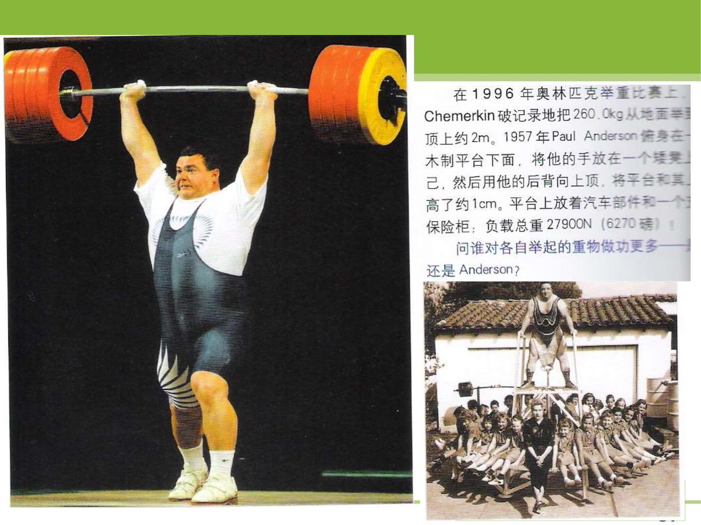

Slide 19
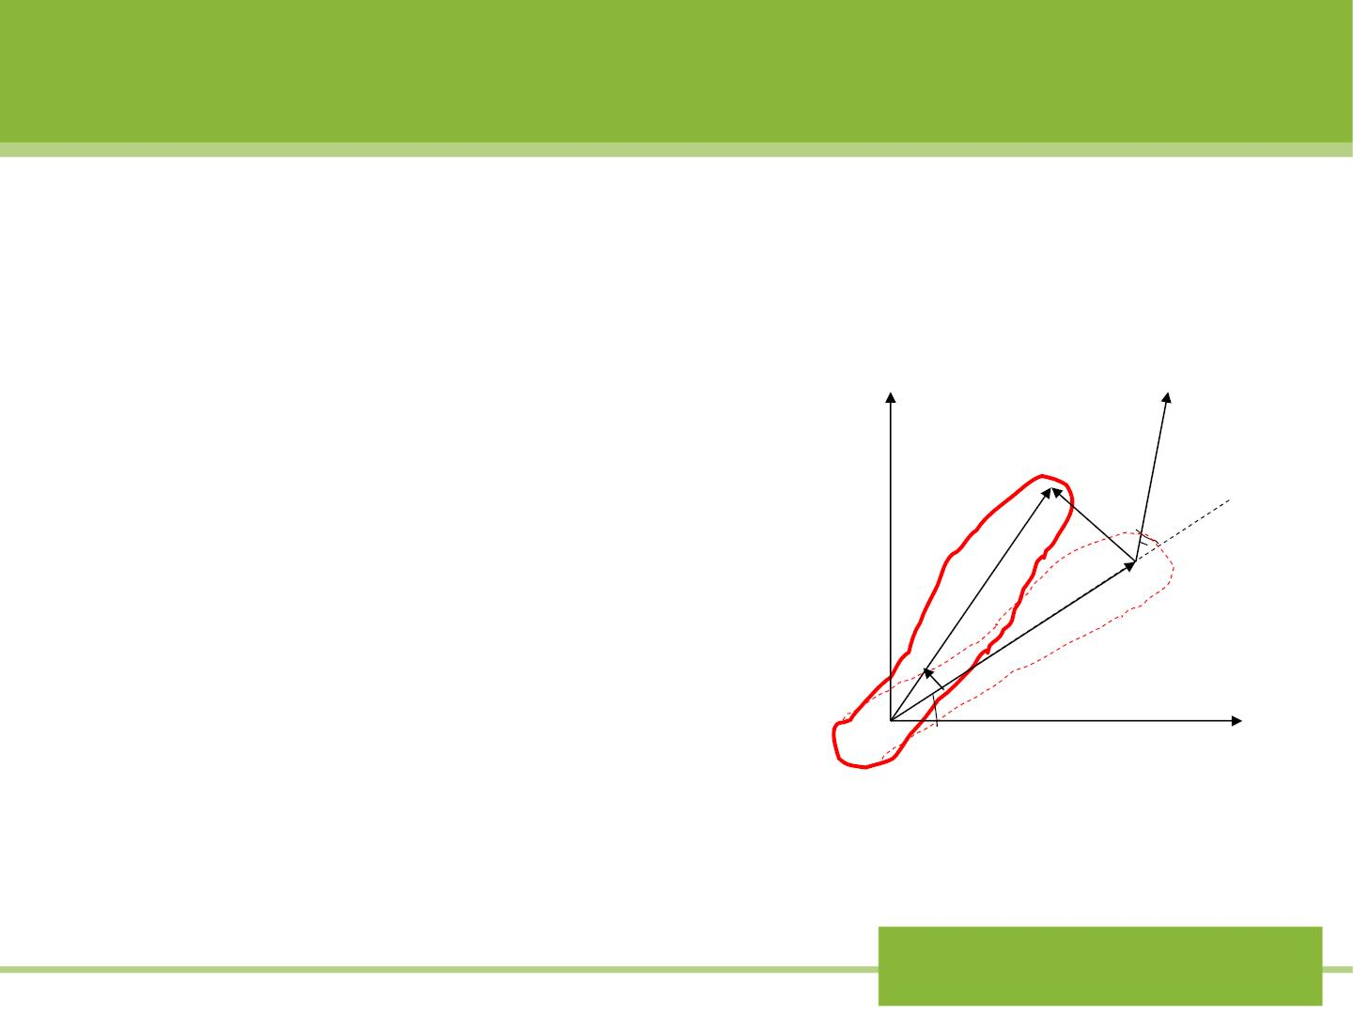
11-7 W ork and kinetic energy in
rotational motion
1.W ork in rotation
Fig 11-19
Fig11-19 shows an
→
F
y
arbitrary rigid body to
which an external agent
ds

→
applies a force F at
P
point p, a distance r
d
❑
r
from the rotational axis.
O
x
Ch.11 Energy I:
Work and kinetic energy

Slide 20

As the body rotates through a small angle d
about the axis, point p mo ves through a
distance =  . The component of the force in
ds rd
the direction of motion of p is
work dw done by the force is
F sin 
,and so the
dW = F sin ds
= (F sin )(rd )
= (rF sin )d
→
→ →
⧫ = r F
=_{z}d
Ch.11 Energy I:
Work and kinetic energy

Slide 21

❑ 
So for a rotation from angle to angle, the
i
f
work in the rotation is
=
⇩
❑
⧫ 
(11-25)
W
f
d
❑
z
i
The instantaneous power expended in rotation
motion is
dW
d
P = = = w
(11-27)
dt
z
dt
z z
Ch.11 Energy I:
Work and kinetic energy

Slide 22
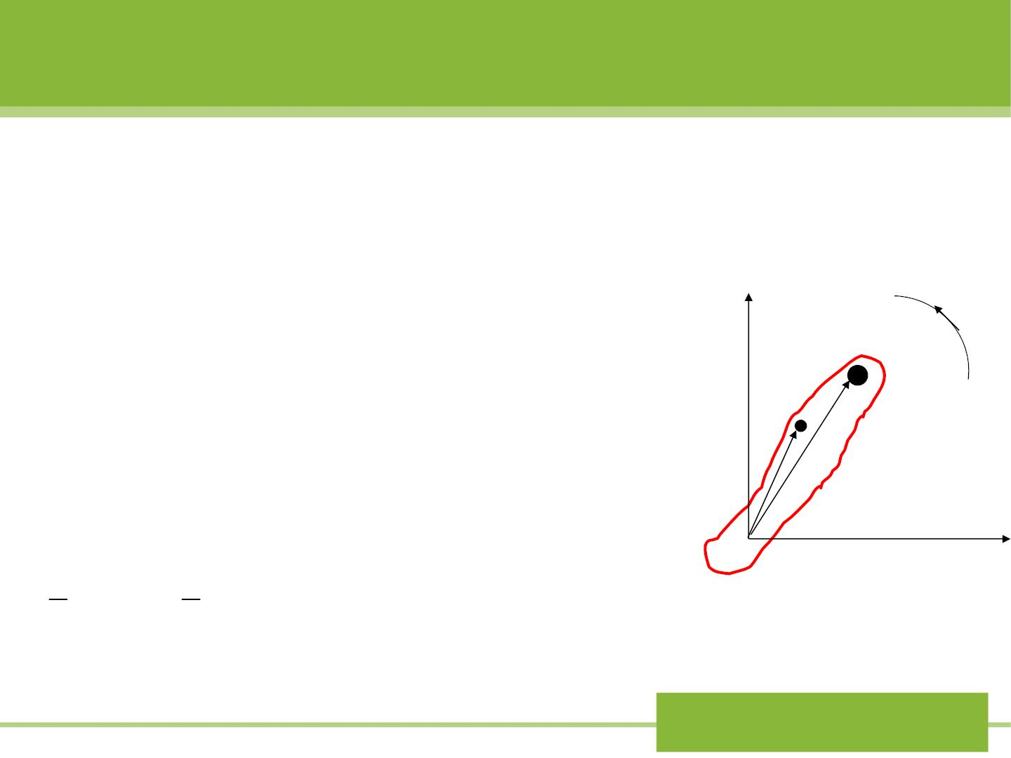
2. Rotational kinetic energy
Fig 11-20
Fig 11-20 shows a rigid body rotating
about a f ixed axi s with angular speed
⬥
y
. We can consider the body as a
m
ω
collection of N particles m₁,m₂ ……
1
v
^{m}2
moving with tangential speed ,v
1
2
r
r₂
…… If indicates the distance of
r
1
n
m
v = r 
particle f rom the axis, then
n
n
n
and its kinetic energy is
O
1
1
x
m v
² =
²
2
m r . The total kinetic
n n
2
n n
2
energy of the entire rotating body is
Ch.11 Energy I:
Work and kinetic energy

Slide 23

1
1
2
=
²² +
m r
²² + 
K m r
2
1 1
2 2
1

=
2
⬥
2
( m r )
(11-28)
2
n n

2
= is the rotational inertia of the body,
m r I
n n
then
1
K = I
2
2
(11-29)
3. The rotational f orm of the work-energy theorem
W = K
which can be obtained similarly as for single particles.
Ch.11 Energy I:
Work and kinetic energy

Slide 24

Table 11-1
Translational quantity Rotational quantity
Work
⇩
⇩
W = F dx
W
=  
d
x
z
=
Power
P F v
P
= 
x x
z z
Kinetic energy
1
1
=
2
K = I ²
K mv
2
2
Work-energy theorem
W = K
W = K
Ch.11 Energy I:
Work and kinetic energy

Slide 25
Sample problem 11-10
A space probe coasting (航线) in a region of
negligible gravit y is rotating with an angular speed
of 2.4rev/s about an axis that points in its direction
of motion.
The spacecraft is in the form of a thin spherical
shell of radius 1.7m and mass 245kg.
It is necessary to reduce the rotational speed to
1.8rev/s by firing tangential thrusters (推进器) along
the equator of the probe.
W hat constant force must the thruster exert if the
change of angular speed is to be accomplished as
the probe rotates through 3.0 revo lu tio n ?
Ch.11 Energy I:
Work and kinetic energy

Slide 26
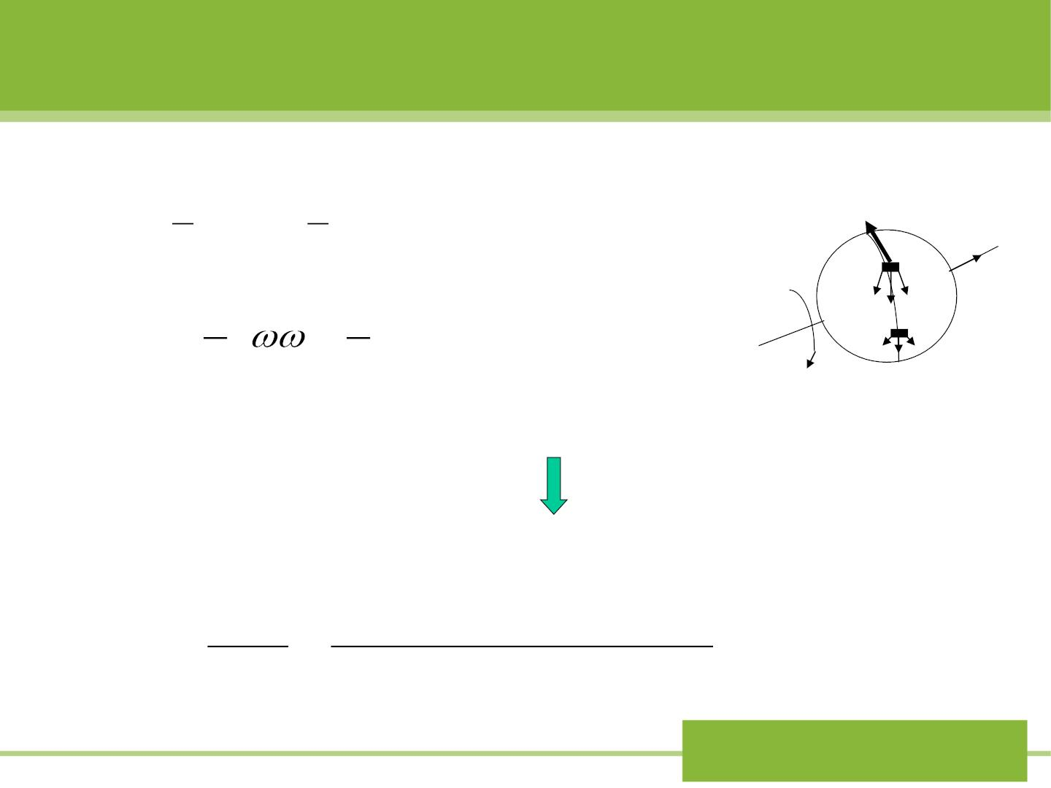
Solution: For a thin spherical shell
2
2
→
F
=
2
=
⋅
2
=
⋅
2
Z
I MR
(245kg) (1.7m) 472kg m
3
3
The change in rotational kinetic energy is
→
v
1
2
1
2
K I
 =
2
−
I
2
f
i
⬥
= −2.6710⁴
J
⧫
_{z}in –z direction
The rotational work is
W =_{z} = −RF = K

2.67 10 J
− 
K
7
then
F =
=
= 833N
− R − (1.7m)[( 2)(3.0rev)]
Ch.11 Energy I:
Work and kinetic energy

Slide 27
11-8 Kinetic energ y in collision
We reconsider a collision between two bodies that
move
along the x axis with the analysis of kinetic energy.
1. Elastic collision: the total kinetic energy before
collision equals the total kinetic energy after the
k = k
i
f
(11-30)
collision.
Ch.11 Energy I:
Work and kinetic energy

Slide 28

Fig (6-17) Two-body collisions in cm frame
→
→
^{m}1
P
' P
'
m₂
1i
2i
1.
2.
3.
initial
→
→
P
'
P
'
1f
2f
elastic
inelastic
Final
Completely
inelastic
4.
5.
explosive
Ch.11 Energy I:
Work and kinetic energy

Slide 29
2. Inelastic collision: the total final kinetic energy is less
than the total initial kinetic energy.
(If you drop a tennis ball on a hard surface, it
does not quite bounce to its original height.)
3. Completely inelastic collision: two bodies stick
together. This type of collision loses the maximum
amount of kinetic energy, consistent with the
conservation of momentum.
4. Explosive or energy releasing collision:
“ The total final kinetic energy is greater than the total
initial kinetic energy.” Often occur in nuclear reactions.
Ch.11 Energy I:
Work and kinetic energy

