Slide 1

Ch. 12 Energy II:
Potential energy
Ch.12 Energy II:
Potential energy

Slide 2

12-1 Conservative forces(保守力)
Kinetic energy Velocity
Potential energy?
It is defined only for a certain class of forces called
conservative forces.
W hat are conservative forces?
Do spring force, gravitational force, and
frictional force et al. belong to conservative
forces?
Ch.12 Energy II:
Potential energy

Slide 3
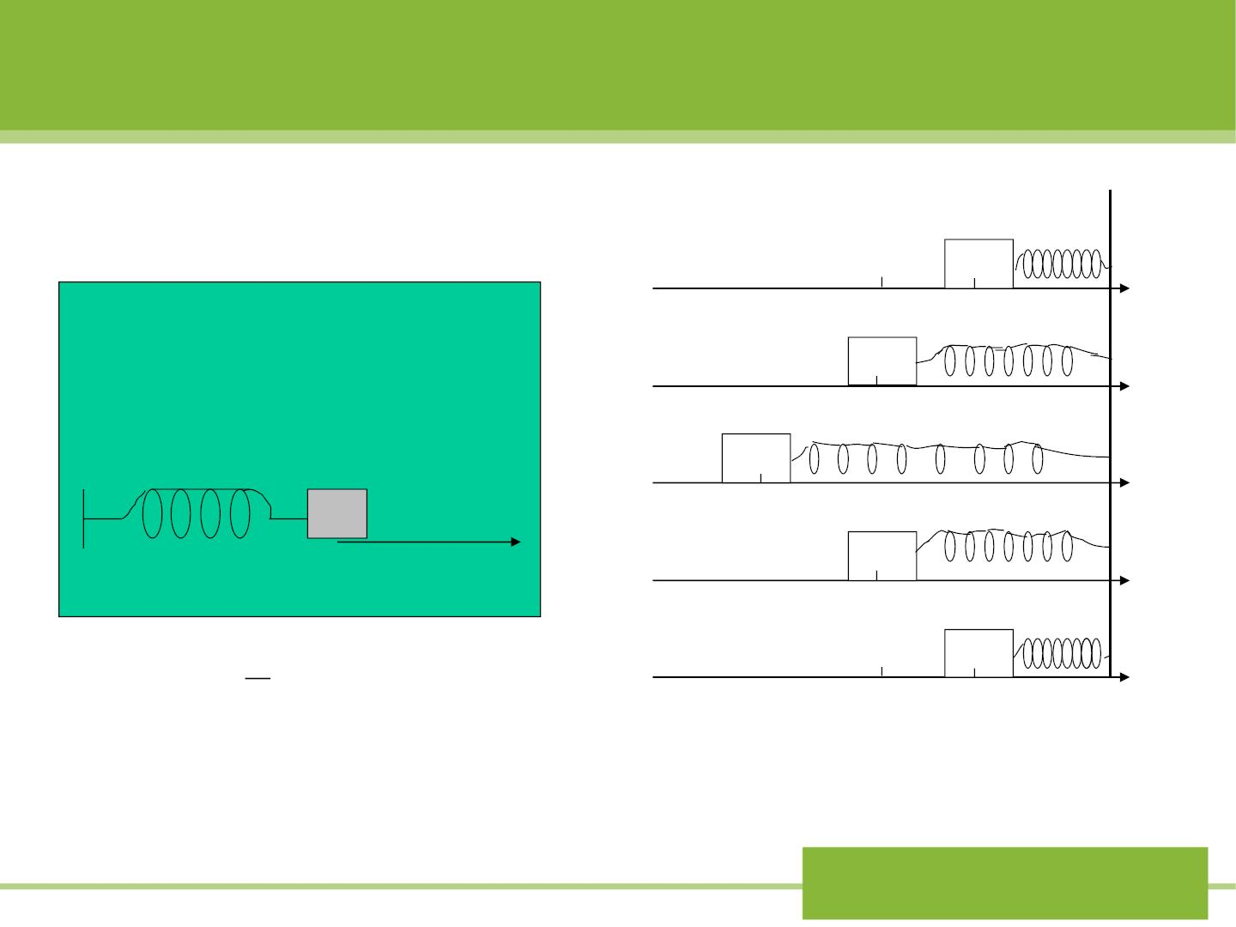
1. The spring force
Fig 12-1
(a)
(b)
x
0
0
d
Fig 11-13
Relaxe d length
(c)
(d)
-d
o
x
0
1
2
(e)
^{W}s
= −
² − 2
k(x x )
f
i
0
d
The total work done by the spin f orce
is zero in the process f rom (a) to (e)
(round trip).
Ch.12 Energy II:
Potential energy

Slide 4

2. The force of gravity
See 动画库 力学夹/ 0 功的计
算举例 (2)
The total work done by the gravity is
zero during the round trip.
If the gravitational force is not constant,
is there still such behavior of the work?
Ch.12 Energy II:
Potential energy

Slide 5

3. The frictional force
See 动画库 力学夹/ 0 功的计
算举例 (1)
The total work done by frictional
force is not zero in a round trip.
Ch.12 Energy II:
Potential energy

Slide 6

Definition of conservative force:
One particle exerted by a force moves around a
closed path and returns to its starting point.
If the total work done by the force during the
round trip is zero, we call the force ‘a conservative
force’，such as spring force and gravity.
If not, the force is a nonconservative one.
Ch.12 Energy II:
Potential energy

Slide 7
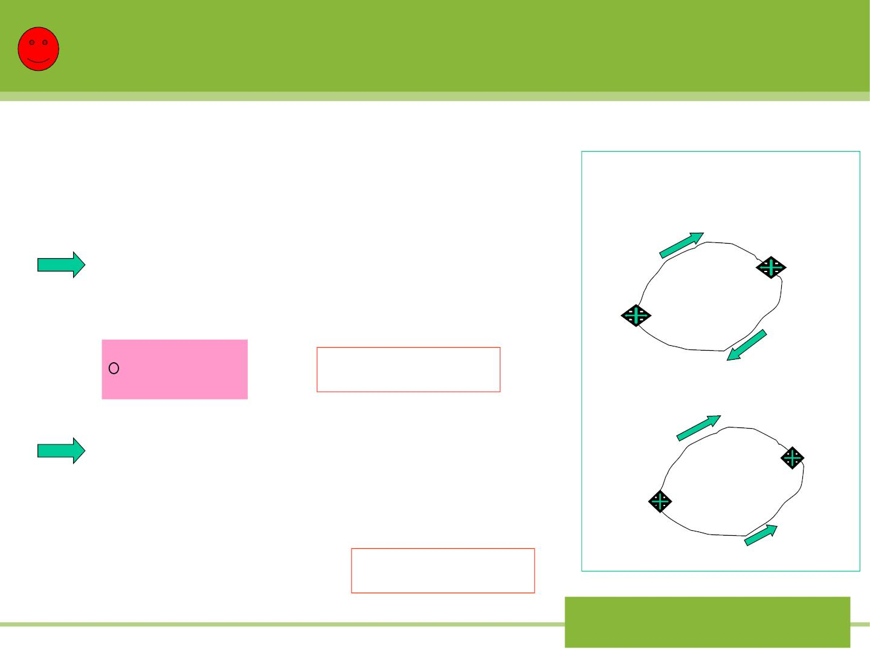
Tw o Mathematical statements:
→
If is a conservative force,
F
we have:
W +W = 0
Fig 12-4
ab.1
ba.2
b
→
→
a
→
→
(a)
⇩ 
F d s+ F d s = 0
(12-1)
b
1
a
b
Path1
Path2
a
❒
❒
2
⇩
F ds =0
Statement 1
→
→
→
→
→
→
(b)
b
b
a
b
1
⇩  
F d s = − F d s = F d s (12-3)
a
Path1
b
a
Path2
Path2
a
b
→
→
b
→
→
2
⇩ 
F d s = F d s
Statement 2
a
a
Path1
Path2
Ch.12 Energy II:
Potential energy

Slide 8
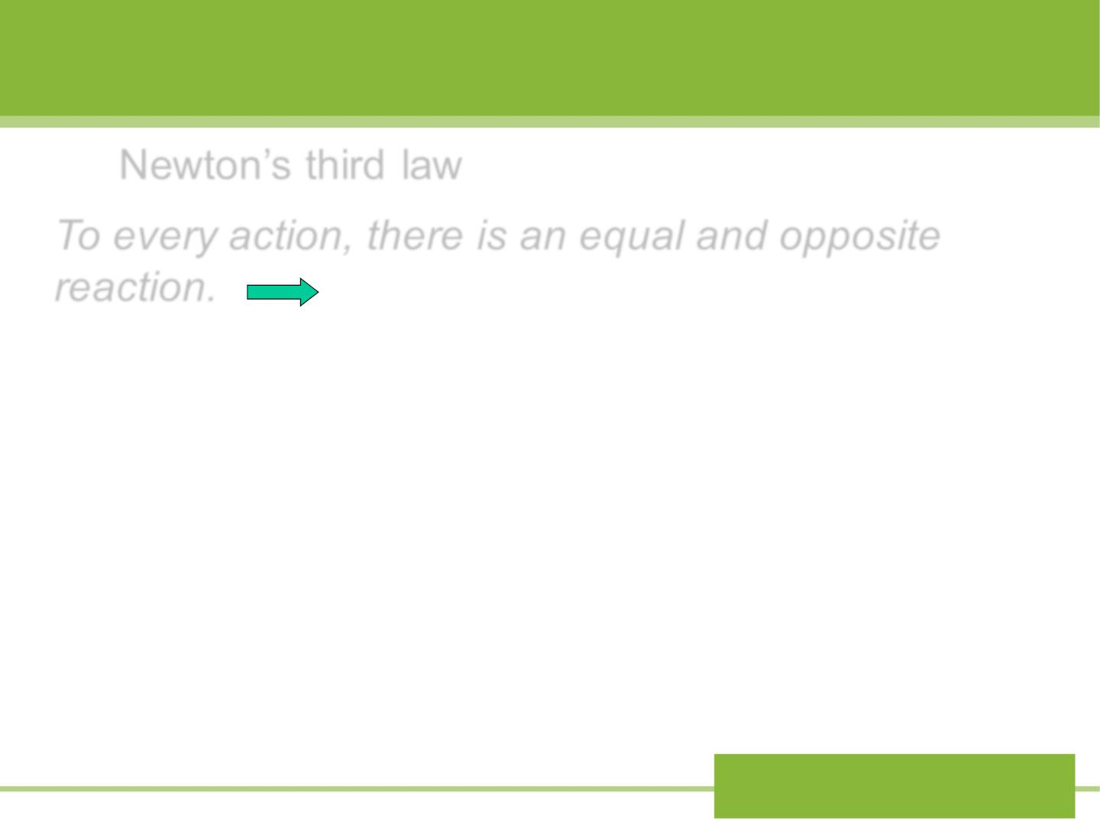
Note:
Newton’s third law
To every action, there is an equal and opposite
reaction.
(1) Both the action and reaction forces belong to
the system.
(2) The total work done by action and reaction forces
is independent of the reference frame chosen (even in
non-inertial frame).
Prove point (2):
Ch.12 Energy II:
Potential energy

Slide 9
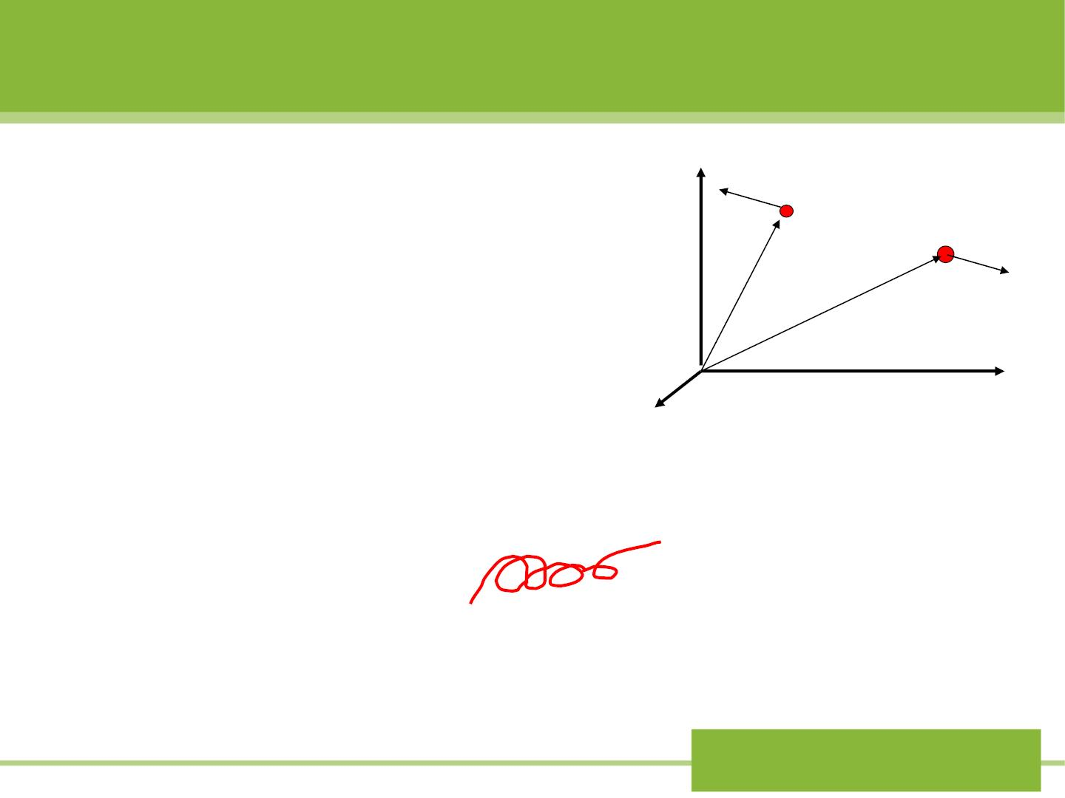
In S frame:
S
y
^{f}1
❖
❖
1
❖
❖
^{m}1
⇩ 
❖
= + =  + 
W W W f dr f dr
^{m}2
1
2
1
2
2
❖
f
❖
r
2
In S’ frame with veloc it y of
relative to S frame:
v
1
❖
s's
r
2
❖
❖
Ｏ
x
❖
1
❖
⇩ 
W' =W' +W ' = f dr' + f dr' z
1
2
1
2
2
❖
❖ 
❖
❖ 
2
⇩
⇩
⇩
= f (dr −v dt) + f (dr −v dt)
1
❖
1
❖
s's
2
s's
❖
❖
❖ 
❖
⇩
= f dr + f dr − (f + f )v dt
= −
 f f
1
1
2
2
1
2
s's
1
2
❖
❖
❖
❖
⇩
= f dr + f dr
1
1
2
2
=W
Ch.12 Energy II:
Potential energy

Slide 10

12-2 Potential energy
1.Definition
When work is done in a system (such as ball and
earth) by a conservative force, the configuration of its
parts changes, and so the potential energy changes
from its initial value to its final value .
U
U
i
f
We define the change in potential energy associated
with the conservative force as:
❒
❒
⇩
ΔU =U −U = −W = − F ds (12-4)
f
i
Ch.12 Energy II:
Potential energy

Slide 11

y
❒
❒
⇩
ΔU =U −U = −W = − F ds
mg
y₂
y₁
f
i
2. The potential energy of gravity
For the ball-Earth system, we take upward direction
to be y positive direction
⇩
y2
U = U (y ) −U (y ) = − (−mg)dy = mg(y − y )
2
1
y1
2
1
U (y ) = U (y ) + mg(y − y )
, dependent on U (y₁)
2
1
2
1
The physically important quantity is ΔU , not
or
.
U(y ) U (y )
2
1
If We set
U(y₁ = 0) = 0
(the reference zero point of U is at O)
We have
U (y) = mgy
(12-9)
Ch.12 Energy II:
Potential energy

Slide 12
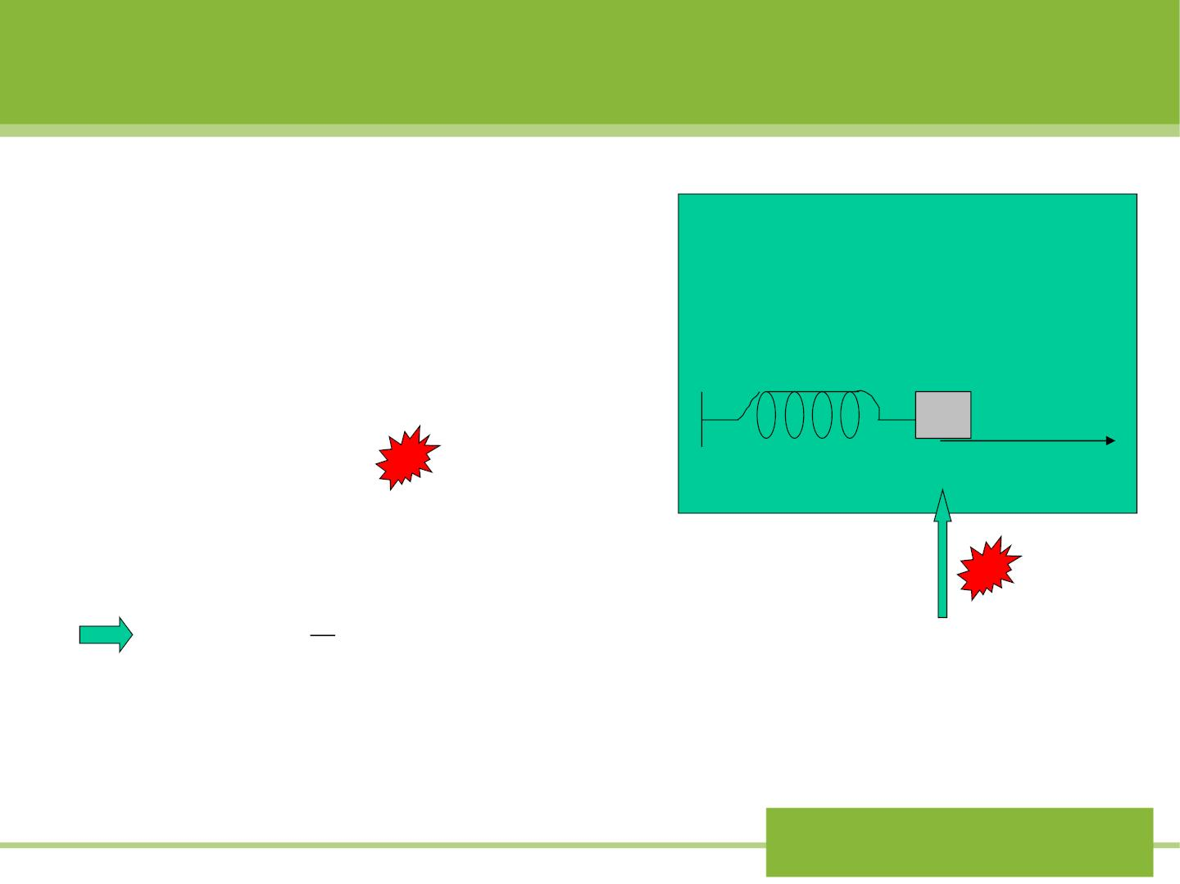
3. The potential energy of
spring force
Fig 11-13
W hen the spring is in its r elaxed
state, and we can declare the
potential energy of the system
Relaxe d length
to be zero (
u = 0
)
1
o
0
x
x
⇩ 
U(x )−0 = − Fdx =− ( −kx)dx
0
2
1
=
2
U (x) kx
(12-8)
2
The reference zero poi nt of potential is at x=0.
Ch.12 Energy II:
Potential energy

Slide 13

Notes:
i.The physically important quantity is = −
ΔU U U
x1
x0
Not or .
U U
x1
x0
ii.We are free to choose the reference point at any
convenient location for the potential energy.
iii.Potential energy belongs to the system (Such as
ball-Earth) and not of any of the individual objects
within the system.
Ch.12 Energy II:
Potential energy

Slide 14

x
⇩
ΔU =U −U = − Fdx
Eq(12-4)
x
0
0
iv. The inverse of Eq(12-4) allows us to
calculate the force from the potential energy
dU(x)
(12-7)
F_{x} (x) = −
dx
Eq(12-7) g ives us another way of looking at
the potential energy:
“The potential energy is a function of position
whose negative derivat ive g ives the force”
dU(y)
U(y) = mgy
−
= −mg = F_{y}
dy
1
dU d 1
− = −
dx dx 2
=
2
² = − =
( kx ) kx F
U(x) kx
2
x
Ch.12 Energy II:
Potential energy

Slide 15
Sample problem 12-1
An elevator cab of mass m=920 Kg moves from
street level to the top of the World Trade Center in
New York, a height of h=412 m above ground. What
is the change in the gravitational potential energy of
the cab-Earth system?
U mg y mgh 920 9.8 412 3.7 10 J.
 =  = =   =  6
Ch.12 Energy II:
Potential energy

Slide 16
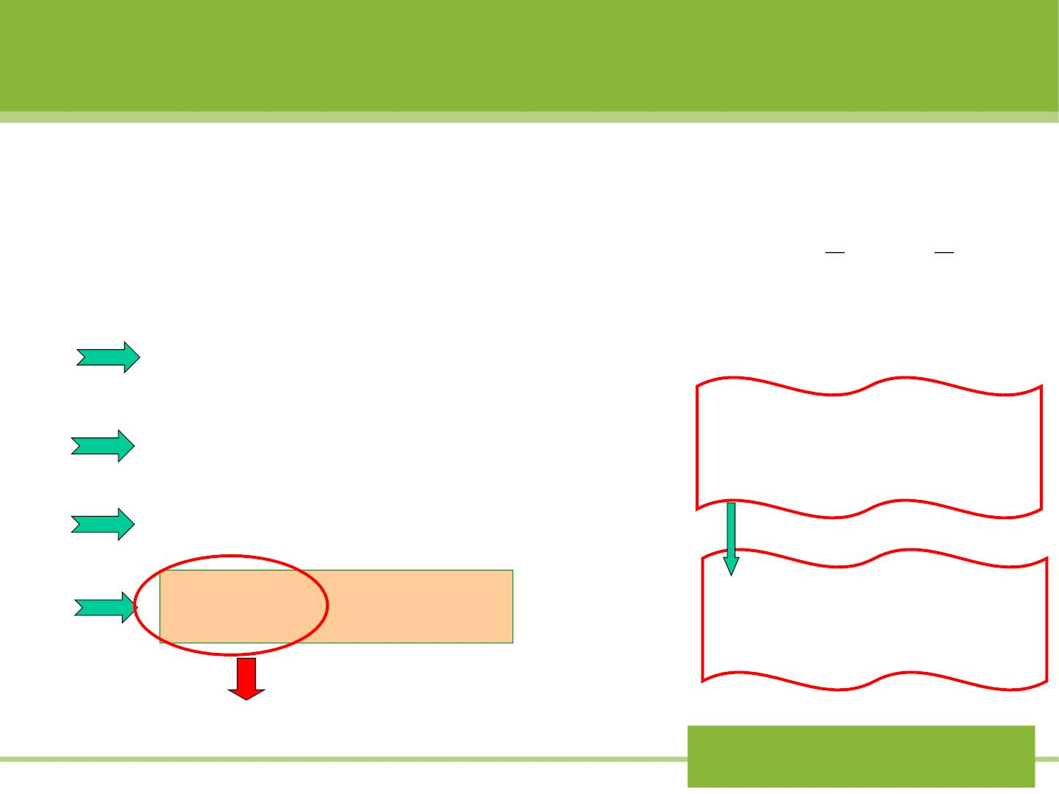
12-3 Conservative of mechanical
energy
From the definition of potential energy, we have:
⇩
1
1
2
ΔU =U −U = −W = − F(x)dx
2
2
f
i
W = mv mv
netF
f
−
i
2
= −K
= K
ΔU = −K
W hen can Eq. (12-
15) be satisfied?
U + K = 0
(12-14)
(U −U ) + (K − K ) = 0
f
i
f
i
❒
K +U = K +U
(12-15)
F ^{is a}
i
i
f
f
conservative force
Mechanical energy
Ch.12 Energy II:
Potential energy

Slide 17
Eq(12-15) is the mathematical statement of the
law of conservation of mechanical energy:
“In a system in which only conservative
forces do work, the total mechanical energy of the
system remains constant.”
Such as the systems of:
Ball-Earth system;
Block-spring system on frictionless table.
Ch.12 Energy II:
Potential energy

Slide 18

How to write the formula of conservation of
mechanical energy for:
Ball-Earth system / m+M system (M>>m) ?
No other forces exerted in the system.
❖
❖
1
1
2
1
+
=
− +
2
+
2
=
mgh mv² const.
U (r R) mv MV const. or
2
2
m and v are the mass and speed for Ball, respectively.
M and V are the mass and speed for Earth, respectively.
W hich one is correct or both correct?
(1)If of M is zero, M is an inertial frame. Take M
a
as our reference frame. Two eqs. are equivalent .
a
(2) If of M is not zero, CM of the system is an
inertial frame. Since M>>m, the position of CM is
very near M. In CM frame, V~0, R~0. So two eqs.
are equivalent.
Ch.12 Energy II:
Potential energy

Slide 19

Sample problem 12-5
Using conservation of mechanical
energy, analyze the Atwood’s
machine (sample problem 5-5) to
find v and a of the blocks after they
h ave mo ved a distance y from rest.
y
Solution: We take the two blocks
plus the Earth as our system. For
simplic it y, we assume that both
m₁ m₂
o
Ch.12 Energy II:
Potential energy

Slide 20

blocks start from rest at the same level, which we
define as y=0, the reference point for gravit at ion al
potential energy.
Thus = =
+ =
K 0,U 0 K U 0,
i
i
i
i
1
1
) ( ) 0
K +U = m v² + m gy + m v² − m gy =
(
f
f
2
1
1
2
2
2
So lvin g for the speed v, we obtain
^{m}2 ^{− m}
m₁ + m₂
v = 2
1
gy
dv m − m
a_{y}
= = 2
1
g
dt m + m
1
2
Ch.12 Energy II:
Potential energy

Slide 21
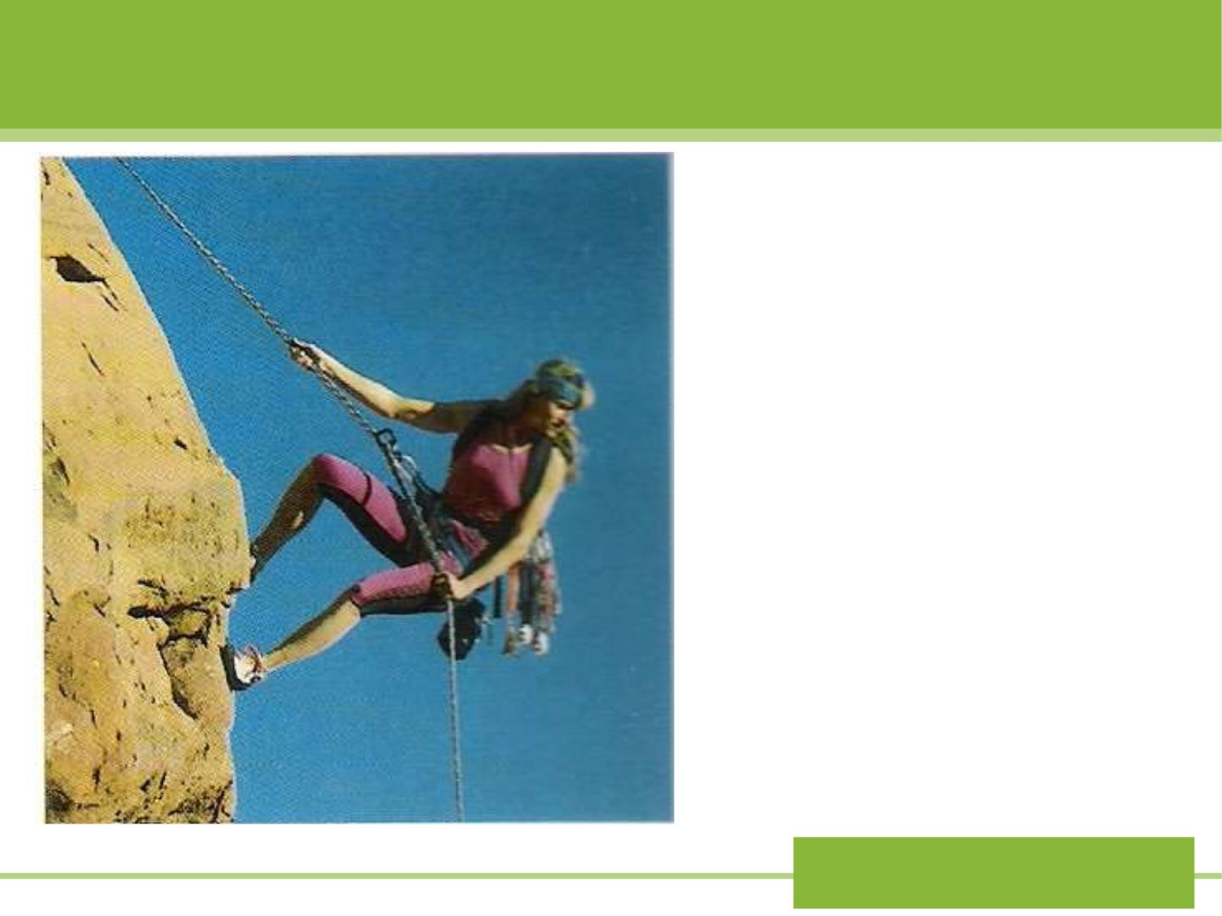
When the climber
goes down, she must
transfer potential
energy to other kinds
of energy, such as
thermal energy.
Ch.12 Energy II:
Potential energy

Slide 22
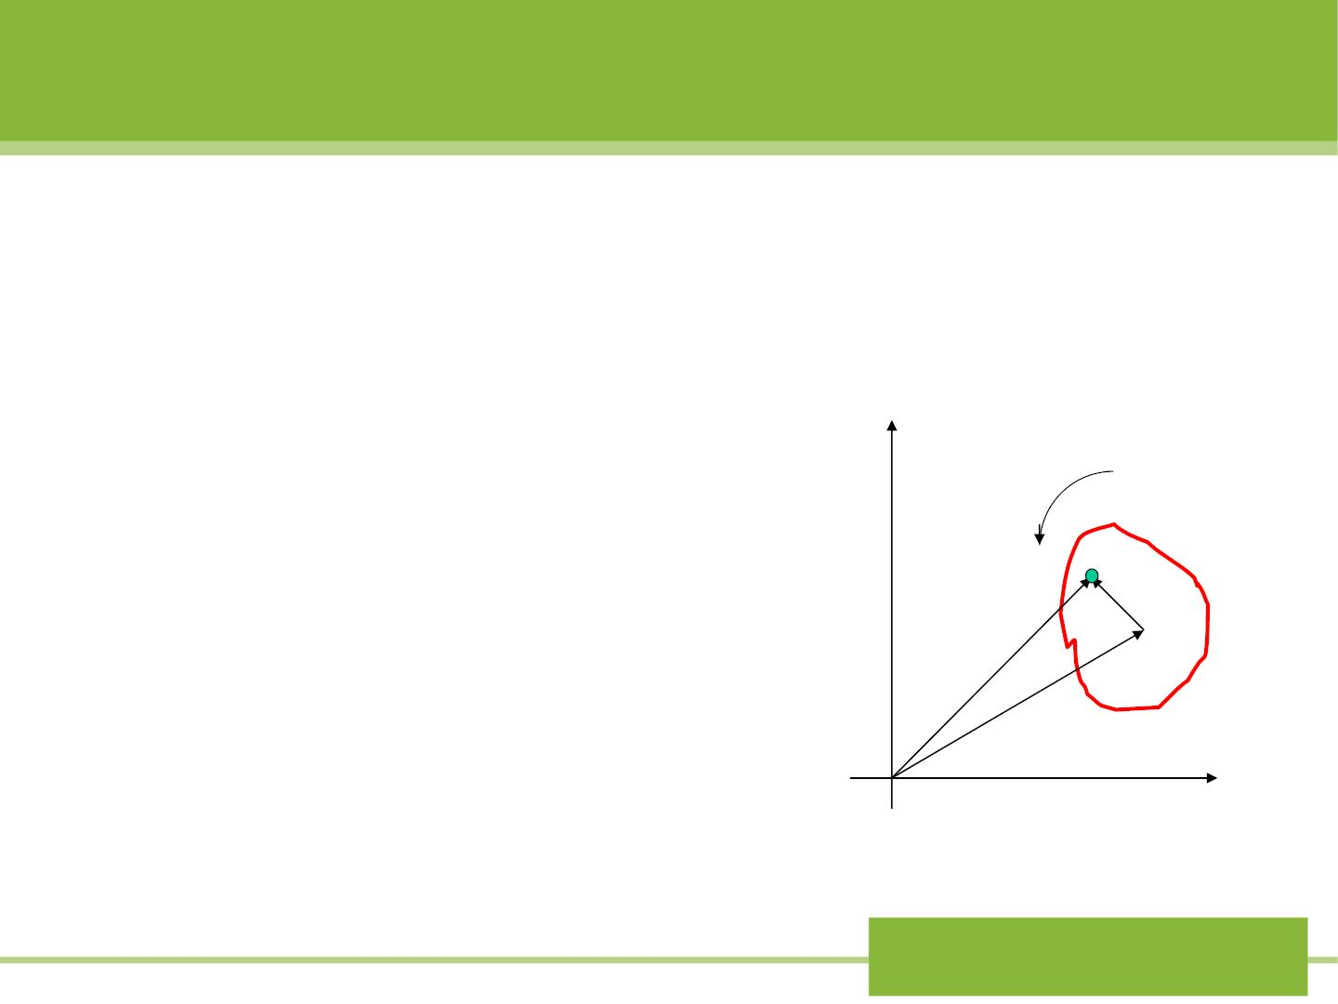
12-4 Energy conservation in rotational motion
We still restrict our analysis
to the case in which the
rotational axis remains in the
same direction in space as the
object moves.
Fig12-7
y
p 
r
'
Fig 12-7 shows an arbitrary
body of mass M .
n
c
→
r_{n}
→
r
cm
0
x
Ch.12 Energy II:
Potential energy

Slide 23

1
2
1. Relative to o, the kinetic energy of m is m v ,
n
2
n n
and total kinetic energy of the body is
N
1

2
K = m v
(12-16)
2
n n
n=1
From Fig12-7,we see that
→
→
→
→
→
→
r = r + r
'
v = v + v
'
n
cm
n
n
cm
n
Then:
1
1
→
→
→
→
 
2
'
'
K = m v = m (v +v )(v +v )
2
n n
2
n cm
n
cm
n
N
1
→
→
(12-17)

2
2
'
'
= m (v +v +2v v )
2
n cm
n
cm n
n=1
Ch.12 Energy II:
Potential energy

Slide 24

In Eq(12-17):
(1)
(2)
1
1
2
⁽  )
m v
2
=
Mv
2
=
m M
2
n cm
cm
n
1
2

1
1
→ → →
'
=
' =
m (r ) I
⬥
m v
2
2
(v '= v −v )
2
1
2
n n
2
n
n
2
cm
n
n cm
→
→
→
→


(3)
m v v ' = v  m v ' =
(2
)
0
n
cm
n
cm
n n
Ch.12 Energy II:
Potential energy

Slide 25

1
1
2
2
2
Thus
K = Mv + I 
(12-18)
2
cm
cm
Eq(12-18) indicate that the total kinetic energy of the
moving object consists of two terms, the pure translational
of Cm, and the pure rotation about Cm. The two terms are
quite independent.
2.Rolling without slipping
For this case,
v_{cm} = R
1
1 v
1
1
2
2
2
2 2
2
=
+
cm =
I ( ) M R I  (12-19)
K Mv
+
2
cm
cm
cm
2 R 2
Ch.12 Energy II:
Potential energy

Slide 26
3.When an object rolls without slipping, there may
be a frictional force exerted at the instantaneous
point of contact between the object and the
surface on which it rolls. However, this frictional
force does no work on the object.
Ch.12 Energy II:
Potential energy

Slide 27
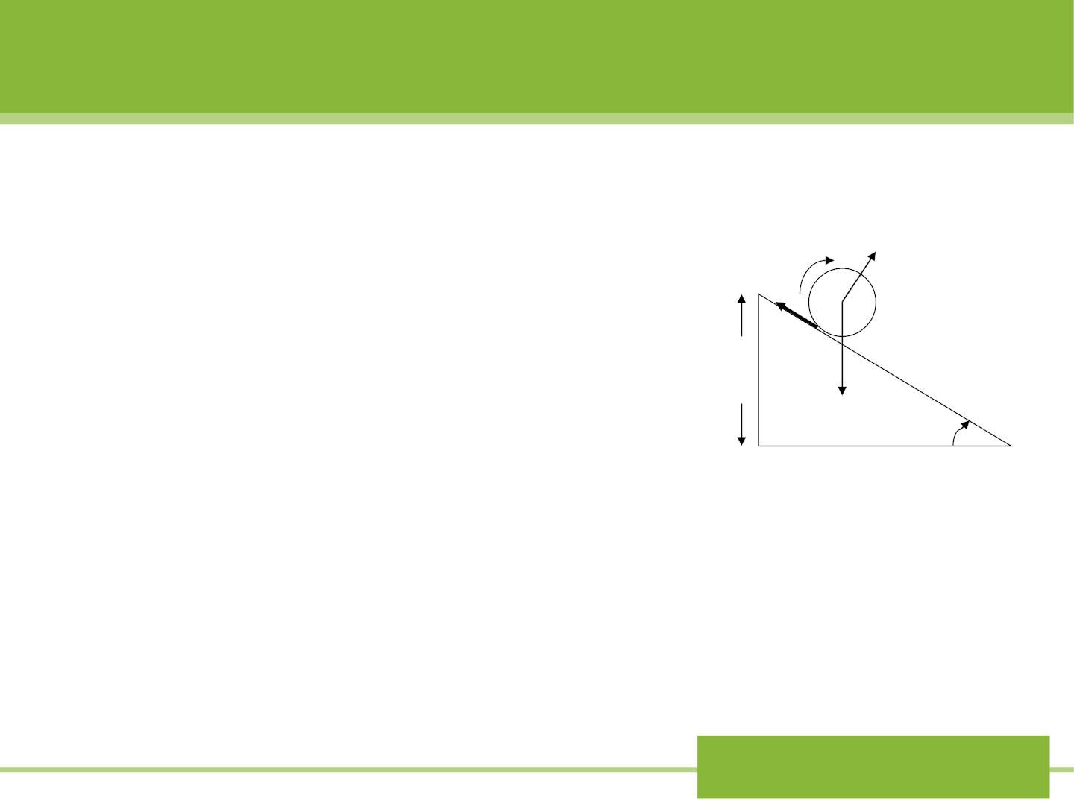
Sample problem 12-8
Using energy conservation
find the final speed of the
ro llin g c ylin d er in Fig 9-32
when it reaches the bottom
of the plane.

→
f
N
c
h
^{mg} 
Fig 9-32
Ch.12 Energy II:
Potential energy

Slide 28
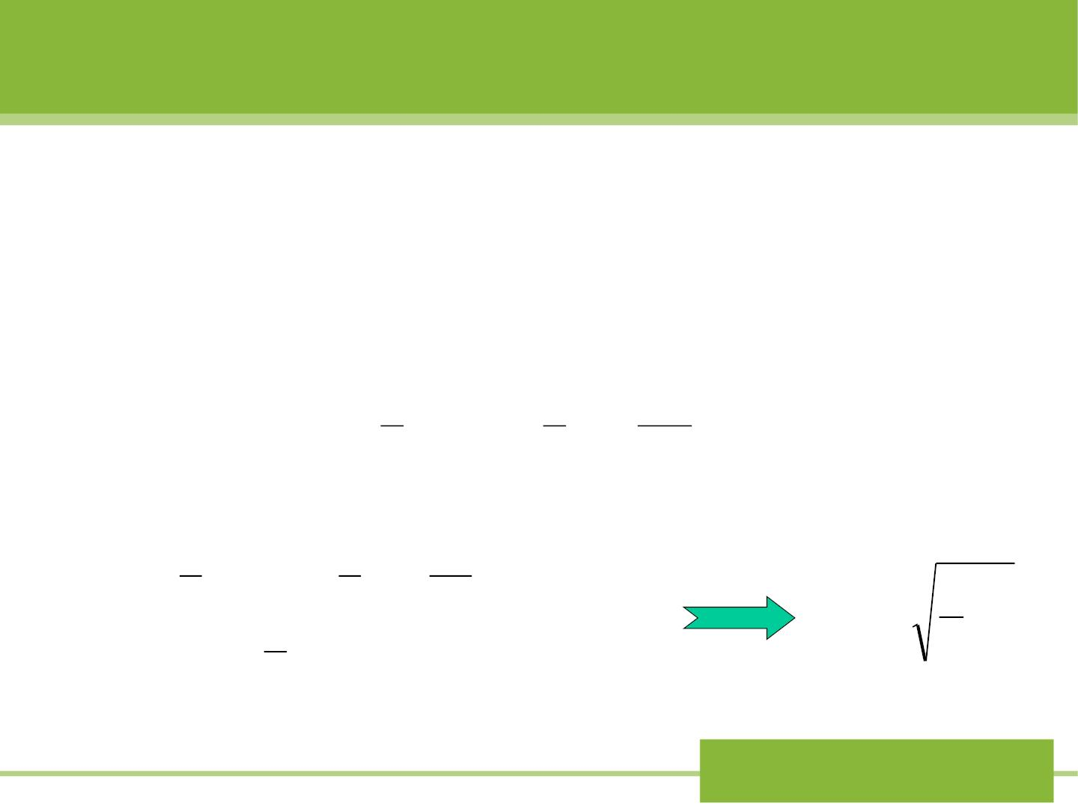
Solution: For our system we take the cylinder and
the Earth. The friction does no work and so it
cannot change the mechanical energy.
E = K +U = 0 + mgh
,
i
i
i
1
2
1 v
2
2
E = K +U = Mv + I ( ) + 0
cm
f
f
f
cm
2
cm
R
Setting
E_{i} = E
f
1
1 v
2
Mv + I (
m
)² = mgh
with
2
cm
cm
4
2 R
v = gh
1
cm
I
=
MR
2
3
cm
2
Ch.12 Energy II:
Potential energy

Slide 29

12-5 One-dimensional conservation
system: the complete solution
1. How to read the curve of potential energy?
If only conservative forces do work in the
system, we have
E K U
= + , (E is constant) (12-20)
1
2
U(x) + mv = E
2
2
x
v_{x}
= 
−

(12-21)
[E U(x)]
E U(x)
m
Ch.12 Energy II:
Potential energy

Slide 30
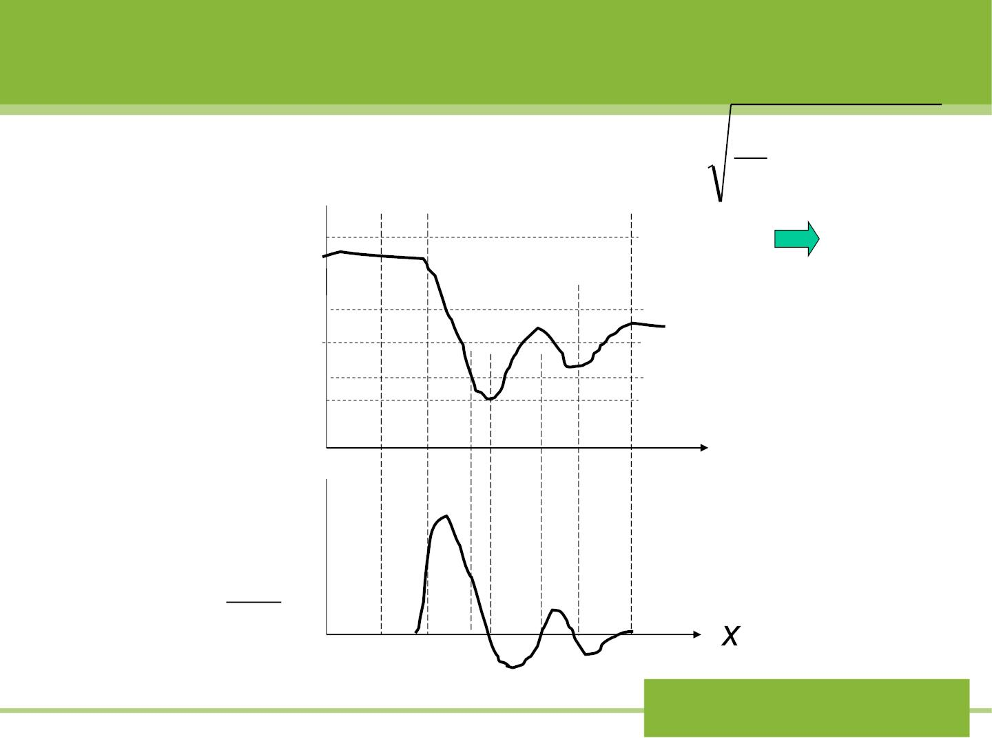
Fig12-8
2
v =  [E −U(x)]
x
m
E₄
E
E
E
E₀

U E
(a)
3
2
1
K=E-U
U(x)
x
x₆ x
x
3 1
x x
x
x
F
0
2
5
4
(b)
dU
dx
F = −
Ch.12 Energy II:
Potential energy

Slide 31

Sample problem 12-10
The potential energy function for the force between
two atoms in a diatomic molecule can be
expressed approximately as follows
a b
U (x) = −
12
6
x x
where a and b are positive constant and x is the
distance between atoms.
(a) Find the equilibrium separation between the
atoms, (b) the force between the atoms, and (c)
the minimum energy necessary to break the
molecule apart.
Ch.12 Energy II:
Potential energy

Slide 32
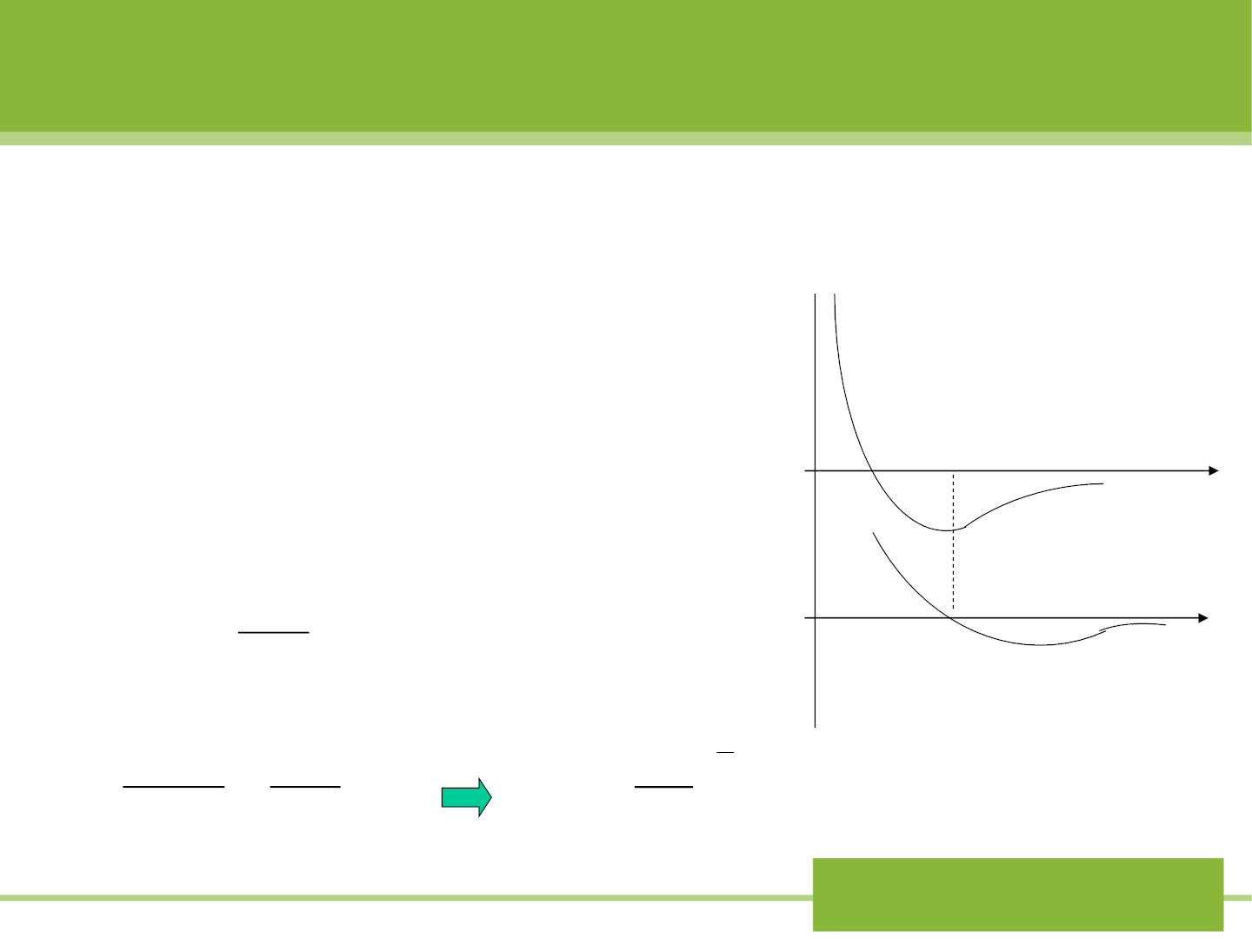
Solution:
(a) Fig12-9 shows u(x)
as a function of x. Equilibrium
U
(a)
(b)
x
occurs at the coordinate ,
m
x_{m}
where
that is
U(x_{m} )
is a minimum.
0
0
x
F_{x}
dU
( )
=
0
dx
x=x_{m}
x
−12a 6b
2a
1
6
=
Fig (12-9)
+ = 0 x ( )
x_{m}13
x
7
m
b
m
Ch.12 Energy II:
Potential energy

Slide 33

dU 12a 6b
F (x) = − = −
(b)
x
dx x¹³
x
7
(c) The minimum energy needed to break up the
molecule into separate atoms is called the
dissoc iat ion energy ,
E E +U x = E =
0 .
2a
( )
d
d
m
a b
1
E = −U(x ) = − +
(x = ( )⁶ )
d
m
12
6
m
x x
b
m
m
b²
E_{d} =
4a
Ch.12 Energy II:
Potential energy

Slide 34
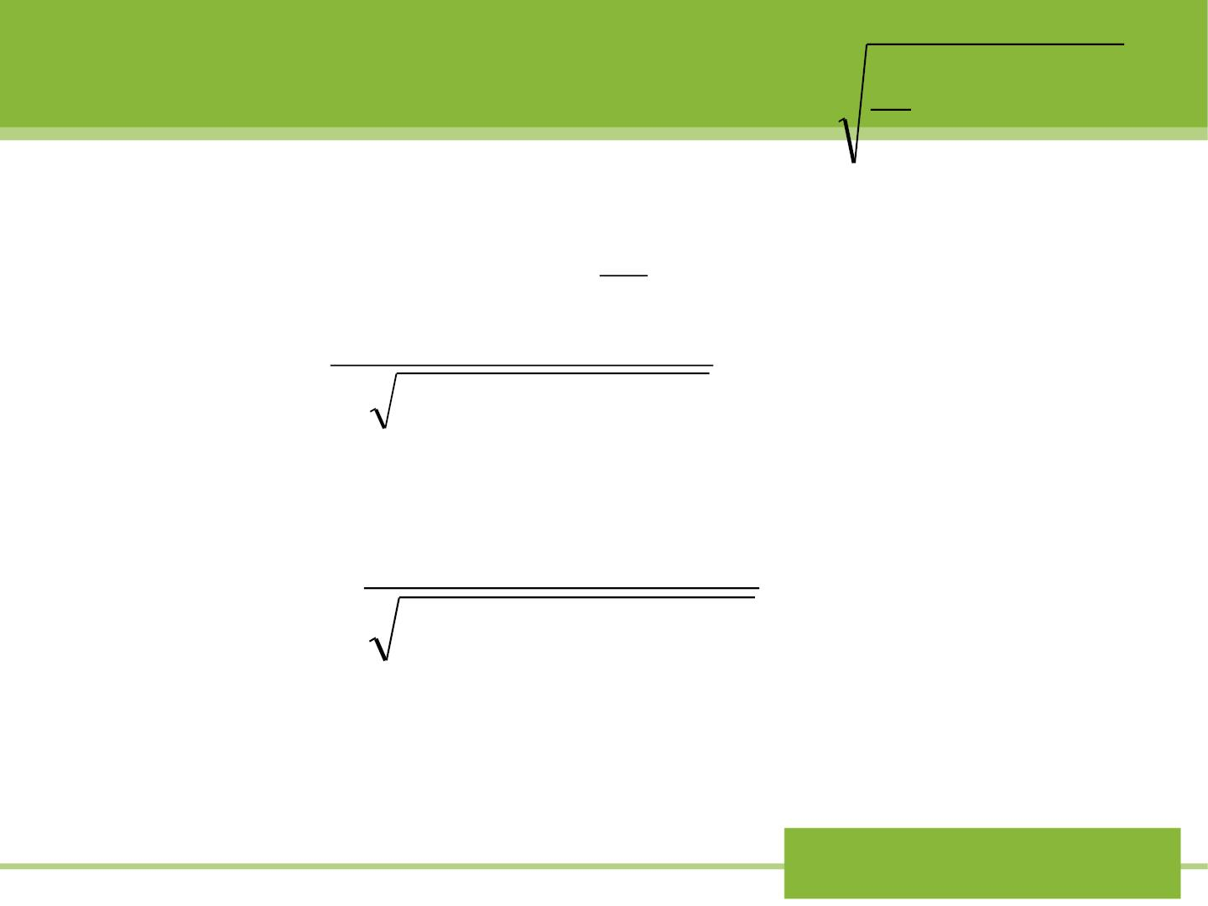
2
v =  [E −U(x)]
x
m
2. General solution for x(t)
From Eq(12-21) ,with
dx
dt
we have
v_{x} =
dx
dt =
(12-22)
 (2/ m)[E −U(x)]
Suppose
= ,
(x) x
(x) x
= , we have
t=0
0
t
x
dx
⇩
t = 
−
(12-23)
x
(2/ m)[E U(x)]
0
After carring out the integration of Eq(12-23), we
would obtain t=t(x), or x=x(t).
Ch.12 Energy II:
Potential energy

Slide 35

Exercise:
In one dimension, the magnitude of the
gravitat ional force of attraction between two
particles of mass m and mass m is g iven by
1
2
m m
F_{x} = G
1 2
2
x
where G is a constant and x is the distance
between the particles. (a) W hat is the potential
energy function U(x)? Assume that U(x)→0, as x
→∞. (b) How much work is required to increase
the separation of the particles form x=x₁ to
x=x₁+d?
Ch.12 Energy II:
Potential energy

