Slide 1

Ch. 13 Energy III:
Conservation of energy
Ch.13 Energy III:
Conservation of energy

Slide 2

Law of conservation of mechanical energy:
K +U = K +U
i
i
f
f
“In a system in which only conservative forces do work, the
total mechanical energy remains constant”
In this chapter: we consider systems of particles for
which the energy can be changed by the work done
by external forces(系统外的力) and nonconservative
forces.
Ch.13 Energy III:
Conservation of energy

Slide 3

13-1 Wor k done on a system by external forces
K + U =W
(13-1)
sys
s ys
ext
Positive external work done by the environment on
the system carries energy into the system, thereby
increasing its total energy; vice versa.
The external work represents a transfer of
energy between the system and the environment.
Ch.13 Energy III:
Conservation of energy

Slide 4

An example
Fig 13-2
Let us consider a block of mass m
attached to a vertical spring near the
Earth’s surface.
1. system=block. Here the spring
force and gravity are external forces;
there are no internal forces within the
system and thus no potential energy.
Using Eq(13-1),
K = W_{spring} +W_{grav}
Earth
Ch.13 Energy III:
Conservation of energy

Slide 5
2. System=block + spring. The spring is within the
system.
K + U_{spring} = W_{grav}
3. System=block + Earth. Here gravity is an
internal Force.
K + U _{grav} = W_{spring}
4. System=block + spring + Earth.
The spring force and gravity are both internal to
the system, so
K + U + U = 0
spring
grav
Ch.13 Energy III:
Conservation of energy

Slide 6
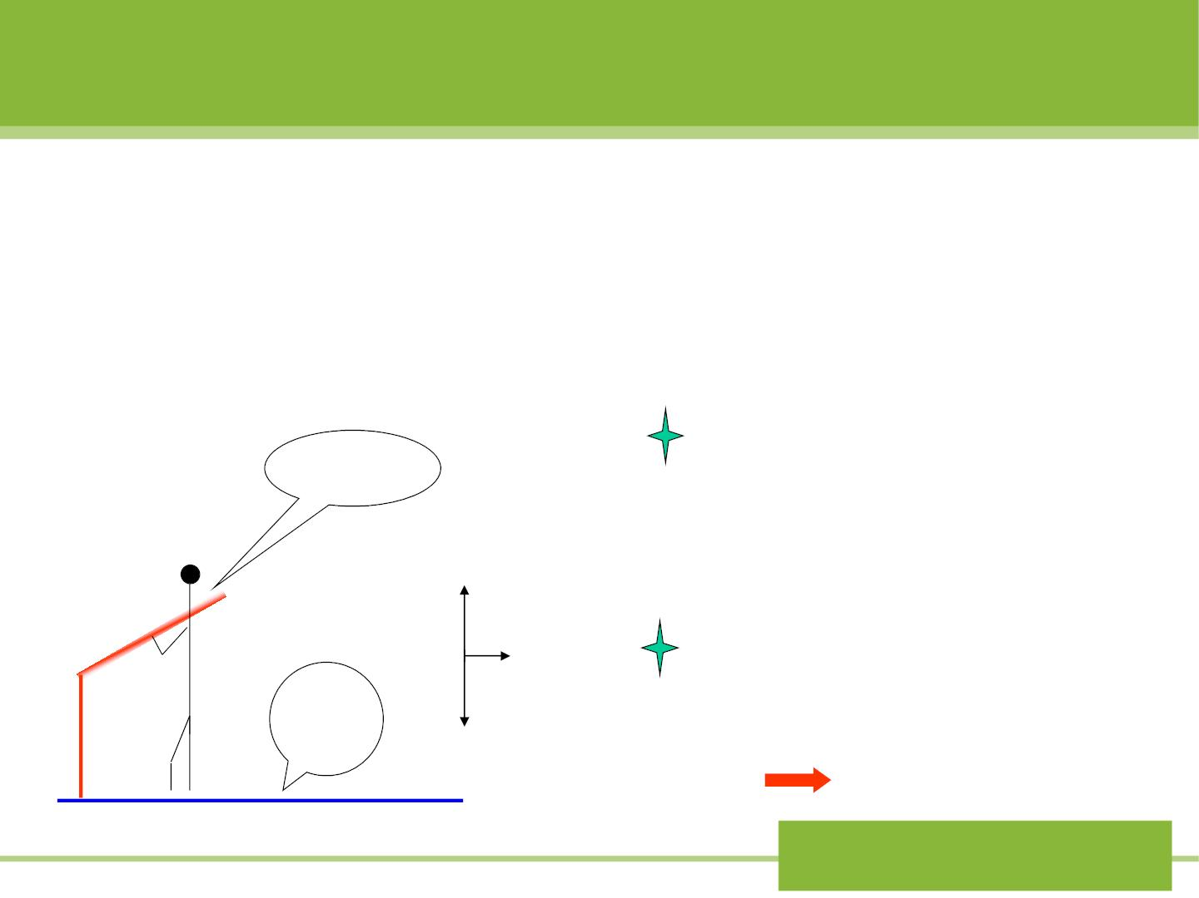
13-2 Internal energy (内能) in a system of particles
1. Consider an ice skater. She starts at rest and then
extend her arm to push herself away from the
railing at the edge of a skating rink（溜冰场）.
Use work-ener gy
relationship to analyze:
railin
g
N
K + U =W_{ext}
F
The system chosen
only include the skater
ice
Mg
U = 0
••••
Ch.13 Energy III:
Conservation of energy

Slide 7

W =0; W =0; W =0
F
N+MG
ext
K = 0 ???
in disagreement with our
observation that she accelerates
away from the railing.
Where does the skater’s kinetic energy
come from?
Ch.13 Energy III:
Conservation of energy

Slide 8
The problem comes from:
The skater can not be regarded as a
mass point, but a system of particles.
For a system of particles, it can store one kind of
energy called “internal energy”.
K + U =W_{ext}
K + U + E_{int} = W_{ext}
(13-2)
It is the internal energy that becomes the
skater’s kinetic energy.
Ch.13 Energy III:
Conservation of energy

Slide 9
2. What’s the nature of “internal energy”?
E = K +U
int
int
int
Sum of the kinetic energy associated with random
motions of the atoms and the potential energy
associated with the forces between the atoms.
Ch.13 Energy III:
Conservation of energy

Slide 10

Sample problem13-1
A baseball of mass m=0.143kg falls from h=443m
=
with , and its v 42m/ s .
v = 0
i
f
Find the change in the internal energy of the ball
and the surrounding air.
Solution: system = ball + air + Earth.
F = 0 K + U + E = 0
ext
int
U = U −U = 0 − (m gh) = −621J
f
i
1
2
² − =
K mv 0 126J
 =
f
E_{int} = −U − K = 495J
Ch.13 Energy III:
Conservation of energy

Slide 11

*13-3 Frictional work
K + U + E_{int} =W_{ext}
1. Consider a block sliding across a horizontal
table and eventually coming to rest due to the
frictional force.
For the system = block + table, no external force
does any work on the system. Applying Eq(13-2)
K + E_{int} = 0
(13-4)

As the Kdecreases, there is a corresponding
increase in internal energy of the system.
v
f
Ch.13 Energy III:
Conservation of energy

Slide 12

K + U + E_{int} =W_{ext}
W_{f} = − fs???
2. If the block is pulled by a string and moves with
constant velocity. f=T
For the system = block + table
E_{int,b lo ck+table} =W_{T}
W is responsible for increasing
T
v
the internal energy
(temperature) of the block and
table.
f
T
Ch.13 Energy III:
Conservation of energy

Slide 13

For the system = block
E =W +W
int,block
T
f
= Ts +W
= fs +W
f
(f=T)
f
If W =-fs,
E = 0
. It is in
disagreement with observation.
So, it must be: W_{f}  fs
f
int,block
is correct only if the object can be
treated as a particle(不考虑内部结构时).
W = fs
f
Ch.13 Energy III:
Conservation of energy

Slide 14

Sample problem 13-2
K + U + E_{int} =W_{ext}
A 4.5 kg block is thrust up a 30□ incline with an initial
speed v of 5.0m/s. It is found to travel a distance
d=1.5 m up the plane as its speed gradually decreases
to zero.
How much internal energy does the system of block +
plane + Earth gain in this process due to friction?
Solution: System = block + plane + Earth,
ignore the kinetic energy changes of the
Earth.
E = −(U + K)
int
U =U −U = (mgh) −0 = mgd s in 30□ = 33J
f
i
1
² = −
K K K 0 mv 56J
 = − = −
f
i
2
E = −(U + K) = 23J
Ch.13 Energy III:
int
Conservation of energy

Slide 15
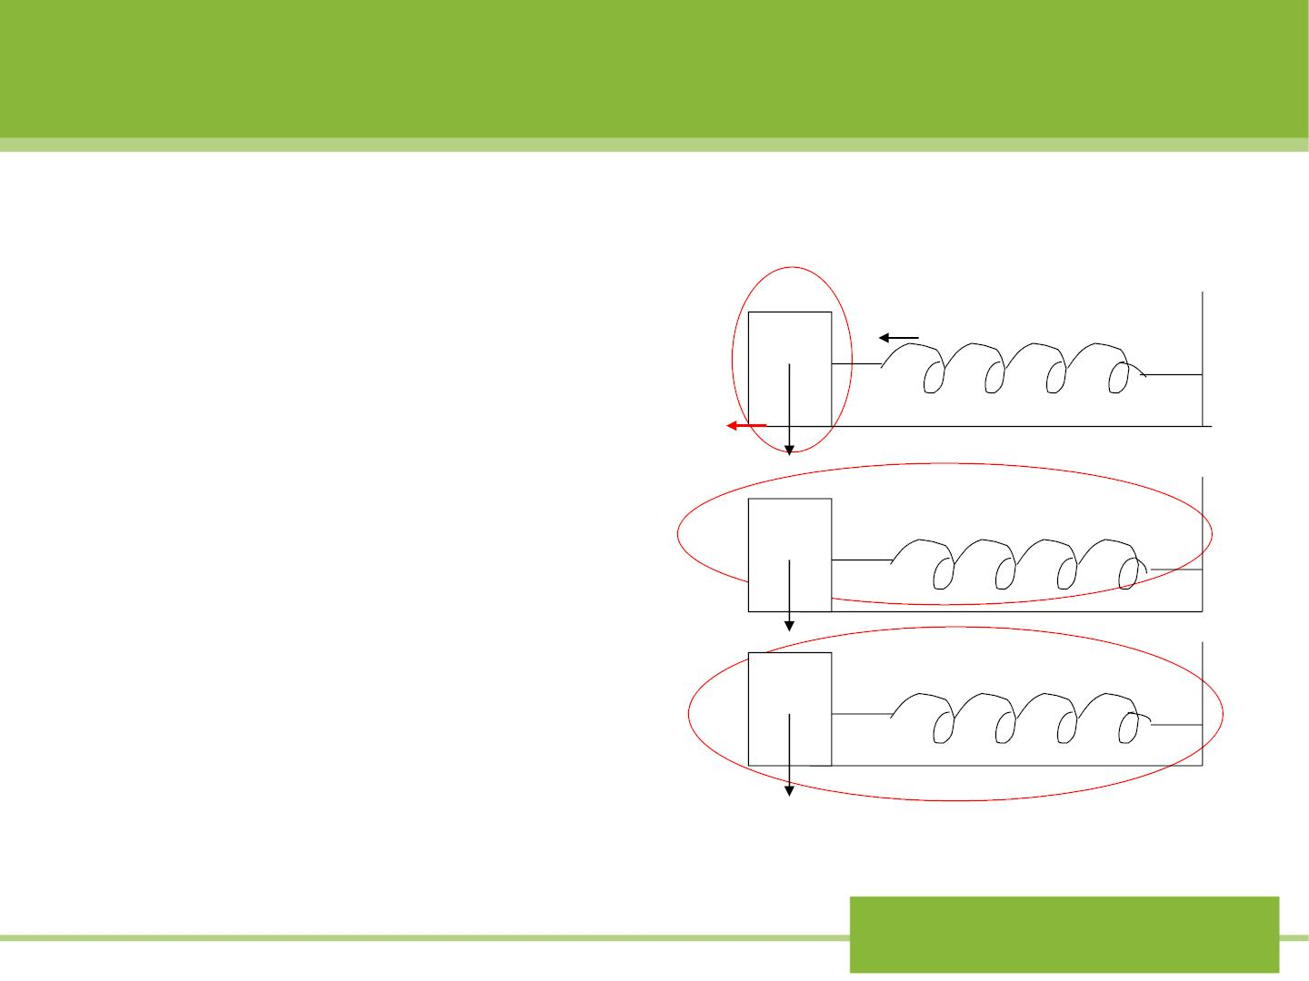
13-4 Conservative of energy in a system of particles
ΔK + ΔU + ΔE =W (13-2)
sys
sys
sys,int
ext
,F
We illustrate these
principles by
W_{s}
(a)
considering block-spring
combination shown in
Fig 13-4. the spring is
initially compressed and
then released.
f
W
W
f
f
(b)
(c)
Fig 13-4
Ch.13 Energy III:
Conservation of energy

Slide 16

(1) system = block.  +  = + (13 -8)
K E W W
int
s
f
U = 0 because the spring is not part of the system.
(2) System = block + spring
U + K + E_{int} =W_{f}
(13-9)
(3) System = block + spring + table
U + K + E_{int} = 0
(13-10)
The frictional force is a nonconservative dissipative force.
The loss in mechanical energy being compensated by an
equivalent gain in the internal energy.
Ch.13 Energy III:
Conservation of energy

Slide 17

13-5 Equation of CM energy
ice
••••
In Fig 13-5, even though the railing exerts a
→
F
force on the skater, it does no work.
ext
→
But we can define a ‘pseudo-work’ for .
F
ext

→
→
From Eq(7-16), (
F = M a
), we suppose the
ext
cm
center of mass moves through a small displacement
dx_{cm}
dx
. Multiplying on both sides by this , we
cm
obtain
dv
F dx = Ma dx = M ^{cm} v_{cm}dt
ext
cm
cm
cm
dt
Ch.13 Energy III:
Conservation of energy

Slide 18

=
Then F dx Mv dv
(13-12)
ext
cm
cm
cm
Integrating Eq(13-12)
x
v
⇩ 
f
F dx
=
cm, f
Mv dv
x
i
ext cm
v
cm,i
cm cm
1
1
2
2
= Mv − Mv
(13-13)
(13-14)
2
cm, f
2
cm,i
x
⇩
f
=
−
= 
Or F dx K
cm, f
K_{cm,i}
K_{cm}
x
i
ext
cm
− =
If is constant, and x x S , we have:
F
ext
f
i
cm
F S = K
(13-15)
ext cm
cm
质心能量方程
Ch.13 Energy III:
Conservation of energy

Slide 19

能量守恒方程
ΔK + ΔU + ΔE =W (13-2)
sys
sys
sys,int
ext ,F
a). Eq(13-14) and (13-15) resemble the work-
energy theorem. The quantities on the left of these
equations look like work, but they are not work, because
dx_{cm}
s
and do not represent the displacement of the point of
cm
application of the external force.
b). Eq(13-14) and (13-15) are not expressions of
conservation of energy, translational kinetic energy
is the only kind of energy that appears in these expressions.
c). However, Eq(13-14) or (13-15) can give
complementary information to that of Eq(13-2).
Ch.13 Energy III:
Conservation of energy

Slide 20

Sample problem 13-3
A 50 kg ice skater pushes away from a railing as in
Fig 13-5. If
distance
F = 50N
, and her CM moves a
ext
=
until she loses contact with
S 32cm
cm
v
the railing. (a) What is the speed as she
breaks away from the railing? (b) What is the E
cm
int
during this process? (there is no friction)
••••
Ch.13 Energy III:
Conservation of energy

Slide 21
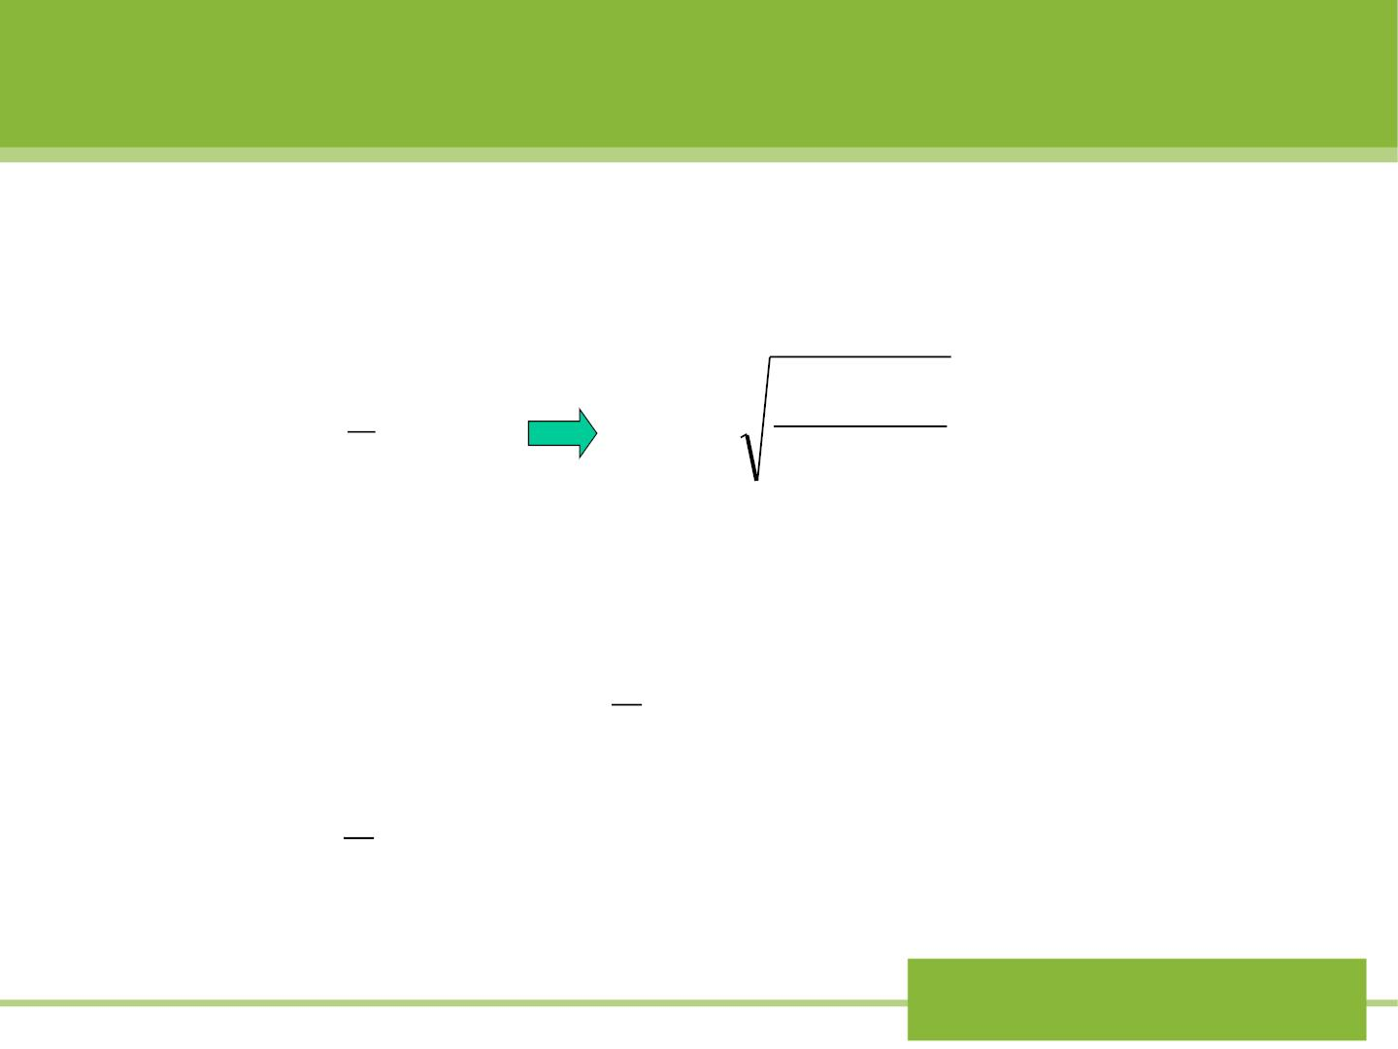
Solution:
(a) We take the skater as our system. From (13-
15), for CM
1
2
2F S
F S
=
2
v =
ext cm
= 0.84m/ s
^{Mv}cm
ext cm
cm
M
(b) From (13-2), for CM
U = 0 W = 0
ext
1
 = − = −
2
E
K
^{Mv}cm
int
2
1
2
= −
= −
(50k g)(0.84m / s) 17.6J
2
Ch.13 Energy III:
Conservation of energy

Slide 22
*13-6 Reaction and decays
Ch.13 Energy III:
Conservation of energy

Slide 23
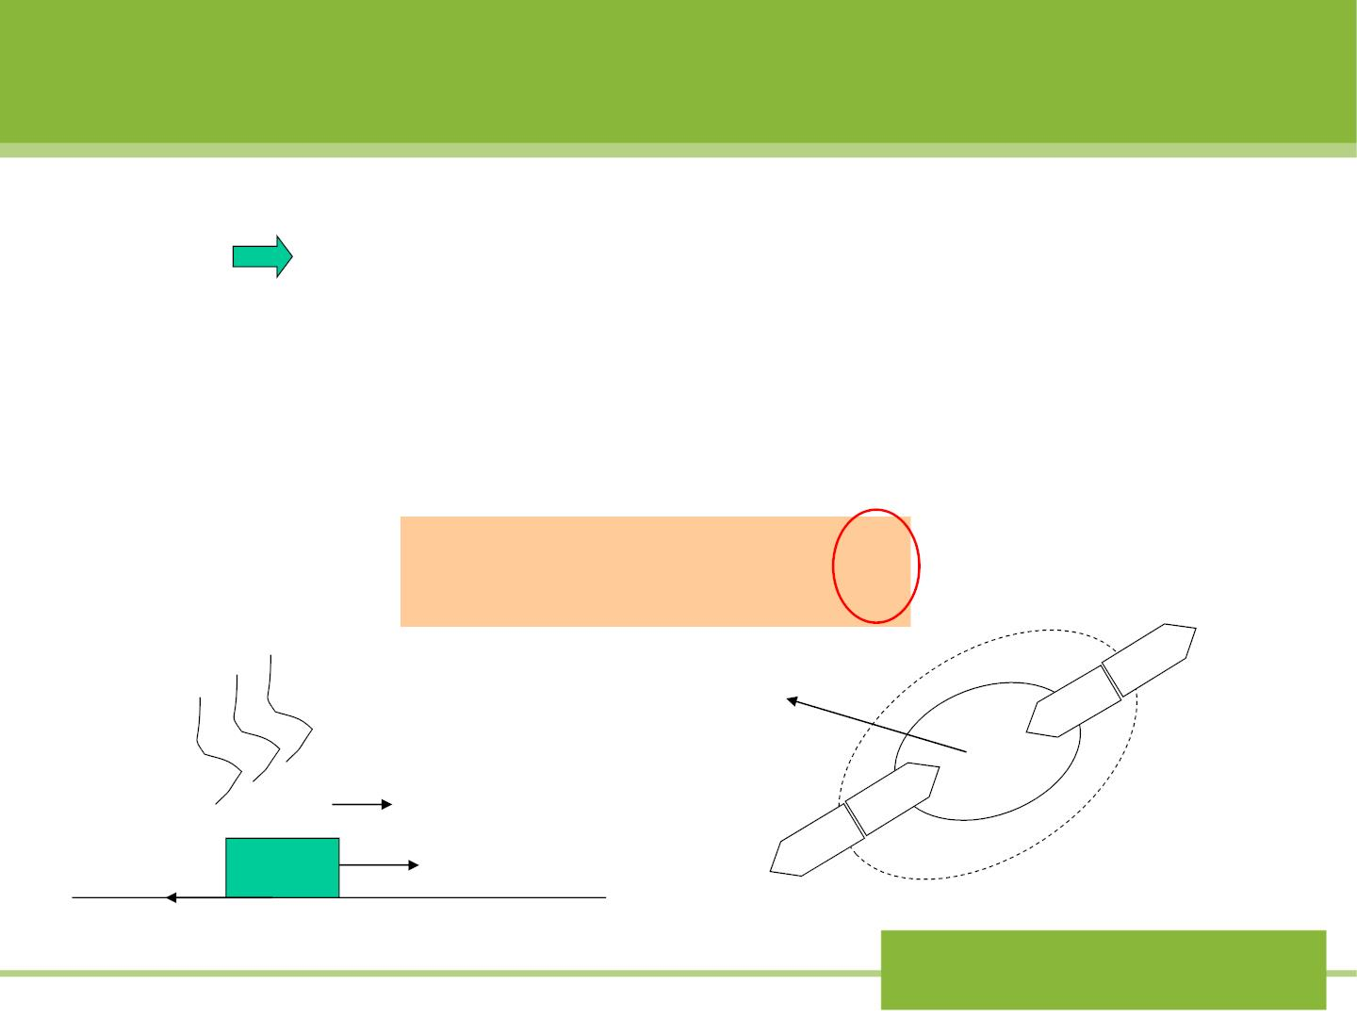
*13-7 Energy transfer by heat
K + U + E_{int} = W_{ext}
(13-2)
E =W
total
ext
If the temperature of the system is different
from the environment, we must extend above
COE Eq. to:
ΔE =W +Q
total
ext
work W
-
System
energy
+
v
^{E}total
+
Heat Q
f
T
-
System
boundary
Ch.13 Energy III:
Conservation of energy

