Slide 1
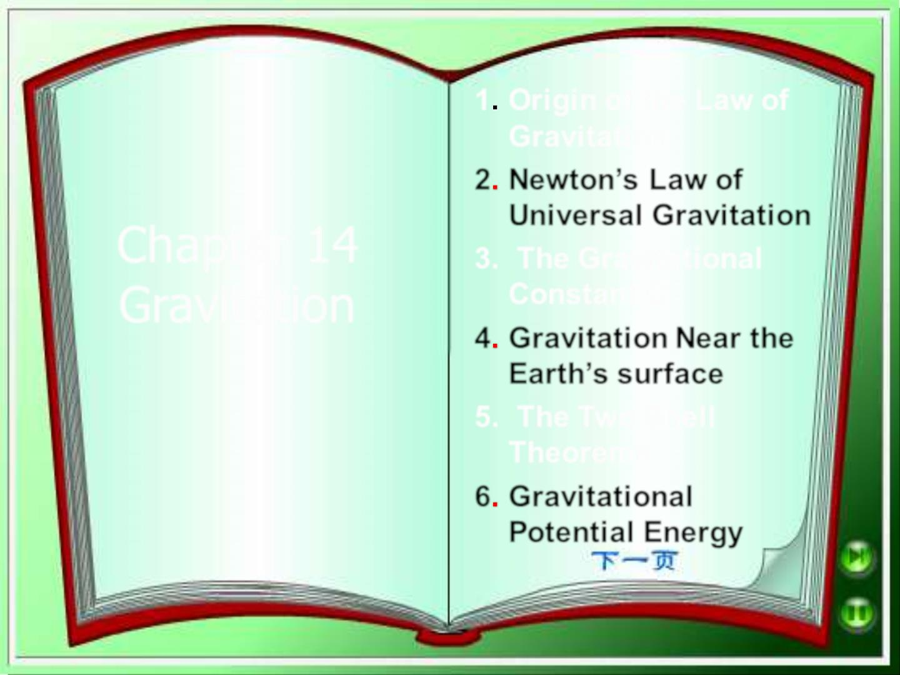
1 Ori gi n of the Law of
Gravitation
2 Newton’s Law of
Uni versal Gravitation
Chapter 14
Gravitation
3. The Gravitational
Constant G
4 Gravitation Near the
Earth’s surface
5. The Two Shell
Theorems
6 Gravitational
Potenti al Energy

Slide 2
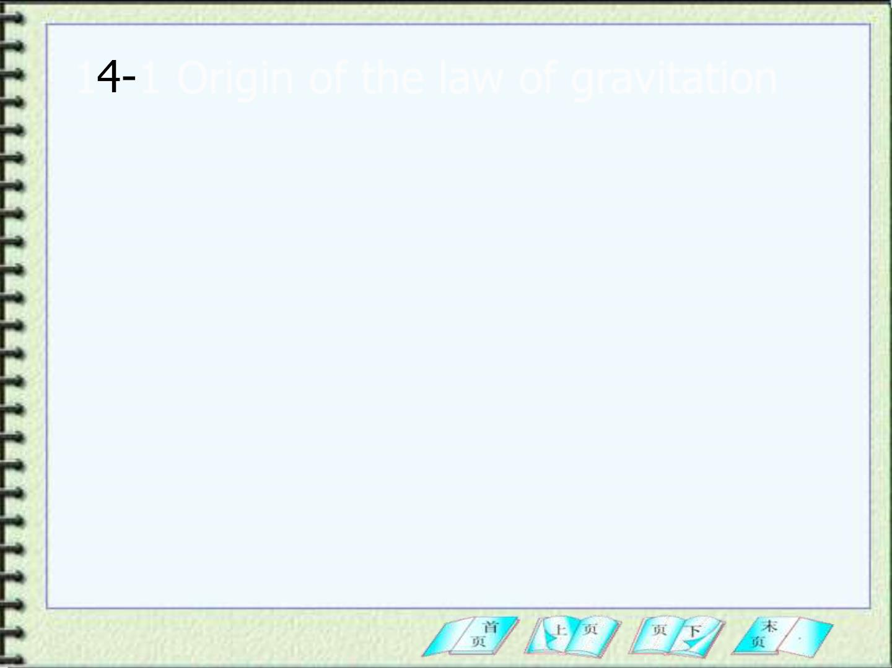
1 1 Origin of the law of gravitation
1. In 16th century Copernicus ( 1473~1543 )
proposed a heliocentric ( sun-centered ) scheme,
in which the Earth and other planets move about
sun.
2. Kepler ( 1571~1630 ) proposed three law
( which we discuss in Section 14-7) that describe
Planet’s motions. However, Kepler’s Laws were
only empirical without any basis in terms of forces.

Slide 3
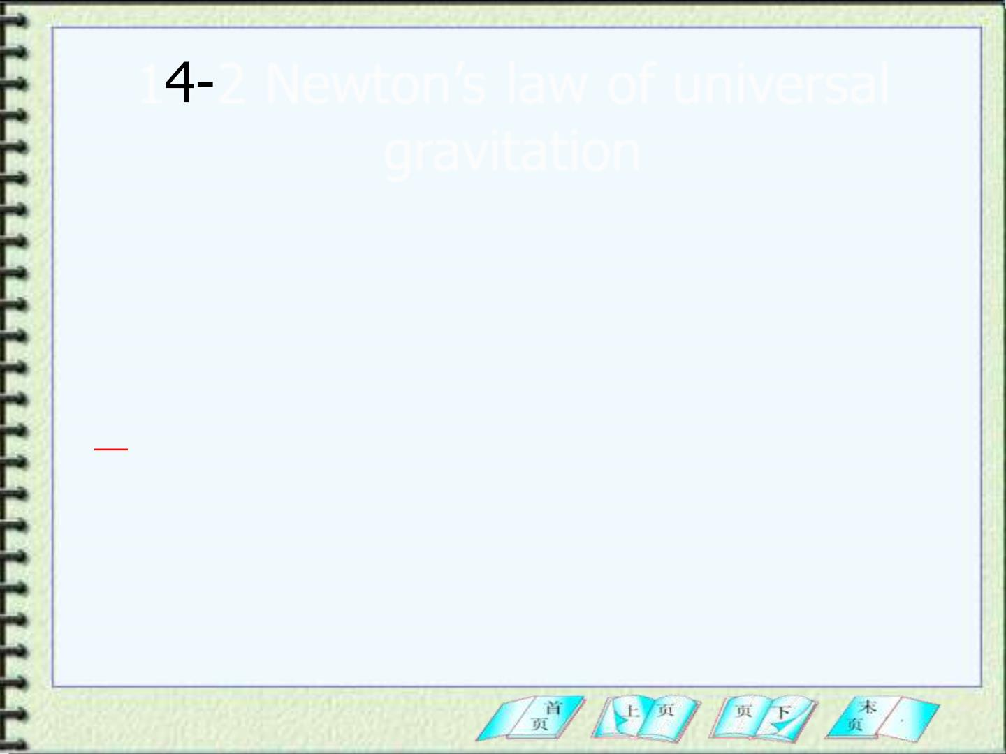
1 2 Newton’s law of universal
gravitation
1. Guided by Kepler’s laws, Newton proposed a
force law for gravitation:
Every particle in the universe attracts every
other particle with a force directly proportional
to the product of their masses and inversely
proportional to the square of the distance
between them. The direction of the force is
along the line joining the particles.

Slide 4
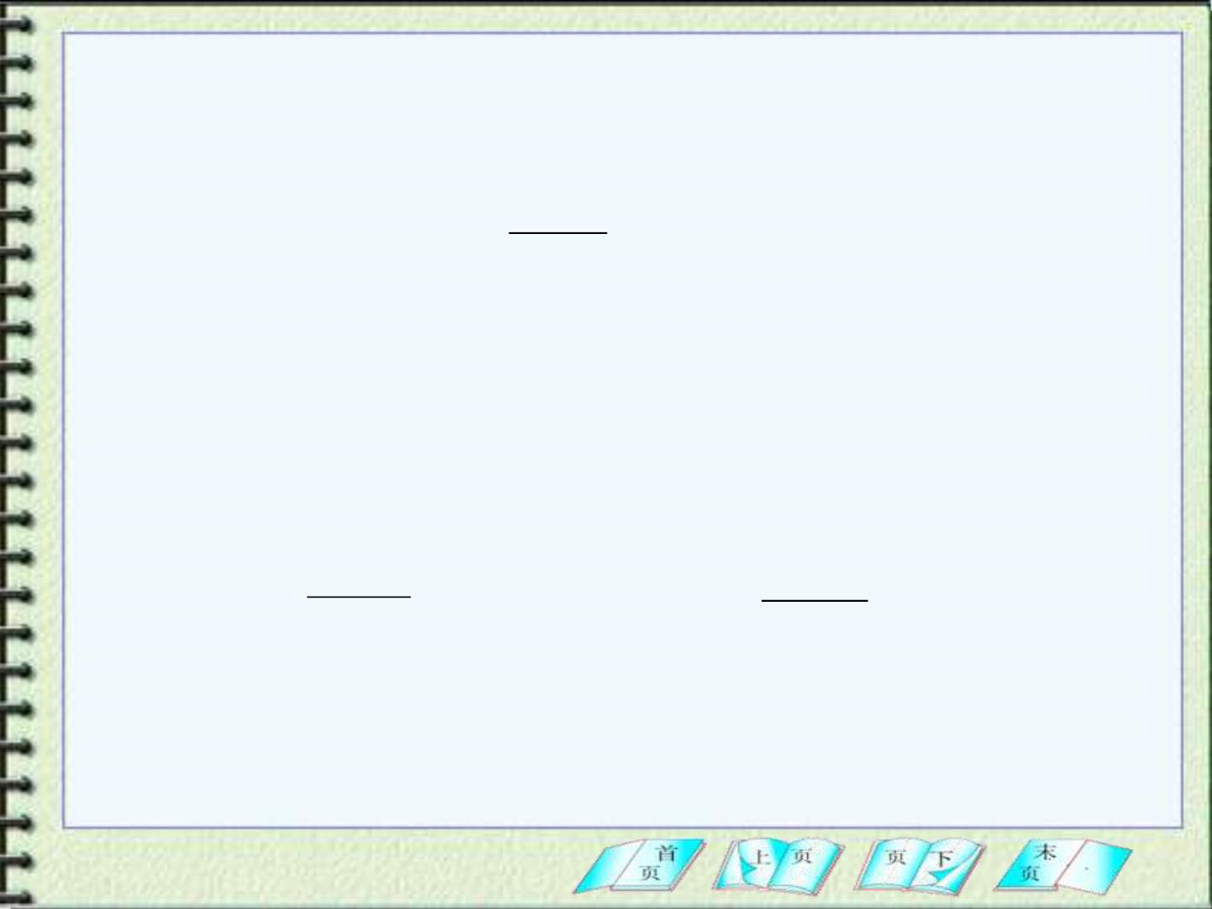
Mathematicall y, the law of gravitation has the
following form
^{m}1^{m}
F = G
2
(14-1)
Here G, called the gravitational constant.
r
2
G 6.67 10 N m /(kg)²
=  −11  2
We can represent Eq(14-1) in vector’s form.
→
m m

→
m m 
F = −G
1 2
2
r
F = −G
1 2
r
Eq(14-3)
and
12
12
r
12
21
r
2
21


21
where and are unit vectors.
r
r
12
21

Slide 5
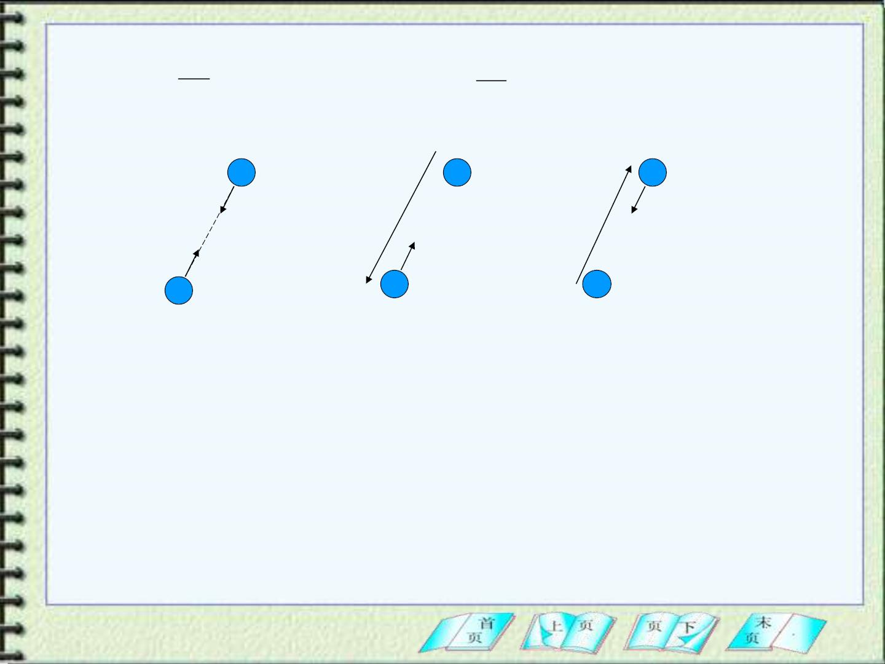
❖
12
r
12
❖
21
^{r}21

r   
, r = r − r

r   
r =
r
=
= −
, r r r
12
12
1
2
21
21
2
1
m₂
→
→
m₂
r
m₂
r
→
12
21
→
F
F
21
21
→
→
F
F
Fig(14-2)
12
m₁
12
m₁
m₁
The negative sign in Eq(14-3) shows that
→
F

12
points in a direction opposite to , which
r
12
indicates that the gravitational force is
attractive.

Slide 6

Sample Problem 14-2
A properly suited astronaut (m_{a}=105Kg) is
drifting through the asteroid belt(小行星带) on a
mining expedit ion（矿业探险）. At a particular
instant he is located near two asteroids of
masses m =346Kg (r =215m) and m =184Kg
1
1
2
(r =142m) two asteroids form an angle of 120
2
degree. At that instant, what is the magnitude
and direction of the gravitation al force on the
astronaut due to these two asteroids?

Slide 7
14-3 The gravitational constant G
1.The first laboratory determination of G was
done by Cavendish in 1798.
This experiment was selected as one of the top 10
beautiful experiments in Phys..
2. It is difficult to improve substantially on the
precision of the measured value of G because of
its small magnitude.
3. This difficulty of measuring G is unfortunate,
because gravitation has such an essential role in
theories of the origin and structure of the
universe.

Slide 8
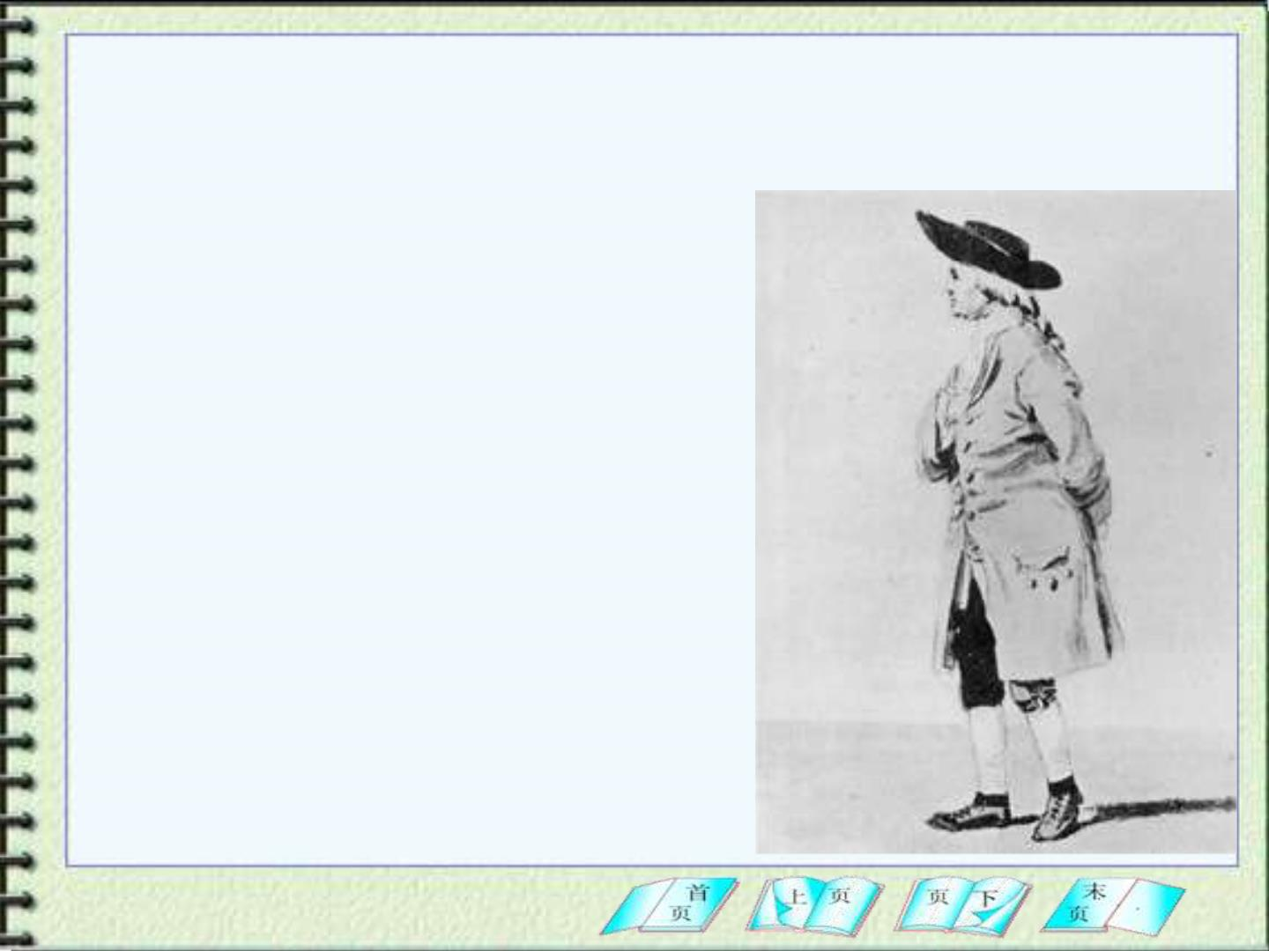
Cavendish, Henry (1731-1810)
English chemist and
physicist who was shy and
absent-minded. He was
terrified of women, and
communicated with his
female servants by notes.
He performed numerous
scientific investigations,
but published only twenty
articles and no books.

Slide 9
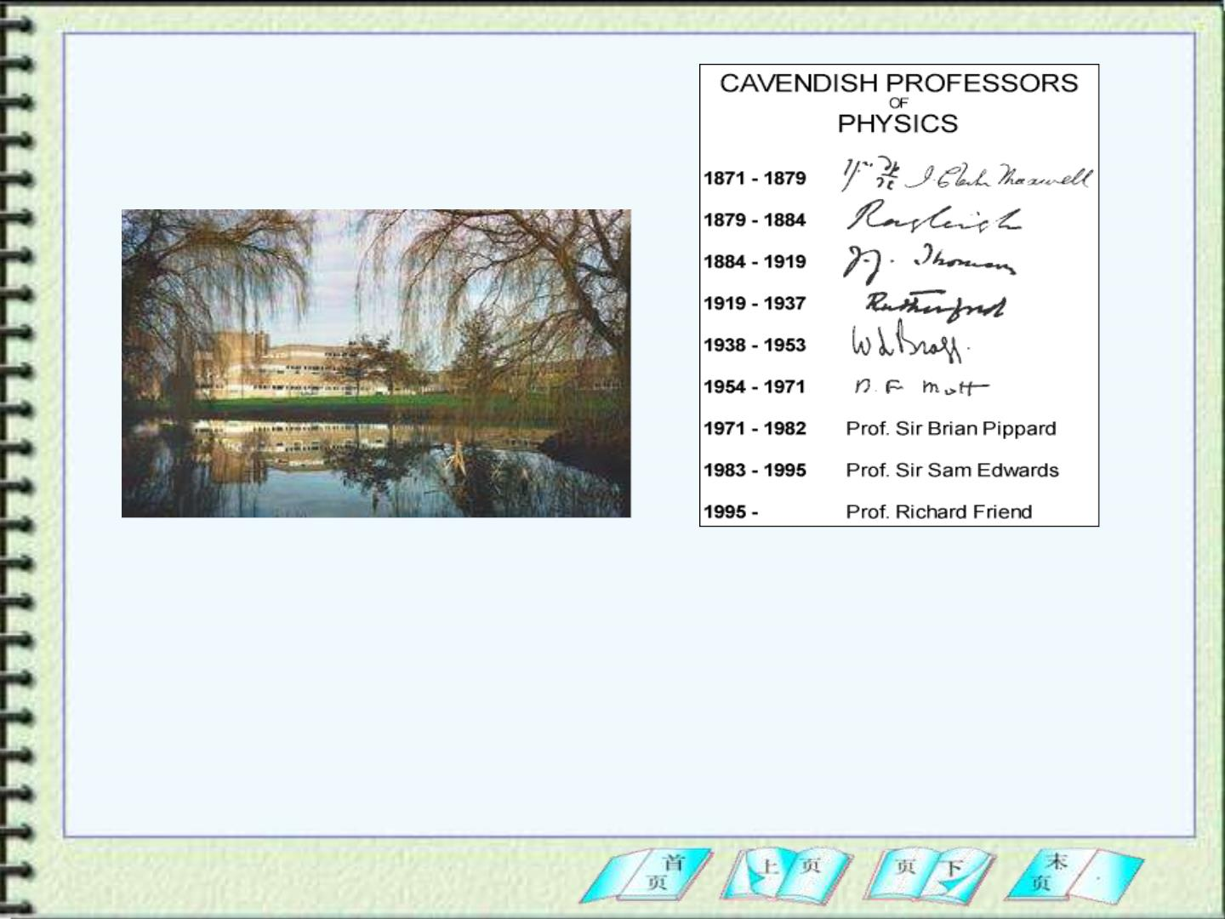
Cavendish Laboratory
at Cambridge Univ.
(1871~ present)
The Cavendish Laboratory was founded in 1871, along with the
appointment of James Clerk Maxwell as the first Cavendish Professor. It
has a distinguished intellectual history, with 29 Nobel prizewinners who
worked for considerable periods within its facilities, and is associated with
many notable discoveries, including the electron and the structure of DNA.

Slide 10
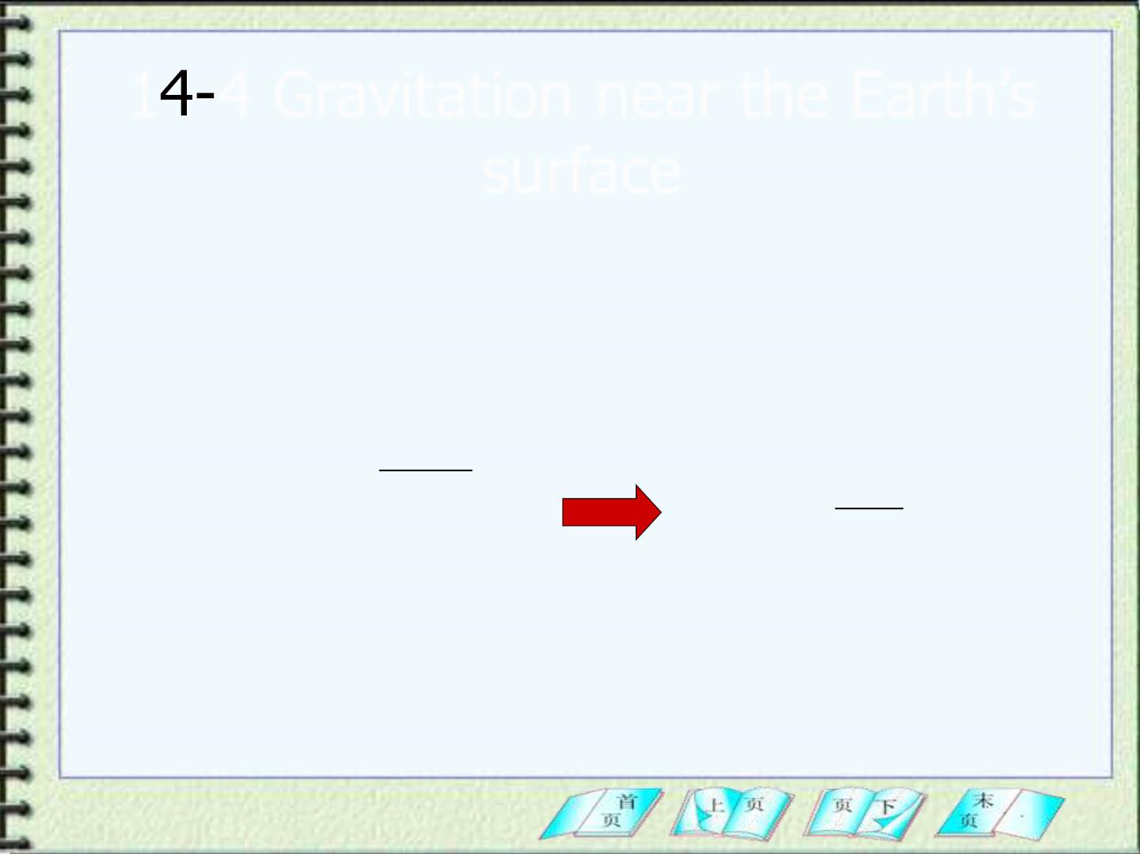
1 4 Gravitation near the Earth’s
surface
1. If we combine the law of gravitation and Newton’s
second law, we can obtain the acceleration of free-
fall body near Earth’s surface. The distance of the
body from the Earth’s center is r.
^{M}E ^{m}
F = G
M
F = m g^{r}
2
｝
=
g G
E
(14-5)
0
r
2
0
M
g₀
is the mass of the Earth;
is the free-fall acceleration due only to
the gravit at ion al pull of the Earth
E

Slide 11
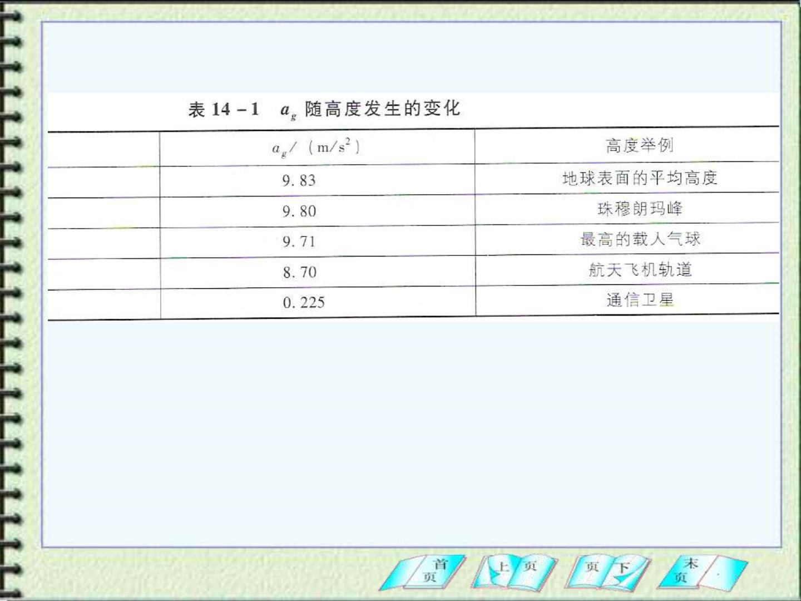
高度/Km
0
8.8
36.6
400
35700
Look at the spacecraft: The acceleration f rom the
gravitational f orce of Earth at that place is not zero!!!

Slide 12
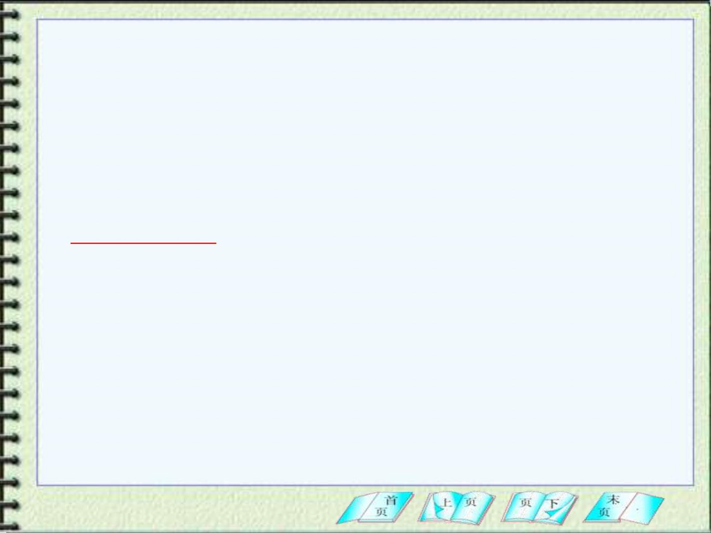
Any assumption in above deduction?
The Earth is regarded as a mass point at its center.
As we will prove in Sec14-5, for spherical mass
distributions we can regard the object as a point
mass concentrated at its center. It is an exact
relationship.
So Eq. (14-5) requires the Earth is spherical
and that its density depends only on the radial
distance from its center

Slide 13
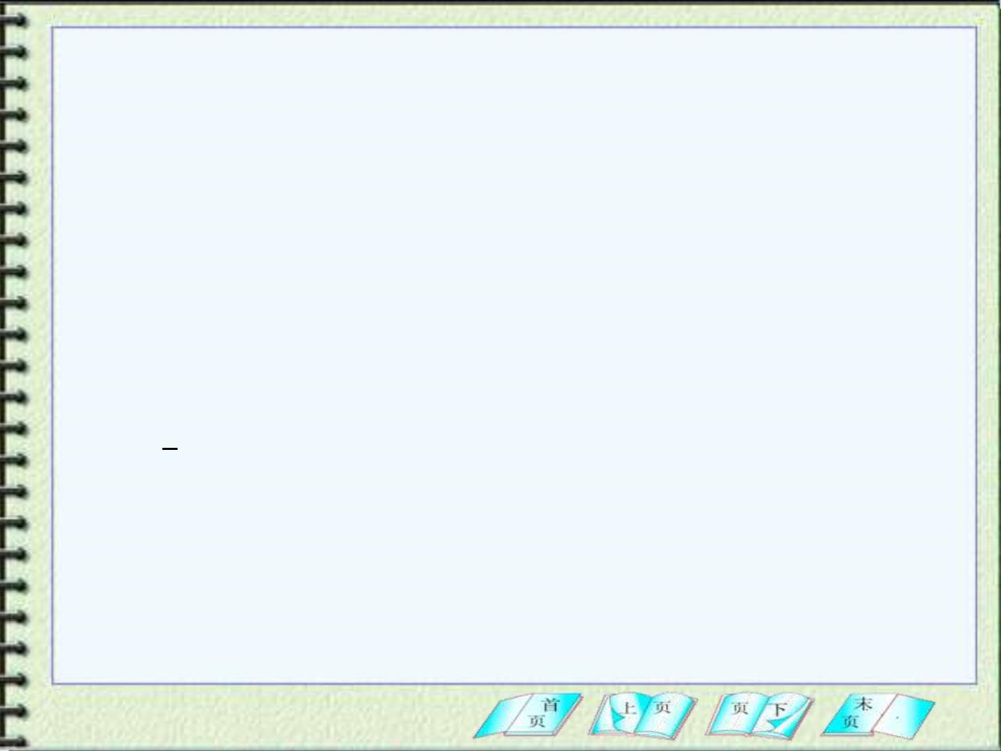
2. The real Earth differs from our model in three way
(a) The Earth is not uniform；
(b) The Earth is approximat el y an ellipso id(椭球)；
flattened at the poles and bulging at the equator
(c) The earth is rotating.
3. How does spin of the Earth affect the measure
valu e g of gravitation al acceleration g₀?
Fig 14-7 shows the rotating Earth from an inertial
frame positioned in space above the north pole. A
crate of mass m rests on a platform scale(台秤) at
the equator.

Slide 14
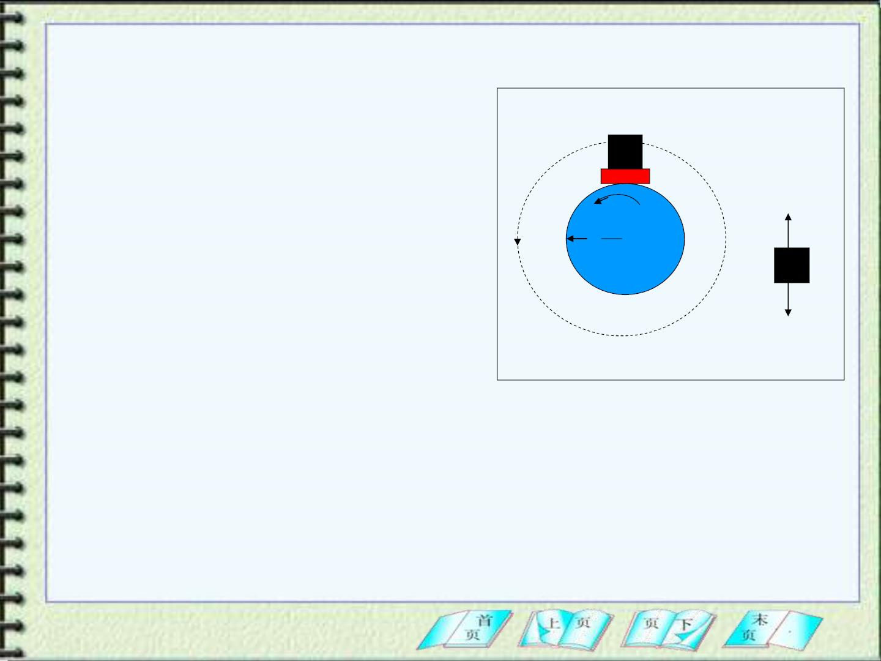
Because of the Earth’s spin,
Fig 14-7
the crate is in uniform
crate
scale
c irc ular motion with radius
R
E
and period of rotation T (=24
hours ).
N
R •
North
pole
mg₀
From Fig14-7
(a)
(b)
− = =
2
= 
2
mg N ma mv / R m R
0
c
E
E
=
− 
2
(14-16)
N m(g
R_{E} )
0

Slide 15
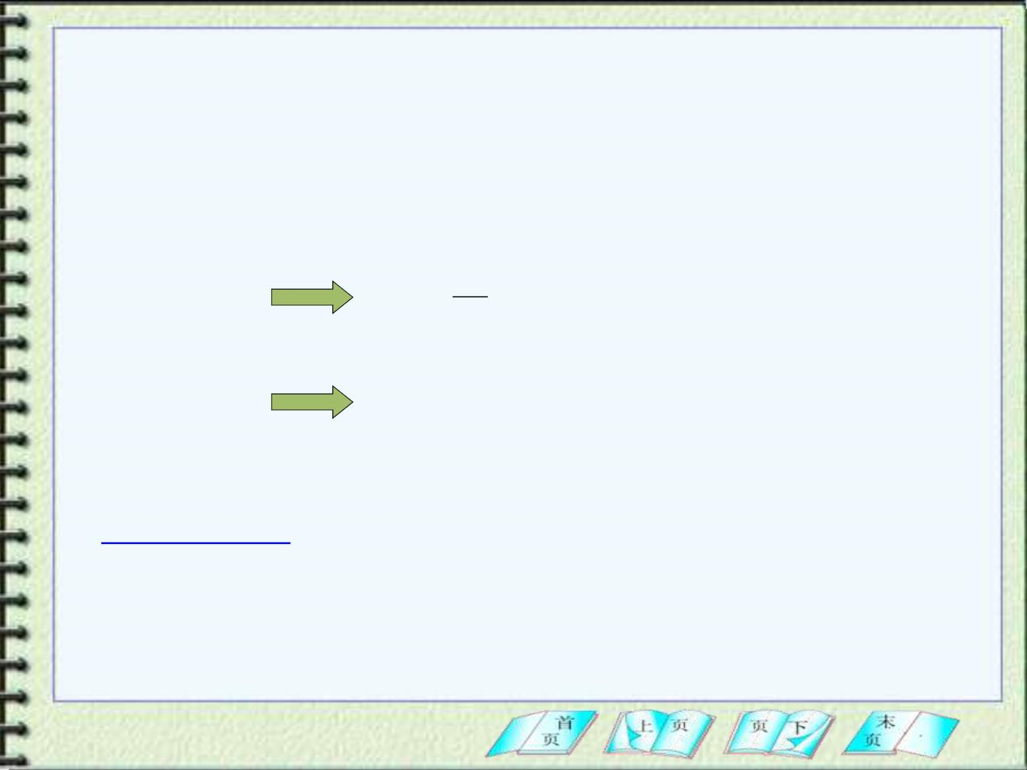
where N is the normal force on the crate due to the
platform scale ( equal to the scale reading mg, and
g is the measure value of gravitational acceleration g₀),
N
g
= = −
² R_{E}
If N=mg,
g
m
0
− = 
g g
2
=
2
R 0.034m / s
0
E
g
0.034m / s
2
The g is smaller than by on ly
, or
0
mg  mg
.
0

Slide 16
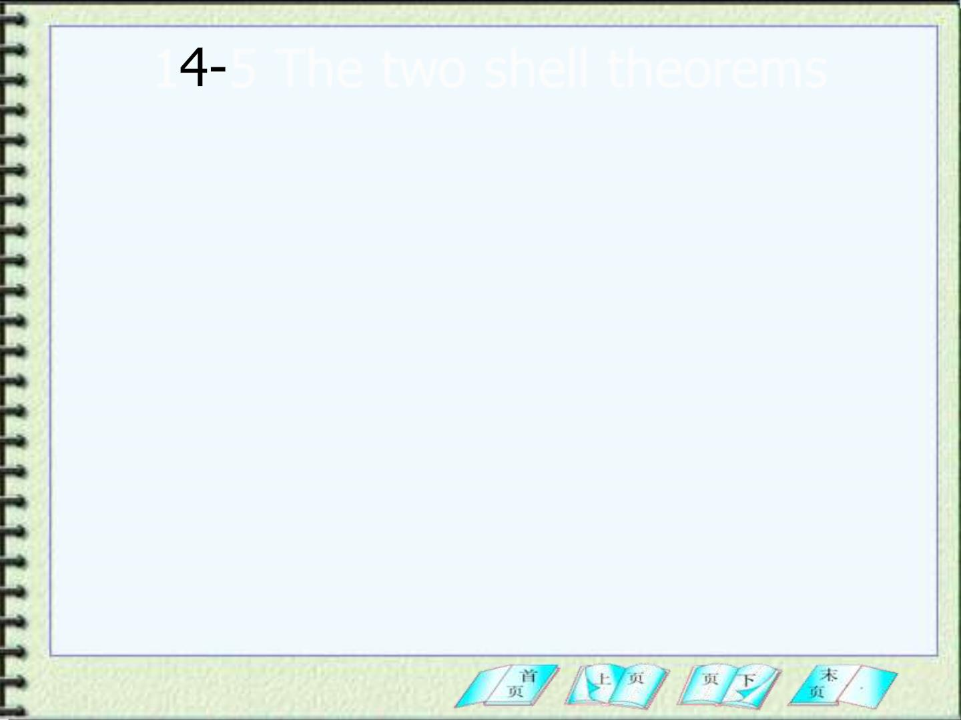
1 5 The two shell theorems
1.Shell theorem
#
1
A uniformly dense spherical shell attracts an
external particle as if the mass of the shell were
concentrated at its c enter.
#
The shell theorem indicates : A spherically symmetric
1
body attracts particle outside as if its mass were
concentrated at its center.
2.Shell theorem
#
2
A uniformly dense spherical shell exerts no
gravitat ional force on a particle located anywhere
in sid e it.

Slide 17
#
The important of shell theorem can be appreciated by
2
imagining a tunnel drilled along a diameter of the Earth. As
we descend into the tunnel, the portions of the Earth
outside our radius exert no gravitational force on us. We
feel only the effect of the portion of the Earth’s mass inside
a sphere whose radius is our distance from the center of
the Earth.
The shell theorem are true on ly for the inverse-square
force.

Slide 18
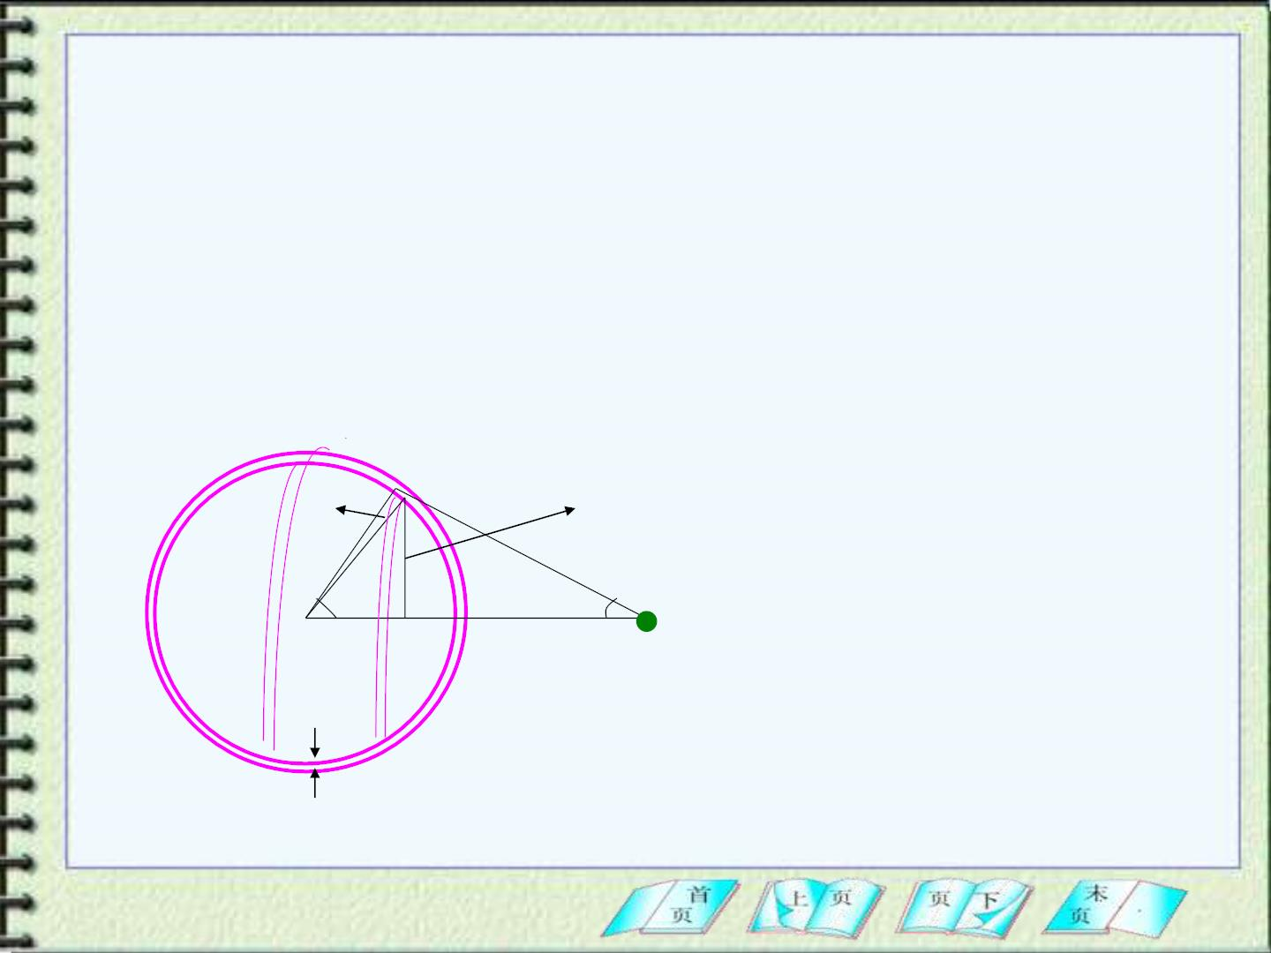
3. Proof of the shell theorems
Fig 14-8 shows a thin shell and the ring we will consider.
The shell has total mass M, thickness t, and uniform
❒
density ( mass per unit volume ). A point mass m is
located at point P, a distance r f rom the center of the shell
( point o ). Our goal is to find the force exer ted on m first by
the ring and then by the entire shell.

d
A
Rcos
R
x
❑

P
o
Q
m
r
t
Fig 14-8

Slide 19
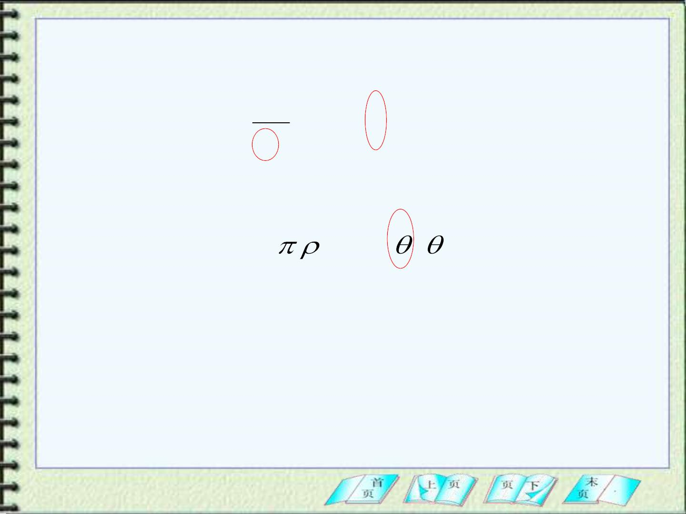
The ring g ives the total force dF exerted on m:
Gm
dF = dM cos
2
(14-7)
x
where the factor
of the force.
cos
g ives the axia l component
dM = 2 t R² sin d
(14-8)

Slide 20
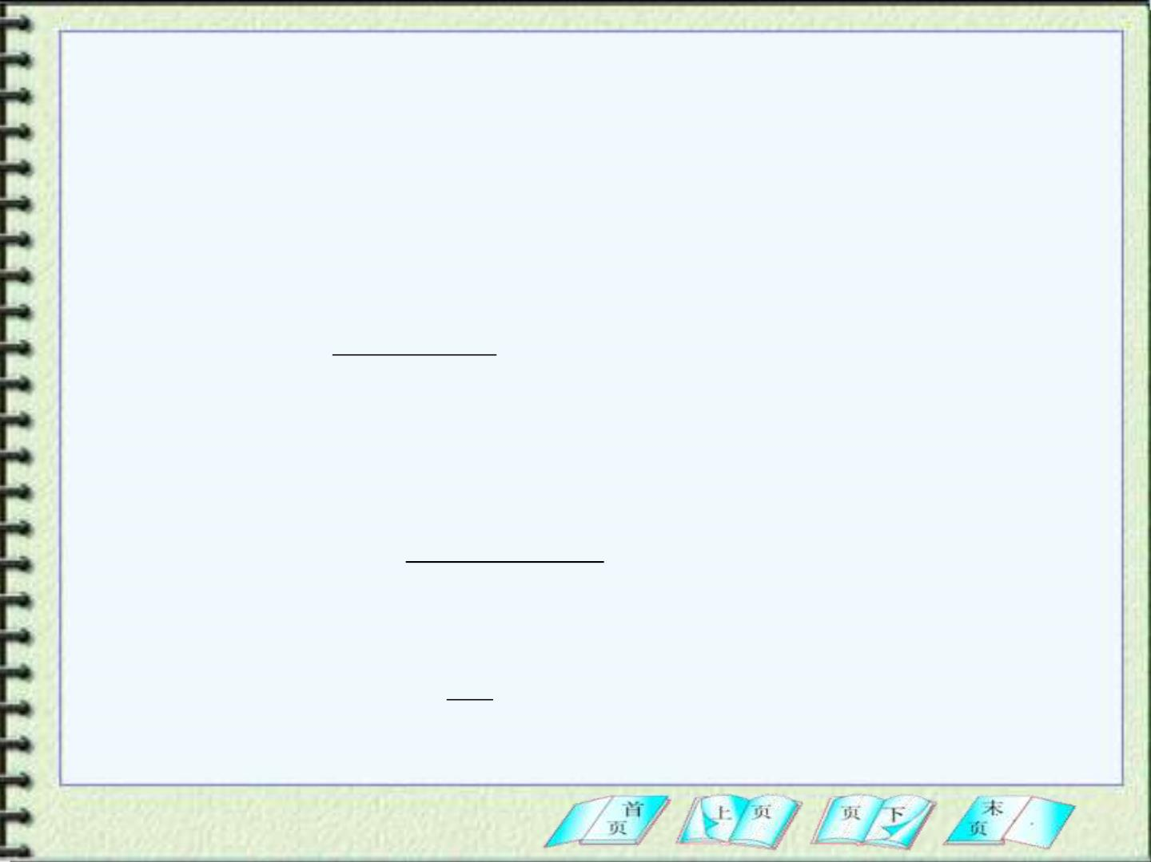
 
From the three variab les ( x , and ), we choose

x
to elimin at e and  , leave as the sin g le
variab le.
PQ = xcos = r − Rcos
so
r − Rcos
(14-9)
cos =
x
Using the law of cosines on triangle Aop we obtain
x r R 2rR cos
2
=
2
+
2
−
or
2
+
2
−
2
(14 -10)
(14-11)
r R x
Rcos =
2r
Differentiate Eq(14-10) to find
x
s in d = dx
rR

Slide 21
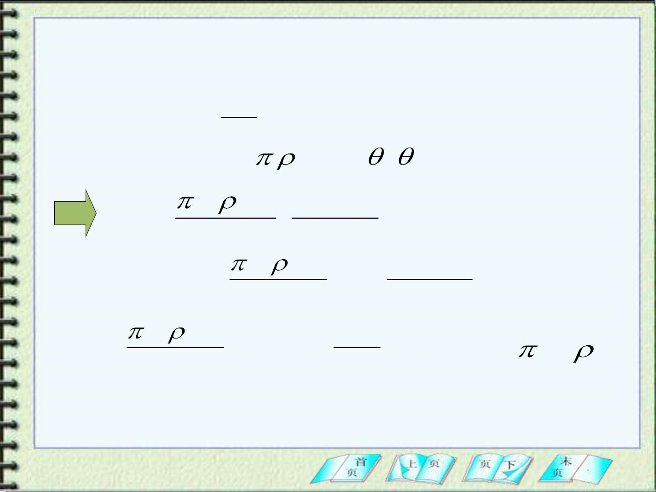
Put Eq(14-10) into Eq(14-9) and then substitute
the result for
cos
into Eq(14-7).
Gm
dF = dM cos
x
2
dM = 2 t R² sin d
Gt mR r² − R²
dF =
(
+1)dx
r ²
x²
² − 2
Gt mR r R
⇩
⇩
r+R
F = dF =
(
+1)dx
2
−
2
r
r R x
Gt mR
Mm
=
(4R) = G ,
=
M 4 R²t
r
2
r
2

Slide 22
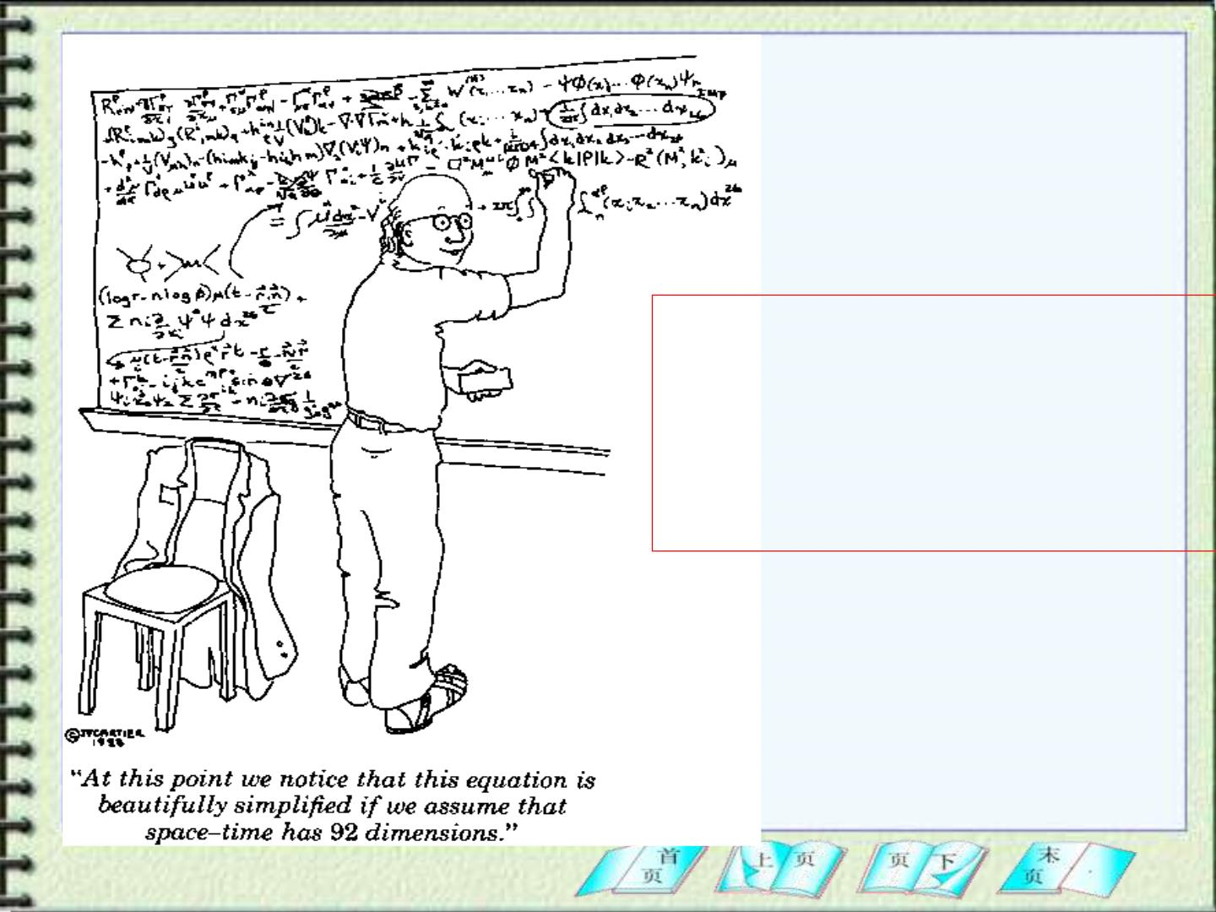
At this point we notice that
this equation is beautifully
simplified if we assume that
space-time has 92
dimensions.

Slide 23
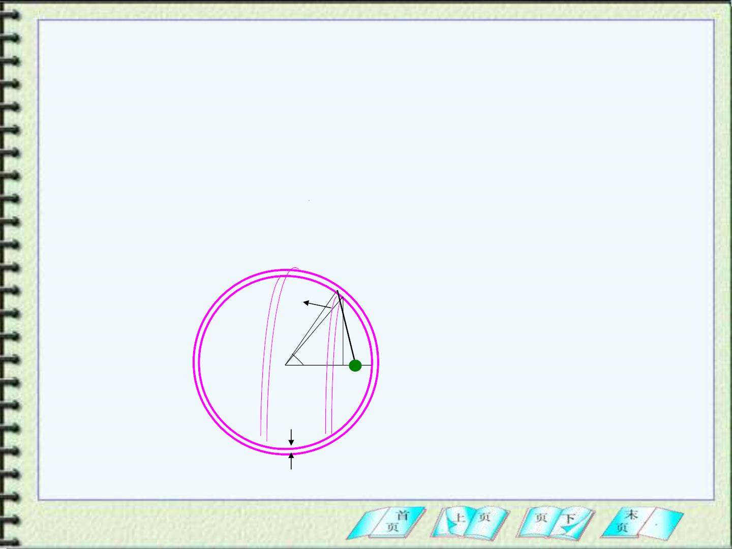
★ The proof of the second shell theorem is
exactly same up to the final step, but the lower
limit of the integral is now R-r rather than r-R. This
small change causes the valu e of the integral to
be zero.
d
A
R
x

❑
r
m
o
t

Slide 24
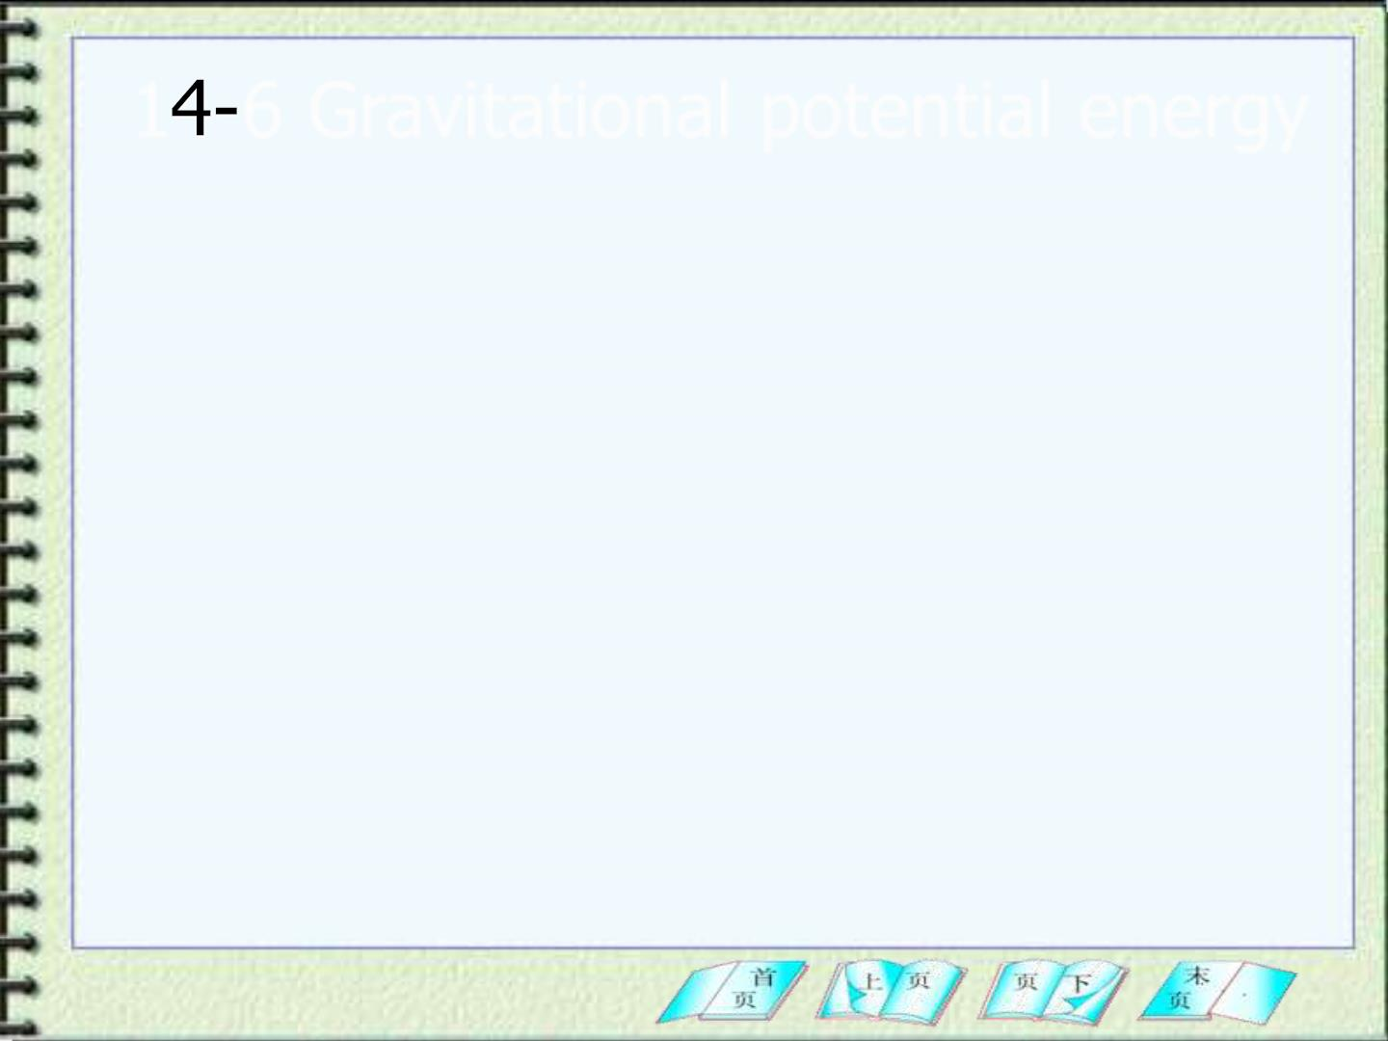
1 6 Gravitational potential energy
In chapter 12, we obtained the potential
energy change due to gravit y for a body :
U = mgy
(Eq(12-9))
where we regard the gravitation al force as
approximately constant.
Our goal now is to find a general expression
of potential energy for universal gravitation.

Slide 25
1. The potential energy difference can be found
from Eq(12-4).
U = U −U = −W
b
a
ab
However this equation applies only if the force is
conservative.
Is the gravitational force conservative?

Slide 26
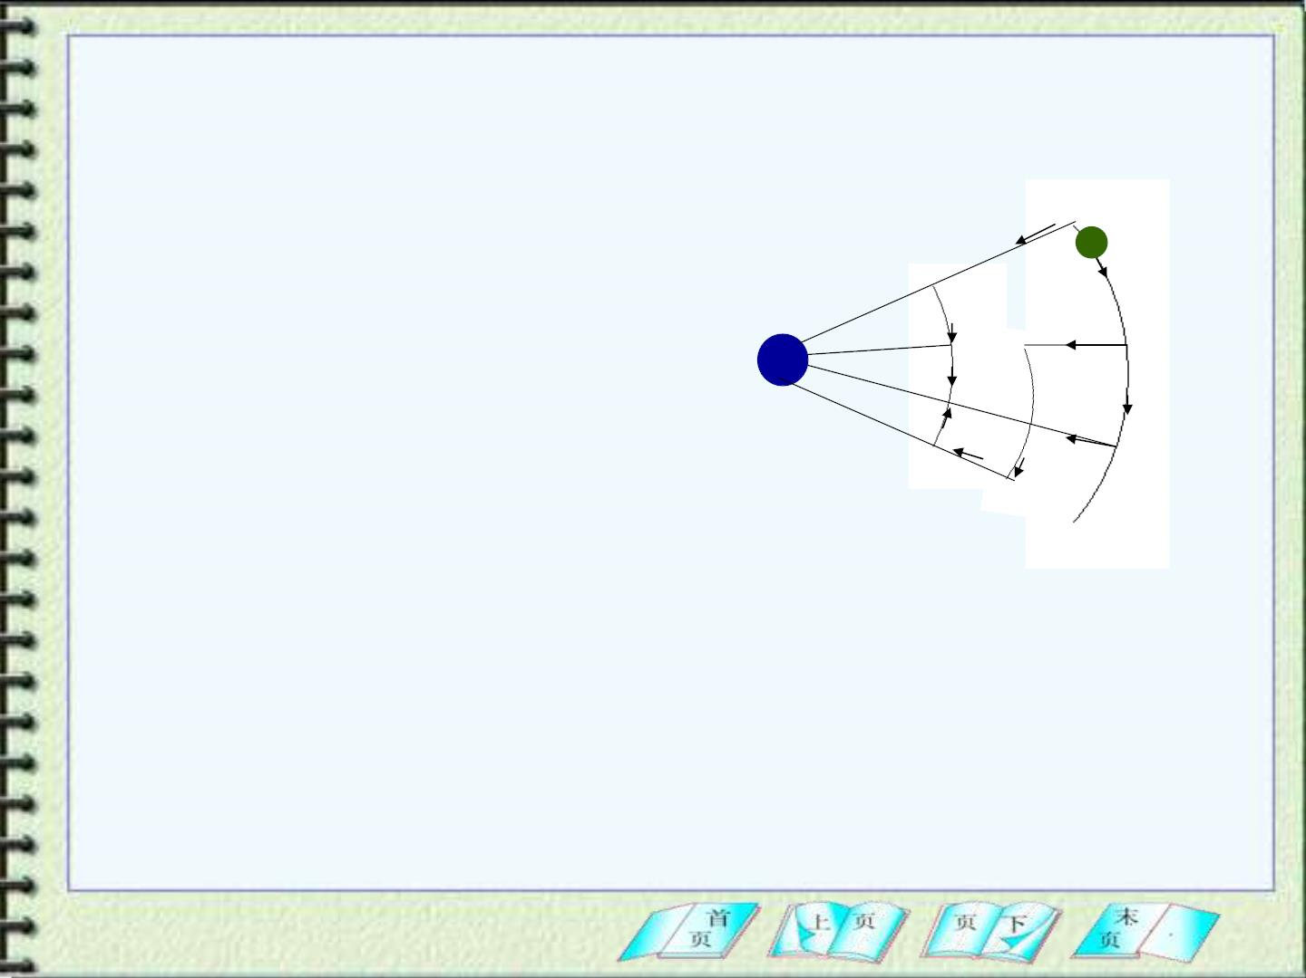
Fig14-11 shows a particle of
mass m moving in a region
where a gravit at ion al force
is exerted on it by a particle
M. Particle m mo ves from a
to b along several different
paths: path 1 (a A b ),
Path 1
a
m
A
M
D
C
b
Path 2
F
B
Path 3
E
path 2 (a B b) and
Fig 14-11
path 3 ( a c D E F b).

Slide 27
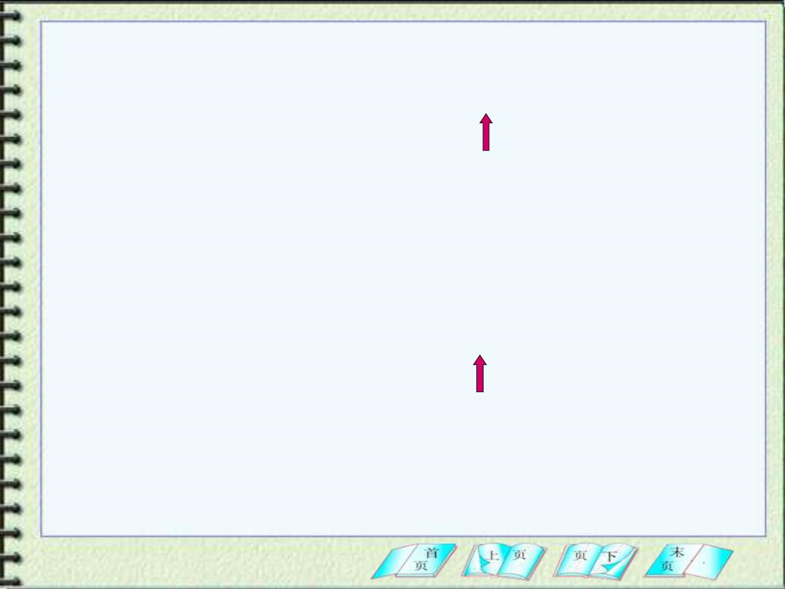
For Path1:
r
→
→
r
→
→
⇩ 
W = W +W = W = F d s = F d s
A
b
1
aA
Ab
aA
r
a
r
a
r_{A} = r_{b}
→
→
F
W is zero, because is perpen dicu la r to d s . So
Ab
For Path2:
r
→
→
r
→
→
⇩ 
W = W +W = W = F  d s = F  d s
b
b
2
aB
Bb
Bb
r
B
r
a
r_{B} = r_{a}

Slide 28
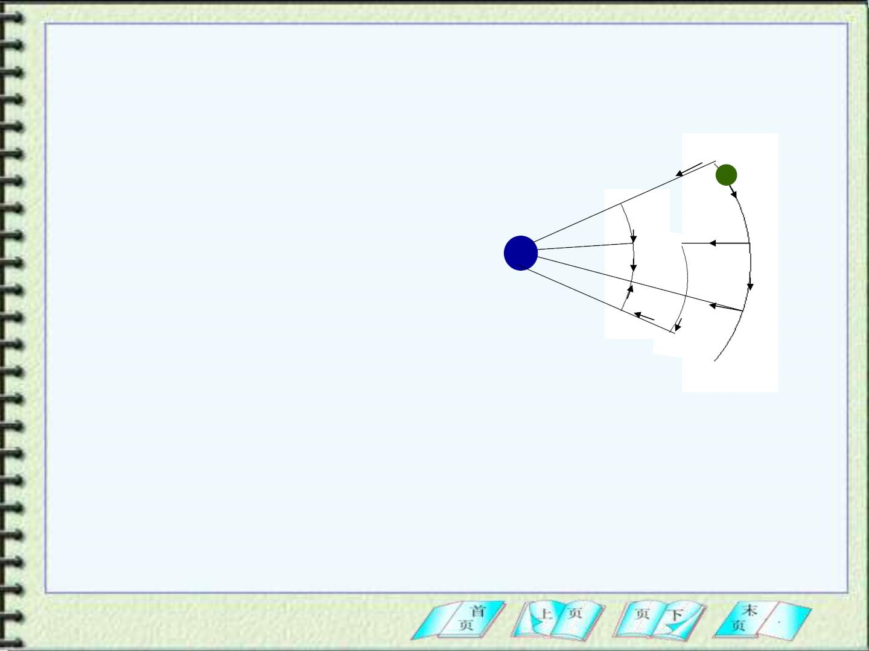
For Path3:
W = W +W +W +W +W = W +W
3
ac
cD
DE
EF
Fb
CD
EF
r
→
→
r
→
→
r
→
→
r
b
→
→
a
=
=
⇩   
D
F  d s+
F
F  d s =
D
F  d s+
F  d s Path 1
m
r
C
r
E
r
a
r
D
A
r
b
→
→
M
⇩
F  d s
D
E
C
r
a
b
Path 2
F
B
Path 3
Fig 14-11
It is clear from this calculat ion that = = ,
W W W
1
2
3
the work is independent of the path, and the
gravitat ional force is conservative.

Slide 29
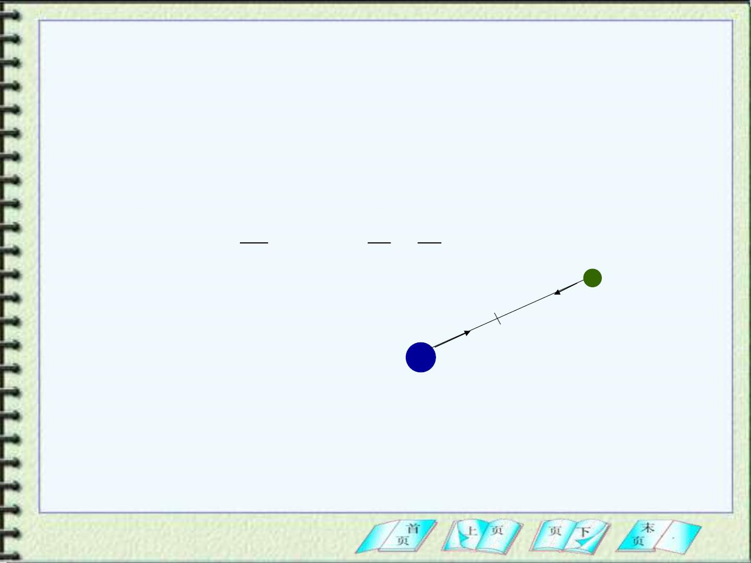
2. Calculat ing the potential energy.
In Fig 14-12. M is at rest. As m mo ves from a to b,
the work done on m by the gravitat ional force is
b
→
→
b
⇩
⇩
a
W = F  d r = − F  dr
ab
a
r
dr
1 1
(14-14)
= −
GMm
⇩
b
=
GMm(
−
)
r
a
r
2
r r
a
b
a
m
b
→
F
M
^
r
Fig 14-12
The negative sign in the first line of this equation arises
^
r
because the force is in opposite direction of .

Slide 30
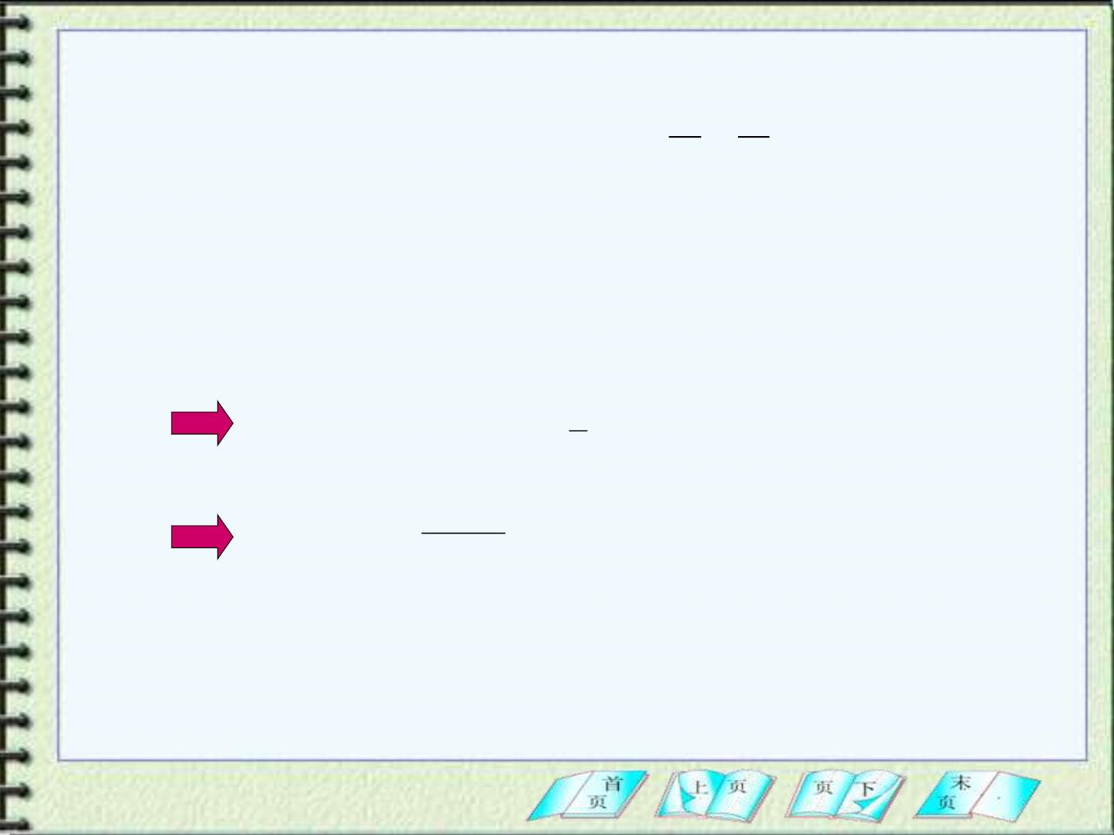
Applying Eq(12-4)
1 1
U = U −U = −W = GMm( − )
(14-15)
b
a
ab
r r
a
b
We can obtain the valu e of the potential energy at
a single point if we define a reference point.
r_{b} = 
U_{b} = 0
1
U() −U(r) = GMm( − 0)
r
GMm
r
U_{a} (r) = −

Slide 31
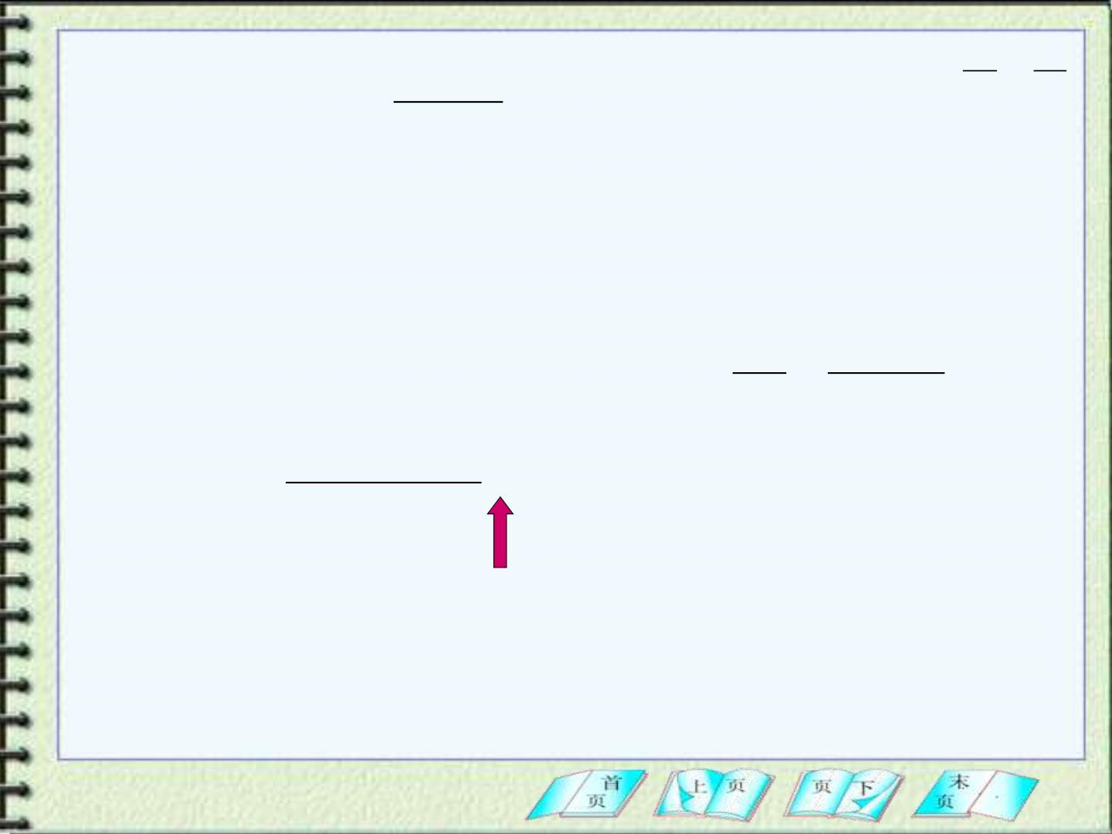
1 1
U = GMm( − )
r r
GMm
r
3 From
U (r) = −
to mgy
a
b
From Eq(14-15), the difference in potential energy
between the loc ation at a h eight y (y is a small valu e)
above the surface and the surface = is
r R
a
E
1
1
+
U = U (R + y) −U (R ) = GM m( −
)
E
E
E
R R y
E
E
y
= GM _{E} m
 GM _{E} my / R_{E}
2
= mgy
+
R (R y)
E
E
y  R_{E}

Slide 32
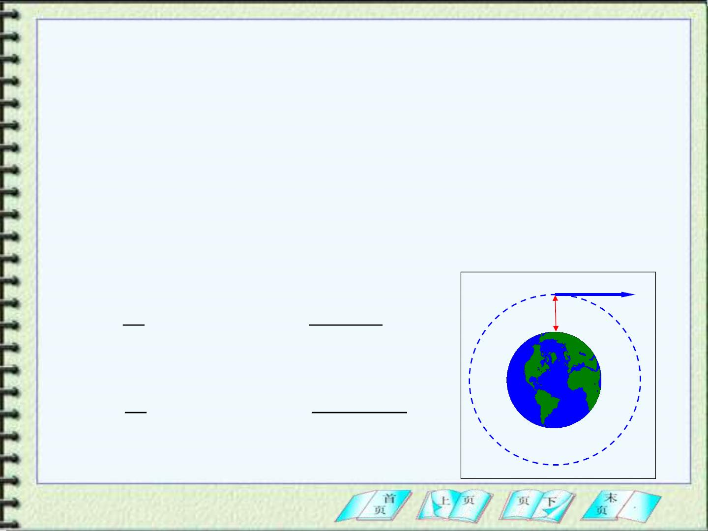
4 The three u n iversa l speeds
A proj ectile fired upward from the Earth’s
surface will usually slow down, come momentarily
to rest, and return to Earth.
v =
(a) The first u n iversa l speed, 7.9km/s
1
For a certain initial speed, however, it will move around
the Earth, not return back to the Earth immediately.
❖
1
^{mm}E
= v + −
h v
2
0
E m ( G
)
2
1
R_{E}
^{mm}E
R_{E} + h
``````
= v + −
2
m ( G
)
2

Slide 33
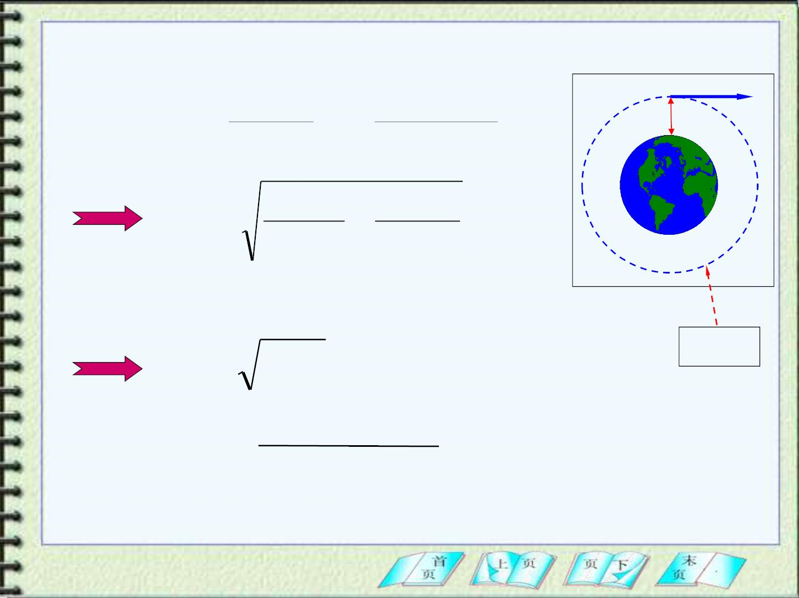
Newton’s second law:
v²
^{mm}E
❖
m
=
G
h v
+
+
2
R h
(R h)
E
E
``````
2Gm Gm
v₀ =
E
−
E
R R + h
E
E
If
R_{E}  h
E  0
v₀ = gR_{E}
7.9 10 m/ s
= 
3
E
= −
Gmm
E
+

0
2 ( R
h )
E

Slide 34
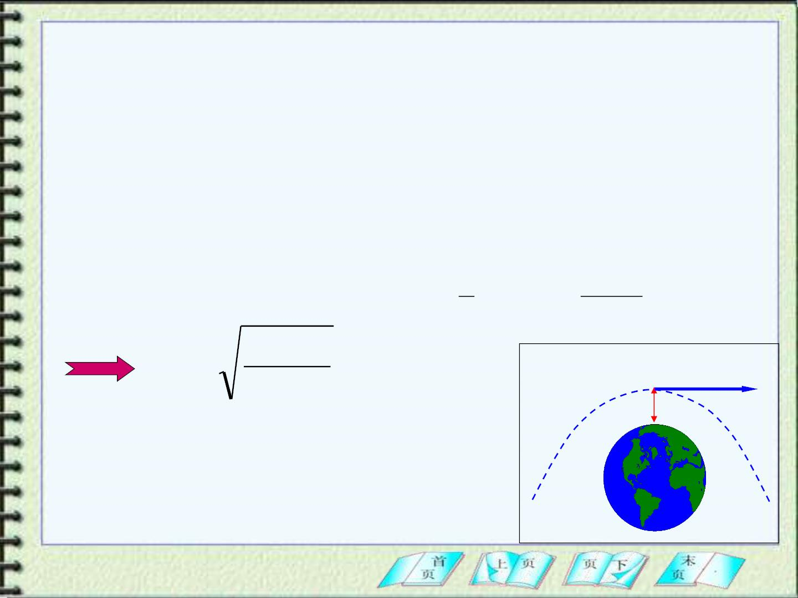
v =
(b) The second universal speed, 11.2km/s
2
For a certain initial speed, the object can move upward
f orever, with its speed decreasing gradually to zero just as its
distance f rom Earth approaches to inf initely.
The initial speed for this case is called the “escape
speed”.
1
GMm
2
U + K = U + K = 0
+ −
mv (
) 0
=
i
i
f
f
2
0
R
2GM
R
❖
v₀ =
= 11.2km / s
v
h
`
E=0

Slide 35
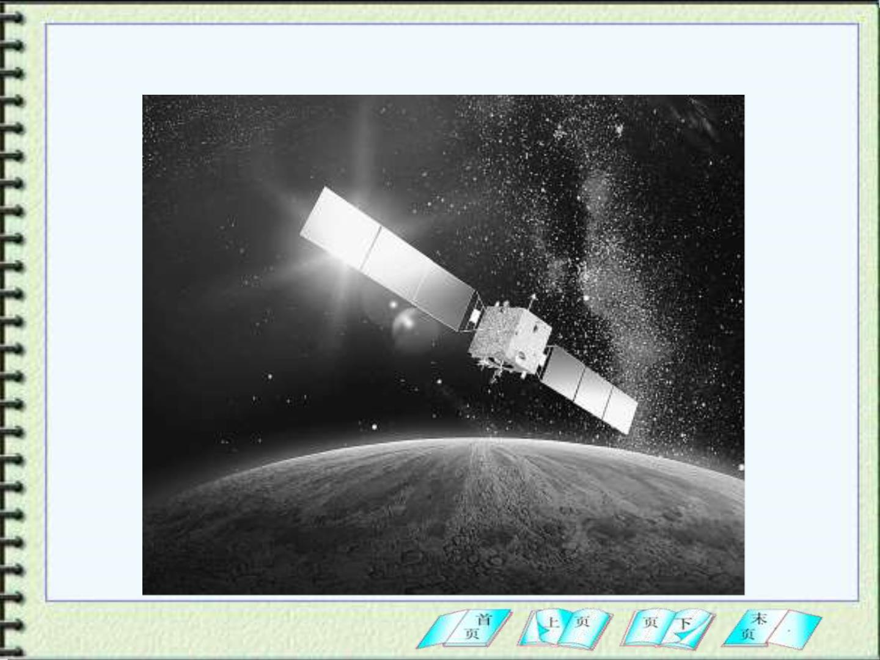
中国“嫦娥一号”绕月探测卫星在轨飞行

Slide 36
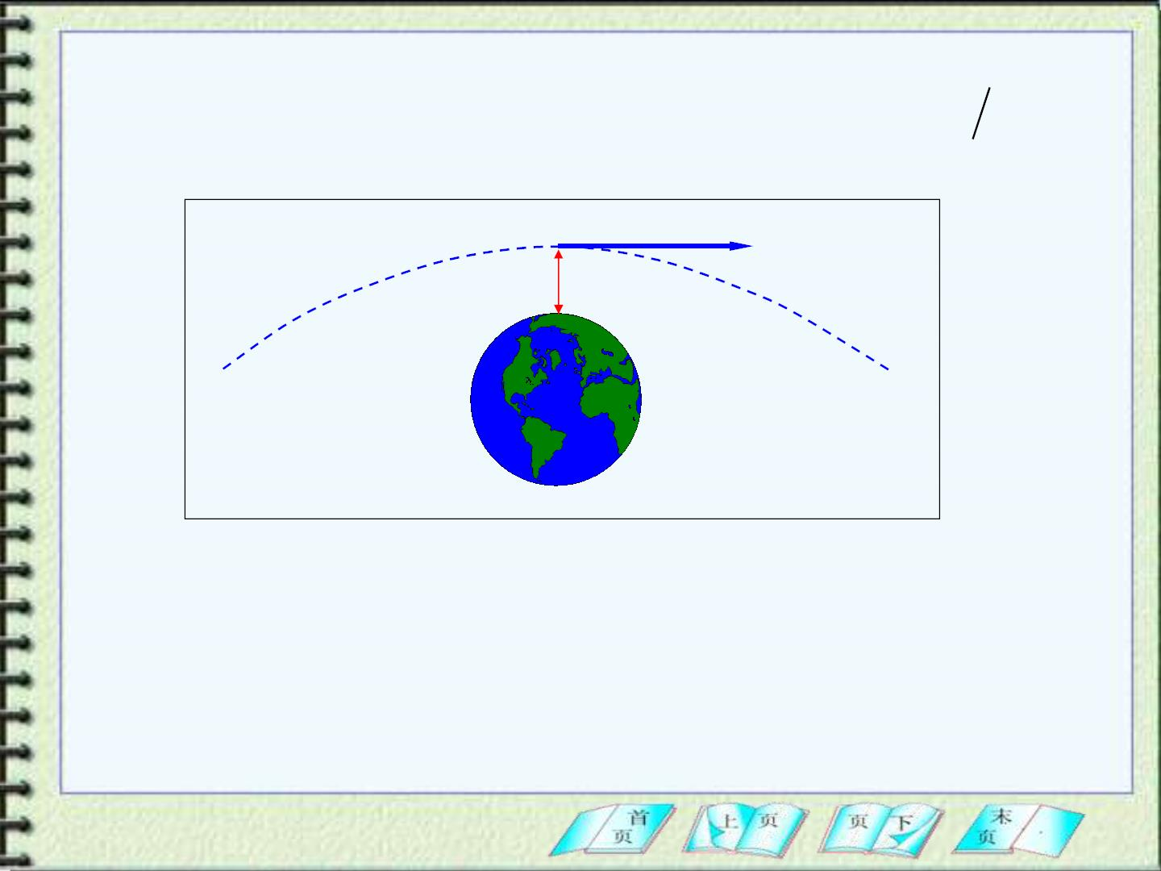
v =
(c) The third universal speed, 16.4k m s
3
❖
v
h
E>0

Slide 37
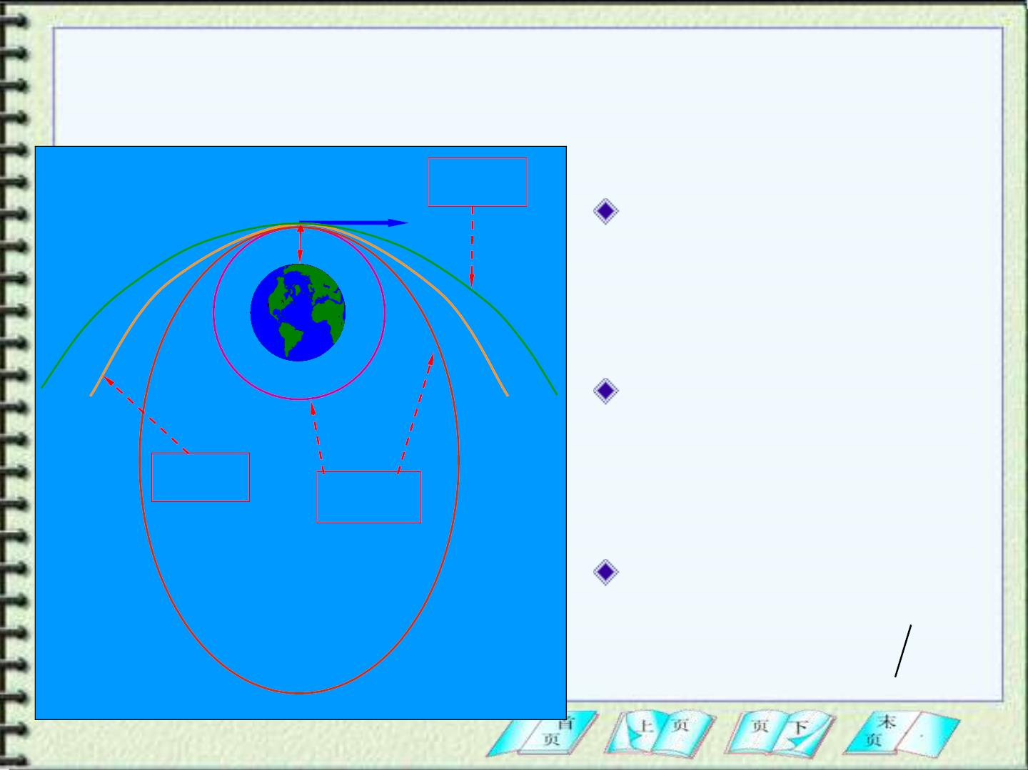
抛 体 的 轨 迹 与 能 量 的 关 系
v
E  0
E  0
椭 圆 包括圆)
(
h
v₁ = 7.9km/s
E = 0
抛物线
v₂ =11.2km/s
E = 0
E  0
E  0
双曲线
v₃ =16.4k m s

Slide 38
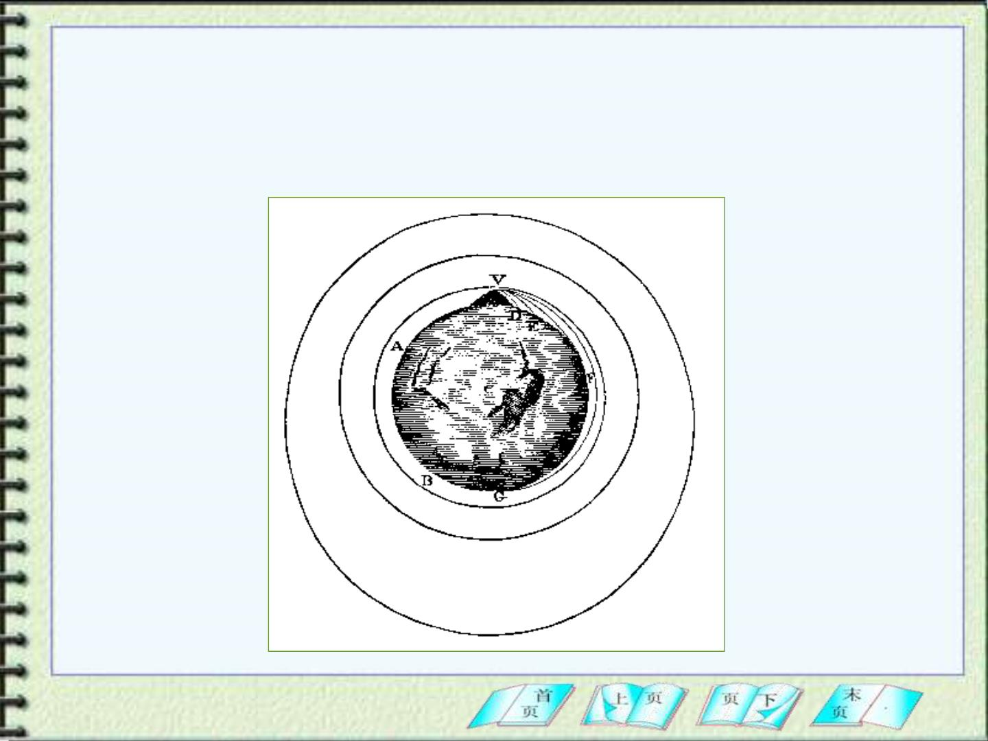
牛顿的《自然哲学的数学原理》插图，抛体
的运动轨迹取决于抛体的初速度
E  0

