Slide 1
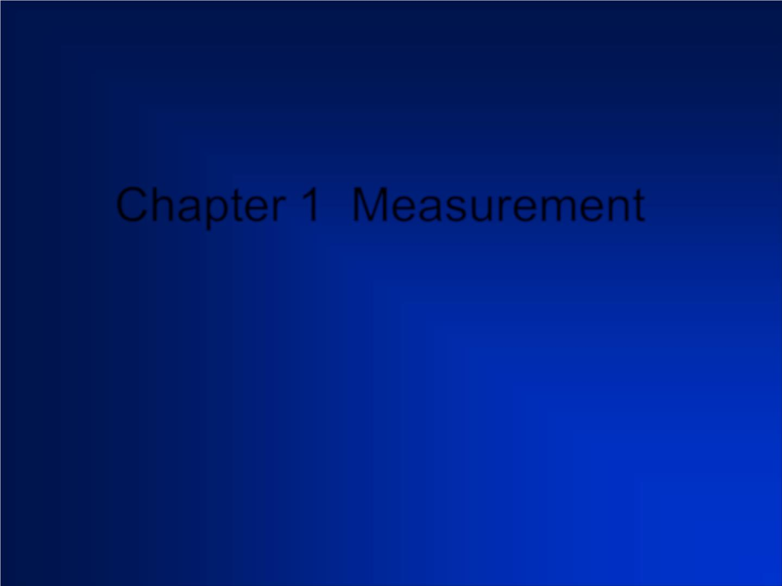
Chapter 1 Measurement

Slide 2

an experimental science

Slide 3
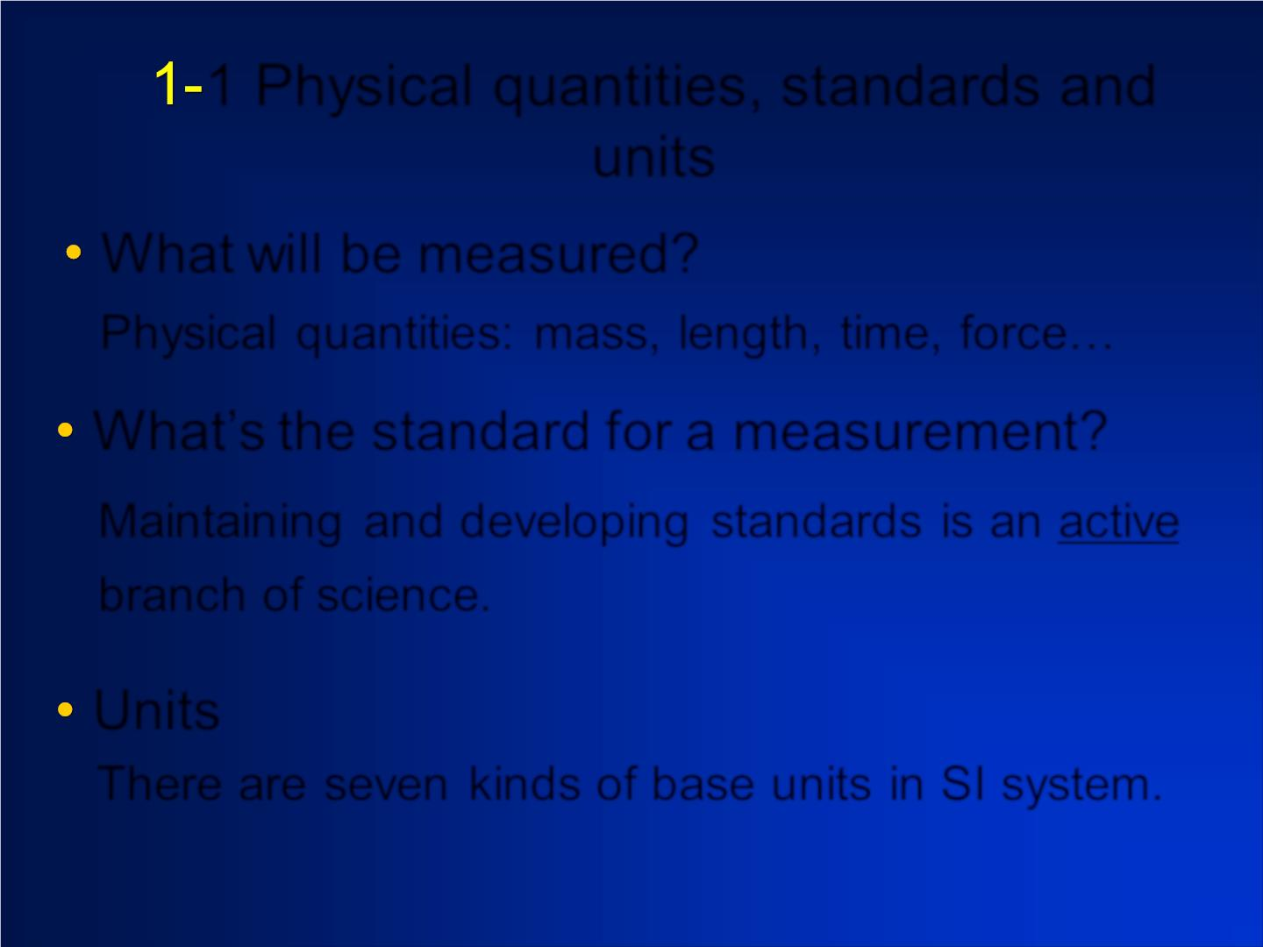
1 Physical quantities, standards and
units
What will be measured?
Ph ysic al quantities: mass, length, time, force…
What’s the standard for a measurement?
Maintain ing and d evelo p in g standards is an ac tive
branch of science.
Units
There are seven kinds of base units in SI system.

Slide 4
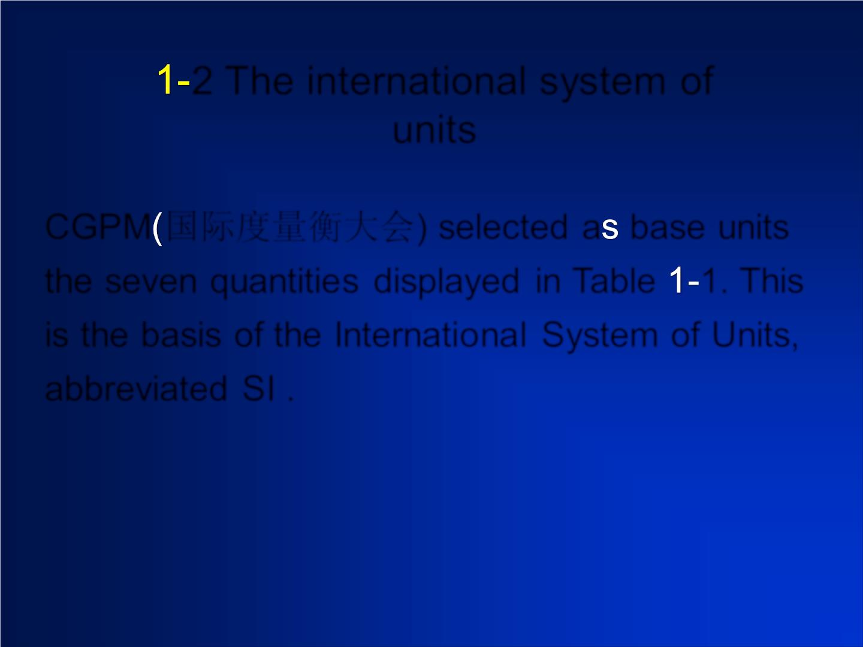
2 The international system of
units
CGPM 国际度量衡大会) selected a base units
the seven quantities displayed in Table 1. This
is the basis of the Internatio na l System of Units,
abbreviated SI .

Slide 5
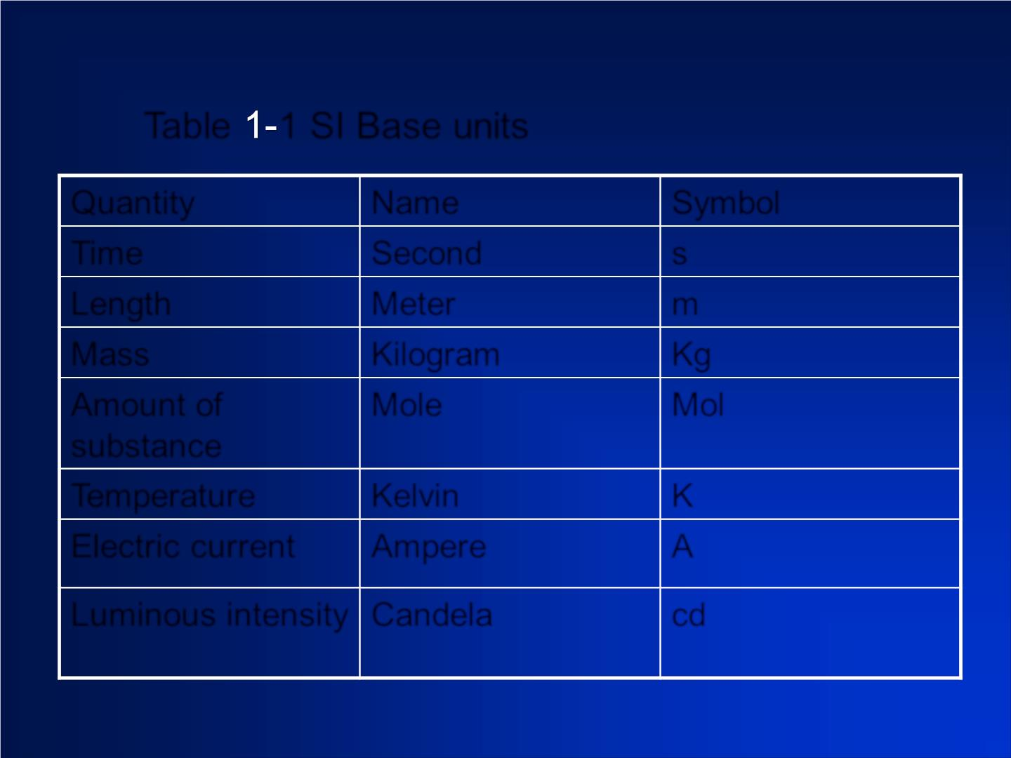
Table 1 SI Base units
Quantity
Name
Second
Meter
Symbol
s
Time
Length
Mass
m
Kilogram
Mole
Kg
Amount of
substance
Mol
Temperature
Kelvin
K
A
Electric current Ampere
Luminous intensity Candela
cd

Slide 6
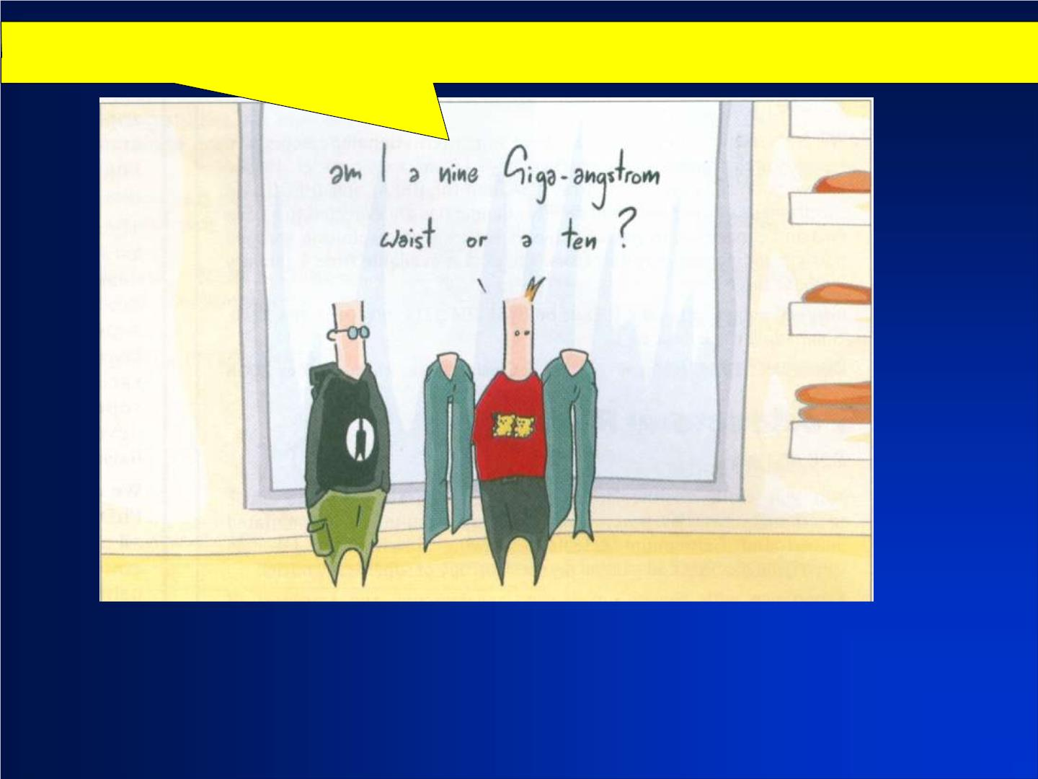
□
Am I a nine giga-angstrom (10⁹ ) waist or a ten?
A

Slide 7
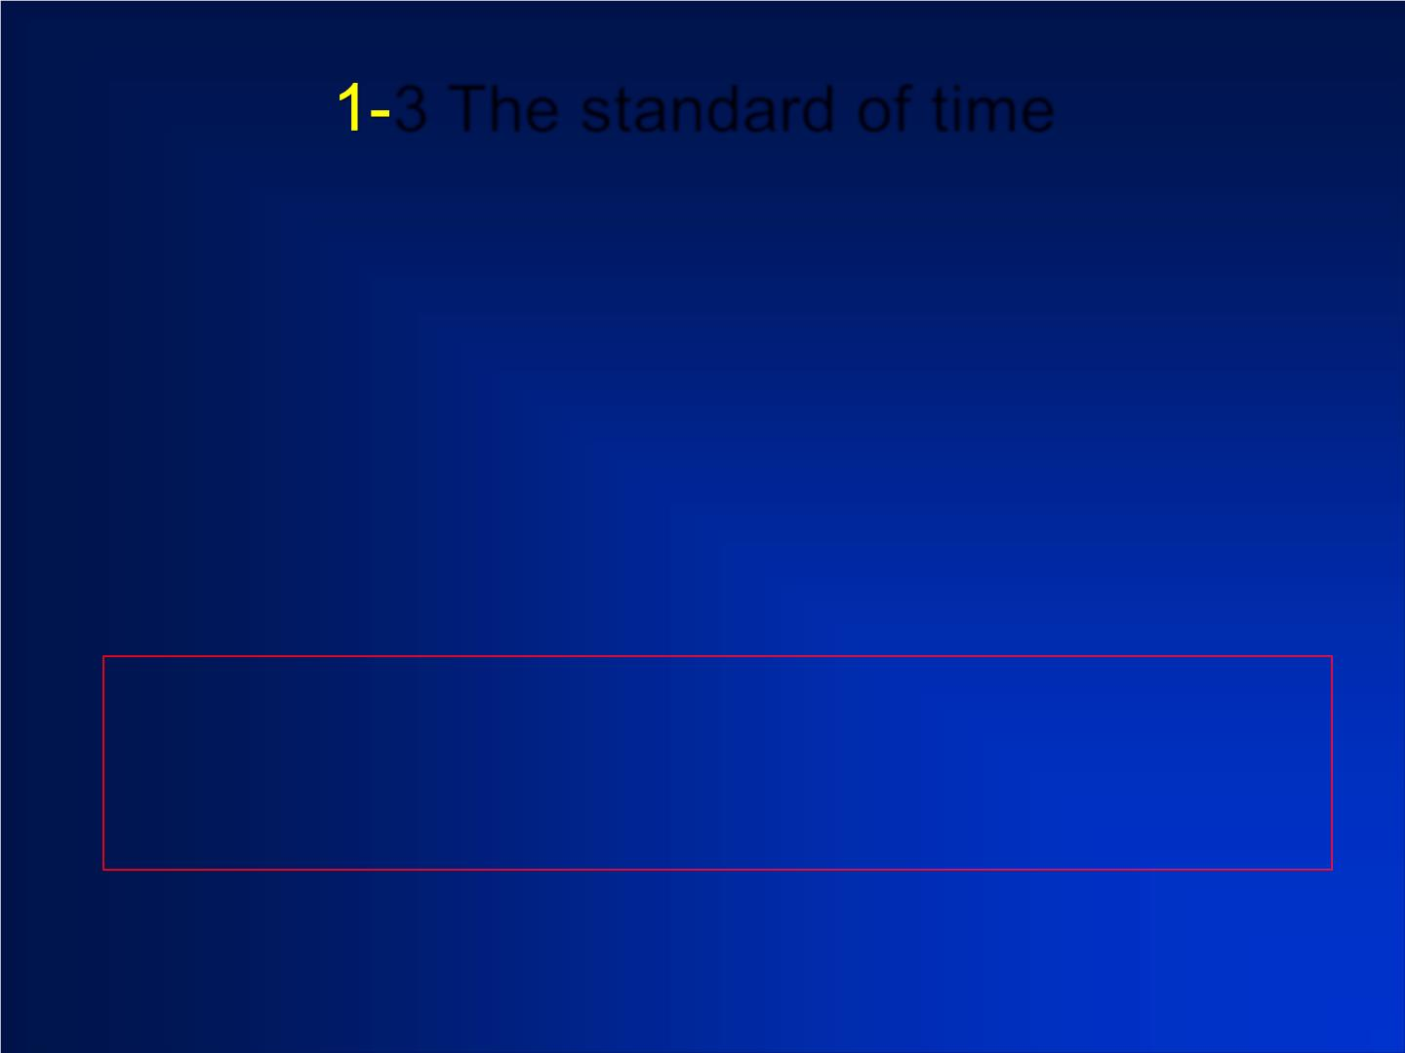
3 The standard of time
n use any phenomenon that repeats itself
second

Slide 8
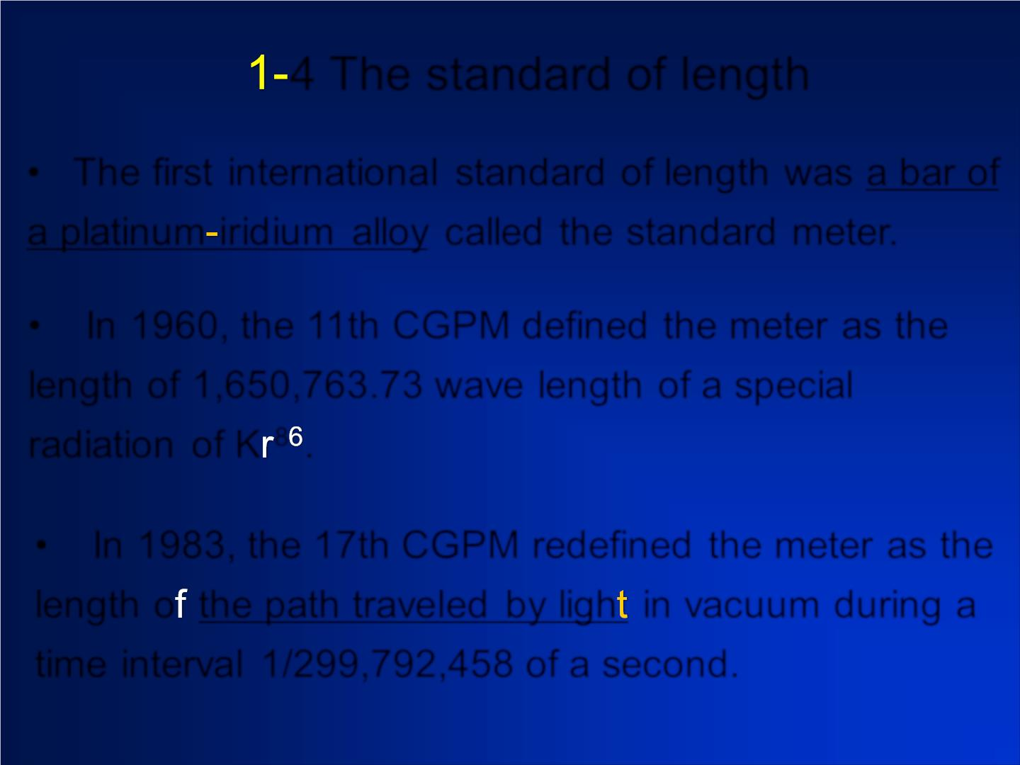
4 The standard of length
• The first international standard of length was a bar of
a platinum irid ium alloy called the standard meter.
• In 1960, the 11th CGPM defined the meter as the
length of 1,650,763.73 w ave length of a special
radiation of K ⁸ .
• In 1983, the 17th CGPM redefined the meter as the
length o the path traveled by lig h in vacuum during a
time interval 1/299,792,458 of a second.

Slide 9
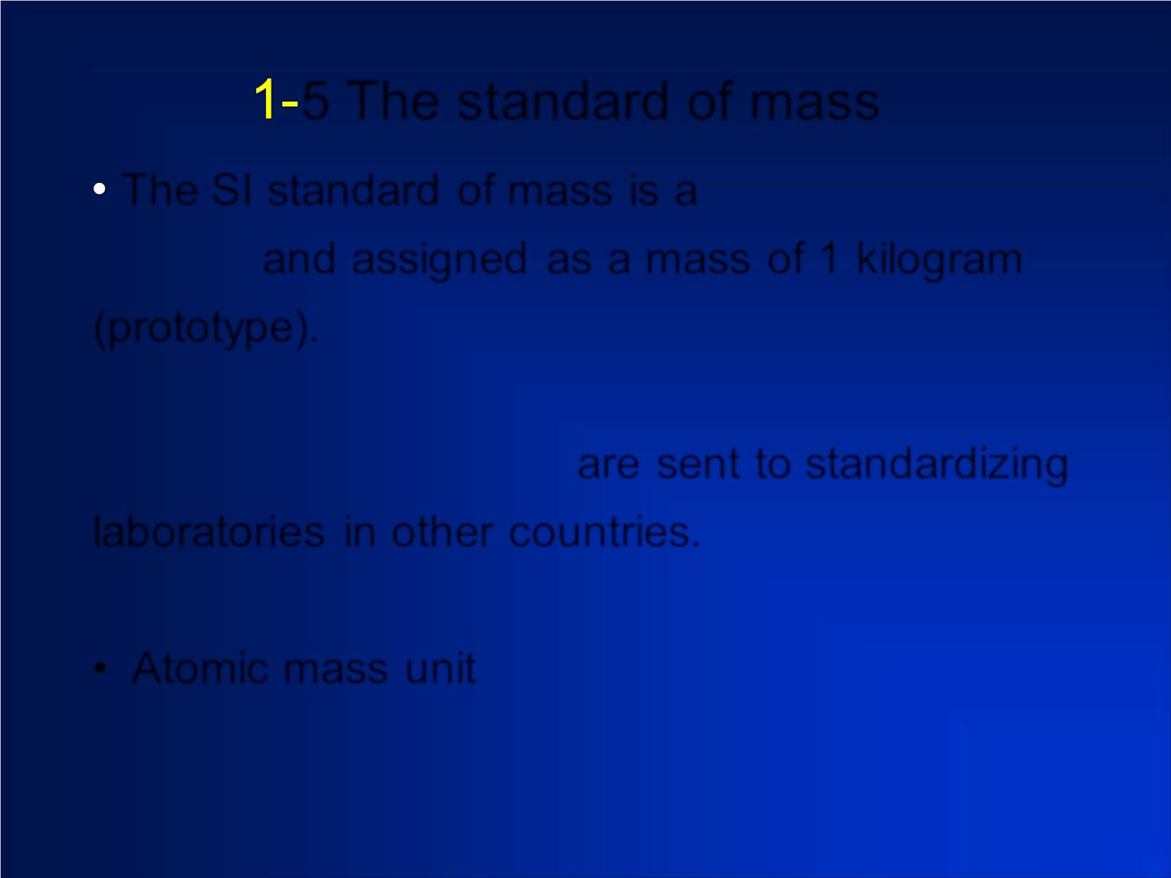
5 The standard of mass
The SI standard of mass is a platinum-ir id ium
c ylin d er and assigned as a mass of 1 kilogram
(prototype).
Secondary standards are sent to standardizing
laboratories in other countries.
• Atomic mass unit

Slide 10
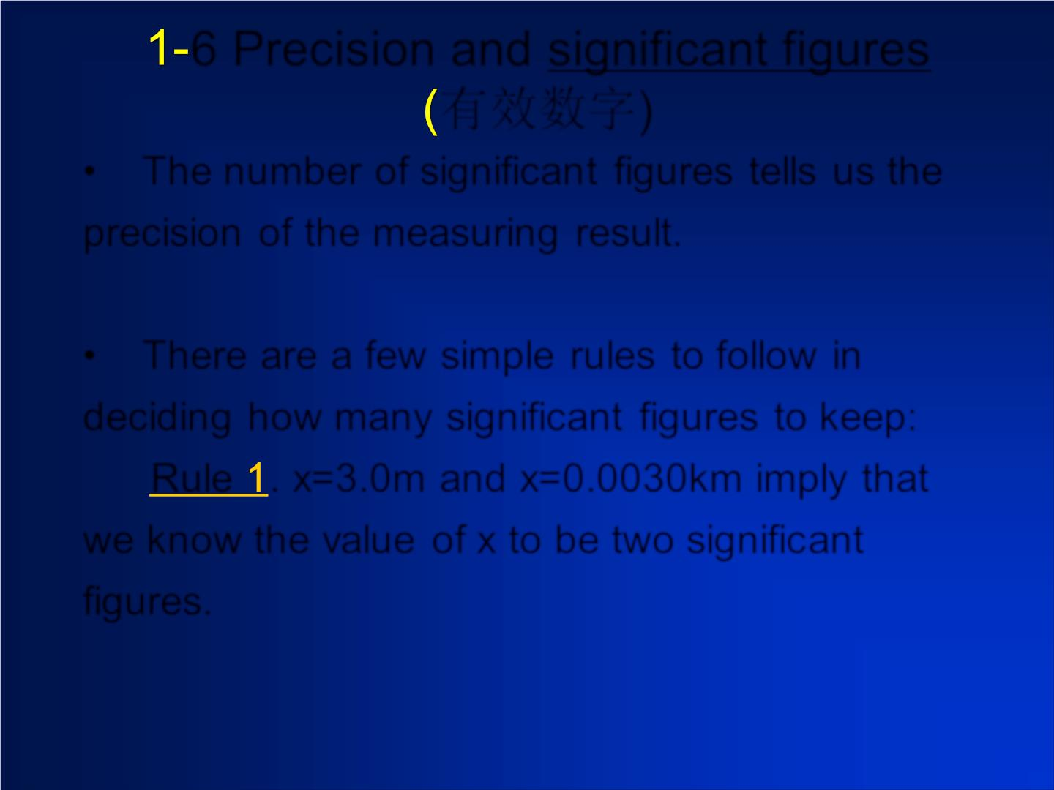
6 Precision and significant figures
有效数字)
• The number of significan t figures tells us the
precision of the measuring result.
• There are a few simple rules to fo llo w in
deciding how many significant figures to keep:
Rule . x=3.0m and x=0.0030km imp ly that
we know the valu e of x to be two signific ant
figures.
Be careful about ambiguous notations: x=300m

Slide 11
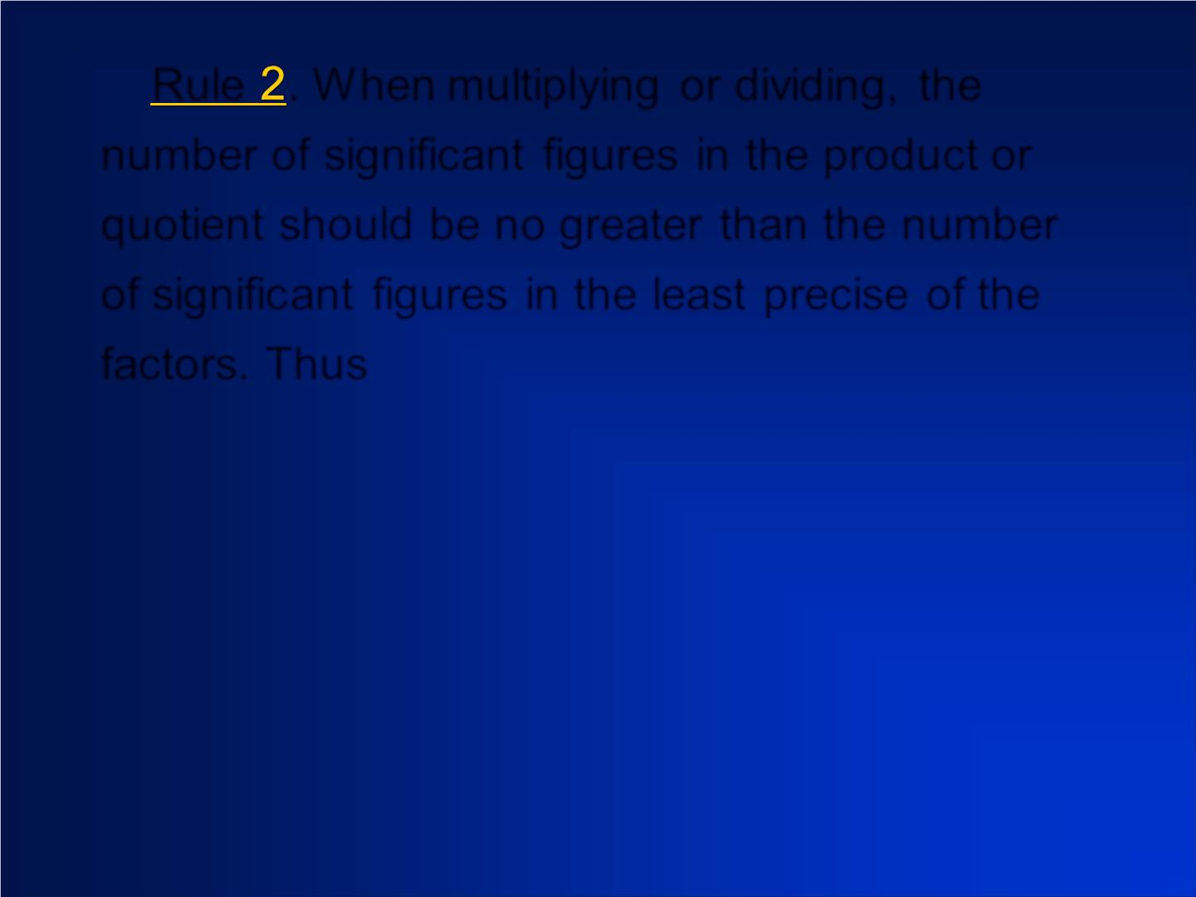
Rule . W hen multiplying or dividing, the
number of significant figures in the product or
quotient should be no greater than the number
of signific ant figures in the least precise of the
factors. Thus
2.3
Be careful of this:

Slide 12
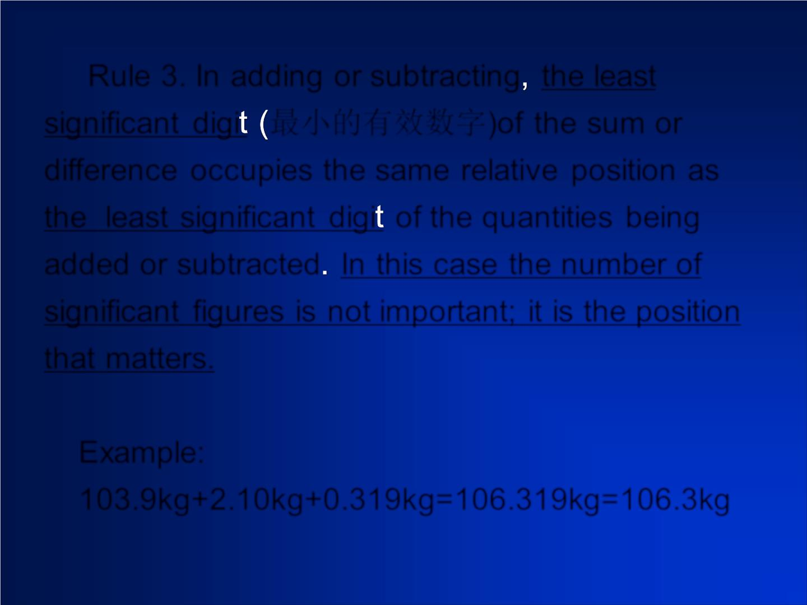
Rule 3. In adding or subtracting the least
significant digi 最小的有效数字)of the sum or
difference occupies the same relative position as
the least significant digi of the quantities being
added or subtracted In this case the number of
significant figures is not important; it is the position
that matters.
Example:
103.9kg+2.10kg+0.319kg=106.319kg=106.3kg

Slide 13
L= 27.9cm
W =21.6 cm
Correct answer is D).

Slide 14
80
L= 1.27 cm.
Correct answer is B).

