Slide 1
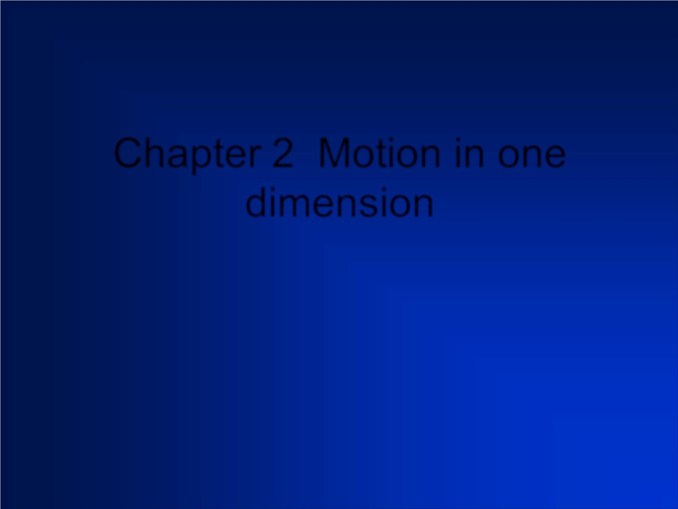
Chapter 2 Motion in one
dimension

Slide 2
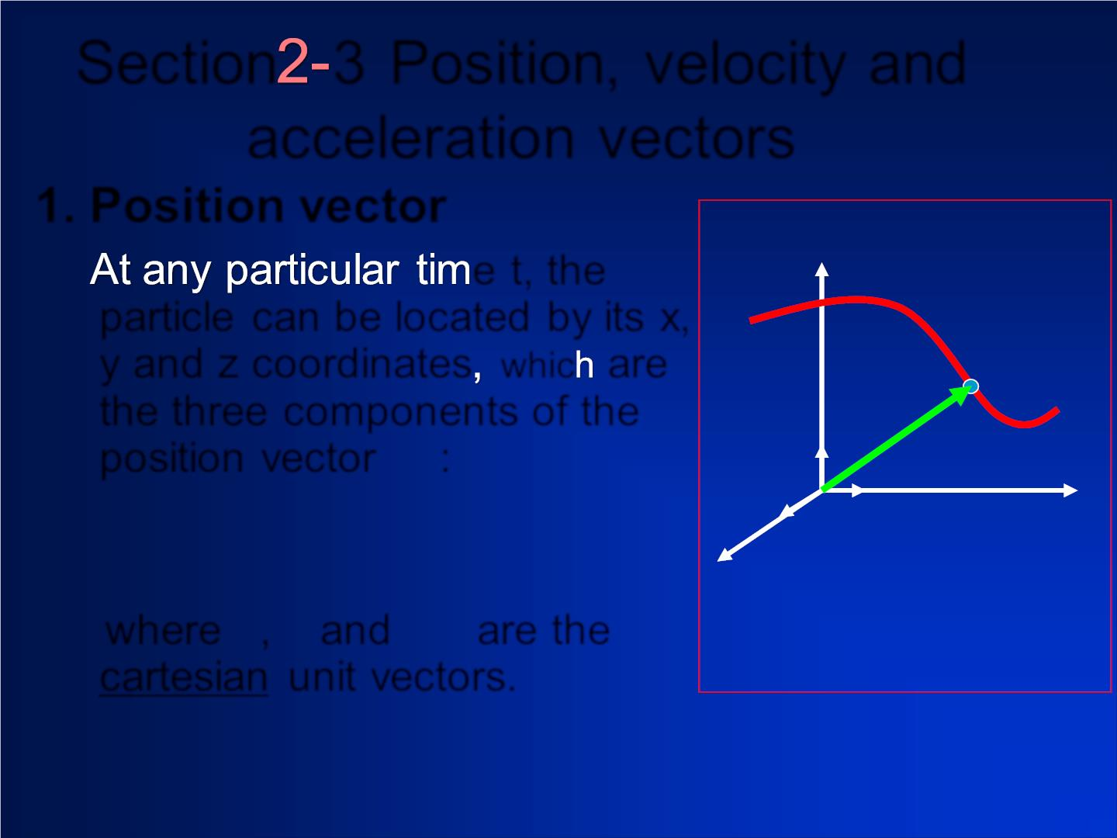
Section 3 Position, velocity and
acceleration vectors
1. Position vector
e t, the
particle can be located by its x,
y and z coordinates whic are
r
the three components of the
→
^{position vec tor} r :
❖


= + +



^{where} i, and are the
j k
cartesian unit vectors.

Slide 3
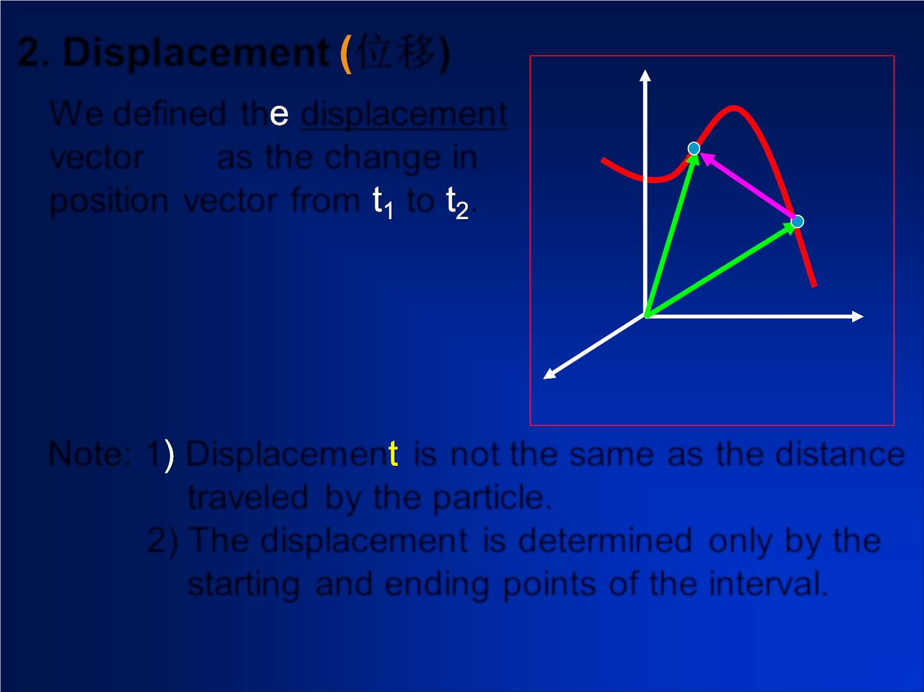
2. Displacement 位移)
s

r
We defined th displacemen t
❖
❖
r
vec tor as the change in
position vec tor from to .
❖
r
❖  
❖
r
Note: 1 Displac em en is not the same as the distance
traveled by the particle.
2) The displacemen t is determined only by the
starting and ending points of the interval.

Slide 4

❖
❖ 
❖
if r = x i + y j +z k

1 1
1
¹ 
❖
2
❖ 
r = x i + y j + z k
2
2
2
Then the displacement is
❖  
r = r −r
2 1
❖
❖
❖
= (x − x )i +(y − y ) j +(z − z )k
2 1
2
1
2 1
Direction: f rom start point to end point
❖
Ma gnitud e : r
 =  ² +  ² +  ²
x y z

Slide 5
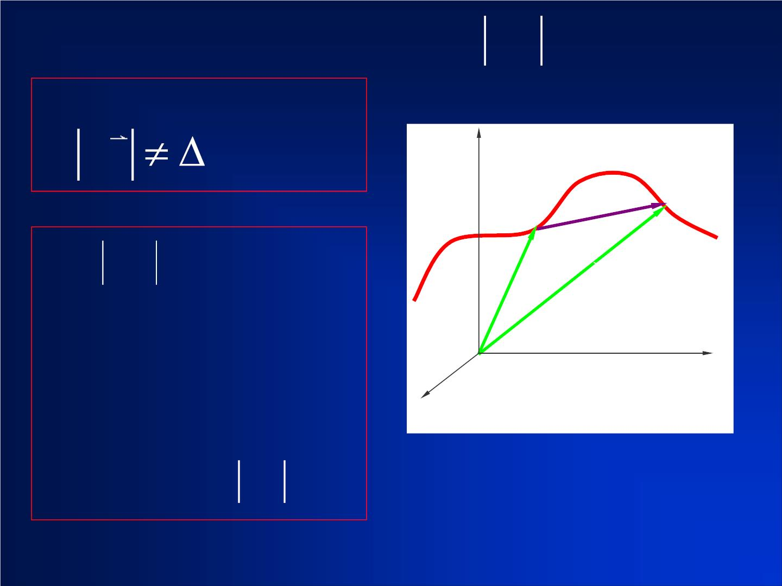
The relationship between and :
neral,
r s
z
s
r
P
❒
P
1
2
❖
1
r
❖
2
r
O
y
x

Slide 6
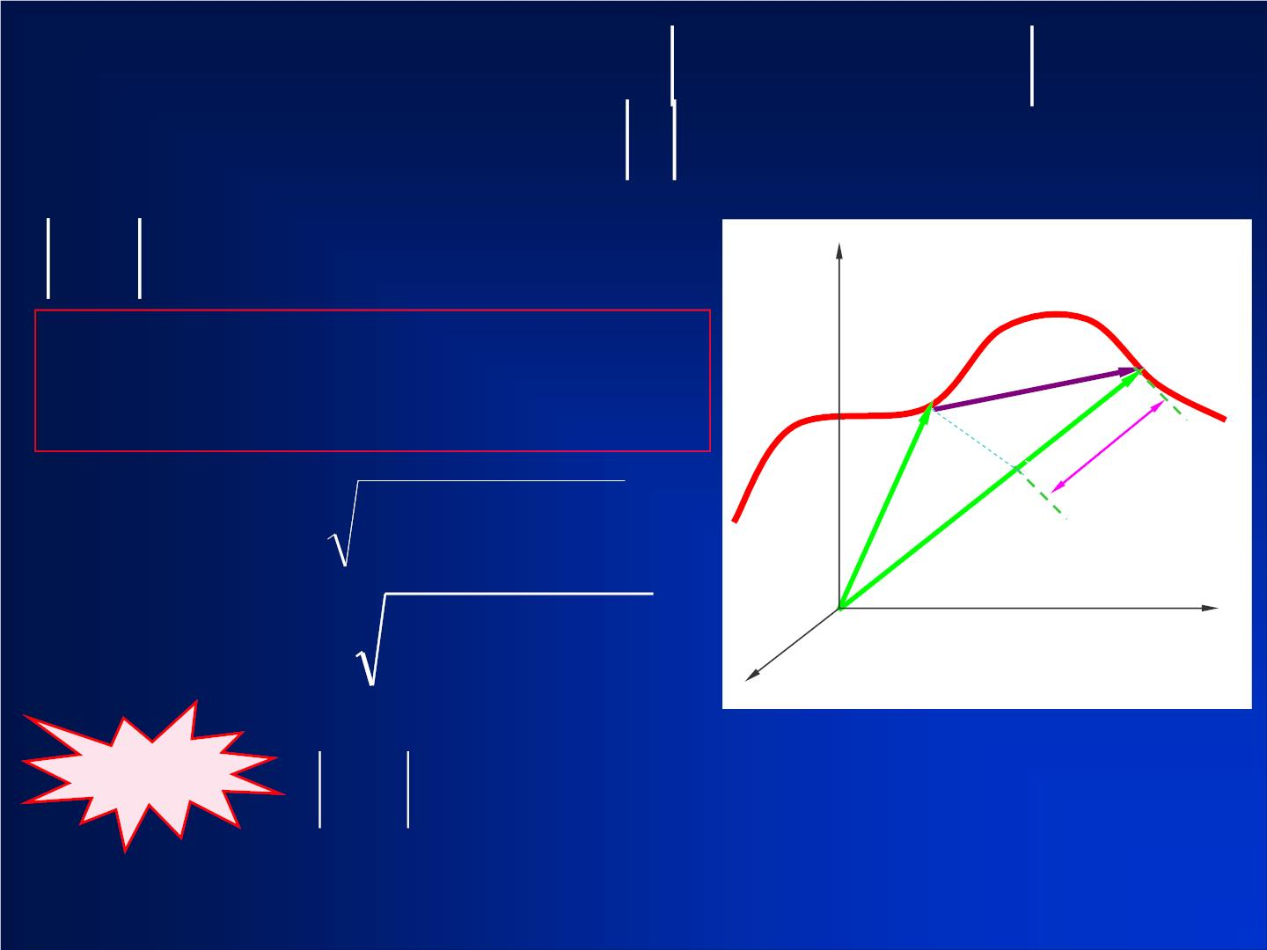
The difference between and ( ):
z
❒
P₁ _{r}
P
2
❖
1
r 
r
❖
r
2
O
y
x
Note

Slide 7


Slide 8
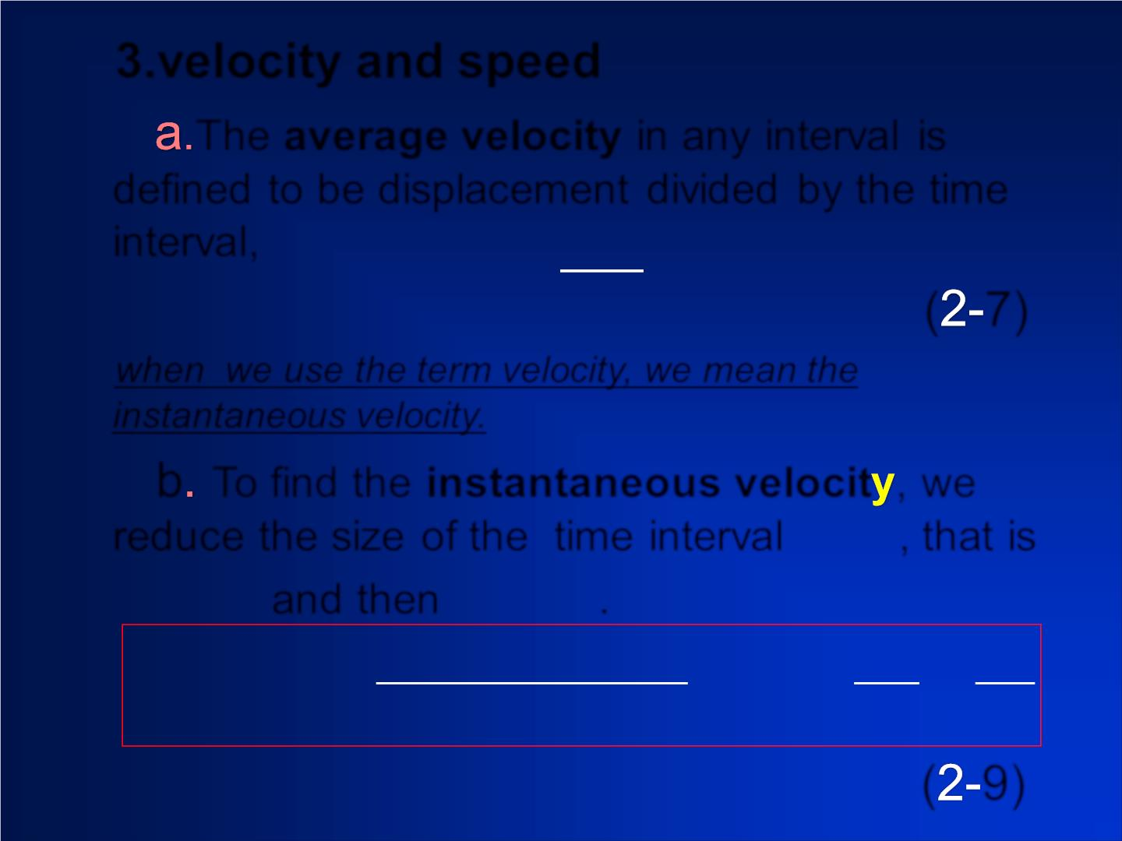
3.velocity and speed
The average velocity in any interval is
defined to be displacement d ivid ed by the time
❖
interval, 
r
v =
a v 
t
( 7)
when we use the term velocity, we mean the
instantaneous velocity.
b To find the instantaneous velocit , we
t
reduce the size of the time interval , that is
→
t → and then  r → 0 .
0
❖
❖
r (t + t) − r (t
= lim
t dt
( 9)

Slide 9
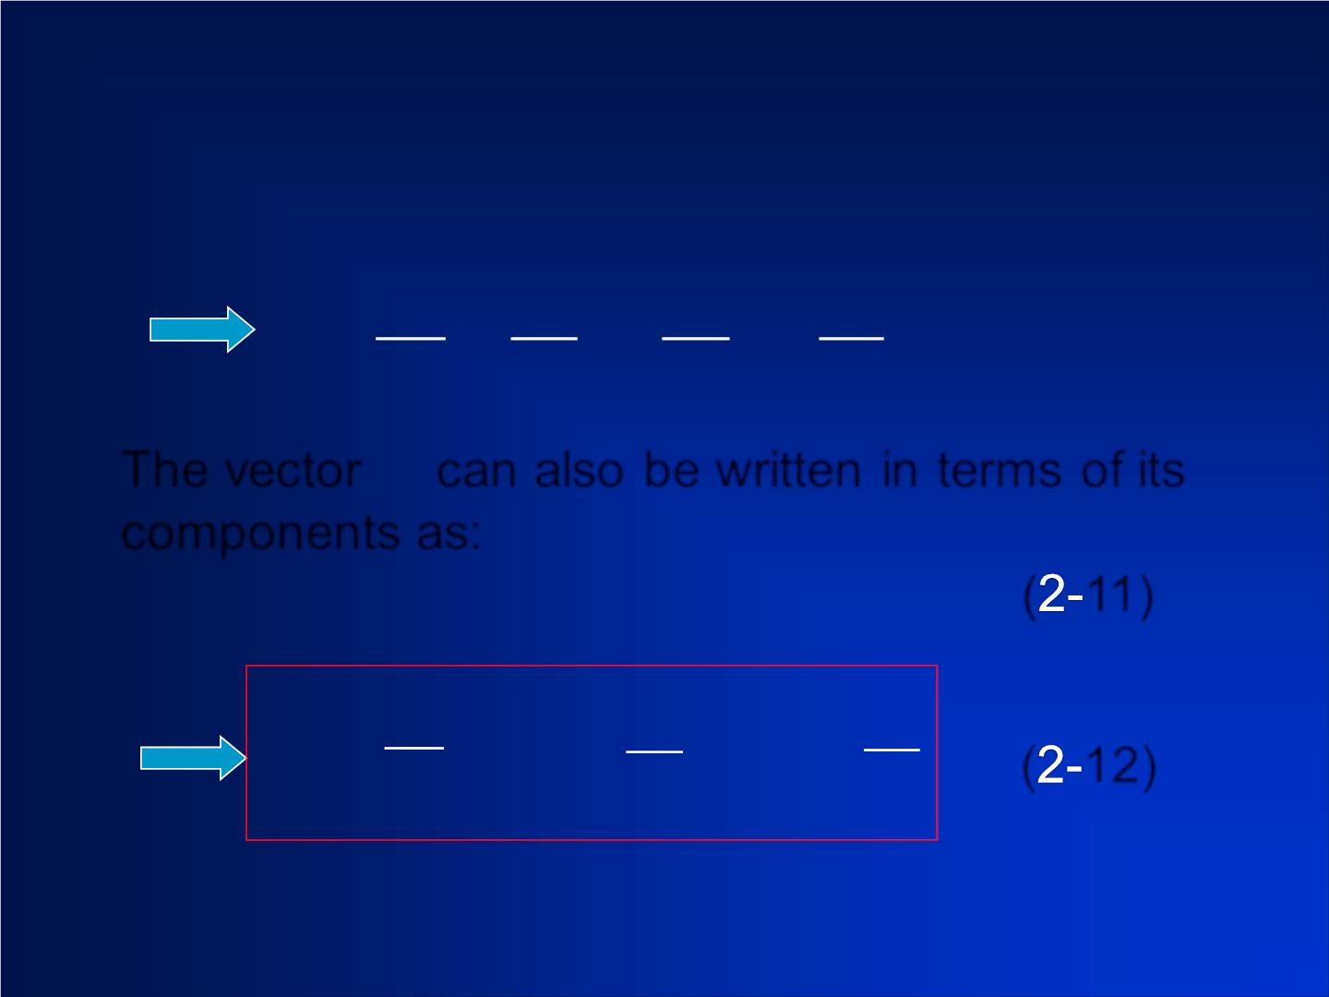
❒
^{The vec tor} v can also be written in terms of its
components as:
❖ 
❖
❖
v = v i
( 11)
( 12)

Slide 10
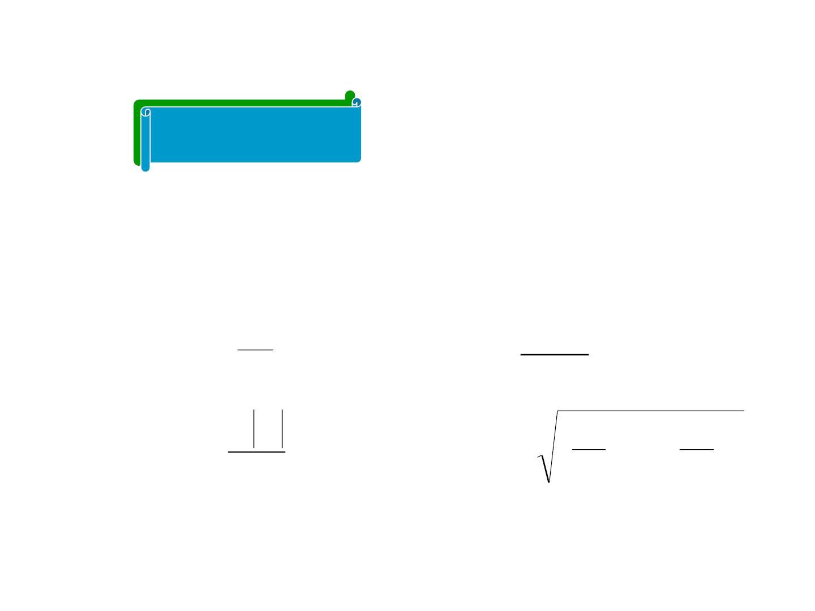
Discussion
The position vector of a movin g particle at a
❖
momen t is
r(x, y)
. The magnitude of the velocity of
the particle at the momen t is:
dr
❖
| dr |
dt
（A）
√
√
（B）
dt
❖
d r
dt
dx dy
( ) ( )
² +
dt dt
2
（C）
（D）

Slide 11
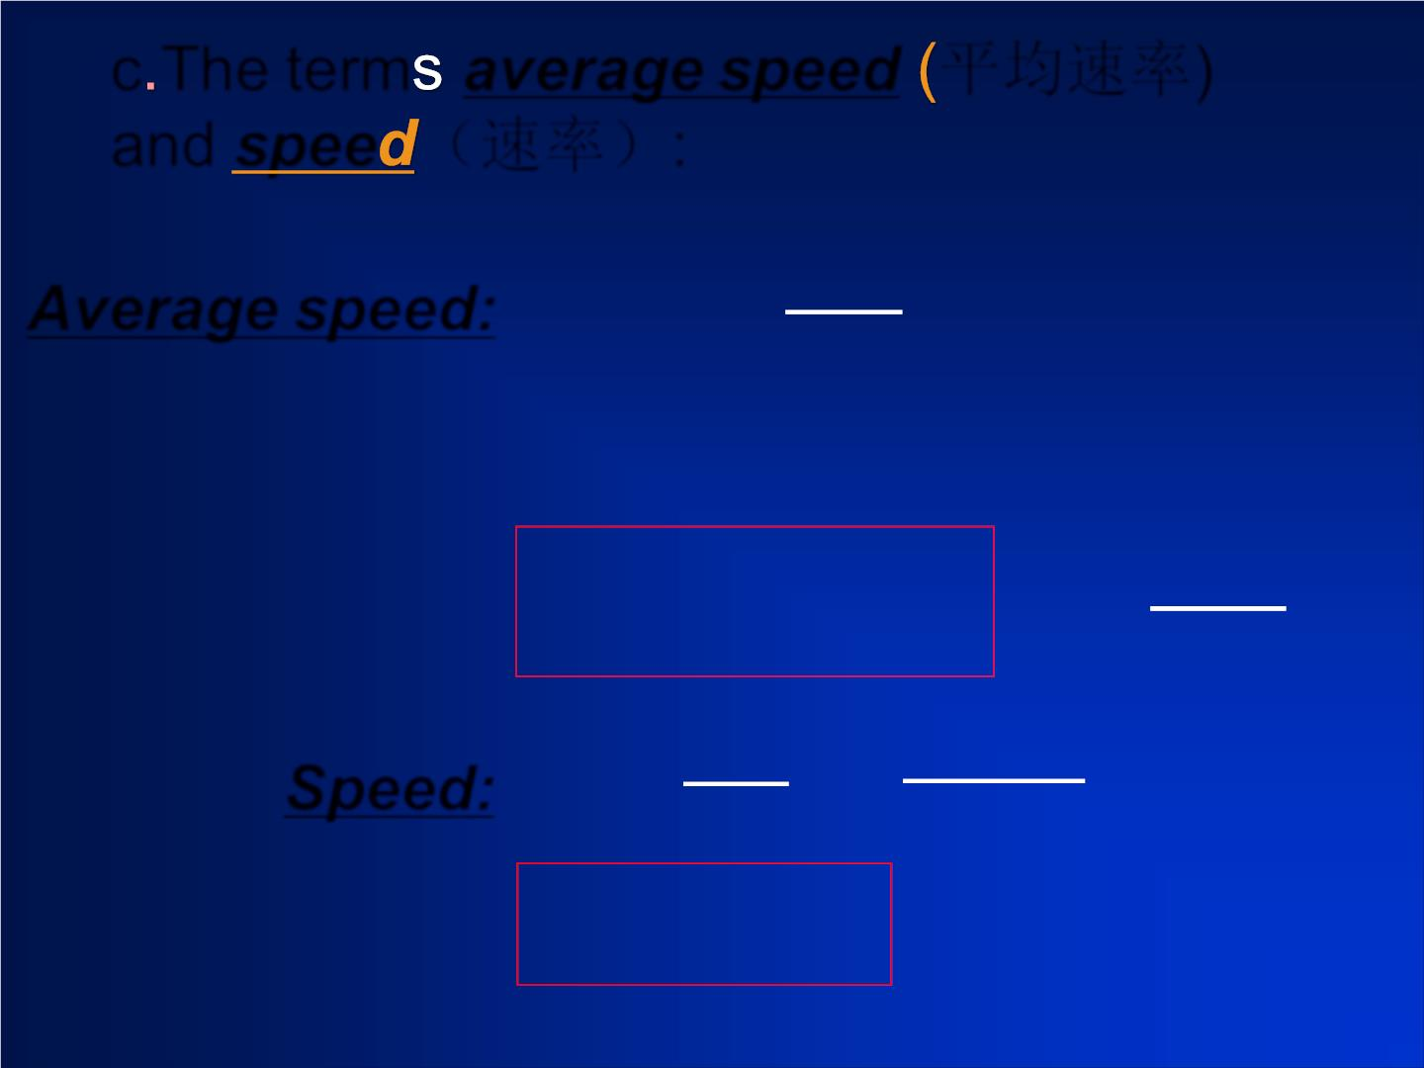
c The term average speed 平均速率)
and spee （速率）:
Average speed:
v
Speed:

Slide 12
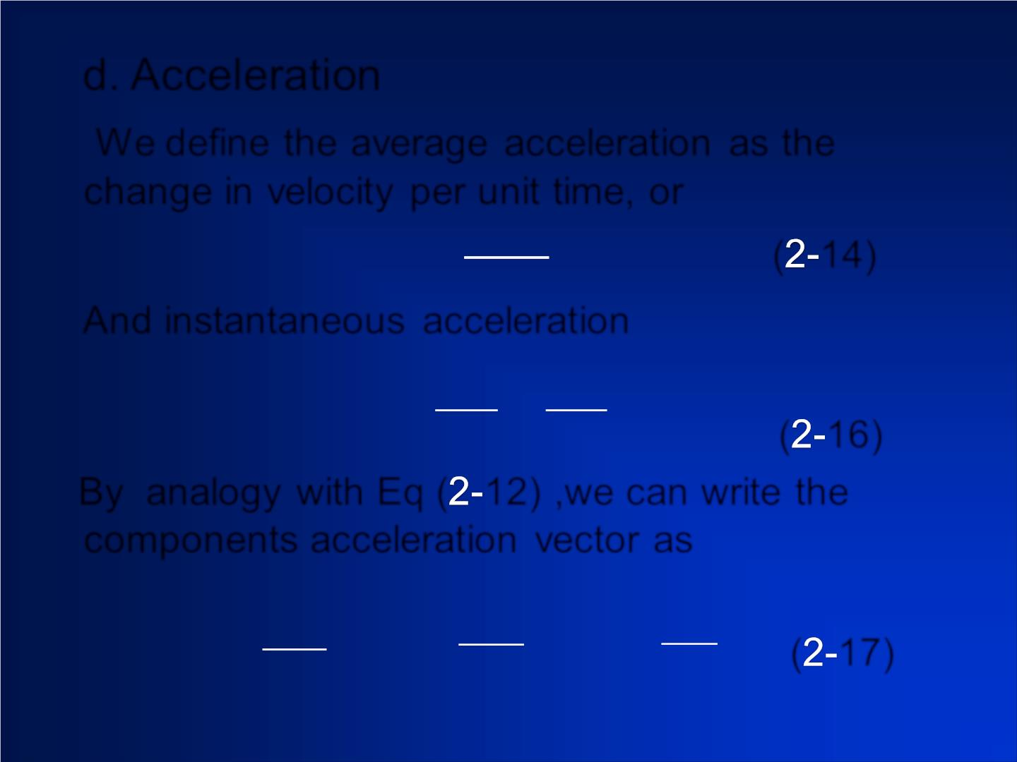
d. Acceleration
We define the average acceleration as the
change in veloc it y per unit time, or
❒
→
 v
a =
( 14)
a v

t
And instantaneous acceleration
→
→
→

v d v

t dt
( 16)
t→0
By analogy with Eq ( 12) ,we can write the
components acceleration vec tor as
dv
( 17)

Slide 13
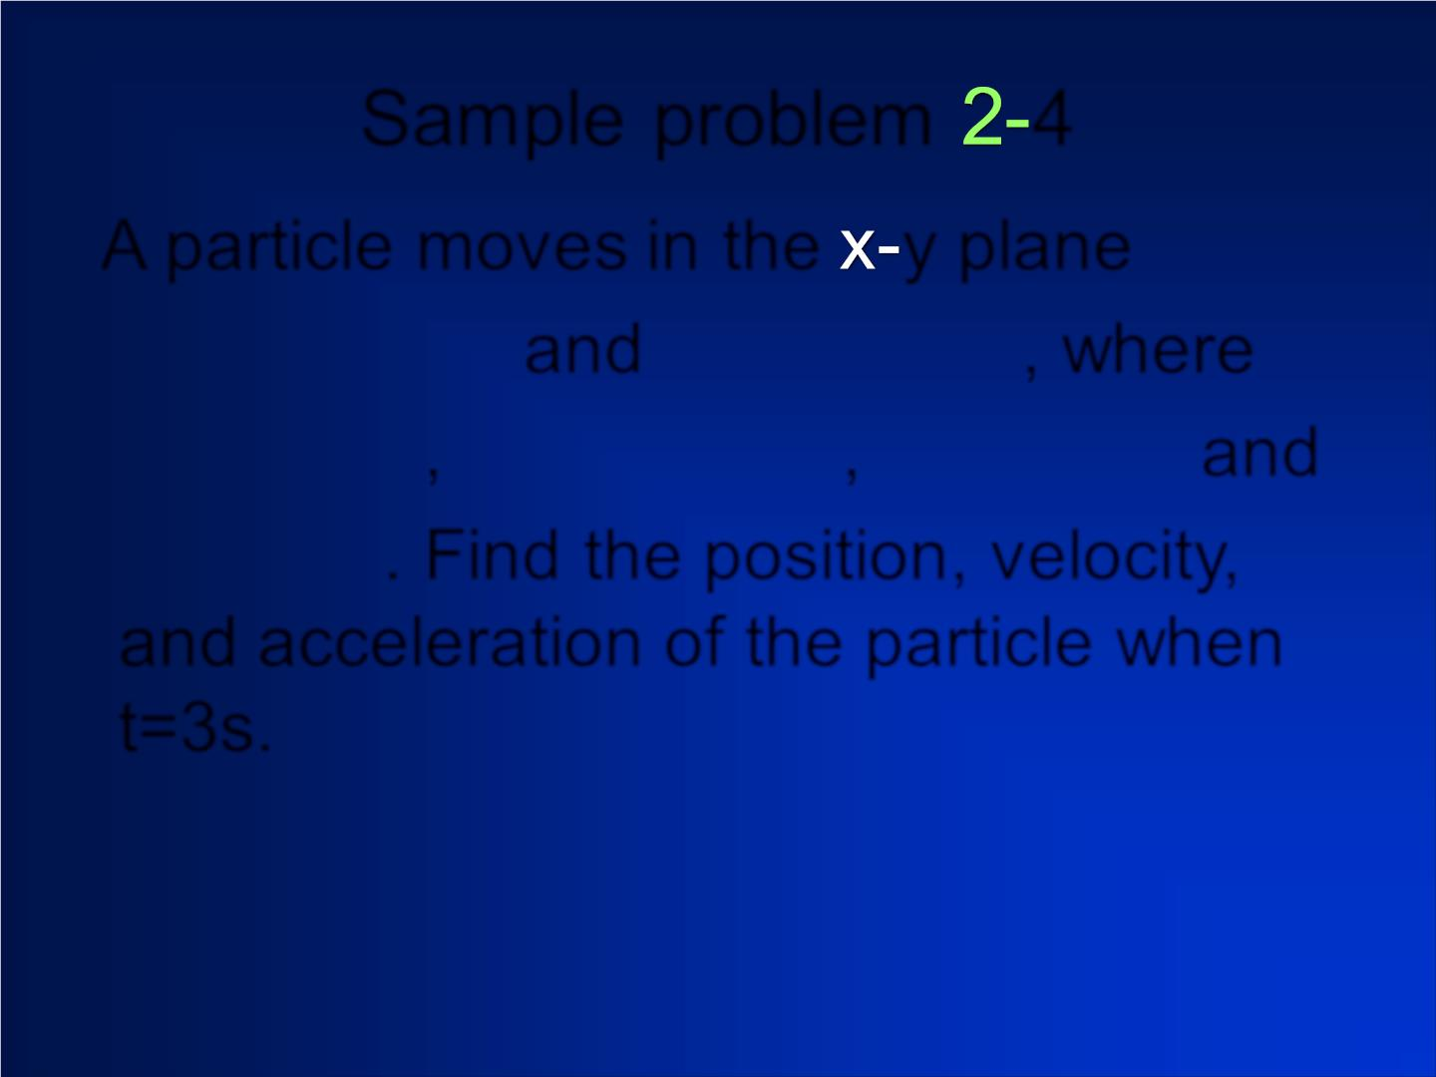
Sample problem 4
A particle moves in the y plane
x(t) = At³ + Bt
and y(t) = Ct² + D, where
= −
/ s B 32.0m/ s
3
,
, = and
C 5.0m/ s
3
D =12.0m. Find the position, velocity,
and acceleration of the particle when
t=3s.

Slide 14

→
Solution:
r

Slide 15
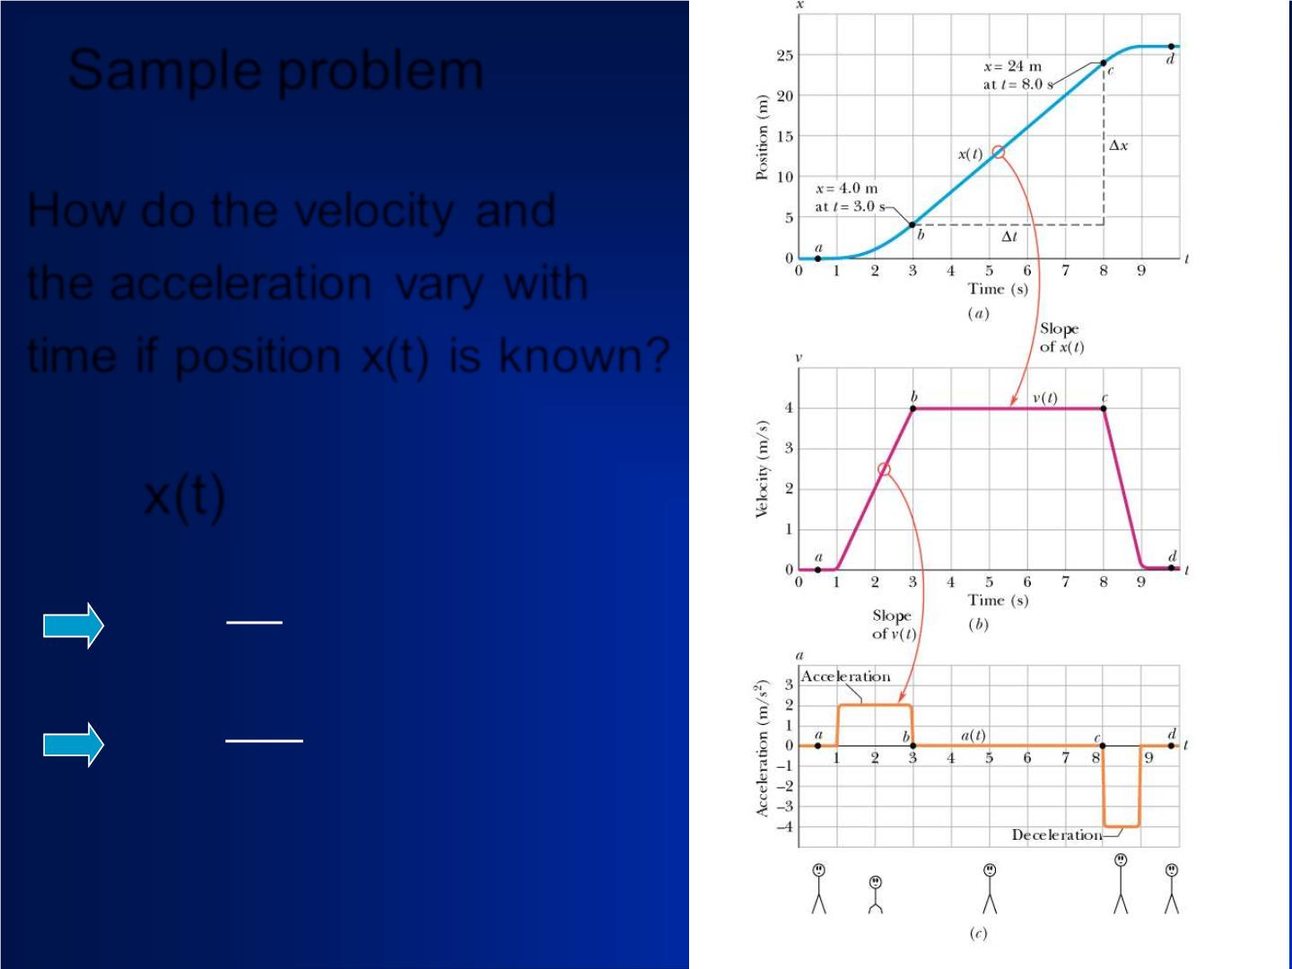
Sample problem
How do the veloc it y and
the acceleration vary with
time if position x(t) is known?
x(t)
dx

Slide 16
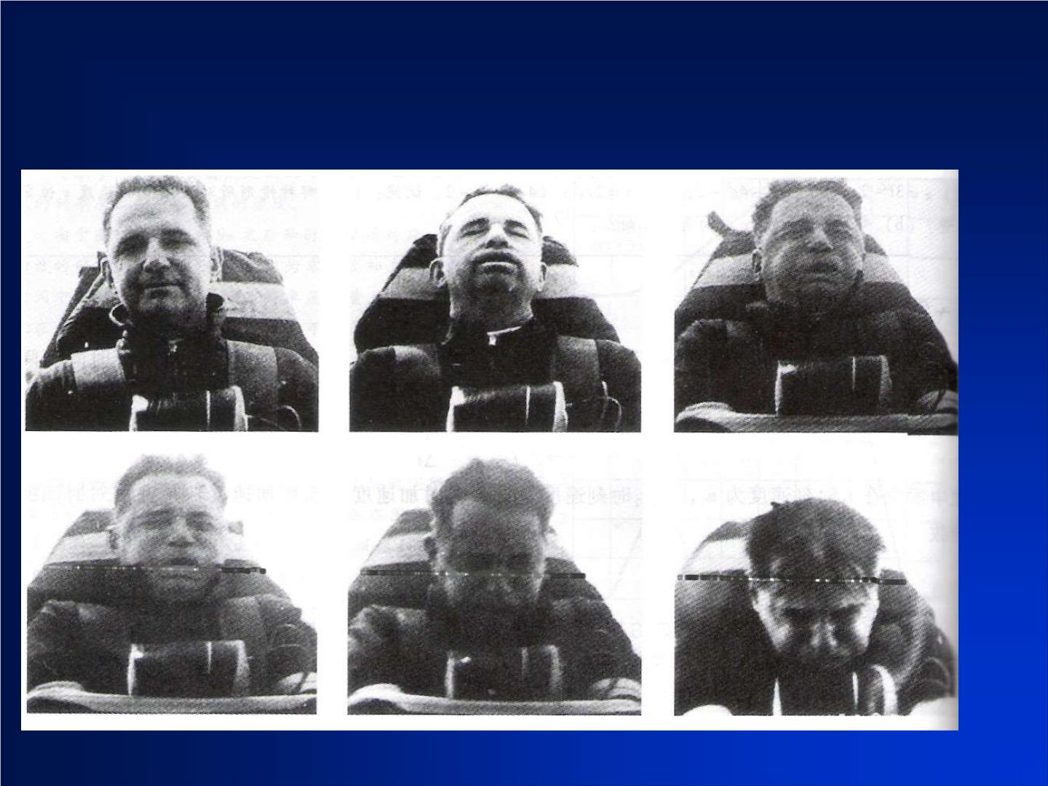
Can you tell the direction of the acceleration f rom the figures?
His body is an accelerometer not a speedometer.

Slide 17
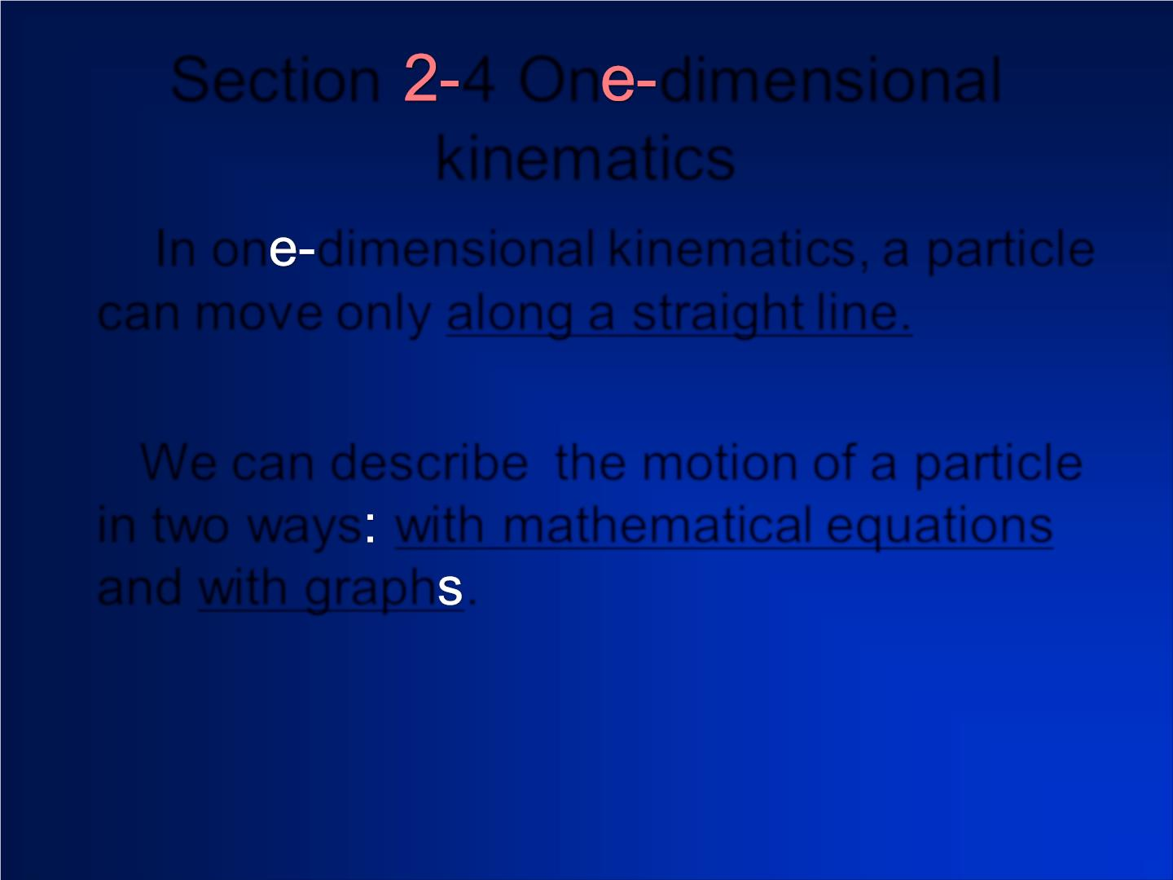
Section 4 On dim ensional
kinem atics
In on dimensional kinematics, a particle
can mov e only along a straight line.
We can describe the motion of a particle
in t wo ways with mathematical equations
and with graph .

Slide 18
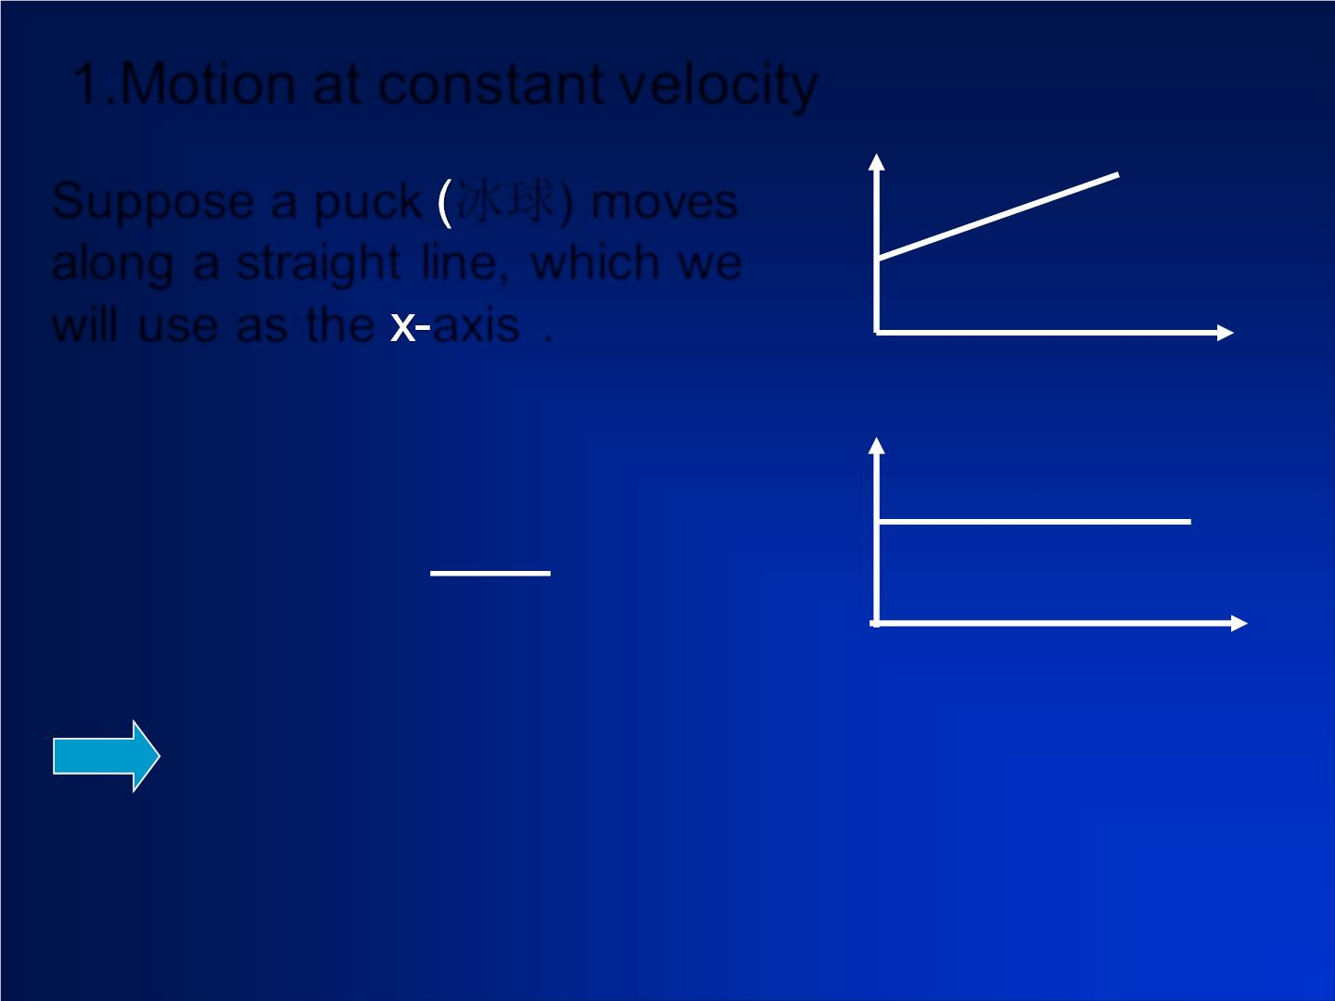
1.Motion at constant velocity
Suppose a puck 冰球) mo ves
along a straight line, which we
will use as the axis .
❖
=

Slide 19
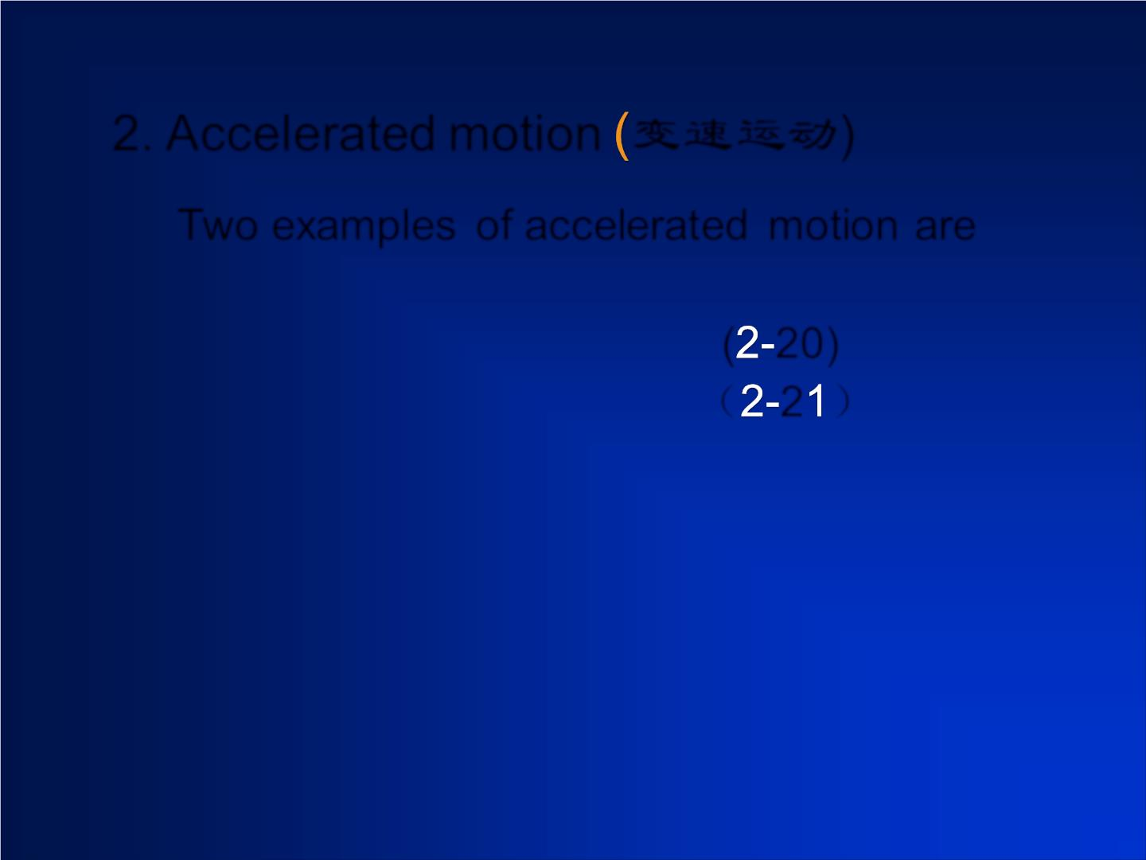
2. Accelerated motion 变速运动)
Two examples of accelerated motion are
( 20)
（ 2 ）

Slide 20
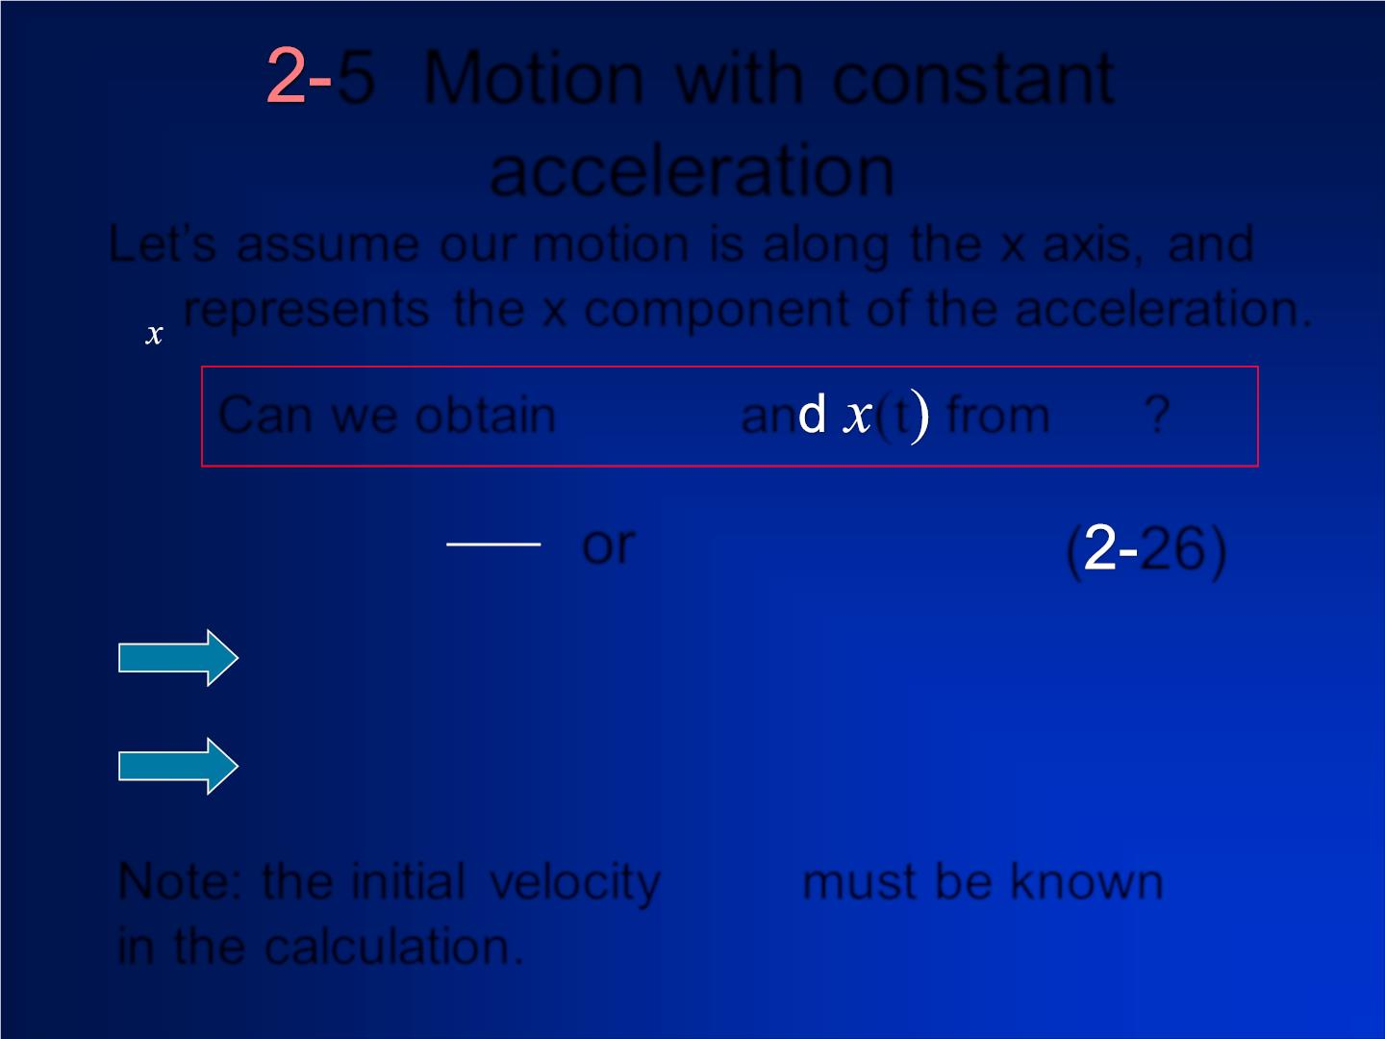
5 Motion wit h c ons tant
acceleration
Let’s assume our motion is along the x axis, and
a
represents the x component of the acceleration.
v_{x} (t)
a
Can we obtain
an (t from ?
x
dv
or
( 26)
=
v
Note: the in itia l veloc it y must be known
in the calculation.
0

Slide 21
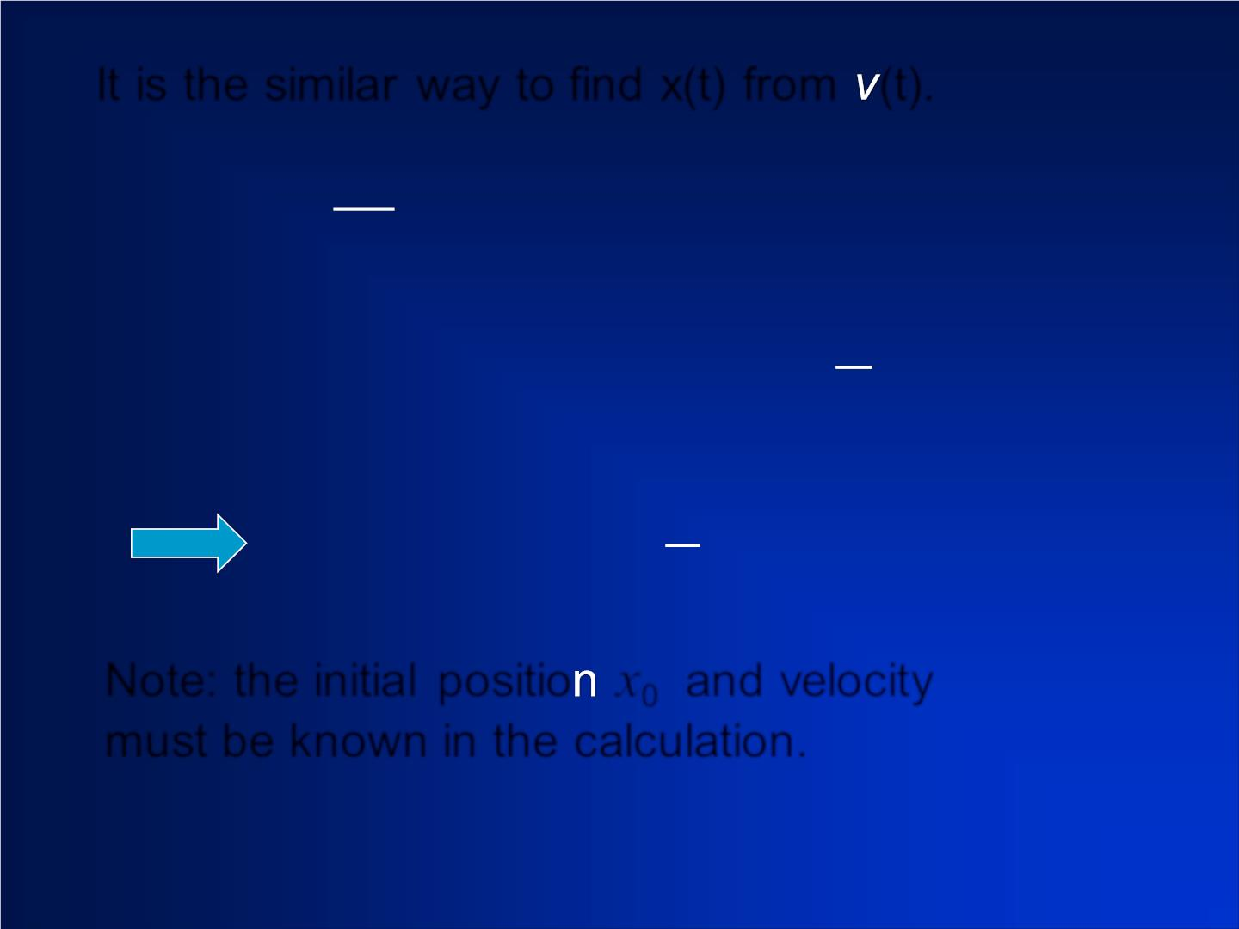
It is the similar way to find x(t) from (t).
dx
Note: the in itia l positio x₀ and veloc it y
must be known in the calculation.
v
0

Slide 22
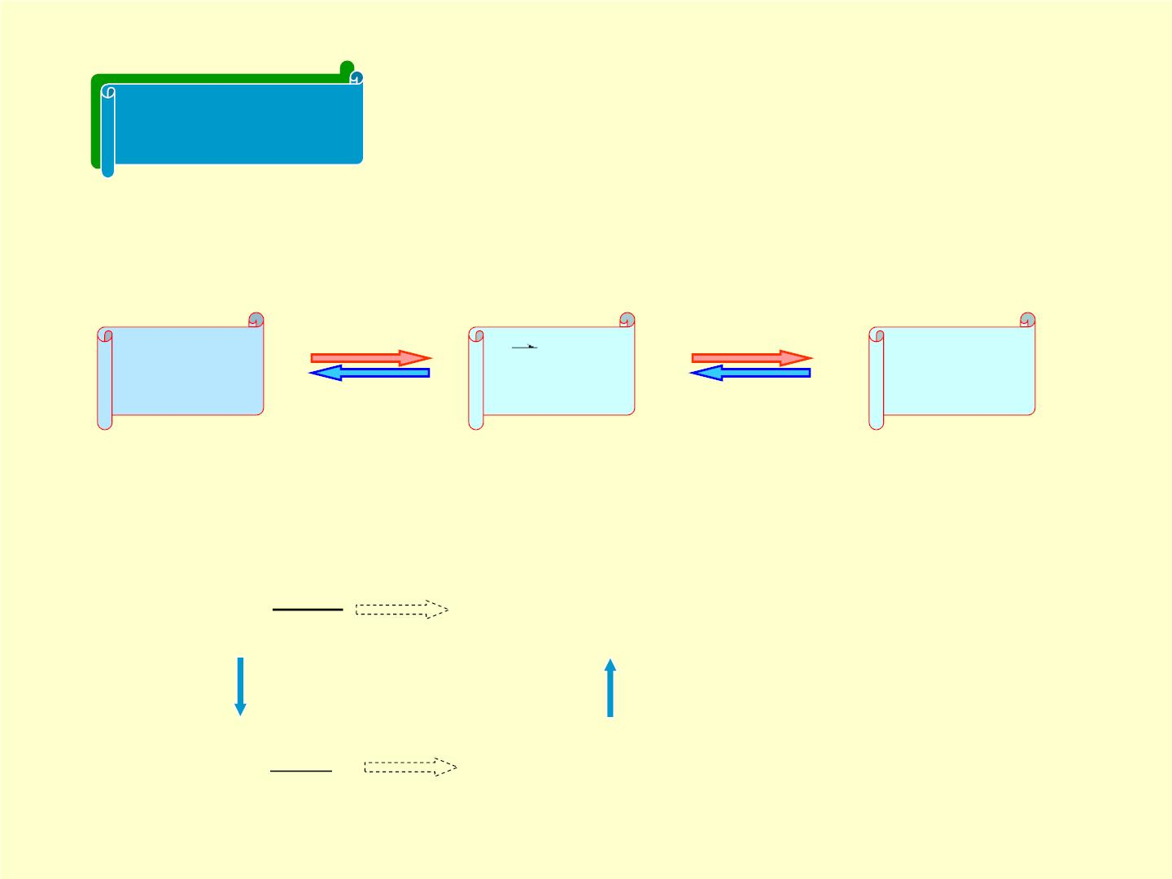
Discussion
❖ 
r (t) v(t)
❖
Relationship between , and
a(t)
❖
Derivative
Derivative
❖
r (t)
v(t)
a(t)
Integral
Integral
❖
❖
(
r (0)
)
(
v(0)
)
❒
❒ dr
❖  
t
⇩
v =
r(t) = r + v(t)dt
dt
0
0
❒
❖
dv
dt
❖ 
t
❖
⇩
a =
v (t) = v + a(t)dt
0
0

Slide 23


Slide 24
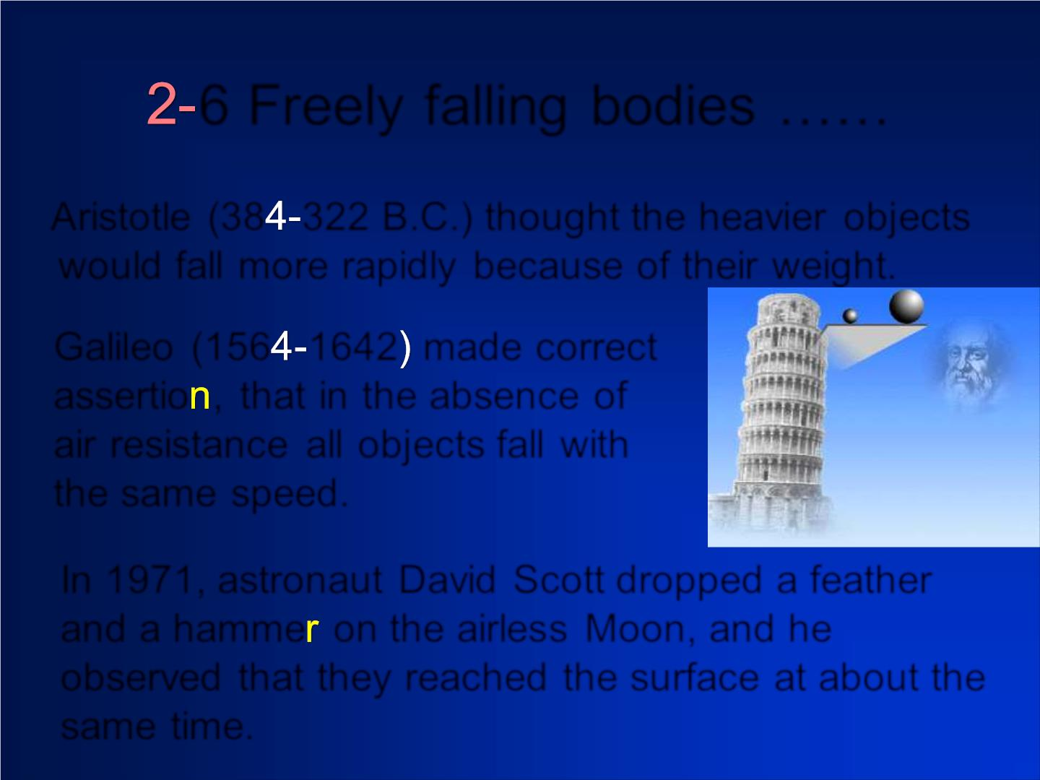
6 Freely falling bodies ……
Aristotle (38 322 B.C.) thought the heavier objects
would fall more rapidly because of their weight.
Galileo (156 1642 made correct
assertio , that in the absence of
air resistance all objects fall with
the same speed.
In 1971, astronaut David Scott dropped a feather
and a hamme on the airless Moon, and he
observed that they reached the surface at about the
same time.

Slide 25
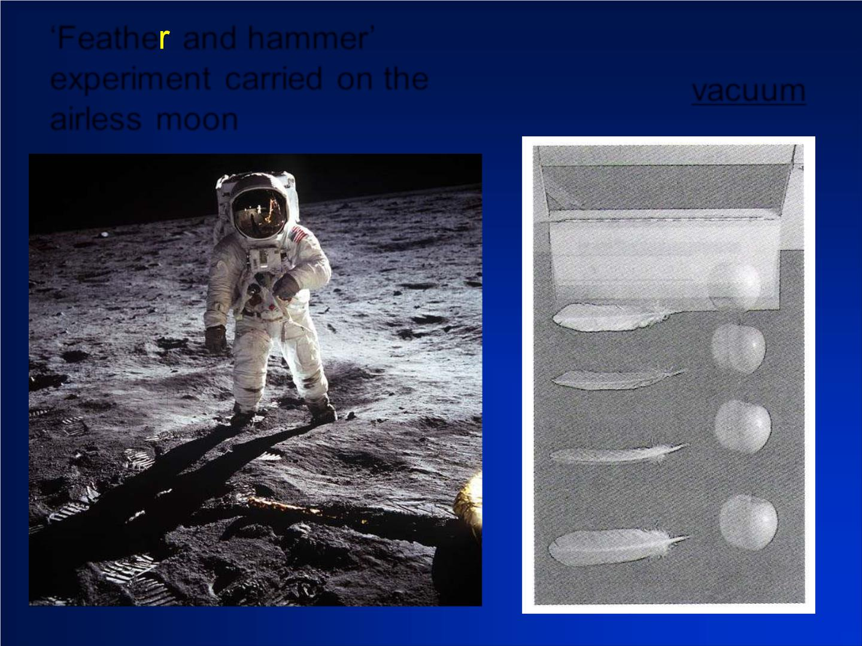
‘Feathe and hammer’
experim ent carried on the
airless moon
‘Feather and apple’ exp .
conducted in vacuum lab.

Slide 26
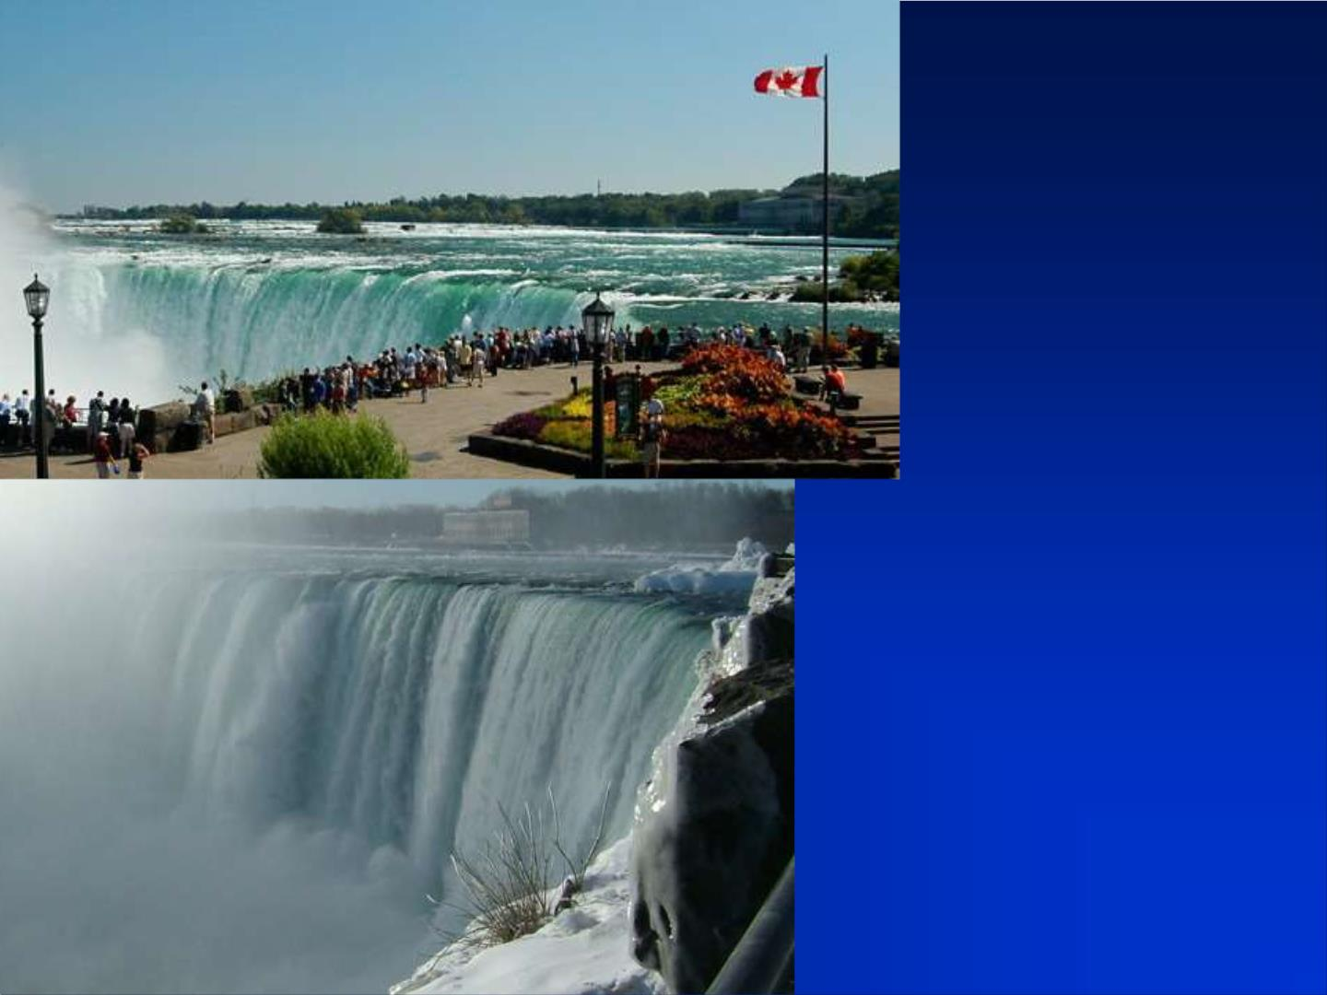
how
long
final
speed?

