Slide 1
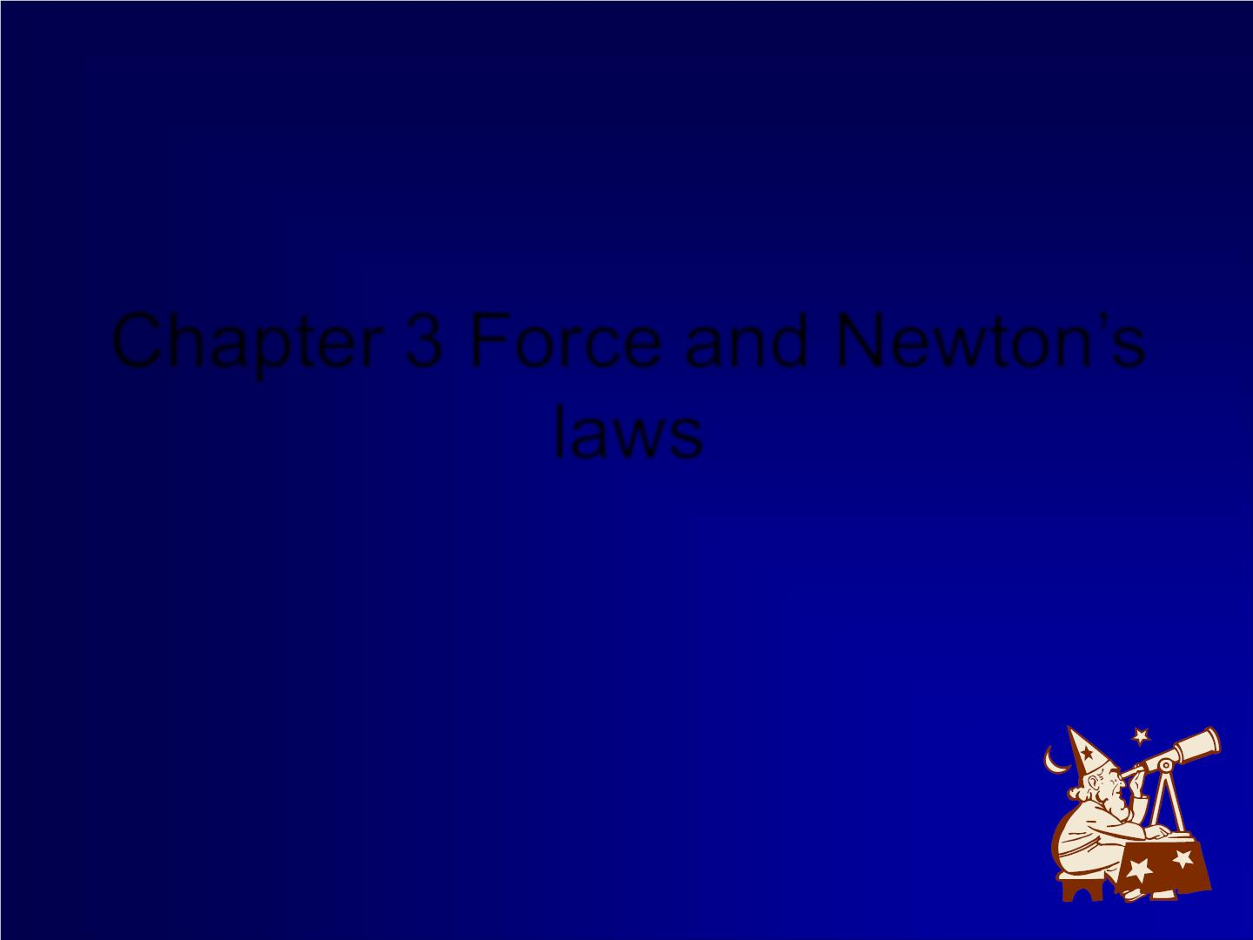
Chapter 3 Force and Newton’s
laws

Slide 2
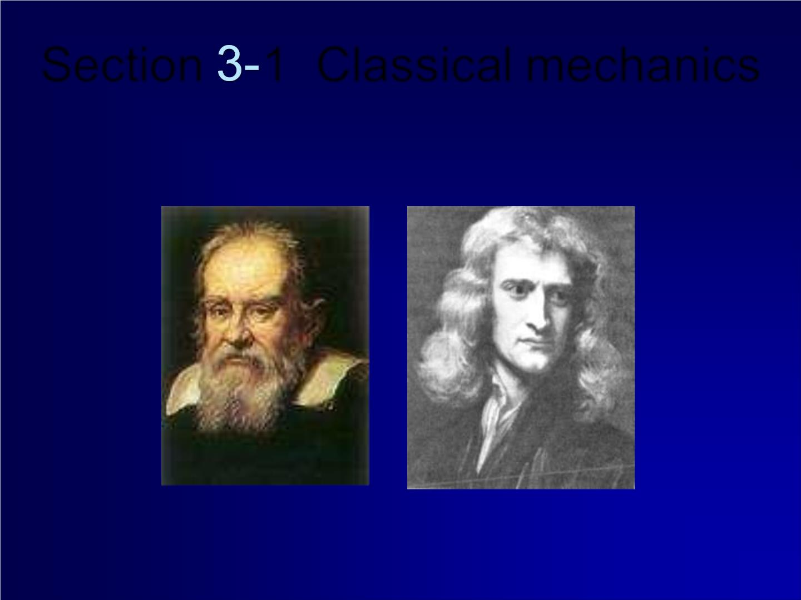
Section 1 Classical mechanics
• The approach to the dynamic s we consider
classical mechanics

Slide 3

Newton’s
three laws.
in certain realms
ordinary objects,

Slide 4
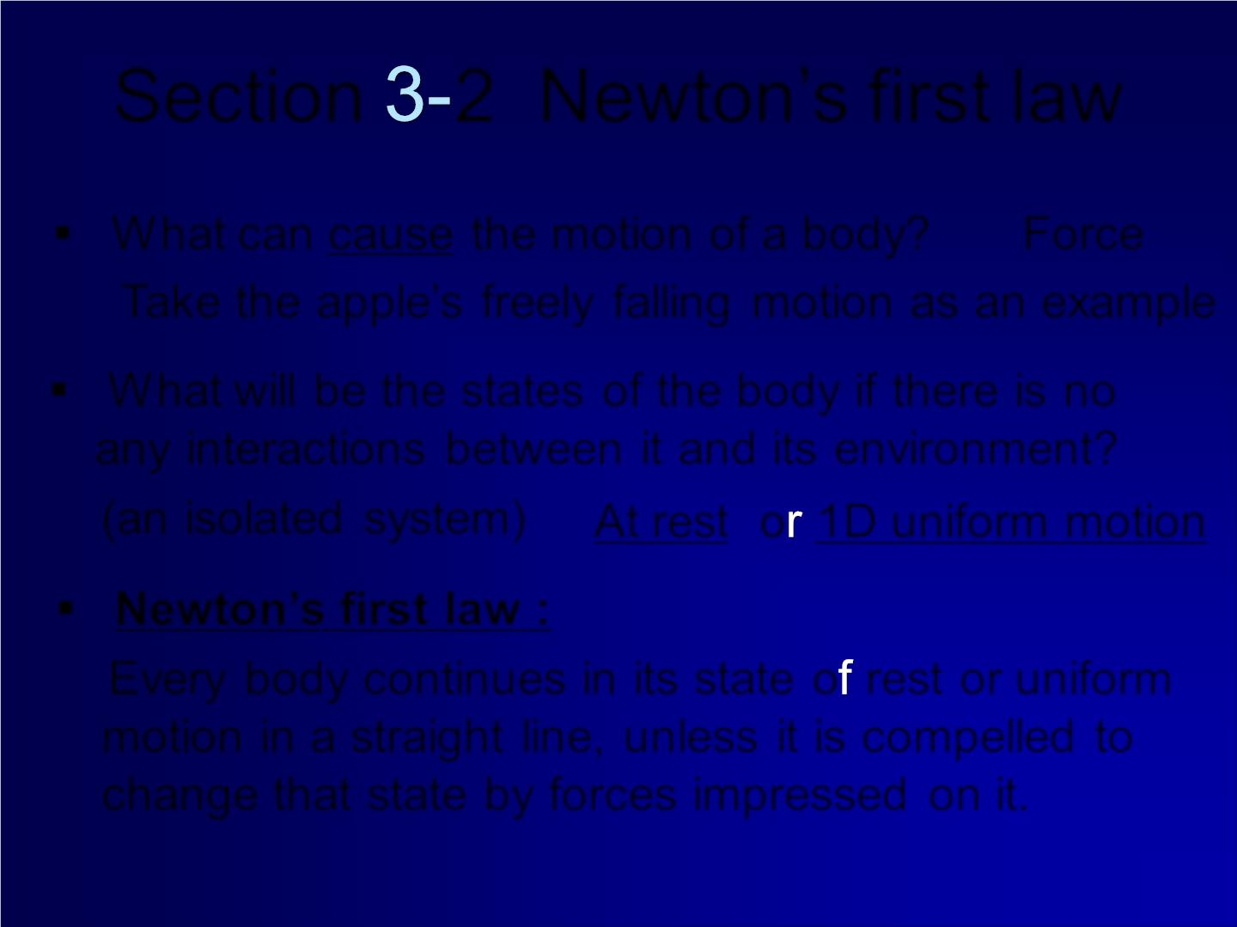
Section 2 Newton’s first law
▪ W hat can cause the motion of a body? Force
Take the apple’s freely falling motion as an example
▪ W hat will be the states of the body if there is no
any interactions between it and its environment?
(an isolated system)
At rest o 1D uniform motion
▪ Newton’s first law :
Every body continues in its state o rest or uniform
motion in a straight line, unless it is compelled to
change that state by forces impressed on it.

Slide 5
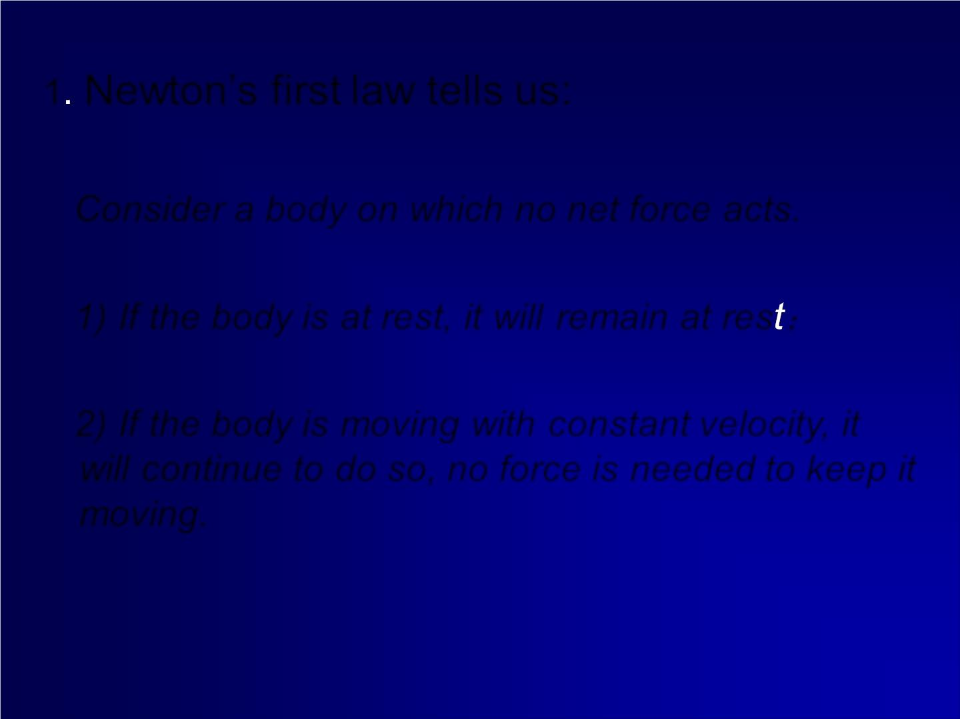
1 Newton’s first law tells us:
Consider a body on which no net force acts.
1) If the body is at rest, it will remain at res ；
2) If the body is moving with constant velocity, it
will continue to do so, no force is needed to keep it
moving.

Slide 6
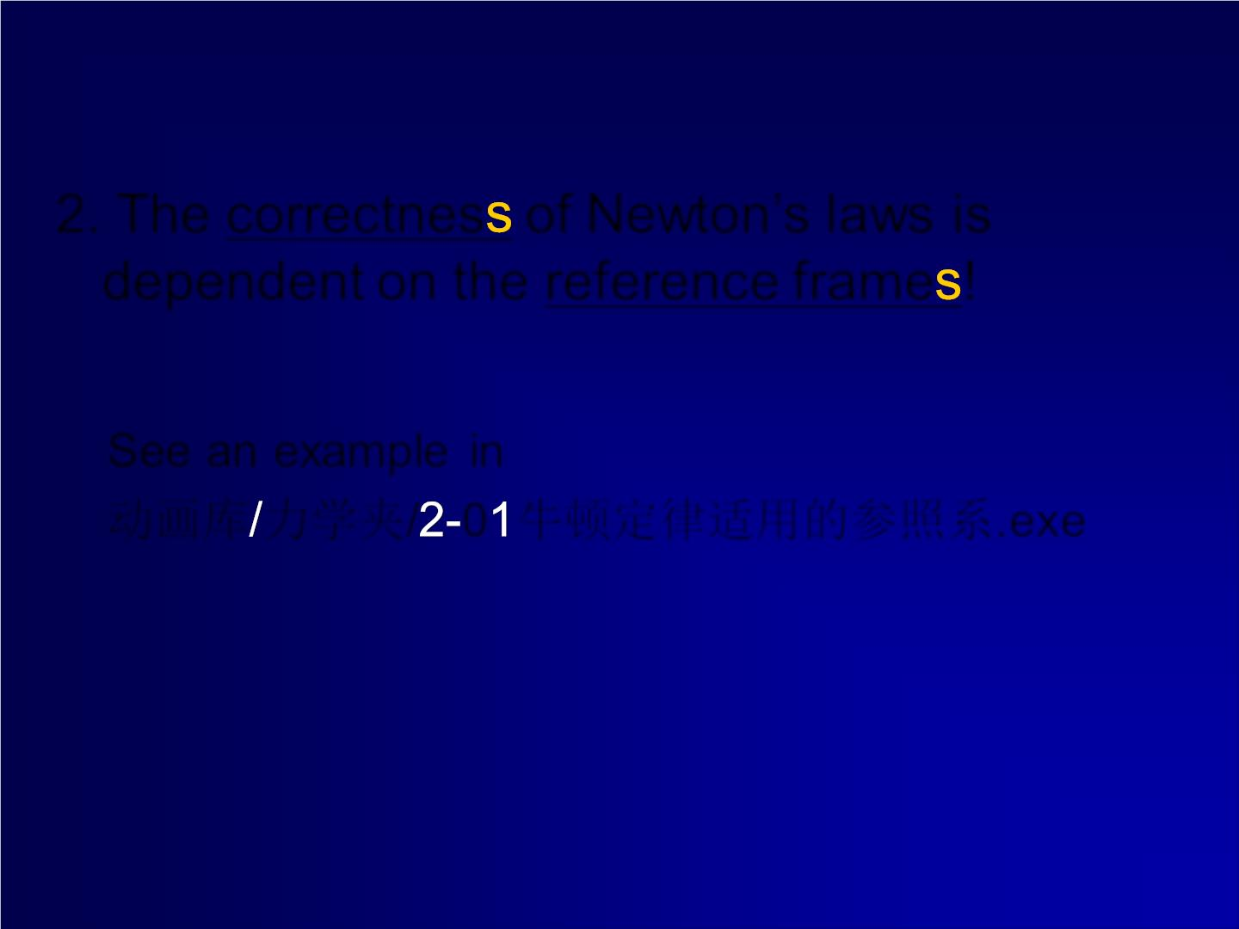
2. The correctnes of Newton’s laws is
dependent on the reference frame !
See an example in
动画库 力学夹/ 0 牛顿定律适用的参照系.exe 1

Slide 7
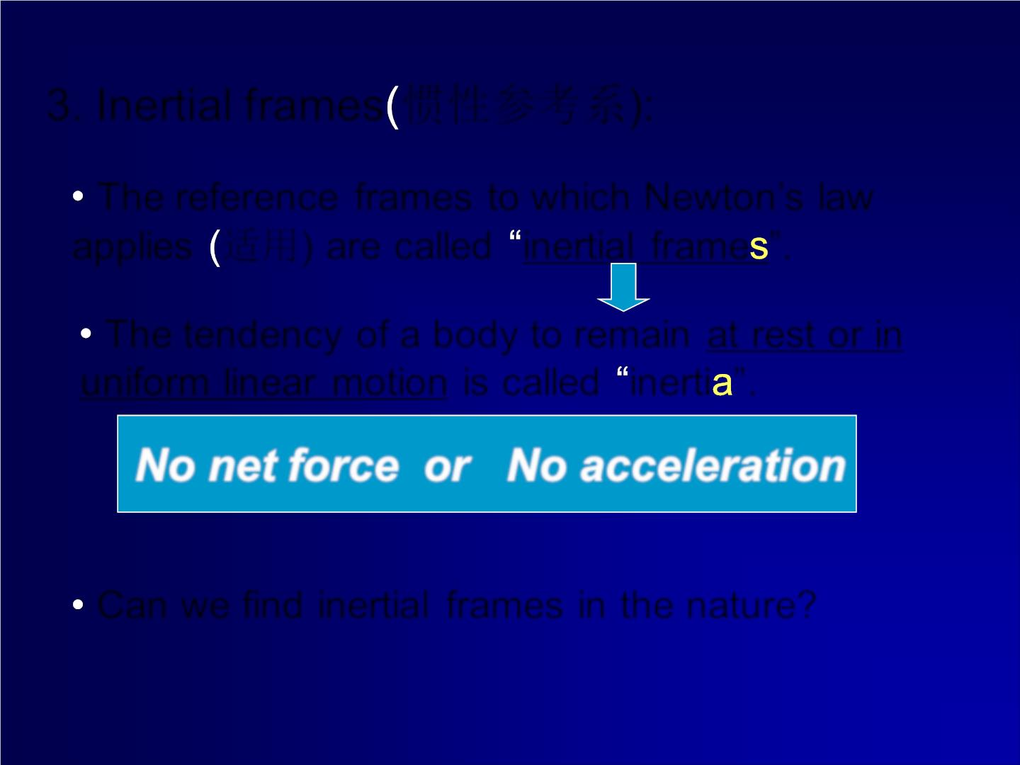
3. Inertial frames 惯性参考系):
The reference frames to which Newton’s law
applies 适用) are called inertial frame ”.
The tendency of a body to remain at rest or in
uniform linear motion is called inerti ”.
No net force or No acceleration
Can we find inertial frames in the nature?

Slide 8
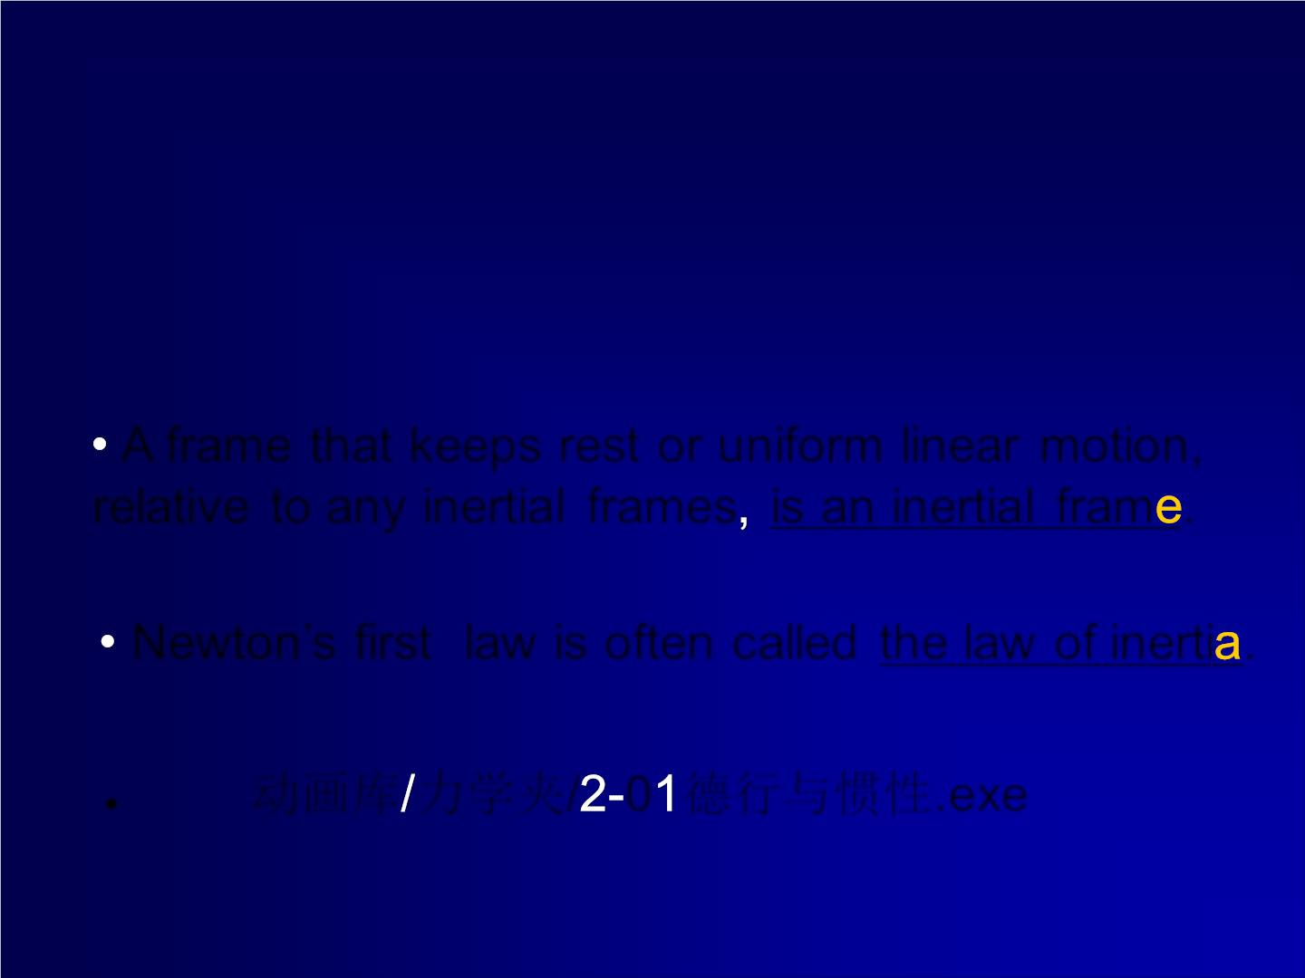
A frame that keeps rest or uniform linear motion,
relative to any inertial frames is an inertial fram .
Newton’s first law is often called the law of inerti .
e 动画库 力学夹/ 0 德行与惯性.exe
⚫

Slide 9
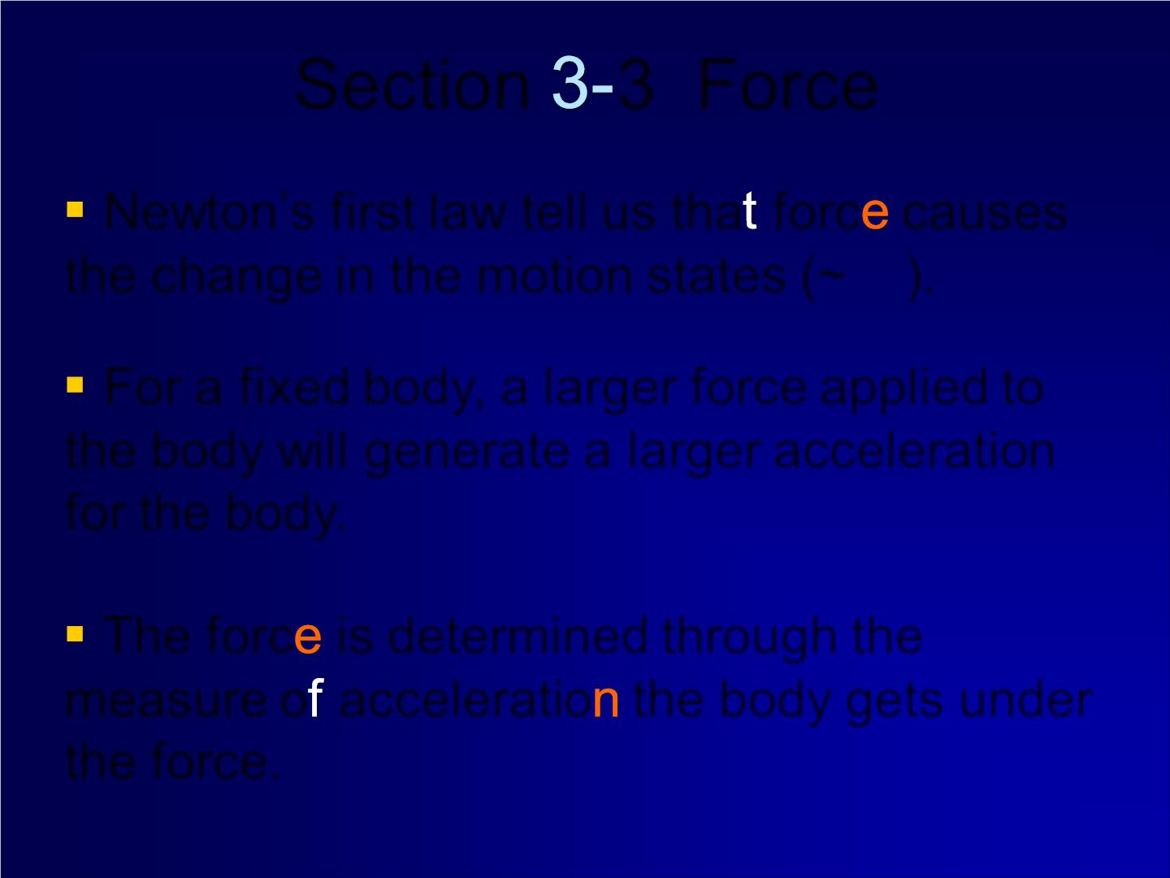
Section 3 Force
Newton’s first law tell us tha forc causes
❖
❖
❖

the change in the motion states (~ ).
v
F → a
For a fixed body, a larger force applied to
the body will generate a larger acceleration
for the body.
The forc is determined through the
measure o acceleratio the body gets under
the force.

Slide 10
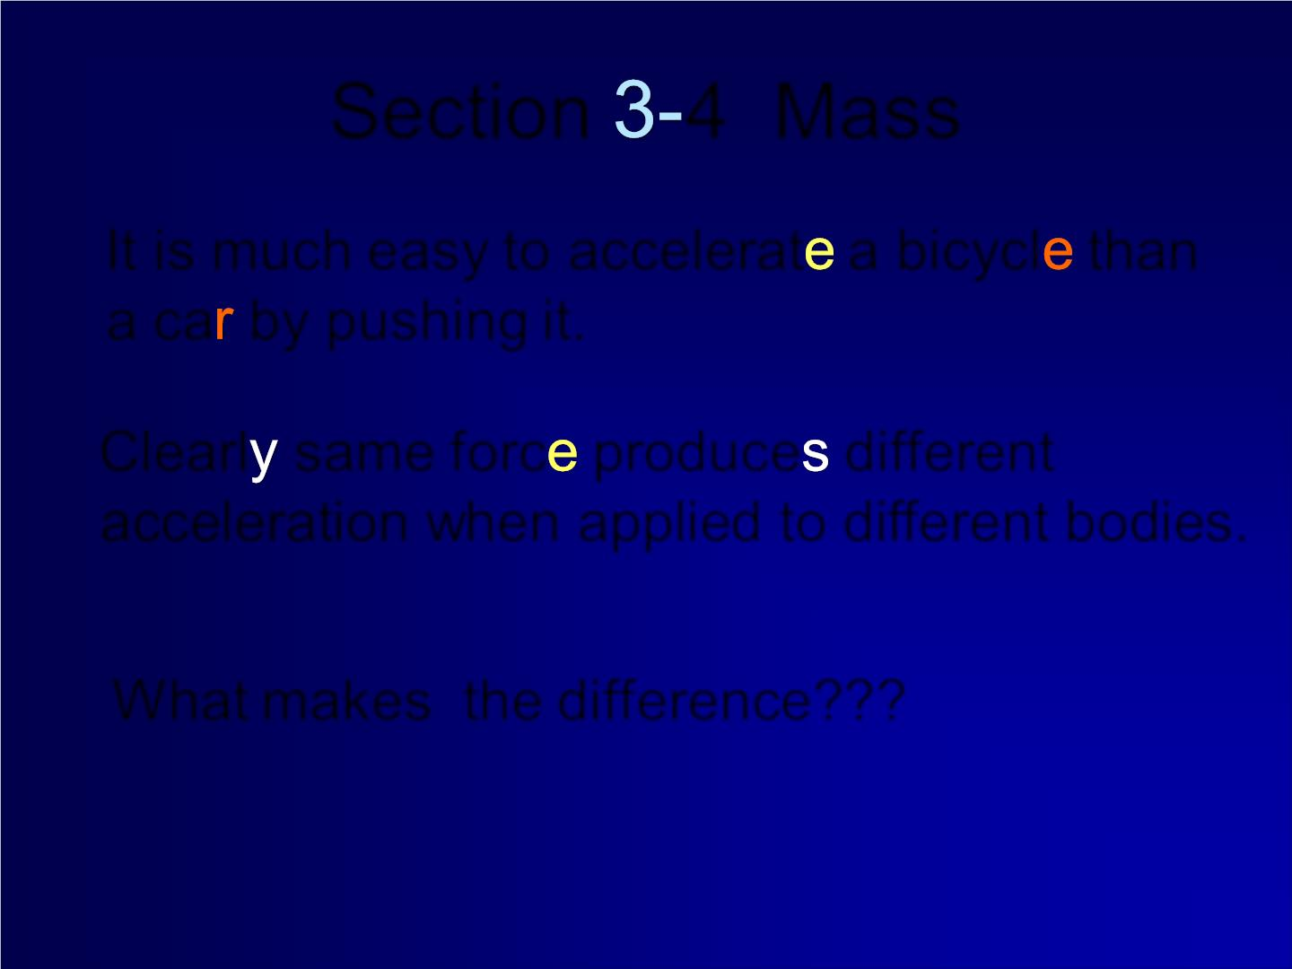
Section 4 Mass
It is much easy to accelerat a bicycl than
a ca by pushing it.
Clearl same forc produce different
acceleration when applied to different bodies.
What makes the difference??? Mass

Slide 11
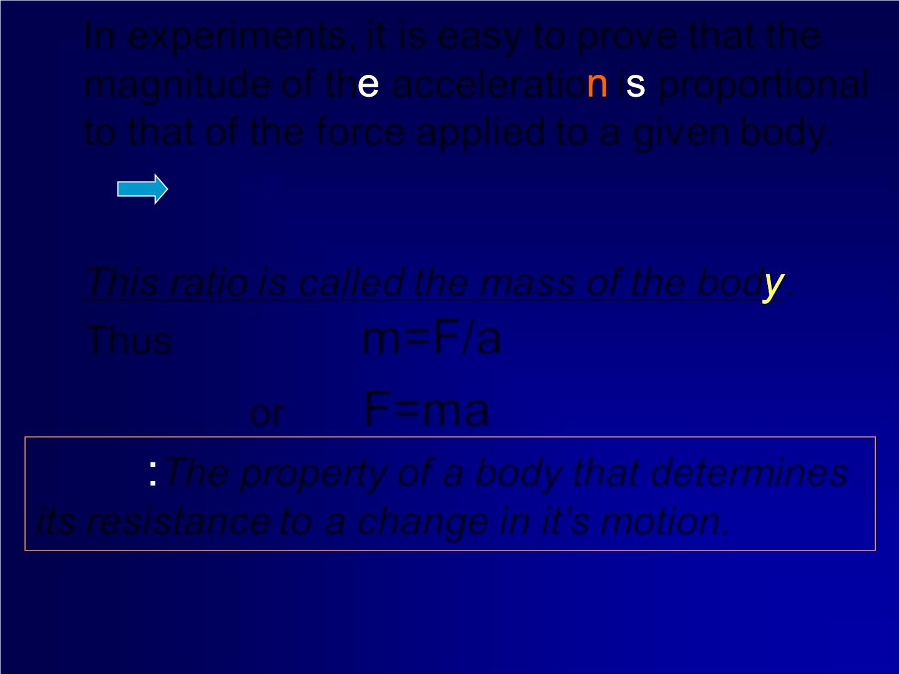
In experiments, it is easy to prov e that the
magnitude of th acceleratio i proportional
to that of the force applied to a given body.
a  F
This ratio is called the mass of the bod .
Thus
m=F/a
or F=ma
Mass The property of a body that determines
its resistance to a change in it’s motion.
The mass defined in Newton’s law is an ine

Slide 12
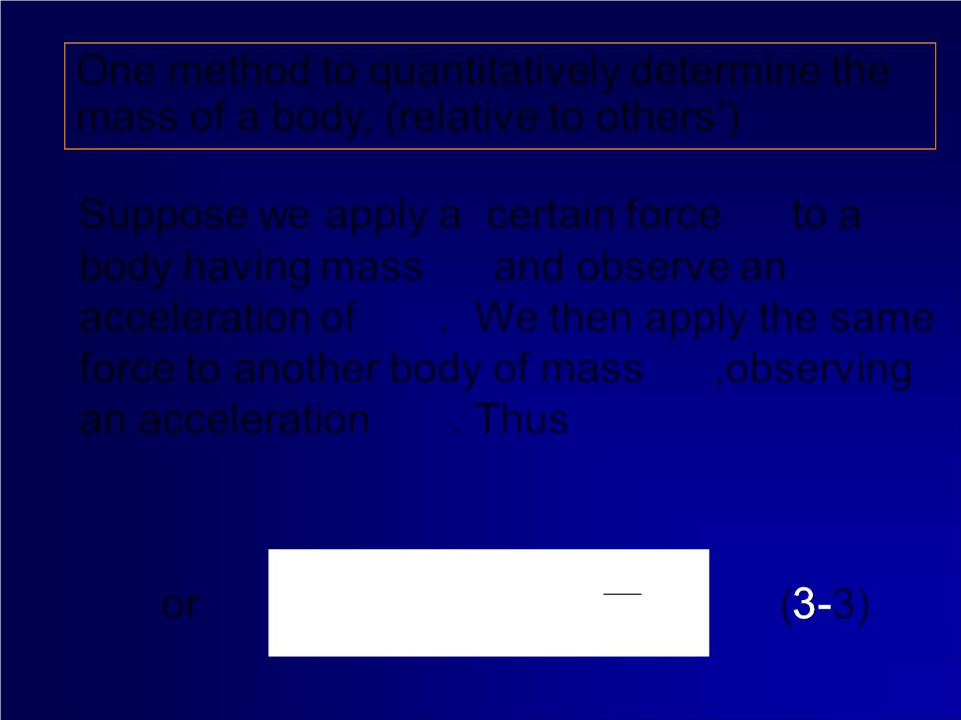
One method to quantitatively determine the
mass of a body, (relative to others’)
→
Suppose we apply a certain force to a
F
m
body having mass and observe an
1
a
acceleration of . We then apply the same
force to another body of mass ,observing
1
m
2
a
an acceleration . Thus
2
m a = m a
m a
a
2
=
1
m m
or m a
=
1
( 3)
2
a
1
1
2
2

Slide 13
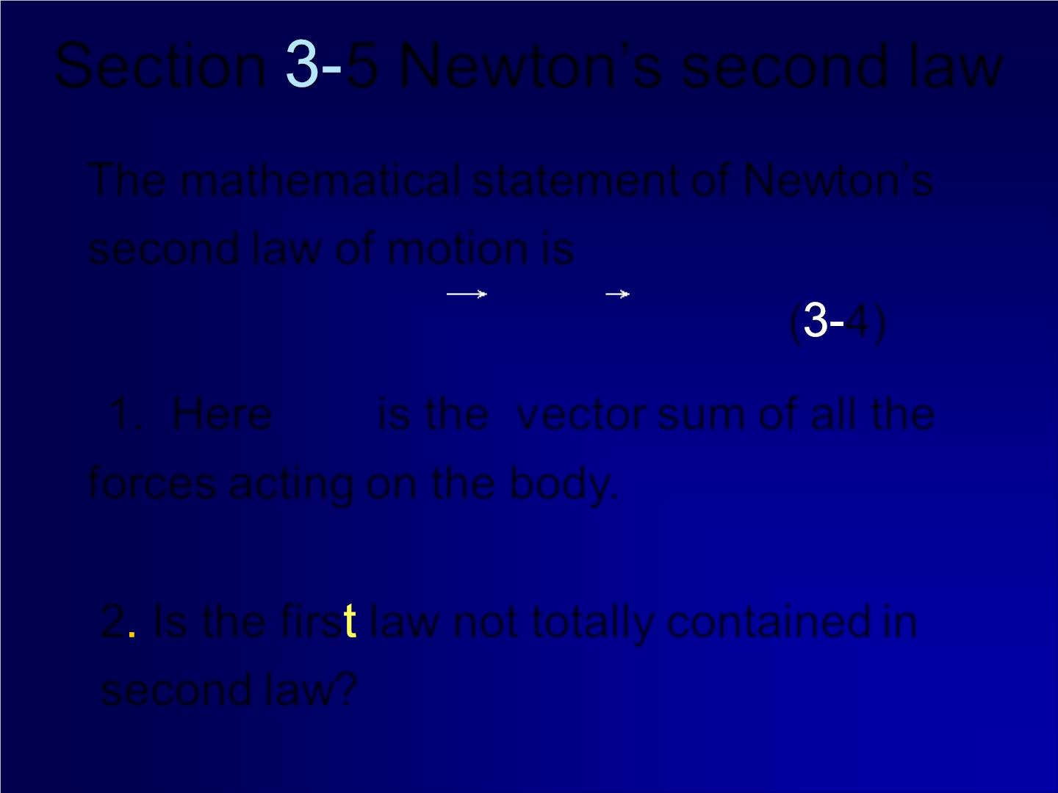
Section 5 Newton’s second law
The mathematical statement of Newton’s
second law of motion is

F = ma
( 4)
i

→
1. Here F is the vector sum of all the
i
forces acting on the body.
2 Is the firs law not totally contained in
second law?
No.

Slide 14
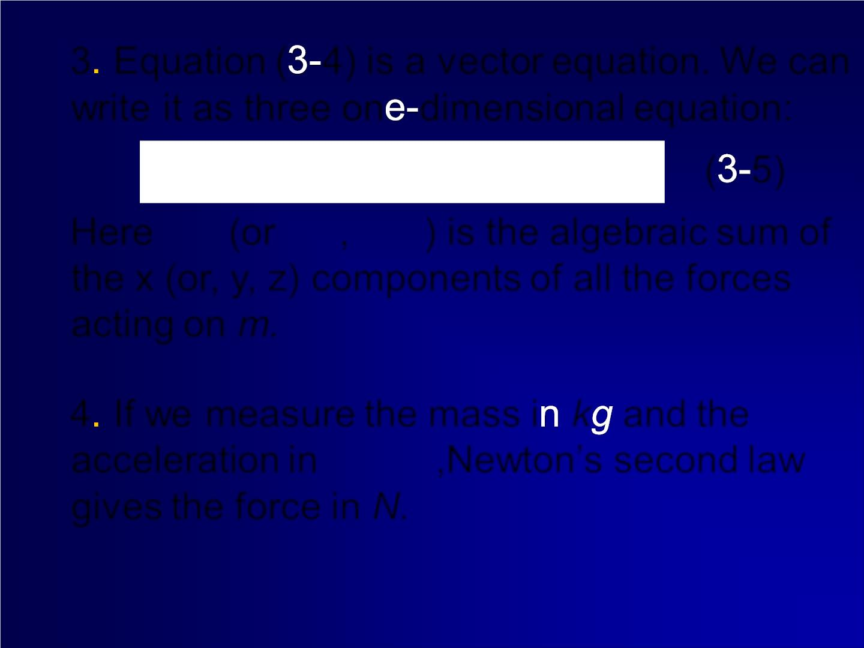
3 Equation ( 4) is a v ector equation. We can
write it as three on dimensional equation:

F = a 

F = a
iz
( 5)
m
Fiy =
m
a
m
ix
x
y
z
Here  (or , ) is the algebraic sum of
F
 
F F
x
y
z
the x (or, y, z) components of all the forces
acting on m.
4 If we measure the mass i k and the
acceleration in
_{m/ s}2 ,Newton’s second law
gives the force in N. = 
1N 1kg m/ s
2

Slide 15
Sample problems
240 kg
2.3 m
130 N
rest

Slide 17

with an
increasing
speed
orth. F

Slide 18
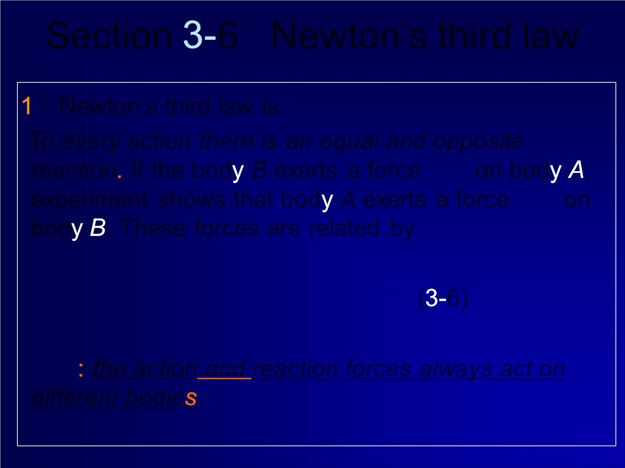
Section 6 Newton’s third law
）Newton’s third law is:
To every action there is an equal and opposite
→
reaction If the bod B exerts a force F on bod ;
A B
→
experim ent shows that bod A exerts a force F on
B A
bod . These forces are related by
F AB = − F
BA
( 6)
Note the action and reaction forces always act on
different bodie .

Slide 19
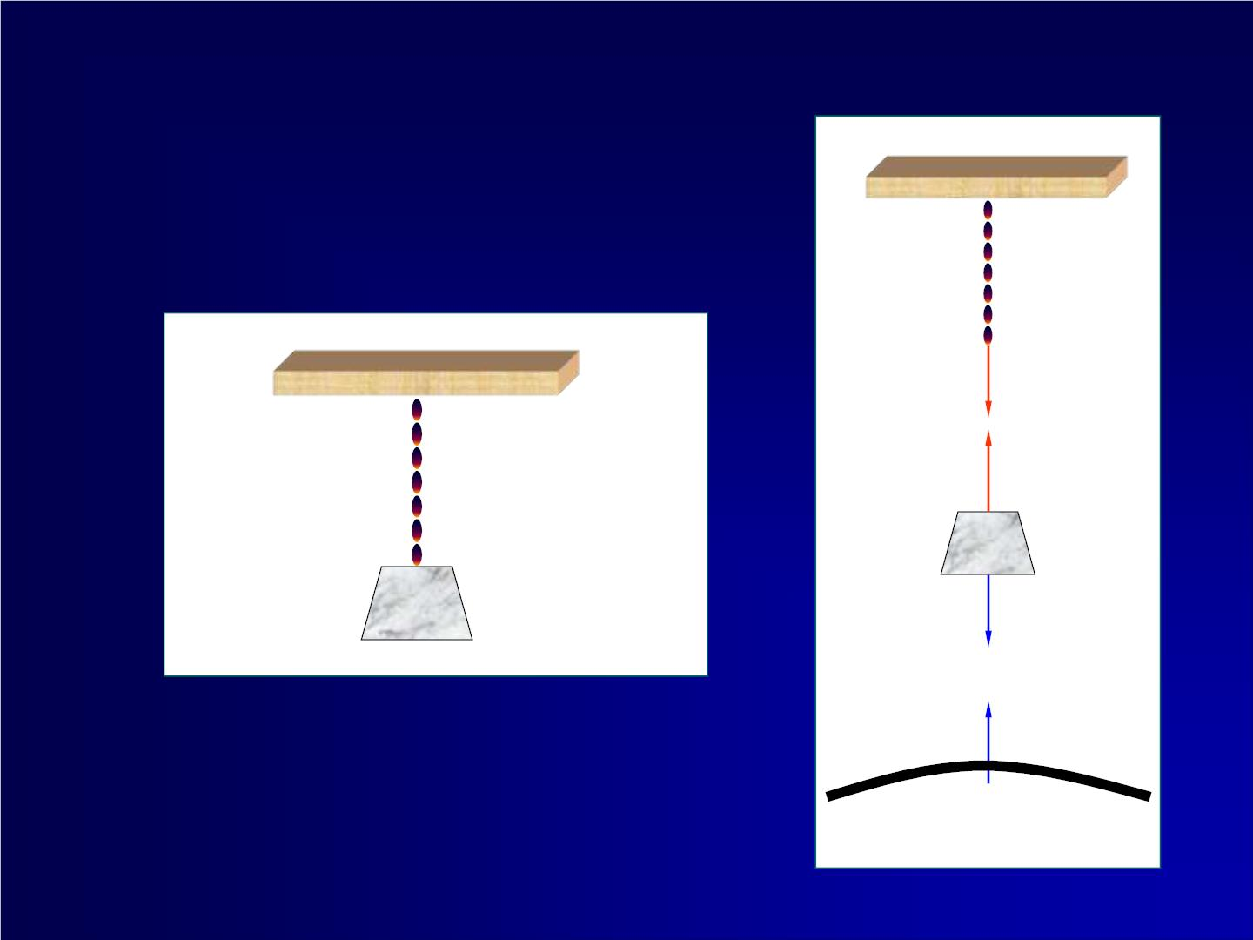
❖
T＇
❖
T
m
m
❖
P
❖
P＇
地球

Slide 20
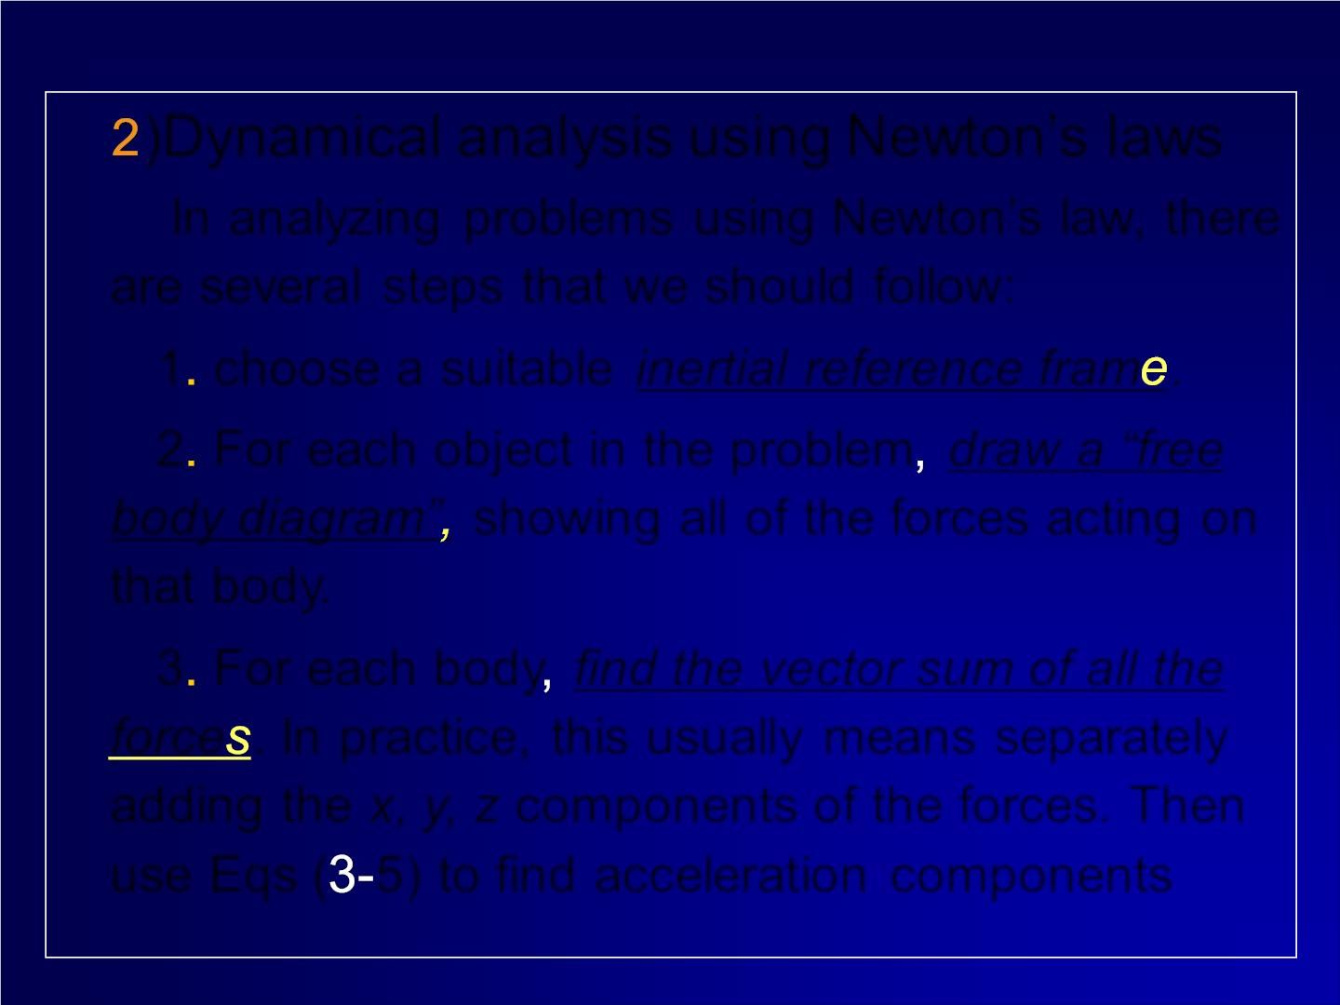
)Dynamical analysis using Newton’s laws
In an alyz in g problems using Newton’s law, there
are sever a l steps that we should follow:
1 choose a suitable inertial reference fram .
2 For each object in the problem draw a “free
body diagram” showing all of the forces acting on
that body.
3 For each body find the vector sum of all the
force . In practice, this usually means separately
adding the x, y, z components of the forces. Then
use Eqs ( 5) to find acceleration components

Slide 21

Sample problems
m₁=4.2 Kg
c
m₂=1.4 Kg.
without friction
F_{1w}=3.2 N.
e 动画库 力学夹/ 0 牛顿定律例题 例1

