Slide 1
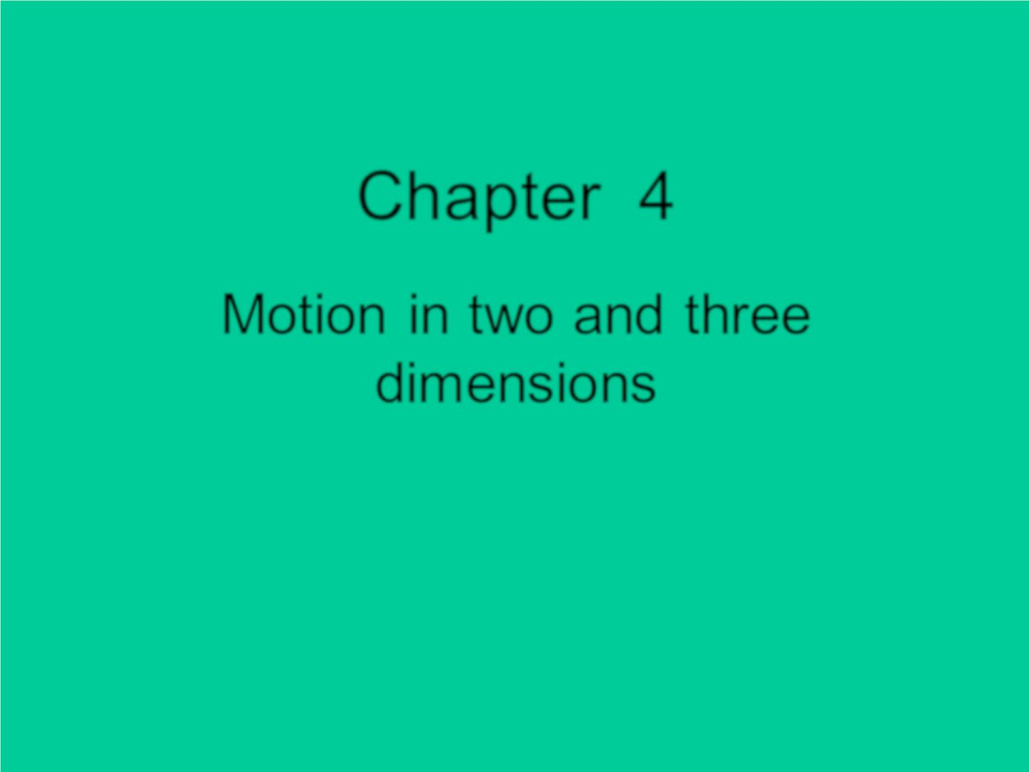
Chapter 4
Motion in two and three
dim ens io ns

Slide 2
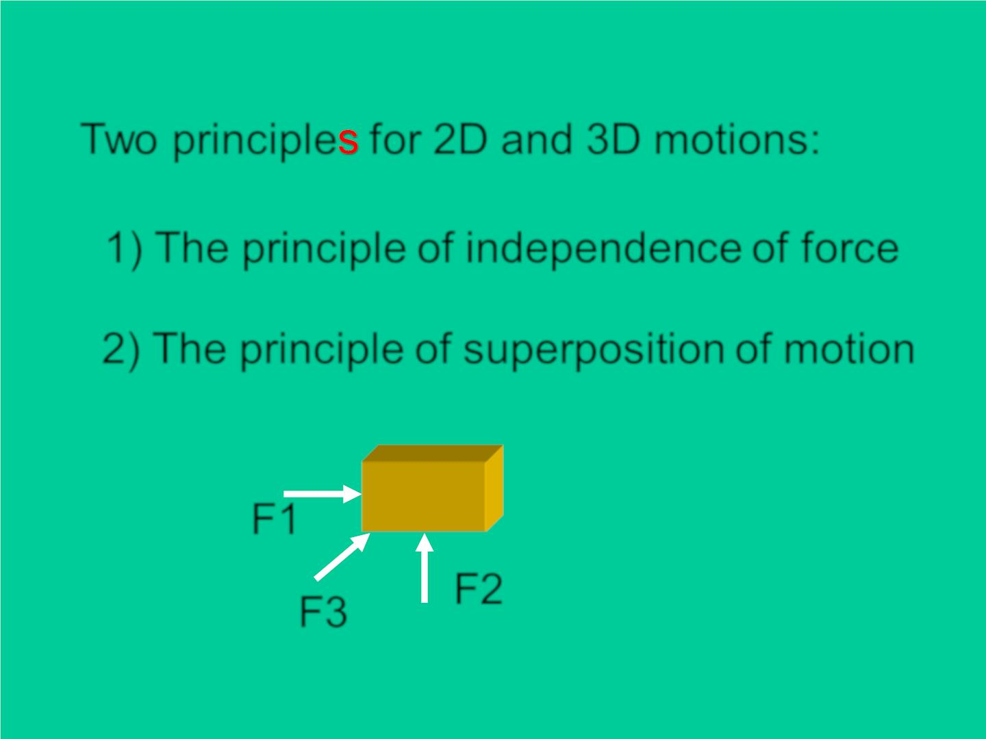
Two principle for 2D and 3D motions:
1) The principle of independence of force
2) The principle of superposition of motion
F1
F3
F2

Slide 3
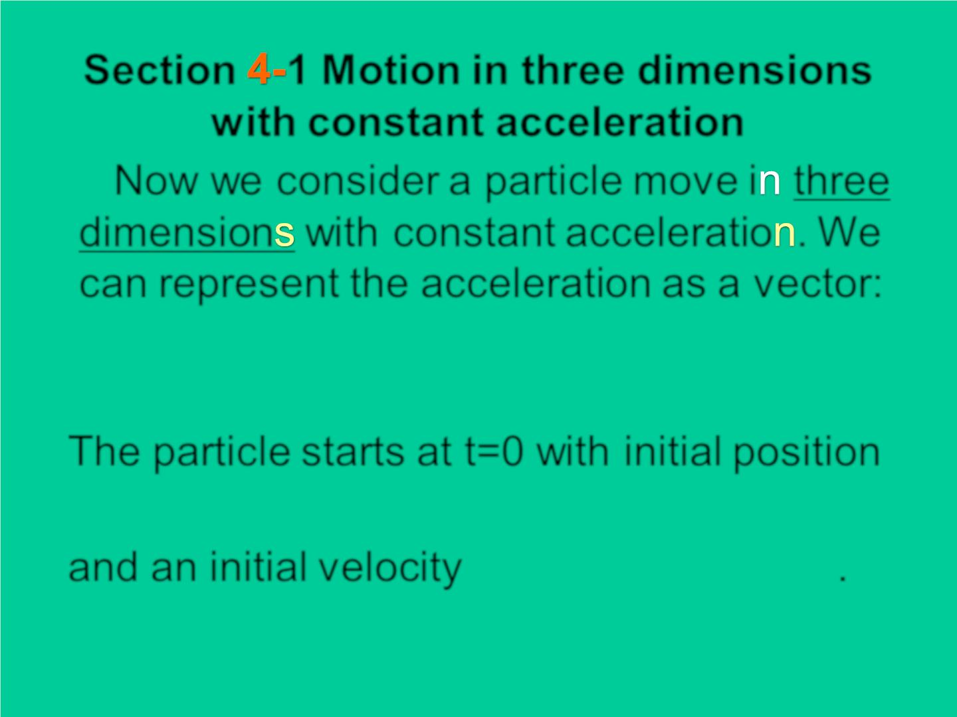
Section 1 Motion in three dimensions
w ith constant acceleration
Now we consider a particle mov e i three
dimension with constant acceleratio . We
can represent the acceleration as a vector:
→



a = a i+ a j+ a k
x
y
z
The particle starts at t=0 with initial position
→



r = x i+ y j+ z k
0
0
0
o
→



and an initial velocity = + + .
v v i v j v k
0
0x
0y
0z

Slide 4
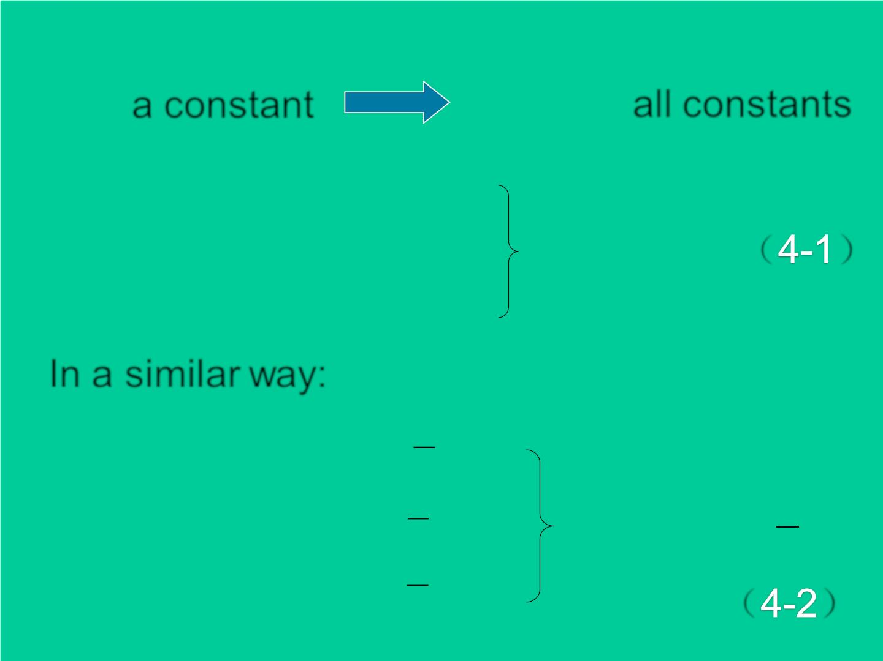
→
a,
a constant
v = v + a
a ,a ,a ,
all constants
x
y
z
t
x
0x
x
→
→
→
v = v + a
t
v = v + a t
y
0 y
y
z
（ ）
0
v = v + a
t
z
0z
In a similar way:
1
x
y
z
= x + v + a t
2
t
0
0x
2
x
y
1
→
→
→
1
→
= + v + a t
2
t
= + +
r r v t a t
2
0
0 y
2
y
0
0
2
（ ）
1
= z + v + a t
2
t
0
0z
2
z

Slide 5
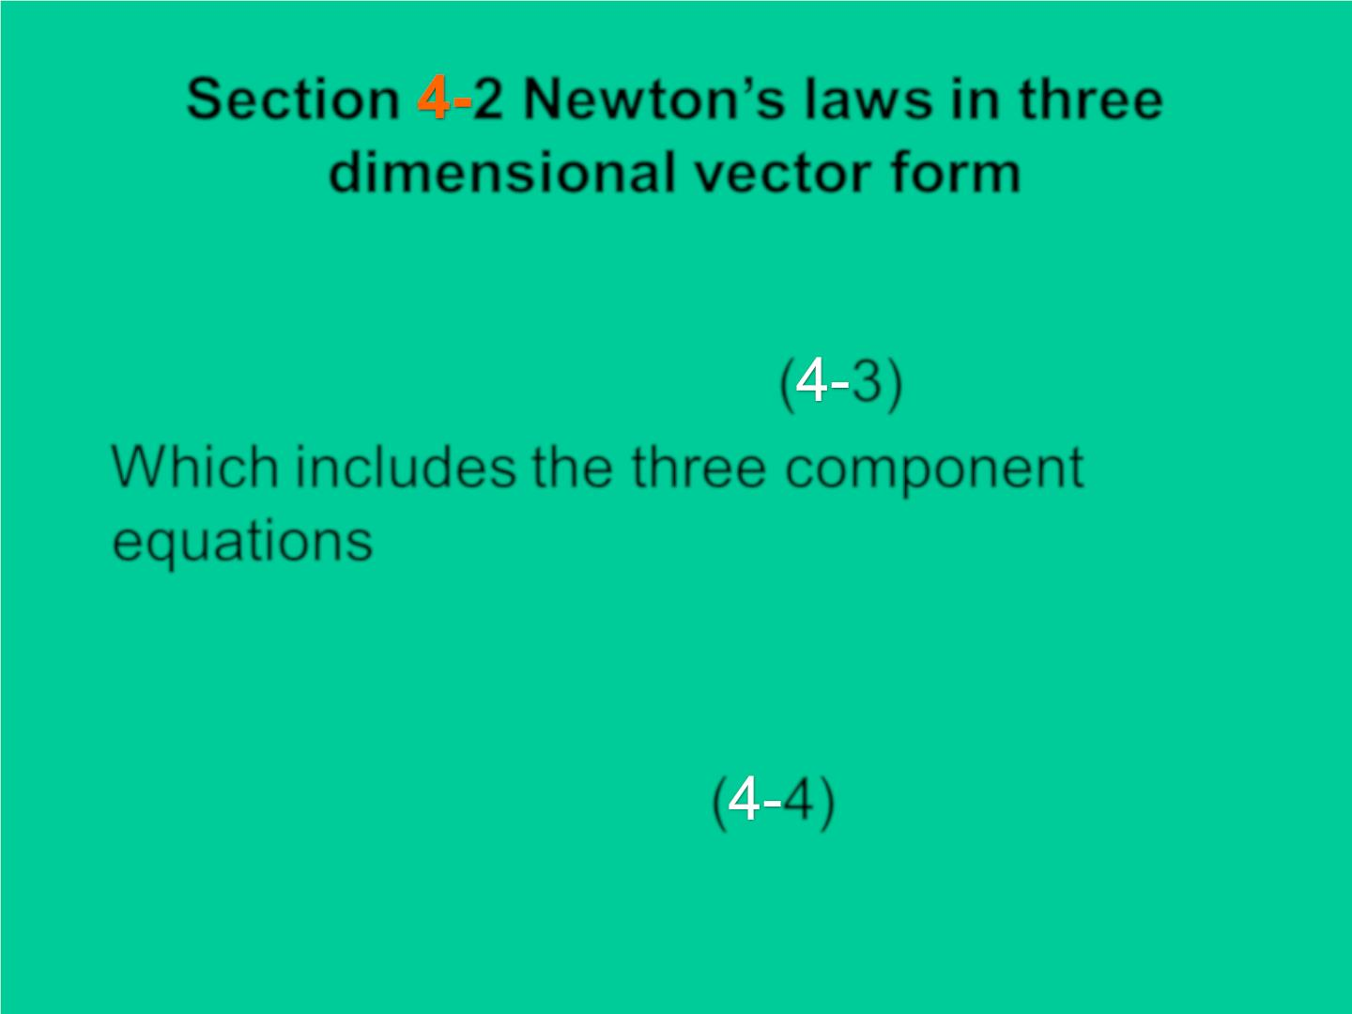
Section 2 New ton’s laws in three
dimensional vector form

→
→
F = m a
( 3)
Which includes the three component
equations



F_{x} = ma_{x}
F_{z} = ma_{z}
F_{y} = ma_{y}
( 4)

Slide 6
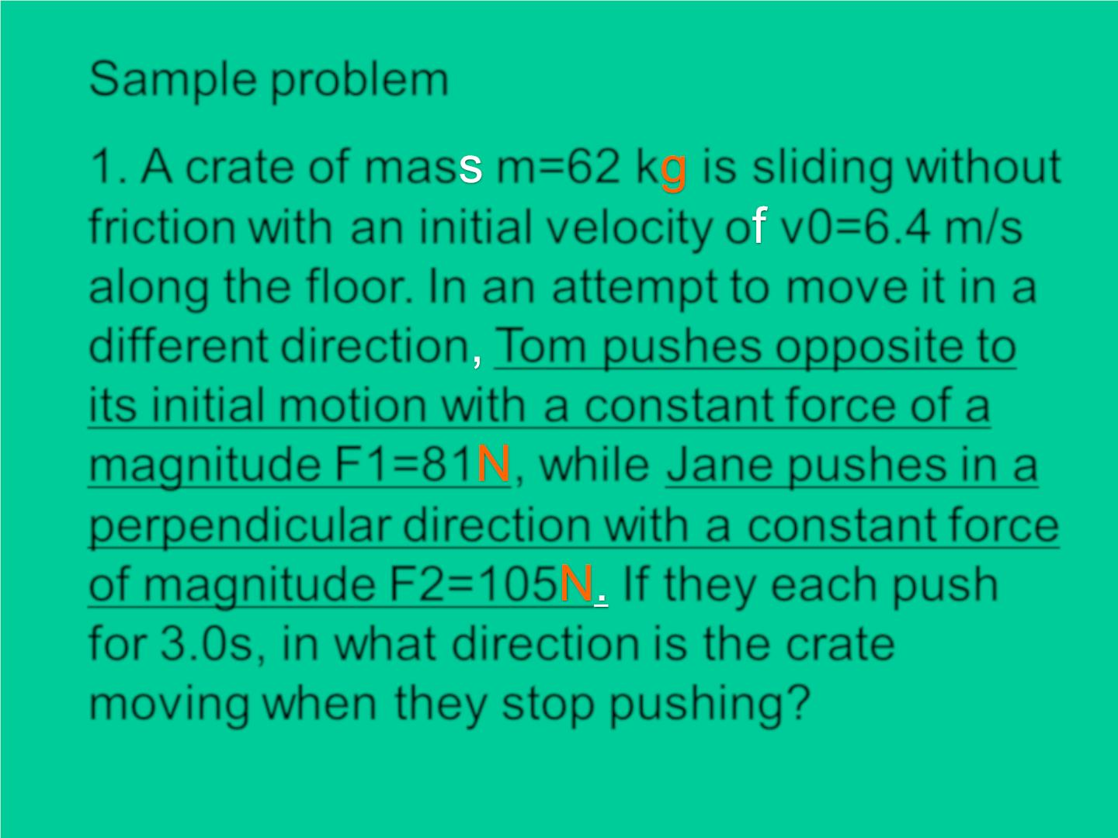
Sample problem
1. A crate of mas m=62 k is sliding without
friction with an initial velocity o v0=6.4 m/s
along the f loor. In an attempt to mov e it in a
different direction To m pushes opposite to
its initial motion with a constant force of a
magnitude F1=81 , while Jane pushes in a
perpendicular direction with a constant force
of magnitude F2=105 If they each push
for 3.0s, in what direction is the crate
moving when they stop pushing?

Slide 7
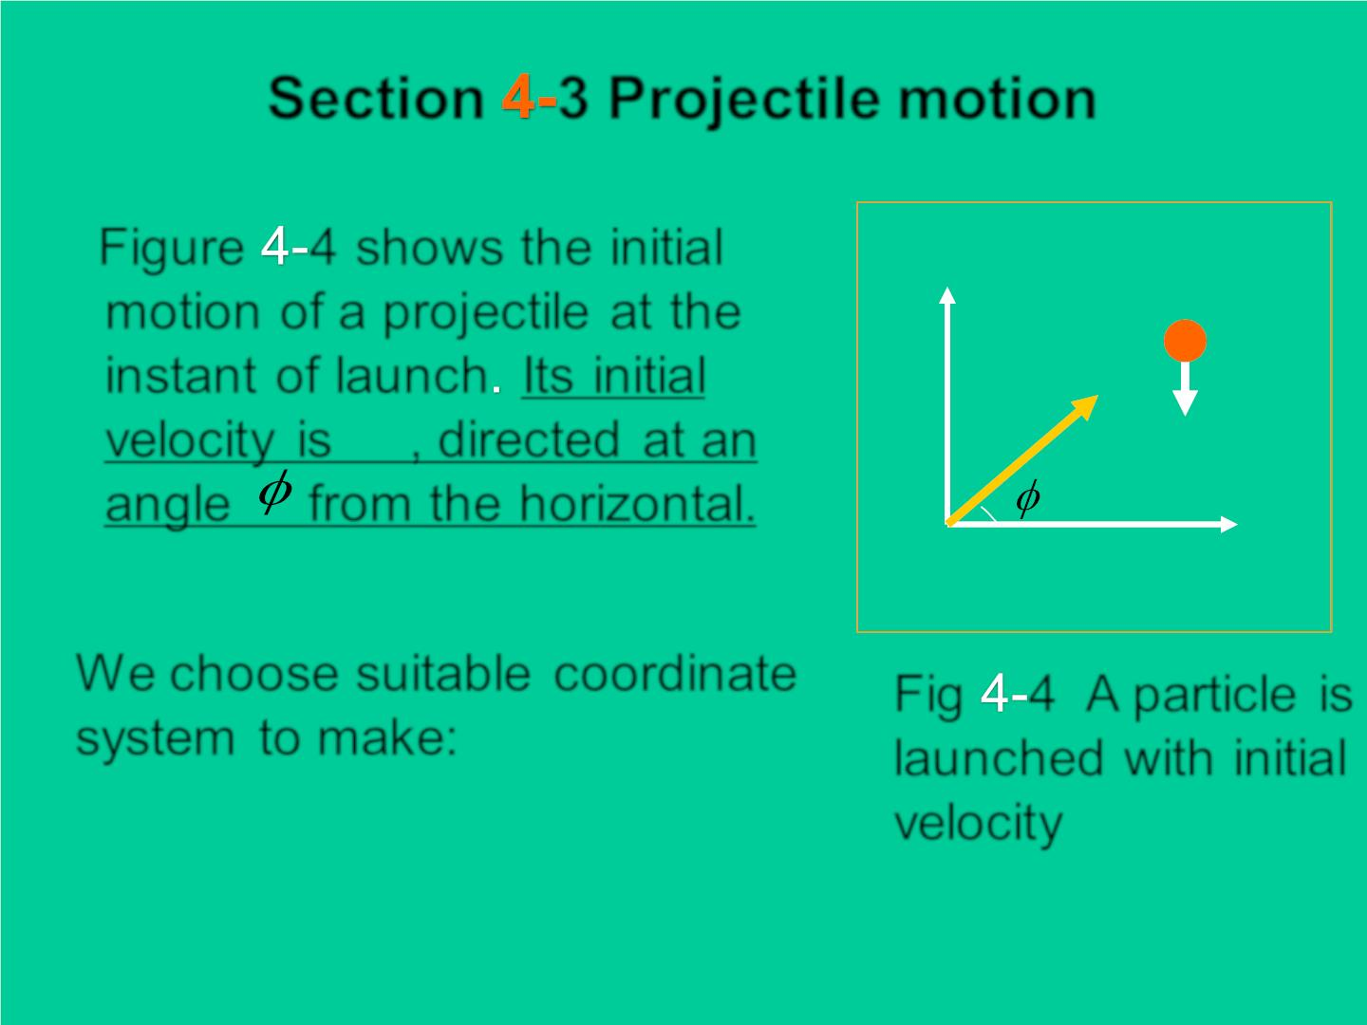
Section 3 Projectile motion
Figure 4 shows the in itia l
y
motion of a proj ectile at the
instant of launch Its in itial
→
v
o
→
v
mg
veloc it y is , directed at an
o
angle 0from the horizontal.
o
0
x
We choose suitable coordinate
system to make:
Fig 4 A particle is
launched with in itia l
veloc it y
x₀ = 0
y₀ =
0

Slide 8
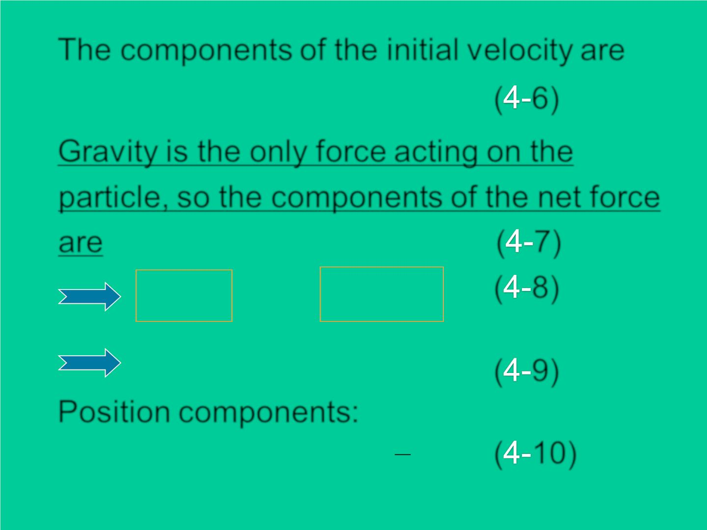
The components of the initial velocity are
v = v cos
sin
v = v 
( 6)
ox
0
0
oy
0
0
Grav ity is the only force acting on the
particle, so the components of the net force
are
 
( 7)
( 8)
F = 0
= −
F mg
x
y
a_{x} =
0
a_{y} = −g
v_{x} = v_{0x}
= −
v v gt
y
0 y
( 9)
Position components:
x = v_{0x}t
1
= −
2
( 10)
y v t gt
0 y
2

Slide 9
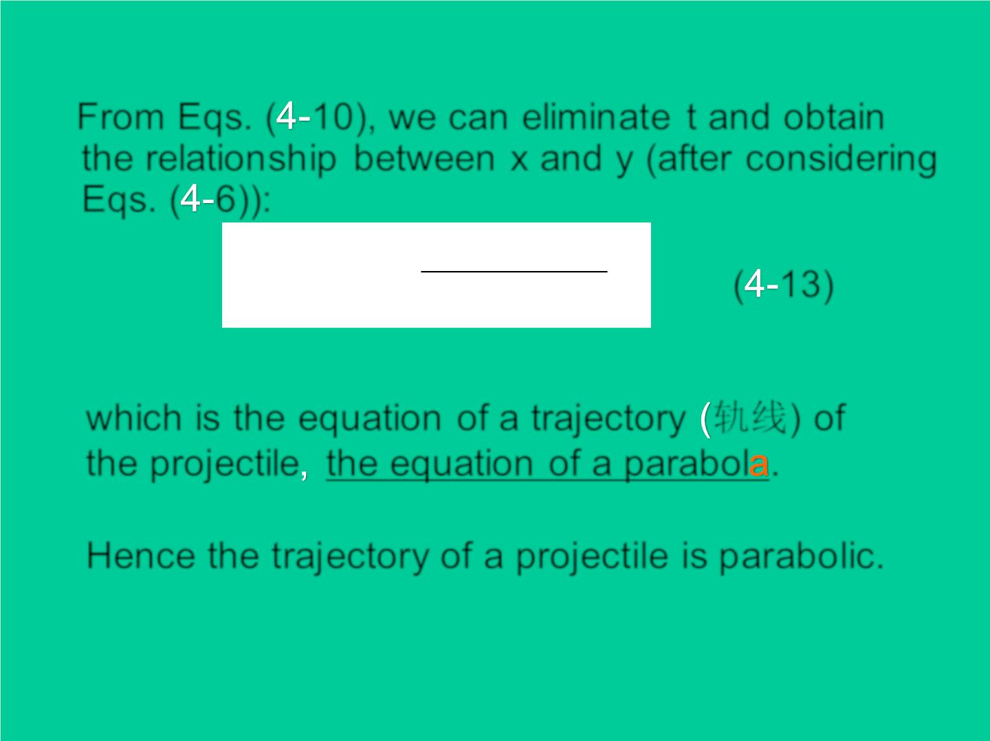
From Eqs. ( 10), we can elimin at e t and obtain
the relation sh ip between x and y (after considering
Eqs. ( 6)):
g
=  −
y tan x
x²
0

2
( 13)
2(v cos )
0
0
which is the equation of a trajectory 轨线) of
the proj ectile the equation of a parabol .
Hence the traj ectory of a projectile is p arabo lic.

Slide 10
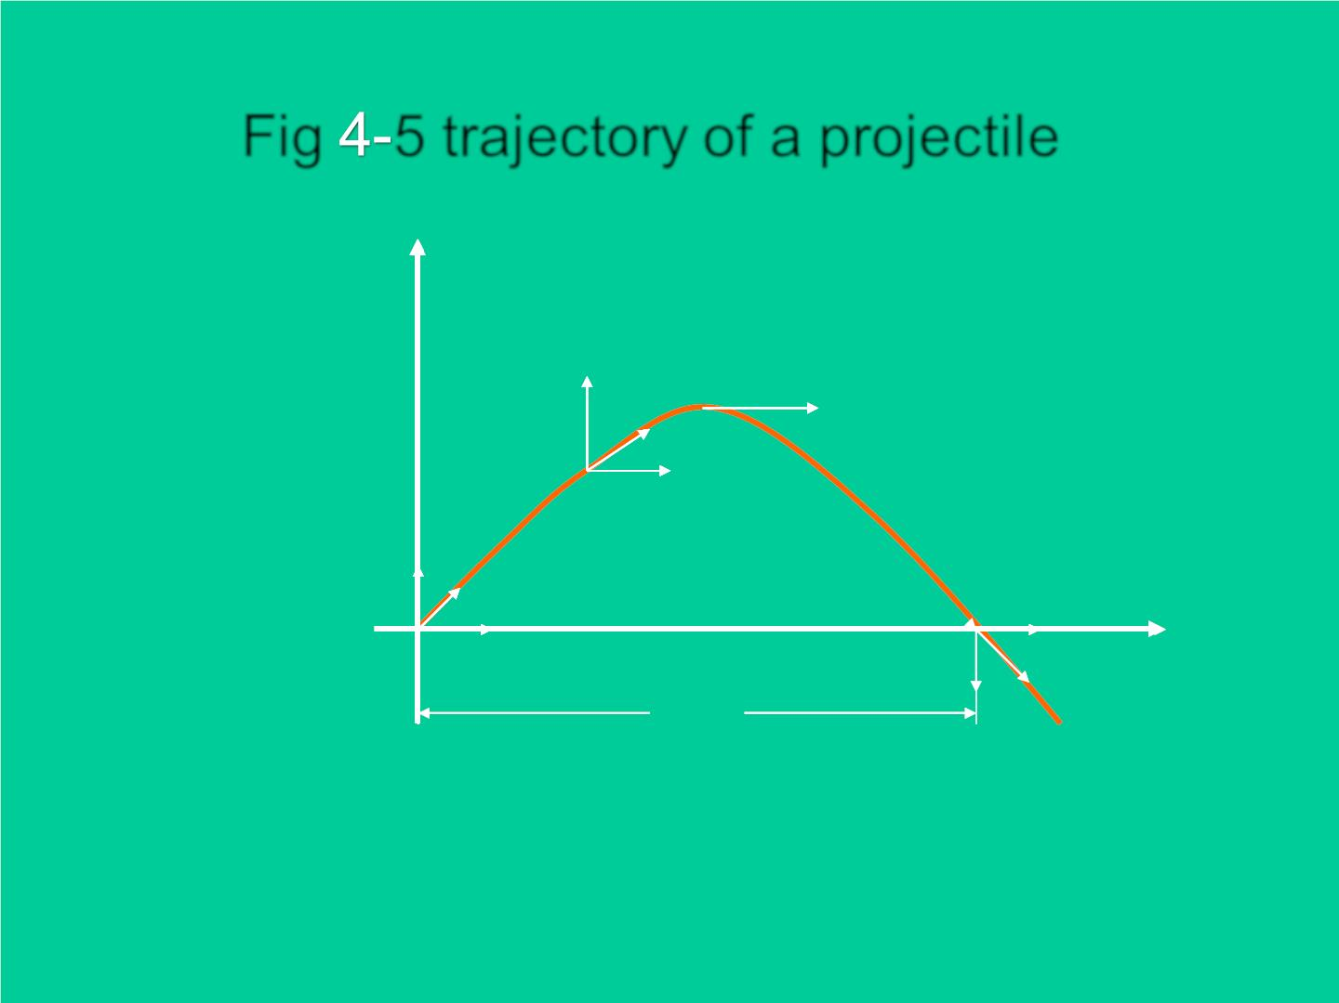
Fig 5 trajectory of a projectile
y
vy
^{v}0x
^{v}0x
v0 y
v₀
v
v0x
x
o
^{v}0 y
v
0x
0x
R

Slide 11
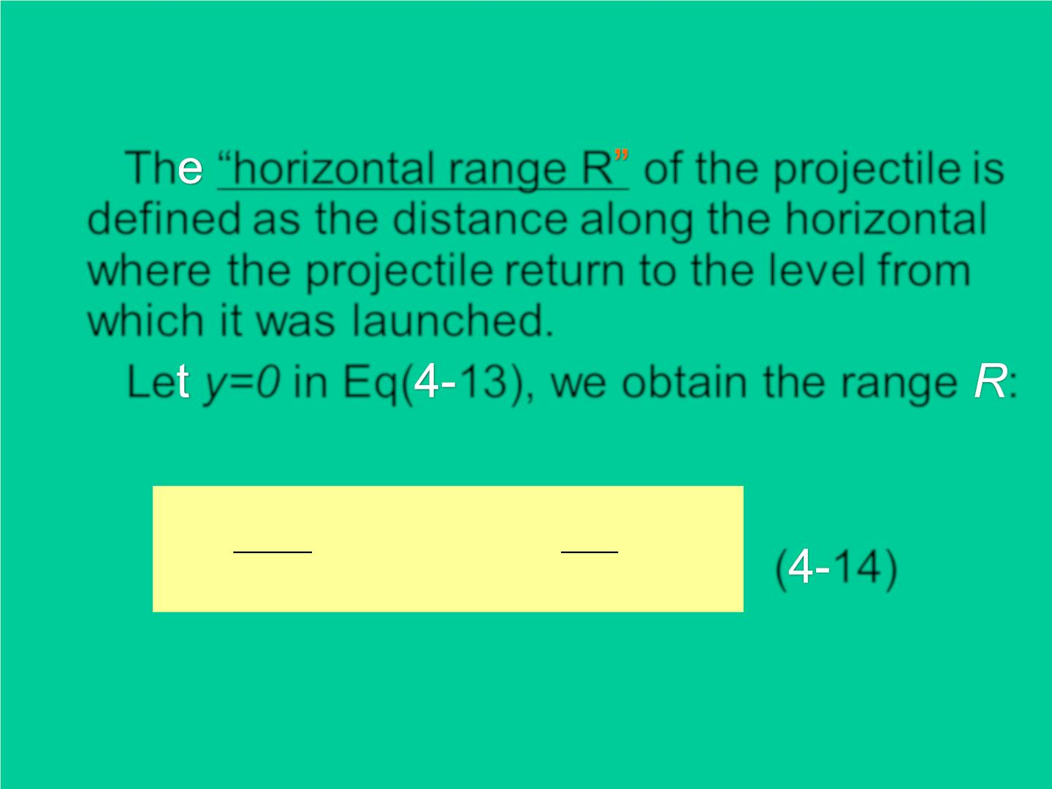
Th “horizontal range R of the projectile is
defined as the distance along the horizontal
where the projectile return to the level from
which it was launched.
Le y=0 in Eq( 13), we obtain the range :
2v₀ ²
v
2
R =
  =
s in cos
0
sin 2

0
0
0
( 14)
g
g

Slide 12

当子弹从枪口射出时，椰子刚好从树上由静止
自由下落 . 试说明为什么子弹总可以射中椰子 ?

Slide 13
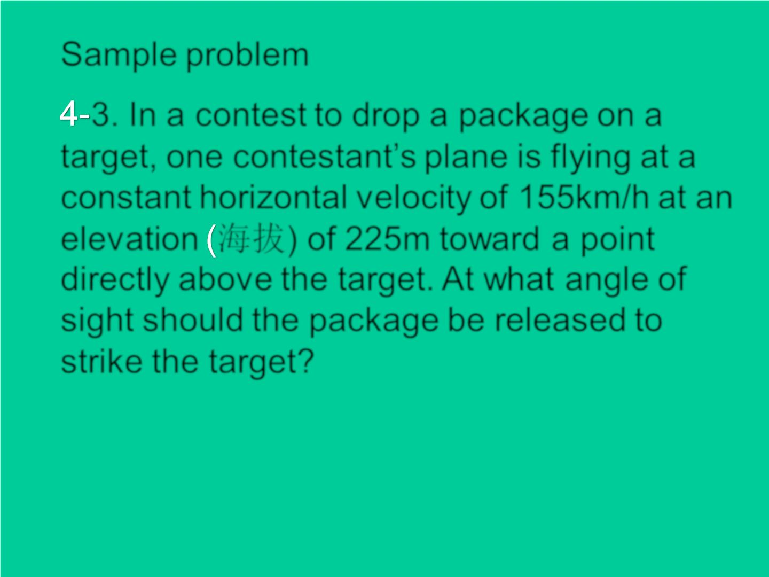
Sample problem
3. In a contest to drop a package on a
target, one contestant’s plane is flying at a
constant horizontal velocity of 155km/h at an
elevation 海拔) of 225m toward a point
directly above the target. At what angle of
sight should the package be released to
strike the target?

Slide 14
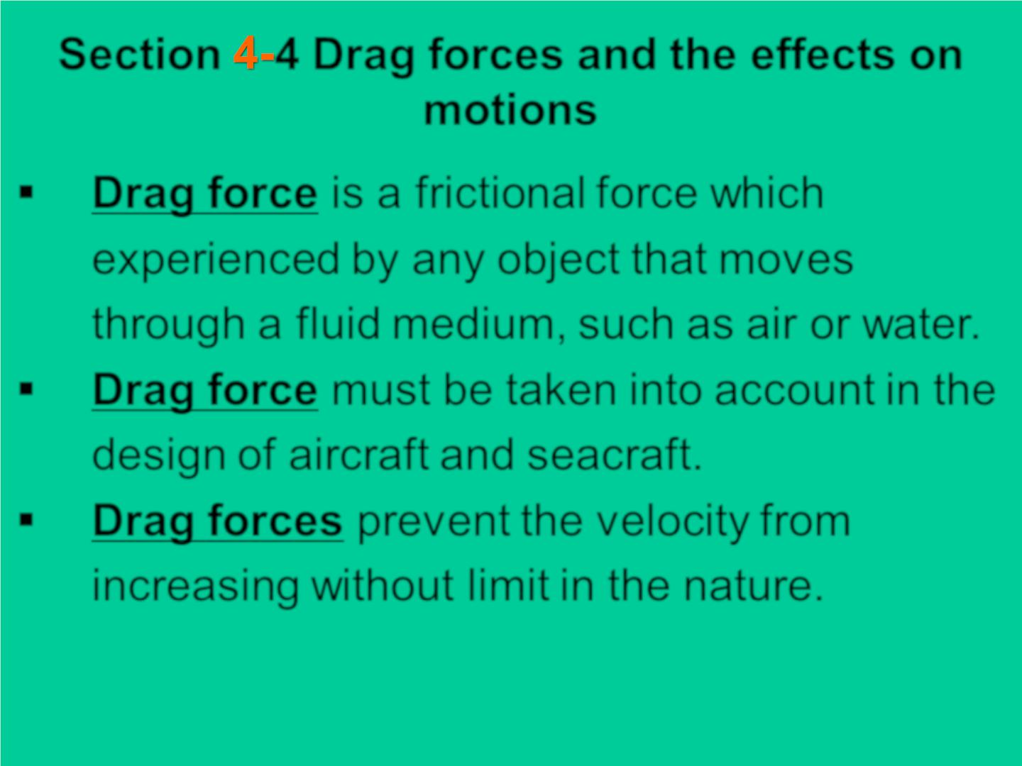
Section 4 Drag forces and the effects on
motions
▪ Drag force is a frictional force which
experienced by any object that moves
through a fluid medium, such as air or water.
▪ Drag force must be taken into account in the
design of aircraft and seacraft.
▪ Drag forces prevent the velocity from
increasing without limit in the nature.

Slide 15
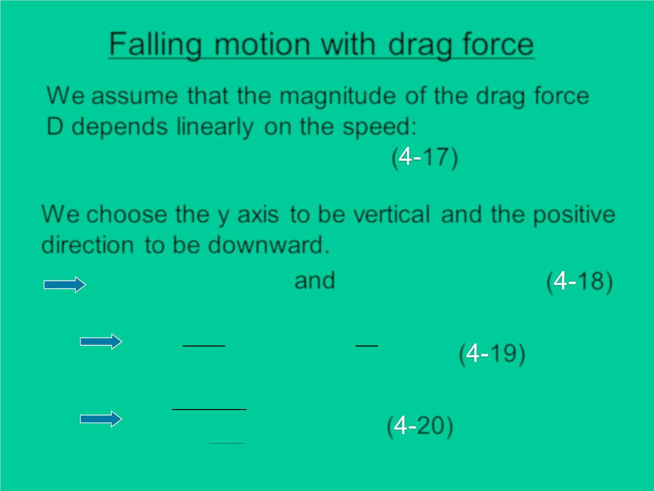
Falling motion with drag force
We assume that the magnitude of the drag force
D depends linearly on the speed:
❖
❖
D = −bv
( 17)
We choose the y axis to be vertical and the positive
direction to be downward.

F = mg −bv and
mg − bv_{y} = ma_{y}
( 18)
y
y
^{dv}y
b
= = −
a g v
y
y
( 19)
dt
m
dv
y
=
dt
bv_{y}
m
( 20)
g
−

Slide 16
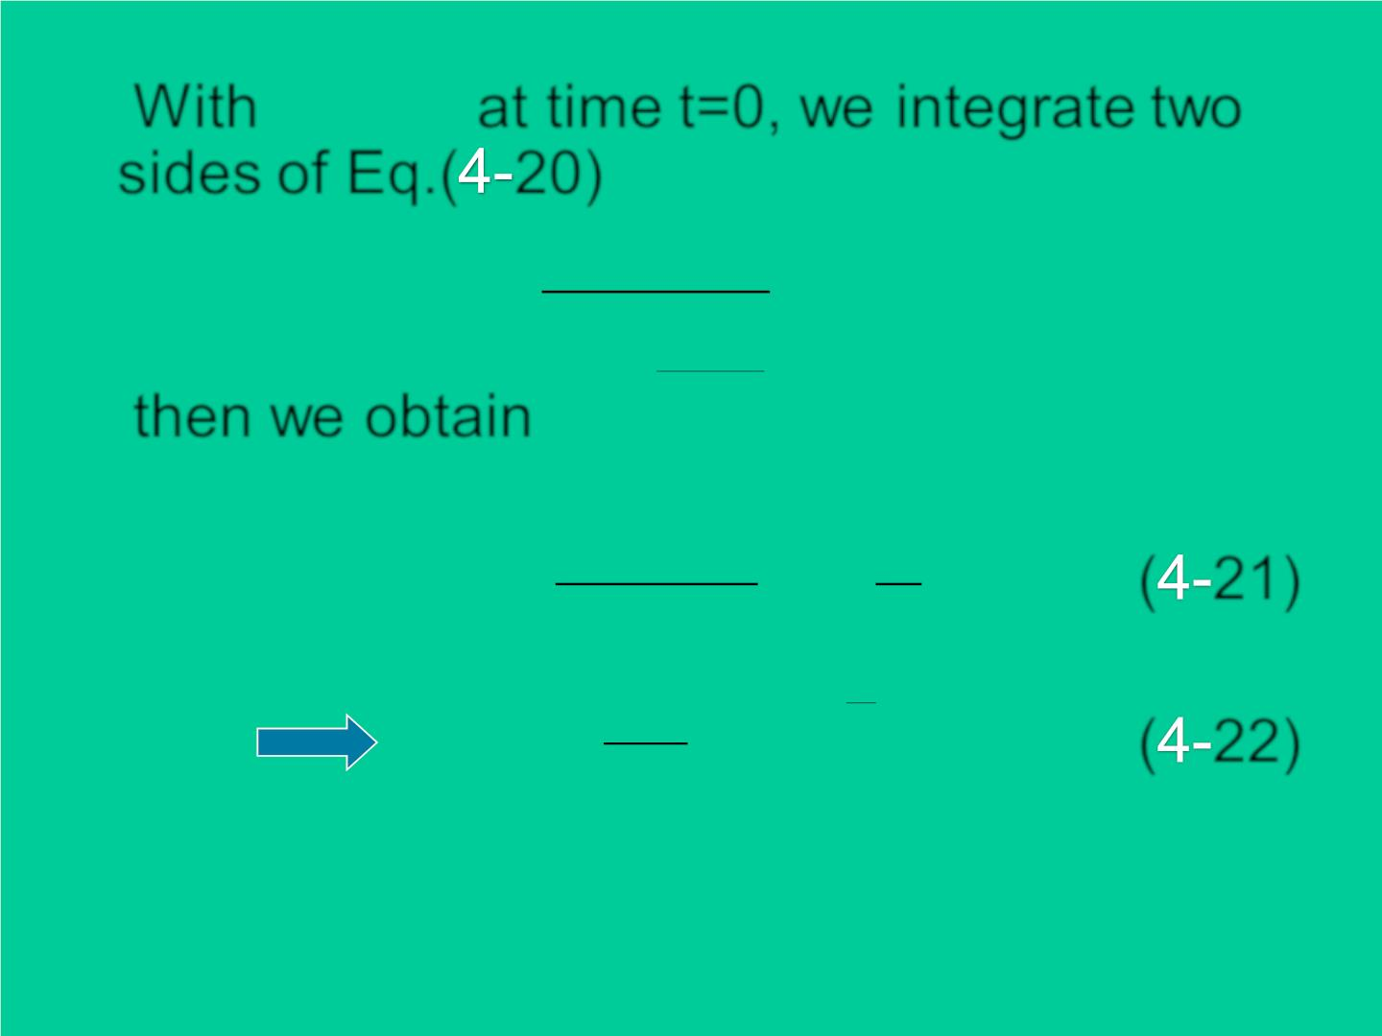
v =
With 0 at time t=0, we integrate two
y
sides of Eq.( 20)
v
dv
t
y
⇩ 
y
=
dt
bv
0
g −
y
0
then we obtain
m
^{mg −bv}y
b
ln(
)
= −
t
( 21)
( 22)
mg
m
mg
b
− t
v = (1− e )
m
y
b

Slide 17
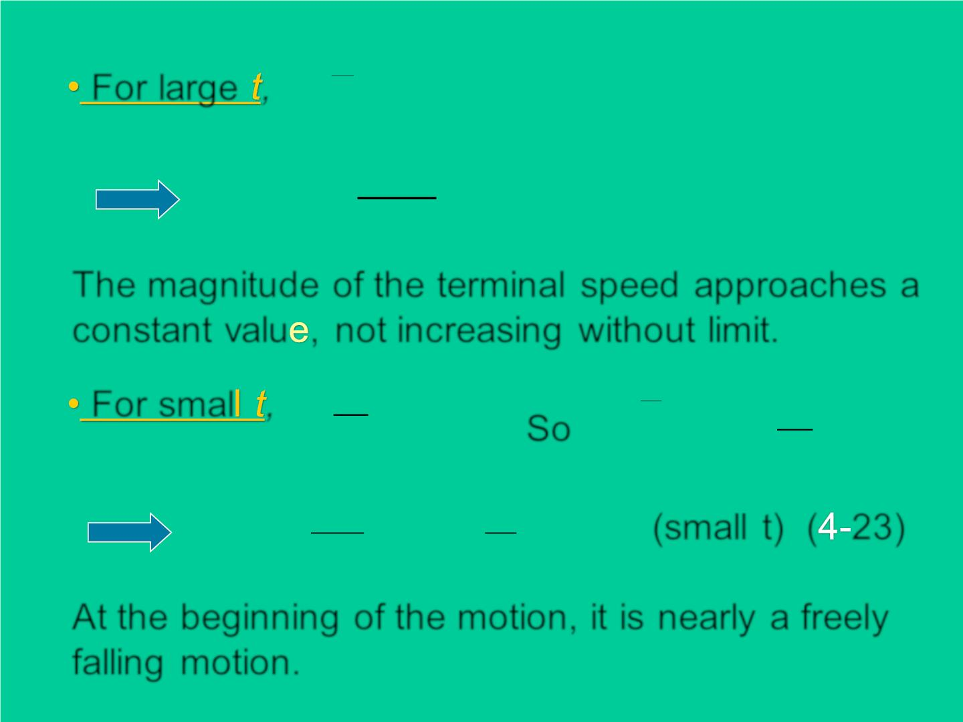
b
For large ,
− t
e → 0
m
m g
v _{y} →
b
The magnitude of the terminal speed approaches a
constant valu , not increasing without limit.
b
b
b
For smal ,

t 1
−
t
e  1− t
So
m
m
m
mg
b
v (t)  [1− (1− t)] = gt
(small t) ( 23)
y
b
m
At the beginning of the motion, it is nearly a freely
falling motion.

Slide 18
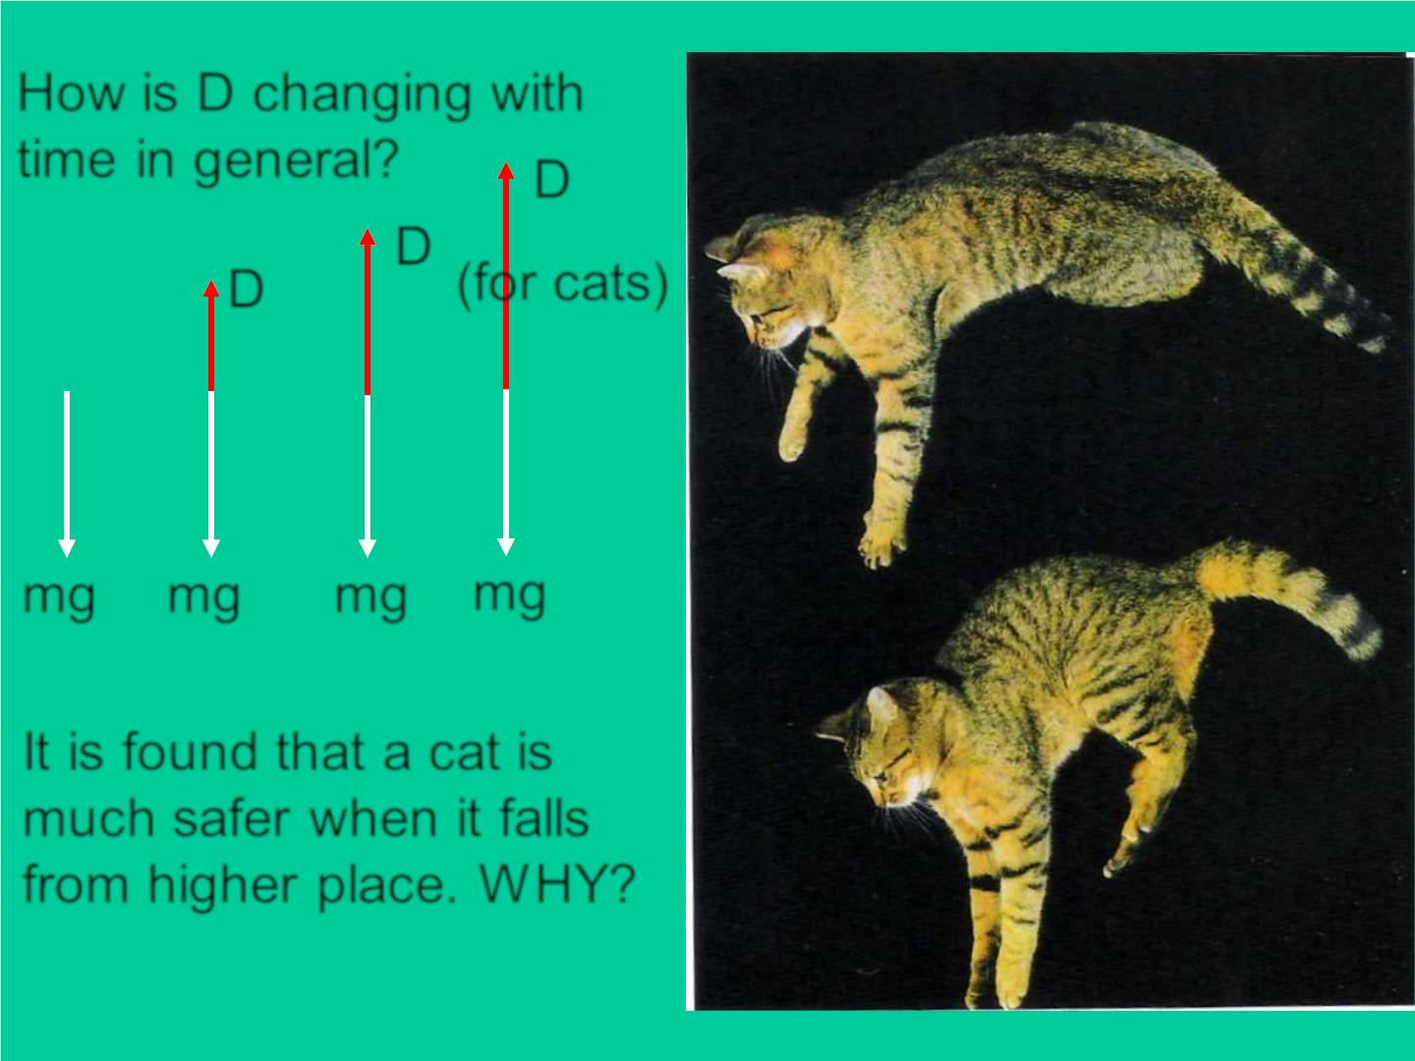
How is D changing with
time in general?
D
D
D
(for cats)
mg mg mg mg
It is found that a cat is
much safer when it falls
from higher place. W HY?

Slide 19
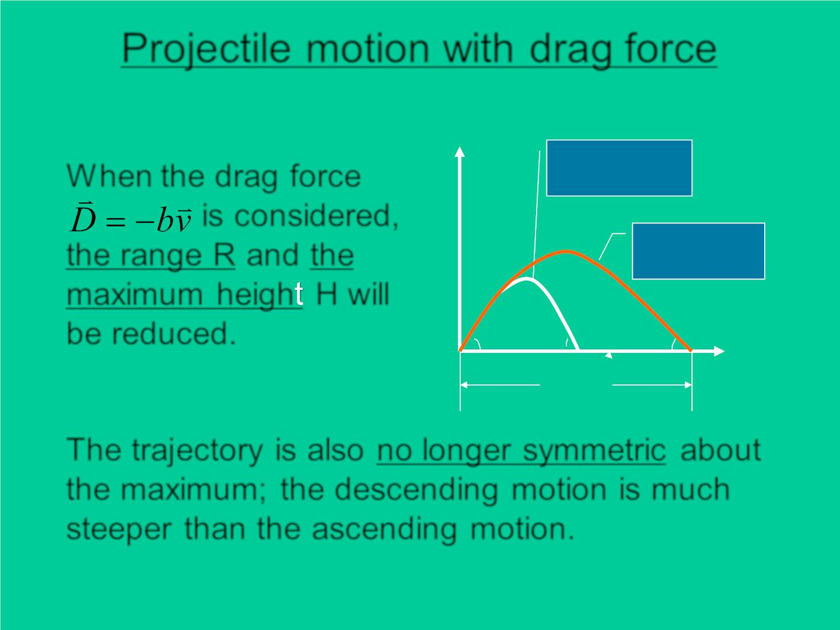
Projectile motion with drag force
Y(m)
W hen the drag force
is considered,
the range R and the
maximu m heigh H will
be reduced.
With drag
force
Without
drag force
 = 60⁰
o
− 79□
− 60⁰
R
-
X (m)
The trajectory is also no longer symmetric about
the maximum; the descending motion is much
steeper than the ascending motion.

Slide 20
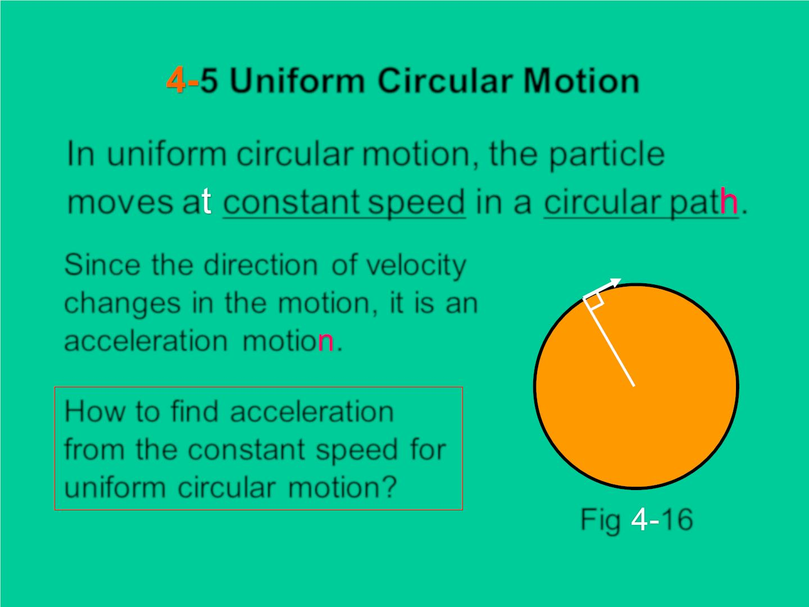
5 Uniform Circular Motion
In uniform circular motion, the particle
mov es a constant speed in a circular pat .
Since the direction of veloc it y
changes in the motion, it is an
acceleration motio .
v
r
How to find acceleration
from the constant speed for
uniform circular motion?
O
Fig 16

Slide 21
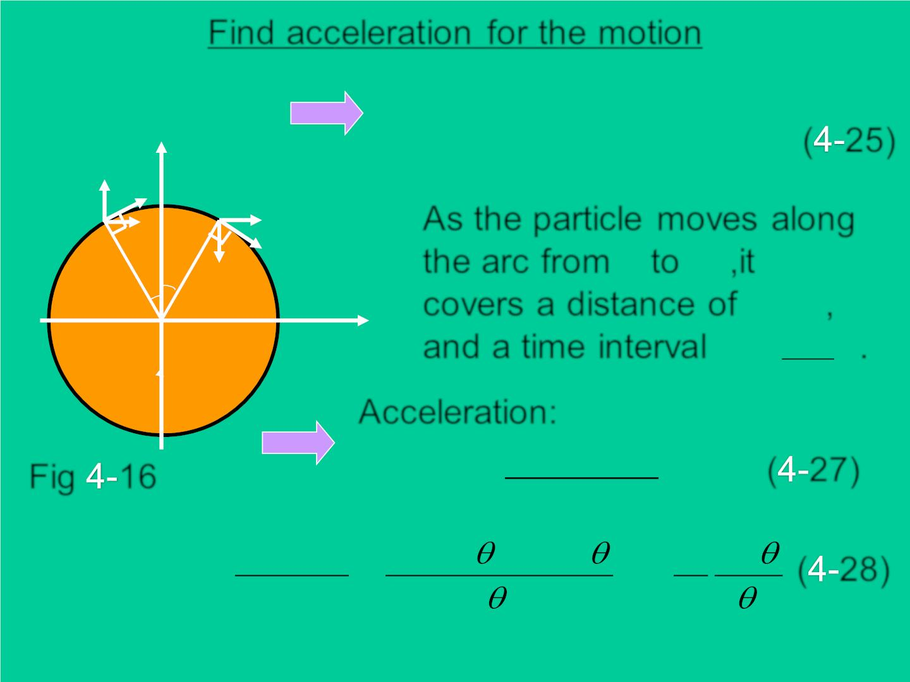
Find acceleration for the motion
v = vcos
v = vcos
y
 
1x
2x
( 25)
v
v = vs in 
^{v}2 y ^{= −vs in }
v
p
p₂
1y
p
1y
1
v
As the particle mo ves along
p p
the arc from to ,it
2x
v_{1x}
v
r 
❑
^{v}2 y
1
2
r2
c overs a distance of ,
x
2 
O
and a time interval
r
.
t =
v
Acceleration:
v − v
a_{x} =
2
x
1x
= ( 27)
Fig 16
0
t
v − v −
−
2
vs in vsin
v
s in
ªy
=
2 y
1y
=
= −
( 28)

t
(2r / v)
r

Slide 22
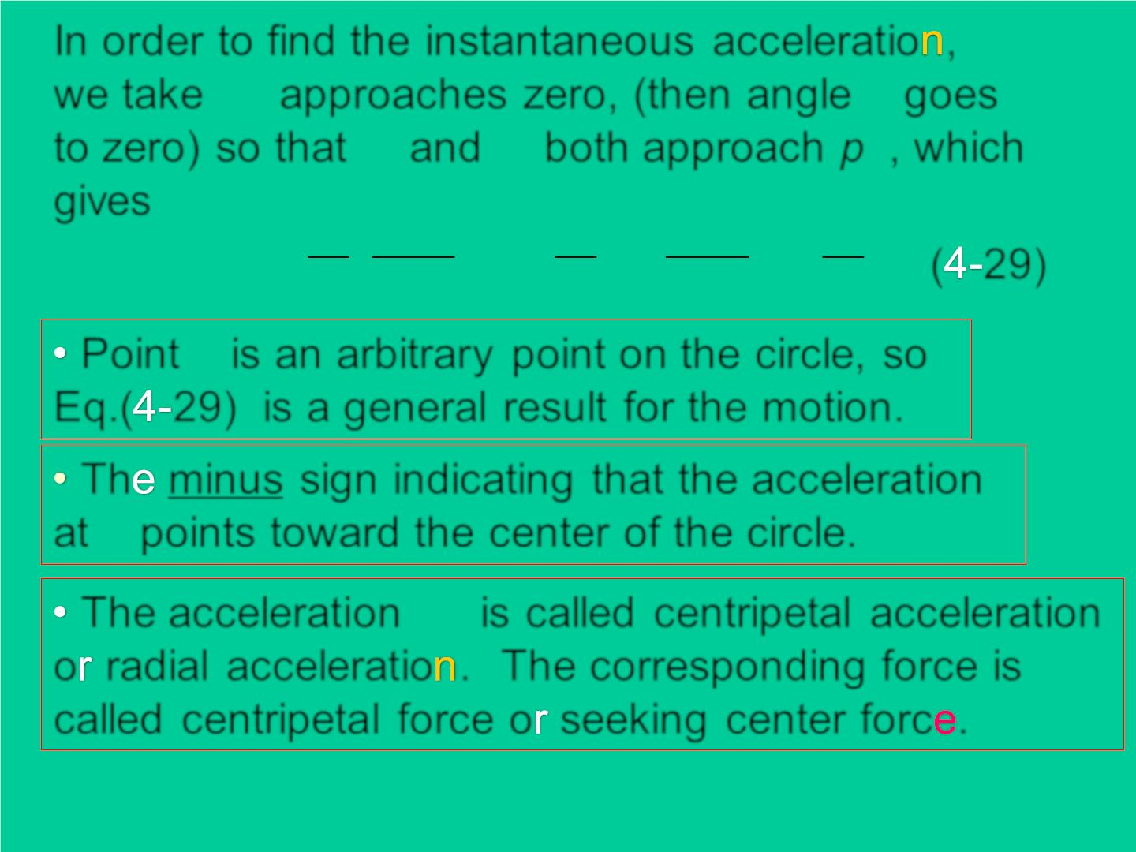
In order to find the instantaneous acceleratio ,

❑
we take t approaches zero, (then angle goes
p p
to zero) so that and both approach p , which
1
2
g ives
2
❑
2
❑
v²
r
v s in
v sin
a = lim [− ( )] = − lim
= −
( 29)
y
❑ →0
r
❑
r
❑ →0
❑
Point p is an arbitrary point on the c irc le, so
Eq.( 29) is a general result for the motion.
Th minus sign indic ating that the acceleration
at p points toward the center of the circle.
a
The acceleration is called centripetal acceleration
y
o radial acceleratio . The corresponding force is
called centripetal force o seeking center forc .

Slide 23
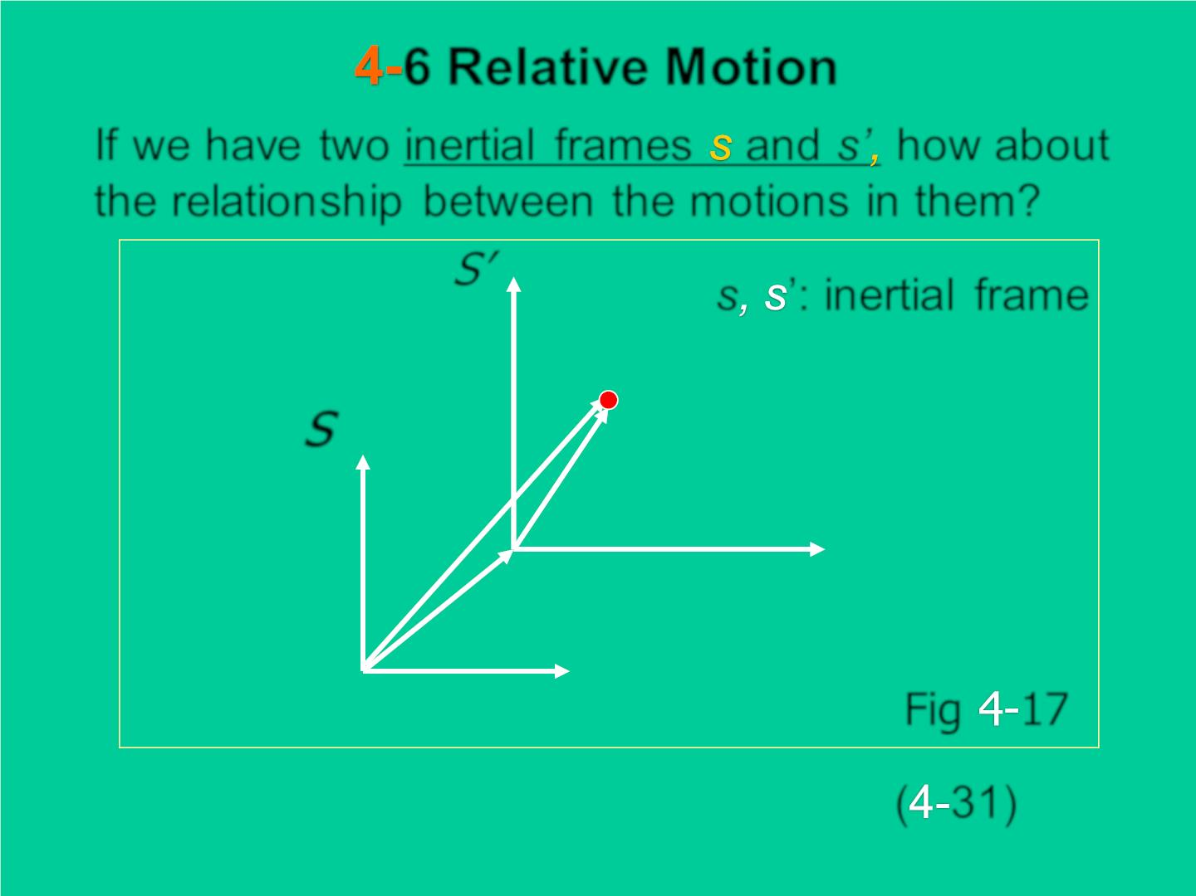
6 Relative Motion
If we h ave two inertial frames and s’ how about
the relation sh ip between the motions in them?
S’
y’
s ’: inertial frame
s
P
y
→
r
→
ps'
r
ps
0’
x’
→
r
s's
0
x
Fig 17
→
→
→
r = r + r
( 31)
ps
_{ps}'
_{s}'_{s}

Slide 24
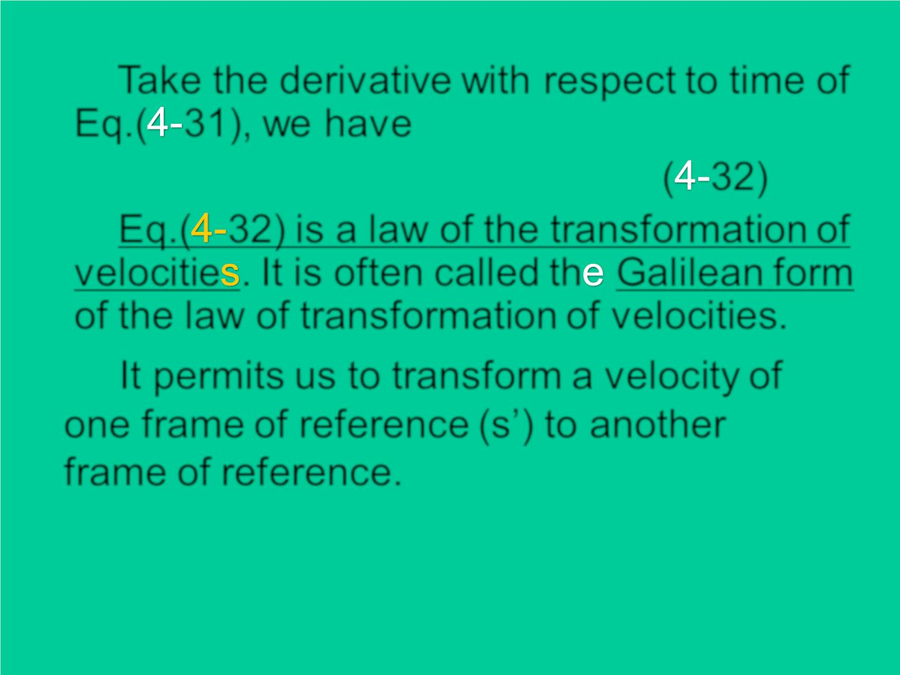
Take the derivative with respect to time of
Eq.( 31), we hav e
→
→
→
v = v + v
( 32)
ps
ps'
s's
Eq.( 32) is a law of the transformation of
velocitie . It is often called th Galilean form
of the law of transformation of velocities.
It permits us to transform a velocity of
one frame of reference (s’) to another
frame of reference.

Slide 25
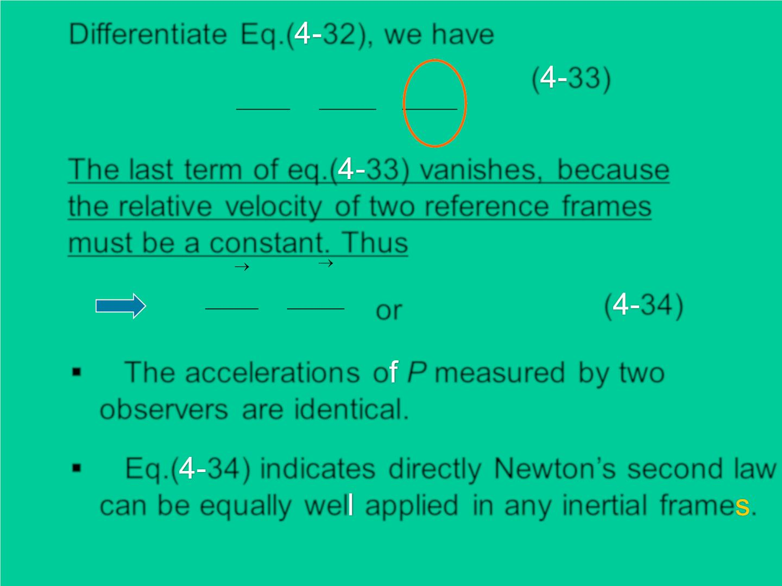
Differentiate Eq.( 32), we h ave
→
→
→
( 33)
d v d v
d v
ps
=
ps'
+
s's
dt
dt
dt
The last term of eq.( 33) van ish e s, because
the relative veloc it y of two reference frames
must be a constant. Thus
^{d v}ps
^{d v}ps'
→
→
=
or
a = a
( 34)
dt
dt
ps
ps'
▪ The accelerat ion s o P measured by two
observers are identical.
▪ Eq.( 34) indicates directly Newton’s second law
can be equally wel applied in any inertial frame .

Slide 26
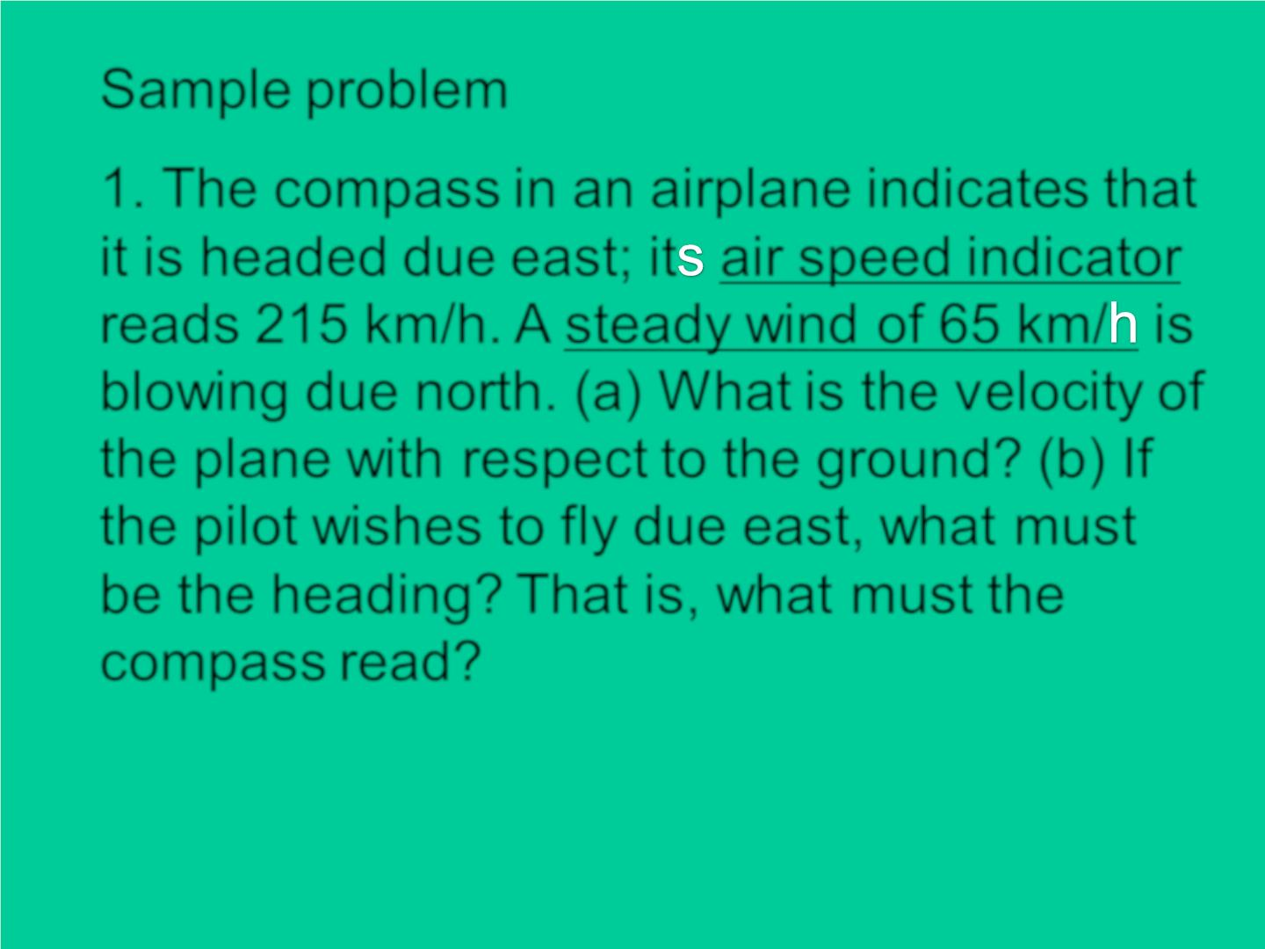
Sample problem
1. The compass in an airplane indicates that
it is headed due east; it air speed indicator
reads 215 km/h. A steady wind of 65 km/ is
blowing due north. (a) What is the v elocity of
the plane with respect to the ground? (b) If
the pilot wishes to fly due east, what must
be the heading? That is, what must the
compass read?

