Slide 1
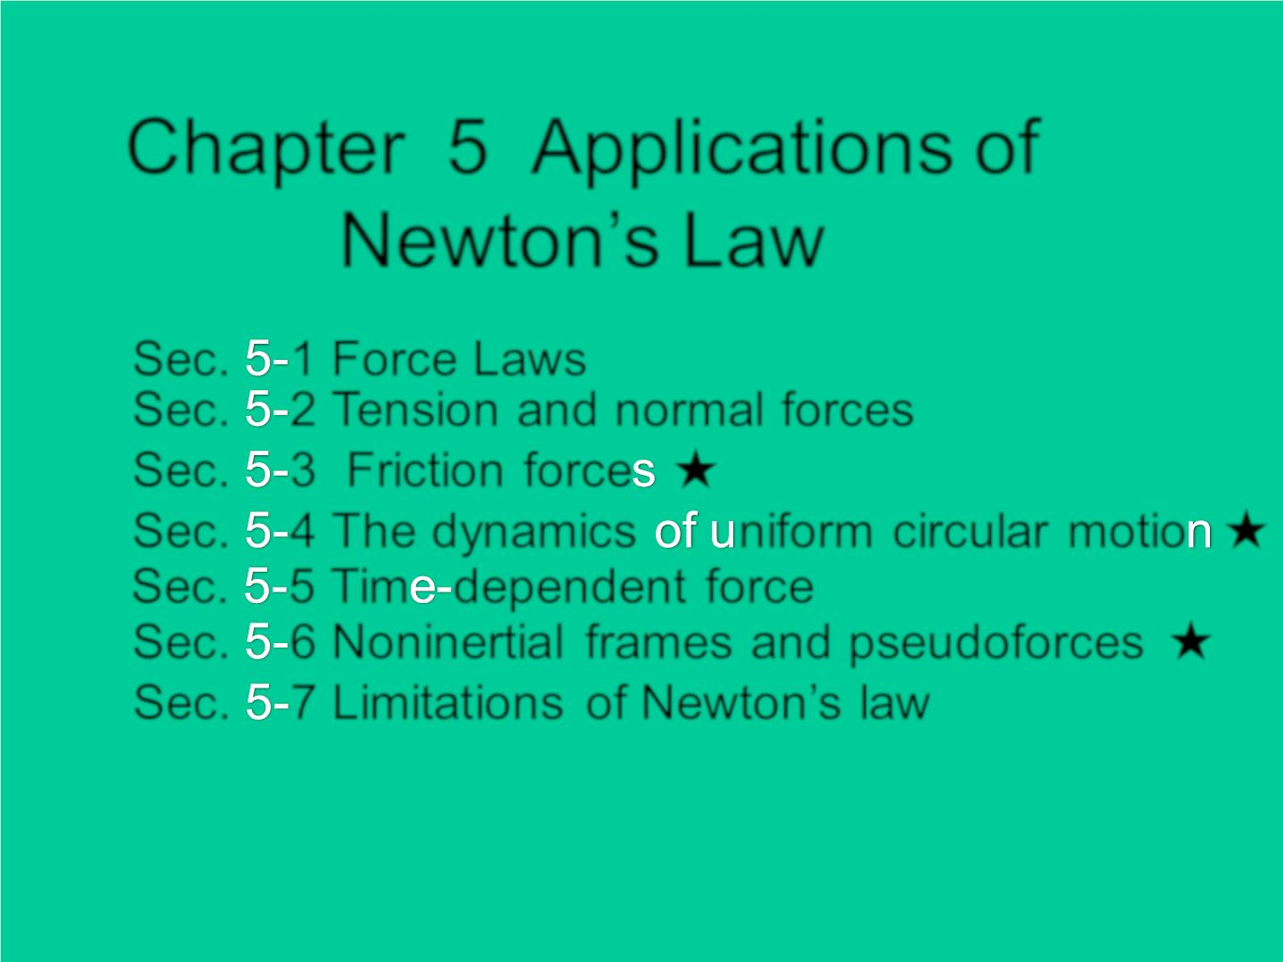
Chapter 5 Applications of
Newton’s Law

Sec. 1 Force Laws
Sec. 2 Tension and normal forces
Sec. 3 Friction force ★
Sec. 4 The dynamic s niform circular motio ★
Sec. 5 Tim dependent force
Sec. 6 Noninertial frames and pseudoforces ★
Sec. 7 Limitat ions of Newton’s law

Slide 2
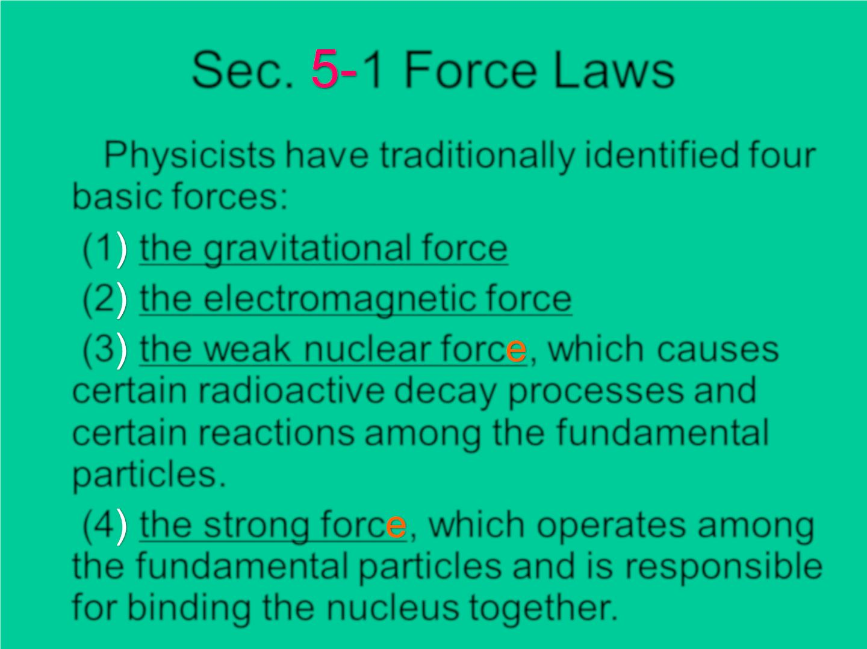
Sec. 1 Force Laws
Physicists have traditionally identified four
basic forces:
(1 the gravitational force
(2 the electromagnetic force
(3 the weak nuclear forc , which causes
certain radioactive decay processes and
certain reactions among the fundamental
particles.
(4 the strong forc , which operates among
the fundamental particles and is responsible
for binding the nucleus together.

Slide 3
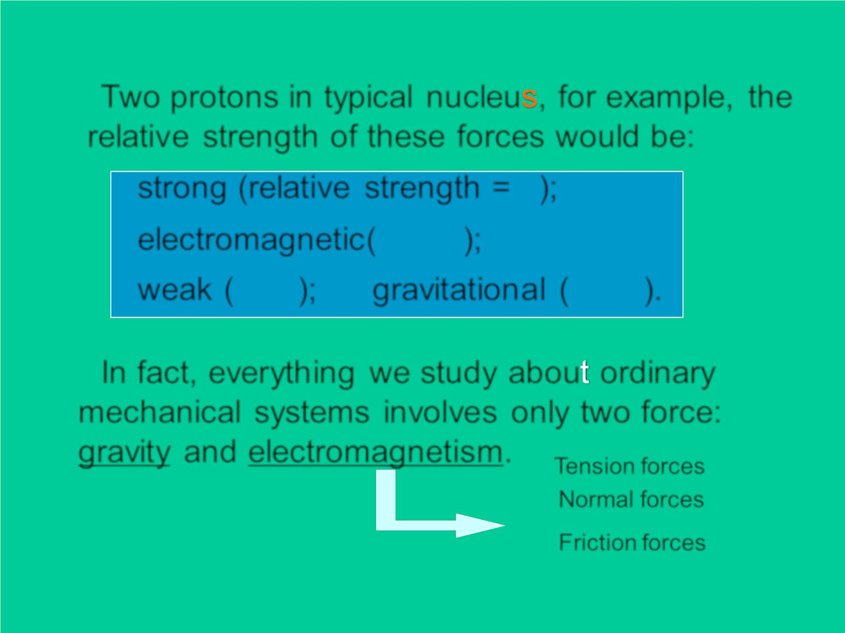
Two protons in typ ic al nucleu , for example, the
relative strength of these forces would be:
1
strong (relative strength = );
10
−2
electromagnet ic ( );
weak ( 10⁻⁹); gravit at ion al (
10−38).
In fact, ever yth ing we study abou ordinary
mechanical systems involves only two force:
gravit y and electromagnetism.

Tension forces
Normal forces
Friction forces

Slide 4
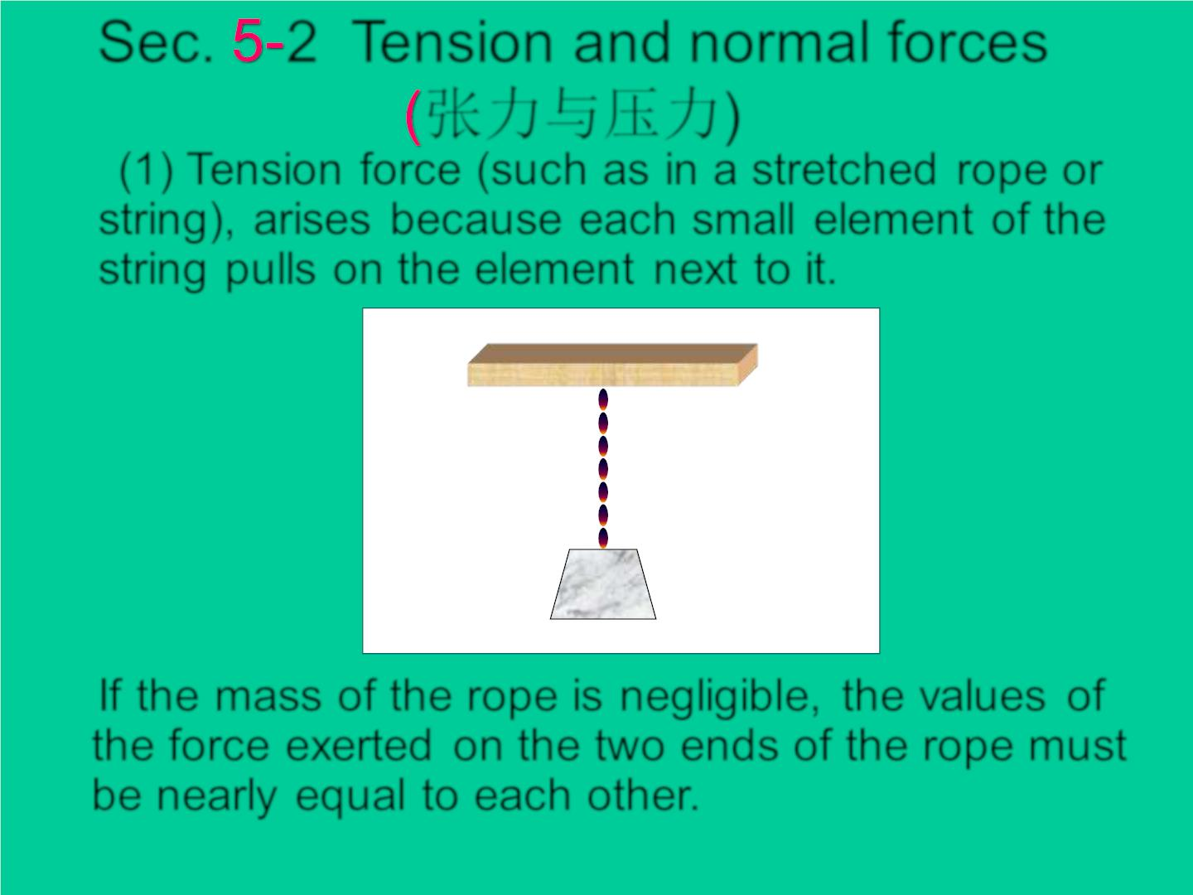
Sec. 2 Tension and normal forces
张力与压力)
(1) Tension force (such as in a stretched rope or
string), arises because each small element of the
string pulls on the element n ext to it.
m
If the mass of the rope is negligible, the values of
the force exerted on the two ends of the rope must
be nearly equal to each other.

Slide 5
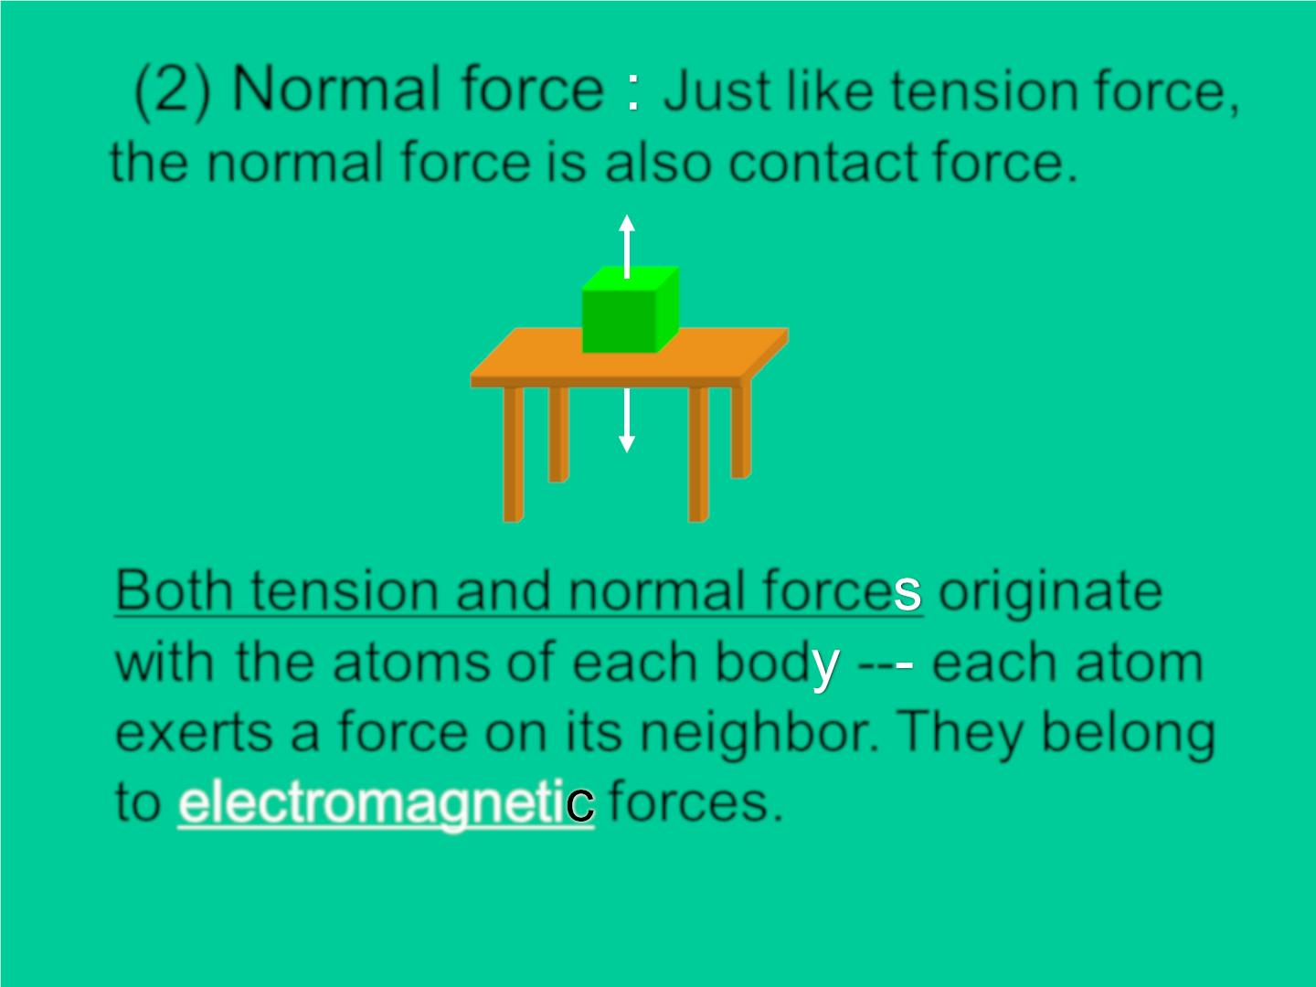
(2) Normal force Just like tension force,
the normal force is also contact force.
❖
N
❖
− N'
Both tension and normal force originate
with the atoms of each bod -- each atom
exerts a force on its neighbor. They belong
to electromagneti forces.

Slide 6
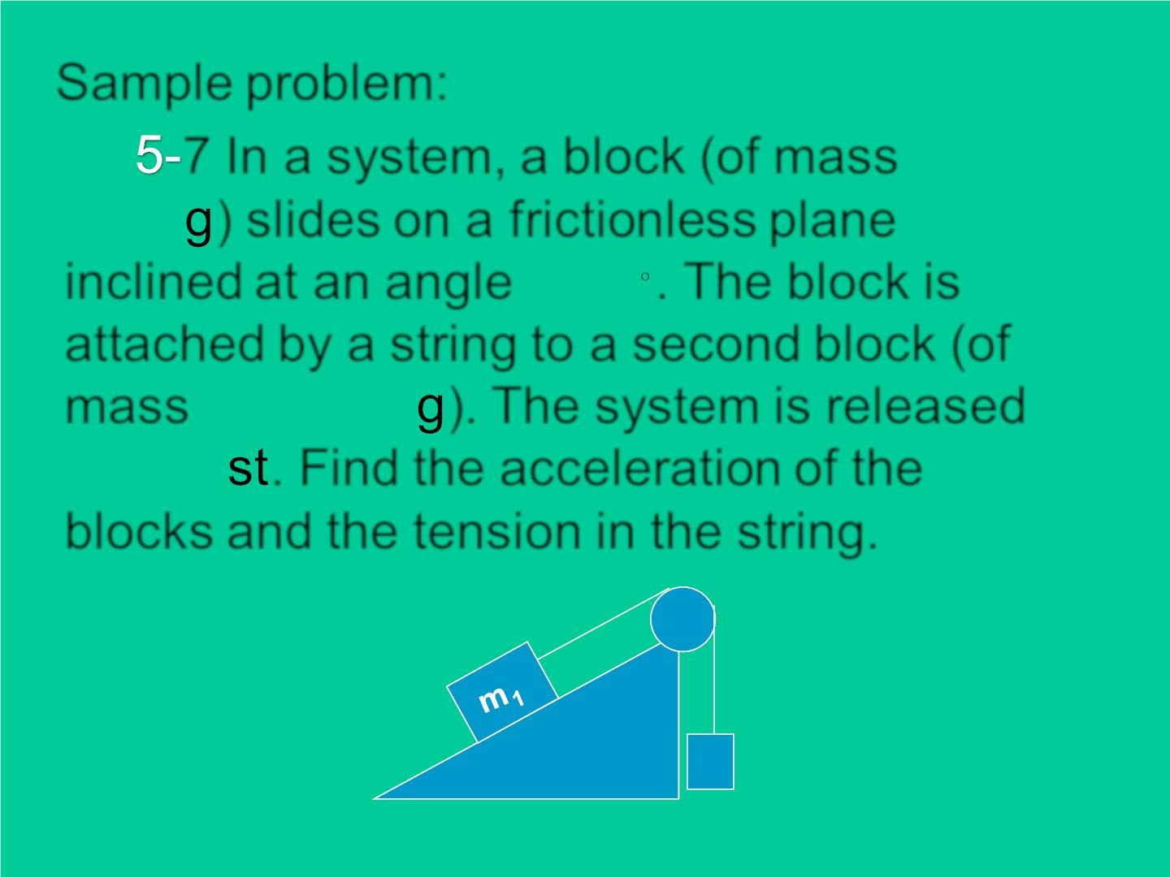
Sample problem:
7 In a system, a block (of mass m₁ =
9.5 K ) slides on a frictionless plane
inclined at an angle_{ = 34} . The block is
attached by a string to a second block (of
mass m₂=2.6 K ). The system is released
from re . Find the acceleration of the
blocks and the tension in the string.
m2

Slide 7
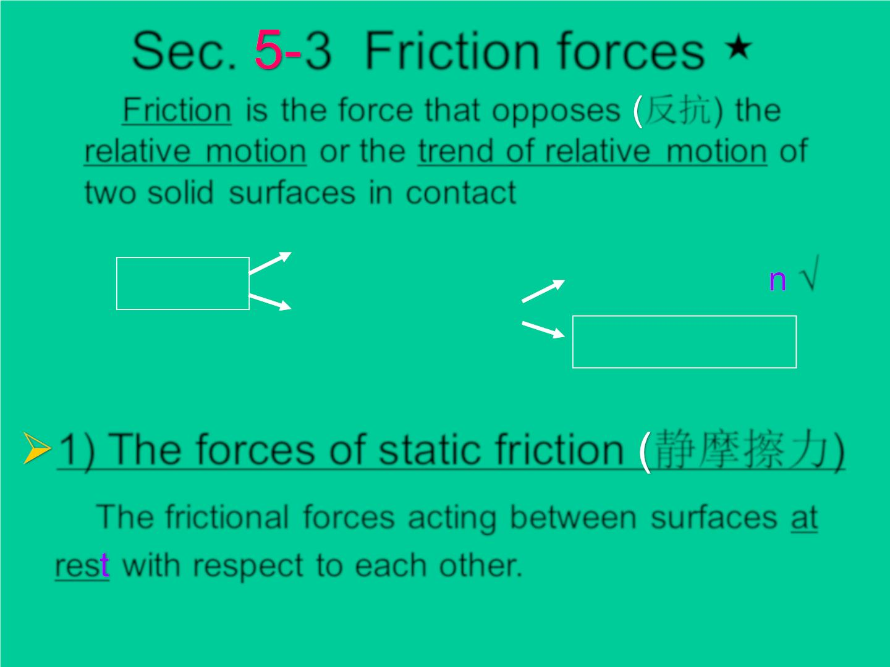
Sec. 3 Friction forces
★
Friction is the force that opposes 反抗) the
relative motion or the trend of relative motion of
two solid surfaces in contact
static friction
Friction
slid in g frictio
ro llin g friction
√
kinetic friction
1) The forces of static friction 静摩擦力)
The frictional forces acting between surfaces at
res with respect to each other.

Slide 8
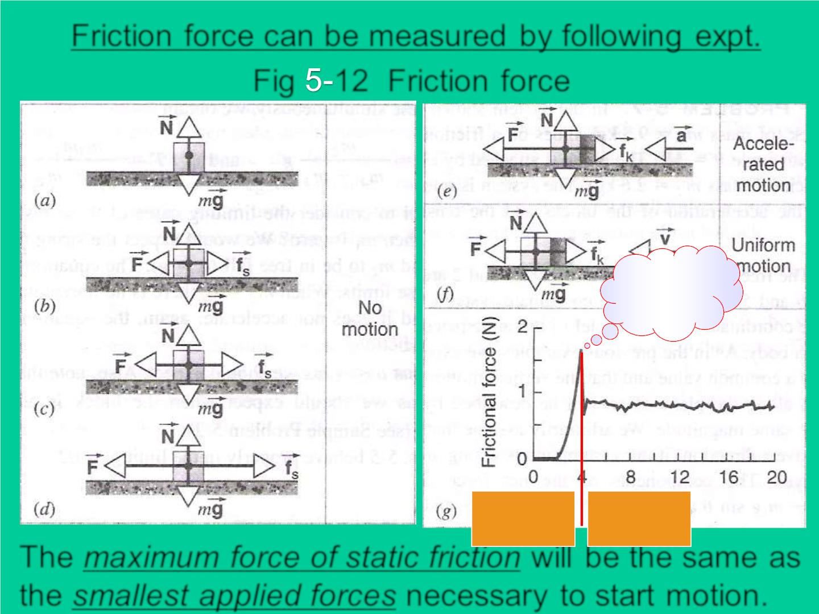
Friction force can be measured by following exp t.
F ig 12 Friction force
❖
f
k
^{f}sM ax
❖
f
s
rest
m oving
The maximum force of static frictio will be the same as
the smallest applied forces necessary to start motion.

Slide 9
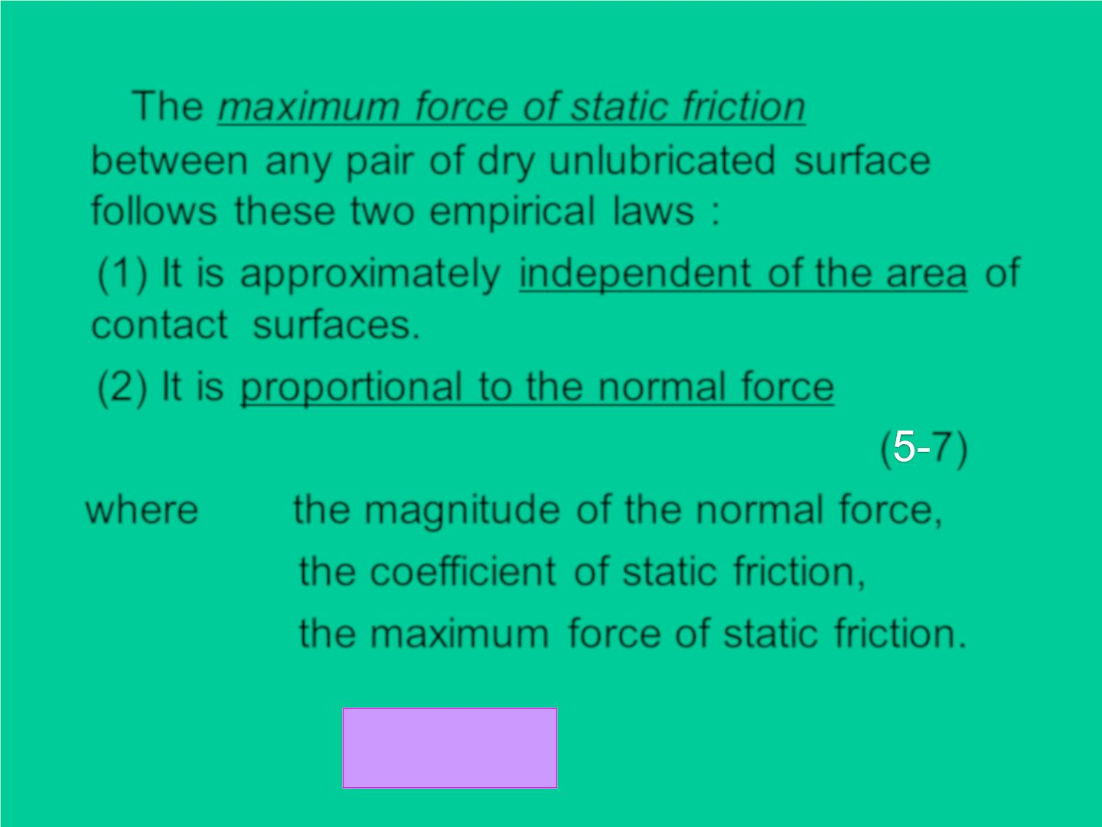
The maximum force of static friction
f
s
Max
between any pair of dry unlubricated surface
follows these two empirical laws :
(1) It is approximately independent of the area of
contact surfaces.
(2) It is proportional to the normal force
f =  N
( 7)
s
Max
s
where N the magnitude of the normal force,
❍
the c o effic ien t of static friction,
s
f_{s}
the maximu m force of static friction.
Max
f_{s}  fs Max

Slide 10
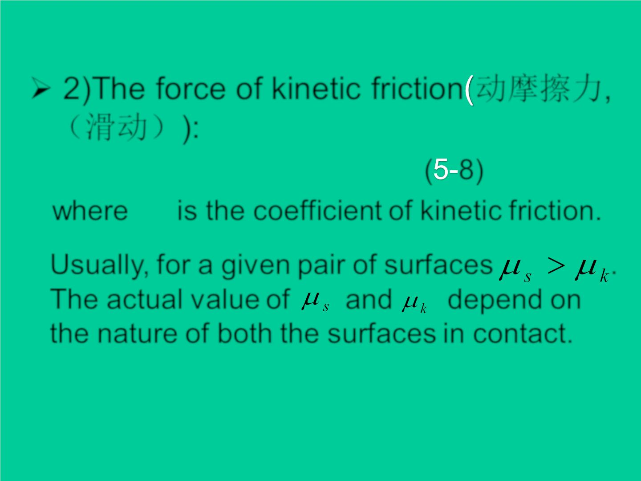
➢ 2)The force of kinetic friction 动摩擦力,
（滑动）):
f =  N
( 8)
k
k
❍
where is the coefficient of kinetic friction.
k
Usually, for a given pair of surfaces
.
The actual value of and depend on
the nature of both the surfaces in contact.

Slide 11
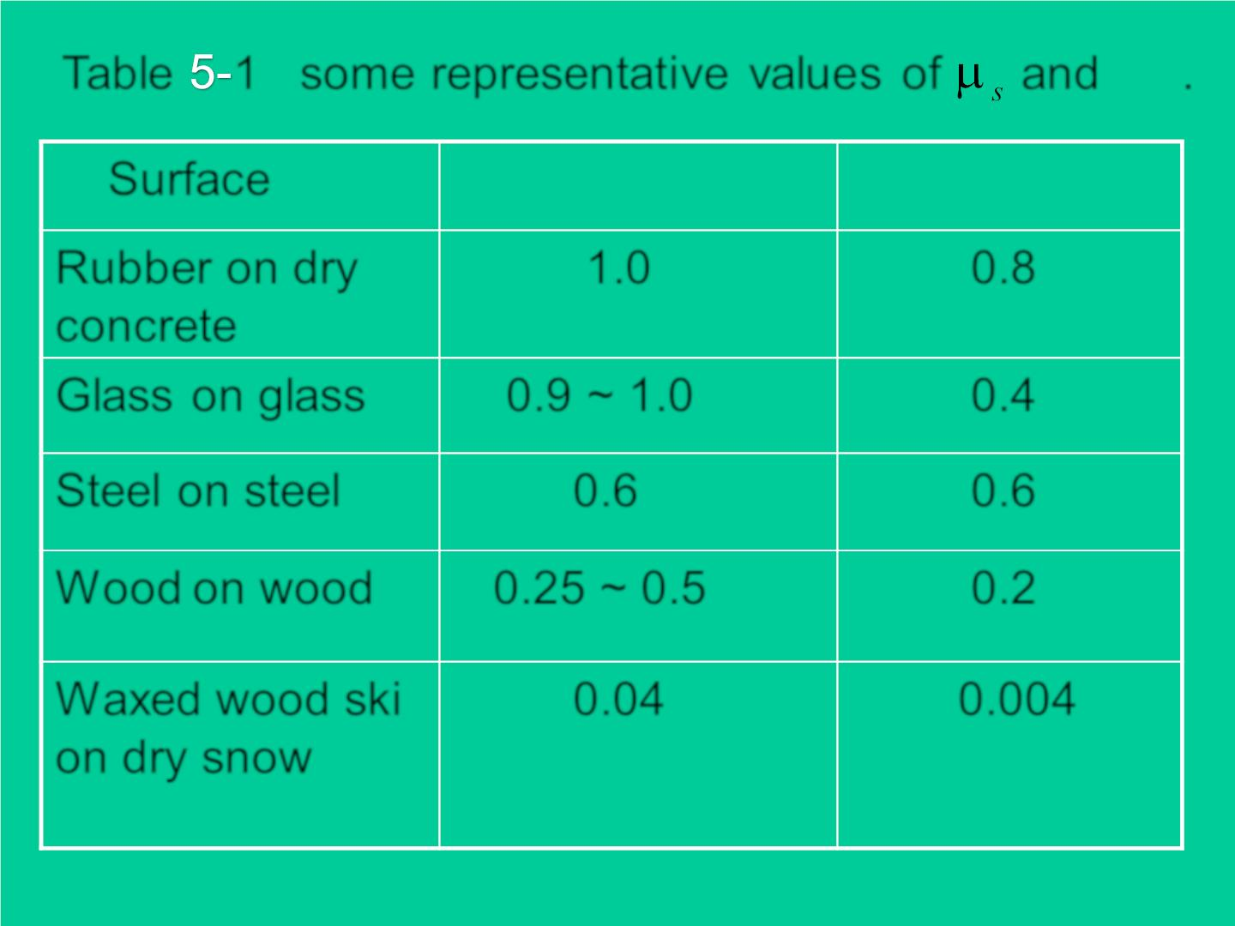
❍
Tab le 1 some representative valu e s of and .
k
Surface
_{s}
_{k}
Rubber on dry
concrete
1.0
0.8
Glass on glass
0.9 ~ 1.0
0.6
0.4
0.6
0.2
Steel on steel
W ood on wood 0.25 ~ 0.5
W axed wood ski
on dry snow
0.04
0.004

Slide 12
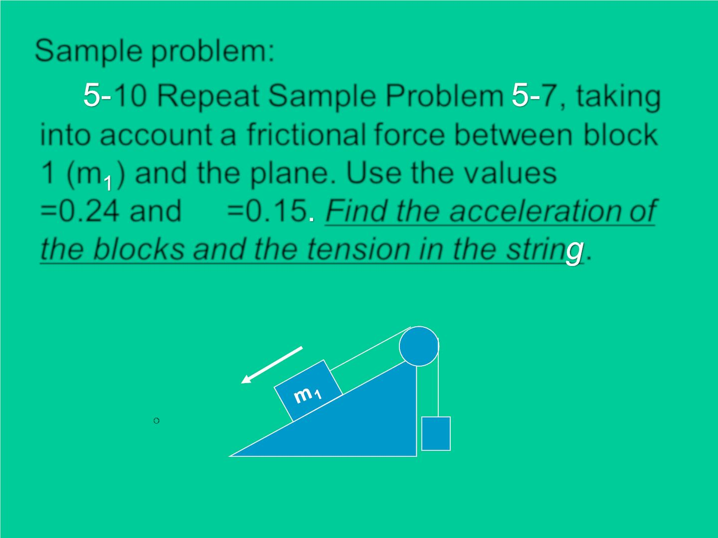
Sample problem:
10 Repeat Sample Problem 7, taking
into account a frictional force between block
1 (m ) and the plane. Use the values
_{s}
❍
=0.24 and =0.15 Find the acceleration of
k
the blocks and the tension in the strin .
m1 = 9.5 Kg
m2=2.6 Kg
❑ = 34
m2

Slide 13
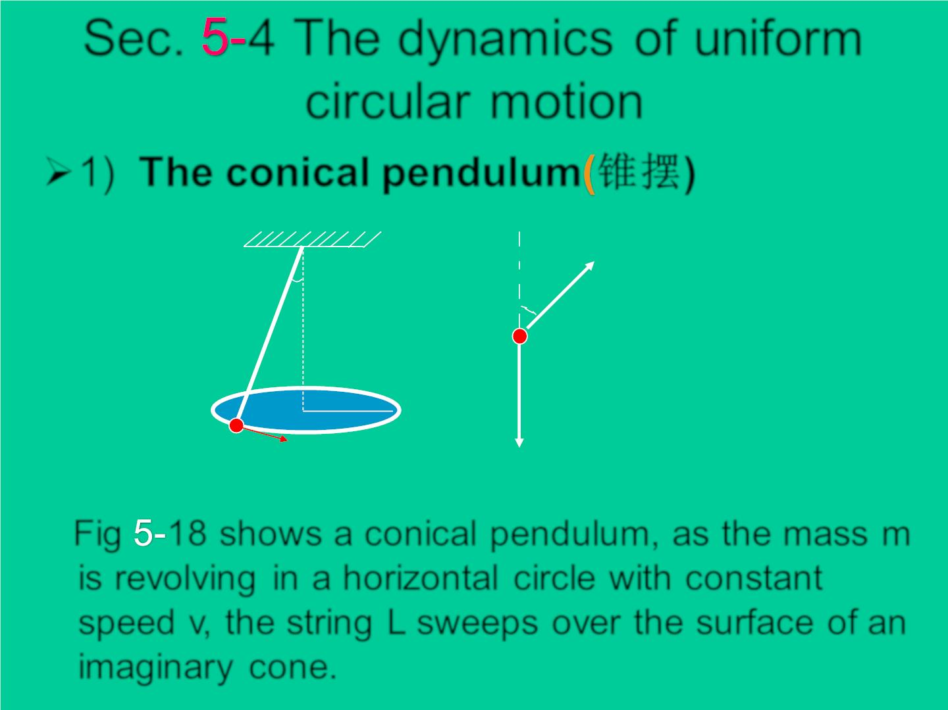
Sec. 4 The dynam ic s of unif or m
c irc ular motion
➢1) The conical pendulum 锥摆)
Fig 5-18
T
❑
❑
L
m
R
m
→
v
mg
Fig 18 shows a conical pendulum, as the mass m
is revolving in a horizontal c irc le with constant
speed v, the string L sweeps o ver the surface of an
imaginary cone.

Slide 14
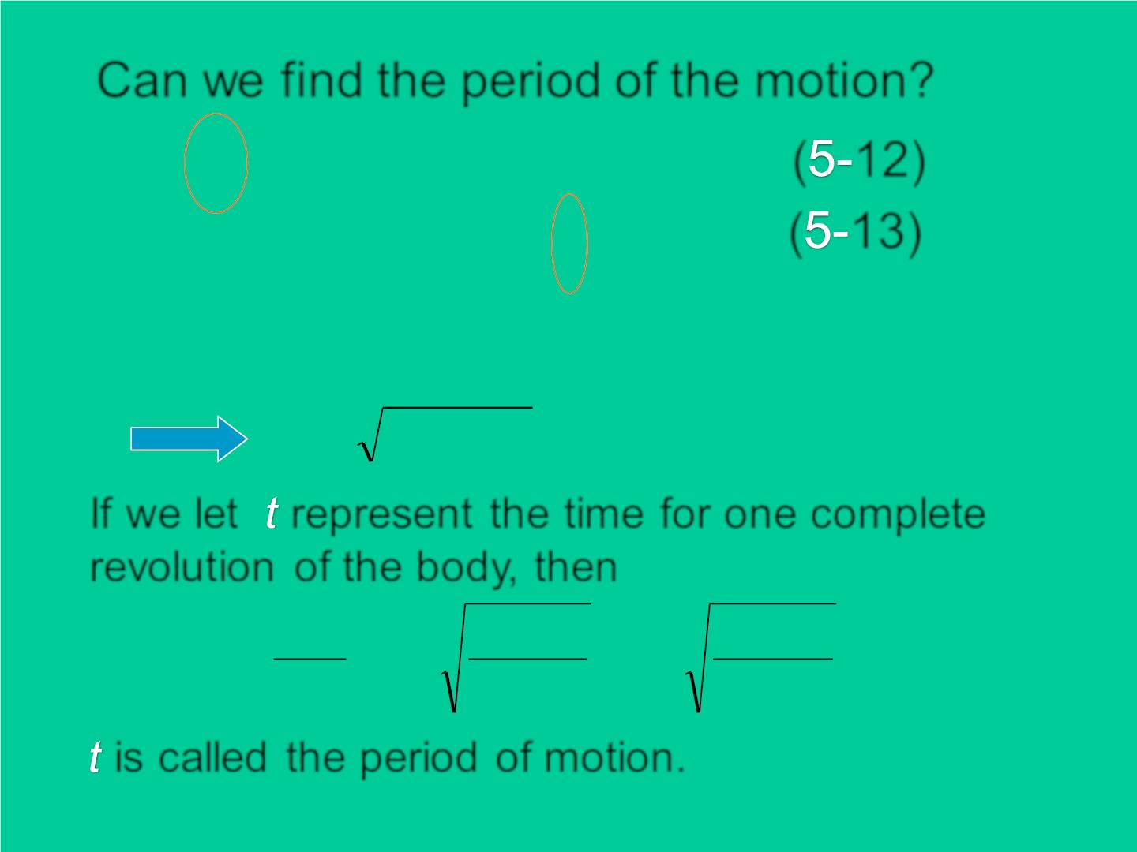
Can we find the period of the motion?
T cos = mg
( 12)
( 13)
｛
❑ = =
2
T s in ma mv / R
r
(R = L sin )
v = Rg tan
If we let represent the time for one complete
revolut ion of the body, then
2R
R
Lcos
t = = 2
= 2
v
g tan
g
is called the period of motion.

Slide 15
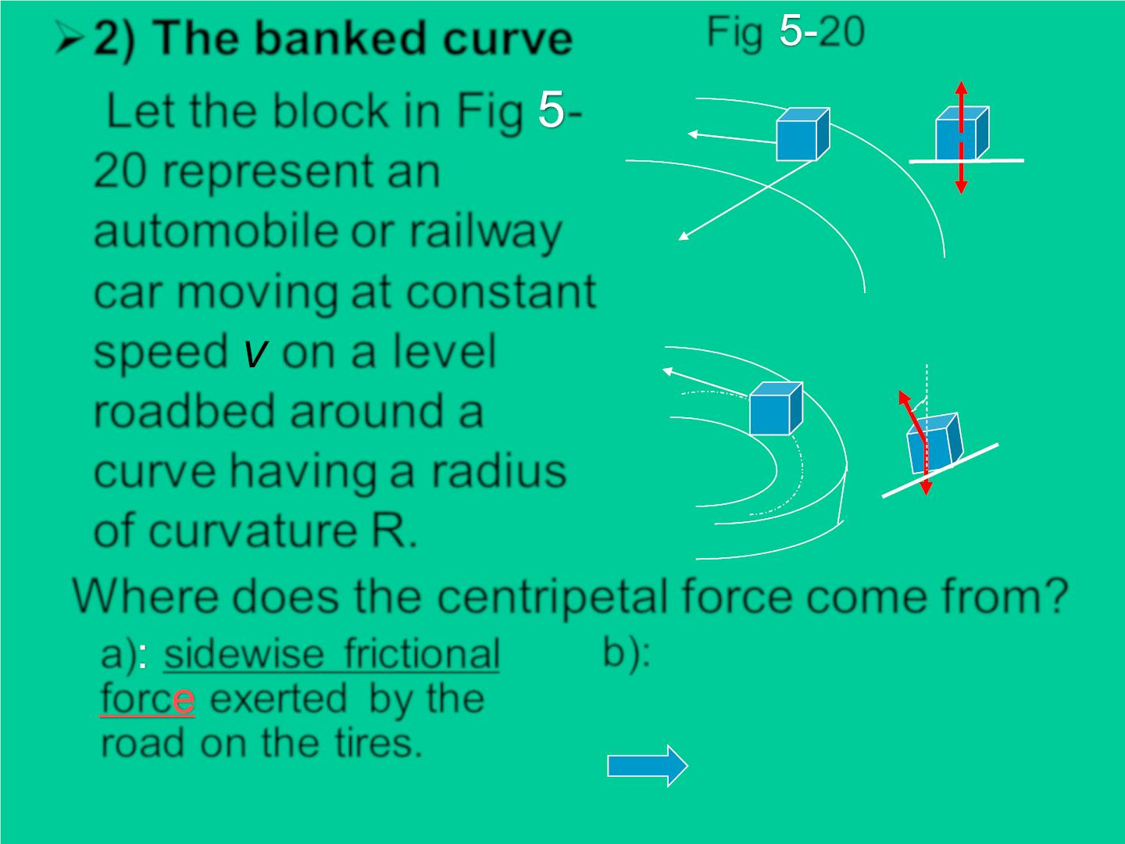
➢2) The banked curve
Fig 20
Let the block in Fig -
20 represent an
→
v
automobile or railway
car moving at constant
speed on a level
roadbed around a
curve having a radius
of curvature R.
a)
b)
•
R
c
→
v
❑
Where does the centripetal force come from?
b):  =
a) sidewise frictional
forc exerted by the
road on the tires.
N s in mv² / R
❑ =
Ncos mg
❑ =
tan v / Rg
2

Slide 16
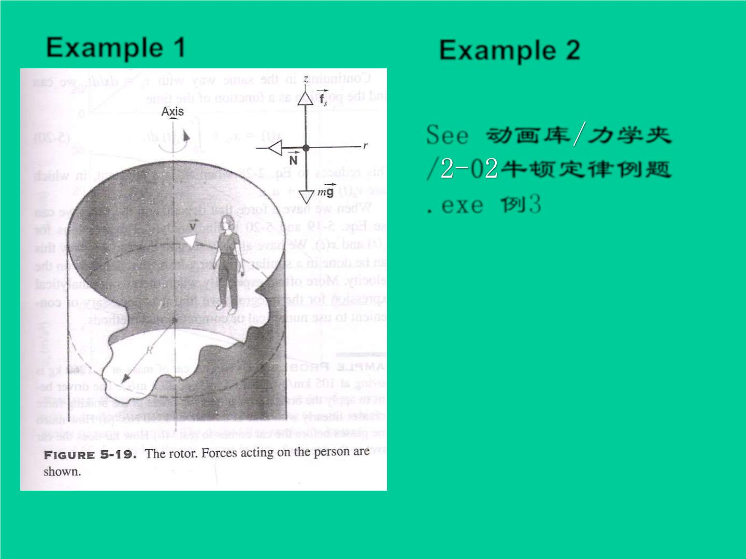
Example 1
Example 2
See 动画库 力学夹
/ 0 牛顿定律例题
.exe 例3

Slide 17
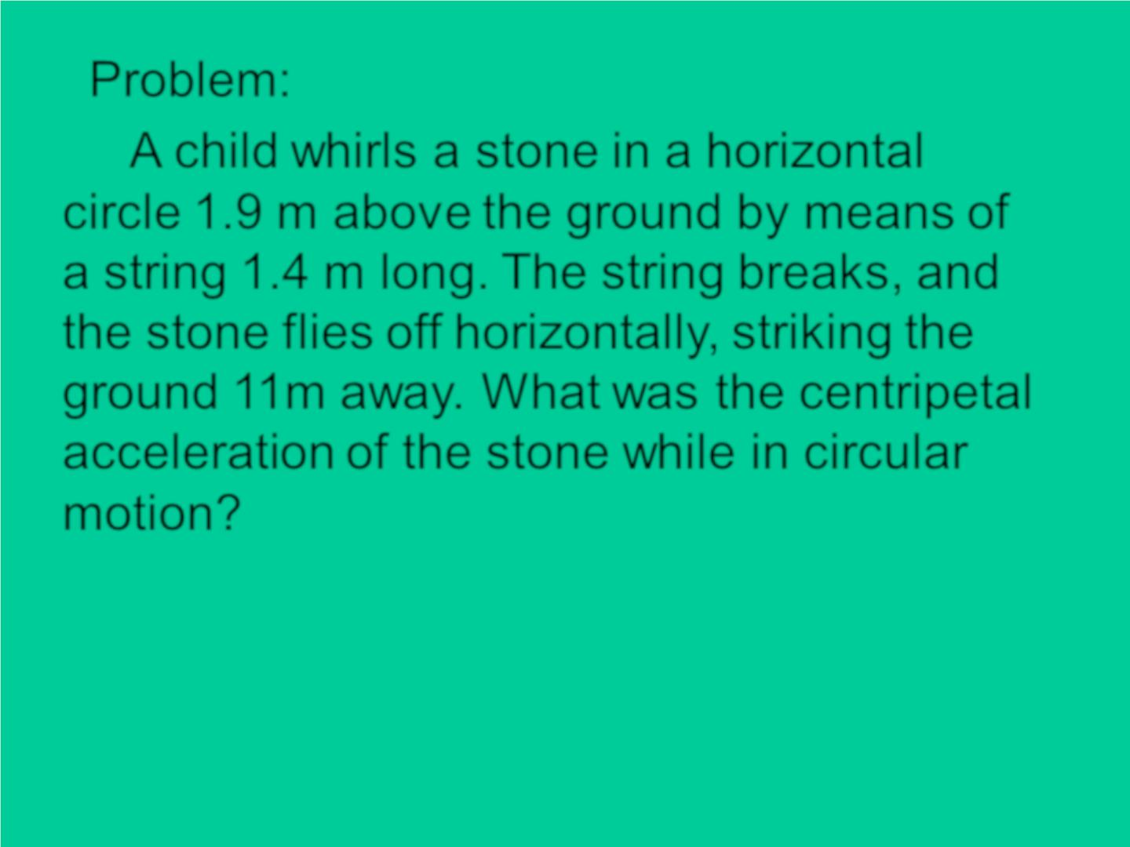
Problem:
A child whirls a stone in a horizontal
circle 1.9 m above the ground by means of
a string 1.4 m long. The string breaks, and
the stone flies off horizontally, striking the
ground 11 m away. What was the centripetal
acceleration of the stone while in circular
motion?

Slide 18
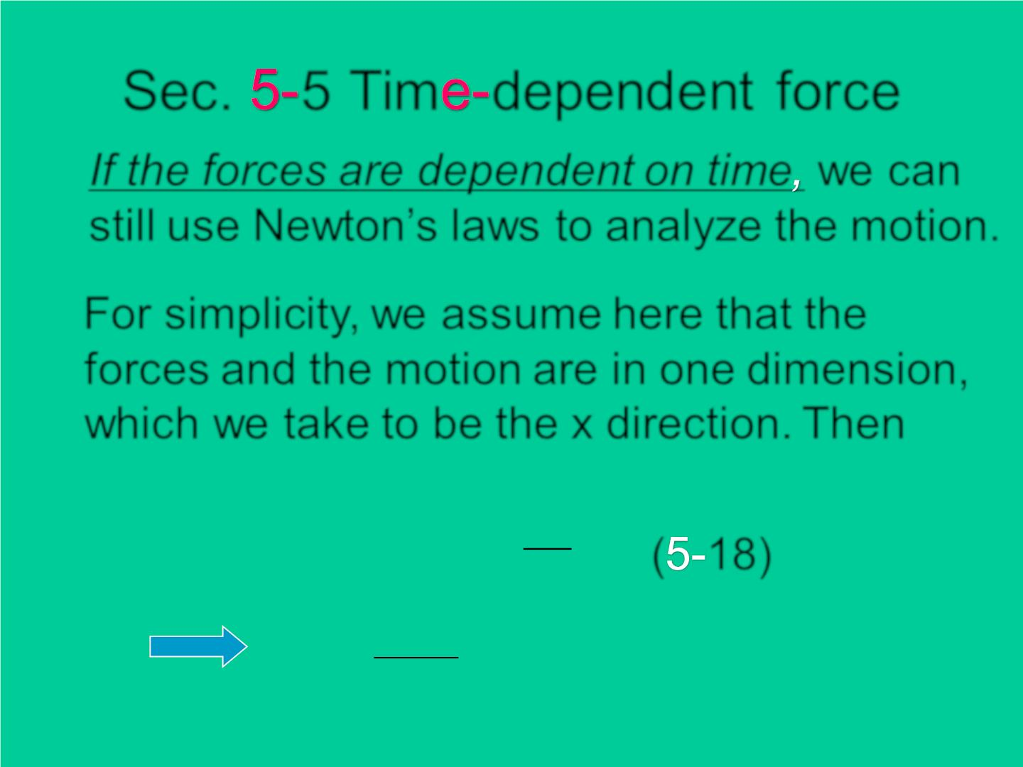
Sec. 5 Tim depend e nt force
If the forces are dependent on time we can
still use Newton’s laws to analyze the motion.
For simplicity, we assume here that the
forces and the motion are in one dimension,
which we take to be the x direction. Then
dv
F_{x}(t) = ma(t)= m
( 18)
dt
F (t)
dv = x dt
x
m

Slide 19
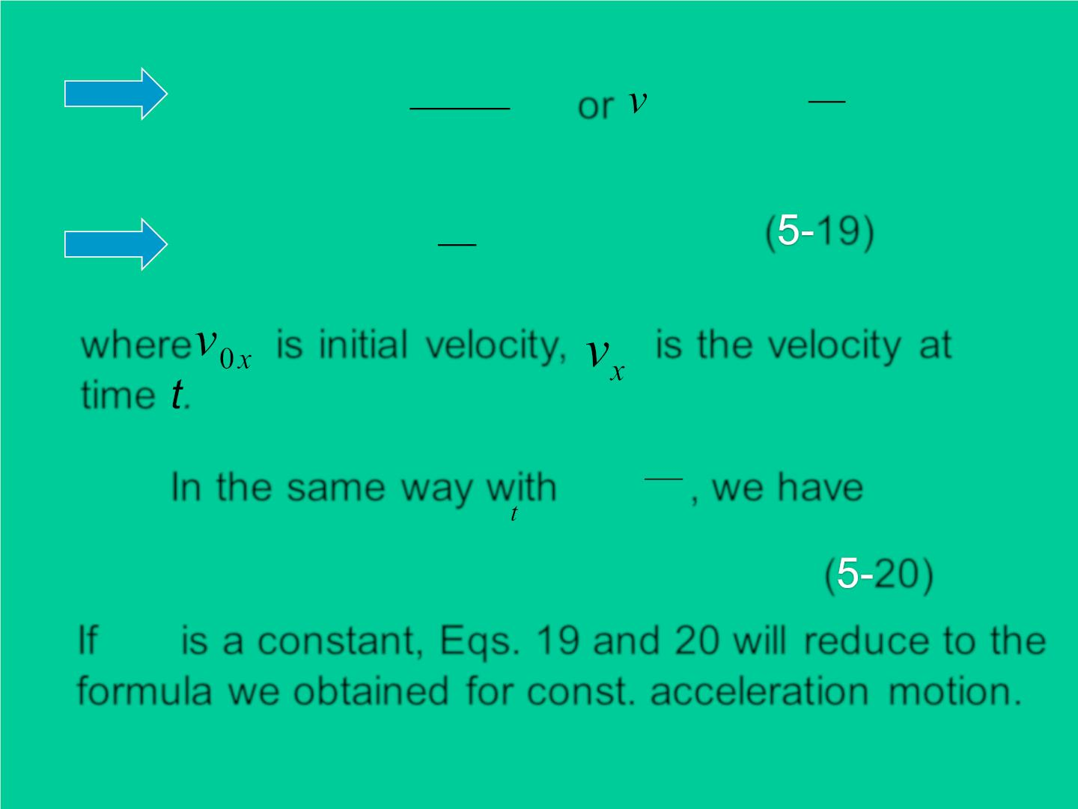
v
t
F_{x} (t)
m
1
t
⇩ 
⇩
0
x
dv
=
dt or
− v = F(t )dt
x
x
0x
m
v
0x
0
1
t
⇩
( 19)
v (t) = v + F(t)dt
x
0x
m
0
where is in itia l veloc it y, is the veloc it y at
time .
dx
In the same way with
v =
, we h ave
x dt
⇩
x(t) = x + v (t)dt
0
x
( 20)
0
If is a constant, Eqs. 19 and 20 will reduce to the
F
x
formula we obtained for const. acceleration motion.

Slide 20
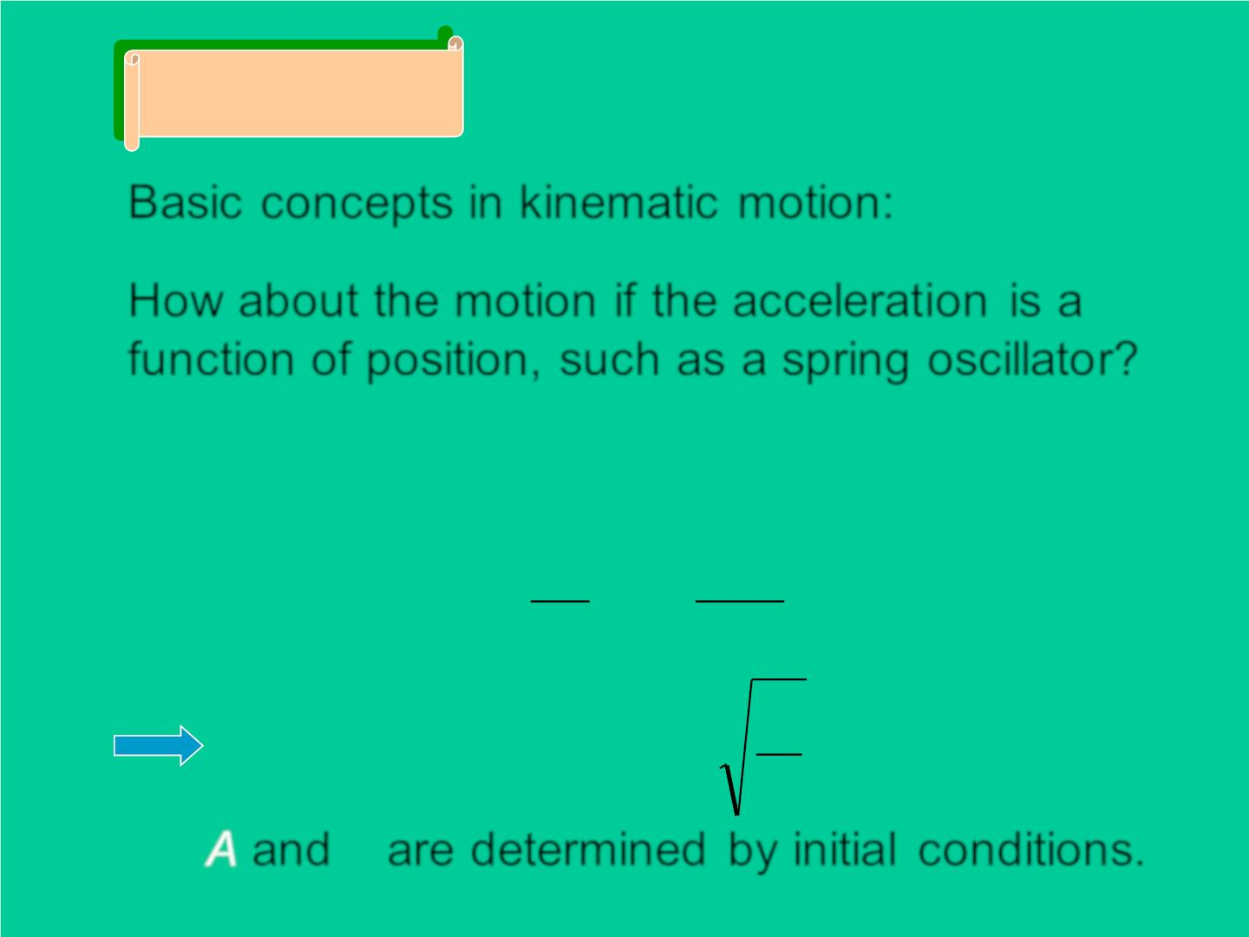
Discussion
❖  
a, v, r, t
Basic concepts in kinematic motion:
How about the motion if the acceleration is a
function of position, such as a spring oscillato r?
F = −kx
v(t) ? a(t) ?
2
dv d x
= − = =
=

F kx m m mx
dt dt
2
k
x = Acos(ωt + φ),ω =
m
φ
A and are determined by in itia l conditions.

Slide 21
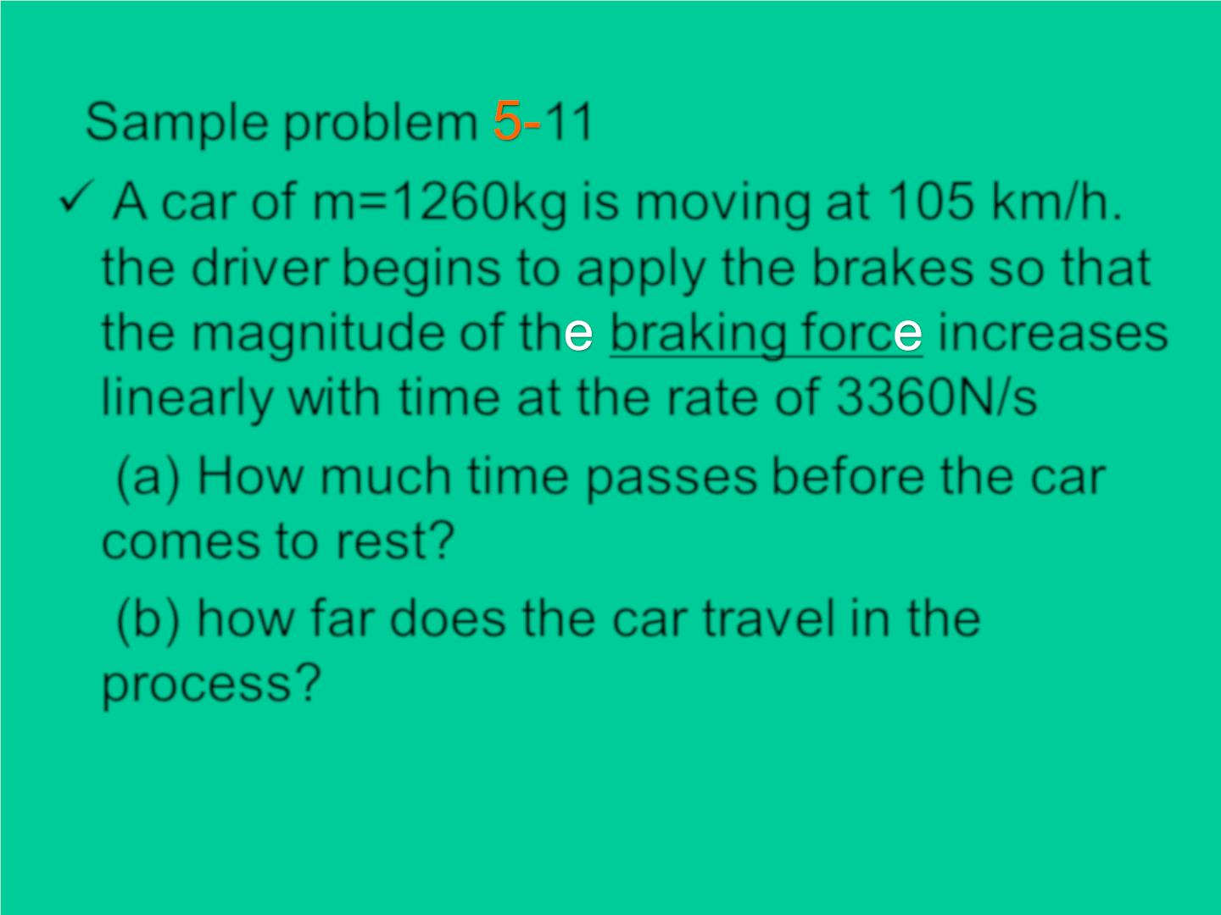
Sample problem 11
✓ A car of m=1260kg is moving at 105 km/h.
the driver begins to apply the brakes so that
the magnitude of th braking forc increases
linearly with time at the rate of 3360N/s
(a) How much time passes before the car
comes to rest?
(b) how far does the car travel in the
process?

Slide 22
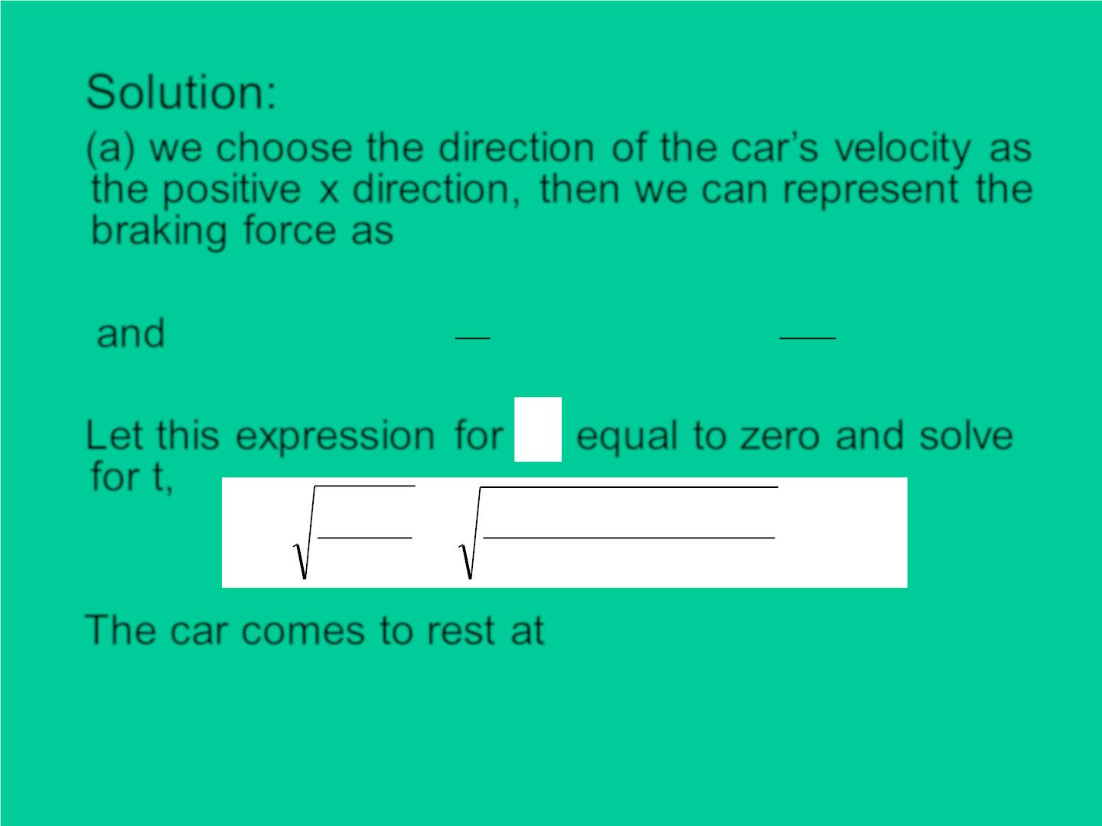
Solution:
(a) we choose the direction of the car ’s veloc it y as
the positive x direction, then we can represent the
braking force as
F_{x} = −ct = −3360t N
1
t
ct
2
⇩
and
v (t） v
= + − = −
^{( ct)dt v}0x
x
0x
m
0
2m
v
Let this expression for equal to zero and so lve
x
for t,
2v m 2(29.2m/ s)1260kg
t₁ =
0x
=
= 4.68s
c
5360N / s
The car comes to rest at =
t 4.68s
1

Slide 23

(b) According to Eq( 20)
t
ct
2
ct³
⇩
x = x + (v − )dt = x + v t −
0
0x
2m
0
0
6m
0
t = t
x₀ = 0
Evaluating the expression at ,
1
we obtain
(3360N / s)( 4.68s)³
6(1260kg)
x(t₁) = (29.2m/ s)(4.68s) −
= 91.1m

Slide 24
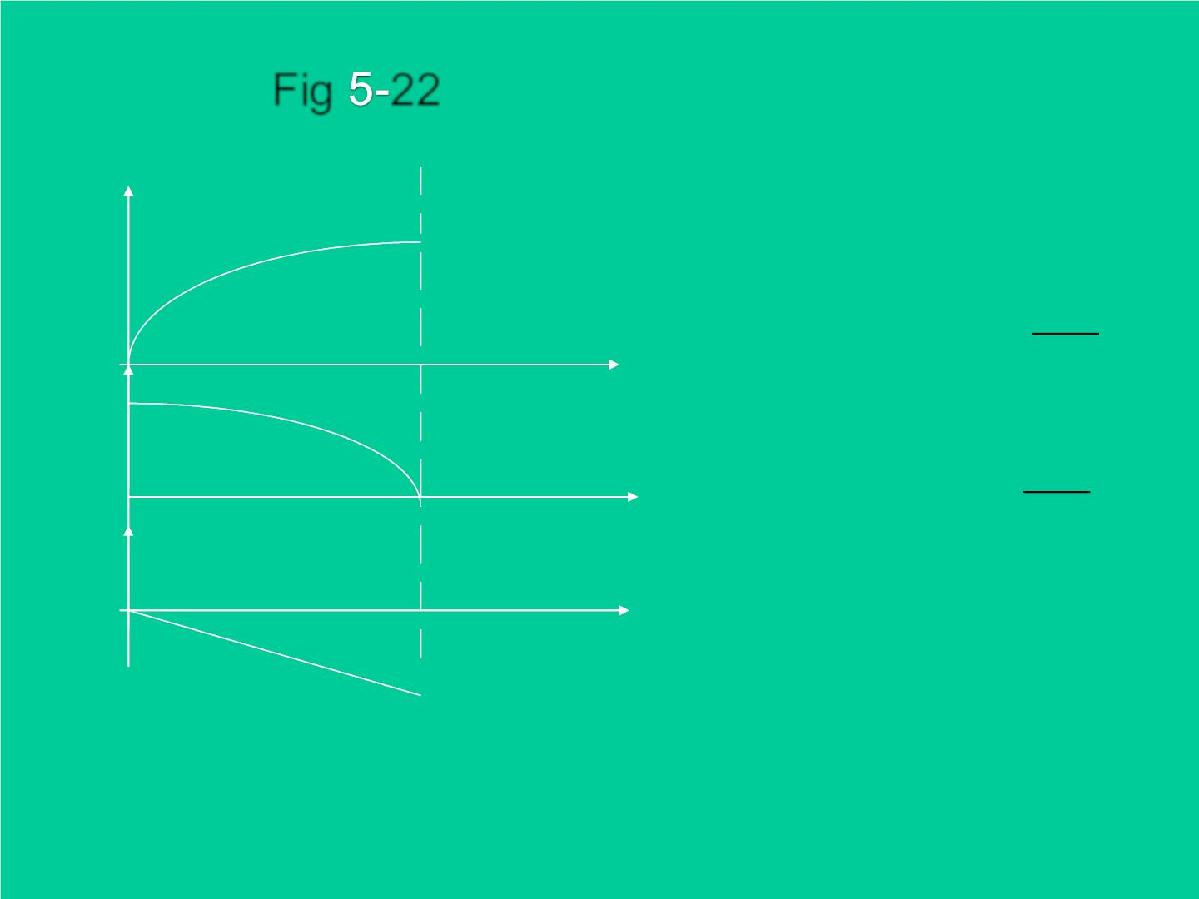
F ig 22
x
ct³
6m
2
x = x + v t −
0
0
v
^{t}1
t (s)
ct
v (t）= v −
^{t}1
x
0x
2m
a
t (s)
t (s)
a_{x} (t) = −ct / m
^{t}1

Slide 25
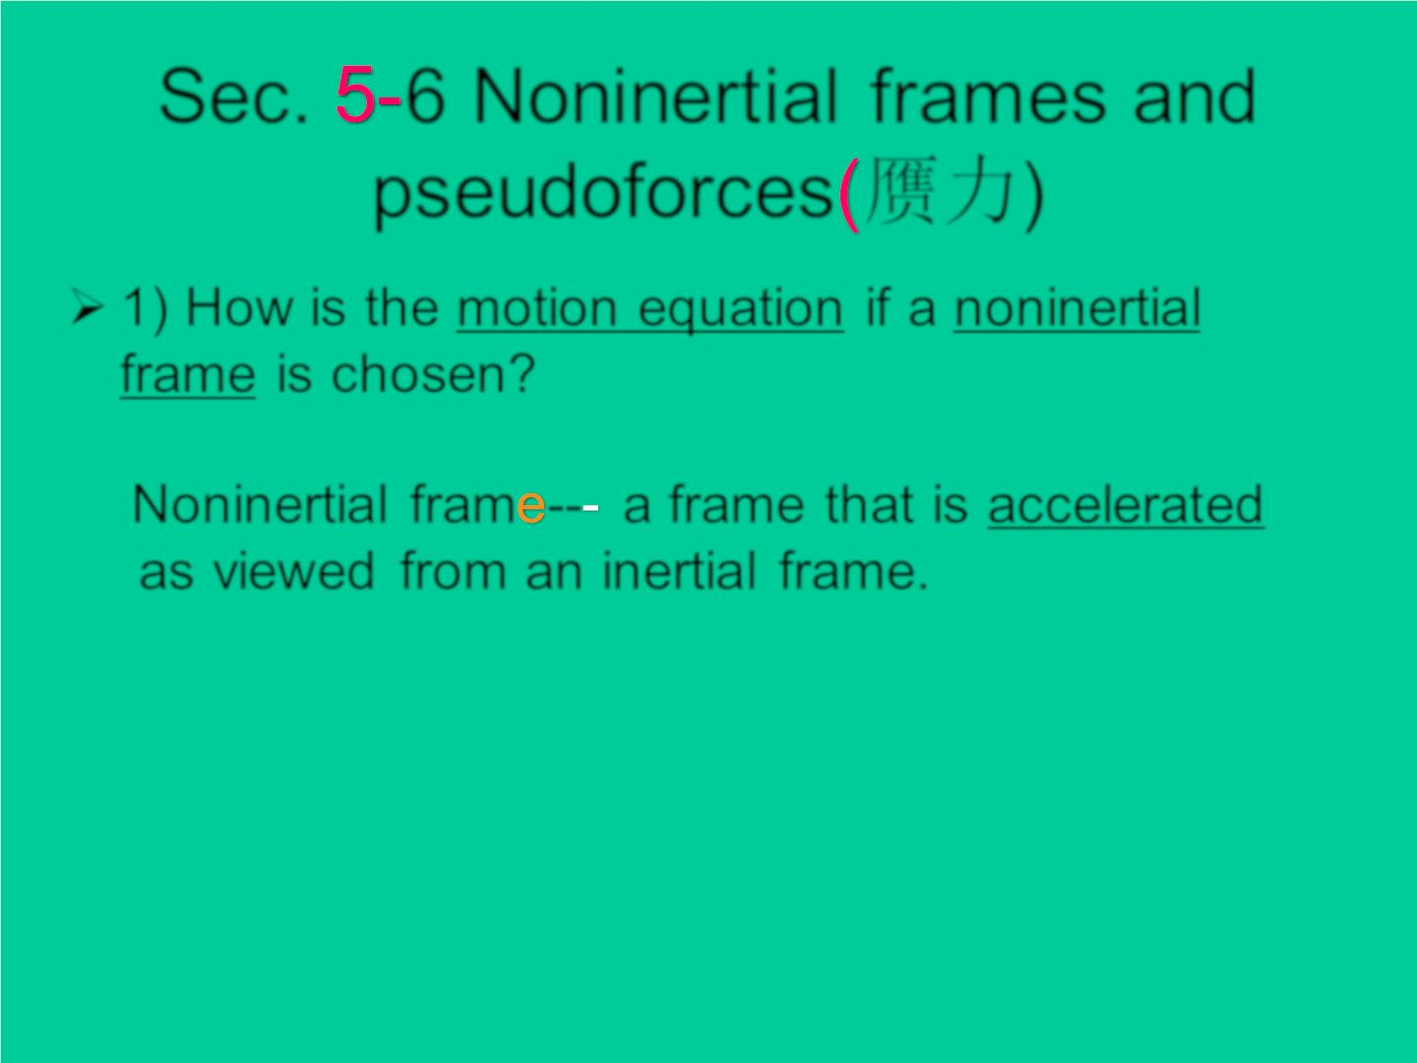
Sec. 6 Noninert ial frames and
pseudoforces 赝力)
➢ 1) How is the motion equation if a noninertial
frame is chosen?
Noninertial fram -- a frame that is accelerated
as viewed from an inertial frame.

Slide 26
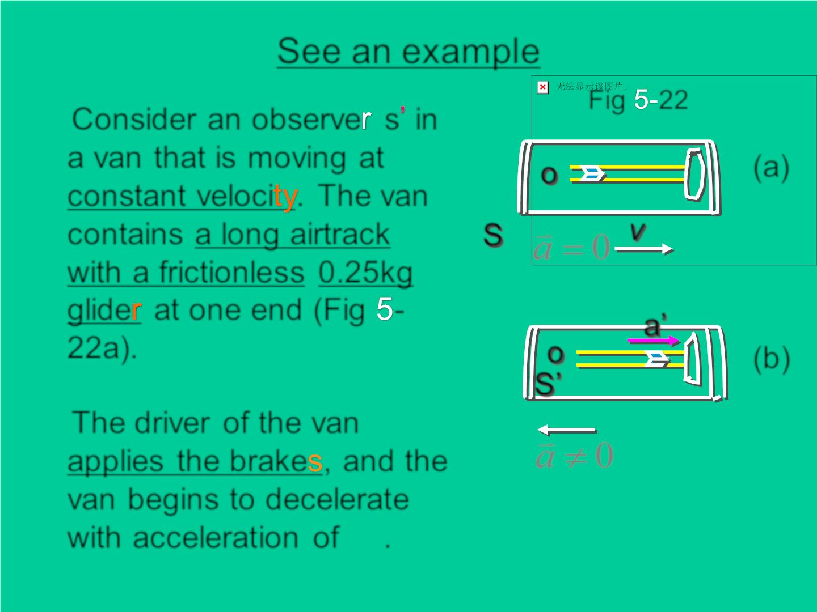
See an example
Fig 22
Consider an observe s in
a van that is moving at
constant velo c i . The van
contains a long airtrack
with a frictionless 0.25kg
g lid e at one end (Fig -
22a).
(a)
(b)
o
❖
v
S
a = 0
a’
o
S’
The driver of the van
❖
a  0
applies the brake , and the
van begins to decelerate
❖
❖ 
a
a'= −a
with acceleration of .

Slide 27
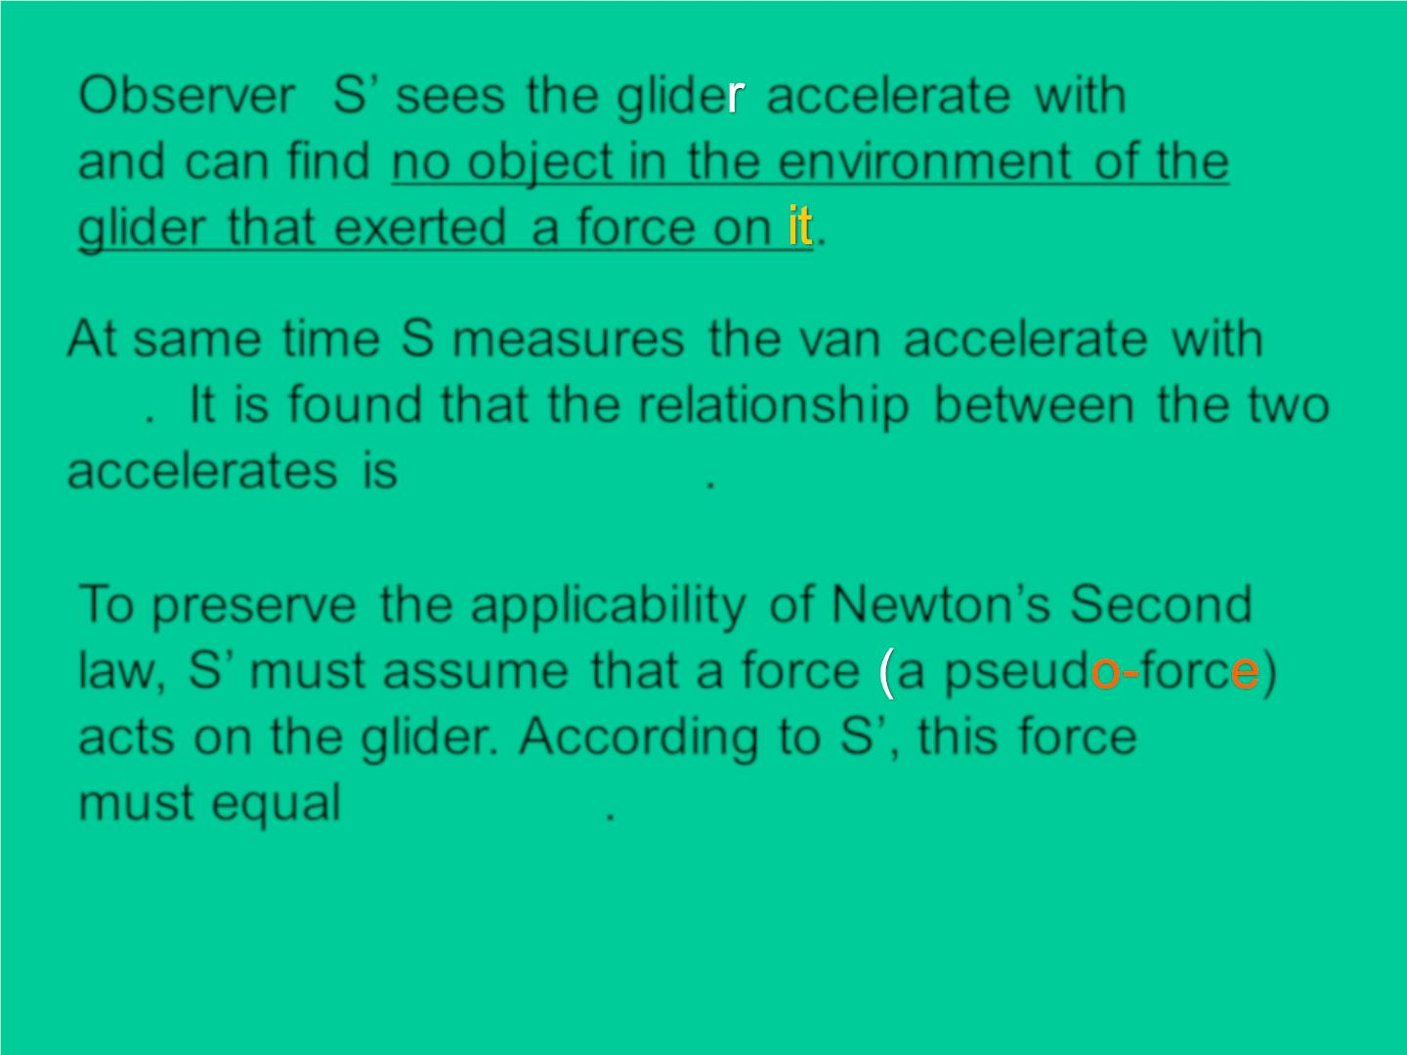
❖
Observer S’ sees the glide accelerate with
a'
and can find no object in the environment of the
g lid er that exerted a force on .
^{A}t same time S measures the van accelerate with
a
. It is found that the relationsh ip between the two
❖ 
'= −
^{accelerates is} a a .
To preserve the applicability of Newton’s Second
law, S’ must assume that a force a pseud forc )
acts on the g lid er. According to S’, this force
must equal ma ma .
→
F
❖ 
'= −
'

Slide 28
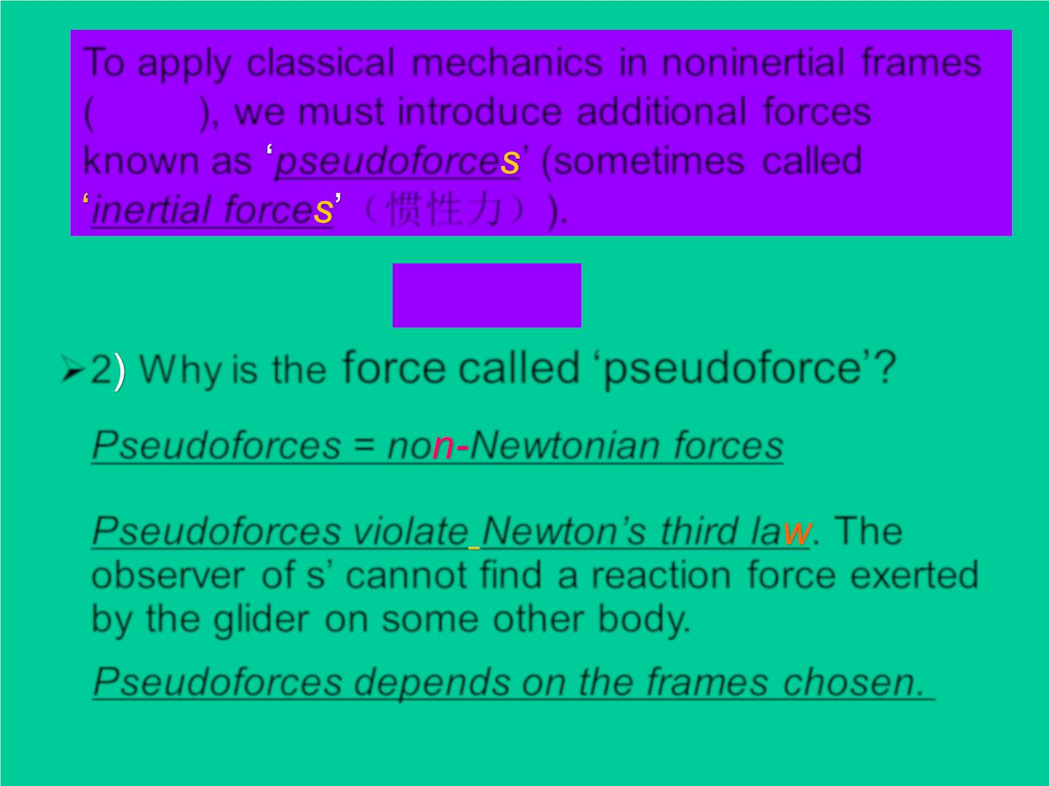
^{To}apply classical mechanics in noninertial frames
a
( ), we must introduce additional forces
known as pseudoforce ’ (sometimes called
inertial force （惯性力）).
❖
❖
F'= −ma
➢2 Why is the force called ‘pseudoforce’?
Pseudoforces = no Newtonian forces
Pseudoforces violate Newton’s third la . The
observer of s’ cannot find a reaction force exerted
by the g lid er on some other body.
Pseudoforces depends on the frames chosen.

Slide 29
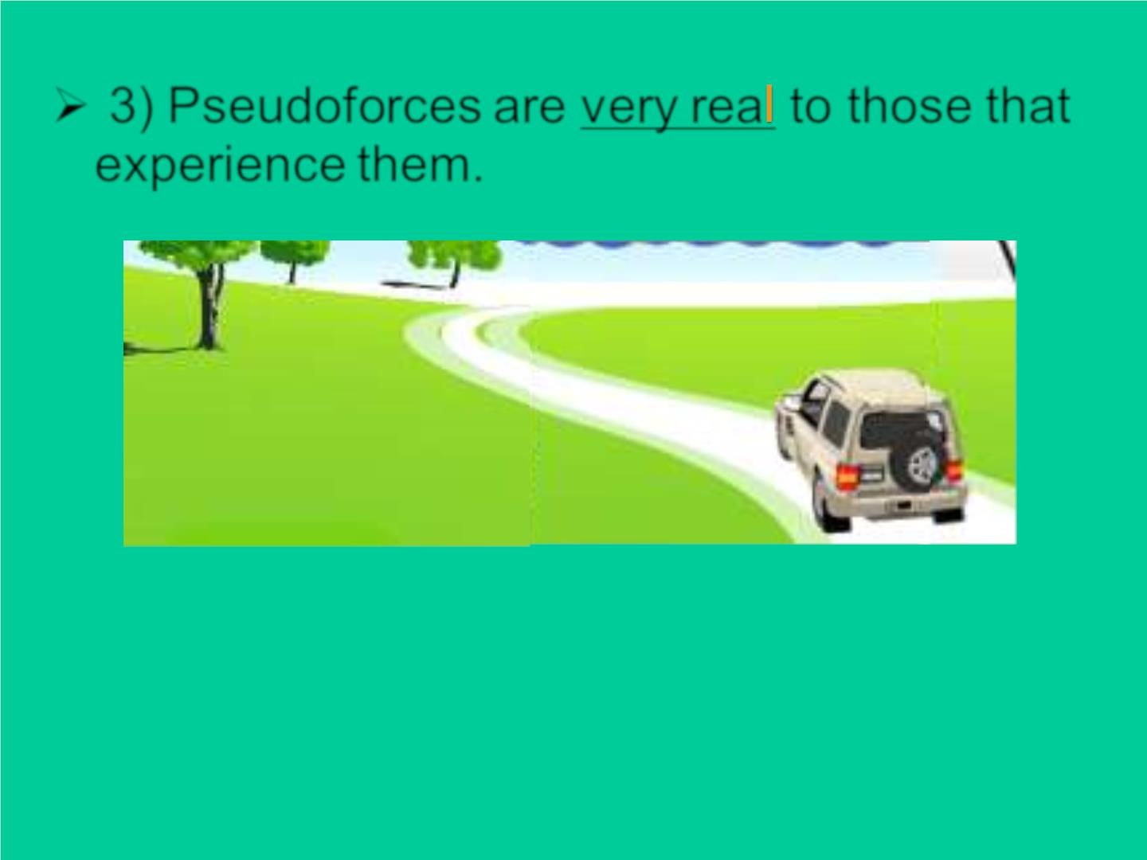
➢ 3) Pseudoforces are v ery rea to those that
experience them.

Slide 30
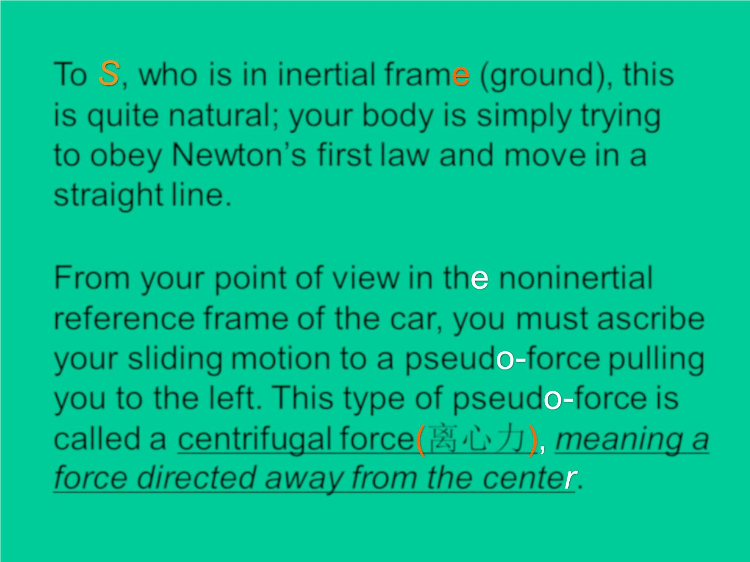
To , who is in inertial fram (ground), this
is quite natural; your body is simply trying
to obey Newton’s first law and mov e in a
straight line.
From your point of view in th noninertial
reference frame of the car, you must ascribe
your sliding motion to a pseud force pulling
you to the left. This type of pseud force is
called a centrifugal force 离心力 meaning a
force directed away from the cente .

Slide 31
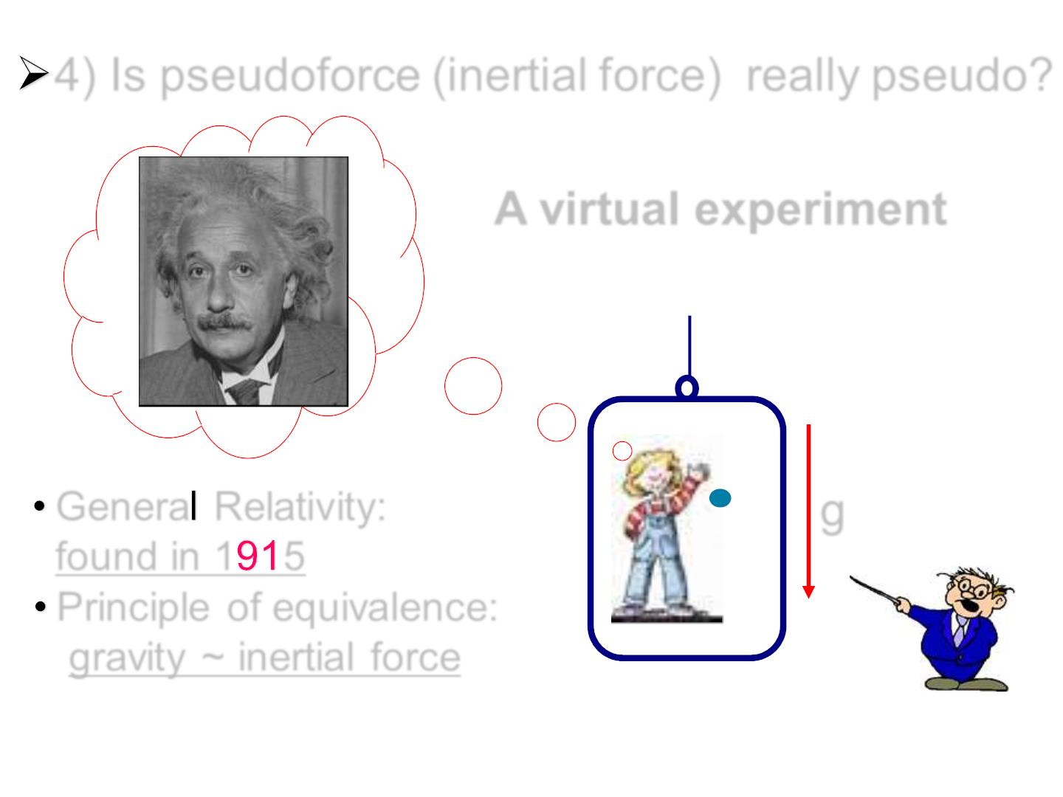
4) Is pseudoforce (inertial force) really pseudo?
A virtual experiment
Genera Relativity:
found in 1 5
g
Princ iple of equivalence:
gravit y ~ inertial force

Slide 32
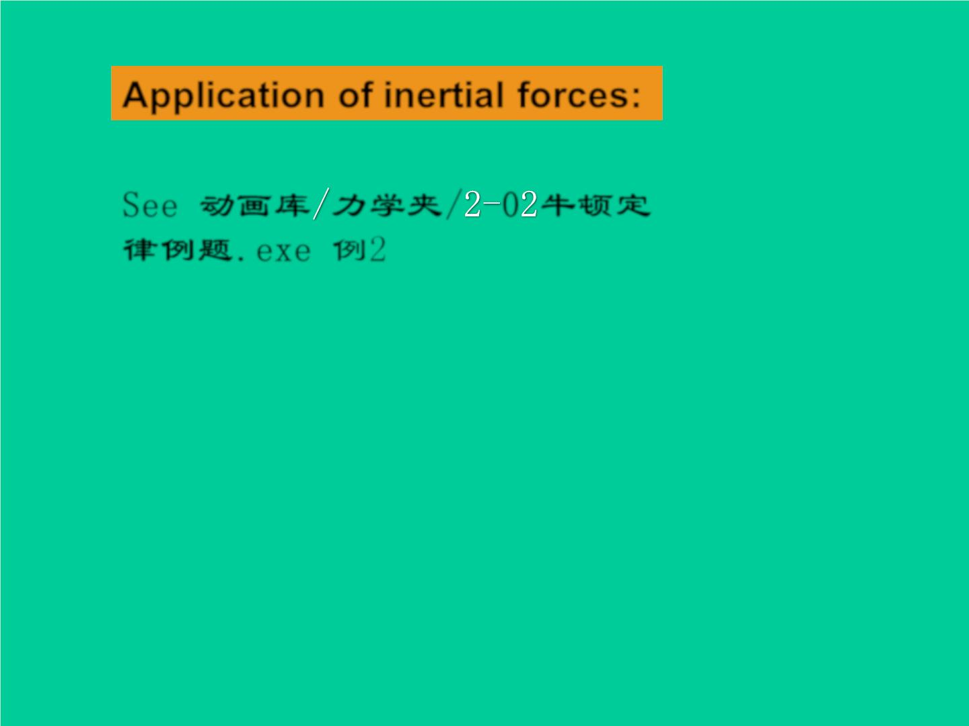
Application of inertial forces:
See 动画库 力学夹/ 0 牛顿定
律例题.exe 例2

Slide 33
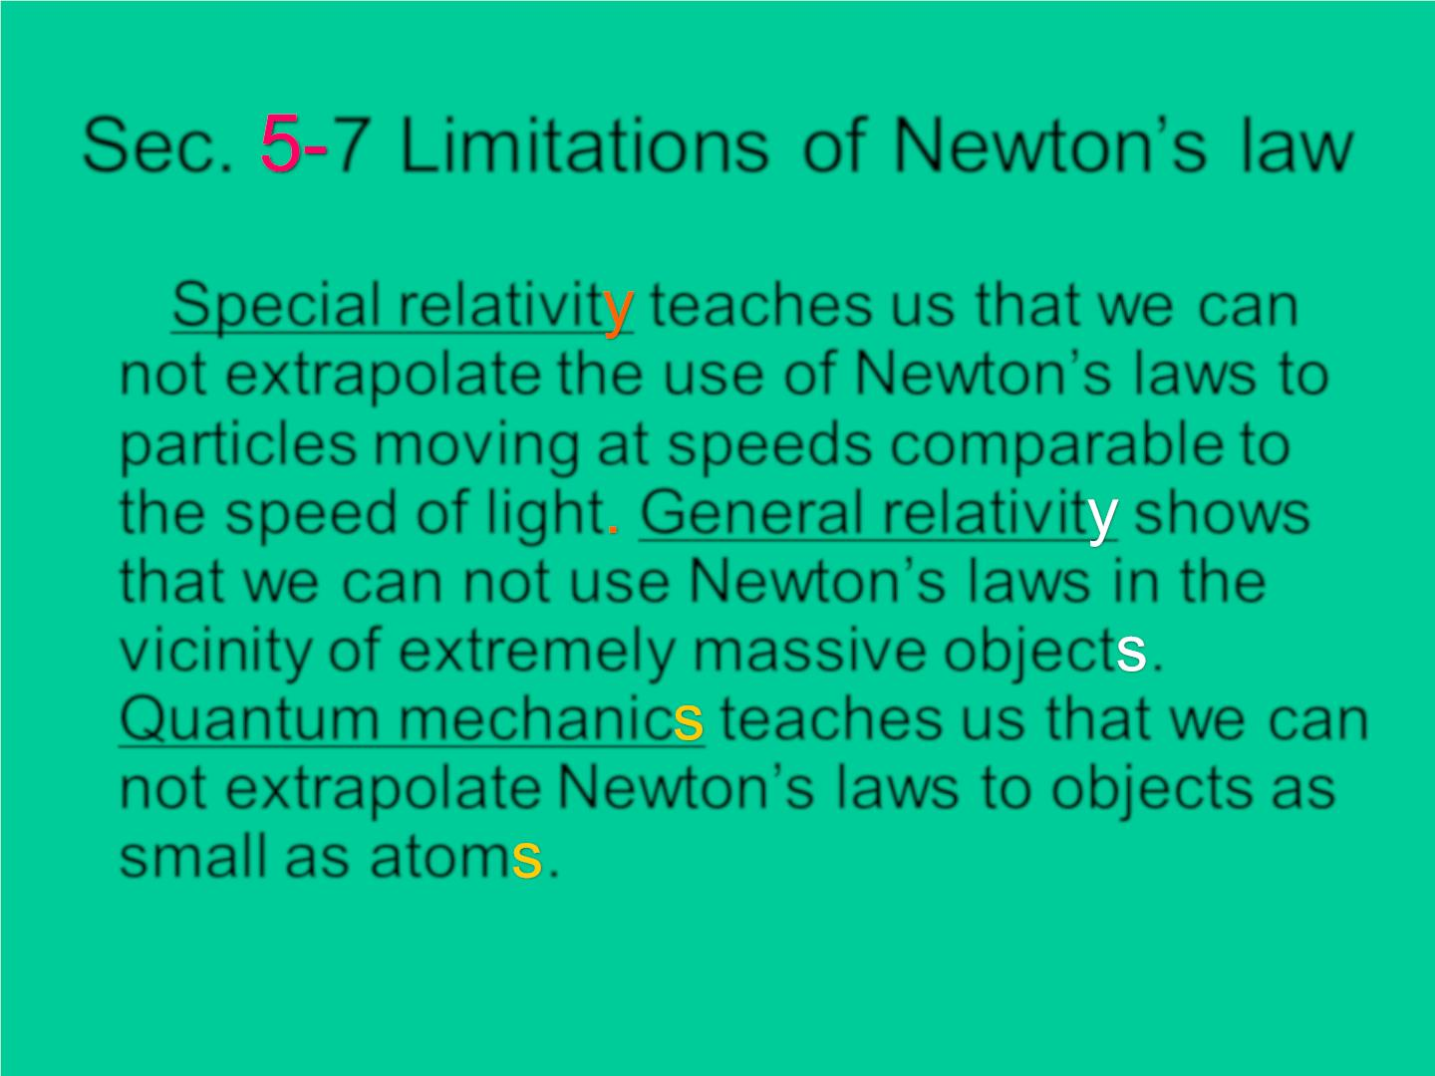
Sec. 7 Limitations of Newton’s law
Special relativit teaches us that we can
not extrapolate the use of Newton’s laws to
particles moving at speeds comparable to
the speed of light General relativit shows
that we can not use Newton’s laws in the
vicinity of extremely massive object .
Quantum mechanic teaches us that we can
not extrapolate Newton’s laws to objects as
small as atom .

