Slide 1

Chapter 6 Momentum
Can we solve conveniently all classical
mechanical problems with Newton’s
three laws?
No, the problems such as collisions.

Slide 2
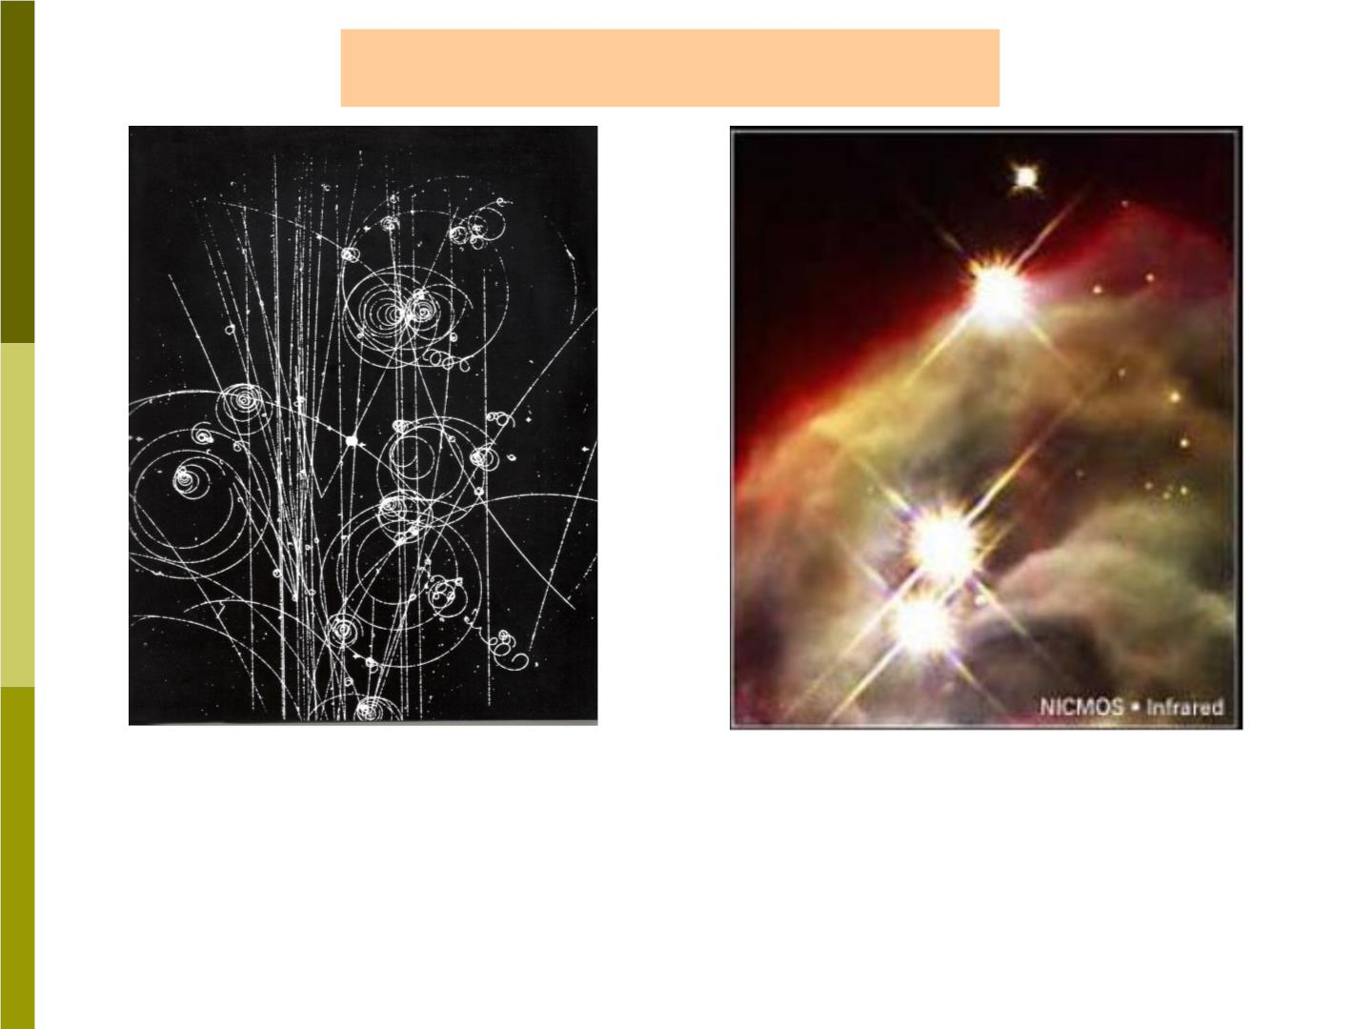
Non-touched collisions
This busy image was
recorded at CERN(欧洲
粒子物理研究所), in
Four galaxies colliding
taken by using Hubble
Space Telescope.
Geneva, Switzerland

Slide 3

6-1 How to analyze a collision?
In a collision, two objects exert forces
on each other for an identifiable (可确认的)
time interval, so we can separate the
motion into three parts.
Before, during, and after the collision.
During the collision, the objects exert
forces on each other, these forces are
equal in magnitude and opposite in
direction.

Slide 4

Characteristics of a collision
1) We usually can assume that these
forces are much larger than any forces
exerted on the two objects by other bodys
in the environment. The forces vary with
time in a complex way.
2) The time interval during the
collision is quite short compared with the
time during which we are watching.
These forces are called “impulsive
forces (冲力)”.

Slide 5

6-2 Linear Momentum
To analyze collisions, we define a new
dynamic variable, the “linear momentum”
as:

❒
(6-1)
The direction of is the same as the
P  m v

❒
P
direction of .
The momentum (like the velocity)
depends on the reference frame of the
v

P
observer, and we must always specify this
frame.

Slide 6
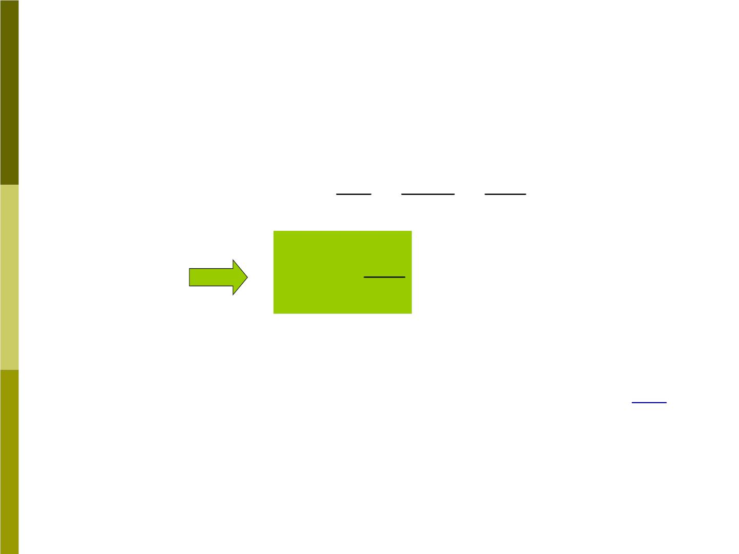

P
→
F
Can be related to ?
❒  
 
dv dmv d P

F  ma  m  
dt dt dt


d P
dt

F 
(6-2)
Any conditions for existence of above Eq.?
 



F
d P
F  ma


The equivalence of
and
dt
depends on the mass being a constant.

Slide 7
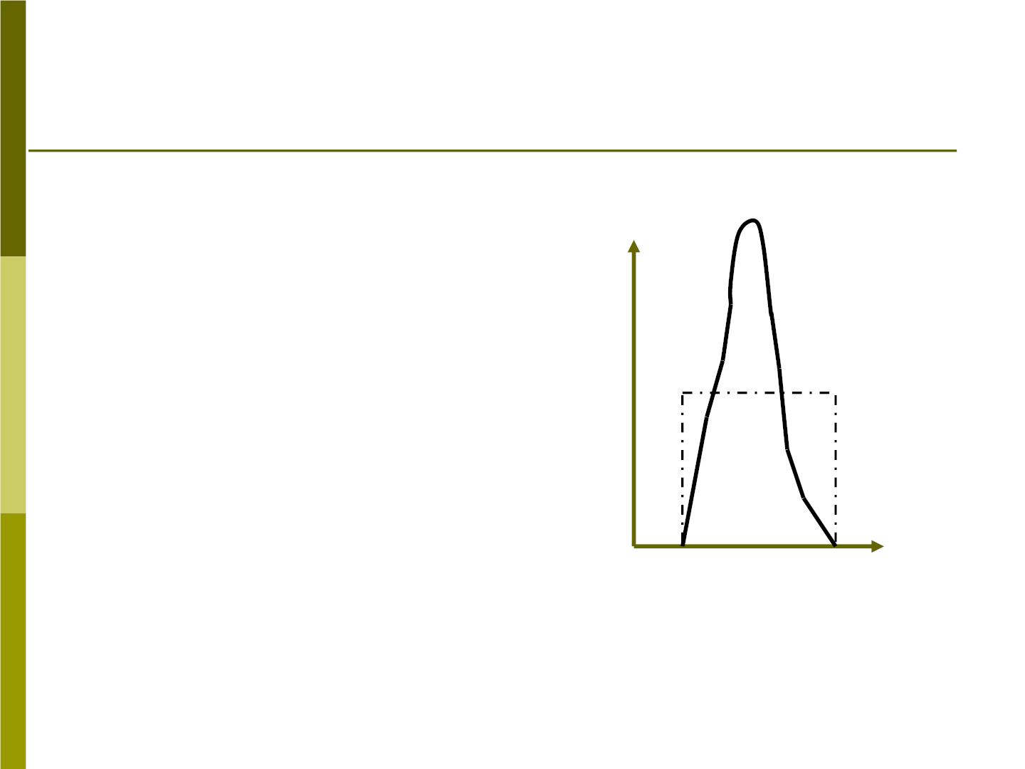
6-3 Impulse(冲量) and Momentum(动量)
Fig 6-6
In this section, we consider
the relationship between
the force that acts on a
body during a collision and
the change in the
F
F(t)
momentum of that body.
F_{av}
Fig 6-6 shows how the
magnitude of the force
might change with time
during a collision.
0 t_{i} t
f
t

Slide 8
From Eq(6-2), we can write the change in
momentum as
 

d P  Fdt
To find the total change in momentum during the
entire collision, we integrate over the time of
t
collision, starting at time (the momentum

i
is P )and ending at time t (the momentum

i
f
is ):
P
→
f
P_{f}

t

f

(6-3)
⇩ 
d P  Fdt
→
t
P
i
i

Slide 9
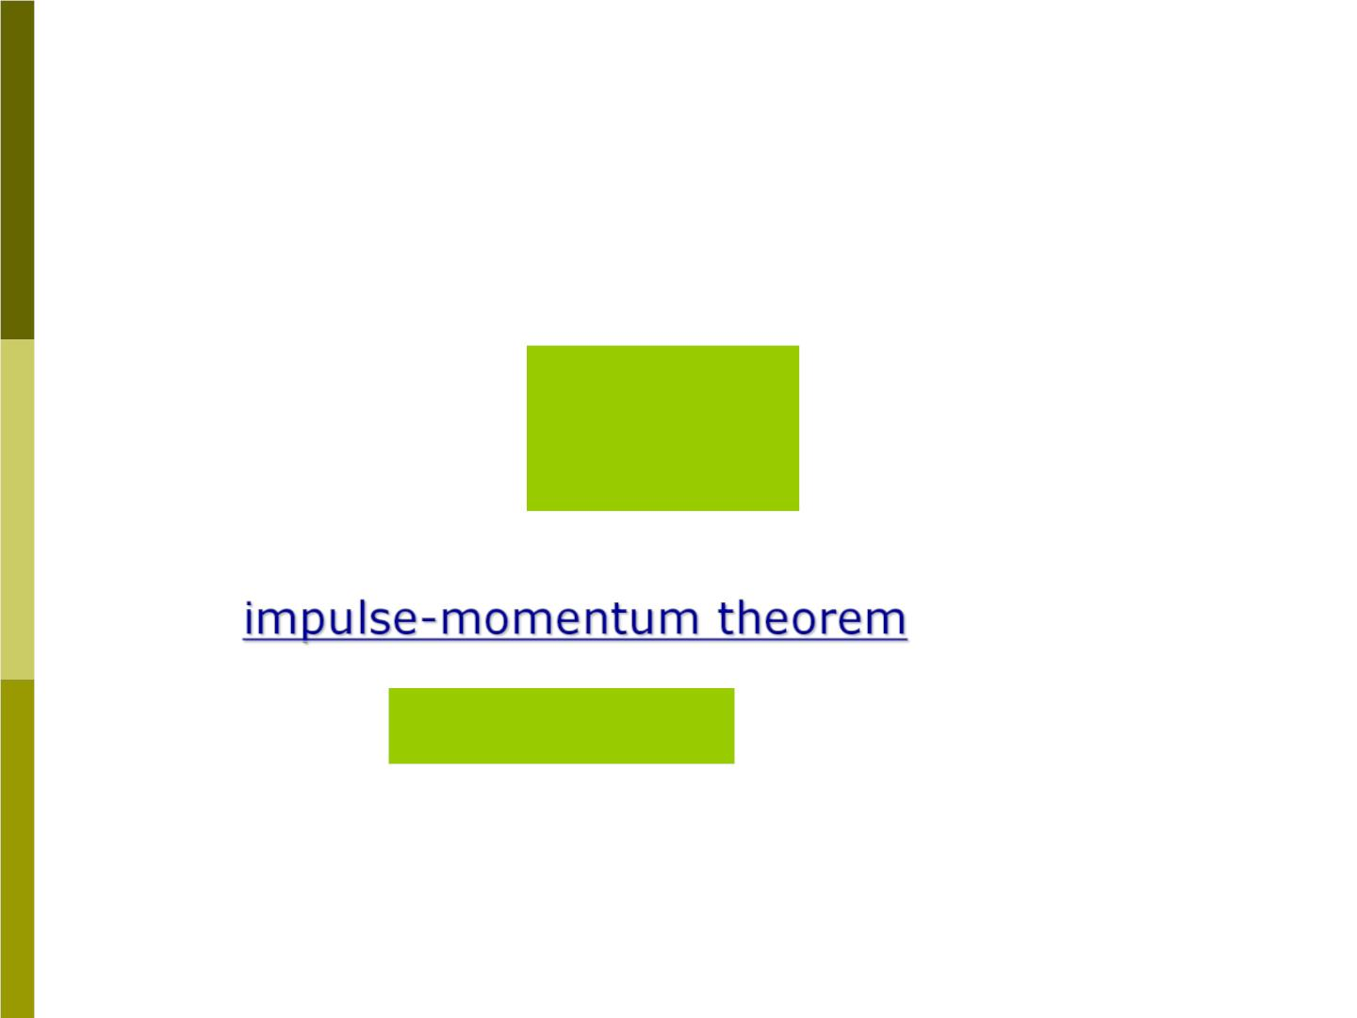
The left side of Eq(6-3) is the change in
momentum,   
P  P  P
f
i
The right side defines a new quantity called the
→
impulse. For any arbitrary force , the impulse

F
J
is defined as

t

f
⇩
J  F d t (6-4)
t
i
A impulse has the same units and dimensions as
momentum. From Eq(6-4) and (6-3), we obtain
the “
” :
   
J P P P
   
(6-5)
f
i

Slide 10
Notes:
1. Eq(6-5) is just as general as Newton’s second
law

2. Average impulsive force
F
   
J  F t  P  P
i
av
av
f
3. The external force may be negligible, compared
to the impulsive force.

Slide 11
Sample problem 6-1
A baseball(棒球) of mass 0.14 kg is moving
horizontally at a speed of 42m/s when it is struck
by the bat it leaves the bat in a direction at an35
angle above its incident path and with a speed
of 50m/s
□
(a) find the impulse of the force exerted on the ball.
(b) assuming the collision lasts for 1.5ms what is
the average force.
(c) find the change in the momentum of the bat.

Slide 12
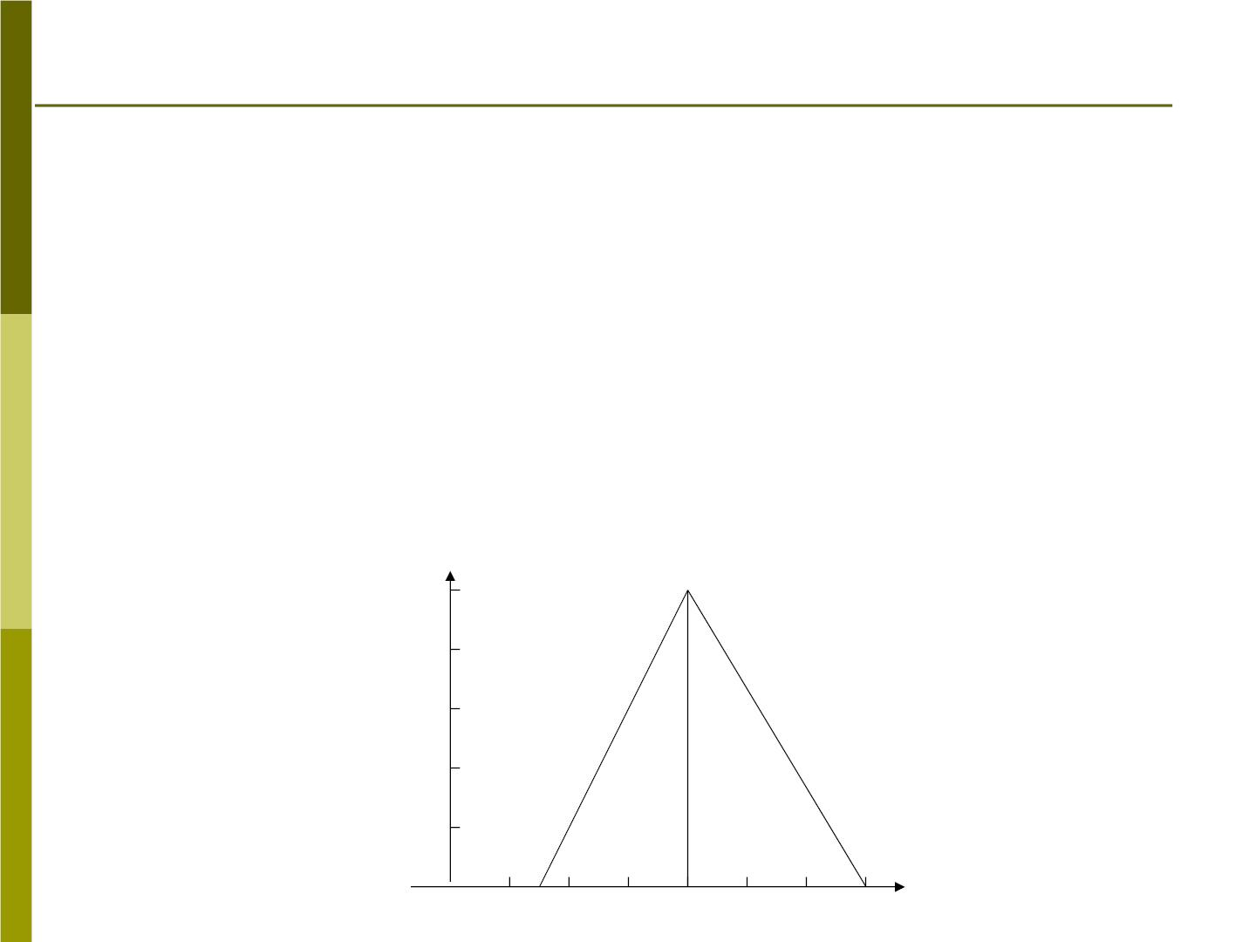
Sample problem 6-2
A cart of mass m =0.24kg moves on a linear
1
track without friction with an initial velocity of
0.17 m/s. It collides with another cart of mass
m =0.68 kg that is initially at rest. The first cart
2
carries a force probe that registers the magnitude
of the force exerted by one cart on the other
during the collision. The output of the force probe
is shown in Fig. 6-9. Find the velocity of each cart
after the collision.
10
F(N)
8
6
Fig 6-9
4
2
T(ms)
4
8
12

Slide 13
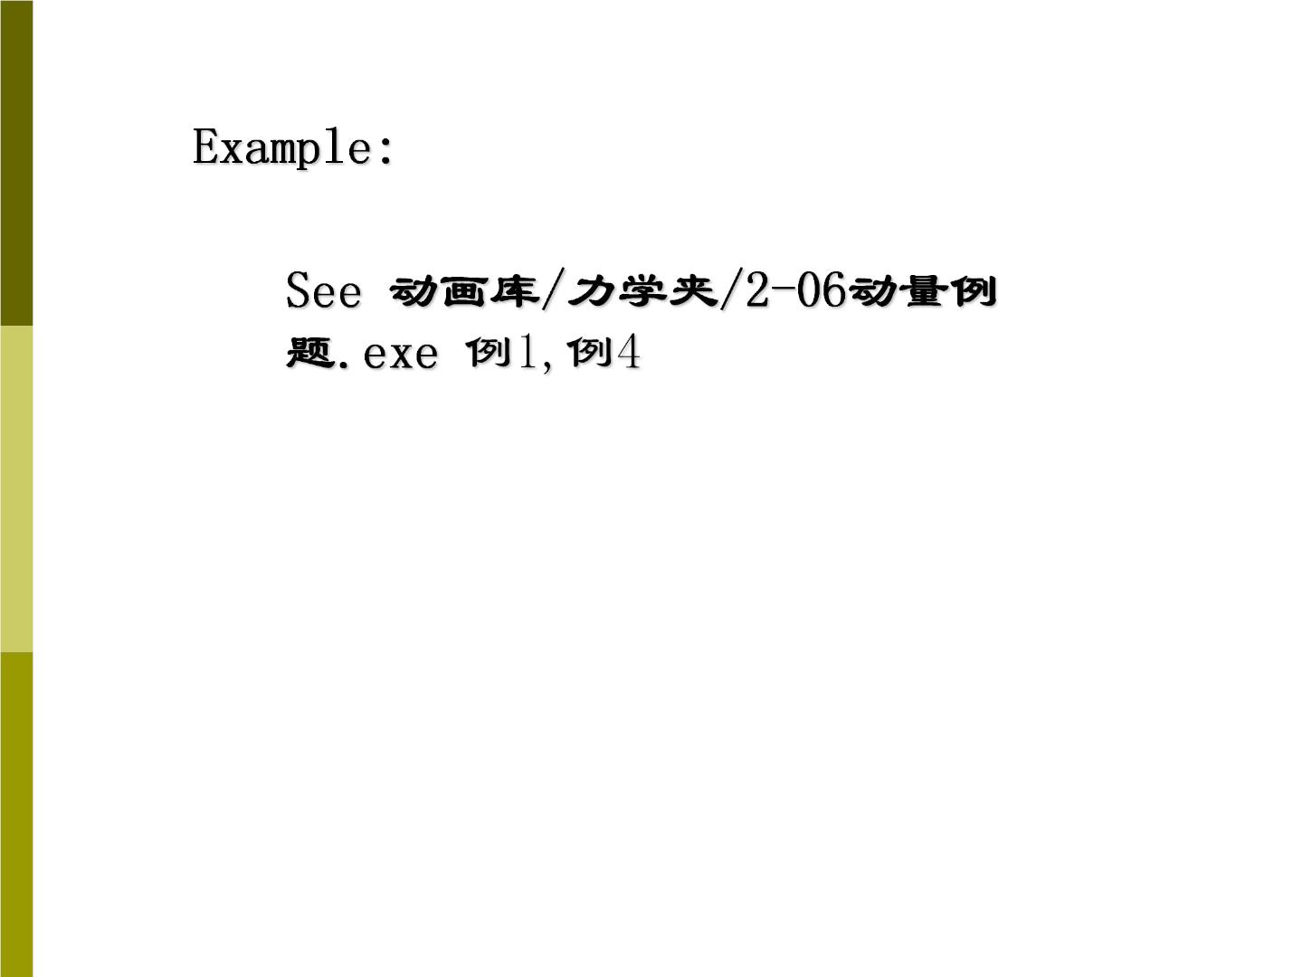

Slide 14

6-4 Conservation of Momentum
❖ 
❖
⇩

P  P  F(t)dt
f
i
❖

if F(t)  0,
(6-12)
❖ 
→
P  P  0
, namely
d P
 0
f
i
dt
❖
or is a constant.
P
1) When the net external force acting
on a system is zero, the total
momentum of the system is conserved.

Slide 15
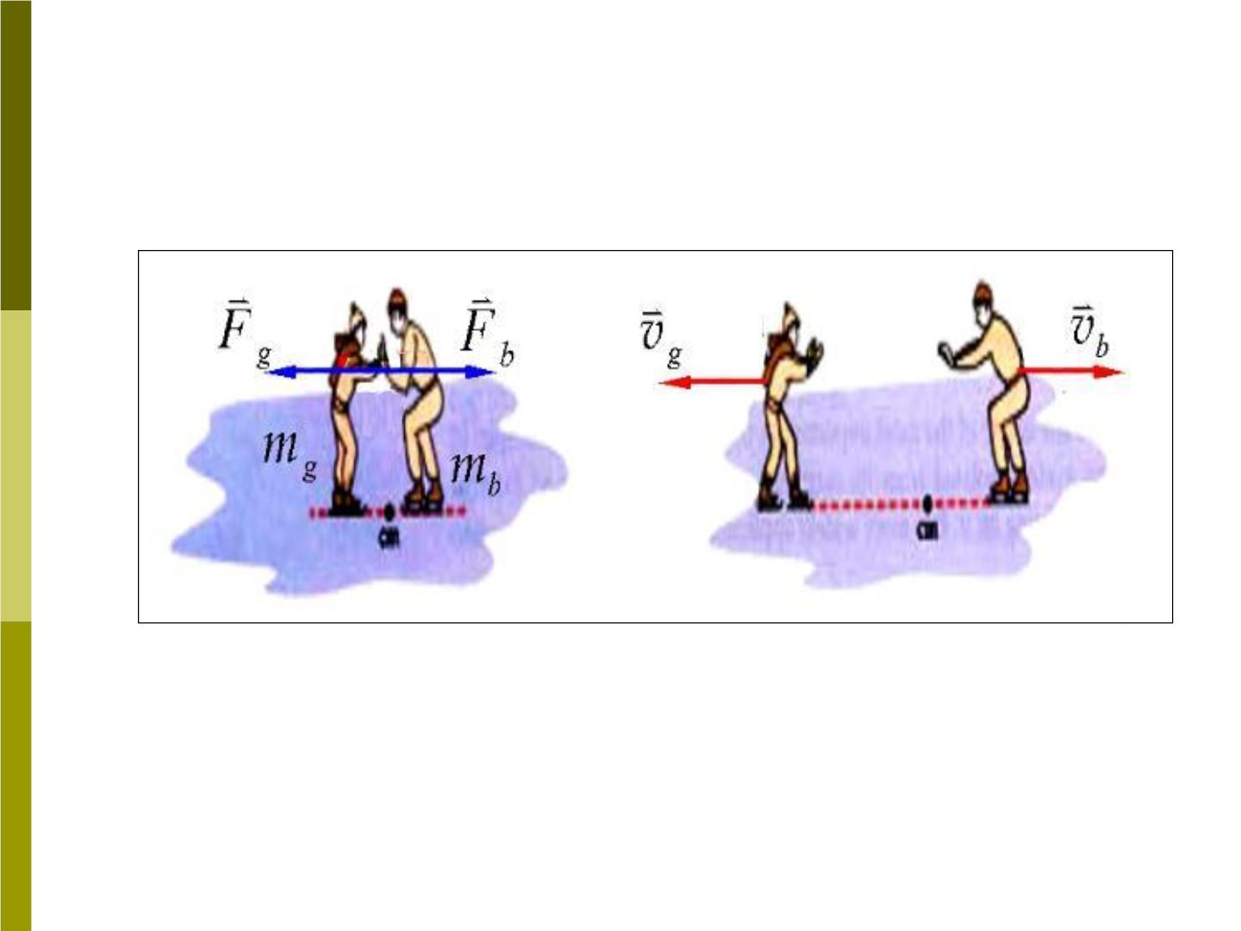
2) The internal forces(内力) of a system do
not change the momentum of the system.
v v  0
m v m v  0
m_{b}  2m_{g}
v_{g}  2v_{b}
g 0
b0
g g
b b
m  2m
 p  0
b
g
❖
0

Slide 16
3) Equation (6-12) is called the ’law of
conservation of linear momentum’. It is a
general result, valid for any type of
interaction between the bodies.
4) Because we derived the law using
Newton’s law, the law is valid in any inertial
frame of reference.
How about the law when using different
inertial frames?
❖
P
may be different, but are conserved.

Slide 17
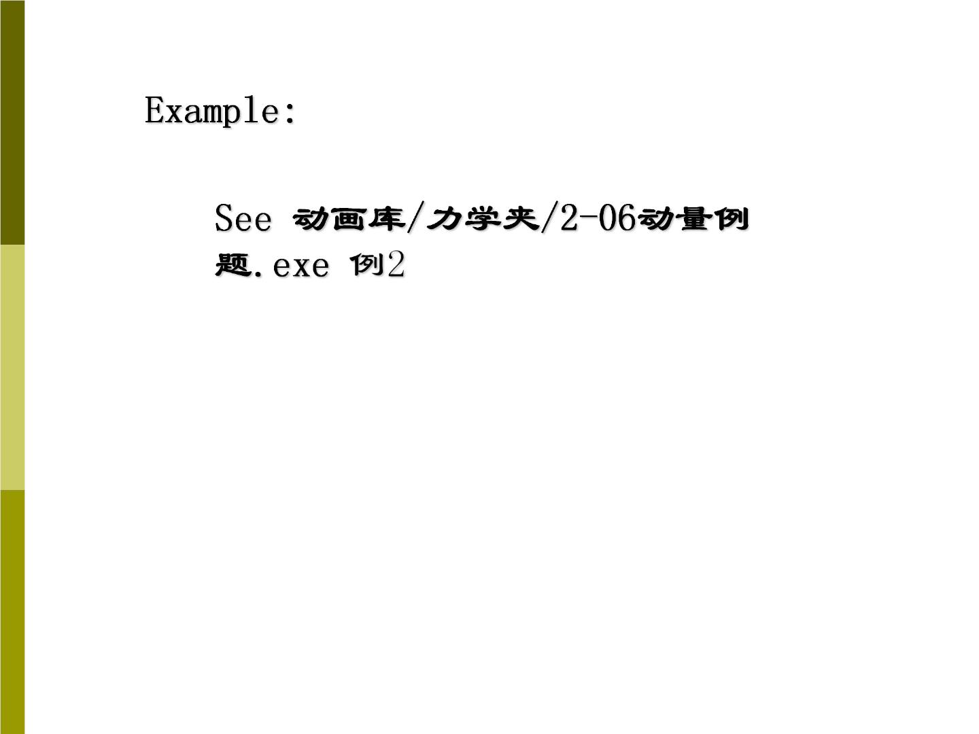

Slide 18

6-5 Two – Body Collisions
J 1）Two-body collision
If the two bodies are isolated from
environment, the total momentum of the
two-body system is conserved before and
after collision:
→
→
→
→
m v  m v  m v  m v
(6-15)
1 1i
2 2i
1 1 f
2 2 f
Another way of writing Eq(6-15) is
→
→
→
→
(6-16)
(6-17)
m (v  v )  m (v  v )
1
1 f
1i
2
2 f
2i
or
→
→
 P   P
1
2

Slide 19
a) Equation (6-17) can be written as
→
→
J   J .This equality follows directly
1
2
from Newton’s third law.
b) In some collision, the bodies stick
together and moves with a common final
→
velocity ,Eq(6-15) becomes
v
→
f
→
→
m v  m v  (m  m )v
1 1i
2 2i
1
2
f
c) Often we have a “ head-on” collision (正
面碰撞), in this case Eq(6-15) can be written
   (6-19)
m v m v m v m v
1 1ix
2 2ix
1 1 fx
2 2 fx

Slide 20
Sample problem 6-8
A puck(冰球) is sliding without friction on
the ice at a speed of 2.48m/s. It collides
with a second puck of mass 1.5 time that
of the first and moving initially with a
velocity of 1.86m/s in a direction away
40□
from the direction of the first puck (Fig 6-
15). After the collision, the m moves at a
1
velocity of 1.59m/s in a direction at a
angle of from its initial direction. Find
□
50
the speed and direction of the second
puck.

Slide 21
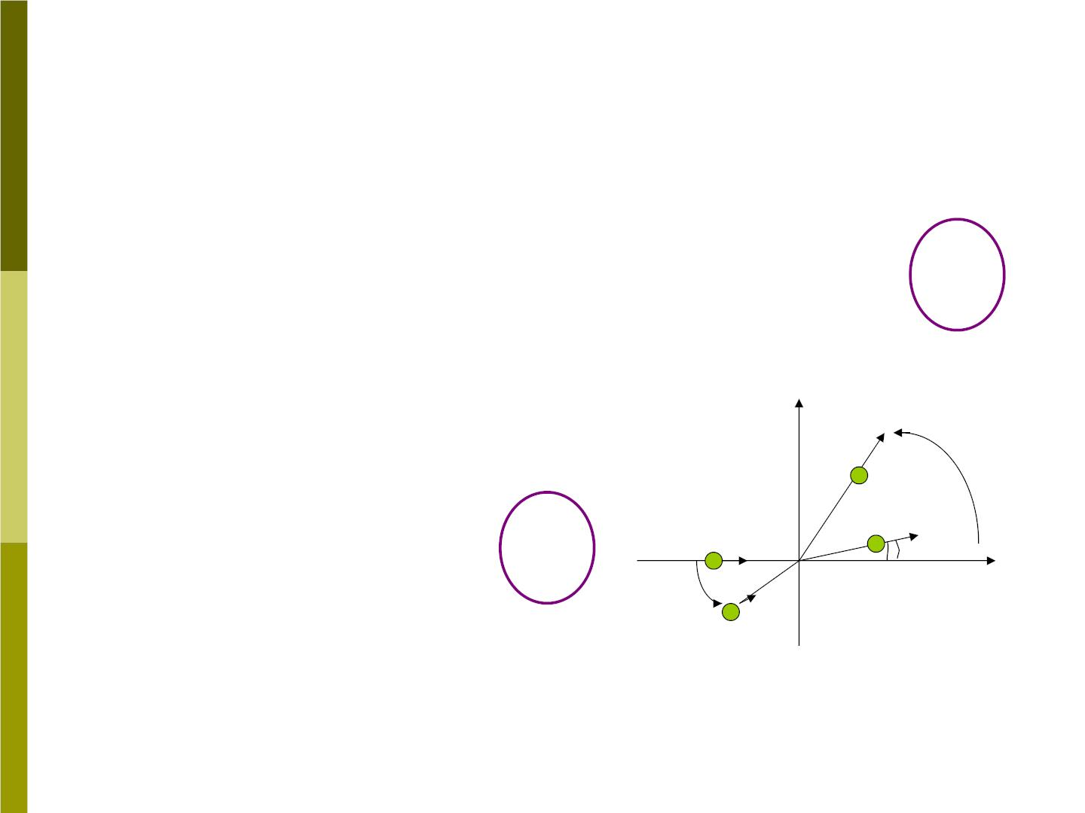
Solution:
From Fig 6-15 and conservation
of momentum, we have:
For x direction
?
m v 1.5m v cos 40  m v cos 50 1.5m
□
□
1 1ix
1 2i
1 1 f
1
For y direction
→
v
1 f
50□
⋅ 
m 0 1.5m v sin 40
□
1
1 2i
?
→
→
m₁ v
v
 m₁v_{1 f} sin 50□ 1.5m₁
1i
2 f
❑
40□
→
v
m
2i
2
Fig 6-15

Slide 22

J 2) One-dimension collision in the center-of-
mass reference frame (cm frame)
a. laboratory reference frame (or lab frame)
This frame is fixed in the laboratory
b. cm frame (质心参考系)
Definition ：
The frame in which the initial momentum
of the two-body system is zero
How to find the velocity of the cm frame?

Slide 23
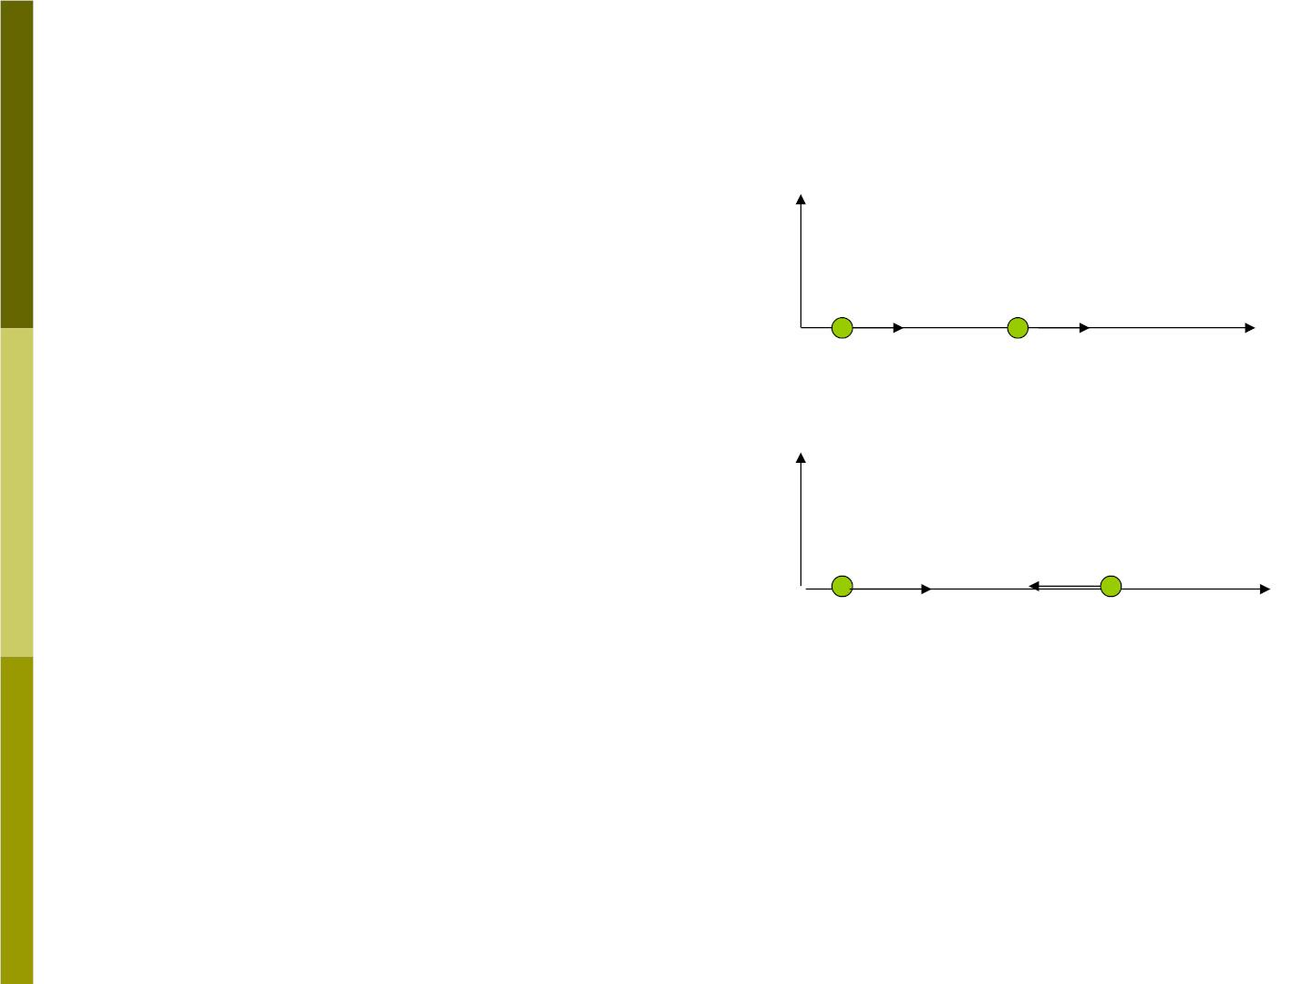
In Fig 6-16,
Fig 6-16
S represents lab frame,
S’ represents cm frame.
S
m₁
^{m}2
(a)
(b)
→
→
x
P
P
According to an observer
in the cm frame, the
initial velocity of two
colliding objects are
1i
2 i
S’
m₁
^{m}2
→
→
^{P}2i
x
'
'
m v'  v v
P_{1i}
:
1
1i
1i
m '  
: v v v
2
2i
2i
v
is the velocity of S’ relative to S.

Slide 24

The total momentum of the two bodies in
cm frame is 
P' 0
i
or P' m v 'm v '
i
1 1i
2 2i
 m (v  v)  m (v  v)  0
1 1i
2 2i
m v  m v
v 
1 1i
2 2i
m₁  m₂
If we travel at this velocity and observe the
collision, the motion of the bodies before the
collision would appear as in Fig 6-17(1).

Slide 25
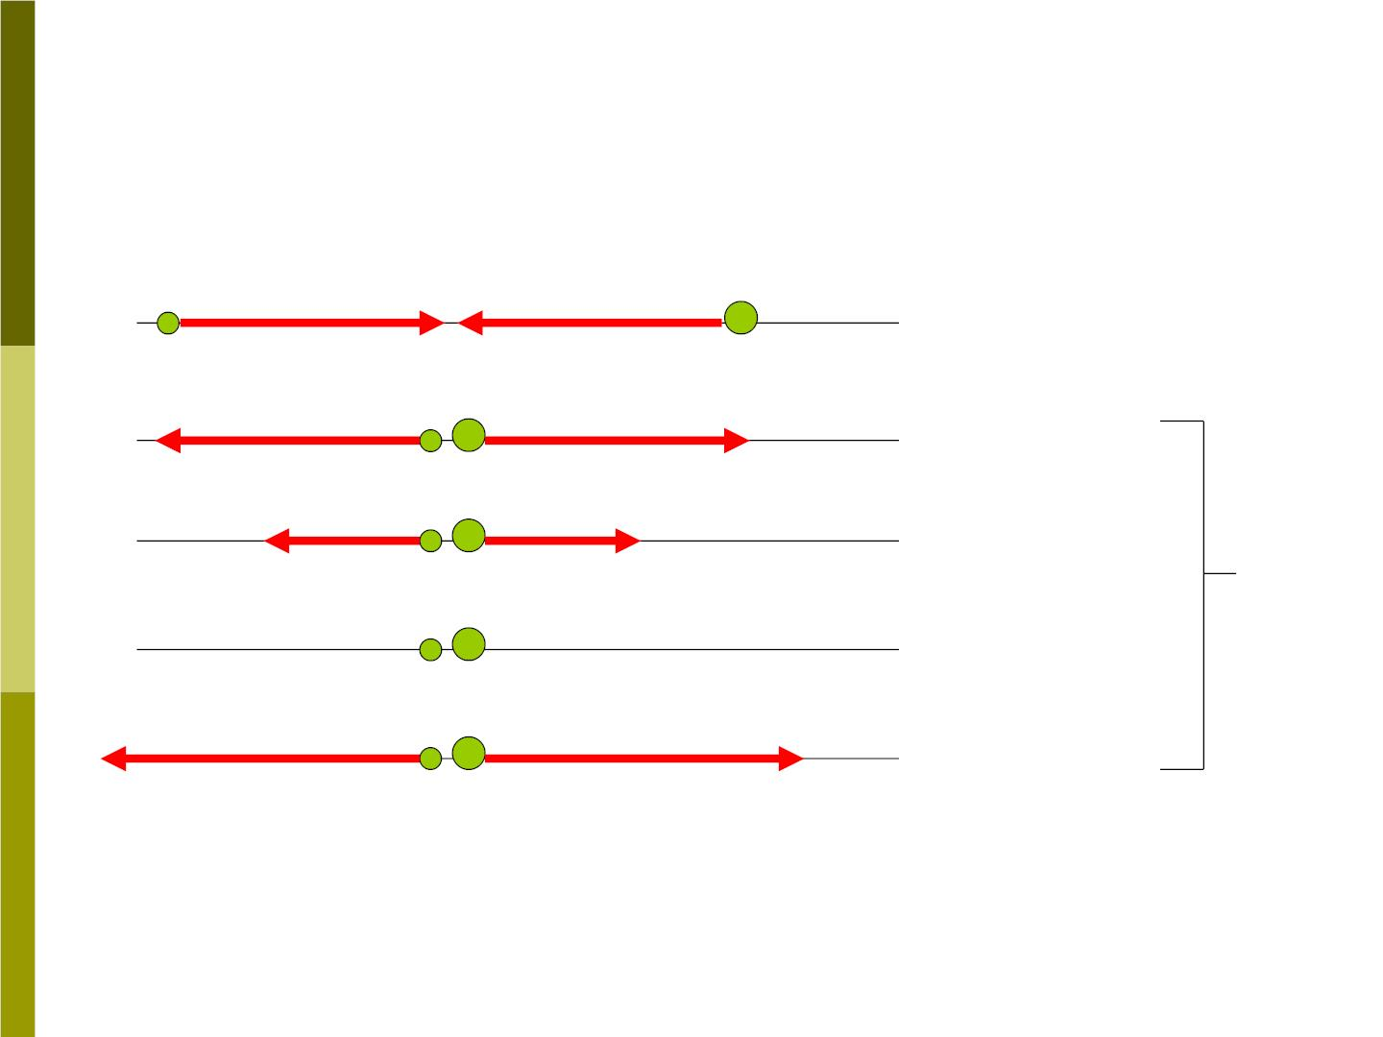
Fig (6-17) Two-body collisions in cm frame
→
→
P_{2i}
m₁
P
'
'
m₂
1.
2.
3.
1i
initial
→
P_{1f}
→
^{P}2f
'
'
elastic
inelastic
Final
Completely
inelastic
4.
5.
explosive

Slide 26

J 3) Elastic collision
In cm frame, for elastic collision, the velocity
of each body changes in direction but not in
magnitude. Thus
^{v}1 f
'  
'
'
 
'
v_{1i}
v
v
2 f
2i
Now we use these results to derive the final
velocity of two bodies in the lab frame.

Slide 27

m
For ,
1
v  v 'v  v 'v
(v ' v ')
1 f
1 f
1i
1 f
1i
v  v 'v
1i
1i
We obtain
v  (v  v)  v  v  2v
1 f
1i
1i
m v  m v
 v_{1i}  2
m₁  m₂
1 1i
2 2i

m m
1
2
^{2m}2
(6-24)

v_{1i}

v_{2i}


m m
m m
1
2
1
2

Slide 28
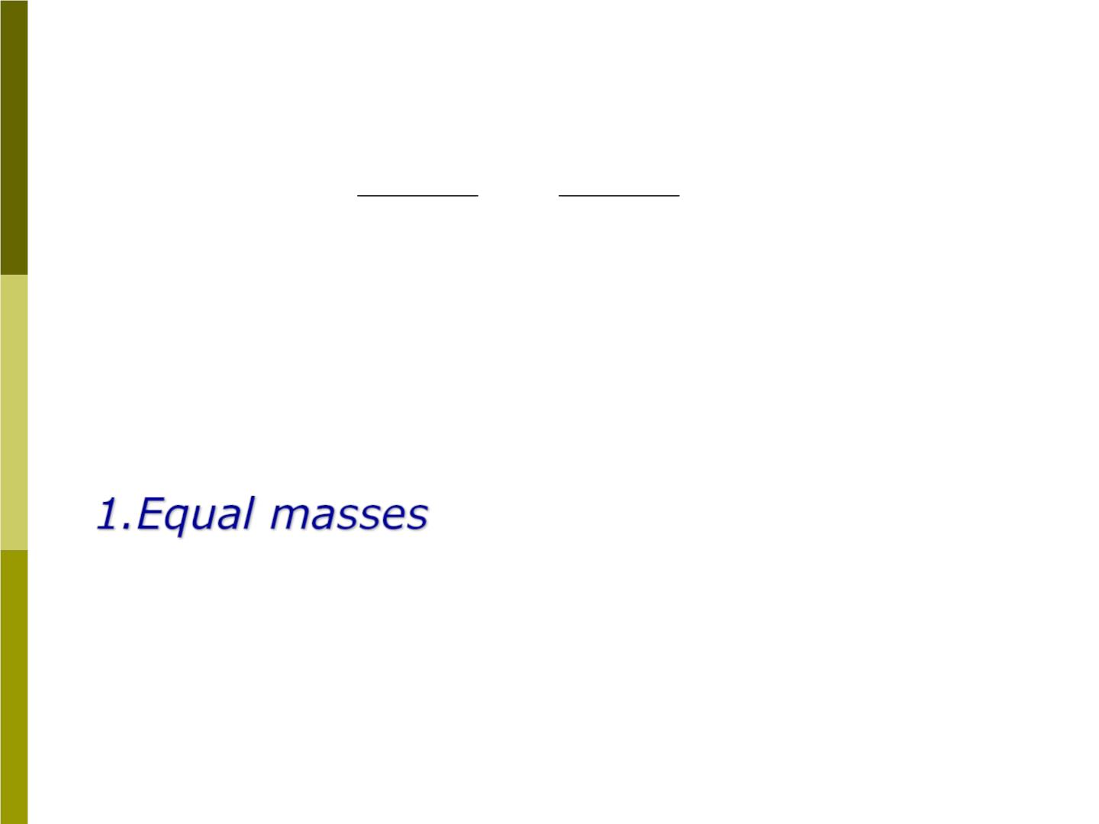
For , in the same way
m
2
^{m}2 ^{ m}
^{2m}1
v 
1
v 
v_{1i}
(6-25)
2 f

2i

m m
m m
1
2
1
2
Equation (6-24) and (6-25) are general
results for one-dimensional elastic
collision. Here are some special cases:
m₁  m₂
v_{1 f}  v_{2i}

and
v v
(6-26)
2 f
1i
two bodies exchange velocity.

Slide 29
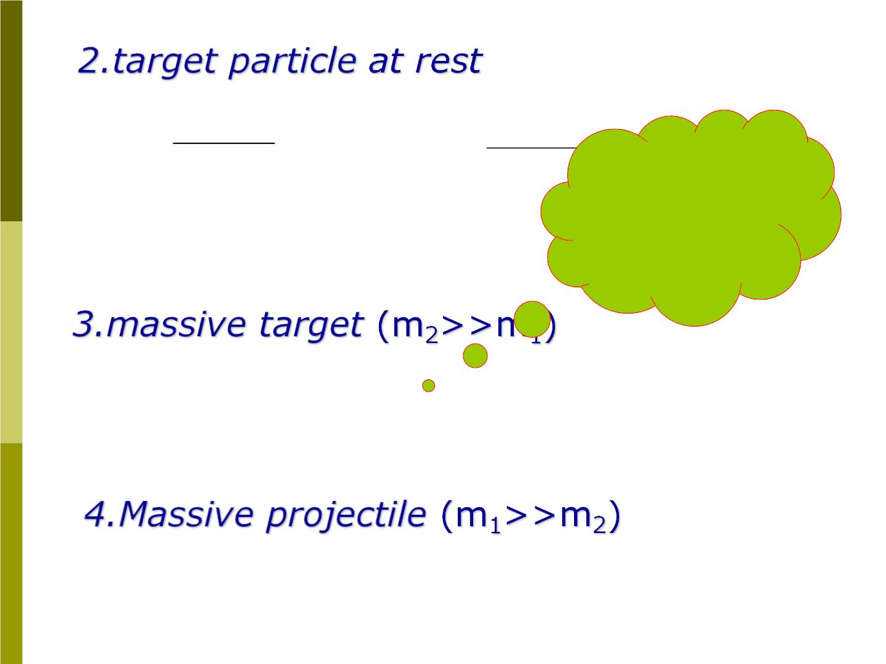
^{2m}1
^{m}1 ^{ m}
v 
v_{1i}
v 
2
2 f

and
1 f
m m

m m
Slingshot
effect
1
2
1
If
m  m
m
then is “stop
1
2
1
m₂
“ take off” with the v
,Eq(6-24) and
Eq(6-25) reduce to
v  v  2v
(6-28)
(6-29)
,
1f
1i
2i

v v
2 f
2i
v_{1 f}  v_{1i}
v2 f  2v1i
(6-30)

