Slide 1

Chapter 7 System s of
particles
7-1 The motion of a complex object
7-2 Two -p artic le system

7-3 Many-part ic le system
7-4 Center of mass of solid objects
7-5 Conservation of momentum in a
system of particles

Slide 2
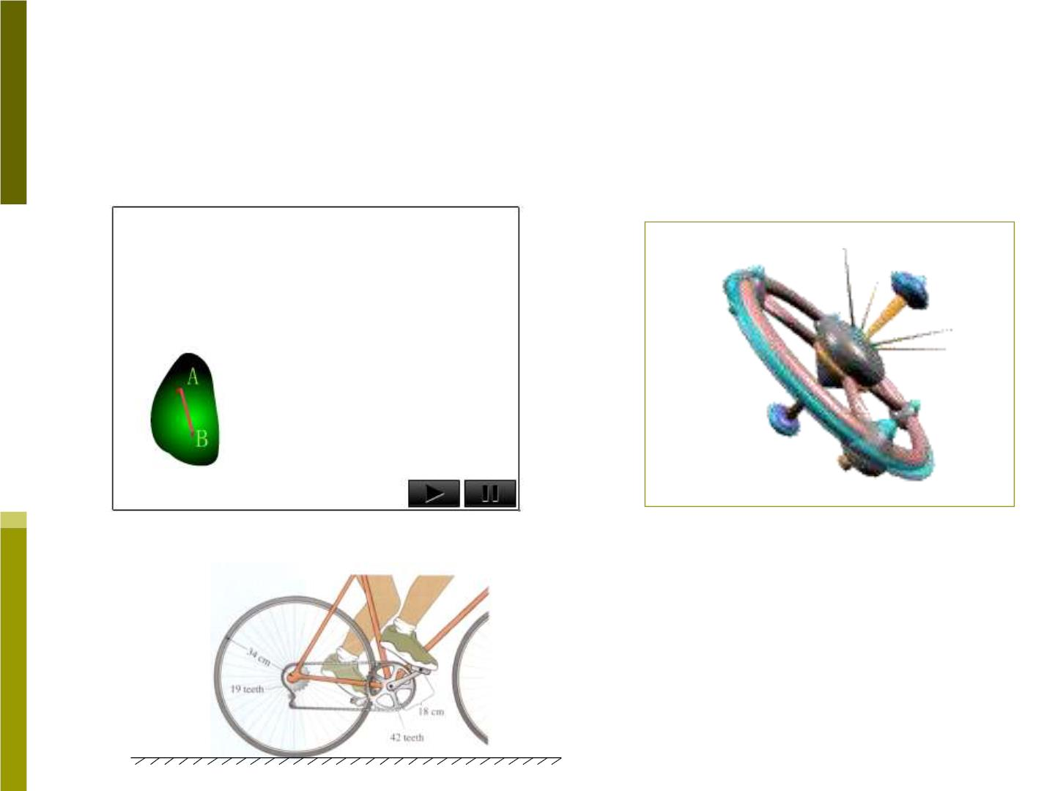
W hen can the object studied be regarded as a
mass point? Doing only translat ion al motion
Translational motion
Rotational motion
Translation al +
Rotational motion

Slide 3

7-1 The motion of a complex obj ect
When we projectile a rigid body, the
motion of the body looks very complicated.
We can consider the motion of the rigid
body to be a combination of a parabolic
trajectory of a “center of mass” (rotational
motion is not considered) plus a rotation
about “center of mass” (translational
motion is not considered).
How to find the center of mass (CM) of
a particle system?

Slide 4
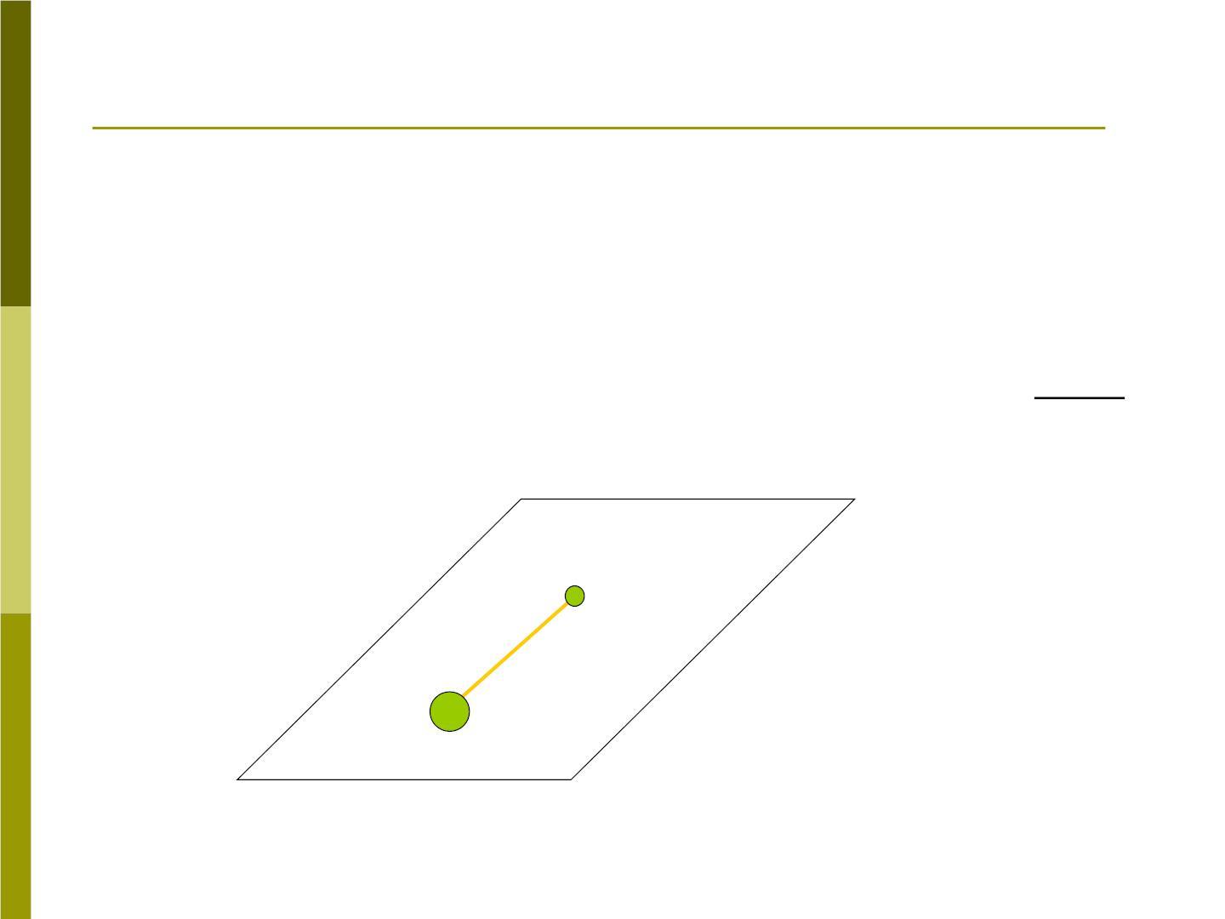
7-2 Two- par tic le system
Do an experiment to find CM in a two-particle
system.
As an example, we consider a baton consists
of two particles m , at its ends A and B,
m
1
2
connected by a thin rigid rod of fixed length and
negligible mass.
A
m₁
m₂ = 2m₁
B
m₂

Slide 5
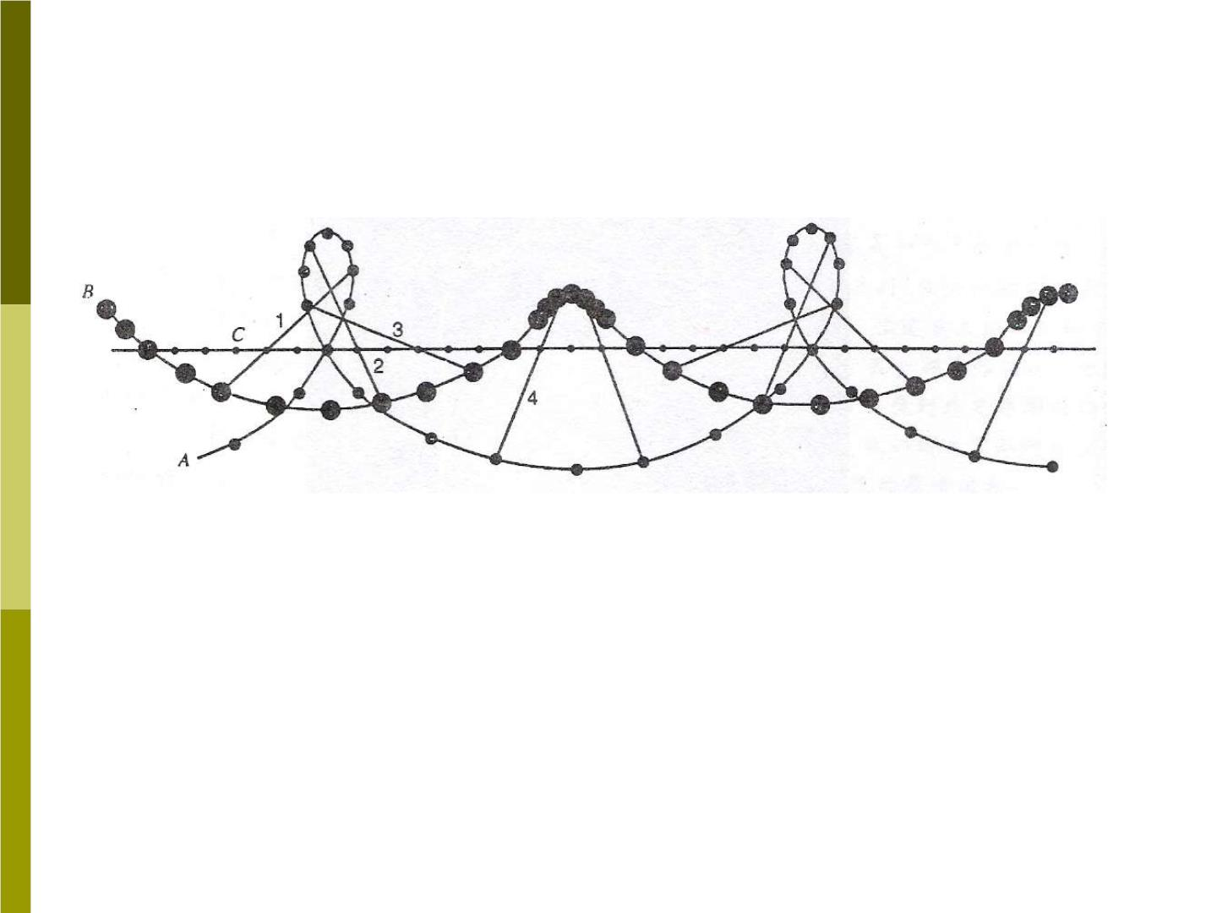
We g ive the rod a push along the frictionless
horizontal surface and examin e its motion.
Snapshots of the locations of points A and
B at successive intervals of time.
m
m
Clearly both and are accelerated, h o wever,
1
2
one point in the rod (point C) mo ves with constant
velocit y.

Slide 6
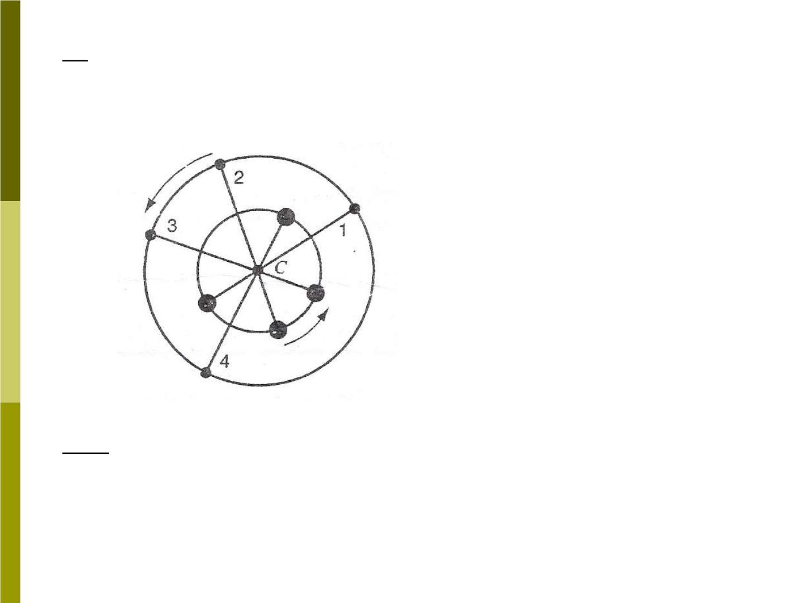
If point c is regarded as a reference, A and B
points rotate with a constant rotational speed.
View the motion
from the reference
of point C.
So point c is actually the center of mass.

Slide 7
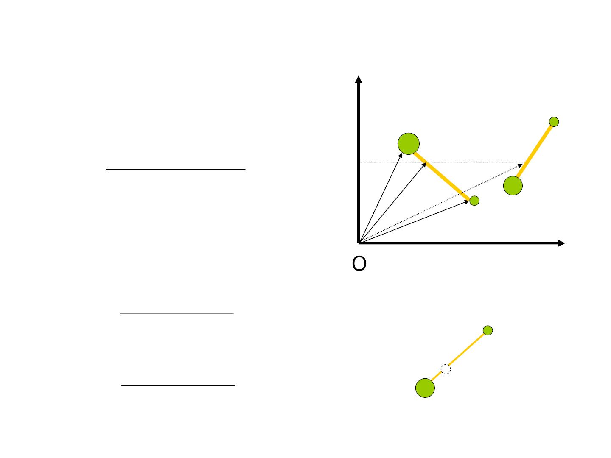
Fig 7-5
By building a Cartesian
coordinate, position of
point c is found at :
y
m₁
❖ 
❖
cm
m r + m r
= 1 1
C
C’
r
2 2
❖
❖
cm
m₂
(7-1)
r 
r
'
m₁ + m₂
1
r
cm
❖
r
2
or written as:
x
m₁x₁ + m x
x =
2 2

cm
+
A
m m
m₁
1
2
(7-2)
m y + m y
C
y =
1 1
2 2
B
cm
+
m₂
m m
1
2

Slide 8

From Eq. (7-1), the velocity and acceleration of
the CM are:
→
→
→
+
+
→
d r m v m v
^{cm} =
dt
v =
1 1
2
2
cm
m m
(7-4)
(7-6)
→
1
2
→
→
+
+
→
d v m a m a
a =
cm
=
1 1
2
2
cm
dt
m m
❖
1
2
a
Can we also find cm is zero from Eq. (7-6)?
→
→
→
→
→
→
m a + m a = F + F
F
= −
F
1 1
2 2
1r
2r
2r
1r
→
a = 0
c

Slide 9

How about the motion if the system has net
external forces?
Suppose there is an external force on each
particle in above expt., then
→
→
→
→
→
→
→
→
 
m a + m a = F + F = F + F + F + F
1 1
2 2
1
2
1ext
1r
2ext
2r
→
→
→
→
→
  
 F + F = 0, and if write
F + F = F
1r
2r
1ext
2ext
ext
❖ 
1 1
❖

❖
❖


+
m a + m a = F
❖ m a m a
 =
1 1
2 2

2 2
ext

a


cm
^{m}1 ^{+ m}
2 

→
→ Newton’s second law for
F = (m +m )a
ext
1
2
cm
systems of particles
m +m
This looks very lik e a particle of mass
at the center of mass.
located
1
2

Slide 10

7-3 Many- partic le system
Consider a system consisting of N
particles of masses
mass is
m₁ m₂
…… . The total
m
N

M = m_{n}
(7-10)
Each particle can be represented by its
❒
❒
r
→
a
location , velocity and its acceleration .
v
n
n
n
The CM of the system can be defined by
logical extension of Eq(7-1):

Slide 11
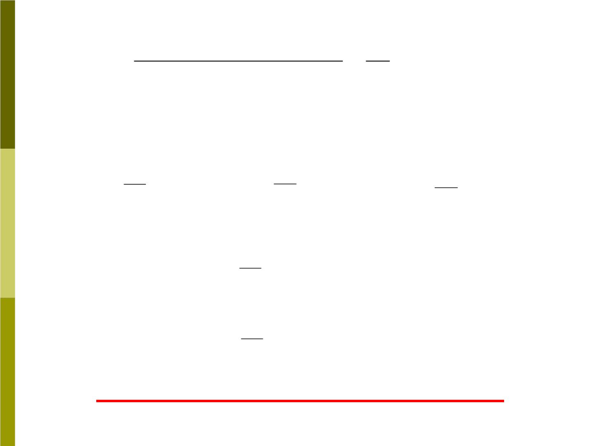
→
→
❒
→
+ + 
m r m r
m r 1

→
r =
1 1
2 2
^{N N} =
m r
(7-11)
cm
m + m + m
M
n n
1
2
N
In terms of components, Eq(7-11) can be
written as
(7-12)
1

1

1

x =
, y =
n n
m y , =
m x
z
m z
.
cm
M
cm
M
n n
cm
M
n n
Taking the derivative of Eq(7-11)
→
1

→
v =
m_{n} v_{n}
(7-13)
cm
M
Differentiating once again:
→
1

→
(7-14)
(7-15)
a =
m_{n} a_{n}
cm
M
→
→
→
→
→
Or
   
M a = m a = F + F + F
cm
n n
1
2
N

Slide 12

By Newton’s third law, in Eq(7-15) the vec tor
sum of all the internal forces is cancelled, and
Eq(7-15) reduces to
❖
❖

F = Ma
(7-16)
ext
cm
Eq(7-16) is just the Newton’s second law for the
system of N particles ^{treated as a sin g le p}^{article}
❖
r
of mass M located at the center of mass( ),
a
cm
experienc ing .
cm
→
1

→
r =
m r
cm
M
n n
→
1

→
m_{n} a_{n}
a =
cm
M

Slide 13

We can summarize this important result
as follow:
“The overall translational motion of a
system of particles can be analyze using
Newton’s law as if the mass were
concentrated at the center of mass and
the total external force were applied at
that point.”
These are general results that apply
equally well to a solid object.

Slide 14
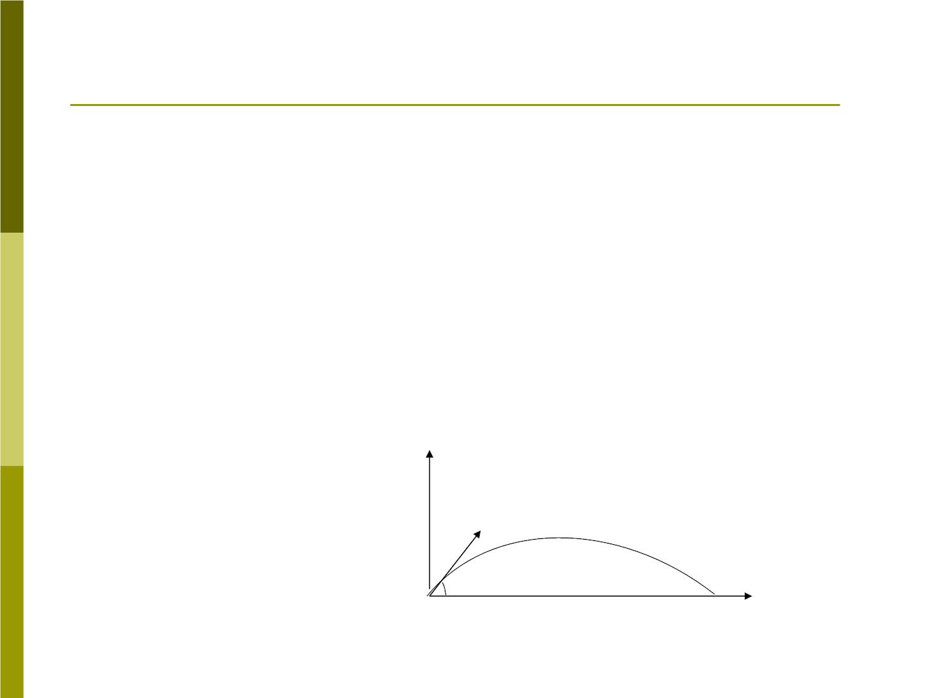
Sample problem 7-3
A projectile(射弹) of mass 9.8kg is launched
from the ground with initial velocity of 12.4m/s at
□
54
an angle of above the horizontal (Fig 7-11).
At some time after its launch, an explosion splits
the projectile into two pieces. One piece of mass
6.5kg, is observed at 1.42s after the launch at a
height of 5.9m and a horizontal distance of
13.6m from the launch point. Find the location of
the second fragment at that same time.
→
•_{m}
v
CM
0
•
1
•
m
₀
2

Slide 15
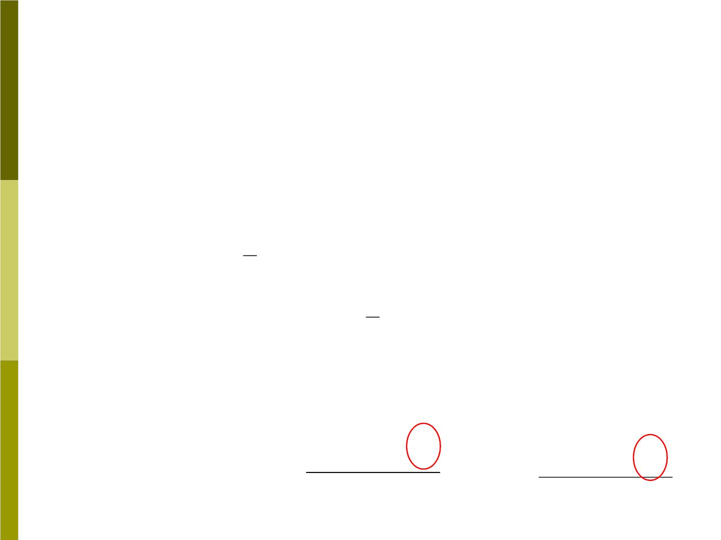
Solution:
If the projectile had not exploded, the
location of the projectile at t=1.42s should
have been
x = v t = (7.3m/ s)1.42s =10.4m
0x
1
= −
y v t gt
2
0y
2
1
² 
(10.0m / s) (1.42s) (9.80m / s ) (1.42s)
=

−
2
2
= 4.3m
It is the location of the CM.
?
m₁x₁ + m x
?
m y + m y
x =
2 2
y =
1 1
2 2
cm
+
m m
cm
m₁ + m₂
1
2

Slide 16
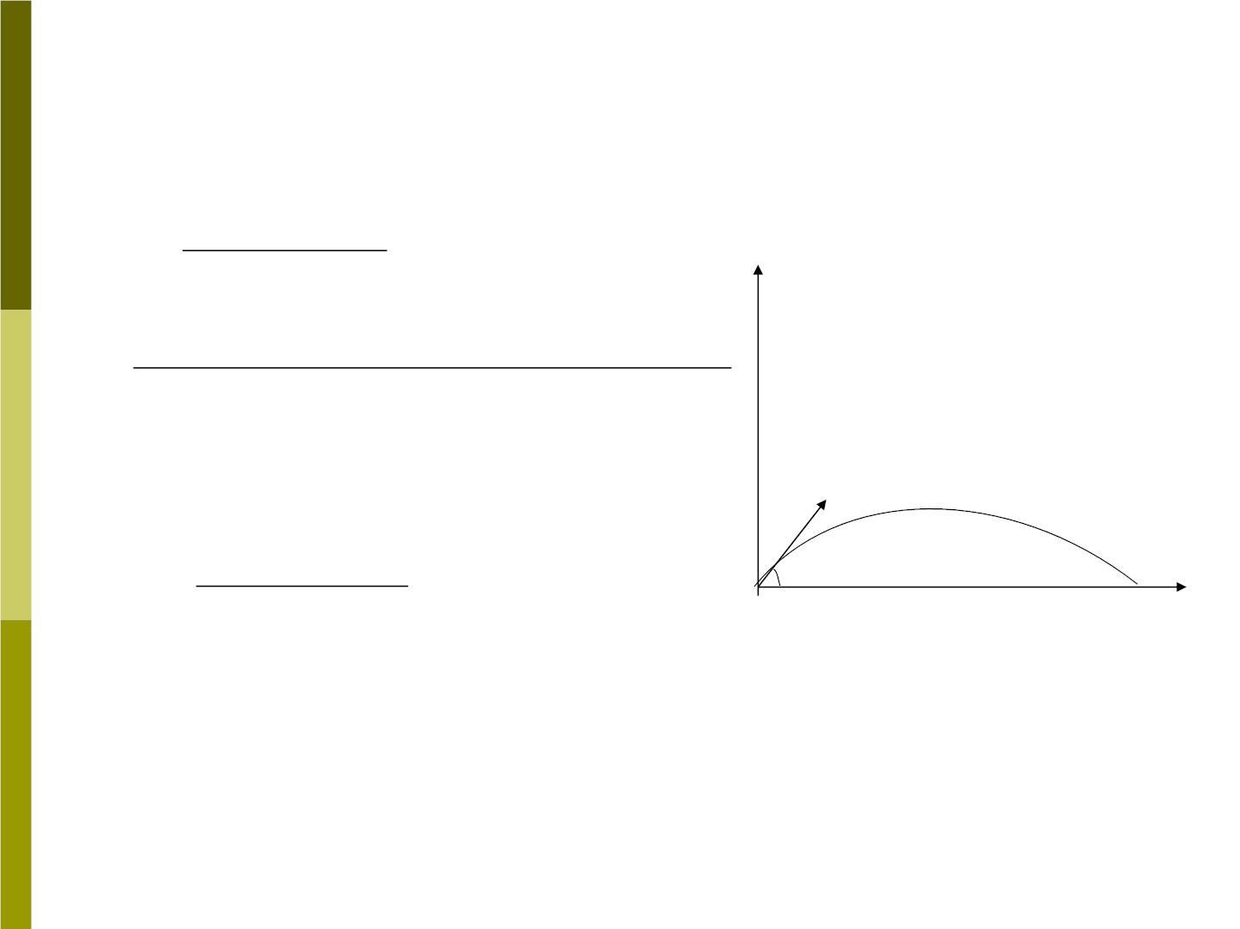
By Eq(7-12)
^{Mx}cm ^{− m x}
^{x}2 ⁼
1 1
Fig 7-11
m₂
(9.6kg) (10.4m) − (6.5kg) (13.6m)
=
3.1kg
= 3.7m
→
•
v
Cm
m₁
0
•
My_{cm} − m y
₀
•
m
y₂ =
1 ¹ = 0.9m
2
m₂

Slide 17

7-4 Center of mass of solid objects
1) If an object has symmetry, the CM must lie at
the geometrical symmetrical center of the object.
Suppose the mass is uniformly distributed.
cm
•
cm •
2) If the object has no symmetry, sometimes it is
also easy to find its cm position:
cm
•
(a)
(b)

Slide 18
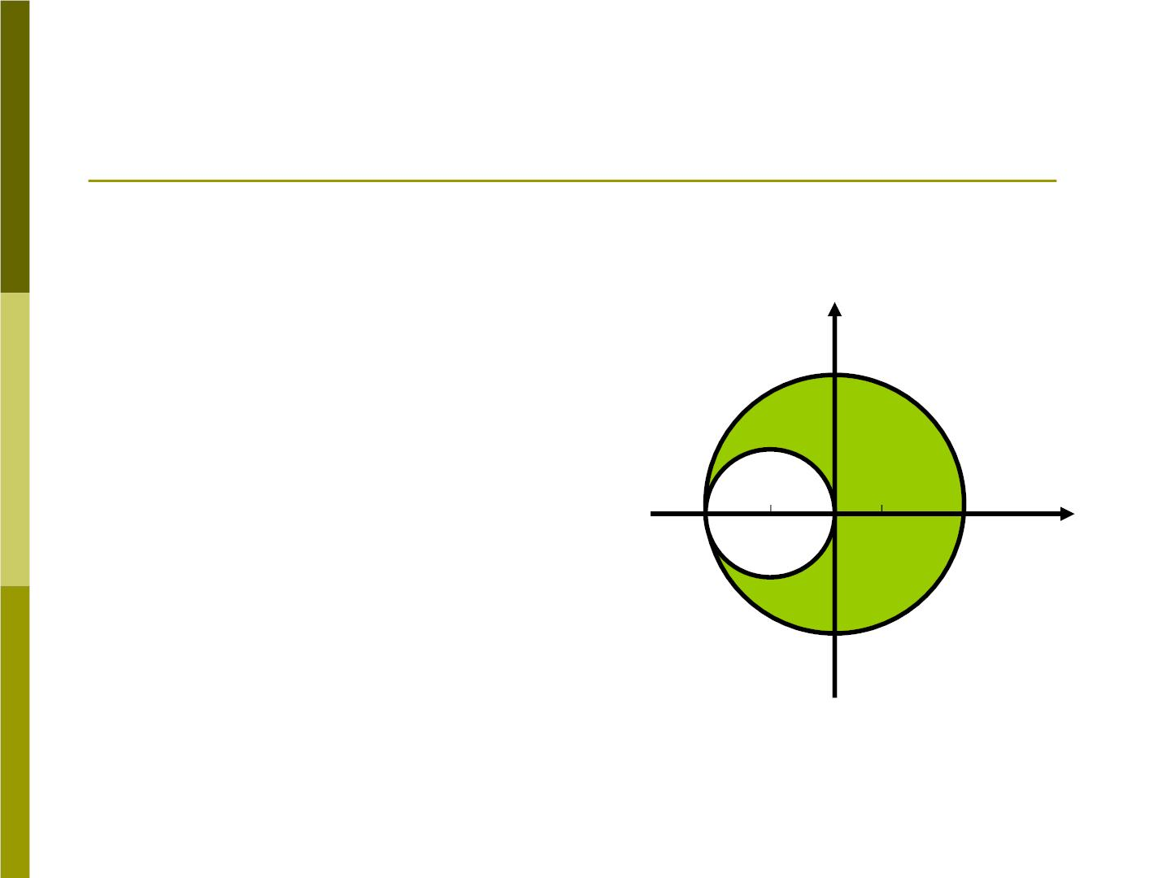
Sample problem 7-4
Fig 7-13 shows a
circular metal plate
of radius 2R from
which a disk of
Fig 7-13
y
radius R has been
removed. Find the
cm (x) of the plate.
R
D C x
x

Slide 19
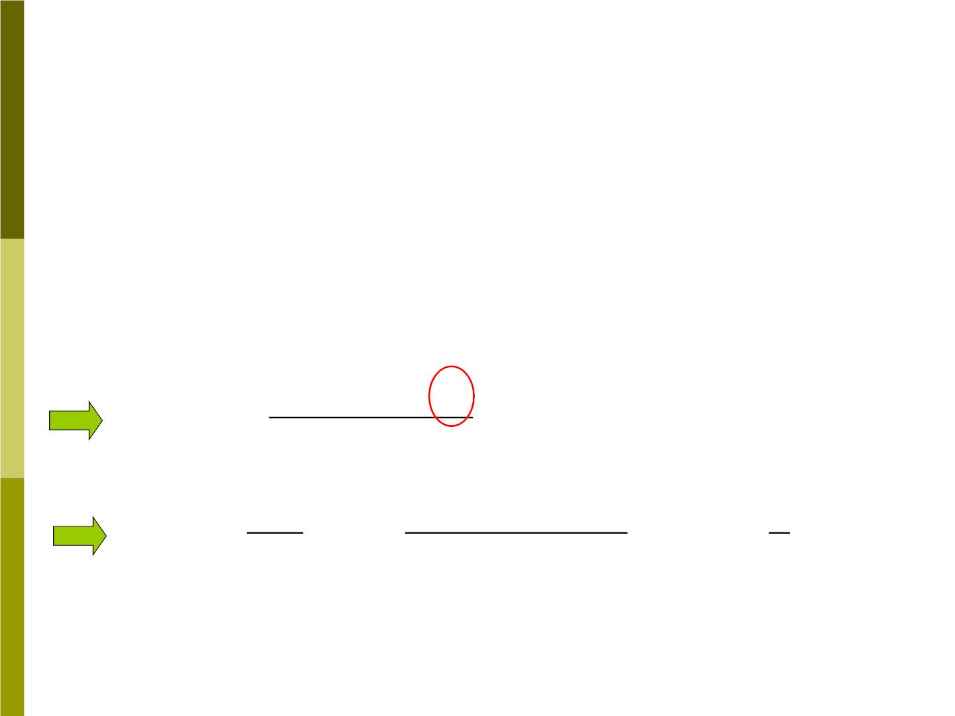
Solution:
Due to the mirror symmetry about the x axis,
the cm must lie along the x axis.
If the hole is filled with a disk of the same
material of radius R, the cm of composite
disk is at the origin of the coordinate system.
?
m x + m x
x_{c} = 0 =
D D
x x
CM for the big
circular plate
+
m m
D
x
m
−R²
(2R) R
1
x = −( ^{D} )x =
(−R) = R
x
m
D
❐
² − ²
3
x

Slide 20
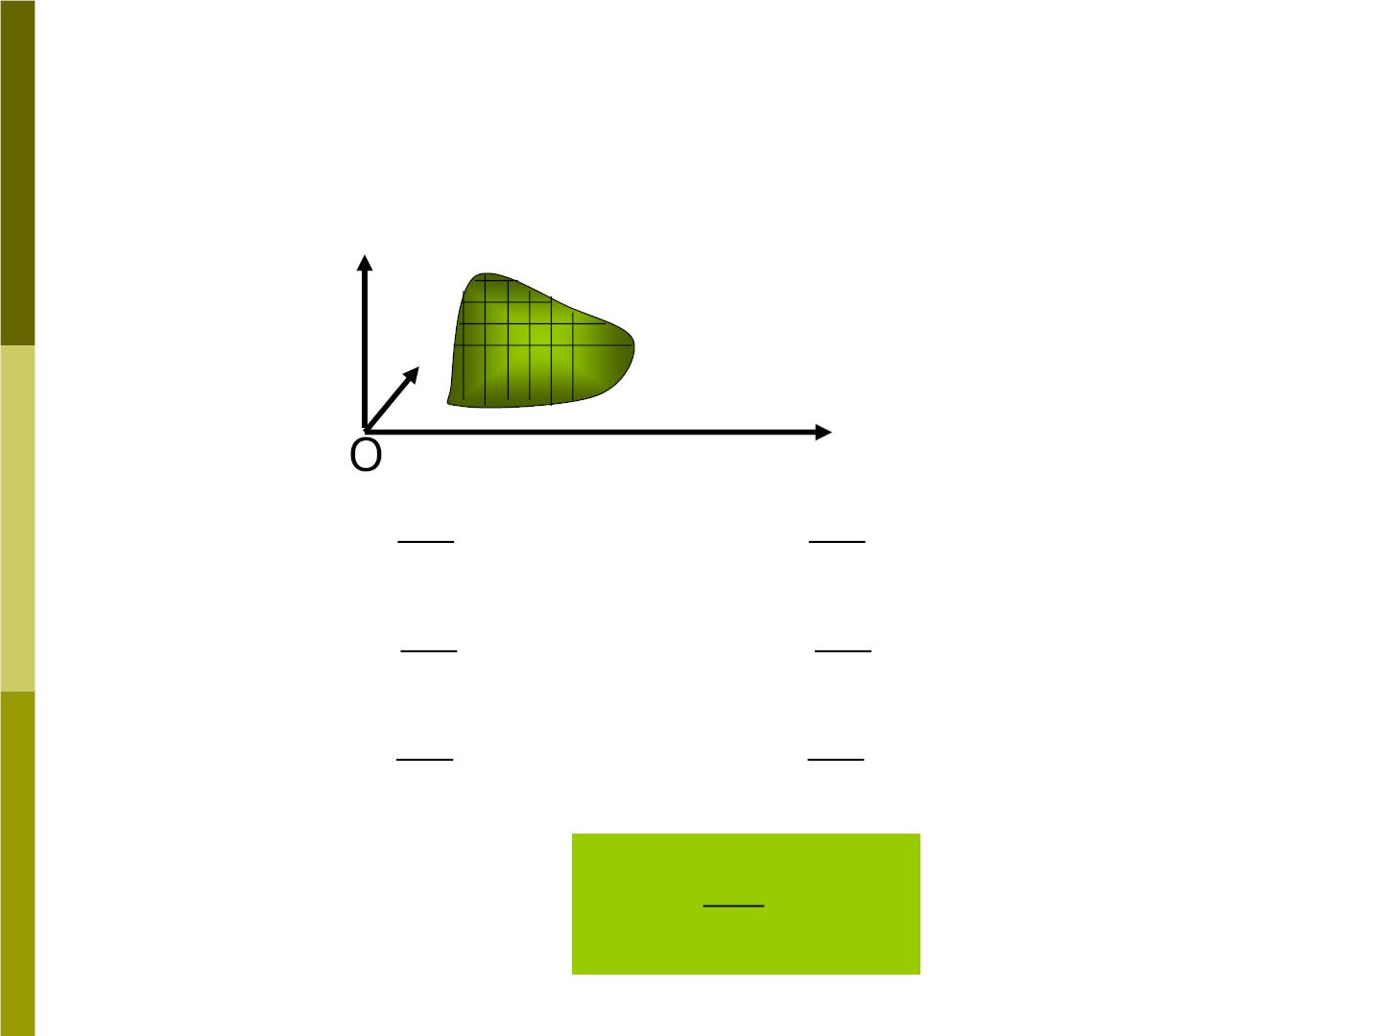
3) If we encounter solid irregular objects, we
can d ivid e infinite small elements. And the
sums of Eqs(7-12) transform into integrals:
x
z
y
1



1
⇩
⇩
⇩
x = lim x m = xdm
cm
M
m→0
n
n
M
1
1
y = lim y m = ydm
cm
M
m→0
n
n
M
(7-18)
1
1
z = lim z m = zdm
cm
M
m→0
n
n
M
In vector form are
→
1
⇩
→
r = r dm
(7-19)
cm
M

Slide 21
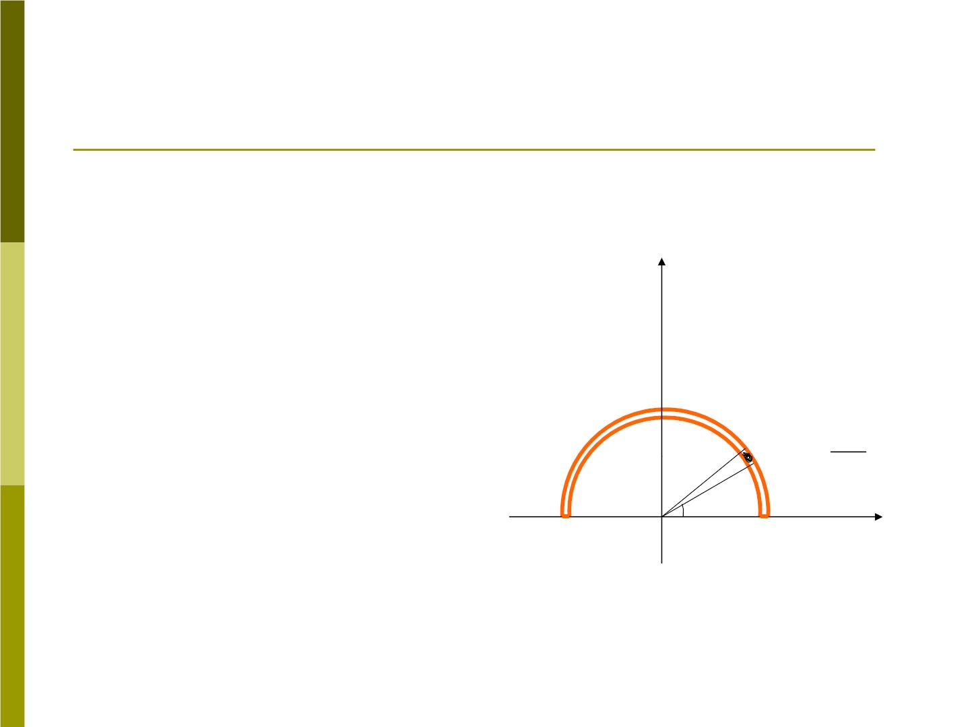
Sample problem 7-5
Fig 7-14
A thin strip of
material is bent
into the shape of a
semicircle of radius
R. Find its center
of mass.
y
M
❐
•
y
dm = d
cm

0
x

Slide 22
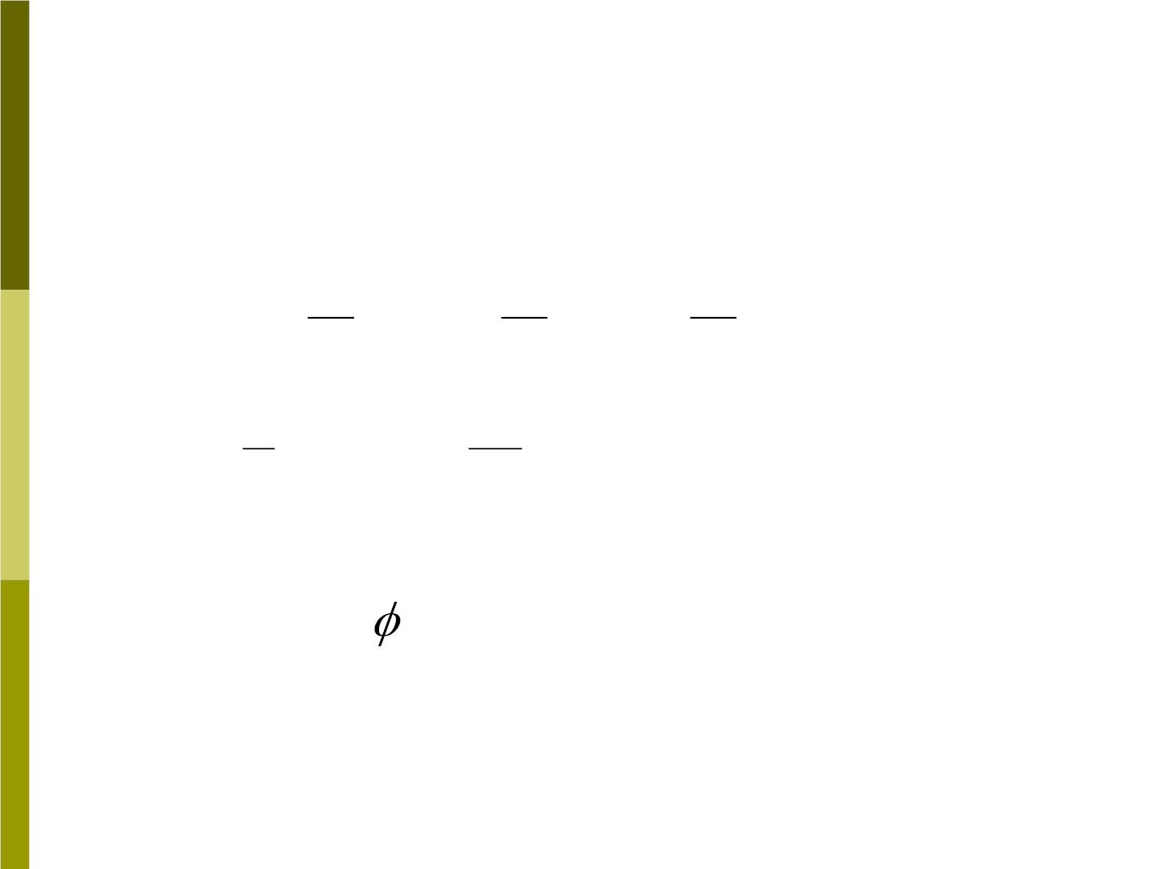
Solution:
The strip has symmetry about the y axis.
So
x =
0
c
1
1
❐
M
❐
y =
⇩ 
ydm = Rsin  d
cm
M
M
0
R
❐
❐
2R
❐
⇩
= s in d = = 0.637R
0
( the small element of mass dm subtends
d
an angle . The location of the dm
=
is y R sin )

Slide 23

7-5 Conservation of momentum in a
system of particles
1) For a system containing N particles,
❖
the total momentum is =

P (M m )
❖
❖
❖
i
N
N
❖
N
m v 
=
  
(7-21)
P P
=
=
^{n n} =
Mv
m v M
n
n n
M
cm
n=1
n=1
n=1
Here
❖
❖
dP dv
❖
❖

= M ^{cm} = Ma = F
(7-22)
dt
dt
cm
ext
If the net external force acting on a
❖
system is zero, then
dP
dt
= 0
and so the
❖
total linear momentum of the system
P
remains constant.

Slide 24

2) If we view the system from the cm frame,
❖
v '
the velocity of a particle in this frame is
n
❖  
v '= (v −v )
(7-24)
n
n
cm
Then in this cm frame, the total momentum is
❖
N
❖
n n
N
❖
n n
N
❖
  
P'= m v ' = m v − m v
(7-25)
n cm
n=1
n=1
n=1
❖ 
= Mv − Mv = 0
cm
cm

Slide 25
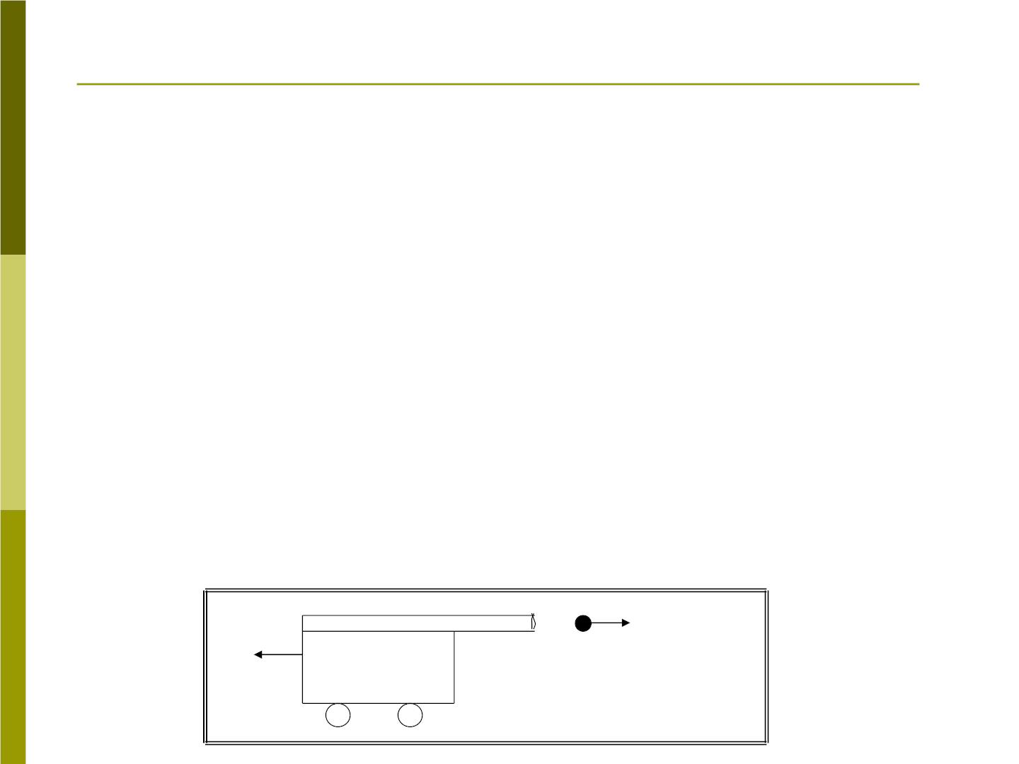
Sample problem 7-8
As Fig 7-17 shows a cannon whose mass
M is 1300kg fire a 72kg ball in a horizontal
direction with a speed v of 55m/s
bc
relative to the cannon. The cannon is
mounted and can recoil (后退) freely.
(a) what is the velocity v_{cE} of the recoiling
cannon with respected to the Earth?
(b) what is the initial velocity v of the
bE
ball with respected to the Earth?
❖
v
M
m
bc
^{v}cE
Fig 7-17

Slide 26
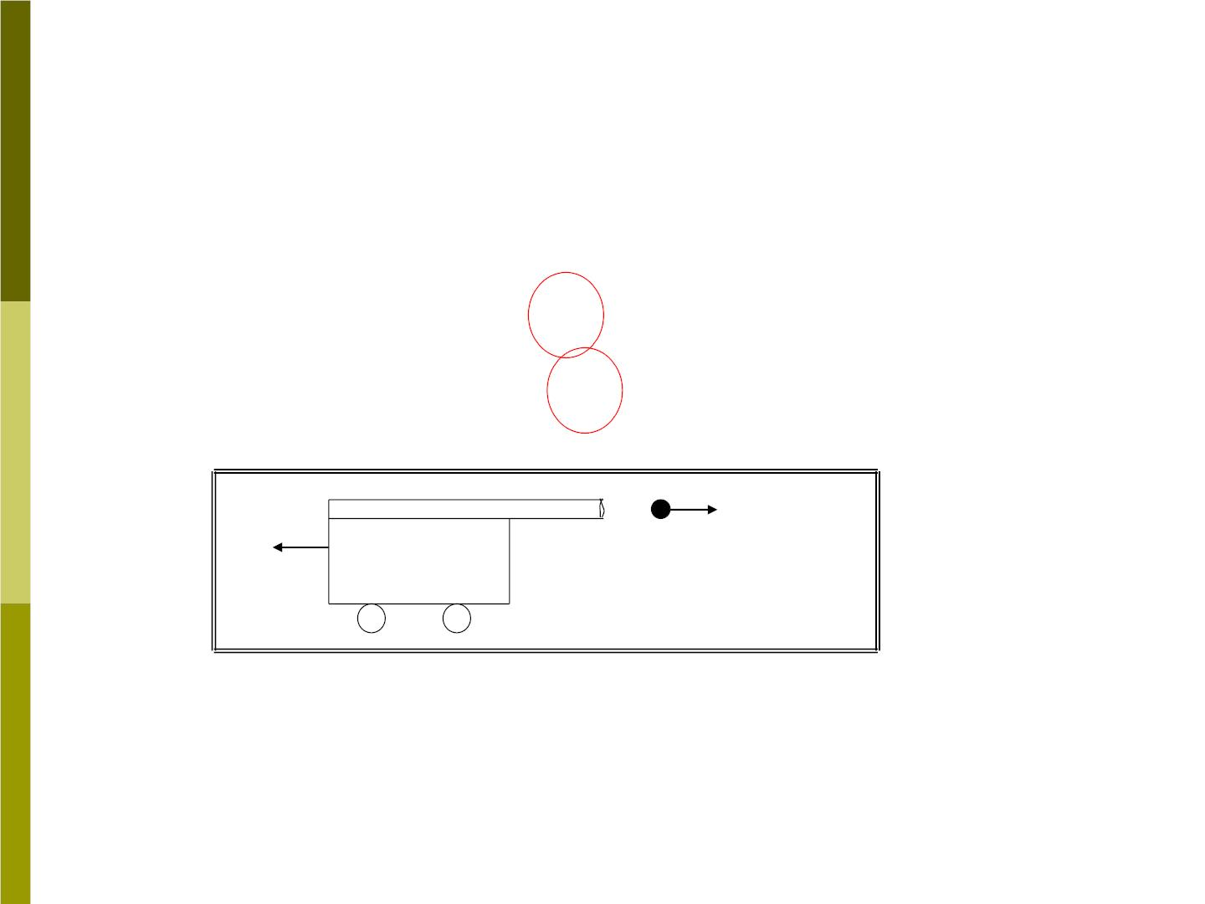
Solution:
Momentum in horizontal direction is conserved.
→
→
P = P = 0
ix
fx
P = Mv + mv = 0
f
cE
bE

v = v −v
bc
bE
cE
❖
v
M
m
bc
^{v}cE
Fig 7-17

