Slide 1
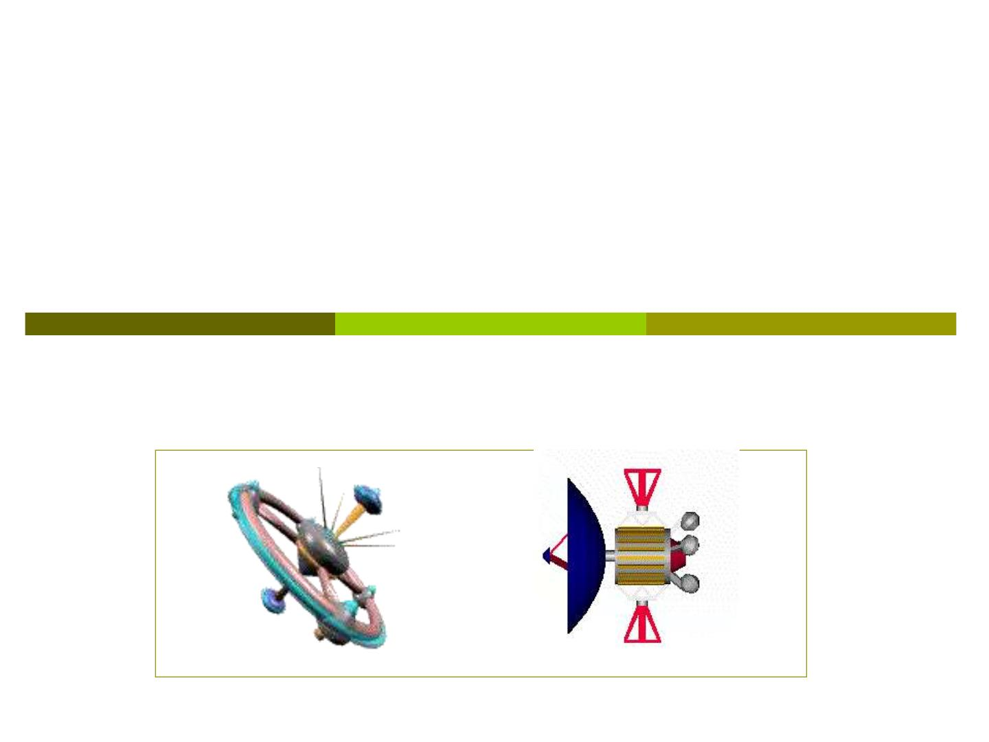
Chapter 8 Rotational
kinematics

Slide 2
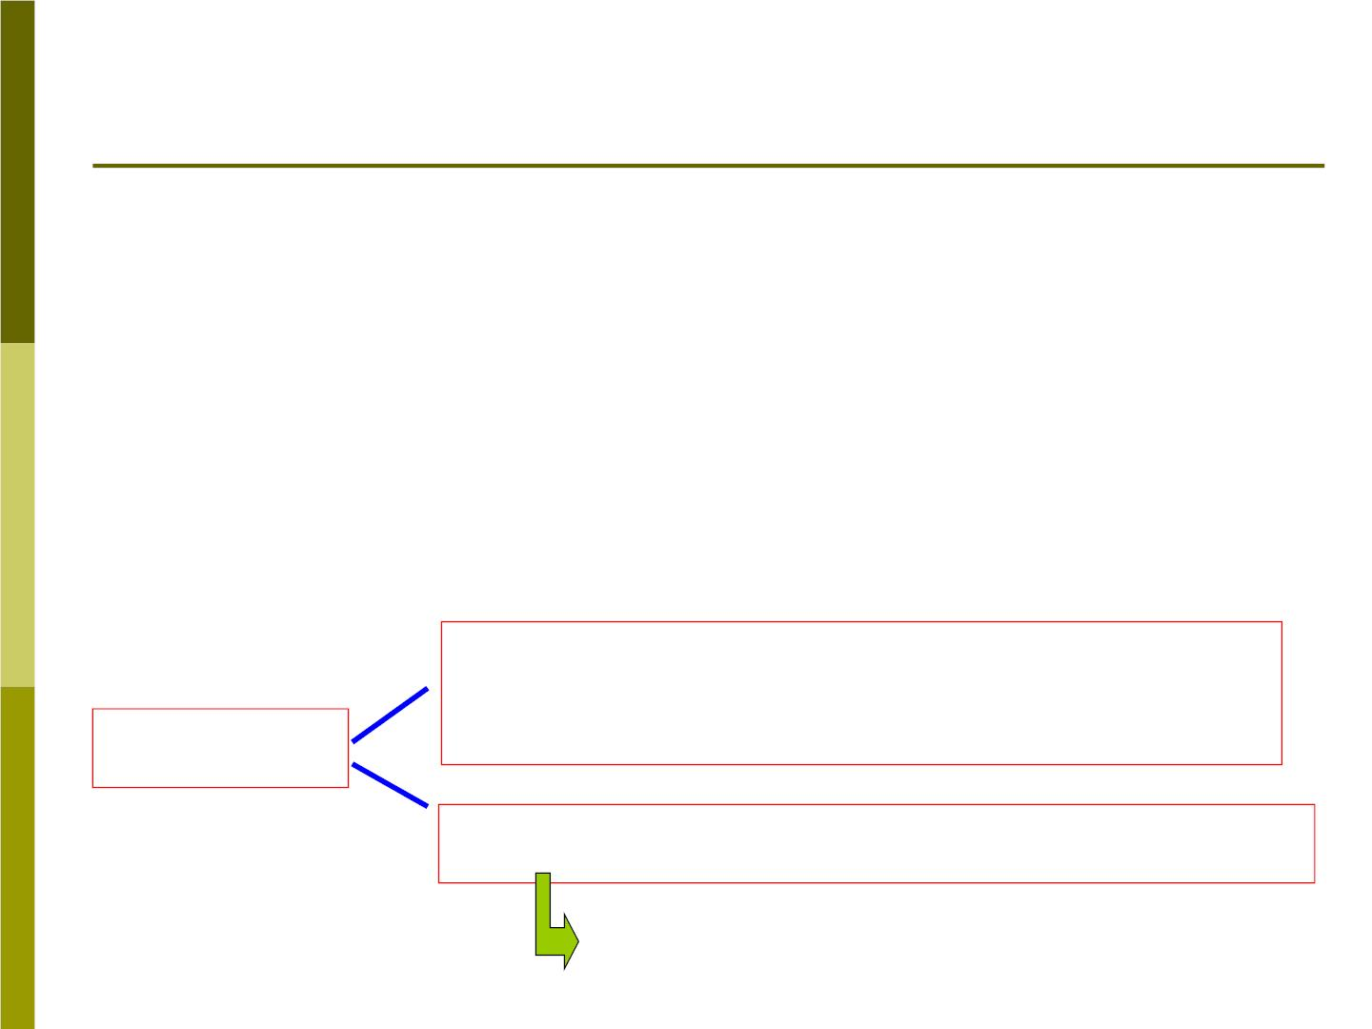
Section 8-1 Rotational motion
The general motion of a rigid object will include
both rotational and translat ion al components.
For example:
The motion of a wheel on a moving b ic yc le;
A wobbling football in flig h t is more complex case.
Rotations with only one fixed point
（定点转动）
Rotations
Rotations with fixed axis(定轴转动)
pure rotation

Slide 3
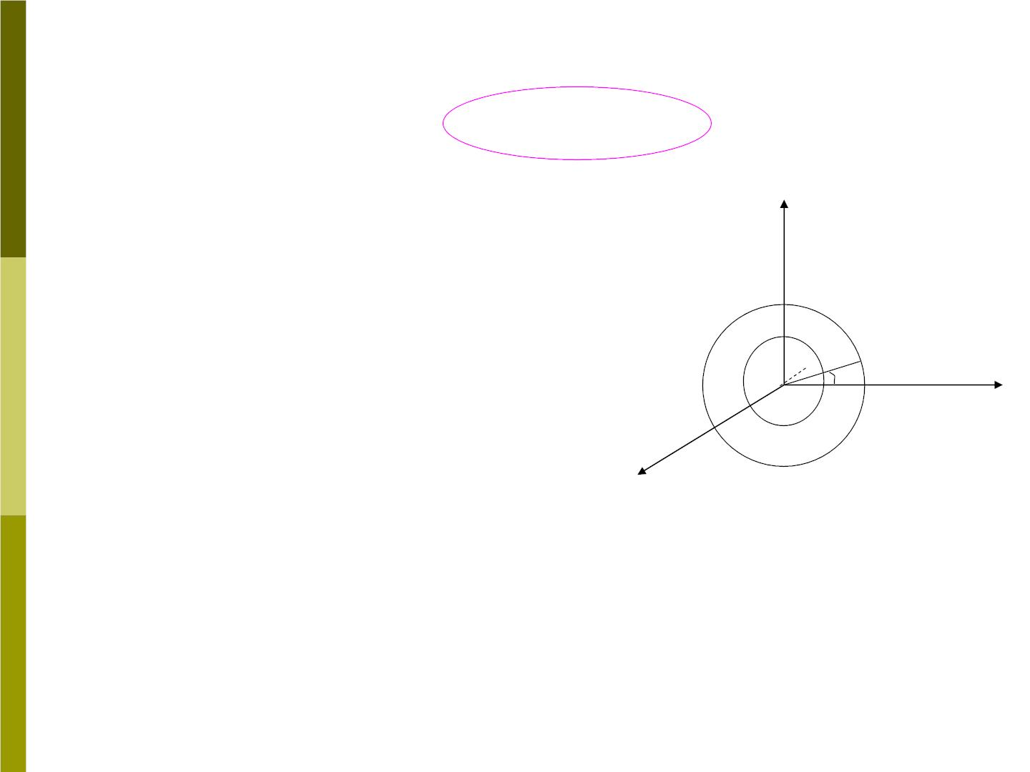
Two definitions of a pure rotation:
❐ Every point of the body
moves in a circular path. The
centers of these circles must
lie on a common straight line
called the axis of rotation.
y
p B

❐ Any reference line
perpendicular to the axis
(such as AB in Fig 8-1)
A
x
z
moves through the same
angle in a given time interval.
Fig 8-1

Slide 4

How many freedoms are needed to describe
completely for a pure rotation? 1(R)
How many for a rotation with only one fixed
point? 3(R)
In general the three-dimensional description of a
rigid body requires six coordinates: three to
locate the center of mass, two angles (such as
latitude and longitude) to orient the axis of
rotation, and one angle to describe rotations
about the axis.

Slide 5
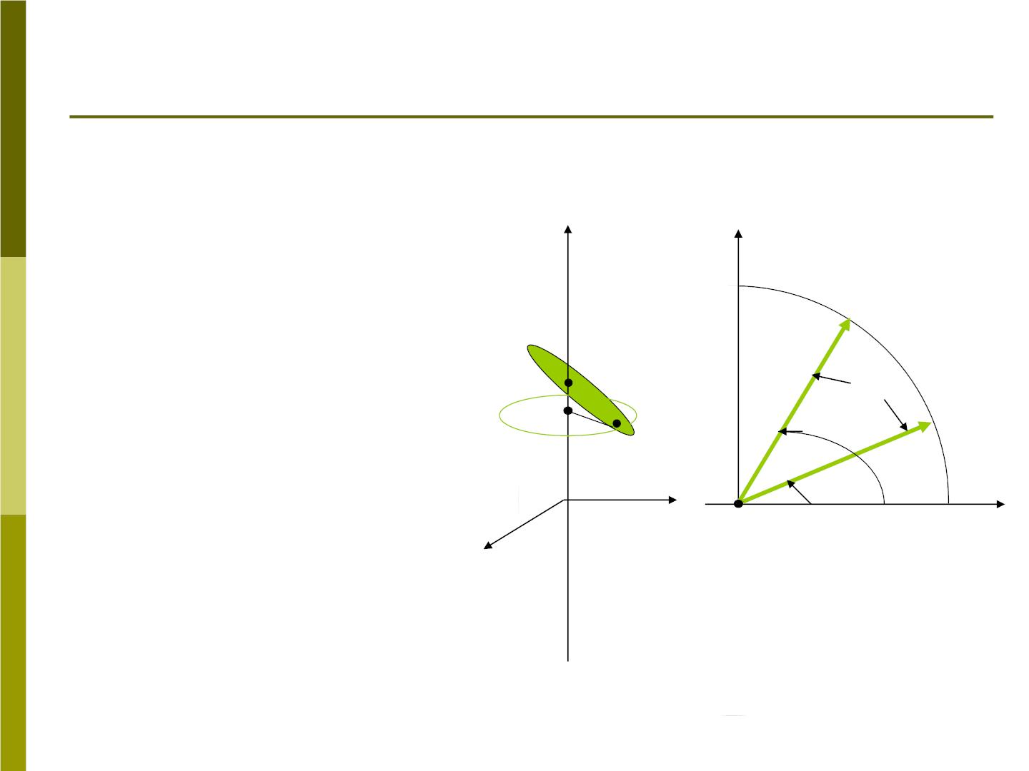
8-2 The rotational variables
1. Angular displacement
Fig 8-4 shows a rod
rotating about the z
axis. Any point P on the
rod will trace an arc of
a circle.
Z
y
P ,t
2 2

 P
A
P
,t

2
1 1
The angle is the
angular position of the
reference line AP with
respect to the x axis.
₁
y
A
x
x
Fig 8-4

Slide 6
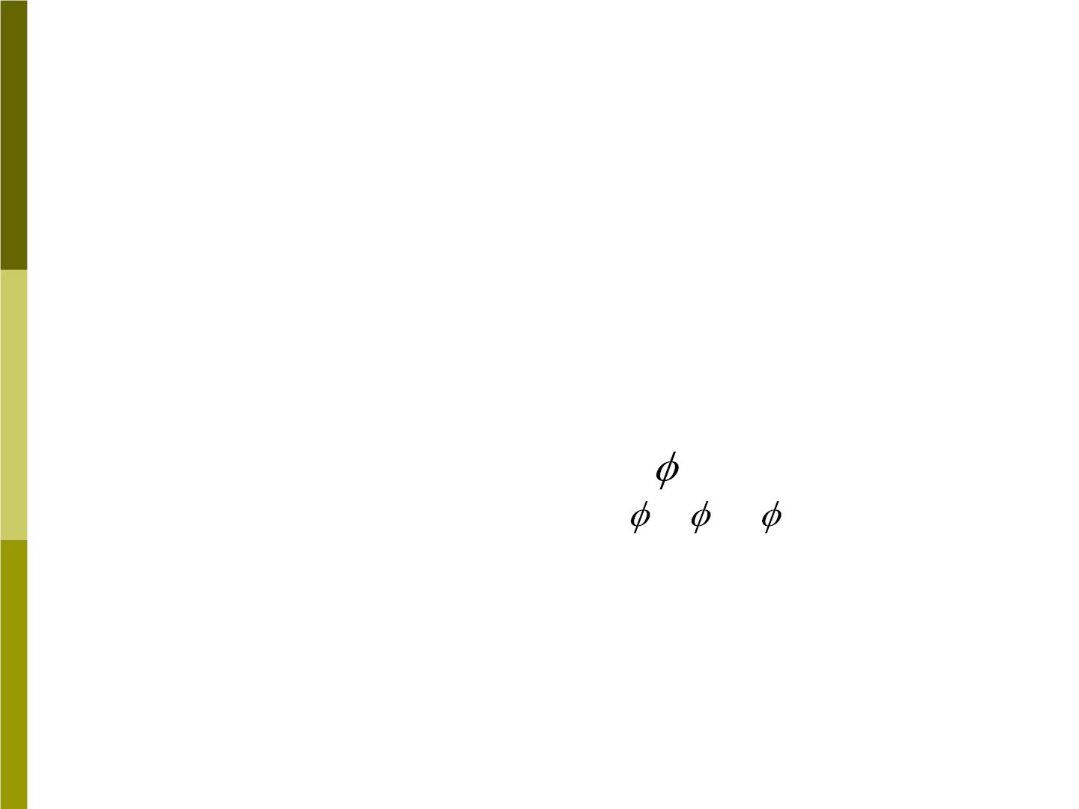
We choose the positive sense of the rotation to be
counterclockwise(逆时针).
 = s / r
(8-1)
where the s is the arc which the point P moves, and
r is the radius (AP).
t
t 
At time the angular position is , at is . The
1
1
2
2
angular displacem ent of P is
 = −
during
2
1
t = t₂ − t
.
1

Slide 7

2. Angular velocity
We define the average angular velocity as


t
⬥ =
(8-2)
av
⬥
The instantaneous angular velocity is
 d
⬥ = lim =
t→0
t dt
(8-3)
⬥
Is a vector quantity?
⬥
The dimensions of inverse time ( ); its
T
−1
rad / s
units may be radians per second ( )
or revolutions per second ( ).
rev / s

Slide 8

3. Angular acceleration
If the angular velocity of P is not constant,
then the average angular acceleration is
defined as

av _{t}
 =
(8-4)
The instantaneous angular acceleration is
(8-5)
 
d
 = lim =
t dt
t→0
Its dimensions are inverse time squared
−
( T
²) and its units might be orrev / s.²
rad / s
2

Slide 9

8-3 Rotational quantities as vectors
Commutative addition law for any vectors:
→
→
→
→
A+ B = B+ A
Can angular displacements satisfy
corresponding formula???
Δφ +Δφ ?= Δφ +Δφ
1
1
2
2
As example, we first rotate a book
 =
₉₀□
about x axis, followed
1
₂ =
₉₀□
by about z
axis. But if we first rotate the book
₂ =
₉₀□
by about z axis and then
₁ =
90□ by
about x axis, the final positions of the
book are different.

Slide 10

We conclude that
 +    + 
1
2
2
1
and so finite angular displacements cannot
be represented as vector quantities.
If the angular displacement are made
infinitesimal, the order of the rotations no
longer affects the final outcome: that is
d +d = d +d .
Hence can be represented as vectors.
d
1
2
2
1

Slide 11
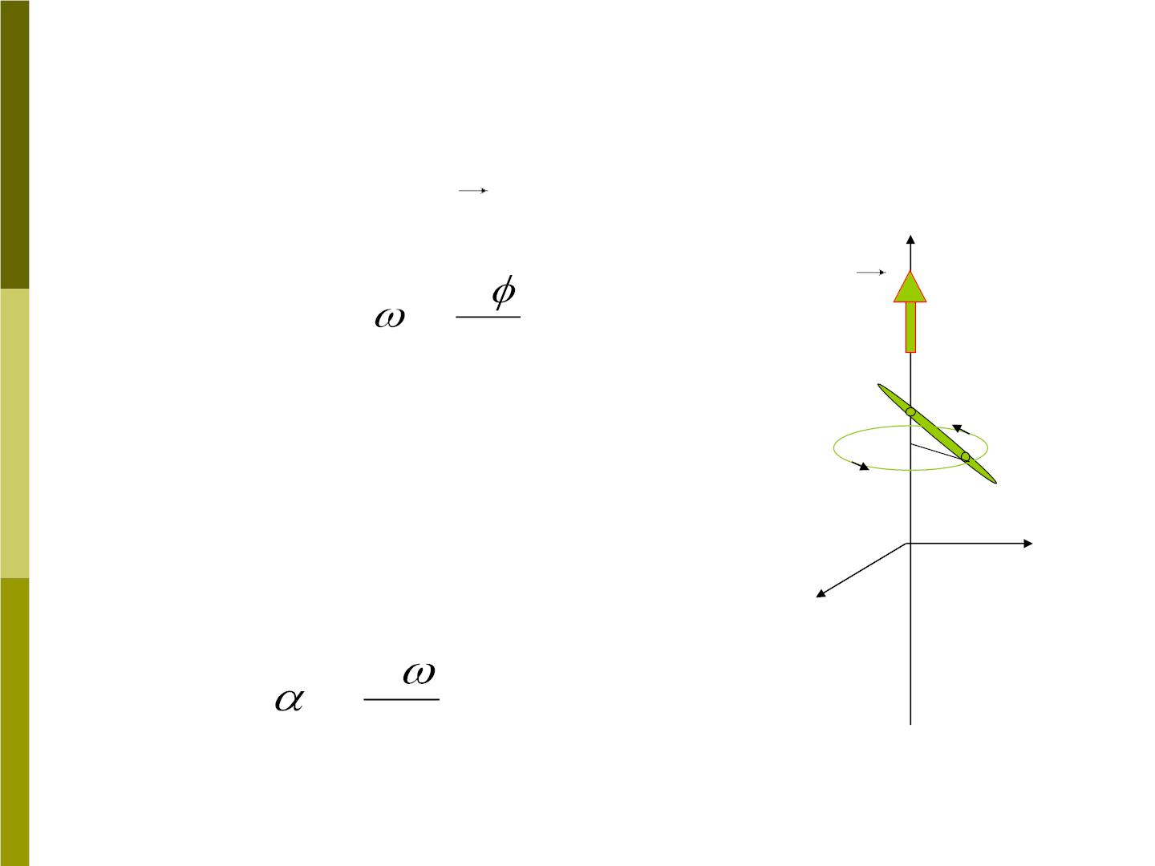
Quantities defined in terms of infinitesimal
angular displacements may also be vectors.
⬥
For example, is a vector
Z
→
Positive
direction
→
d
dt
⬥
=
Its direction is determined
by a right handed system
A
P
y
Angular acceleration
→
x
→
d
dt
=
is also a vector quantity.

Slide 12

8-4 Rotation with constant angular
acceleration
For the rotational motion of a particle or
a rigid body around a fixed axis (which we
take to be z axis ), the simplest type of
motion is that in which the angular
acceleration is zero. The next simplest
motion is  = constant. From Eq(8-5),
a
z
d =  dt
, we now integrate on the left
z
z
⬥ 
from to and on the right from time 0
0z
z
to time t,
⬥
t
t
z
⇩  
d =  dt =  dt
z
z
z
⬥
0
0
0 z

Slide 13

⬥
t
t
z
⇩  
d =  dt =  dt
z
z
z
⬥
0
0
0 z
We obtain  =  + t . (8-6)
d
z
0z
z
And
=  , d =  dt , integrate Eq. again,
dt
z
z

t
⇩ 
d = ( + t)dt
0z
z

0
0
So
 =  +  + 2
t t / 2 , (8-7)
0
0z
z
which is similar to Eq(2-28)
= + +
x x v t a t / 2
2
0
0x
x

Slide 14
Sample problem 8-3
Starting from rest at time t=0, a grindstone
(旋转研磨机)has a constant angular
acceleration of 3.2 rad/s². At t=0 the
reference line AB is horizontal. Find (a) the
angular displacement of the line AB and (b)
the angular speed of the grindstone 2.7 s later.
 =  + +
2
( = 0, = 0)
t t / 2,
0
0z
z
0
0z
⬥ =  + t, ( = 0)
z
0z
z
0z

Slide 15
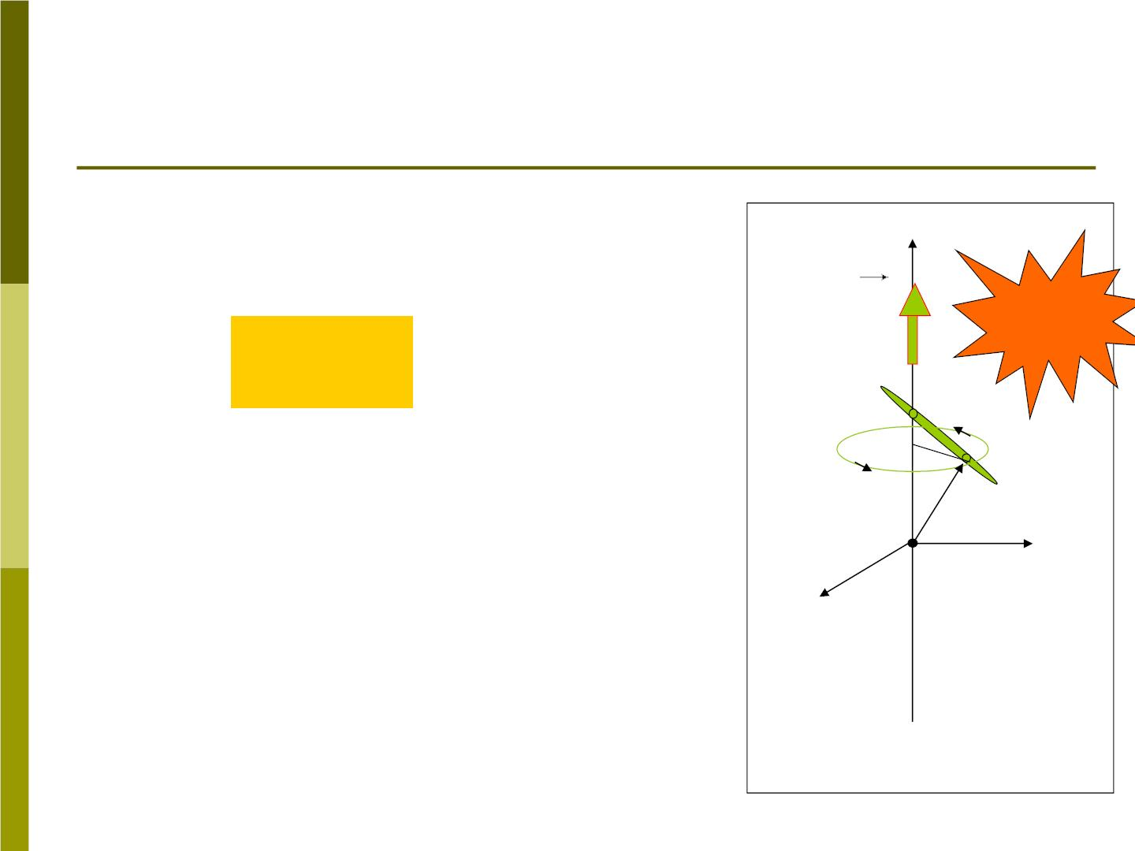
8-5 Relationship between linear and
angular variables
When a rigid body rotates
about a fixed axis, we have
Z
⬥
s = r
r=|AP|
(8-8)
where s is the distance which
the particle moves along the
arc, the radius r is the
A
P
perpendicular distance from
O
y
the particle to the axis, and
is the angle which the rigid
body rotates through.

x

Slide 16
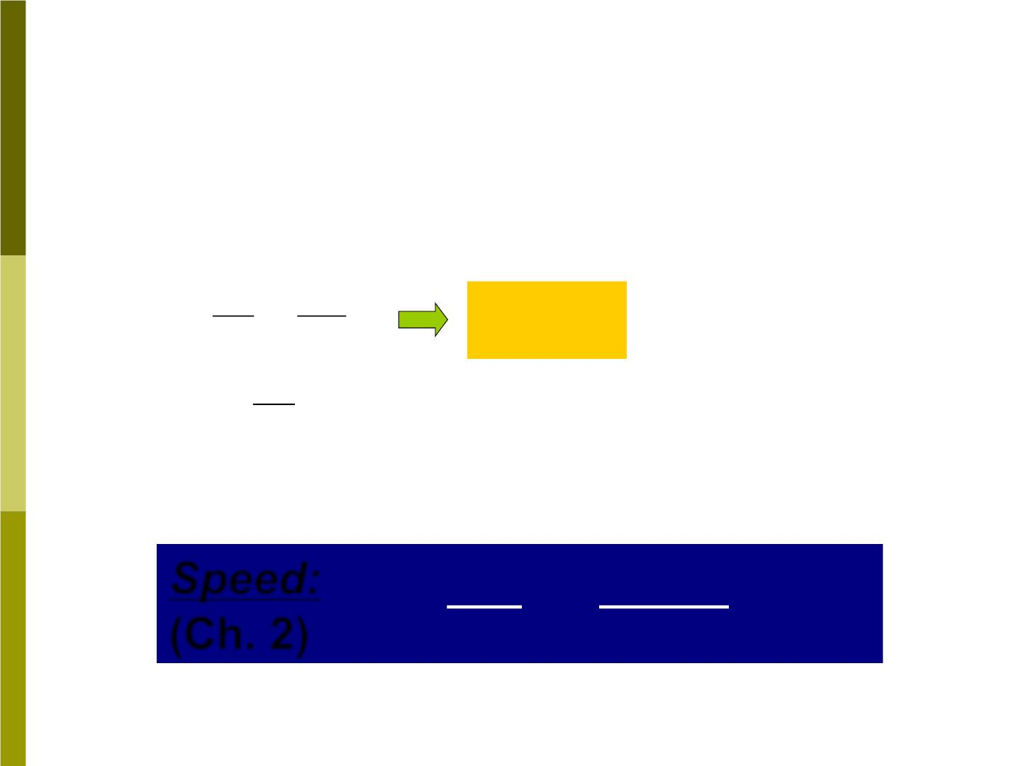
s = r
(8-8)
❐ Differentiating both sides of Eq(8-8) with
respect to the time, and note that r is
constant, we obtain
ds d
=
r
v_{t} = r
(8-9)
dt dt
ds
Where
= v_{t}
is the (tangential) linear
dt
speed v .
t
❒
ds | dr |
❖
Speed:
(Ch. 2)
v = = =| v |
dt dt

Slide 17

❐ Differentiating Eq(8-9), then
dv d
t
=
r
or
a_{t} = r
(8-10)
dt dt
dv
=
Where
t a
is the magnitude of the
dt
t
tangential component of the acceleration.
The radial (or centripetal) acceleration is
v
2
= = 
²r
(8-11)
a_{r}
t
r

Slide 18
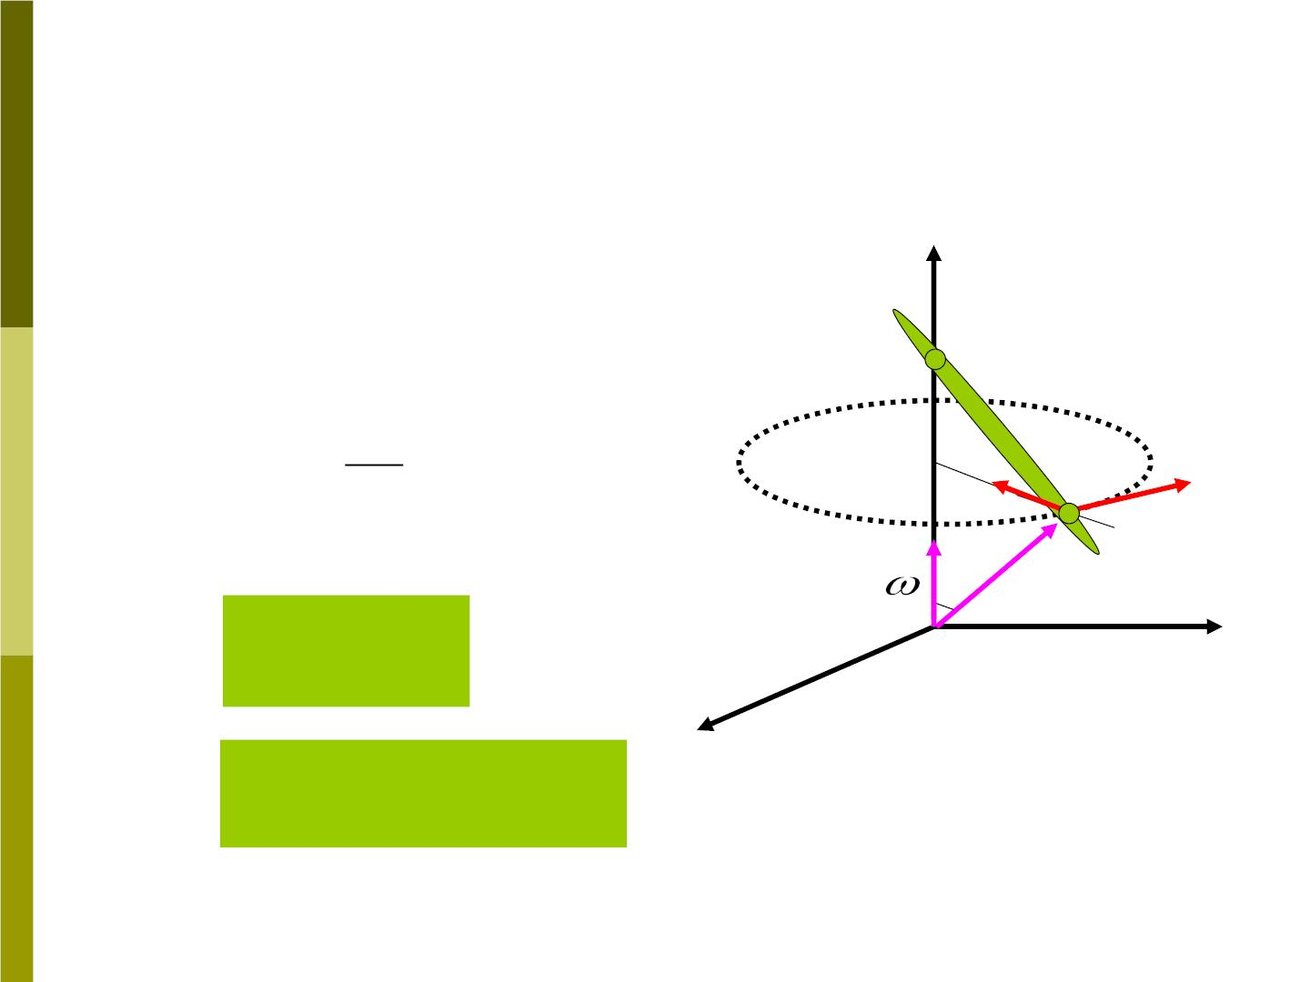
For rotations with fixed
axis, we have:
s = r
r=|AP|

v = r
t
z
a = r
t
2
→
v
v
❖
= = 
2_{r}
A
ªr
t
a P
→
( )
r
r
a
t
Notate them in vector style:
→
→

❑
→
R
( )
→
→ →
v =  R
o
y

→
→ → → →
x
Fig 8-11
a =  R+ v

Slide 19
Sample problem 8-5
If the radius of the grindstone of Sample
Problem 8-3 is 0.24m, calculate (a) the
linear or tangential speed of a point on the
rim, (b) the tangential acceleration of a
point on the rim, and (c) the radial
acceleration of a point on the rim, at the
end of 2.7s. (d) Repeat for a point halfway
in from the rim-that is, at r=0.12 m.
At 2.7 s, we have known:
 =
2
⬥ =
3.2rad / s , 8.6rad / s,
r=0.24m
=
(a)v = r (b)a r = ²
(c)a r
t
T
R
 
(d) ,
are the same,
r=0.12m

