Slide 1

Chapter 9 Rotational
dynamics

Slide 2
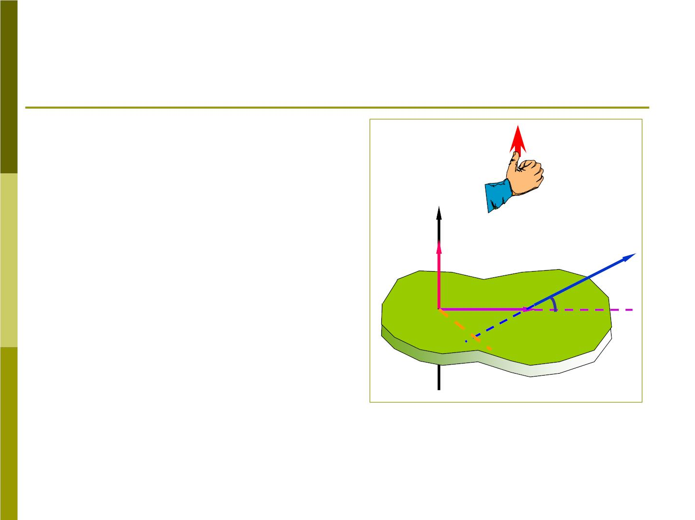
9-1 Torque
1. Torque
M
In this chapter we will
consider only case in
which the rotational
axis is fixed in z
z
F
M
direction.
r
❑
Fig 9-2 shows an
arbitrary rigid body that
is free to rotate about
O
*
d
P
the z axis.
→
A force F is applied at point P, which is located a perpendicular
→
→
r
distance r from the axis of rotation. Fand lie in x-y plane,
❑
and make an angle .

Slide 3
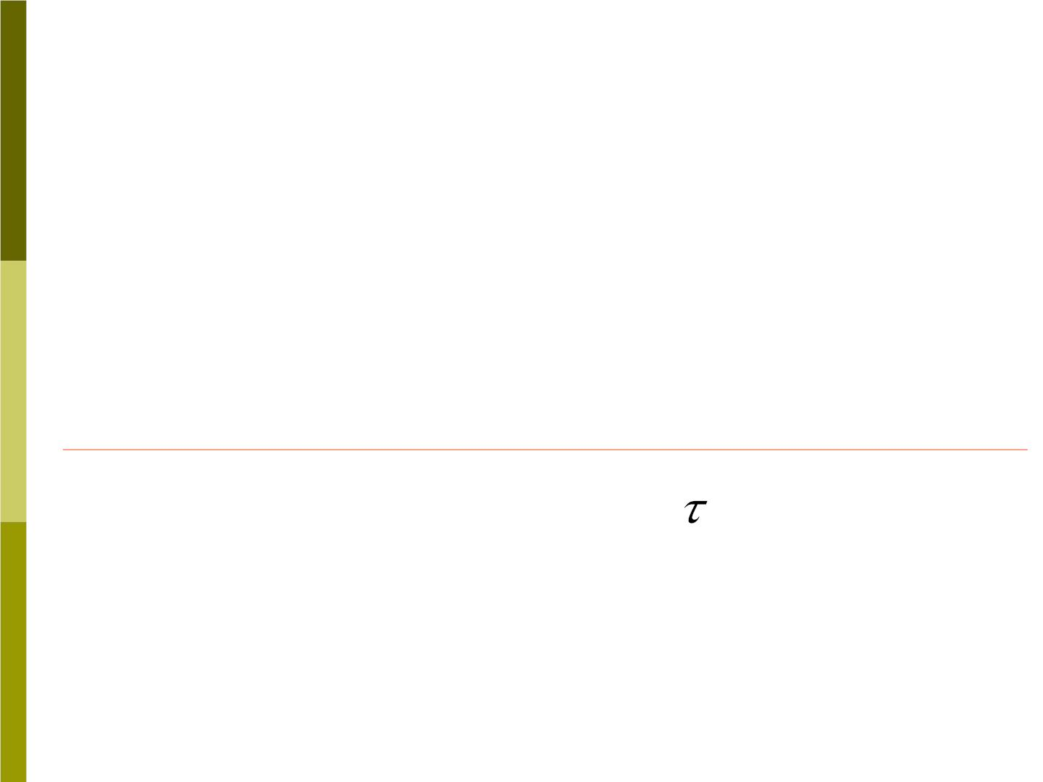
The radial component =
F F cos
❑ has no effect
R
on rotation of the body about z axis.
Only the tangential component =
F F s in
a rotation about the z axis.
❑ produces
⊥
The angular acceleration also depends on the
magnitude of r
The rotational quantity “torque” is defined as
⧫ = rF sin 
(9-1)
Nm
The unit of torque is the Newton-meter ( )

Slide 4

⧫
When =0 ?
⧫ = rF sin
If r=0 -that is the force is applied at or
through the axis of rotation;
If  = or , that is the force is applied in
0
□
180
the radial direction;
→
If =0.
F

Slide 5
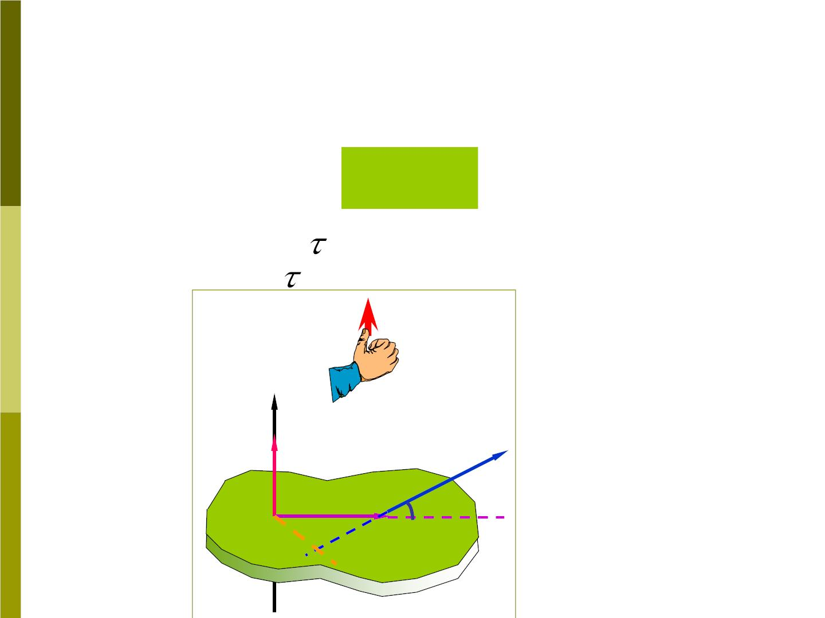
2.Torque as a vector
⧫ = rF sin 
In terms of the cross product, the torque
is expressed as
→
→ →
(9-3)
⧫ = r F
→
Magnitude of :
Direction of : using righ-hand rule
rF sin
❑
→
M
z
F
M
r
❑
O
*
d
P

Slide 6

Components of torque:
→



r = x i+ y j+ z k
→



F = F i+ F j+ F k
x
y
z



i j k
→
→ →
So  = r F = x y z
F F F
x
y
z



= (yF − zF ) i+ (zF − xF ) j+ (xF − yF )k
z
y
x
z
y
x

Slide 7
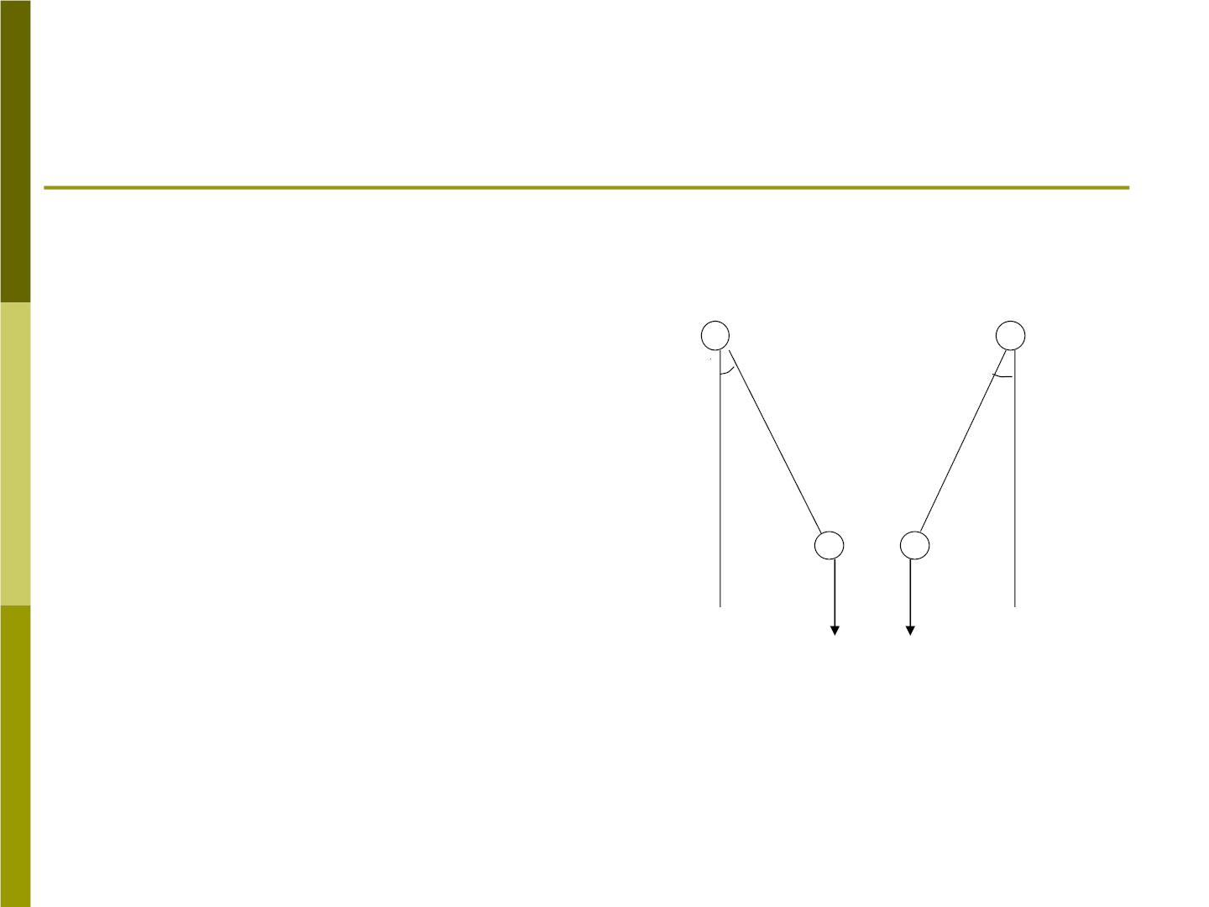
Sample problem 9-1
Fig 9-5 shows a
pendulum .
Fig 9-5
x
.
The magnitude of
the torque due to
gravity about the
point o is
❑
❑
⧫ = Lmg sin 
it has the opposite
direction.
mg mg

Slide 8
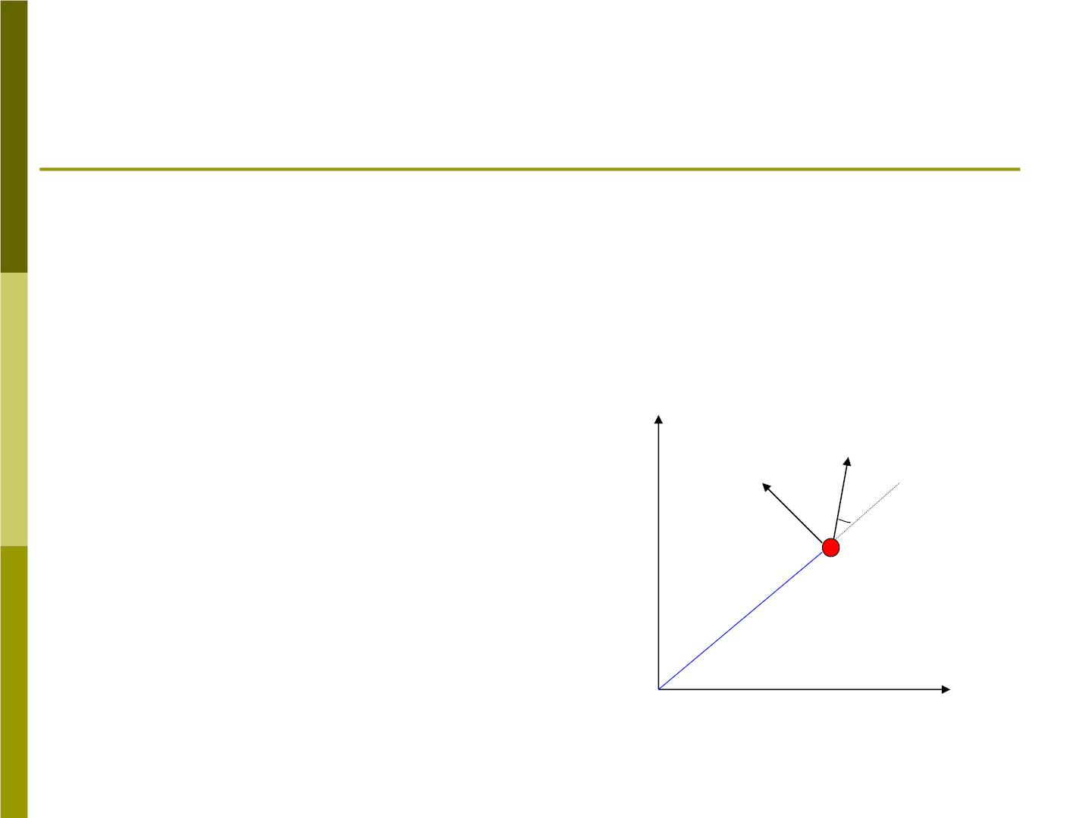
9-2 Rotational inertia and Newton’s
second law
1. Rotational inertia of a single particle
Fig 9-7 shows a
Fig 9-7
single particle of mass
m which is attached
by a thin rod of length
r and of negligible
y
→
F
Fs in
❑
❑
mass, and free rotates
about the z axis.
r
m
o
x

Slide 9

→
A force is applied to the particle in a
F
❑
direction at an angle with the rod(in x-y
plane).
Newton’s Second law applied the
tangential motion of the particle gives
F = ma = F sin 
and
a =  r
, we obtain
t
t
t
z
F sin  = m_{z} r
rF sin  = rm_{z}r
⧫ = mr 
→
→
2
F = m a
z
z
I I mr
⧫ =  , =
2
z
z

Slide 10

We define to be the “rotational inertia”
mr
2
I of the particle about point o.
=
2
I mr
(9-6)
The rotational inertia depends on the
mass of the particle and on the
perpendicular distance between the
particle and the axis of rotation.

Slide 11
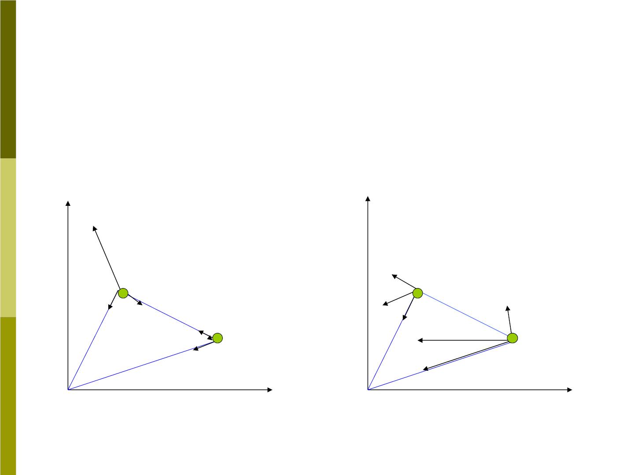
2. Newton’s second l aw for rotation
(For system of particles)
Fig 9-8
y
→
P
y
^{F}
1t
m₁
→
^{m}1
T
→
→
1r
T
^{F}
→
F
^{F}
2t
T
2r
^{m}2
1R
r
1
1
→
1
F
^{m}2
r₂
→
2
→
T
^{F}2R
2
0
0
x
x

Slide 12
  
That is  =  + 
2z
z
1z
 
(9-7)
= ( F )r + ( F )r
1t
1
2t
2
For each particle

F = m a

=
F m a
1t
1 1t
2t
2 2t
Substituting them into Eq(9-7), we obtain
  
τ = ( F )r +( F )r
z
1t
1
2t
2
= m a r + m a r
1 1t 1
2 2t 2
=
=
2
+
2
m r α m r α
1 1
z
2 2
z
z
2
+
2
(m r m r )α
1 1
2 2
Iα
= ,
=
2
+
2
(9-8)
I m r m r
z
1 1
2 2

Slide 13


The are the same for both particles ,the
z
total rotational inertia of this two-particle
system:
² +
I m r m r (9-9)
=
2
1 1
2 2
The obvious extension to a rigid object
consisting of N particles rotating about the
same axis is
=
2
+
2
+ +
2
I m r m r
m r
1 1
2 2
N N
(9-10）
=

m r
2
n n

Slide 14
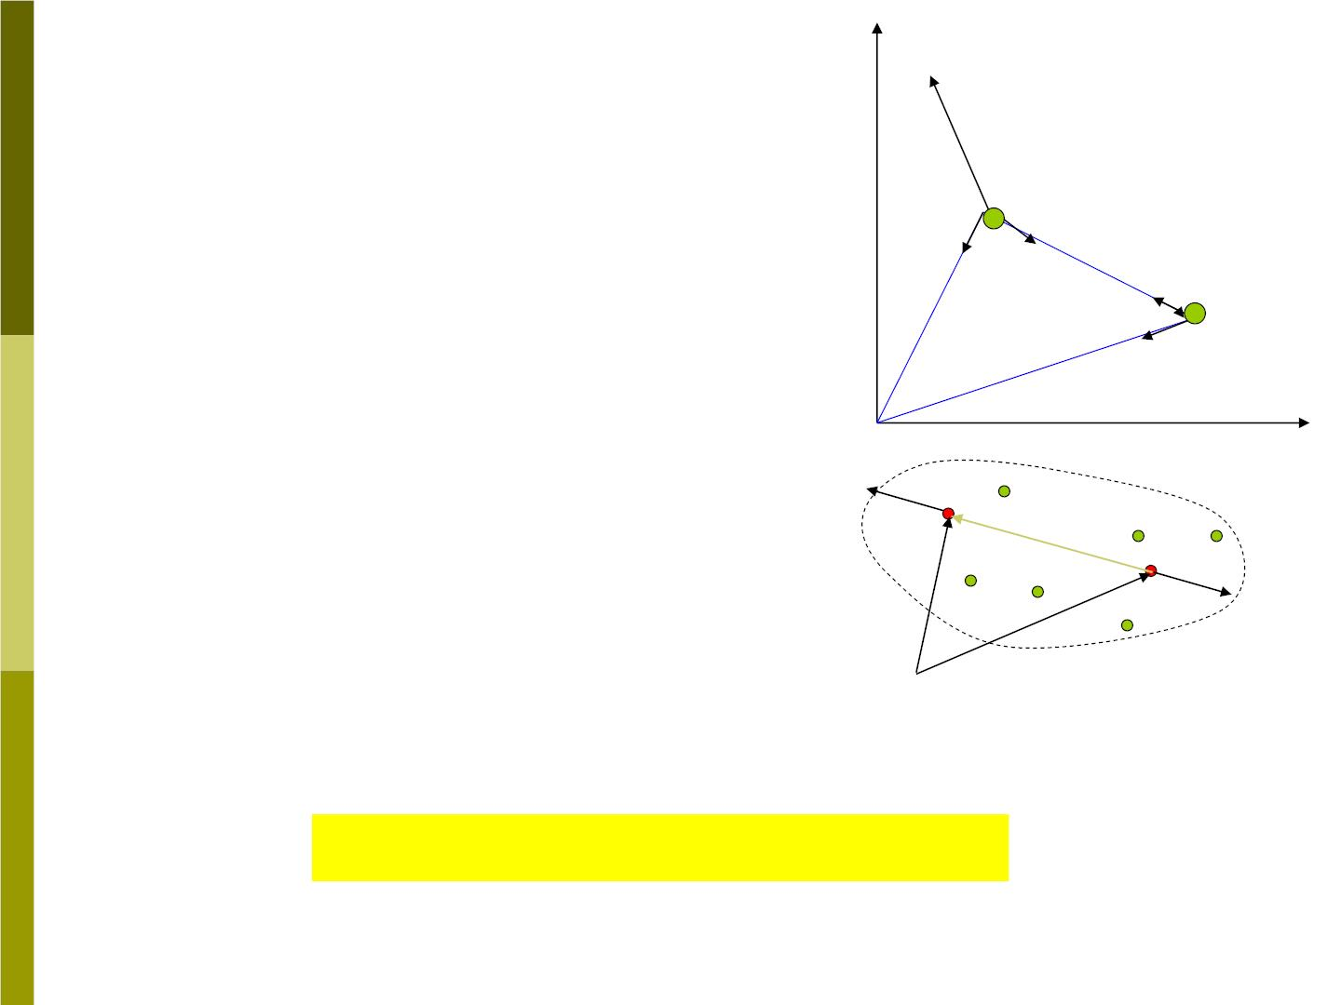
y
→
P
Fig. 9-8
For system of particles,
what kinds of force
induce torque?
→
m₁
T
→
→
1r
T
T
2r
m₂
r
1
1
→
r₂
T
2
0
^{f}1
•Torque of Internal Forces:
❖
x
❖
❖ 
r
M = r f + r f
❖
12
In
1
1
2
2
r
❖
1
❖
f
 f₁ = − f
r
2
2
2
❖
❖ 
❖
Ｏ
M = (r − r )f = r f
=0
In
1
2
1
12
1
Torque of Internal Forces is zero!!!
→
→
•TensionsT and have also no torque about o.
T
1
2

Slide 15

Thus the torque about o is due only to the
→
external force . Thus we can rewrite the
P
Eq(9-8) as

⧫ = I
z (9-11)
ext,z
This is the rotational form of Newton’s
Second law.

Notes:
same axis.
, I, must be calculated about

ext,z
z
For rotations about a single axis, I is
scalar.
If many external forces act on the
system, we add up the torques due to all the
external forces about that same axis.

Slide 16
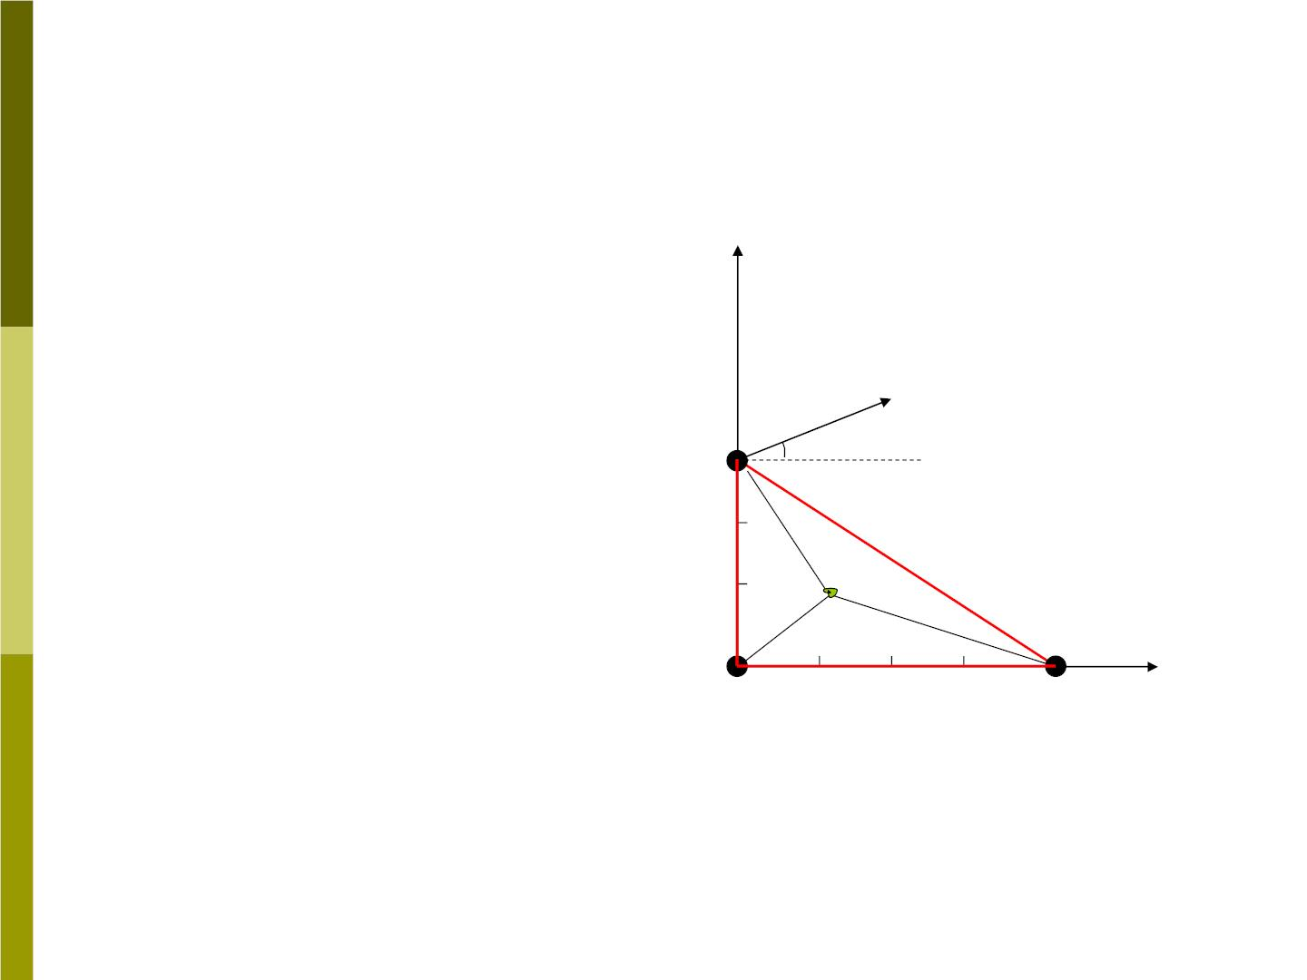
Sample problem 9-2
Three particles of
Fig 9-9
y (m)
masses =2.3kg,
m
1
m =3.2kg and
2
m
=1.5kg are
→
3
F
=4.5N
connected by thin
rods of negligible
mass, so that they
lie at the vertices
of 3-4-5 right
m₂
3
30□
r₂
c
r
1
r₃
m₃
triangle in the x-y
plane.
^{m}1
X (m)
4

Slide 17
Question:
(a) Find the rotational inertia about each of
the three axes perpendicular to the x-y
plane and passing through one of the
particles.
(b) A force of magnitude 4.5N is applied to
m in the xy plane and makes an angles
2
of 30⁰ with the horizontal. Find the
angular acceleration about oz axis.
(c) Find the rotational inertial about an axis
perpendicular to the xy plane and
passing through the center of mass of
the system

Slide 18
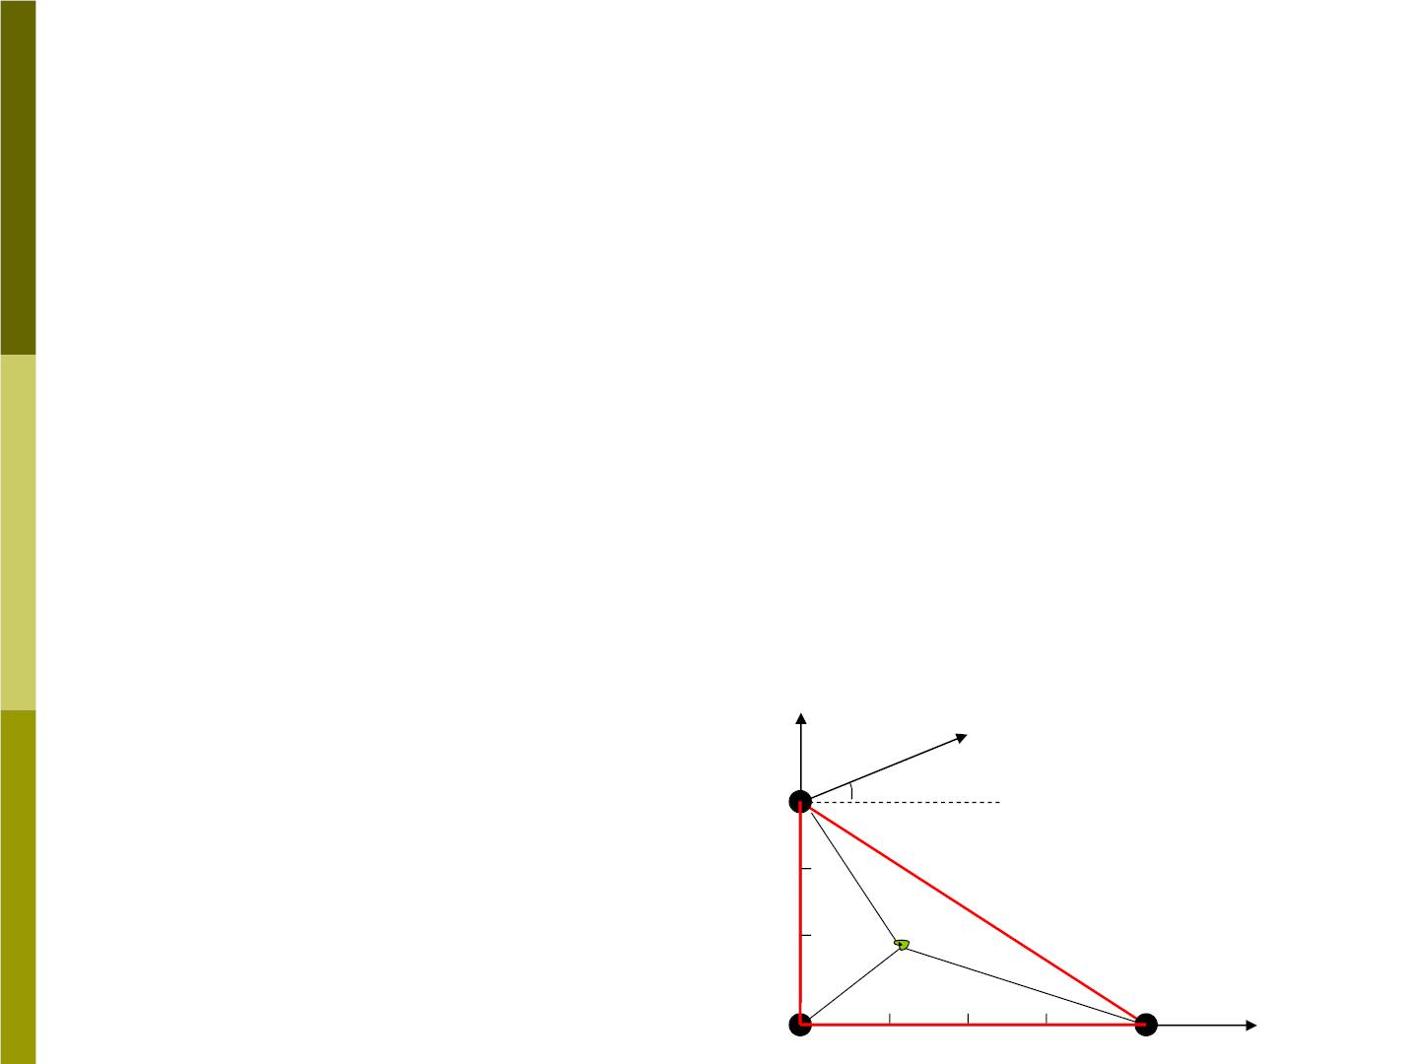
Solution:
(a) consider first axis through
^{m}1
I₁
=
=
=

m r
2
n n
⋅
2
+
⋅
2
+
⋅
2
(2.3kg) (0m) (3.2kg) (3.0m) (1.5kg) (4m)
⋅
2
53kg m
m
Similarly for the axis through , we have
2
=
⋅
2
+
⋅
2
+
⋅
2
I (2.3kg) (3.0m) (3.2kg) (0m) (1.5kg) (5.0m)
2
=
⋅
2
58kg m
y (m)
→
F
For the axis through m
=4.5N
3
m₂
=
⋅
2
3
30□
I 117kg m
3
r₂
c
r
1
r₃
m₃
m₁
4 X (m)

Slide 19

(b) Using Eq(9-2)
⧫ = rF = −(3m)(4.5N) cos 30
z
⊥
⧫
(3m)(4.5N)
 = = −
cos 30
z
z
I
⋅
2
53kg m
1
(c) Rotational inertial about an axis
passing through the cm.

m x
x_{cm}
=
n n
=
0.86m
^{m}n

m y
y_{cm}
=
n n
=
1.37m
^{m}n

Slide 20
2
=
2
+
2
=
2
r x y 2.62m
1
cm
cm
2
=
2
+ − =
2
2
r x (y y ) 3.40m
2
cm
2
cm
2
= − +
2
=
2
2
r (x x ) y 11.74m
3
3
cm
cm
I_{cm}
=

m r
2
n n
=
=
⋅
2
+
⋅
2
+
⋅
2
(2.3kg) (2.62m ) (3.2kg) (3.40m ) (1.5kg) (11.74m )
⋅
_{35kg m}2
I <I ,I ,I
cm 1 2 3

Slide 21

3. The parallel-axis theorem
The result of the previous sample problem
leads us to an important general result,
the parallel-axis theorem:
“The rotational inertia of any body about
an arbitrary axis equals the rotational
inertial about a parallel axis through the
center of mass plus the total mass times
the squared distance between two axes ”.
= +
I I Mh
2
cm

Slide 22
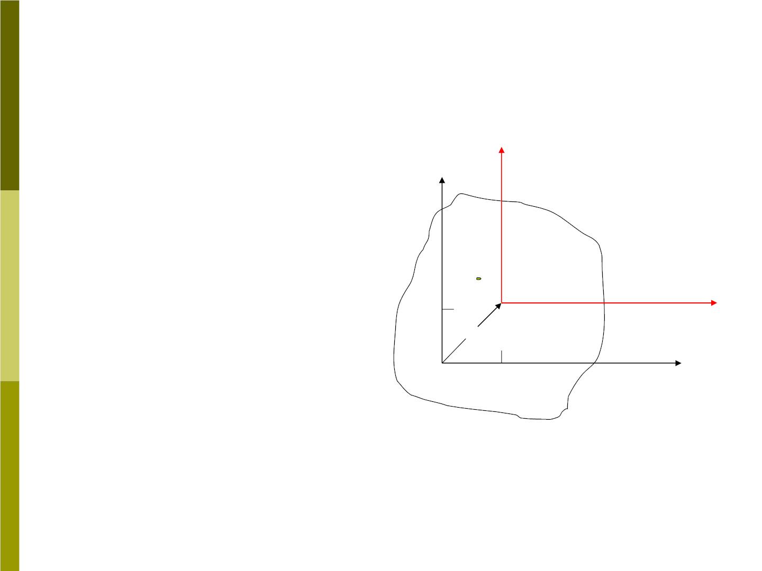
4. Proof of Parallel -Axis theorem
Fig 9-10 shows a
thin slab in the x-y
plane, the
Fig 9-10
y’
y
rotational inertia
about oz is
P

c
I
=
m r
2
n n
^{y}cm

X’
=
2
+
2
h
m (x y )
n
n
n
x x x
= +
'
o
x_{cm}
x
n
cm
n
n
= +
y y y
'
n
cm

Slide 23
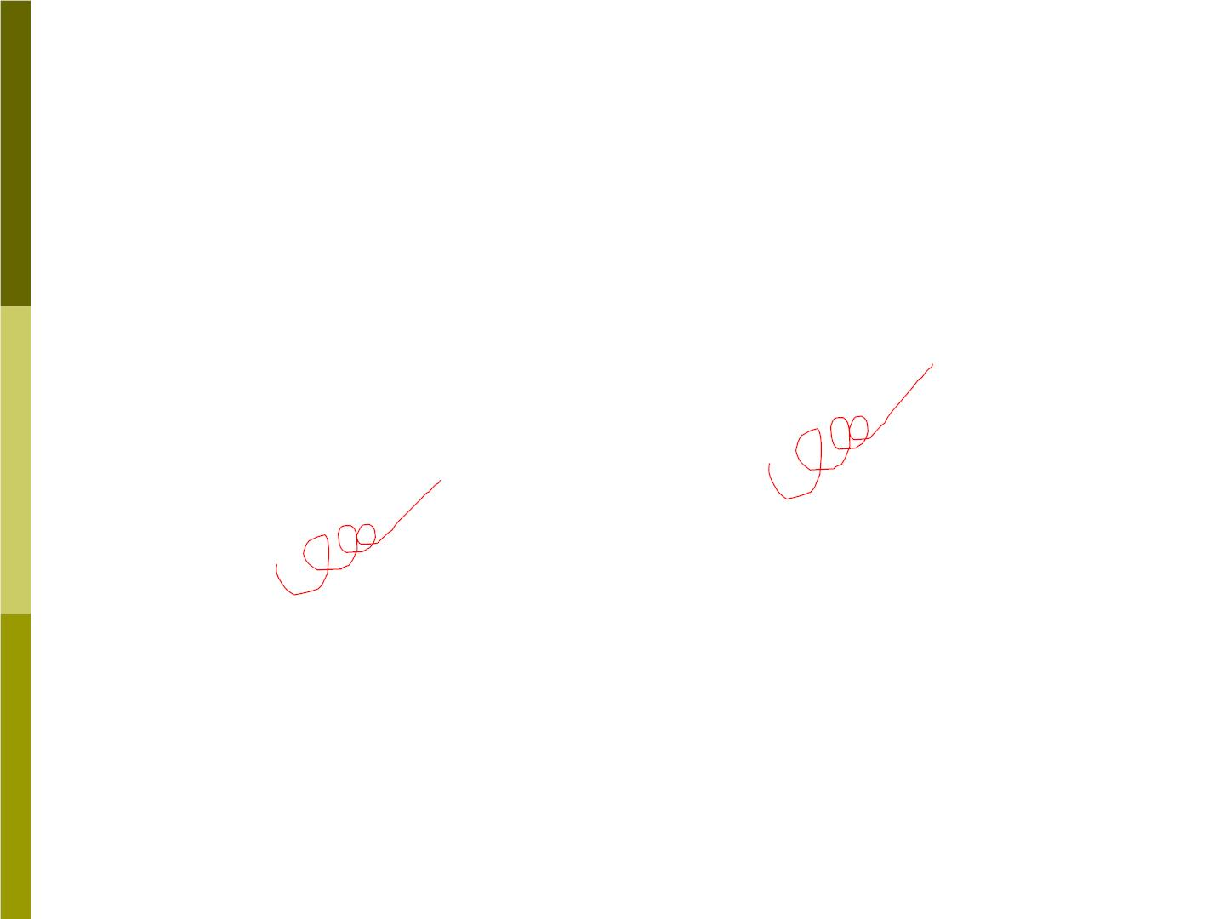
Substituting these transformations, we
have
=

+ ' + + '
2
2
I m [(x x ) (y y ) ]
n
cm
n
cm
n
Regrouping the terms, we can write this
as

2
2

'
'
'
I = m (x + y ) + 2x m x
n
n
n
cm
n n


+ 2y m y ' + (x ² + y ² ) m
cm
n n
cm
cm
n
= +
2
I Mh
cm


'
=
'
=
m x Mx 0
n n
cm
'
=
'
=
m y My 0
n n
cm

Slide 24

9-3 Rotational inertia of solid bodies
For a rigid body which is a continuous
distribution of matter. We can imagine it
divided into a large number of small
mass . Eq(9-10) become
m_{n}
=

2

(9-13)
I r m
n
n
Take this to the limit of infinitesimally
small so that the sum becomes an integral
=lim

2
⇩
2
(9-15)
I
 =
r m r dm
m
n
n
The integraln is carried out over the entire
volume of the object.

Slide 25
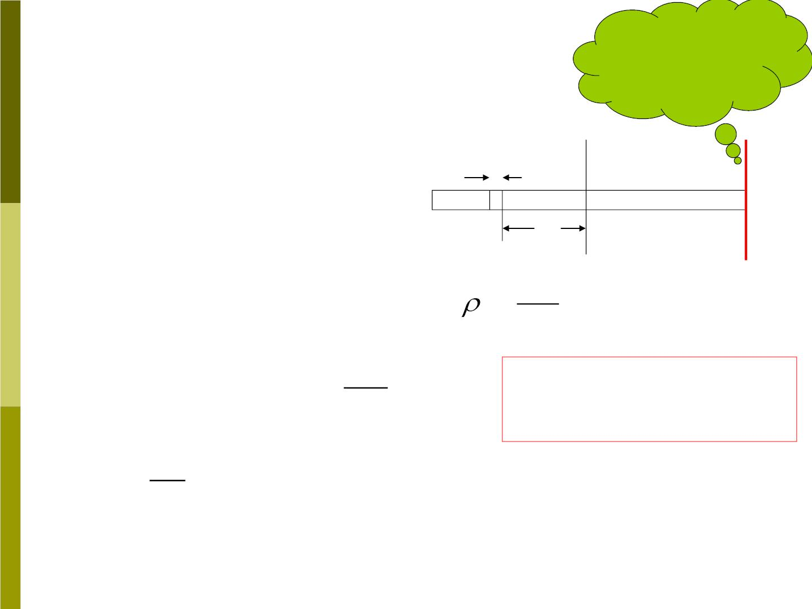
How
1. As an example, a
rod rotates about an
axis through its center.
Find its rotational
inertia.
Fig 9-13
about I of
this axis
dx
dm
x
dV = Adx
dm = dV = Adx
M
AL
=
⇩ 
M
=
2
=
2
Use the parallel-
axis theorem
I r dm x Adx
AL
M
L
L/ 2
=
⇩
2
=
2
x dx ML / 12
−L/ 2

Slide 26
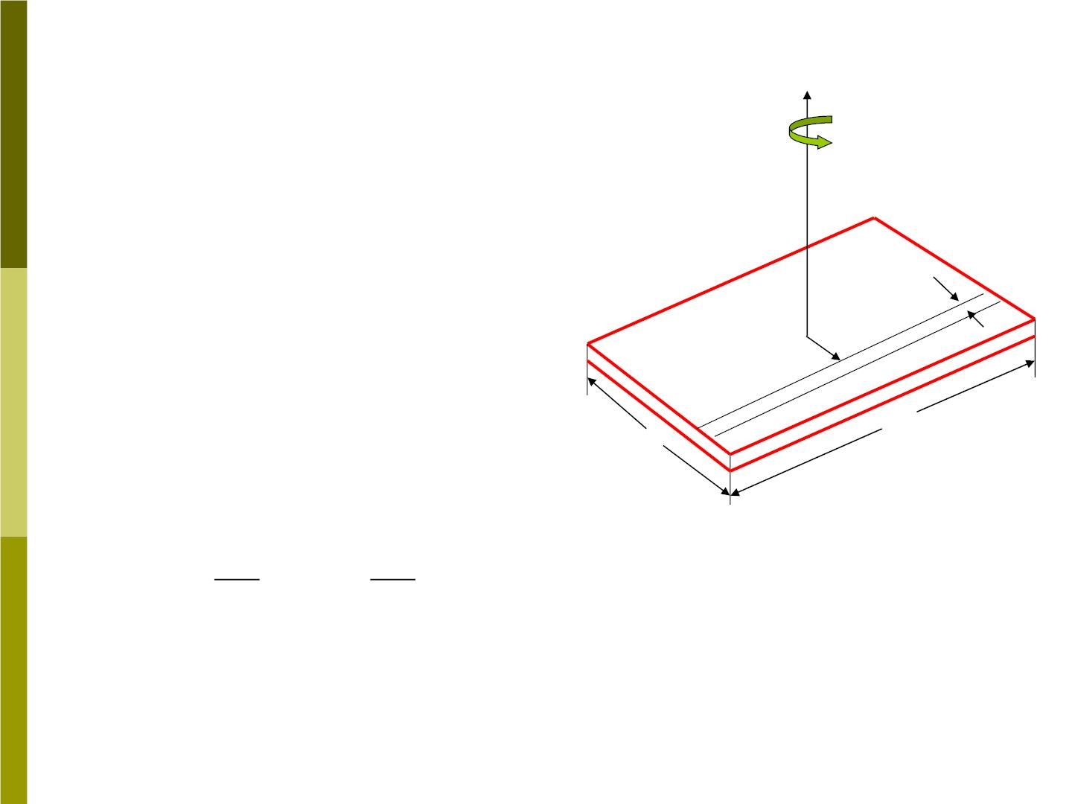
2. Another example:
axis of rotation
calculate the rotational
inertia of a uniform solid
rectangular about an axis
perpendicular to the
plate and through its
center.
dx
The plate (3D) can be
x
divided into a series of
strips, each of which is to
be regarded as a rod.
The mass dm of the strip
is
a
b
M
M
dm = adx = dx
ab
b

Slide 27
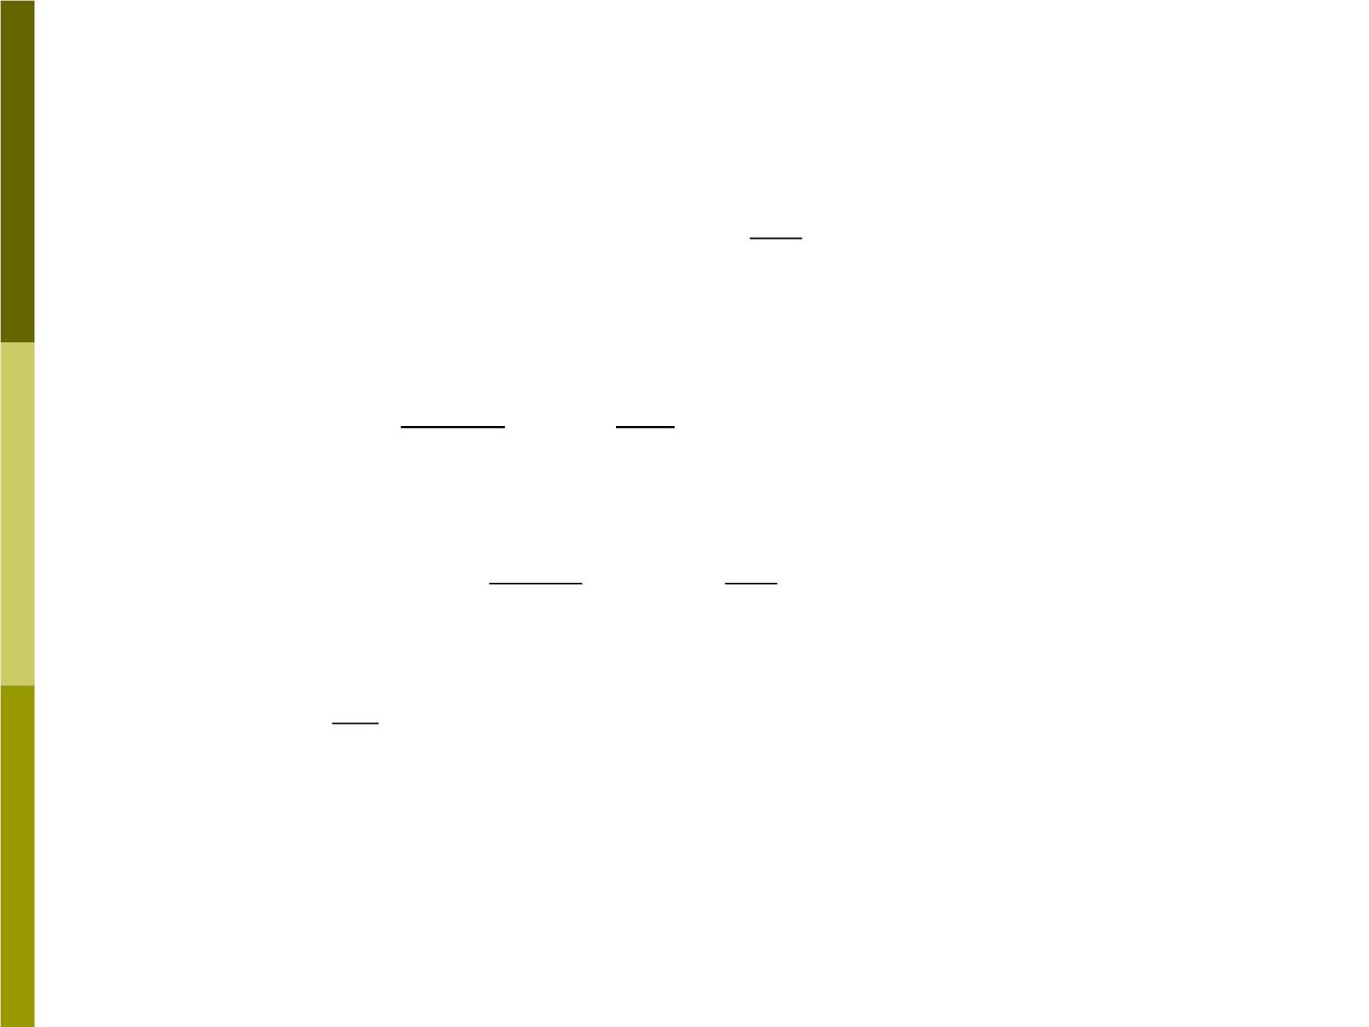
The rotational inertia of the strip about the
axis is
1
= + 
dI dI dm x
=
+ 
dm a dm x
2
⋅
2
2
cm
12
Substituting for dm yields
Ma
2
M
dI
=
+
2
dx x dx
thus
12b
b
2
b / 2
b / 2
Ma
M
⇩  
= =
+
x²dx
I dI
dx
12b
b
−b / 2
−b / 2
1
=
² + ²
M (a b )
12

Slide 28
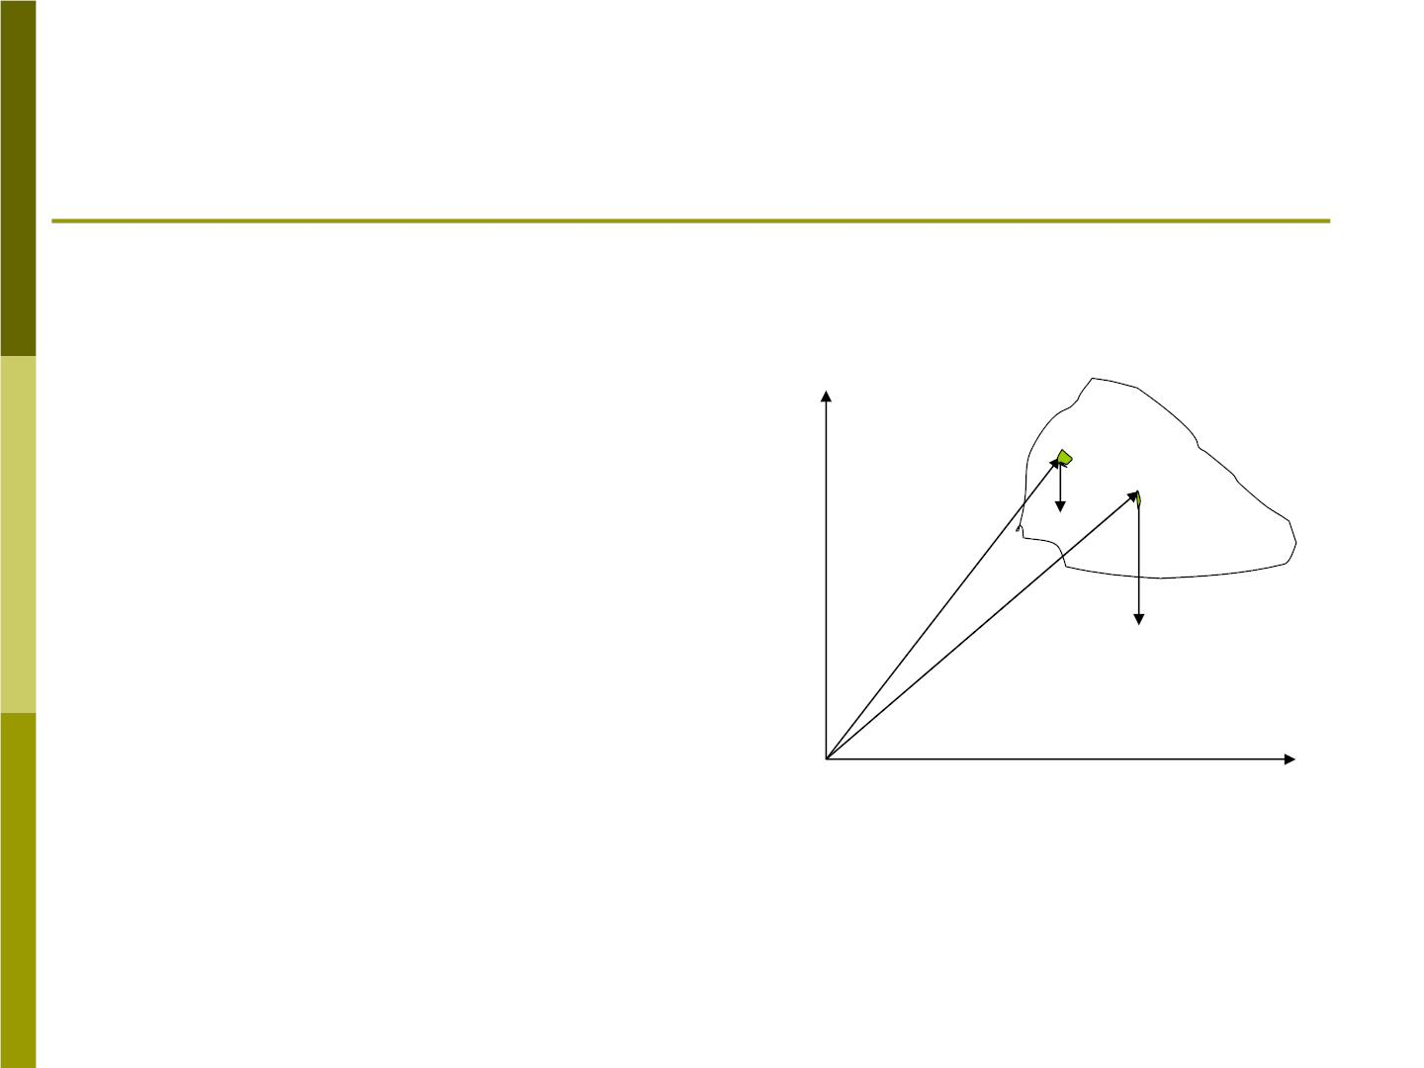
9-4 Torque due to gravity
1. center of gravity
fig 9-18
Imagine a body of
mass M (Fig 9-18)
to be divided into a
large number of
particles.
y
m_{n}
Cg
→
r_{n}
→
→
M g
r
cg
o
x

Slide 29

The net torque about arbitrary axis oz due
to gravity acting on all the particles is
❒
→
→
→
g
 

Assume is a
constant vector.
⧫ = (r m g )
n
n n
→ →
= (m r  g )
n n
n

→
→
→
→
= (m r ) g = r  M g
(9-20)
n n
cg
The torque on the body thus equals the
torque that would be produced by a single
→
force M g acting at the center of mass of
→
the body. is also the location of the
r
cg
“center of gravity (cg)”.

Slide 30

2.Center of mass (cm) and center of
gravity(cg)
To calculate the center of gravity, we must
know not only the mass distribution of the
→
body, but also the variation of over the
g
→
body. If is not constant over the body,
g
then the cg and cm may not coincide,
→
because cannotgbe removed from the
sums in eq. (9-20).
→
→
→
→
→
 
⧫ = (r m g ) = r  M g
If
n
n
n
cg
cg
,
→
r
the is the location of the “center of
cg
gravity (cg)”.

Slide 31
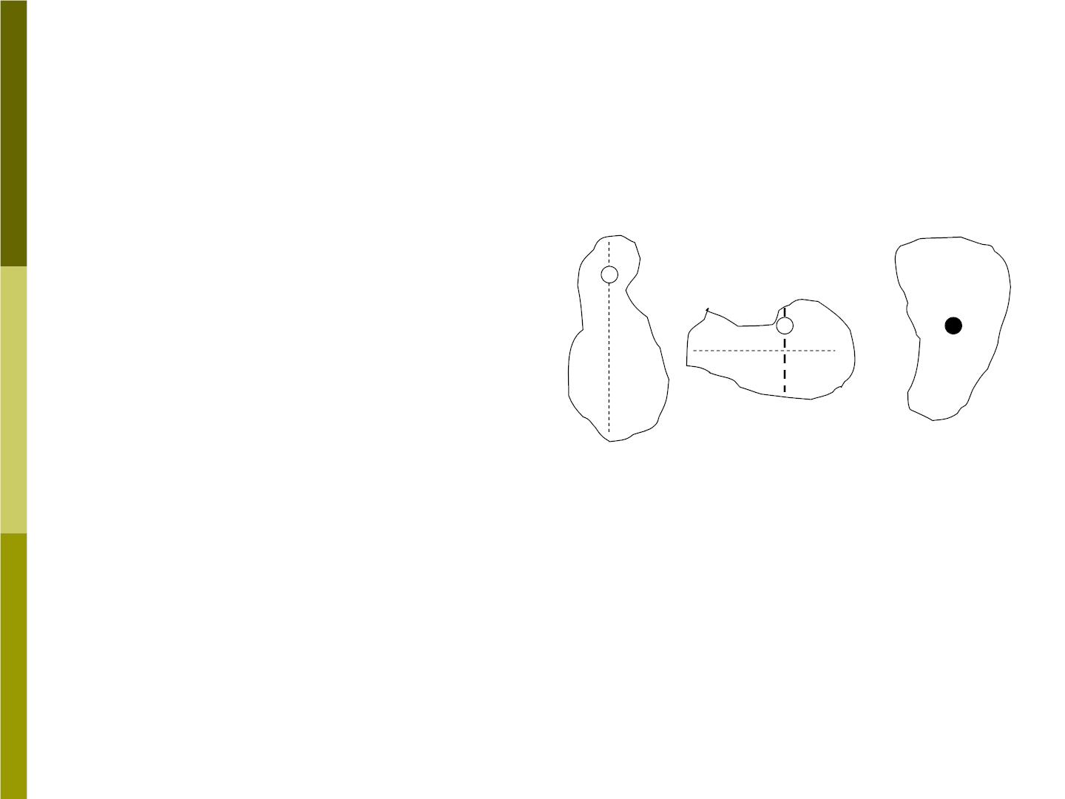
3. Find the cg
Consider a body of
arbitrary shape
Fig 9-20
suspended from a point
S (Fig 9-20). If we draw
a vertical line through S,
then we know that cg
must lie somewhere on
the line.
s
s
a
b
c

Slide 32
Repeating the procedure with a new
choice of point S as in Fig 9-20 b, we can
find a second line t hat must contain the cg.
The cg must lie at the intersection of the
lines. If we suspend the object from the cg
as in Fig 9-20c, and release it, the body
will remain at rest no matter what its
orientation.

Slide 33

9-5 Equilibrium applications of
Newton’s law for Rotation
1.For a body to be in equilibrium both the
net external force and net external torque
must be zero. In this case the body will
have neither an angular acceleration nor a
translational acceleration. We therefore
have two conditions of equilibrium:


→
(9-22)
(9-23)
F = 0
ext
and
→
⧫ = 0
ext

Slide 34
The equilibrium condition for the torques
is true for any choice of the axis, when

F = .
0
ext
To prove this statement,we consider
Fig9-21.

Slide 35
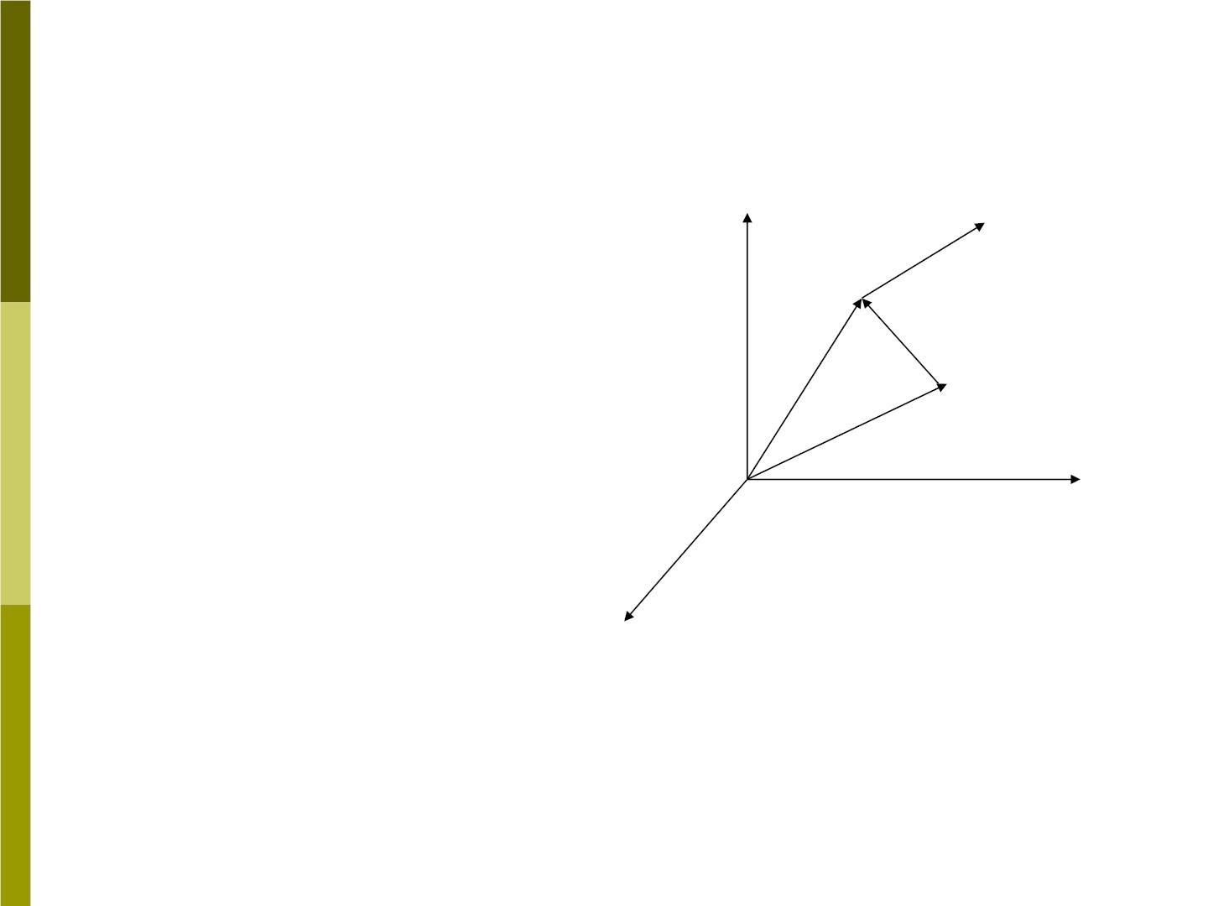
In Fig 9-21, many
Fig 9-21
forces act on a body,
→
→
force is applied at
z
F
F
1
1
the point located
→
→
→
→
→
at r ,force at ,
F r
r r
1
2
2
→
-
P
and so on. The net
1
r
1
torque about an axis
through o is
→
r
o
P
y
→
→
→
→
⧫ = + +
x
0
1
2
N
→
→
→
→
→
→
=rF +r F +r F
(9-26)
1
1
2
2
N
N

Slide 36
→
Suppose a point P is located at with
r
P
respect to o. The torque about P is
→
→
→
→
→
→
→
→
→
→
⧫ = (r − r ) F + (r − r ) F + (r − r ) F
P
1
P
1
2
P
2
N
P
N
→
→
→
→
→

→
→
= (r  F +  r  F ) −[r  ( F )] = 
1
1
N
N
P
ext
0
where

F 0
= for a body in translational
ext
equilibrium. Thus “the torque about any
two points has the same value when the
body is in translational equilibrium.”

Slide 37
Often we deal with problems in which all
the forces lie in the same plane (x-y plane).
Equilibrium condition is then
 
F = 0
0
x
^{F}y ⁼
(9-27)
(9-28)
 z ⁼ ⁰

Slide 38

2.Equilibrium analysis problems
Here are the procedures you should follow:
1 .Draw a boundary around the system,
so that you can separate the system you
are considering from its environment.
2 .Draw a free-body diagram showing all
external forces that act on the system.
3 .Set up a coordinate system, resolve the
forces into their components.
4 .Set up a coordinate system and axis
for resolving the torque into their
components.

Slide 39
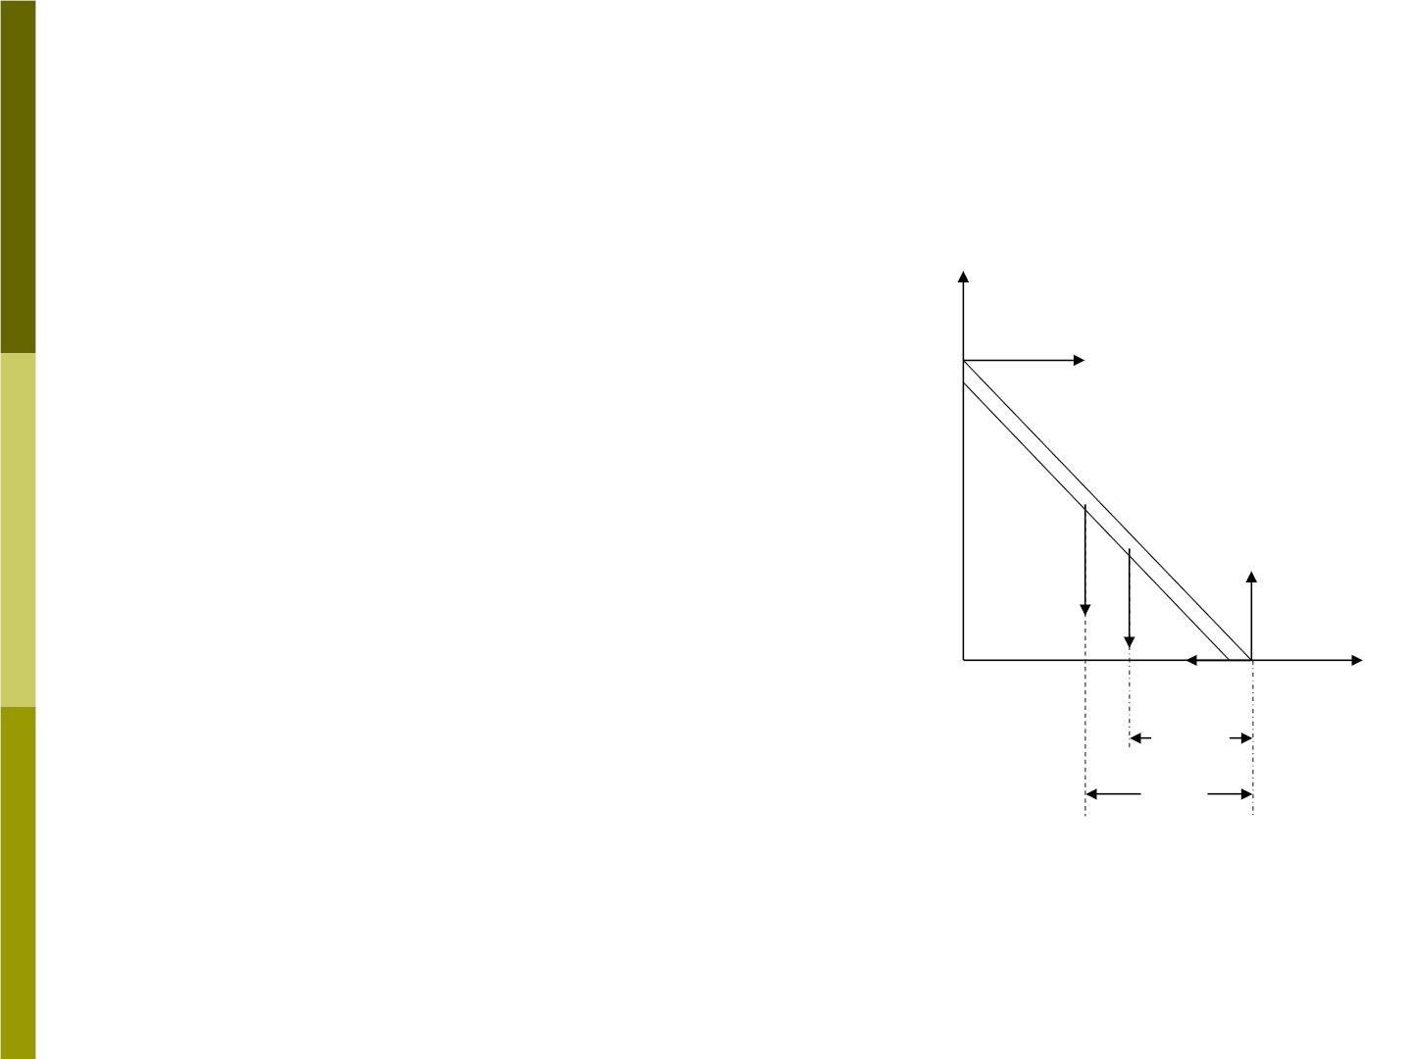
Sample problem 9-7
A ladder whose length L is 12m Fig 9-23
and whose mass m is 45kg
rests against a wall. Its upper y
→
end is a distance h of 9.3m
above the ground, as in Fig 9-
23. the cm of the ladder is
one-third of the way up the
ladder. A firefighter of mass
M=72kg climbs halfway up the
ladder. The wall is frictionless.
What forces are exerted on the
ladder by the wall and by the
ground?
F
w
firefighter
→
M g
→
→
N
m g
→
f
o
x
a/3
a/2

Slide 40
Solution:
Fig 9-23 shows a free-body diagram. The
→
wall exerts a horizontal force on the
F
w
ladder. It can not exert vertical force
because the wall-ladder contacts is
assumed to be frictionless. The ground
exerts a force with a horizontal component
f due to friction and a vertical component
N: the normal force.

Slide 41
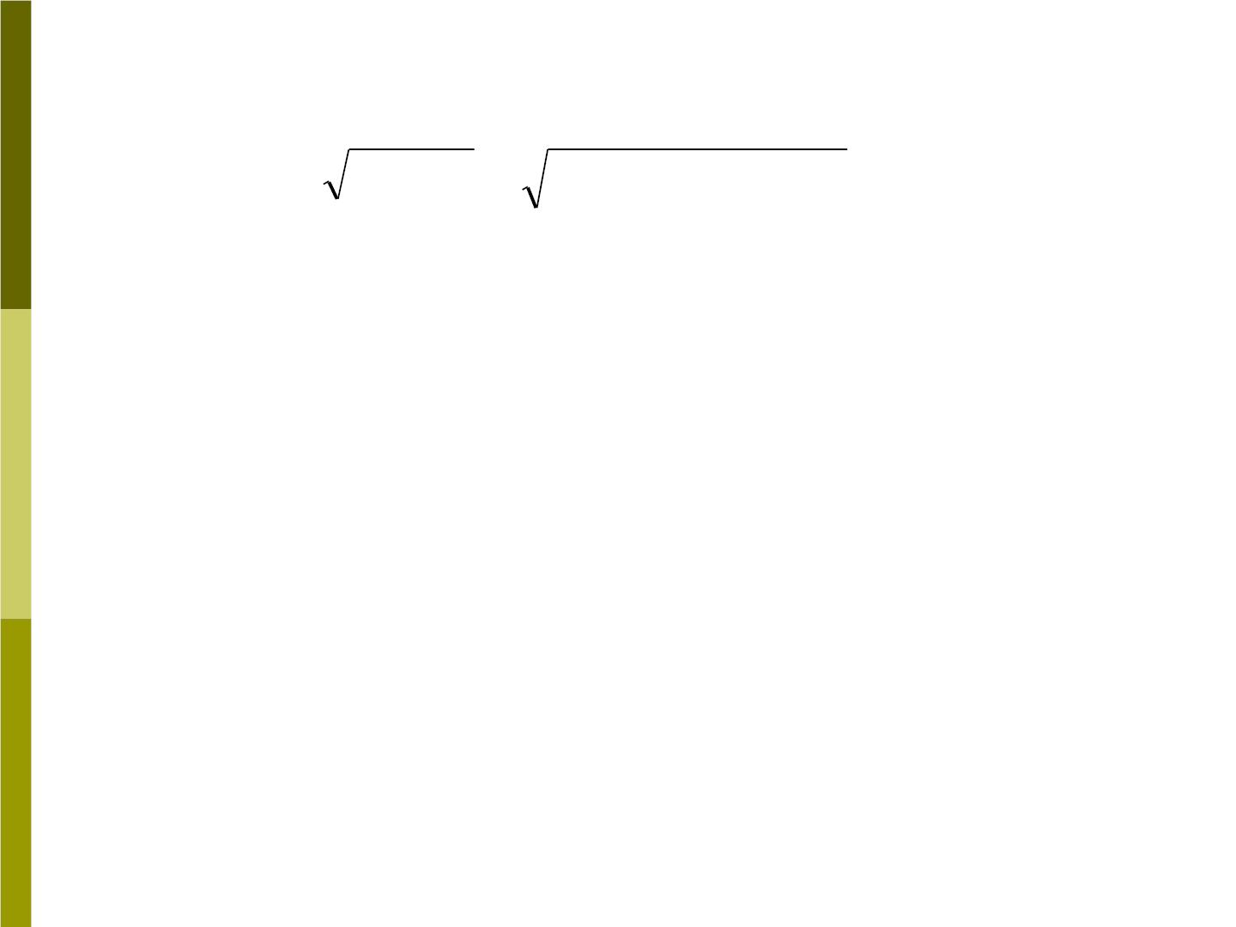
The distance a from the wall to the foot of
ladder is
=
2
−
2
=
2
−
2
=
a L h (12m) (9.3m) 7.6m
 
= ),we have
Using Eq(9-27) (
=
F 0
F 0
x
y
F_{w} − f = 0
and
N − Mg − mg =
0
N = (M + m)g
=
+

2
(72kg 45kg) (9.8m/ s )
=1150N

Slide 42

Taking torque about an axis through the
point o and parallel to the z direction, then
F_{w}
→
→
M g
gives a negative torque, m g and
give positive torques. Multiplying each
force by its moments arm, we find
Mga mga
− F_{w}h +
+
= 0 (9-32)
2
3
M m
F = [ga( + )]/ h
w
2 2
2

+
(9.8m/ s ) (7.6m)(72kg/ 2 45kg/3)
=
9.3m
= 410N

Slide 43
9-6 Nonequilibrium applications of
Newton’s Law for rotation
In this section we will analyze
problems involving angular
acceleration produced by a nonzero
net torque applied to an object with
a fixed axis of rotation.

Slide 44
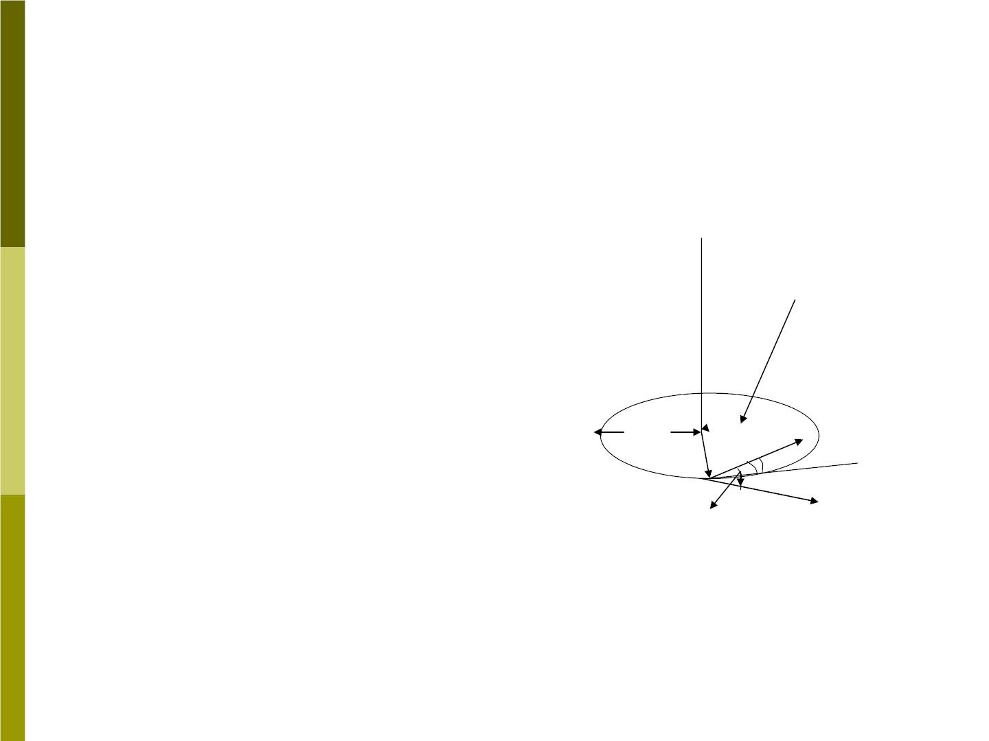
Sample problem 9-9
A playground merry-go-round
is pushed by a parent who
❐
Fig 9-25
→
exerts a force of magnitude
F
115N at a point P on the rim a
distance of r=1.5m from the
axis. The force is exerted in a
direction at an angle 32□ below
the horizontal, and the
Horizontal
component
1.5m
tangent
at P
horizontal component of the
r
P
15□
force is in a direction 15□
→
F
32□
inward from the tangent at P.

Slide 45
(a) Find the torque .
(b) Assuming that the merry-go-round
can be represented as a disk 1.5m in
radius and 0.40cm thick and that the child
riding on it can be represented as a 0.25-
kg “particle” 1m from the axis of rotation,
find the resulting angular acceleration of
the system.

Slide 46

Solution:
(a) =
□
□
=
F F cos 32 cos15 94.2N
⊥
⧫ = rF = (1.50m)(94.2N) =141N m
z
⊥
(b)
1
=
2
+
2
I ( MR mr )
2
1
2
=
=
⋅
2
+
⋅
2
(223kg) (1.5m) (25kg) (1.0m)
⋅
2
276kg m
⧫
141N m
I 276kg m²
 = =
=
2
z
0.51rad / s
z
⋅

Slide 47
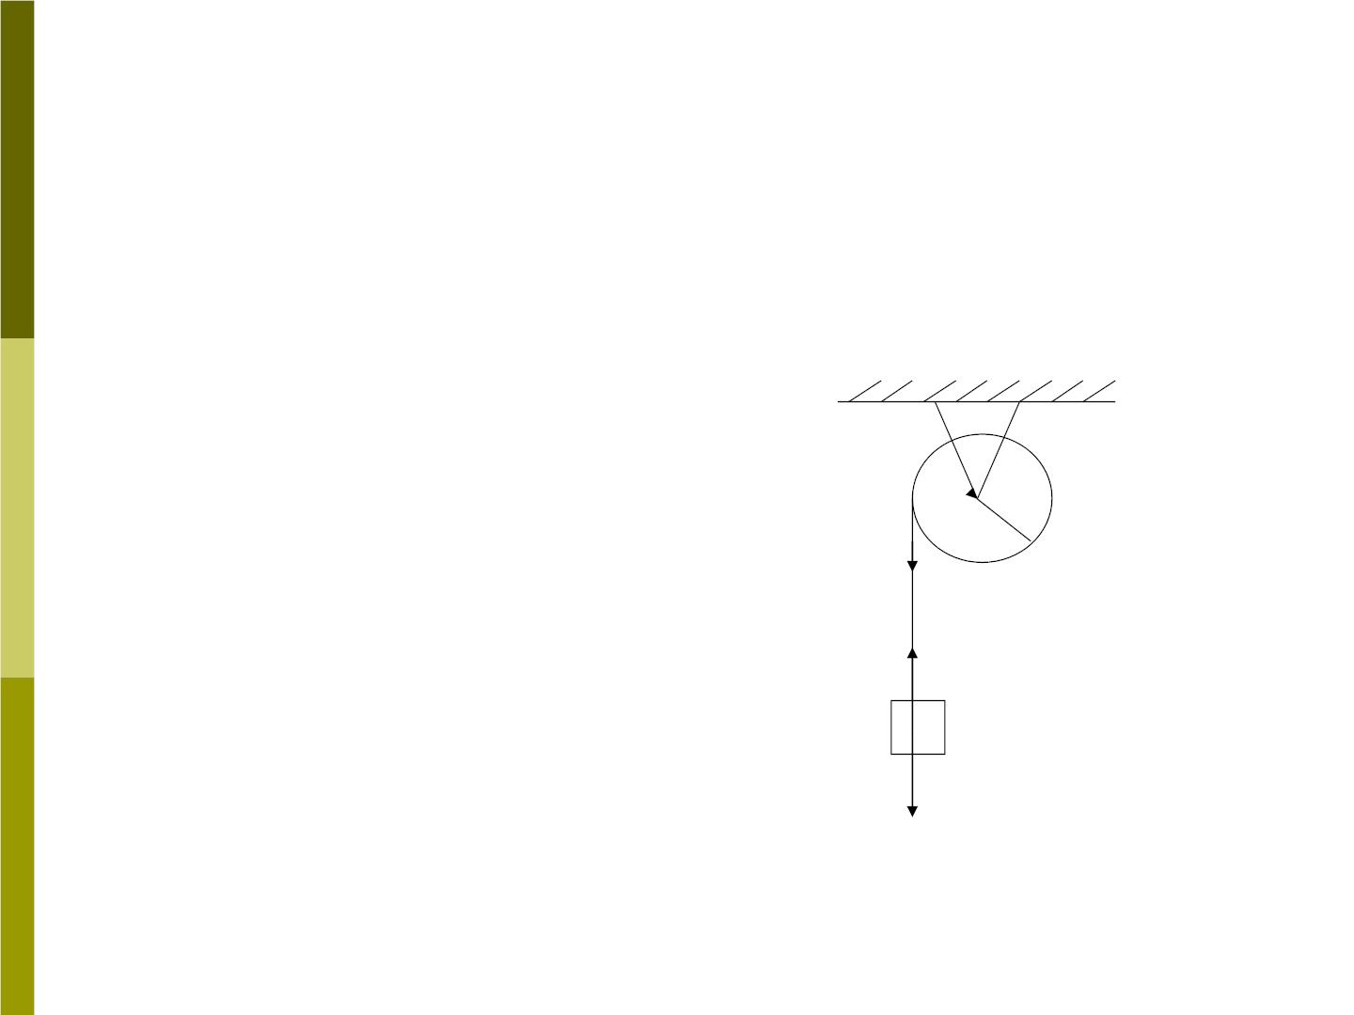
Sample problem 9-10
Fig 9-26 shows a pulley,
which can be considered as
a uniform disk of mass
m=2.5kg and radius
R=20cm,mounted on a fixed
frictionless horizontal axis. A
block of mass m=1.2kg
hang from a light cord that
is wrapped around the rim
of the disk. Find the
Fig 9-26
0
R
T
T
•
acceleration, tension in the
cord.
mg

Slide 48

Solution:
Fig 9-26 shows the system and its free-
body diagram. We choose the y axis to be
positive downward. We have
mg −T = ma
1
TR = I = MR

2
a =R
2
Because the cord does not slip or stretch
a must equal R. Combine the equations to
obtain

Slide 49

2m
M + 2m
a
=
=
2
g 4.8m / s
and
M
M + 2m
T = mg
= 6.0N
We see also that the acceleration and
tension depend on the mass of the disk
but not the radius. As a check, we note
that the formulas predict a=g and T=0 for
the case of a massless disk (M=0). This is
what we expect: the block simply falls as
a free body.

Slide 50
9-7 Combined rotational and
translational motion
In general, an object simultaneously
undergoes both rotational and
translational displacements, and the
translational and rotational motions may
be completely independent. It has only
rotational and no translational motion, or
it has only translational and no rotational
motion.

Slide 51
1. In a special case of a rolling wheel: or
(1) the axis of rotation passes through the
center of mass (2) the axis always has the
same direction in space. If these two
conditions are valid, we may apply Eq(9-11)

⧫ = 
(
I _{z}) to the rotational motion.
z
Independent of the rotational motion, we
may apply Eq(7-16)(
translational motion.

→
→
= ) to the
cm
F M a

Slide 52
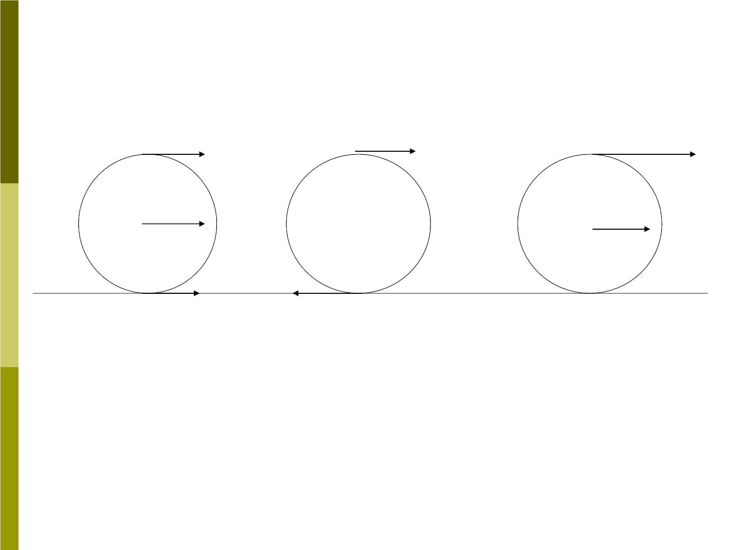
Fig 9-30
T
c
T
T
^{2v}cm
v_{cm}
v_{cm}
⬥
R
c
•
•
^{c}•
v_{cm}
R
v_{cm}
B
B
B
(a)
(b)
(c)

Slide 53
2. If the wheel rolls across a surface in the
way that there is no relative motion
between the object and the surface at the
instantaneous point of contact, this case is
called “rolling without slipping”. Fig 9-30
shows one way to view rolling without
slipping as a combination of rotational and
translational motions.

Slide 54

In pure translational motion (Fig 9-30a),
the center of mass c (along with every
point on the wheel) moves with velocity
^{v}cmto the right. In pure rotational motion
(Fig 9-30b) at angular speed  , every
point on the rim has tangential speed R.
When the two motions are combined, the
resulting velocity of point B (at the bottom
of the wheel) is − .
v
R
cm

Slide 55
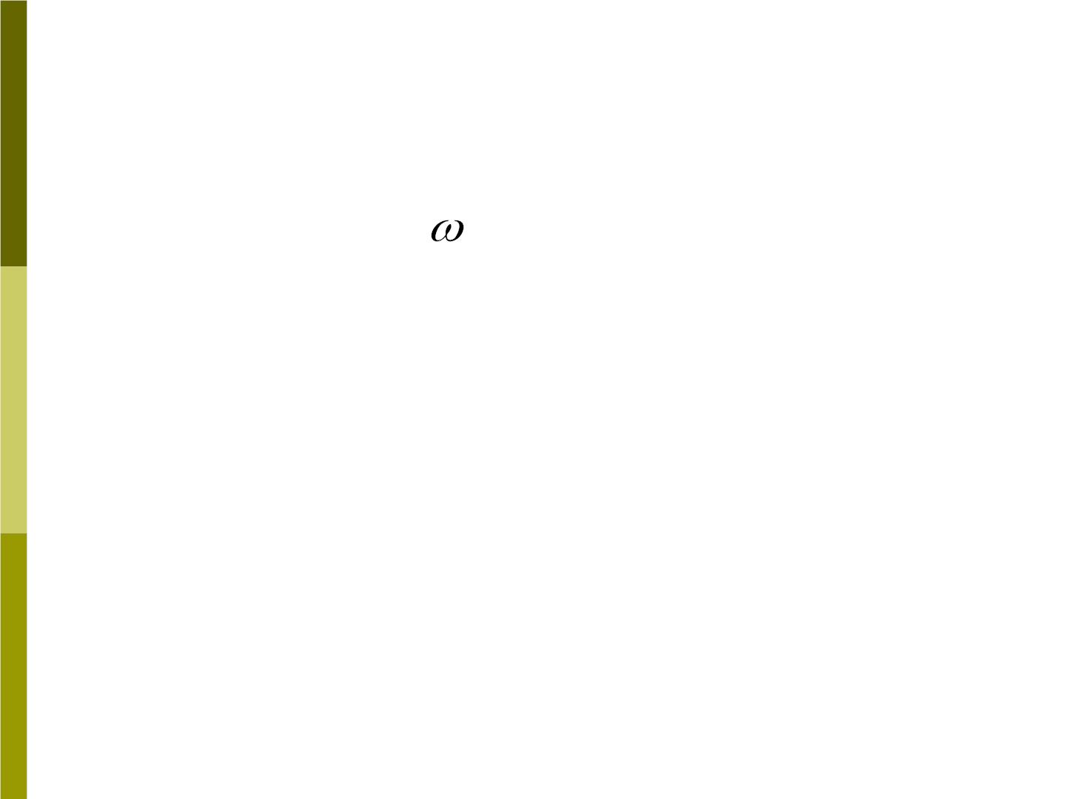
For rolling without slipping, the point
where contacts the surface must be at
rest; thus
v_{cm} − R = 0
v_{cm} = R
or
(9-36)
Superimposing the resulting translational
and rotational motions, we obtain
Fig 9-30c.
v_{T} = 2v
( at point T)
cm

Slide 56
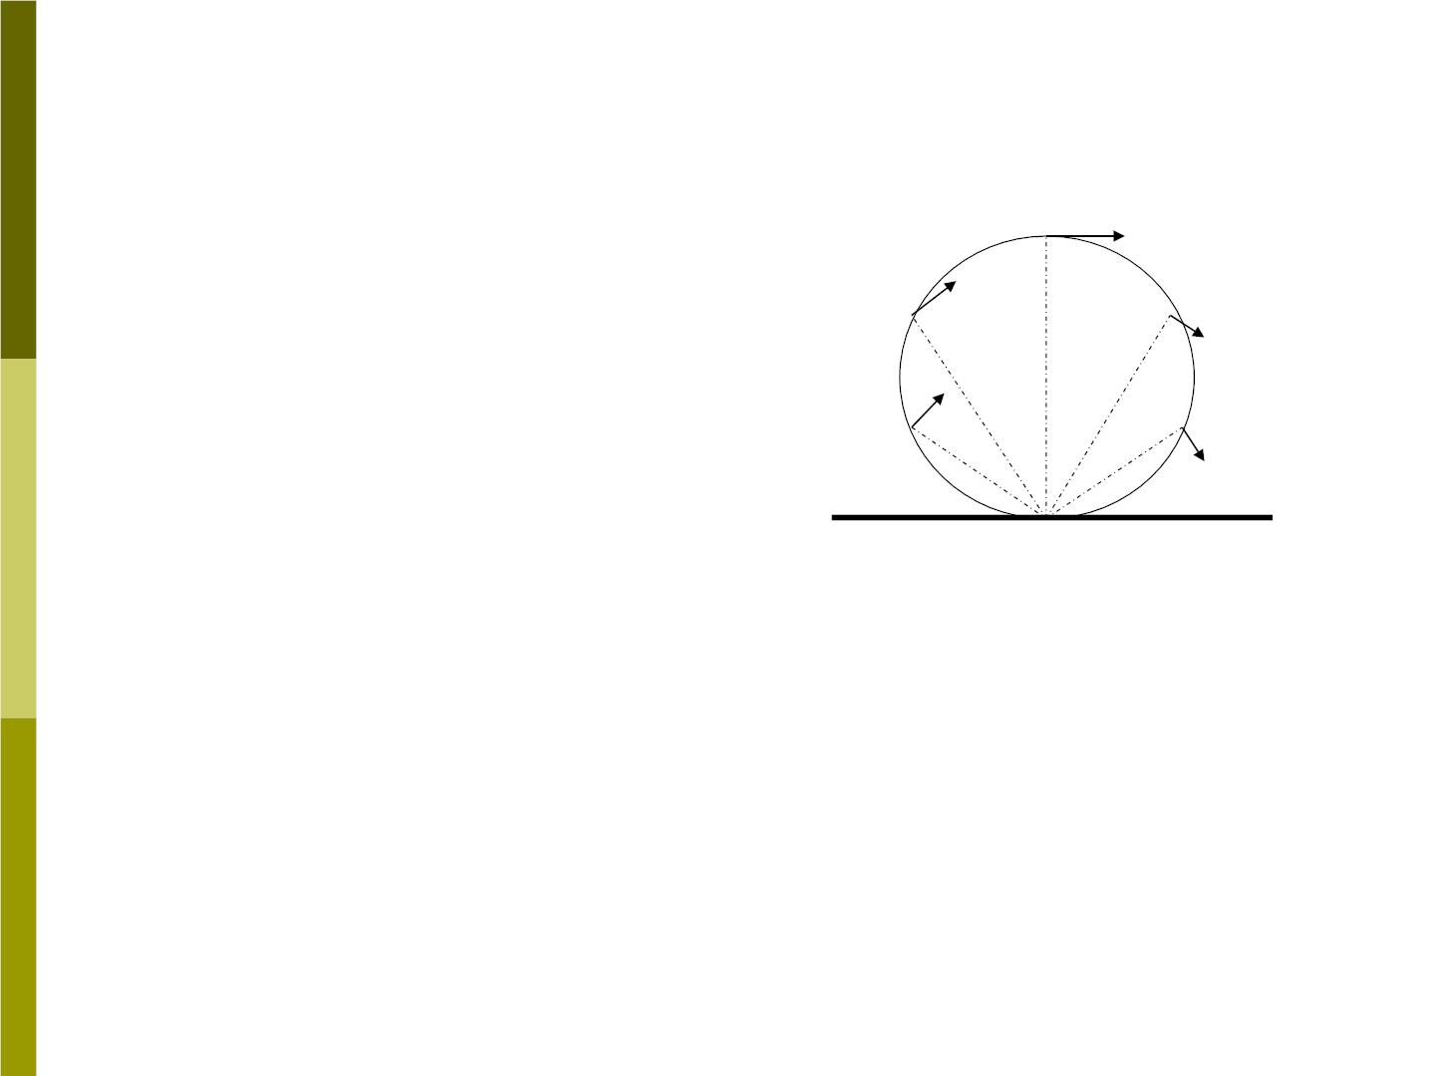
3.Another
instructive way to
analyze rolling
without slipping:
we consider the
point of contact B
to be an
Fig 9-31
0
•
instantaneous axis
of rotation, as
illustrate in Fig 9-
31.
B

Slide 57
At each instant there is a new point of
contact B and therefore a new axis of
rotation, but instantaneously the motion
consists of a pure rotation about B. the
angular velocity of this rotation about B is
the same as the angular velocity of the
rotation about the center of mass. Since
the distance from B to T is twice the
distance from B to C, we conclude
that
^{v}T ^{= 2v}
.
cm

Slide 58
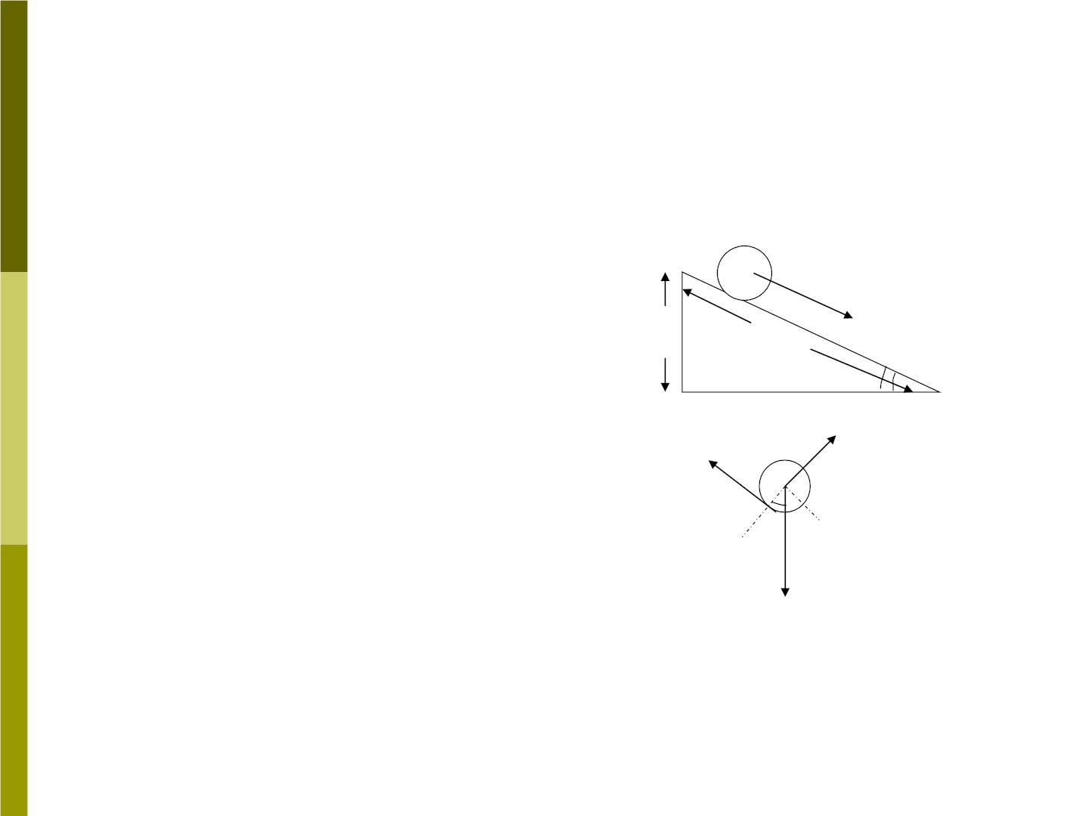
Sample problem 9-11
A solid cylinder of mass
M and radius R starts
from rest and rolls
without slipping down
an inclined plane of
length L and height h
(Fig 9-32). Find the
speed of its center of
mass when the cylinder
reaches the bottom.
c
→
(a)
h
L
a
cm
❑
→
N
f
❑
(b)
Mg
Fig 9-32

Slide 59
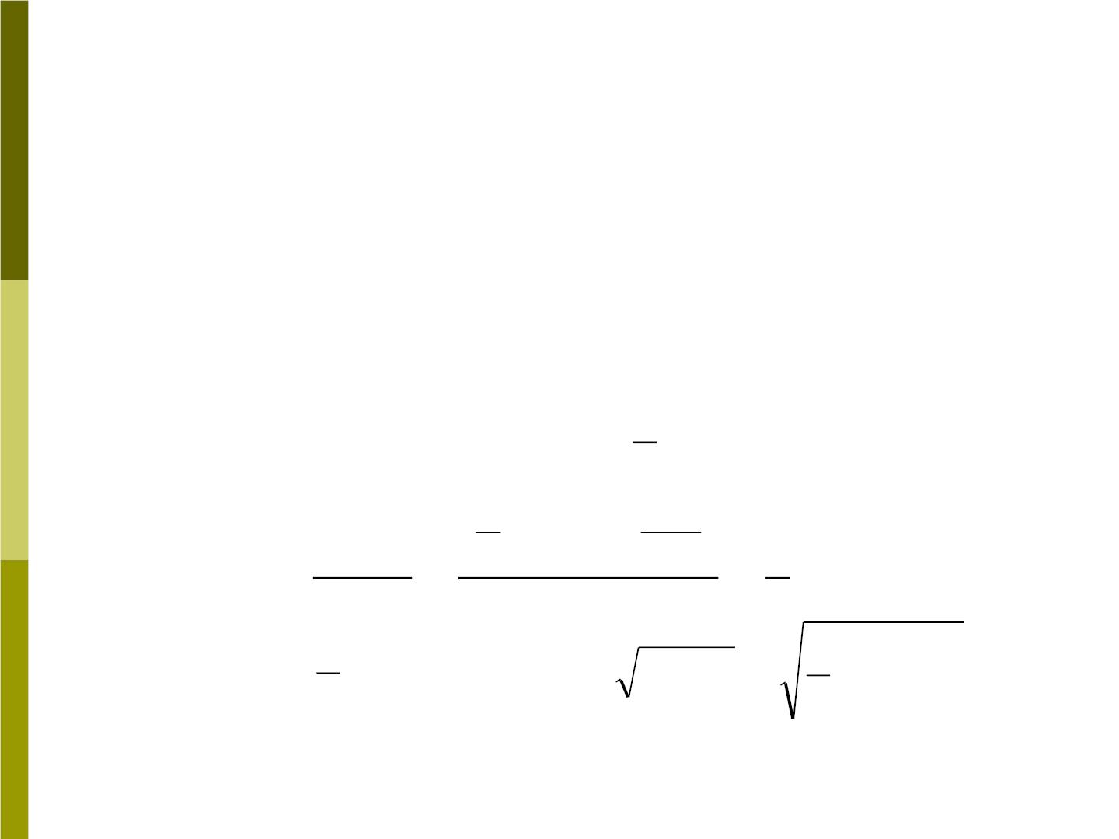
Solution:
The free-body diagram of Fig 9-32b,
Mg sin  − f = Ma_{cm}
N = mg cos
The net torque about the cm
_{cm} = fR = I 
cm z
1
2
and
a =  R
I
=
2
MR
cm
z
cm
thus
1
a
2
⋅
cm
I 
( MR ) (
)
2
R
1
2
f =
cm
z
=
= Ma
R
R
cm
2
4
a = g sin 
v = 2ba = Lg s in 
cm
3
cm
cm
3

Slide 60
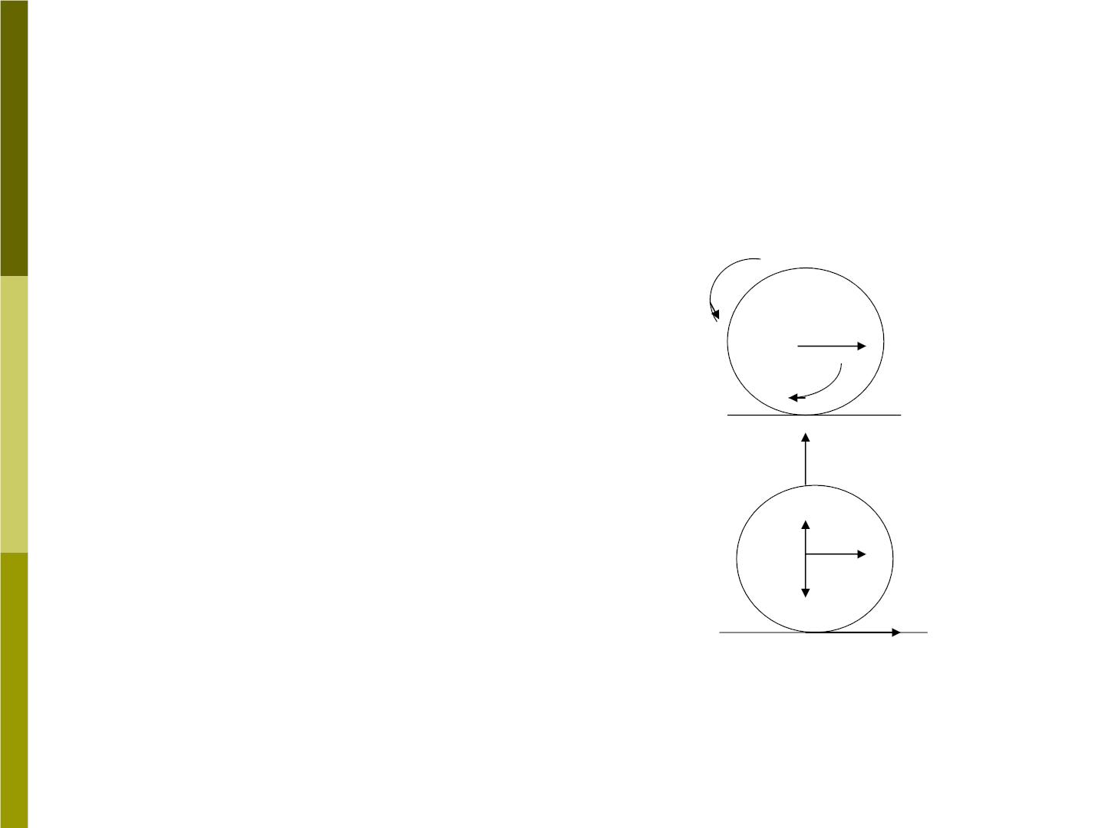
Sample problem 9-12
A uniform solid
cylinder of radius
R=12cm and mass
M=3.2kg is given
an initial (clockwise)
angular velocity

→
z
a
₀
cm
(a)
₀
y
of 15 rev/s and
→
N
then lowered on to
a uniform
horizontal surface
(Fig 9-33).
c
x
mg
(b)
→
f
Fig 9-33

Slide 61
The coefficient of the kinetic friction
between the surface and the cylinder
is
_{k} =
0.21.Initially the cylinder slips as it
moves along the surface. But after a time
t pure rolling without slipping begins
v
(1) What is the velocity of the cm at
cm
the time t ?
(2) t=?

Slide 62

Solution :
 
=
(a)
=
F f
F 0
y
x
During the interval from time 0 to time t
while slipping occurs, the forces are
→
constant and so the must be constant,
a
cm
^{v}ix ⁼ ⁰
v _{fx} = v_{cm}
v − 0 v
a = a =
cm
=
cm
t
cm
x
t
^{v}cm
f = Ma_{cm} = M
t

Slide 63
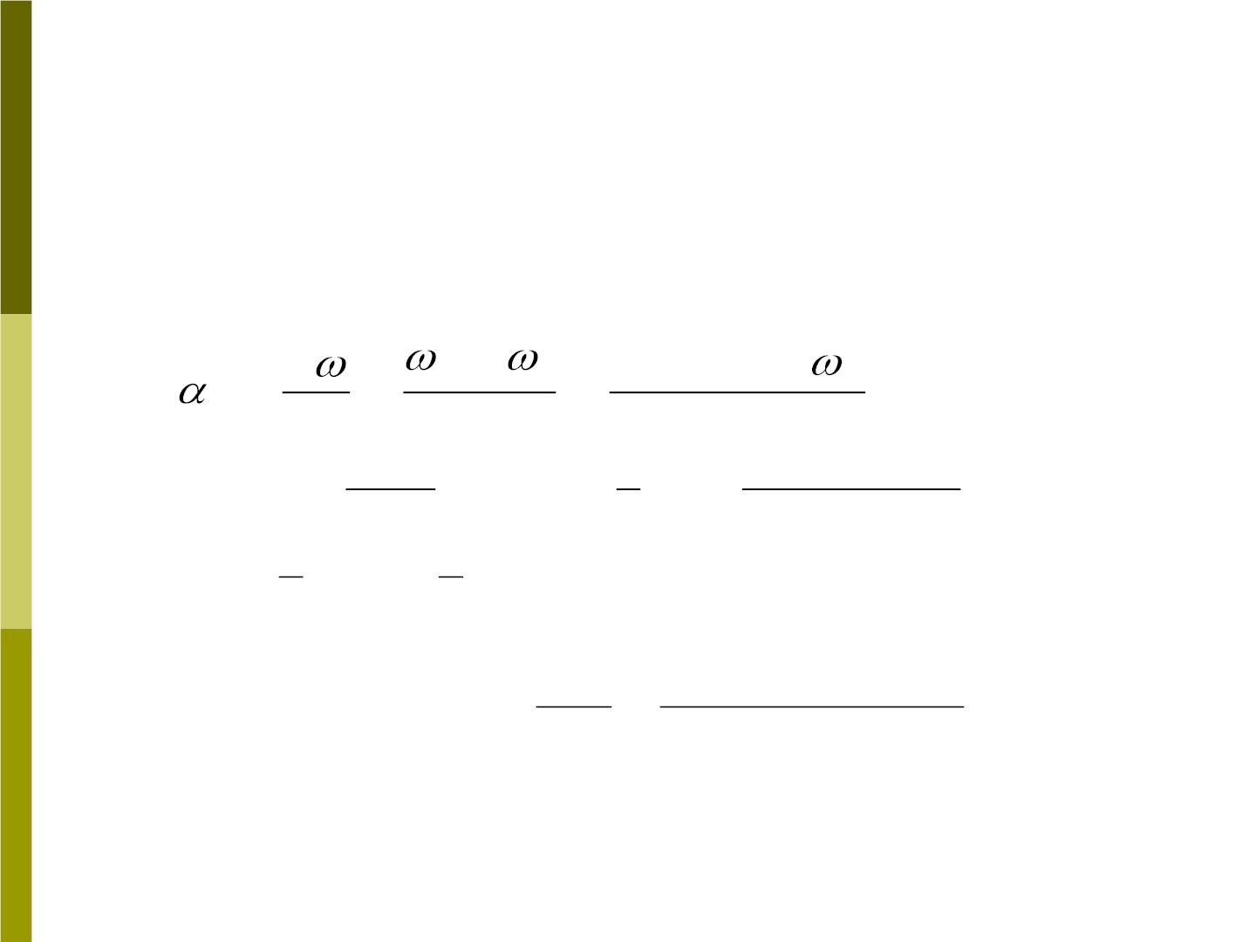
The torque about cm is  _{z} = fR . With
⬥ = −  = −v / R ( the negative sighs
i
0
f
cm
indicating that the cylinder is spinning
clockwise ), then

−
− vcm / R +
= =
f
i
=
0
z

t
t
t
Mvcm
t
1
2
−v_{cm} / R +₀
⧫ = =
=  =
MR² (
fR
R I
1
)
z
z
then
t
1
v =  R = (15rev / s)( 2rad / rev)(0.12m) = 3.8m / s
cm
3
0
3
(b)
^{v}cm
f = _{k} Mg
3.8m/ s
❍ g (0.21)(9.80m/ s
t =
=
=1.8s
2
)
k

