Slide 1
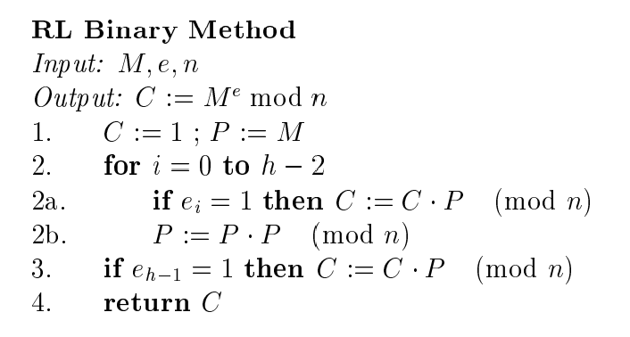
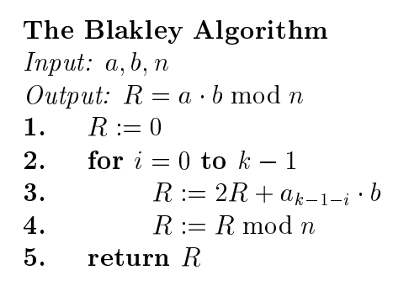

Slide 2
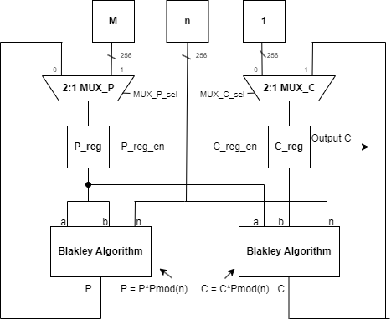
RL Binary Method

Slide 3
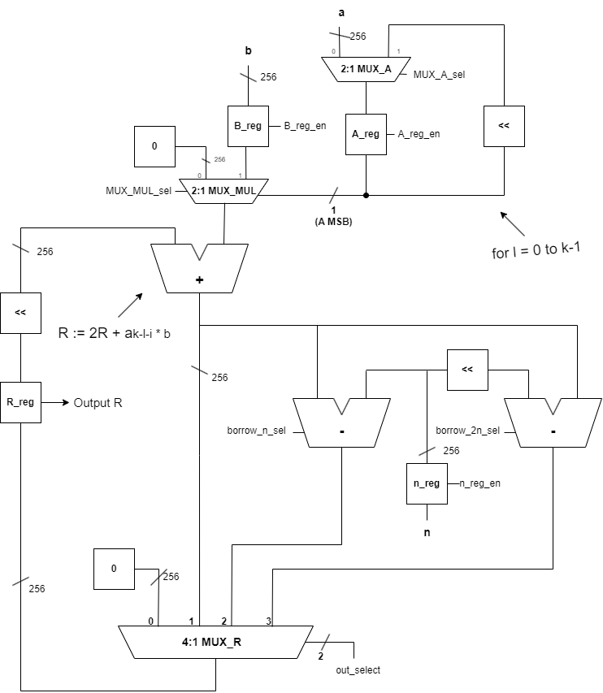
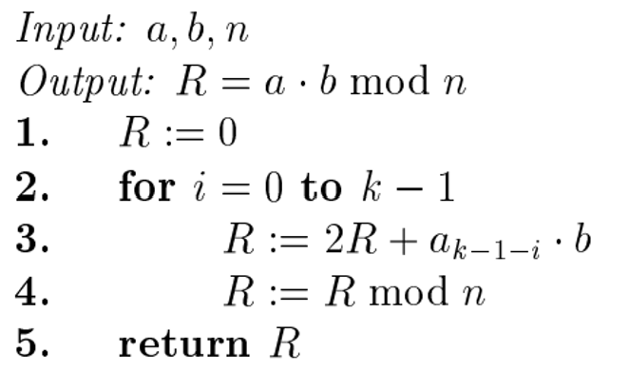
Blakley Algorithm

Slide 4
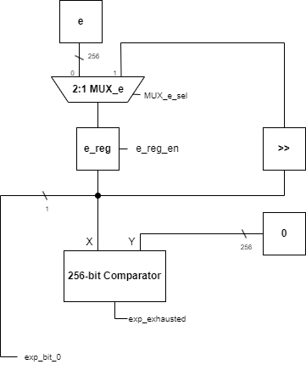
Loop Control

Slide 5
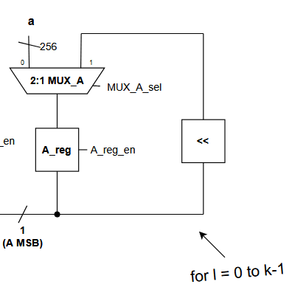
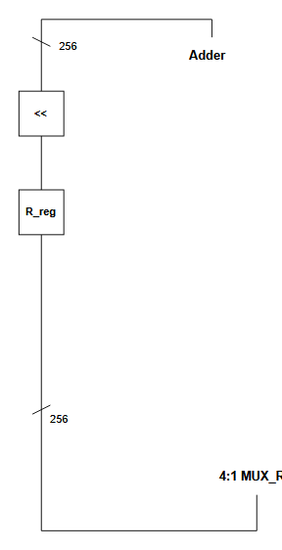
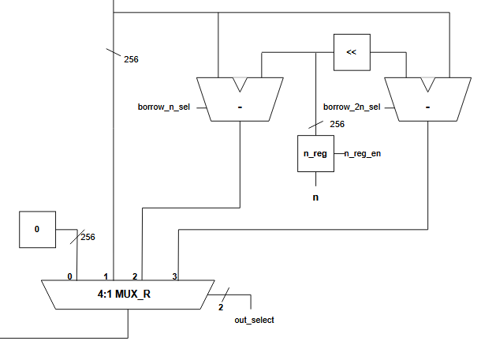
Performance Estimate
← These modules are in parallel → Clock cycles: 2
The adder after
Clock cycles: 1
Worst case this uses: 0 cycles Best case this uses: 2 cycles
Blakley runs k-times and binary shift runs k-times. This implies a range between: [3k^2, 5k^2] cycles.

