Slide 1
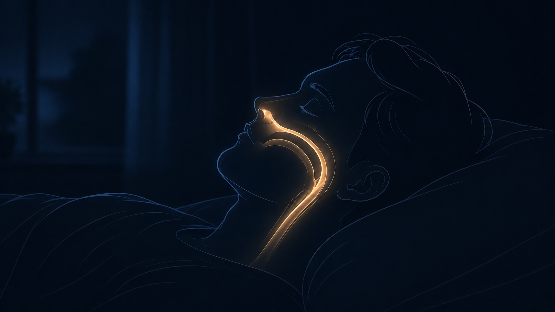
Notes:
HOLD IN SILENCE FOR 3 SECONDS BEFORE SPEAKING. "I am a chiropractor. For twenty years my job has been to look at a person and see what is carrying weight the wrong way. Some of you were here last time. Last time I showed you the pipe — the nose, the skull, the airway, and the fact that almost nobody checks whether it is bent. Tonight is the other half. Not what it is. What to do about it." CALLBACK DONE. Do not re-teach the pipe.

Slide 2
GEOMETRY GOVERNS BREATH.
BREATH GOVERNS SLEEP.
DR. ROBERT ZERAVICA, DC
Notes:
Say the line out loud as this comes up. "The shape you are built in decides how you breathe. How you breathe decides how you sleep. And how you sleep decides almost everything else." Then: sleep is not rest, sleep is work. Brain clears, body repairs, hormones reset — only if it goes deep, and it only goes deep if you are breathing well. SCOPE LINE HERE: "I do not diagnose sleep apnea. No chiropractor does. A medical doctor does. My lane is the structure around the airway. Tonight I am teaching, not treating."

Slide 3
THREE THINGS
01
02
03
CLOSE YOUR
MOUTH
LIFT YOUR
HEAD
FIND OUT
Open the gate.
Straighten the pipe.
Measure it.
Two are free and start tonight. The third is a phone call.
Notes:
"So tonight, three things. Not ten. Three. Open the gate. Straighten the pipe. Measure it. Two of them are free and you can start tonight. The third is a phone call." Then: "I am going to keep this tight, because I want real time for your questions." CLOCK: leave this slide by 3:00.

Slide 4
1
CLOSE YOUR MOUTH
Open the gate.
Notes:
3:00 - 7:00 LINE: "Your mouth is for eating and talking. Your nose is for breathing. Most people have those two jobs mixed up." WHY (90 sec): - Nose warms, cleans, wets the air. Mouth does none of it — cold, dry, dirty air straight down. - The nose is the FIRST GATE and it is meant to be tight. That resistance is not a fault. Mouth breathing is like taking the door off the house because the door slowed you down. - Nose breathing puts the TONGUE UP on the roof of the mouth, which helps hold the airway open behind it. Mouth open -> tongue drops back -> airway narrows. OPTIONAL CALLBACK (one line only): "Last time I read you the line from Genesis — breathed into his nostrils. Not the mouth."

Slide 5
IS IT YOU?
Dry mouth in the morning
Sore or scratchy throat
Waking up thirsty
Drool on the pillow
Ask whoever sleeps next to you
TONIGHT
Walk 30–40 minutes
with your mouth closed.
If you cannot hold it on a slow walk,
you will not hold it asleep.
Do not tape your mouth shut at night until you know whether you have untreated sleep apnea.
Notes:
Read the signs SLOWLY. People are checking themselves. On the warning, say it out loud: "Do not tape your mouth shut because you saw it online. Not until you know whether you have untreated sleep apnea. Taping over a real problem is covering the alarm, not putting out the fire. Point three tells you how to find out." If the nose feels too small for the job, that is usually because it has not been used in years. Easier in about two weeks. LAND IT: "That is the gate. It is free, it starts tonight, and you have been walking around with it open."

Slide 6
2
LIFT YOUR HEAD
Straighten the pipe.
Notes:
7:00 - 11:00 LINE: "Your head weighs about five kilos. Every centimeter it drifts forward, your neck carries it like it weighs more." THE BIG IDEA — say this slowly: - The airway is NOT just a tube. It is held open, or squeezed shut, by everything around it: bone, soft tissue, your tongue, your jaw, the position of your neck, even how wound up your nervous system is. - The bones of your face are not decoration. They are the architecture your breath moves through. - It runs the whole way up: feet, hips, spine, ribs, neck, jaw, palate, skull. Then: put a phone in that system. Head forward, neck bends, throat narrows. NEXT SLIDE SHOWS IT.

Slide 7
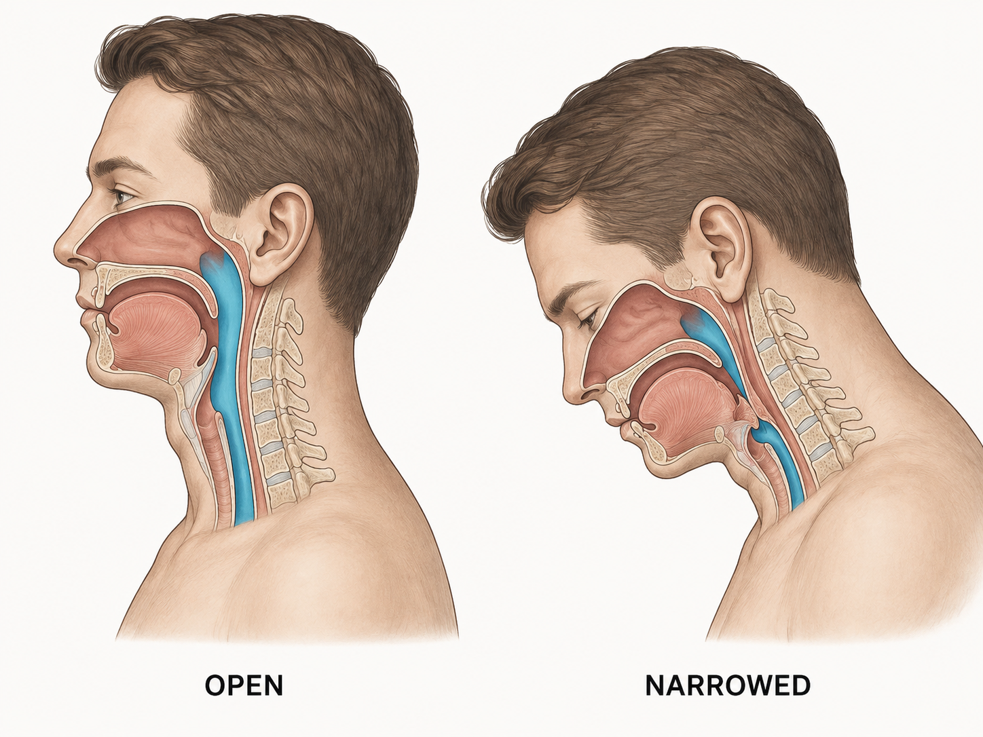
Your posture and your breathing are the same subject.
Notes:
THE MONEY SLIDE. Let them look before you talk. "When the head goes forward, the neck bends and the space at the front of your throat gets smaller. Your posture and your breathing are the same subject. I cannot separate them and neither can you." CALLBACK: "This is the kink I showed you last time. And it is the one you are doing to yourself right now, looking down at a phone." PRINT THIS ONE. It works on stage even with no screen.

Slide 8
WHAT TO DO
1
Screen to eye level
Phone off your lap. Biggest one, costs nothing.
2
Walk every day
The spine has no pump. Discs feed on movement.
3
Long exhale before bed
Out longer than in. Five minutes. Same routine nightly.
4
Notice your jaw
Clicking, morning tightness, worn teeth. It sits on the airway.
Notes:
Keep this brisk — four items, about 90 seconds total. On walking: "I am not going to tell you to stand up every thirty minutes. Nobody does that in real life. Walk." LAND IT: "Bodies take the shape you hold most. That is not a character flaw, that is how tissue works. But it does mean the shape you hold most is a choice — even when it does not feel like you are choosing."

Slide 9
3
FIND OUT
Measure it.
Notes:
11:00 - 15:00 LINE: "Snoring is not a personality. It is the sound of tissue shaking in a narrow airway. It is information." Next slide: read the signs slowly. People are checking themselves and their partner.

Slide 10
GO FIND OUT IF
You snore loudly
Someone has watched you stop breathing
You gasp or choke awake
You wake up tired after a full night
You get morning headaches
You fall asleep in the daytime
Your blood pressure will not come down
Two or three of those is not a sleep habit. It is a question that needs an answer.
Notes:
Read these SLOWLY. This is the slide people photograph. Then the two ways to measure: CHEAP, TONIGHT: a ring, a band, or a phone app. Any of them. Every night matters more than the brand. Watch the TREND, not one night. It is a mirror, not a medical test. REAL: a home sleep test. Small device comes to your house, you wear it one night in your own bed, a doctor reads it. "I do not read it and I do not diagnose it. A medical doctor does. I read the structure." CPAP, oral devices, surgery WORK for the right people. Do not attack them. CALLBACK: "Same as last time. I am not throwing rocks at the mask. I do not have to."

Slide 11
The system waits until you qualify.
A symptom. A diagnosis. A label.
I start before you are anyone’s patient.
Notes:
Slow down here. This is your strongest line and they heard it last time as an idea — tonight it is the instruction. Set it up first: "Pain and tiredness are LATE signals. Bodies cover. They borrow from one place to hide a loss in another, and they do it quietly. I feel fine is not proof — it means the cover-up is still holding." LAND IT: "Get a picture while you feel good. Then look again later. A first measurement you never compare to is just a souvenir."

Slide 12
THREE THINGS
1
CLOSE YOUR MOUTH
Open the gate.
2
LIFT YOUR HEAD
Straighten the pipe.
3
FIND OUT
Measure it.
Two are free and start tonight.
Notes:
15:00 - 17:00 "Two of those are free and they start tonight. Walk with your mouth closed. Get your screen up to eye level." Then the one you chase them down the hall about: "If you snore, if you gasp, if somebody has watched you stop breathing, or if you wake up tired after a full night — go find out what is happening. Do not wait until you qualify for a label." "You spend a third of your life doing this work. It is worth knowing whether you are doing it well." Do NOT thank them yet. Straight into Q&A.

Slide 13
ASK ME ANYTHING
Notes:
17:00 - 27:00. TEN MINUTES. Open with: "Now. Ten minutes. Ask me anything." NO MIC — THEY SHOUT. Six rules: 1. REPEAT EVERY QUESTION OUT LOUD. Every one. Recording only has my voice. 2. Name the order: "you, then you in blue, then the back." 3. WALK toward whoever is asking. 4. Did not hear it? "Say that again, louder." Never guess. 5. Call on the BACK of the room. Then wait. 6. About 45 seconds an answer. Rambler: "Let me take a couple more and I will find you after" — then TURN MY BODY. Say "last question" at 26:00. If the room freezes, ask my own: "How do I know if I breathe through my mouth at night, when I am asleep for the whole thing?" — dry mouth, sore throat, thirsty, drool, ask your partner. NEVER: cure claims, telling anyone to stop CPAP, attacking sleep doctors or dentists, promises about someone I have not examined.

Slide 14
Close your mouth.
Lift your head.
And if you snore, go find out why.
Dr. Robert Zeravica, DC · ChiropracticSleepAcademy.net
Notes:
27:00 - 28:00. Do NOT let Q&A be the ending. "One last thing and I will let you go. Close your mouth. Lift your head. And if you snore, go find out why. If any of that sounded like you, come find me after. It costs nothing to ask." THANK VIT BY NAME. Stop. After: take names on your phone. Anyone who mentions snoring, gasping, or waking tired is a real conversation. Follow up within two days.

