Slide 1




Decoding DNS Centralization: Measuring and Identifying NS Domains Across Hosting Providers
Qihang Peng, Mingming Zhang, Deliang Chang, Jia Zhang, Baojun Liu, Haixin Duan
Notes:
Hello everyone, my name is Qihang Peng. Currently I am a first-year PhD student at Tsinghua University. I will give a presentation named as Decoding DNS Centralization: Measuring and Identifying NS Domains Across Hosting Providers.

Slide 2



Domain Name System
DNS is a critical infrastructure that translates domain names to IP addresses.
2. example.com?
Root NS
Outlines
3. redirect to .com
1. example.com?
4. example.com?
TLD NS
8.IP of example.com
5. redirect to ns.example.com
Client
Recursive
resolver
6. example.com?
7.IP of example.com
ns.example.com
Auth NS
Notes:
What is DNS, or Domain Name System? It’s a critical infrastructure that translates domain names to IP addresses. If we use a browser to try to access example.com, our browser will request the DNS automatically for the IP address. The progress for resolving is recursive, as shown in the picture, we need to access several name servers, such as the Root, TLD name server and authoritative name servers. Each name server has a domain name and we will call it NS for short. We call that the final name server which returns the IP host this domain, usually this name server is provided by an external hosting provider.

Slide 3
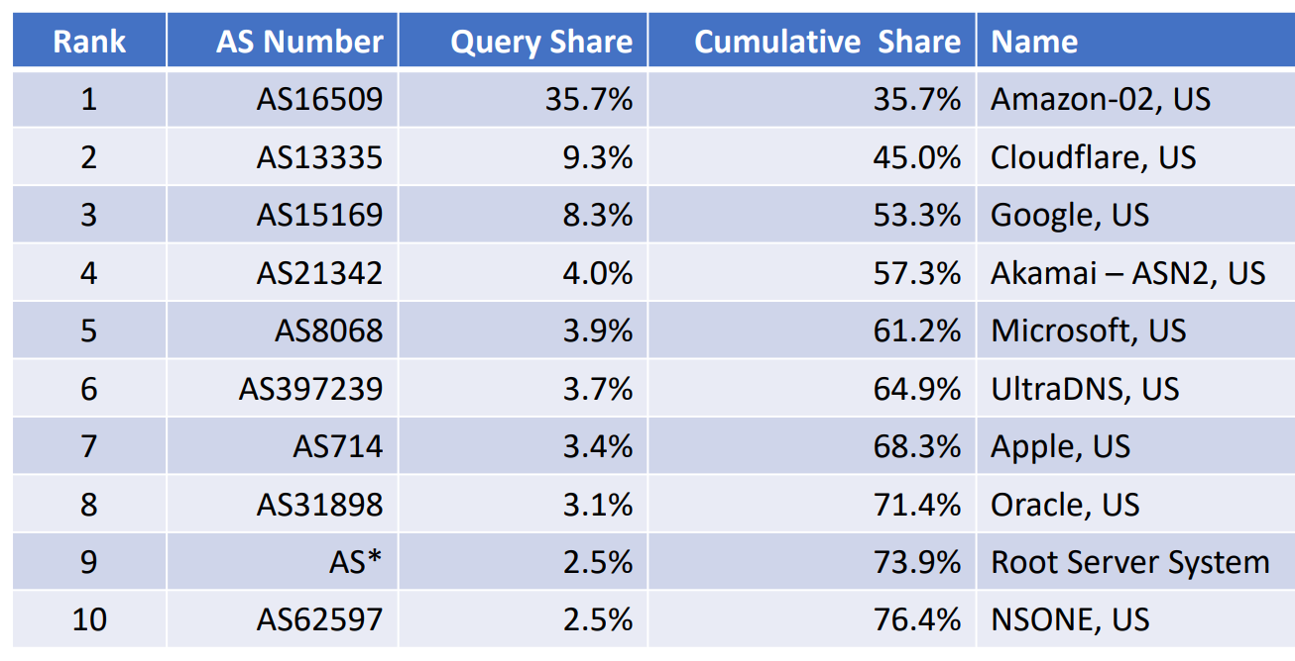
DNS Centraliztion
DNS is designed as a distributed system, but…
DNS is becoming more and more centralized.
Notes:
DNS is designed as a distributed system for low delay and high robustness. But in recent years, DNS has become more and more centralized across multiple layers. The table shows a measurement result from APNIC. We can observe that the top 10 ASes handle over 76% of DNS queries, indicating a clear trend of centralization at the hosting provider level. However, this data does not clearly reflect the degree of centralization of DNS in the hosting provider sector.

Slide 4



DNS Centraliztion
Assume there is a provider hosting 50% domains of the Internet…
Then assume its NSes are vulnerable,
or just offline
A.com IN A
B.com IN A
……..
x.x.x.x
z.z.z.z
A.com?
y.y.y.y
z.z.z.z
x.x.x.x
z.z.z.z
provider
timeout
NS
B.com?
……
vulnerable
x.x.x.x
z.z.z.z
timeout
NS
50% are unavailable now!
50% are redirected to malicious IPs at once!
Notes:
What is the harm of the centralization of hosting providers in DNS? Well, assume that there is a provider hosting 50% domains, and unluckily, the service of the provider is vulnerable so that hackers can change the IP of the domains it records. Or the service becomes unavailable. As we can say that these raise significant harm to the Internet

Slide 5

Measure DNS Centraliztion
It is necessary to measure how centralized DNS provider is.
So we first need to identify providers, but how?
hosting
provider1
hosting
provider2
hosting
provider3
Checking AS?
Logical
Many-to-many
Less accurate
Physical
AS
provider1
AS
provider2
AS
provider3
Good idea, but …
dns2.hichina.com
?
Checking NS?
rs61a.registrar-servers.com
ns.linode.com
How to identify which provider an NS belongs to?
Notes:
If we want to avoid this, we may first measure how centralized DNS is, then we will face the problem of how to identify providers. Checking AS, or checking the physical servers belong to which entity is a usual method. But, NS is not a physical server but a logical server, the relationship between NS and physical servers may be many-to-many. It’s impossible for us to identify hosting providers by identifying physical server providers. We can also check NS, it’s a good idea, but we may not identify their providers simply. In fact, accurately identifying NS records remains a major challenge. For example, can we identify the providers of these NS?

Slide 6



Challenge
dns2.hichina.com
rs61a.registrar-servers.com
ns.linode.com
How to identify which provider an NS belongs to?
Notes:
These three examples highlight two challenges in identifying NS records. First, the NS domain name may not explicitly contain information about the corresponding provider—for instance, hichina.com and registrar-servers.com belong to Alibaba Cloud and Namecheap, respectively. Second, even when a domain name appears to indicate the provider, this information may be inaccurate due to mergers or partnerships between providers. For example, while linode.com seems to belong to Linode, its NS domain is now controlled by Akamai following Akamai’s acquisition of Linode. So, how to overcome these challenges to identify providers by checking NS?

Slide 7






Identifying NS
Workflow:
Grouping NS seemed to belong to the same provider
Labeling group with providers
?
NS list
NS groups
Identified NS
Textual Pattern Similarity
Co-hosting Similarity
WHOIS data
Certificates
Notes:
Now we have a workflow. Given a list of NS, we will identify them by grouping and labeling. Labeling is simple by using the registration information from WHOIS and so on. How about grouping? We will introduce our method, which is grouping by textual pattern similarity and co-hosting similarity.

Slide 8
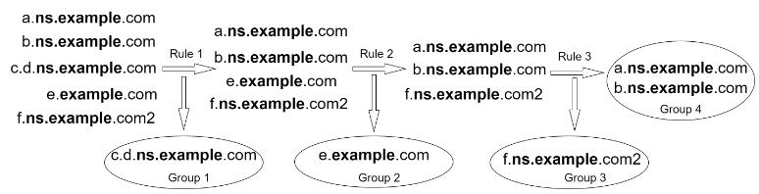
Textual Pattern Similarity
core
Flexible but effective
a.b.ns.example.com
subdomains
base
eTLD
(1) The subdomains of NS1 and NS2 are the same
We define NS1 and NS2 are similar if and only if
(2) Cores of NS1 and NS2 are the same
(3) ETLDs are both in PSL
Notes:
What is textual pattern similarity? Given an NS domain like this, we will cut it into subdomains, base and eTLD. We introduce “core” which consists of base and part of subdomains. We can define NS1 and NS2 are similar if and only if they meet the three rules. Here is an example of using these rules for grouping. You may think it simple, but it is effective in our practice.

Slide 9
Co-hosting Similarity
For most users, utilizing two or more hosting providers only increases operational costs.
Given this observation, NS domains co-hosting a substantial volume of user domains likely belong to the same provider.
Threshold: co-hosting rate over 90%
a.com…
b.com
90 co-hosting
a.com…
b.com
ns1.example.com
ns2.example.com
Hosting 100 domains
Co-hosting rate 90%
c.com…
d.com…
Hosting 96 domains
Co-hosting rate 93.75%
ns1.example.com
ns2.example.com
Regarded as the same provider
Notes:
As for co-hosting similarity, it’s based on the fact that for most users choosing two or more hosting providers only increases operational costs, so NS domains co-hosting a substantial volume of user domains likely belong to the same provider. As for the threshold for grouping we choose 90% after enough experiments. Here is an example.

Slide 10
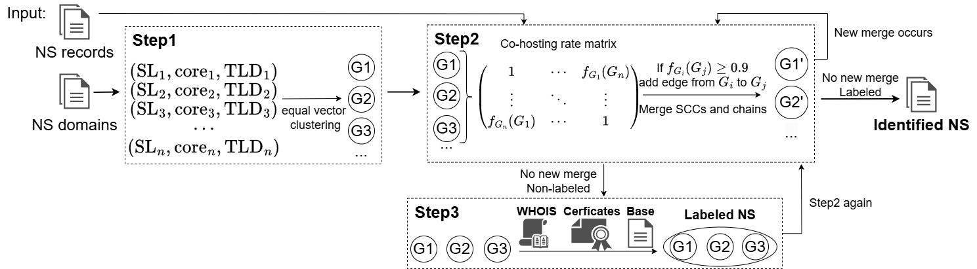
Full Workflow
Textual Pattern Similarity
Co-hosting Similarity
Labeling
PS: Given inconsistent names of providers in our data for labeling, we perform an additional Step2 to merge functionally equivalent providers for measuring centralization more easily. This is not strictly required for core analysis.
Notes:
Given the description of these two methods, we can give the full workflow of our method as the slides.

Slide 11
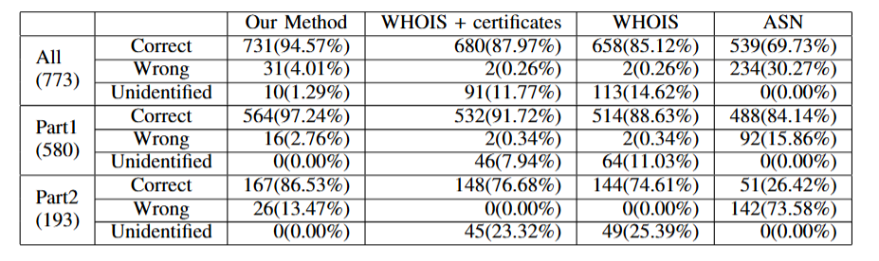
Evaluation and Comparison
Test dataset: 773 NS domains randomly sampled from 57 hosting providers.
Higher accuracy!
Notes:
For evaluation and comparison, to the best of our knowledge, there is currently no widely recognized benchmark dataset available in this area, so we make a test dataset consisting of 773 NS domains to conduct the experiments, all of these NS domains are manually labeled by us. For comparison, we adopt three domain identification methods commonly used in prior work as baselines: the combination of WHOIS and digital certificates, WHOIS alone, and AS registration information alone. The result proves that our method achieves higher accuracy.

Slide 12
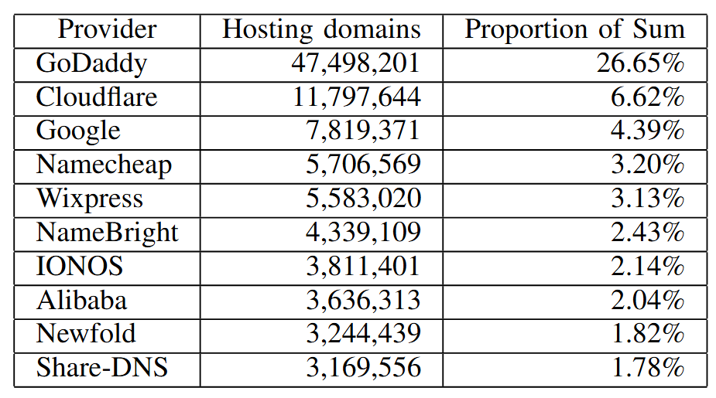
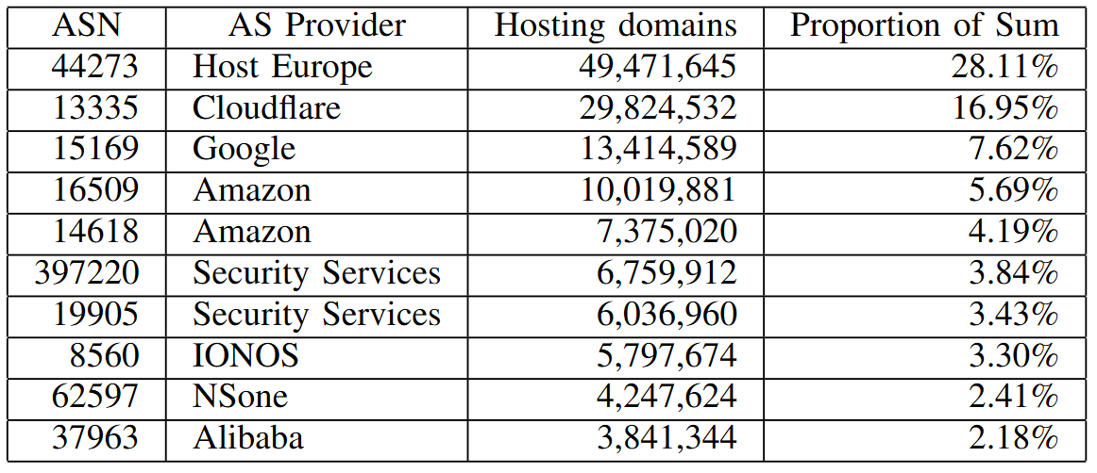
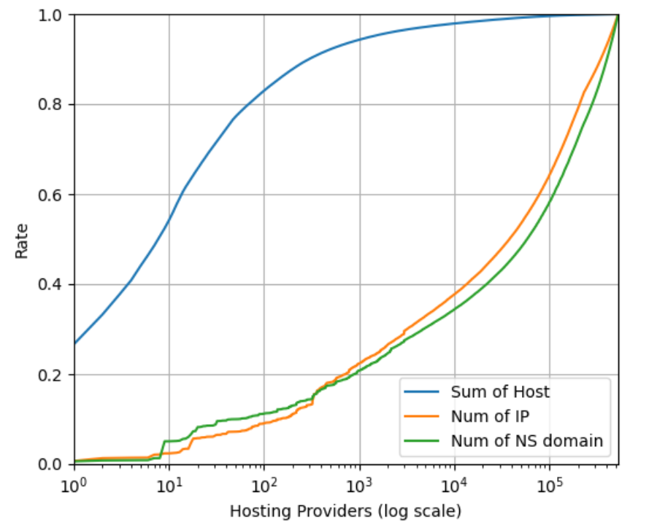
Measurement Results
Data: .com .net .org zone files on 2024.09.14 from CZDS
We also measure AS-level hosting centralization as a comparative basis
Top 100 providers hosting 82.99%
Top 10 providers hosting 54.19%
530,111 providers
Notes:
We conduct a measurement on .com .net and .org zone, here is top 10 providers that host the most domains. For the whole measurement result, we can see that top 10 hosting 54.19% while top 100 hosting 82.99%, while there are over 530 thousand providers.

Slide 13
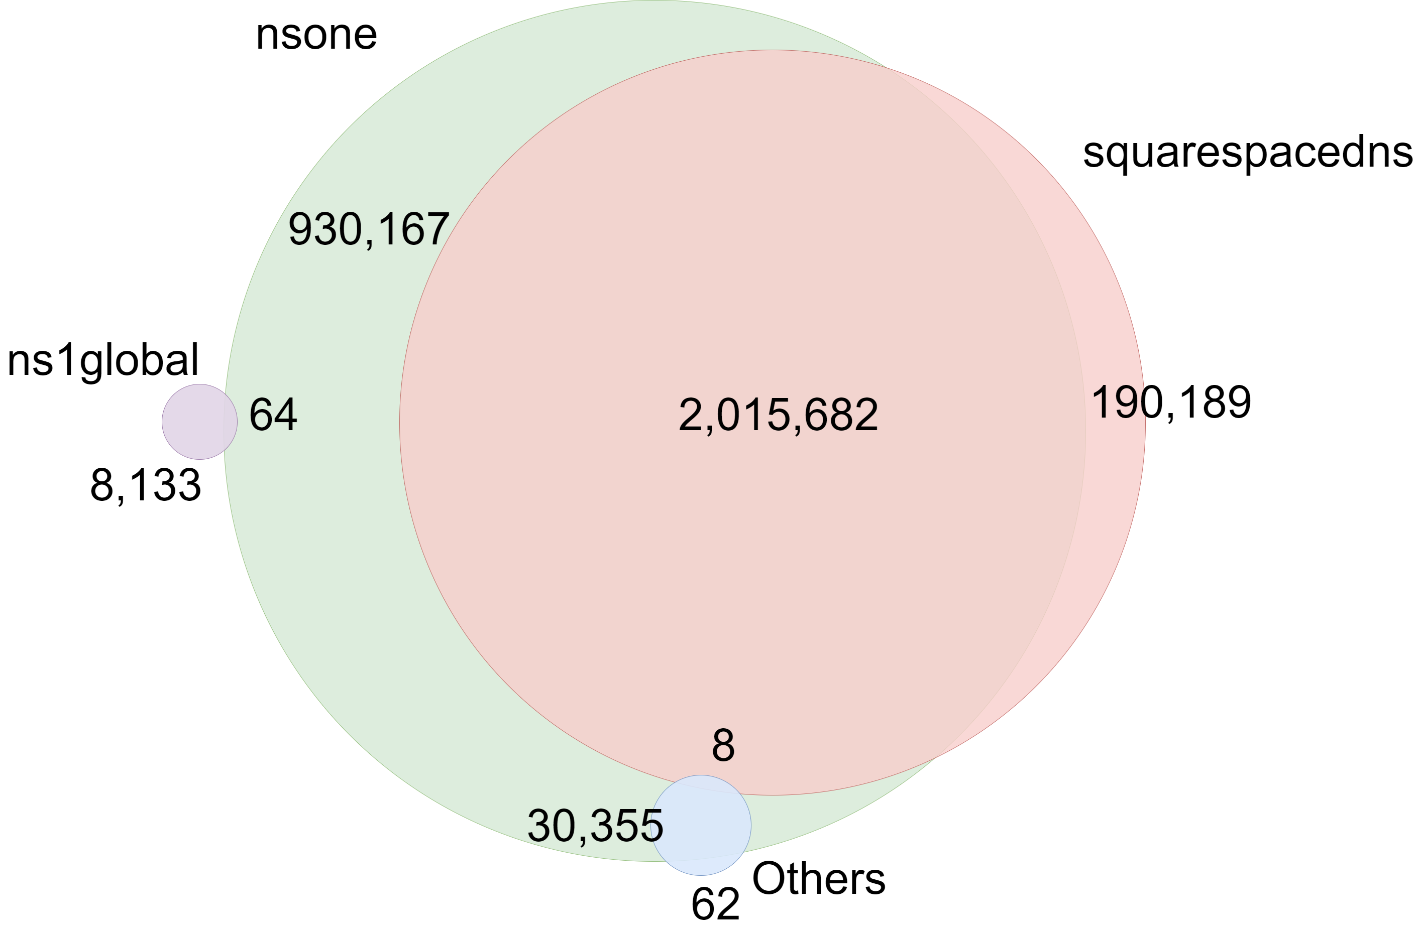
An Interesting Finding
squarespacedns.com and gannett-dns.com are categorized under NSone
High rate of Co-hosting
“Unrelated” base domain
gannett-dns.com
kenvuedns.com
jnjdns.com
……
Base domain ≠ hosting providers

Slide 14
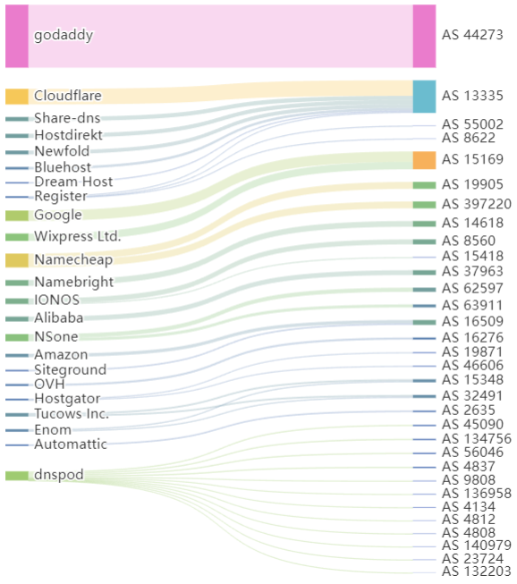
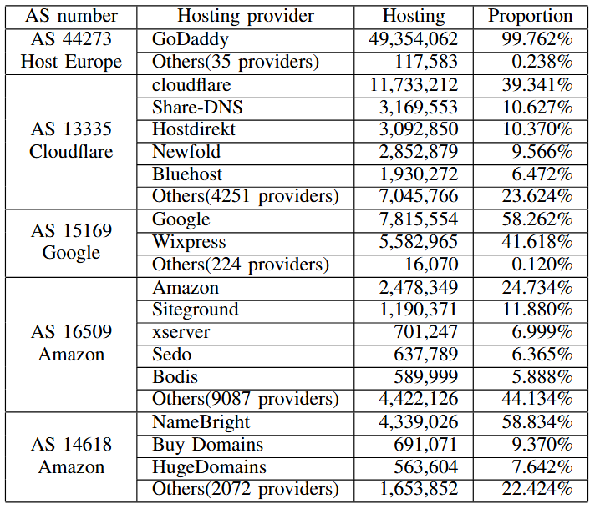
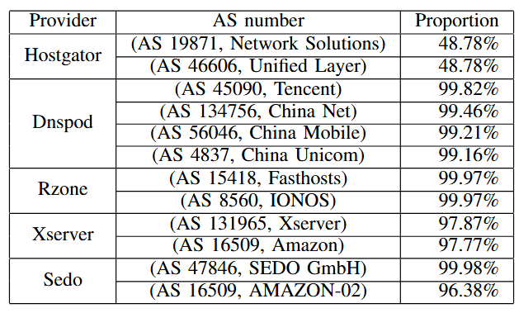
Providers vs Infrastructures
Exhibit no one-to-one correspondence
Providers to infrastructures
Top 5 infrastructures to providers
Complex many-to-many relationships

Slide 15
Conclusion
Two kinds of clustering for identifying hosting providers are effective.
DNS exhibits significant centralization at the cloud hosting provider level
NS cannot be directly inferred from their visible characteristics
Hosting providers and physical infrastructure operate as a complex many-to-many relationship.

Slide 16
Thanks for your listening!
Presenter: Qihang Peng

