Slide 1
Anuncius
Protocolos de las tecnologias y servicios de Internet

Slide 2
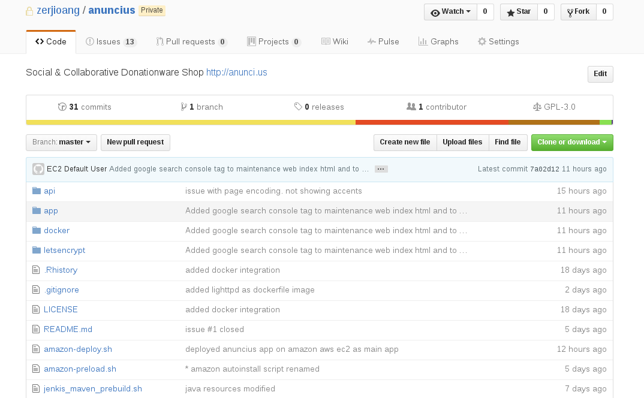
CVS: Github private repo

Slide 3
Platform architecture: design

Slide 4
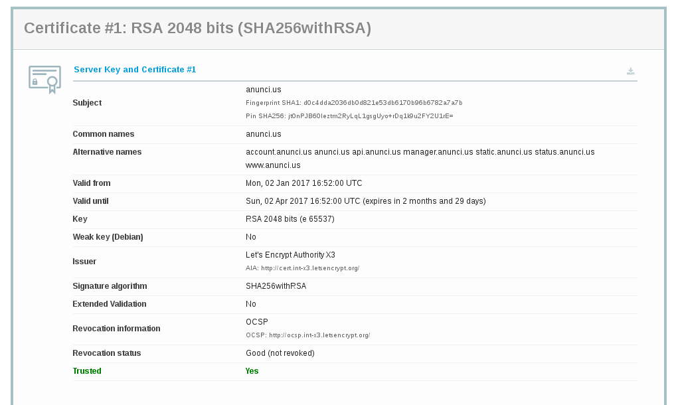
Platform architecture: SSL

Slide 5
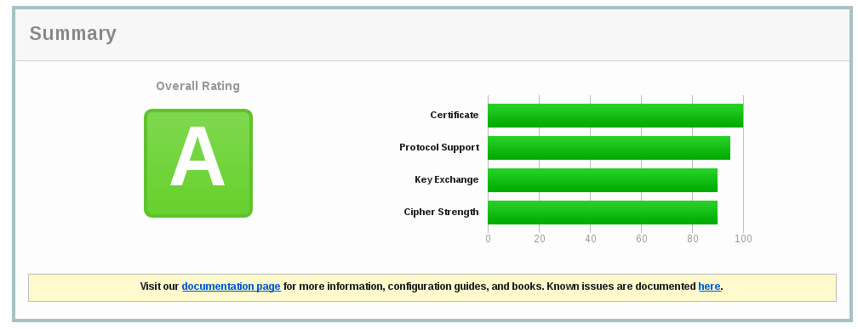
Platform architecture: SSL

Slide 6
Platform architecture: ports
Redis: port 6379
Mongo db: port 27017
Tomcat server: port 8080
Nginx server: port 80, 443
Nmap scan report for anunci.us (52.212.54.13)
Host is up (0.071s latency).
rDNS record for 52.212.54.13: ec2-52-212-54-13.eu-west 1.compute.amazonaws.com
Not shown: 997 filtered ports
PORT STATE SERVICE
22/tcp open ssh
80/tcp open http
443/tcp open https
Nmap done: 1 IP address (1 host up) scanned in 6.75 seconds

Slide 7
Platform architecture: tweaks
Ping blocked
http://$server_ip blocked
https//$amazon_public_dns blocked
301 redirects:
http://www.anunci.us → https://anunci.us
https://www.anunci.us → https://anunci.us
http://anunci.us → https://anunci.us
52.212.54.13 → https://anunci.us
ec2-52-212-54-13.eu-west 1.compute.amazonaws.com → https://anunci.us
Image hot linking blocked
Leverage browser cached enabled
GZIP compression enabled
Resource html, js, css minification enabled
.jsp suffix removal for friendly url enabled

Slide 8
Platform architecture: analytics
Google Analytics js added
Google Search Console linked
Json-ld & schema.org info (structured data) added

Slide 9



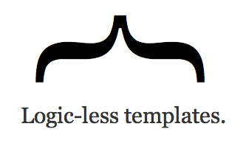




Technologies: frontend

Slide 10









Technologies: backend

Slide 11
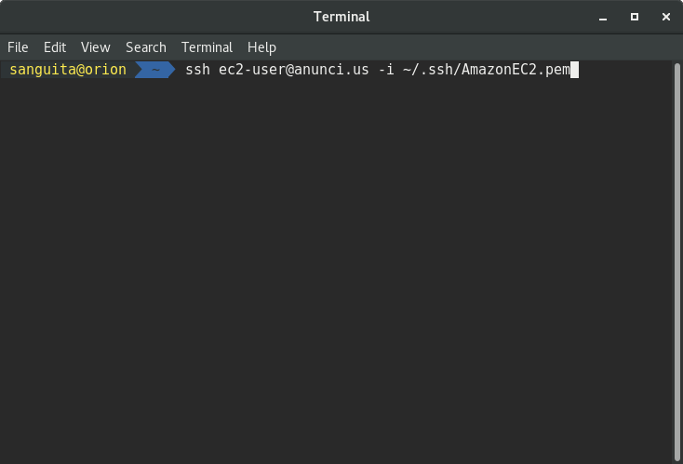
Platform deploy via ssh

Slide 12
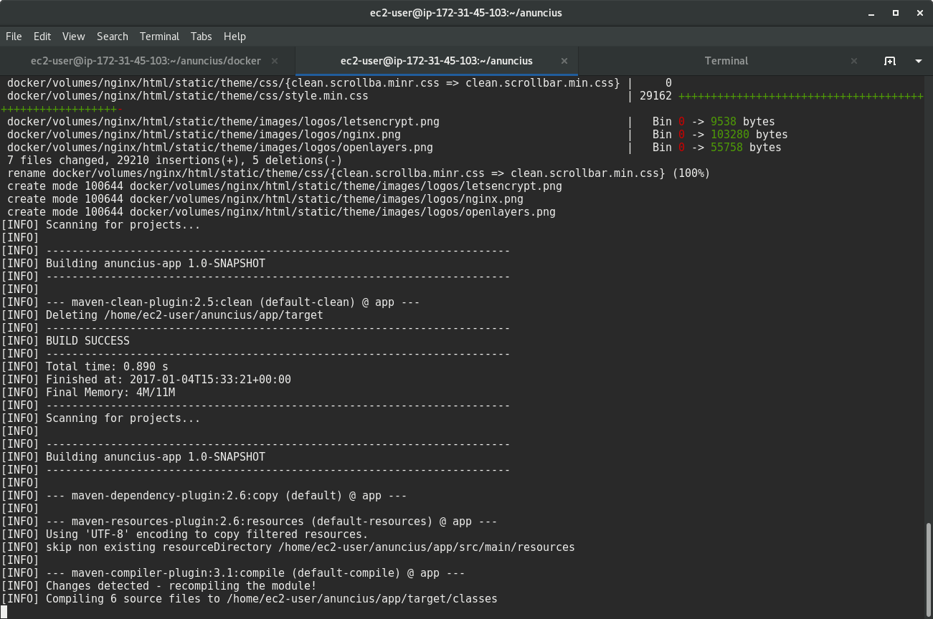
Platform deploying...

Slide 13
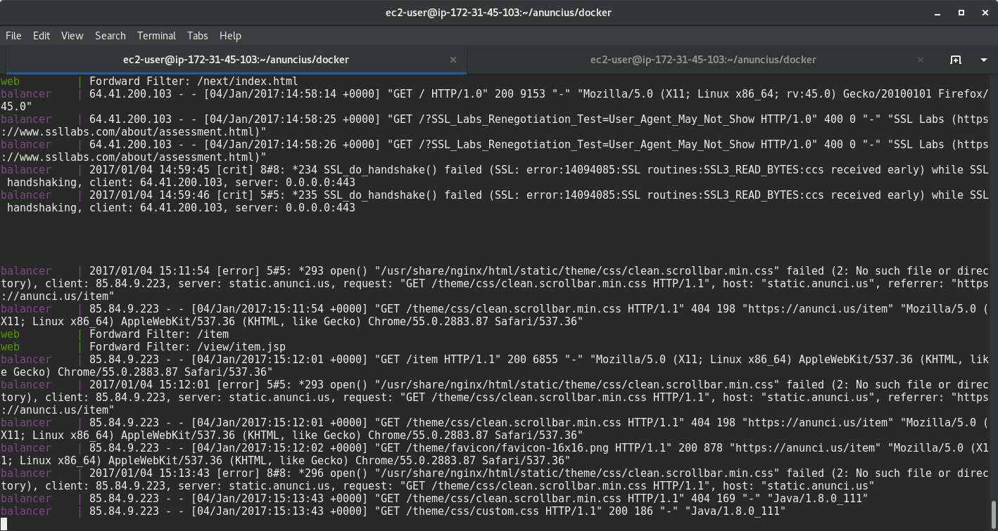
Platform deployed

Slide 14
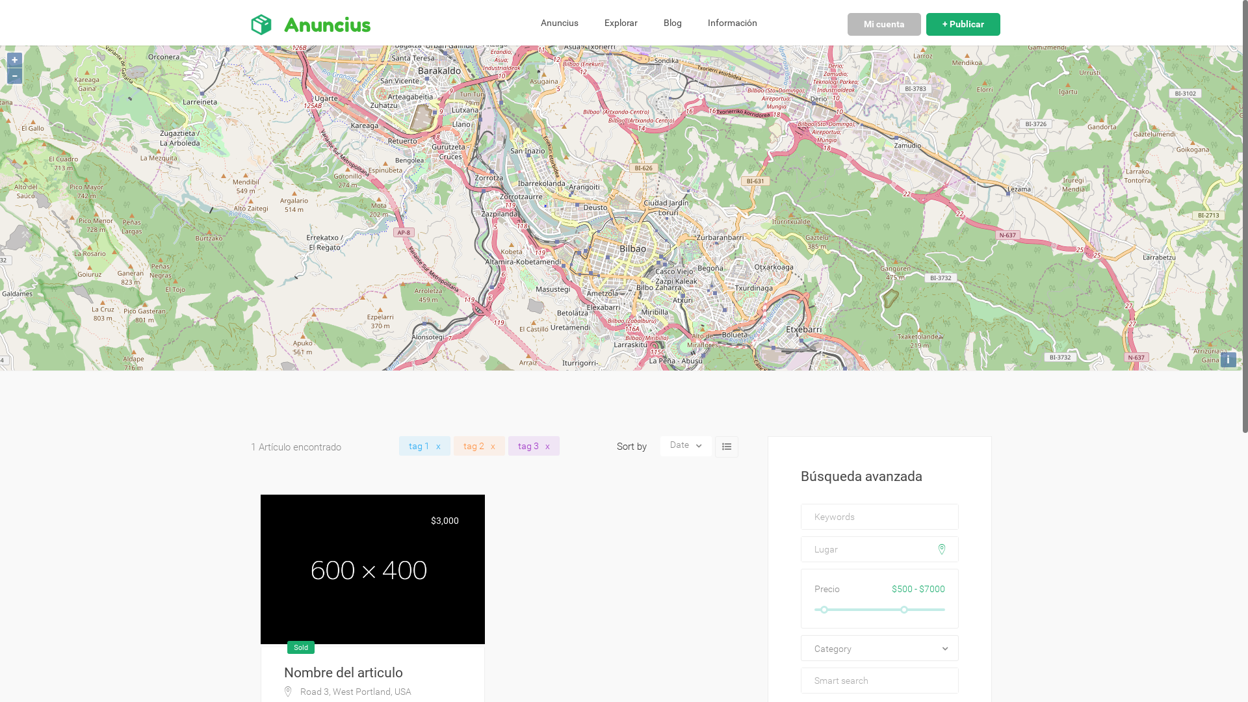
Enjoy!

