Slide 1
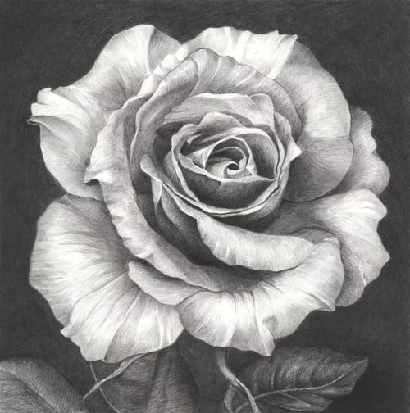
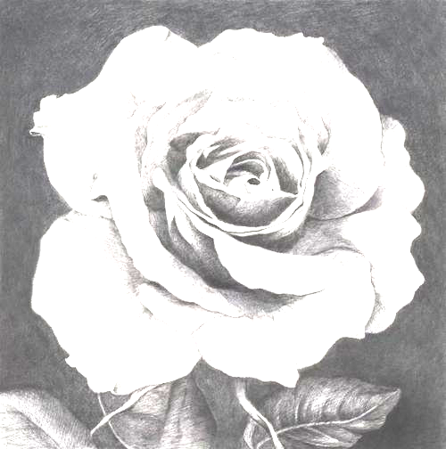

Homework-3: Histogram Equalization
For a/b/c.bmp
Show the results of performing Histogram Equalization of these images.
Compare the histogram before and after processing and explain the effect
Using C++/Matlab/Python
Upload a zip/rar with a report, source codes and results

