Slide 1
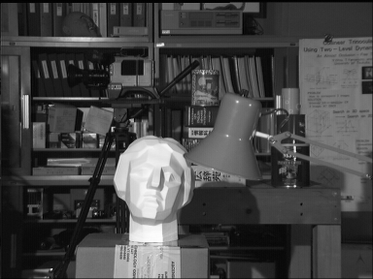
Homework-2 Interpolation & rotation
For tsukuba-left.bmp(gray, 8bits/pixels, 384*288 pixels)
Do bilinear interpolation ( into 1152*864,pixels)
Do rotation +40 degree
Using C++/Matlab/Python

Slide 2
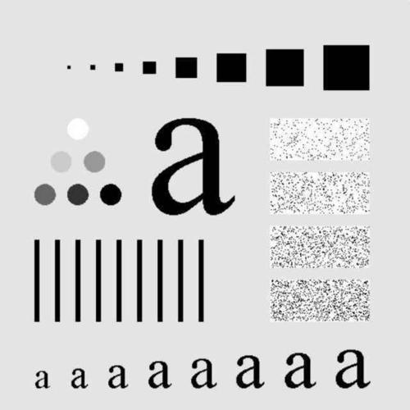
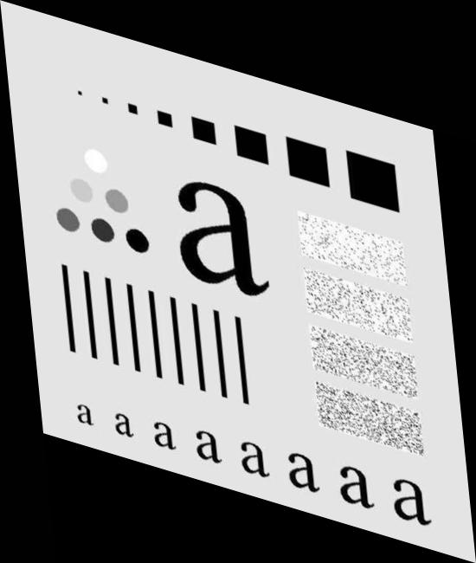
Homework-2 Image registration
For a_ori.jpg and a_trans.jpg
a_trans is the affine transformation result of a_ori
Find the affine transformation matrix of them, and make both transforming from a_ori to a_trans and transforming from a_trans to a_ori possible
Using C++/Matlab/Python
Upload a zip/rar with a brief report, source codes and results (both Interpolation & rotation and Image registration)

