Slide 1
Week 12
Maintaining Information Systems

Slide 2
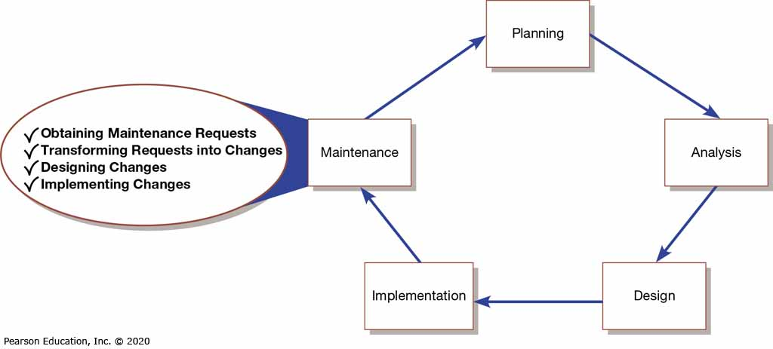
Figure 1: Systems Development Life Cycle

Slide 3
Maintaining Information Systems
Four major activities occur within maintenance:
  Obtaining maintenance requests
  Transforming requests into changes
  Designing changes
  Implementing changes

Slide 4
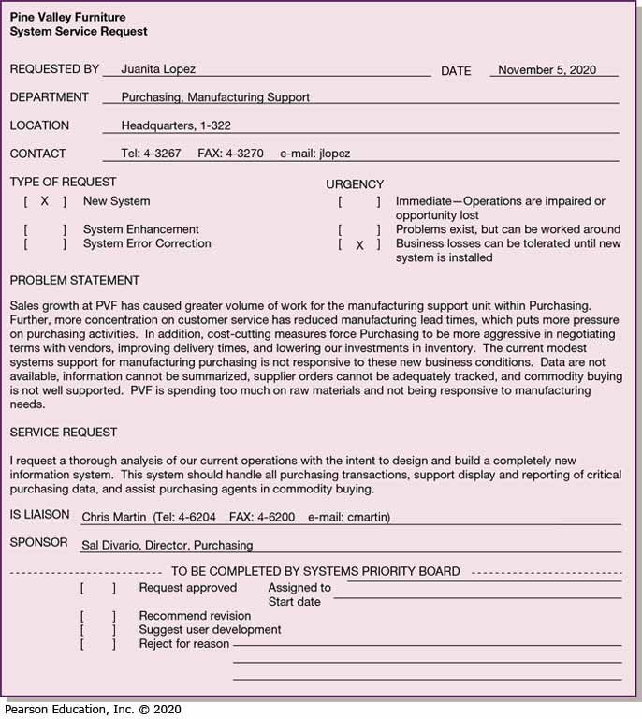
Figure 2: System Service Request for Purchasing Fulfillment System (PVF)

Slide 5
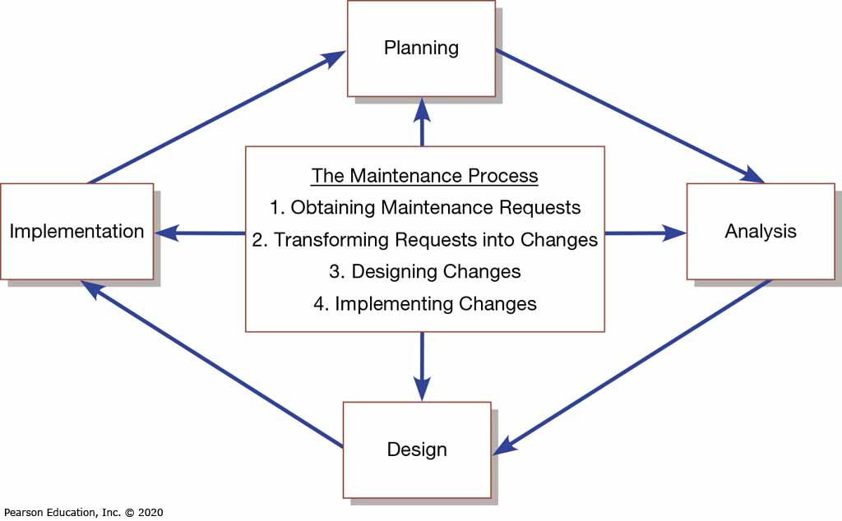
Figure 3: Maintenance Activities Parallel Those of the SDLC

Slide 6
Deliverables and Outcomes
SDLC maintenance phase is a subset of the activities of the entire development process
Development of a new version of the software and new versions of all design documents created or modified during maintenance

Slide 7
Types of Maintenance (1 of 2)
Maintenance refers to changes made to a system to fix or enhance its functionality
Corrective maintenance refers to changes made to a system to repair flaws in its design, coding, or implementation
Adaptive maintenance refers to changes made to a system to evolve its functionality to changing business needs or technologies

Slide 8
Types of Maintenance (of 2)
Perfective maintenance refers to changes made to a system to add new features or to improve performance
Preventative maintenance refers to changes made to a system to avoid possible future problems

Slide 9
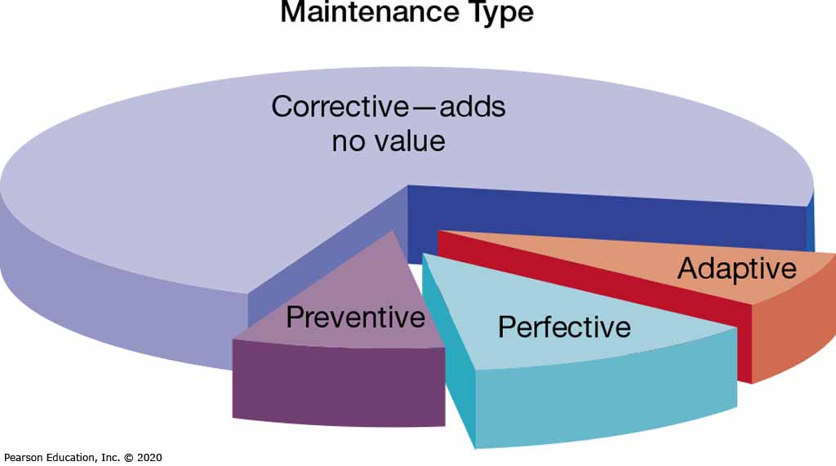
Figure 4: Value and Non-Value Adding of Different Types of Maintenance
(Sources: Based on Andrews & Leventhal, 1993; Pressman, 2005)

Slide 10
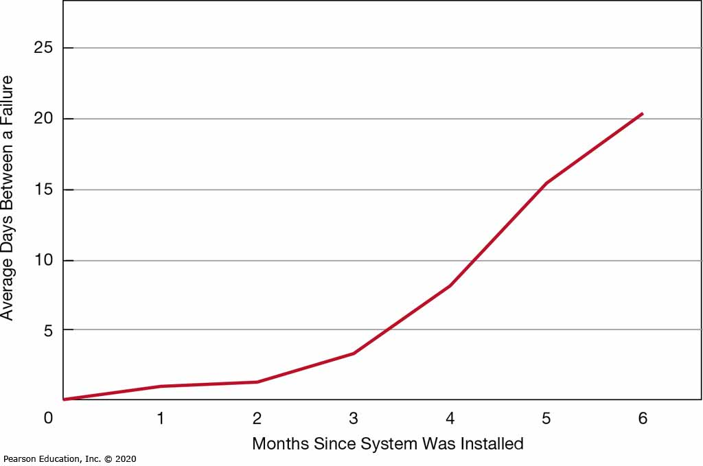
Figure 5: How the Mean Time Between Failures Should Change Over Time

Slide 11
Controlling Maintenance Requests
Maintenance requests can be frequent
Prioritize based on type and urgency of request
Evaluations are based on feasibility analysis

Slide 12
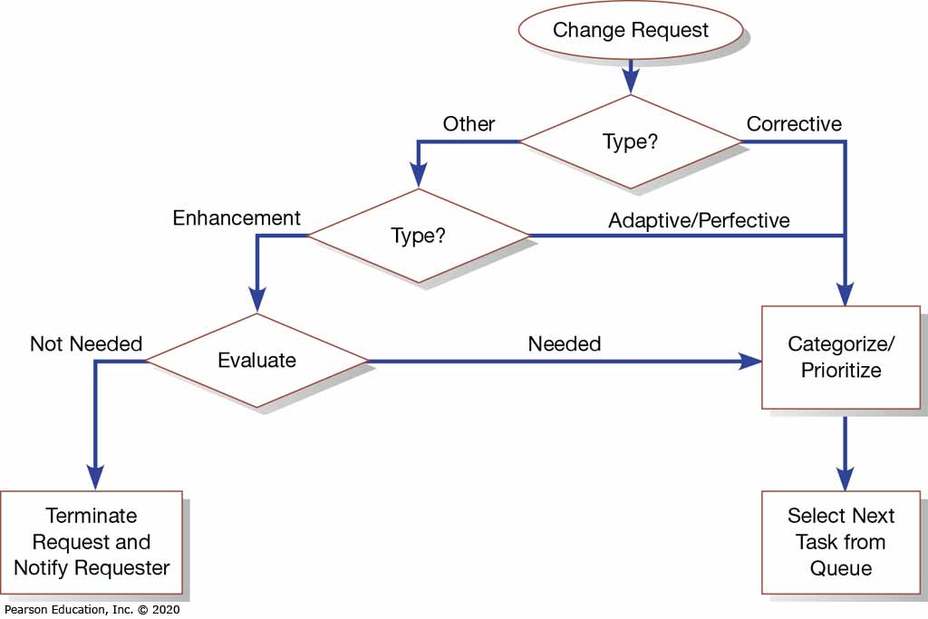
Figure 6: How to Prioritize Maintenance Requests

Slide 13
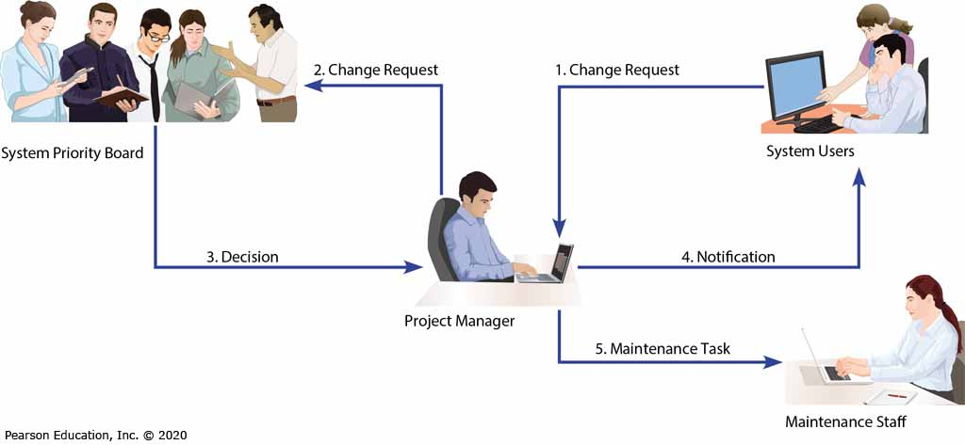
Figure 7: How a Maintenance Request Moves Through an Organization

