Slide 1
Week 3
Identification of System Development Project

Slide 2
Learning Objectives
Describe steps involved when identifying, selecting, initiating and planning projects
Discuss the content of and need for a Statement of Work and Baseline Project Plan
Describe various methods for accessing project feasibility.

Slide 3
Managing the Information Systems Project
Project manager – systems analyst with a diverse set of skills—management, leadership, technical, conflict management, and customer relationship—who is responsible for initiating, planning, executing, and closing down a project.
Project – planned undertaking of related activities to reach an objective that has a beginning and an end
Deliverable – end product of an SDLC phase;

Slide 4
Deciding on Systems Projects
System Service Request (SSR) – standard form for requesting or proposing systems development work within an organization
Feasibility study – study that determines whether a requested system makes economic and operational sense for an organization

Slide 5
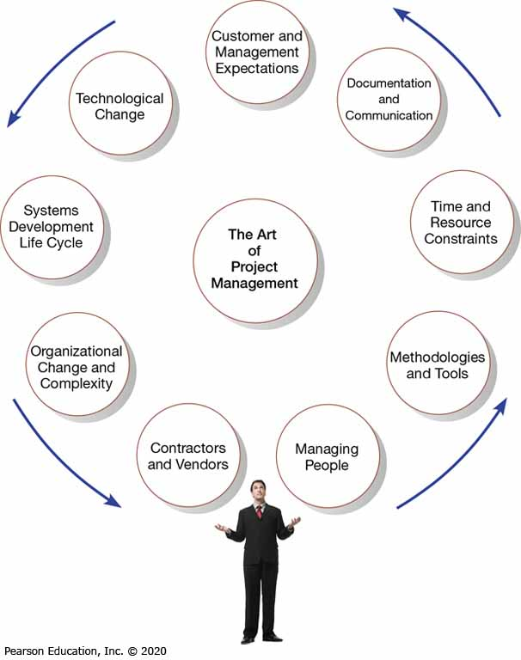
Figure 1: A Project Manager Juggles Numerous Activities
(Source: Media Bakery13/Shutterstock)

Slide 6
Table 1: Common Activities and Skills of a Project Manager
Activity | Description | Skill
Leadership | Influencing the activities of others toward the attainment of a common goal through the use of intelligence, personality, and abilities | Communications; liaison between management, users, and developers; assigning activities; monitoring progress
Management | Getting projects completed through the effective utilization of resources | Defining and sequencing activities; communicating expectations; assigning resources to activities; monitoring outcomes
Customer relations | Working closely with customers to ensure that project deliverables meet expectations | Interpreting system requests and specifications; site preparation and user training; contact point for customers
Technical problem solving | Designing and sequencing activities to attain project goals | Interpreting system requests and specifications; defining activities and their sequence; making trade-offs between alternative solutions; designing solutions to problems
Conflict management | Managing conflict within a project team to assure that conflict is not too high or too low | Problem solving; smoothing out personality differences; compromising; goal setting
Team management | Managing the project team for effective team performance | Communication within and between teams; peer evaluations; conflict resolution; team building; self-management
Risk and change management | Identifying, assessing, and managing the risks and day-to-day changes that occur during a project | Environmental scanning; risk and opportunity identification and assessment; forecasting; resource redeployment

Slide 7
Project Management
Project Management – controlled process of initiating, planning, executing, and closing down a project
Phases of project management:
  Initiating
  Planning
  Executing
  Closing down

Slide 8
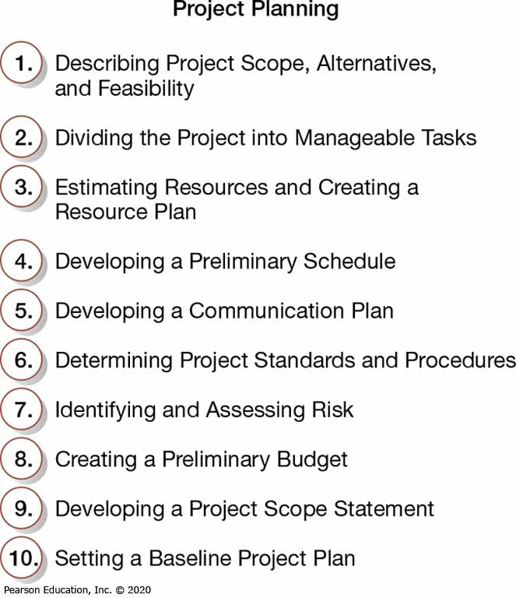
Figure 2: Ten Project Planning Activities

Slide 9
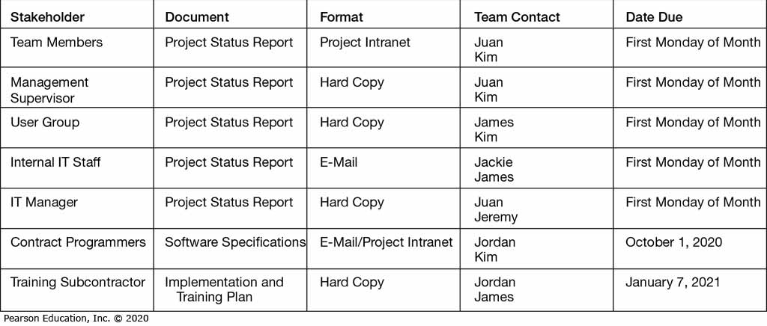
Figure 3: The Project Communication Matrix Provides a High-Level Summary of the Communication Plan

Slide 10
Identifying and Selecting Systems Development Projects
Identifying and selecting systems development projects is part of the first phase (Planning) of the SDLC
Many firms follow a very formal process for selecting projects
Requests come from a variety of sources:
  By managers needing to replace aging existing systems
  By managers wanting to make a system more efficient
  By managers needing a new system

Slide 11
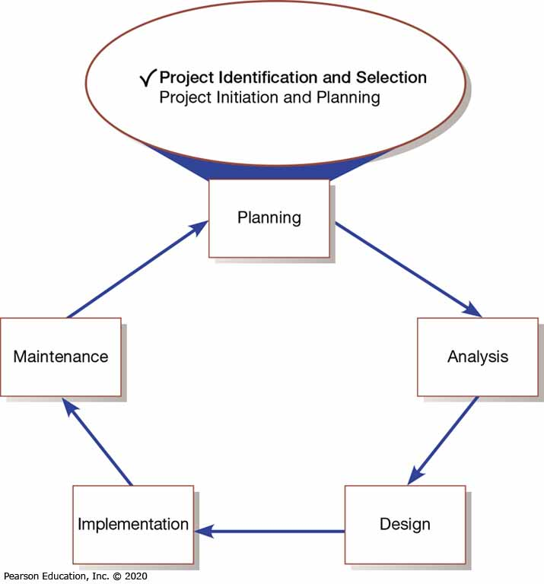
Figure 4: Systems Development Life Cycle with Project Identification and Selection Highlighted

Slide 12
Identifying and Selecting Projects
Project identification and selection consists of three primary activities:
  Identifying potential development projects
    By key member of top management
    By steering committee (top-down source)
    By user departments (bottom-up source)
    By development group or senior IS manager

Slide 13
Identifying and Selecting Projects
  Classifying and ranking IS development projects
    Using value chain analysis or other evaluation criteria
      Value chain analysis – used in analyzing an organization’s activities to determine where value is added to products and/or services and the costs incurred for doing so; it usually also includes a comparison with the activities, added value, and costs of other organizations for the purpose of making improvements in the organization’s operations and performance
  Selecting IS development projects
    Based on various factors with short- and long-term projects
    Numerous factors must be considered-Figure 5.

Slide 14
Table 2: Characteristics of Alternative Methods for Making Information Systems Identification and Selection Decisions
Selection Method | Characteristics
Top Management | Greater strategic focus Largest project size Longest project duration Enterprise-wise consideration
Steering Committee | Cross-functional focus Greater organizational change Formal cost-benefit analysis Larger and riskier projects
Functional Area | Narrow, nonstrategic focus Faster development Fewer users, management layers, and business functions involved
Development Group | Integration with existing systems focus Fewer development delays Less concern with cost-benefit analysis
(Source: Based on Fuller et al., 2018; McKeen et al., 1994; GAO, 2000)

Slide 15
Table 3: Possible Evaluation Criteria When Classifying and Ranking Projects
Evaluation Criteria | Description
Value Chain Analysis | Extent to which activities add value and costs when developing products and/or services
Strategic Alignment | Extent to which the project is viewed as helping the organization achieve its strategic objectives and long-term goals
Potential Benefits | Extent to which the project is viewed as improving profits, customer service, and so forth, and the duration of these benefits
Resource Availability | Amount and type of resources the project requires and their availability
Project Size/Duration | Number of individuals and the length of time needed to complete the project
Technical Difficulty/Risks | Level of technical difficulty to successfully complete the project within given time and resource constraints

Slide 16
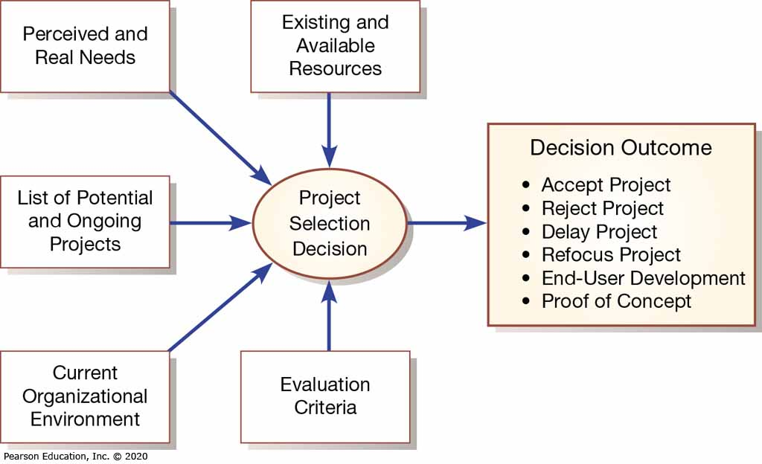
Figure 5: Project Selection Decisions Must Consider Numerous Factors and Can Have Numerous Outcomes

Slide 17
Deliverables and Outcomes
Primary deliverable from first phase of planning is schedule of specific IS development projects
Project initiation and planning is next phase
Incremental commitment is a strategy in systems analysis and design in which the project is reviewed after each phase and continuation of the project is rejustified

Slide 18
Information Systems Planning
Information systems planning (ISP) – orderly means of assessing the information needs of an organization and defining new systems, databases, and technologies that will best satisfy those needs.

Slide 19
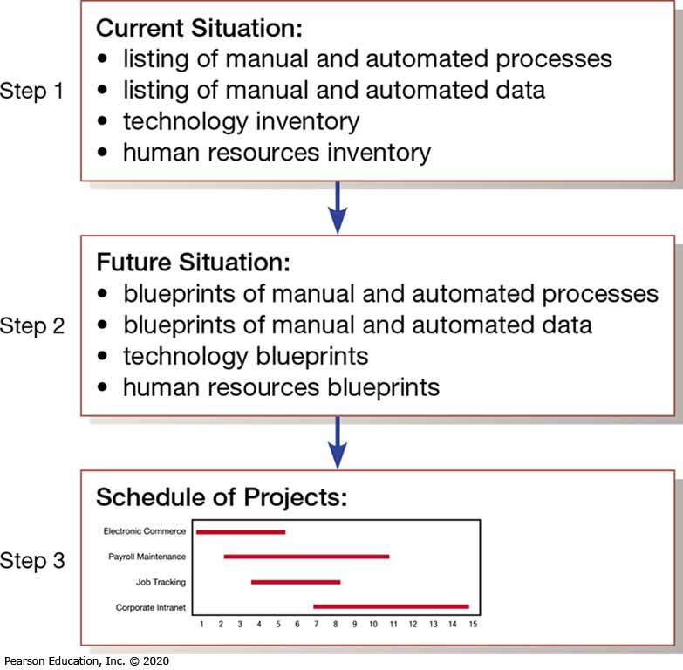
Figure 6: Information Systems Planning is a Three-Step Process

Slide 20
Gantt Chart
List tasks
Divide into phases
List milestone
Add time

Slide 21
Using Project Management Software
Many powerful software tools exist for assisting with project management
Microsoft Project is an example that can be used to:
  Establish a project starting or ending date
  Enter tasks and assign task relationships
  Select a scheduling method to review project reports

Slide 22
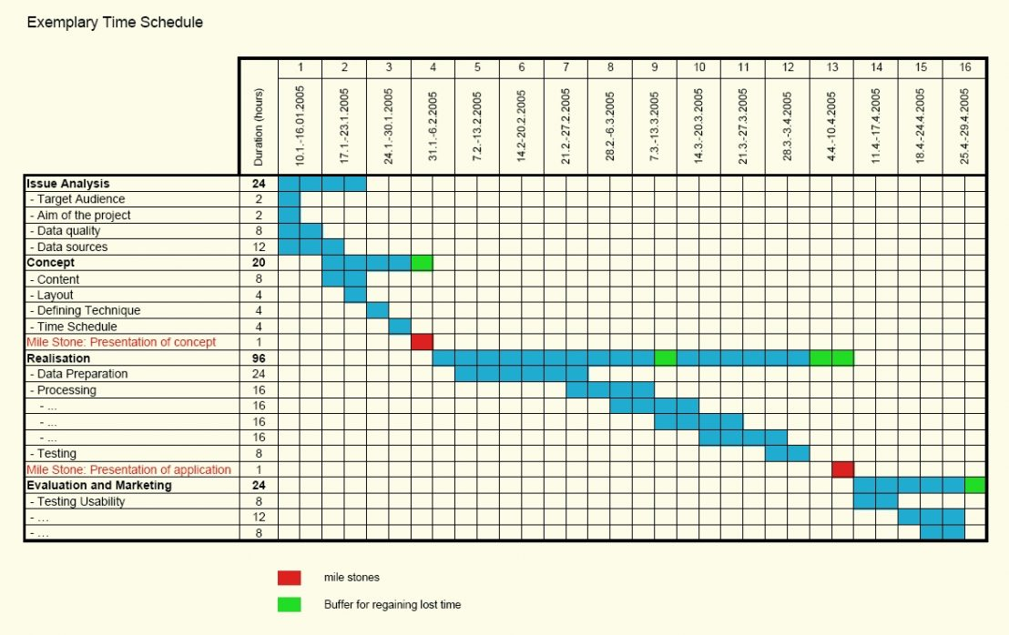
Figure 7: Gantt Chart Showing Project Tasks, Duration Times for Those Tasks, and Predecessors
(Source: Microsoft Corporation)

Slide 23
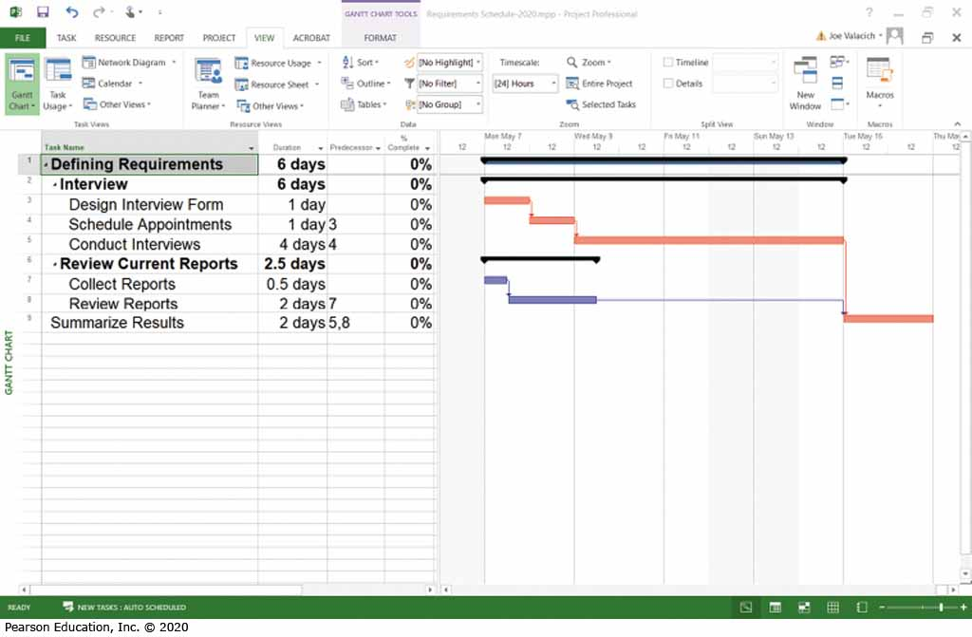
Figure 8: Gantt Chart Showing Project Tasks, Duration Times for Those Tasks, and Predecessors
(Source: Microsoft Corporation)

Slide 24
Group Activity
Role Play in 4 situations:
Speech from Project Manager briefing his job scope to his team members.
Meeting System Analyst with IT Manager about Project Planning Activities.
Discussion on project selection among top management and steering committee at Rimba Cafe.
Training on Project Management Software with IT Staff.

