Slide 1
Week 5
Initiating and Planning System Development Projects

Slide 2
Introduction
Project initiation focuses on activities designed to assist in organizing a team to conduct project planning

Slide 3
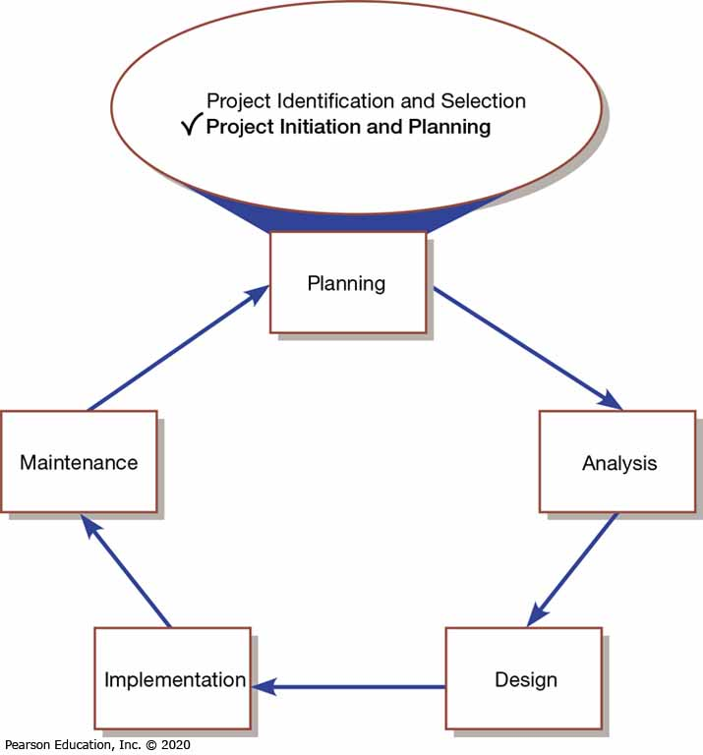
Figure 1: Systems Development Life Cycle with Project Initiation and Planning Highlighted

Slide 4
Table 1: Elements of Project Initiation
Elements of Project Initiation
Establishing the project initiation team
Establishing a relationship with the customer
Establishing the project initiation plan
Establishing management procedures
Establishing the project management environment and project workbook
Developing the project charter

Slide 5
Table 2: Elements of Project Planning
Elements of Project Planning
Describing the project scope, alternatives, and feasibility
Dividing the project into manageable tasks
Estimating resources and creating a resource plan
Developing a preliminary schedule
Developing a communication plan
Determining project standards and procedures
Identifying and assessing risk
Creating a preliminary budget
Developing the project scope statement
Setting a baseline project plan

Slide 6
Deliverables and Outcomes
Business case – justification for an information system, presented in terms of the tangible and intangible economic benefits and costs and the technical and organizational feasibility of the proposed system
Baseline Project Plan (BPP) – major outcome and deliverable from the project initiation and planning phase that contains the best estimate of a project’s scope, benefits, costs, risks, and resource requirements

Slide 7
Deliverables and Outcomes
Project Scope Statement (PSS) – document prepared for the customer that describes what the project will deliver and outlines generally at a high level all work required to complete the project

Slide 8
Assessing Project Feasibility
Most feasibility factors are represented by the following categories:
  Economic
  Technical
  Operational
  Scheduling
  Legal and contractual
  Political

Slide 9
Assessing Economic Feasibility
Economic feasibility – process of identifying the financial benefits and costs associated with a development project
Tangible benefit – benefit from the creation of an information system that can be measured in dollars and with certainty
Most tangible benefits:
  Cost reduction and avoidance
  Error reduction
  Increased flexibility
  Increased speed of activity
  Improvement of management planning and control
  Opening new markets and increasing sales opportunities

Slide 10
Assessing Economic Feasibility
Intangible benefit – benefit derived from the creation of an information system that cannot be easily measured in dollars or with certainty (See Table 3)

Slide 11
Table 3: Intangible Benefits from the Development of an Information System
Intangible Benefits from the Development of an IS | Intangible Benefits from the Development of an IS
Competitive necessity | More confidence in decision quality
More timely information | Improved processing efficiency
Improved organizational planning | Improved asset utilization
Increased organizational flexibility | Improved resource control
Promotion of organizational learning and understanding | Increased accuracy in clerical operations
Availability of new, better, or more information | Improved work process that can improve employee moral or customer satisfaction
Ability to investigate more alternatives | Positive impacts on society
Faster decision making | Improved social responsibility
Better usage of resources (“greener”) | .
(Source: Based on Parker & Benson, 1988; Brynjolfsson & Yang, 1997; Keen, 2003; Cresswell, 2004)

Slide 12
Determining Project Costs
Tangible costs – costs associated with an information system that can be measured in dollars and with certainty
Intangible costs – costs associated with an information system that cannot be easily measured in terms of dollars or with certainty

Slide 13
Table 4: Possible Information Systems Costs
Type of Cost | Examples | Type of Cost | Examples
Procurement | Hardware, software, facilities infrastructure Management and staff Consulting and services | Project | Infrastructure replacement/improvements Project personnel Training Development activities Services and procurement Organizational disruptions Management and staff
Start-Up | Initial operating costs Management and staff Personnel recruiting | Operating | Infrastructure replacement/improvements System maintenance Management and staff User training and support
(Source: Based on King & Schrems, 1978; Sonje, 2008)

Slide 14
Determining Project Costs
Total cost of ownership (TCO) – cost of owning and operating a system, including the total cost of acquisition, as well as all costs associated with its ongoing use and maintenance
One-time costs – costs associated with project start-up and development or system start-up
Recurring cost – costs resulting from the ongoing evolution and use of a system

Slide 15
Determining Project Costs (3 of 3)
Examples of recurring costs include:
  Application software maintenance
  Incremental data storage expenses
  Incremental communications
  New software and hardware leases
  Supplies and other expenses (e.g., paper, forms, data center personnel)

Slide 16
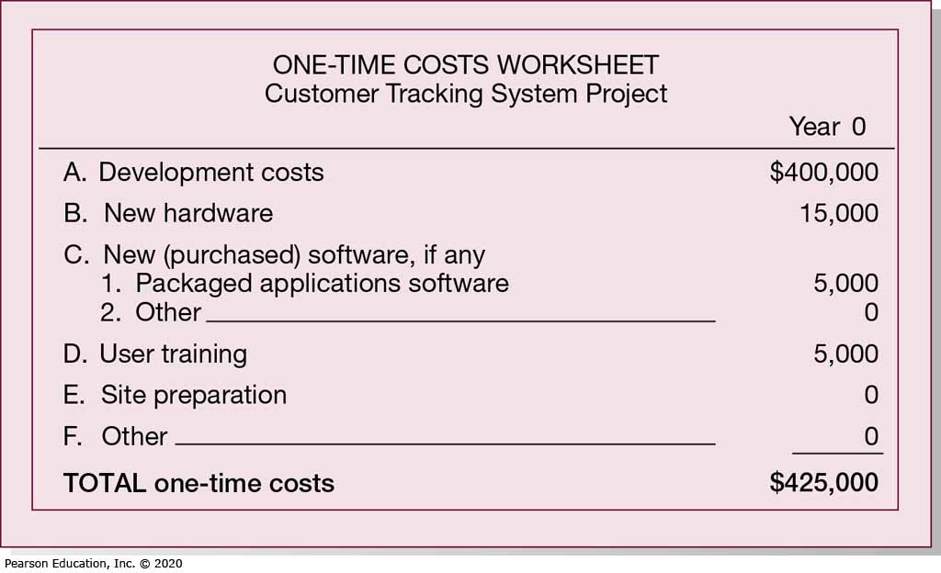
Figure 5: One-Time Costs for Customer Tracking System (Pine Valley System)

Slide 17
Table 6: Web-Based System Costs
Cost Category | Examples
Design | Number of pages / content Style of design / graphic design System comprehensiveness / functionality Copyrighting of pages Responsive design (mobile devices)
Development | Programming Database integration Hosting Technical site manager Content / support staff
Marketing | Search Engine Optimization Launch and ongoing public relations Search engine advertising / paid links from other websites Promotions Marketing / advertising staff

Slide 18
Table 7: PVF WebStore – Project Benefits and Costs
Lower Per-Transaction Overhead cost | First to Market
Repeat business | Foundation for complete Web-based IS
New customers | Simplicity for customers
Tangible Costs (one-time) | Intangible Costs
Site and usability design | No face-to-face interaction
Programming | Not all customers use Internet
Initial Marketing / Search Engine Optimization | .
Database integration | .
Tangible Costs (recurring) | ,
Hosting fee | .
Site management | .
Annual Marketing / Search Engine Optimization | .
Maintenance | .
Decreased sales via traditional channels | .

Slide 19
Assessing Technical Feasibility
Technical feasibility – process of assessing the development organization’s ability to construct a proposed system
Potential consequences of not accessing and managing risks can include the following:
  Failure to attain expected benefits from the project
  Inaccurate project cost estimates
  Inaccurate project duration estimates
  Failure to achieve adequate system performance levels
  Failure to adequately integrate the new system with existing hardware, software, organizational procedures

Slide 20
Table 8: Project Risk Assessment Factors
Risk Factor | Examples
Project Size | Number of members on the project team Project duration time Number of organizational departments involved in project Size of programming effort (e.g., hours, function points) Number of outsourcing partners
Project Structure | New systems or renovation of existing system(s) Organizational, procedural, structural, or personnel changes resulting from system User perceptions and willingness to participate in effort Management commitment to system Amount of user information in system development effort
Development Group | Familiarity with target hardware, software development environment, tools, and operating system Familiarity with building similar systems of similar size
User Group | Familiarity with information systems development process Familiarity with proposed application area Familiarity with using similar systems
(Source: Based on Applegate, Austin, & Soule, 2009; Fuller et al., 2018)

Slide 21
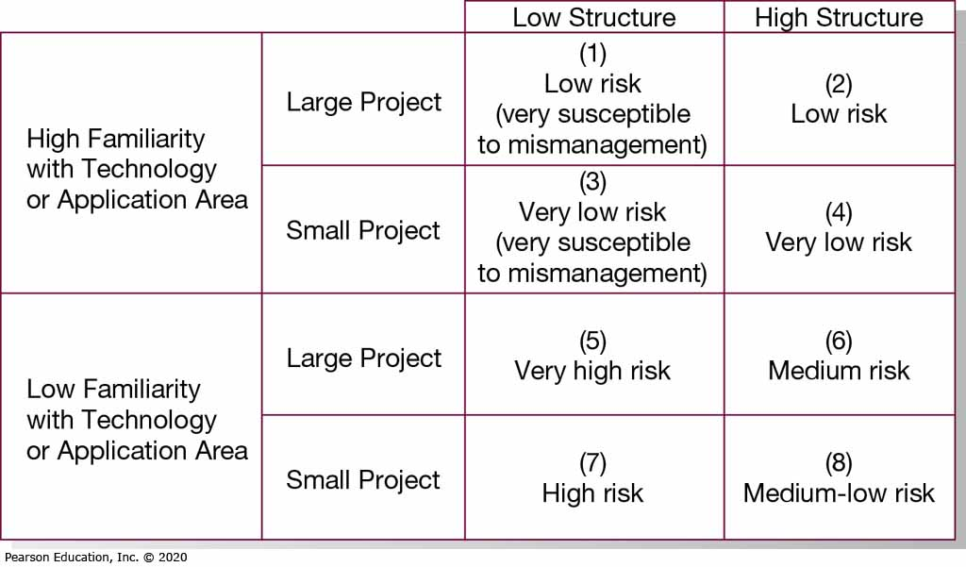
Figure 3: Effects of Degree of Project Structure, Project Size, and Familiarity with Application Area on Project Implementation Risk
(Source: Based on Applegate, Austin, & Soule, 2009; Fuller et al., 2018)

Slide 22
Assessing Other Feasibility Concerns
Operational feasibility – process of assessing the degree to which a proposed system solves business problems or takes advantage of business opportunities
Schedule feasibility – process of assessing the degree to which the potential time frame and completion dates for all major activities within a project meet organizational deadlines and constraints for affecting change
Legal and contractual feasibility – process of assessing potential legal and contractual ramifications due to the construction of a system
Political feasibility – process of evaluating how key stakeholders within the organization view the proposed system

Slide 23
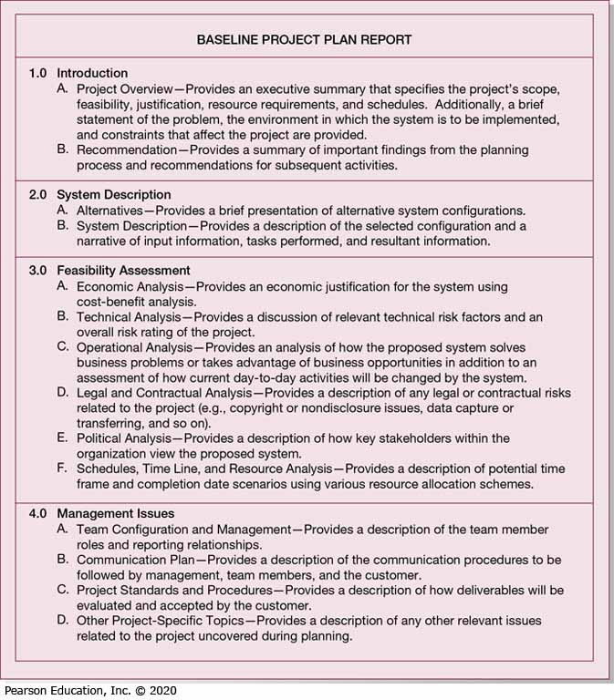
Figure 4: Outline of a Baseline Project Plan

Slide 24
The Baseline Project Plan (1 of 3)
There are four major sections of the baseline project plan as follows:
  Introduction
    Provides a brief overview of the entire document and a recommended course of action
    Should include the definition of project scope (example seen in figure 5-10). Scope depends on these factors:
      Organizational units affected by new system
      Current systems that will interact with or change because of new system
      People who are affected by new system
      Range of potential system capabilities

Slide 25
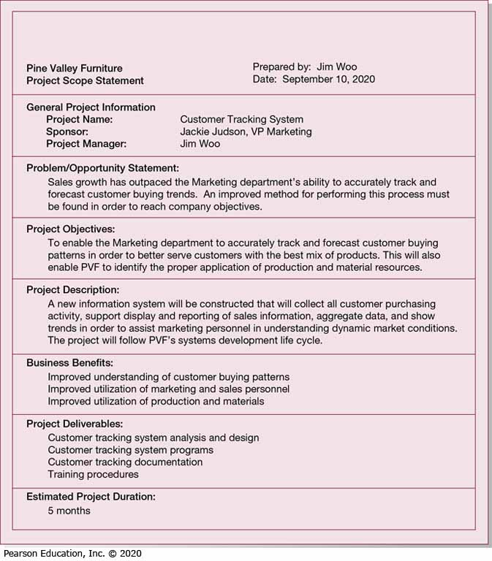
Figure 5: Project Scope Statement for the Customer Tracking Systems (Pine Valley Furniture)

Slide 26
The Baseline Project Plan (2 of 3)
  System Definition Section
    Contains an outline of alternative solutions which could be stated as follow:
      Web-based online system
      Mainframe with central database
      Local area network with decentralized database
      Batch data input with online retrieval
      Purchasing of a prewritten package
  Feasibility Assessment Section
    Relates to project costs and benefits
    Primarily concerned with gaining rough estimates of human resource requirements

Slide 27
The Baseline Project Plan (3 of 3)
  Management Issues Section
    Includes managerial concerns related to the project
    Figure 6 reveals the task responsibilities for an sample project
    Figure 7 reveals the project communications matrix sample

Slide 28
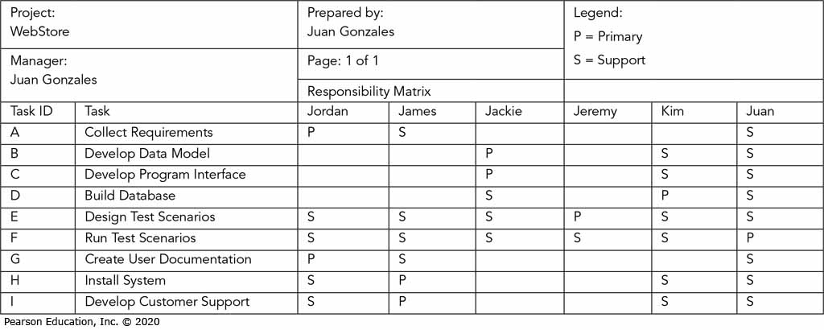
Figure 6: Task Responsibility Matrix

Slide 29
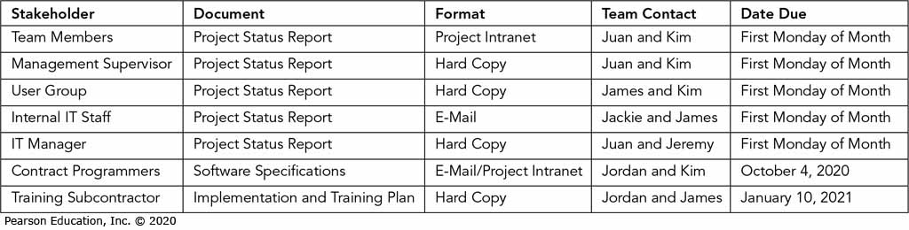
Figure 7: The Project Communication Matrix Provides a High-Level Summary of the Communications Plan

Slide 30
Reviewing the Baseline Project Plan
Must review the BPP to verify it makes sense
Walk-through – peer group review of any product created during the systems development process; also call a structured walk-through
  Not rigid nor formal or long
  Roles include coordinator, presenter, user, secretary, standards bearer, and maintenance oracle
  Can be applied to reviewing BPP, system specifications, logical and physical designs, program code, test procedures, manuals, and documentation
  Ensures formal review points occur during the project

Slide 31
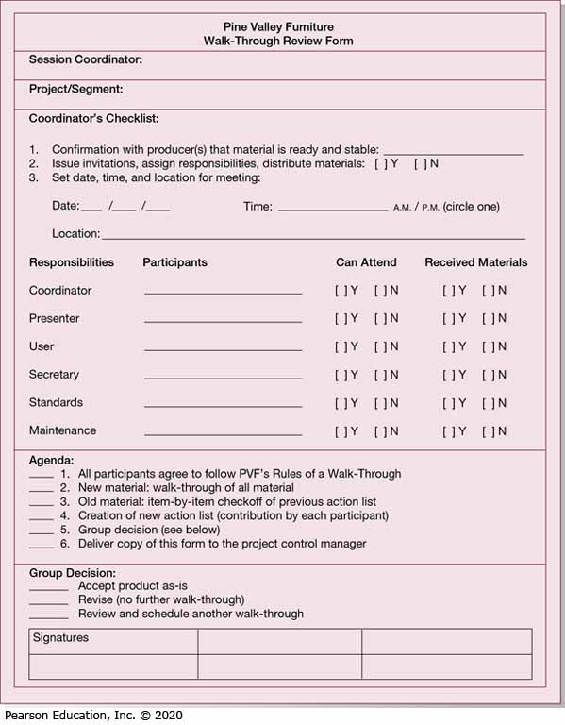
Figure 8: Walk-Through Review Form (Pine Valley Furniture)

Slide 32
Table 9: PVF WebStore – Feasibility Concerns
Feasibility Concerns | Description
Operational | Online store is open 24/7/365 Returns/customer support
Technical | New skill set for development, maintenance, and operation
Schedule | Must be open for business by Q1, 2021
Legal | Credit card fraud
Political | Traditional distribution channel loses business

Slide 33
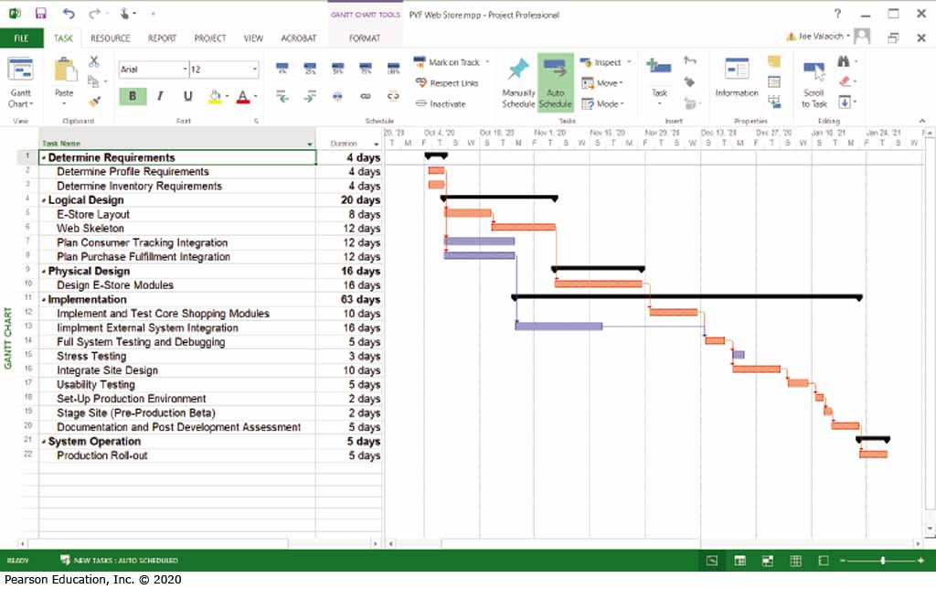
Figure 9: Schedule for WebStore Project as Pine Valley Furniture
(Source: Microsoft Corporation)

Slide 34

Group Activity
Create lyrics and song (song adaption) for the following topics and perform to the class:
Project Cost
Project Risk Assessment
Project feasibility
Baseline Project Plan

