Slide 1
Week 6
Determining System Requirements

Slide 2
Introduction
Analysis has two subphases:
  Requirements determination
  Requirements structuring

Slide 3
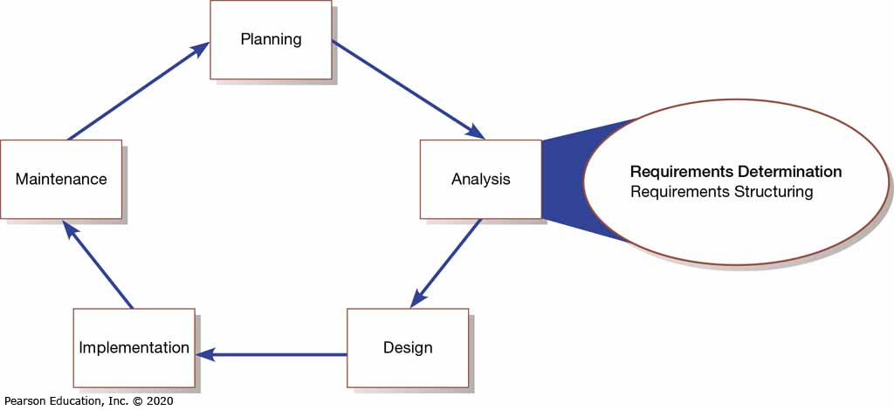
Figure 1: System Development Life Cycle with Analysis Phase Highlighted

Slide 4
The Process of Determining Requirements
Characteristics of a good systems analyst:
  Impertinence – question everything
  Impartiality – consider all issues to find the best solution
  Relax constraints – assume anything is possible and eliminate the infeasible
  Attention to detail – every fact must fit with every other fact
  Reframing – challenge yourself to look at the organization in new ways

Slide 5
Organizational Components to Understand
Systems analysts need to understand:
  Business objectives that drive what and how work is done
  Information people need to do their jobs
  The data (definition, volume, size) handled in support of jobs
  Data transformation and storage (when, how, by whom)
  Data handling dependencies and sequences
  Data handling and processing rules
  Policies and guidelines that describe the nature of the business and market and the environment it operates in
  Key events that affect data values and when they occur

Slide 6
Table 1: Deliverables for Requirements Determination
Deliverables for Requirements Determination
Information collected from conversations with or observations of users: interview transcripts, notes from observation, meeting minutes
Existing written information business mission and strategy statements, sample business forms and reports and computer displays, procedure manuals, job descriptions, training manuals, flowcharts and documentation of existing systems, consultant reports
Computer-based information: results from JAD ( Joint Application Design) sessions, reports of existing systems, and displays and reports from system prototypes

Slide 7
Table 2: Traditional Methods of Collecting System Requirements
Traditional Methods of Collecting System Requirements
Individually interview people informed about the operation and issues of the current system and future systems needs
Interview groups of people with diverse needs to find synergies and contrasts among system requirements
Observe workers at selected times to see how data are handled and what information people need to do their jobs
Study business documents to discover reported issues, policies, rules, and directions as well as concrete examples of the use of data and information in the organization

Slide 8
Figure 3: Guidelines for Effective Interviewing
Guidelines for Effective Interviewing
Plan the Interview Prepare interviewee: appointment, priming questions Prepare checklist, agenda, and questions
Listen carefully and take notes (record if permitted)
Review noes within 48 hours of interview
Seek diverse views

Slide 9
Interviewing and Listening
Open-ended questions – questions in interviews that have no prespecified answers
Closed-ended questions – questions in interviews that ask those responding to choose from among a set of specified responses

Slide 10
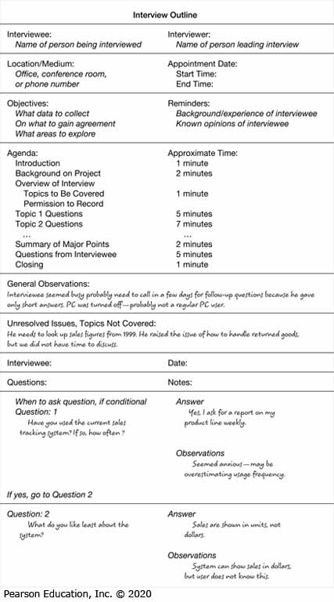
Figure 2: Typical Interview Guide

Slide 11
Interviewing Guidelines
Don’t phrase a question in a way that implies a right or wrong answer
Listen carefully to what is being said
Record notes within 48 hours after an interview
Don’t set expectations about the new system unless you know these will be deliverables
Seek a variety of perspectives from the interviews

Slide 12
Interviewing Groups
Drawbacks to interviewing individuals:
  Reconciling contradictions in information collected
  New interviews may require new questions
  Not an efficient process
Group interview advantages:
  More effective use of time
  Allows synergy when groups can hear each other
Primary disadvantage is difficulty in scheduling with multiple people involved

Slide 13
Directly Observing Users
Direct observation of workers:
  Watching users work at their jobs
  Observe actual measure of how employees interact with information systems and how they do their jobs
  More accurate than interview
  People can change their normal behavior when they know they are being observed
  Observation cannot be continuous, thus you are getting only a snapshot of how they work

Slide 14
Analyzing Procedures and Other Documents (Page 1 of 3)
An analysis of existing documents can give you a wealth of information:
  Problems with existing systems
  Opportunities to meet new needs with critical information
  Identify key people of current system
  Values of organization who help determine priorities desired by different users
  Special information processing circumstances that might not otherwise be identified

Slide 15
Analyzing Procedures and Other Documents (Page 2 of 3)
  Identify left out features of current software that may lead to needed features in future systems
  Identify processing rules that must be enforced
A written work procedure describes how a job or task is performed
Formal system – official way a system works as described in organizational documentation.
Informal system – way a system actually works

Slide 16
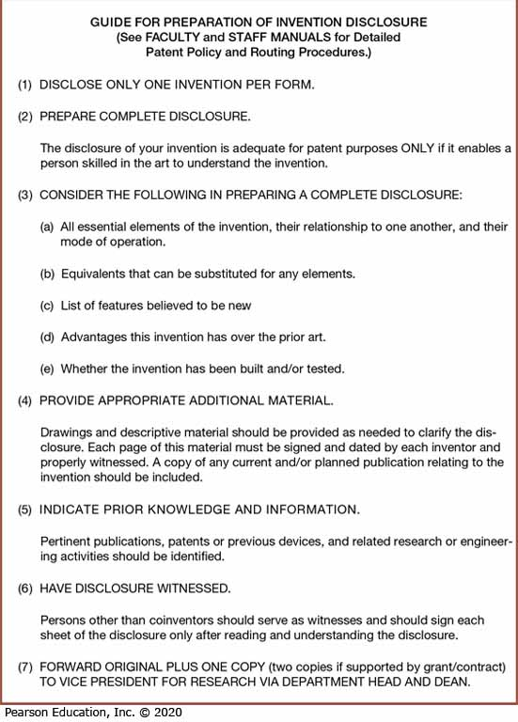
Figure 3: Example of a Procedure

Slide 17
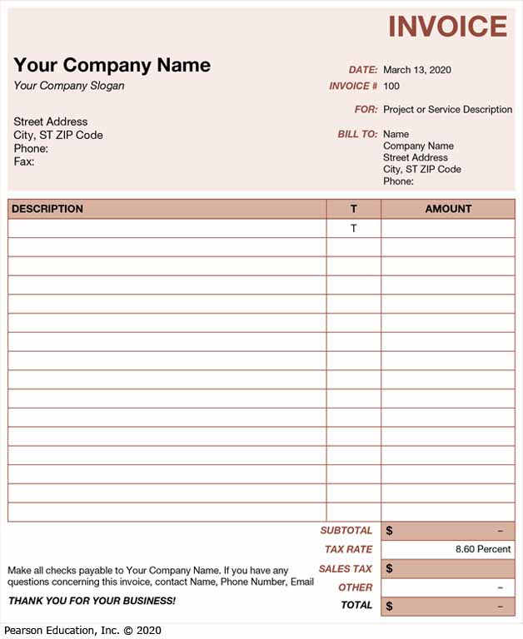
Figure 6: An Invoice Form from Microsoft Excel
(Source: Microsoft Corporation)

Slide 18
Analyzing Procedures and Other Documents (Page 3 of 3)
Four major documents analyzed when creating a new system:
  Written work procedure (Figure 3)
  A form such as the invoice form on the previous slide
    Gives crucial information about the nature of the organization
  A report such as the one on the next slide
    Can be used to analyze to determine which data to capture
  Documents used to describe the system and how it is used
    Examples include flowcharts, data dictionaries, user manuals

Slide 19
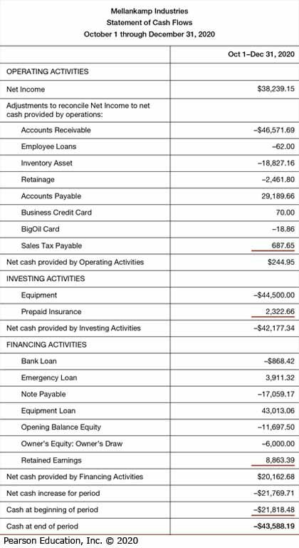
Figure 5: Example of a Report – As Statement of Cash Flows

Slide 20
Table 4: Comparison of Observation and Document Analysis
Characteristic | Observation | Document Analysis
Information Richness | High (many channels) | Low (passive) and old
Time Required | Can be extensive | Low to moderate
Expense | Can be high | Low to moderate
Chance for Follow-Up and Probing | Good: probing and clarification questions can be asked during or after observation | Limited: probing possible only if original author is available
Confidentiality | Observee is known to interviewer; observee may change behavior when observed | Depends on nature of document; does not change simply by being read
Involvement of Subject | Interviewees may or may not be involved and committed depending on whether they know if they are being observed | None, no clear commitment
Potential Audience | Limited numbers and limited time (snapshot) of each | Potentially biased by which documents were kept or because document was not created for this purpose

Slide 21
Table 5: Contemporary Methods for Collecting System Requirements
Contemporary Methods for Collecting System Requirements
Bringing session users, sponsors, analysts, and others together in a JAD session to discuss and review system requirements
Iteratively developing system prototypes that refine the understanding of system requirements in concrete terms by showing working versions of system features

Slide 22
Table 7: Desired Layout and Navigation Feature of WebStore
Desired Layout and Navigation Feature of WebStore | Desired Layout and Navigation Feature of WebStore
Layout and Design | Navigation menu and logo placement should remain consistent throughout the entire site (this allows users to maintain familiarity while using the site and minimizes users who get “lost” in the site) • Graphics should be lightweight to allow for quick page display • Text should be used over graphics whenever possible
Navigation | Any section of the store should be accessible from any other section via the navigation menu • Users should always be aware of what section they are currently in

Slide 23
Requirement Report 1 – based on requirement procedure
Procedure | Sources | Procedure | Summary of Output
Interview | Manager | Individual Interview | Existing system cannot capture x function Need report on volunteer profile
Observation | Existing Website | Observe Website Function | No login require No print function

Slide 24
Requirement Report 2 – based on modules/functions
Module | Existing Function | Needed Function | Source
Registration Module | NA | Login and Register Function | Observation
Manage Volunteer Information | Manual Record | Add Volunteer Information Update Volunteer Information | Interview

Slide 25
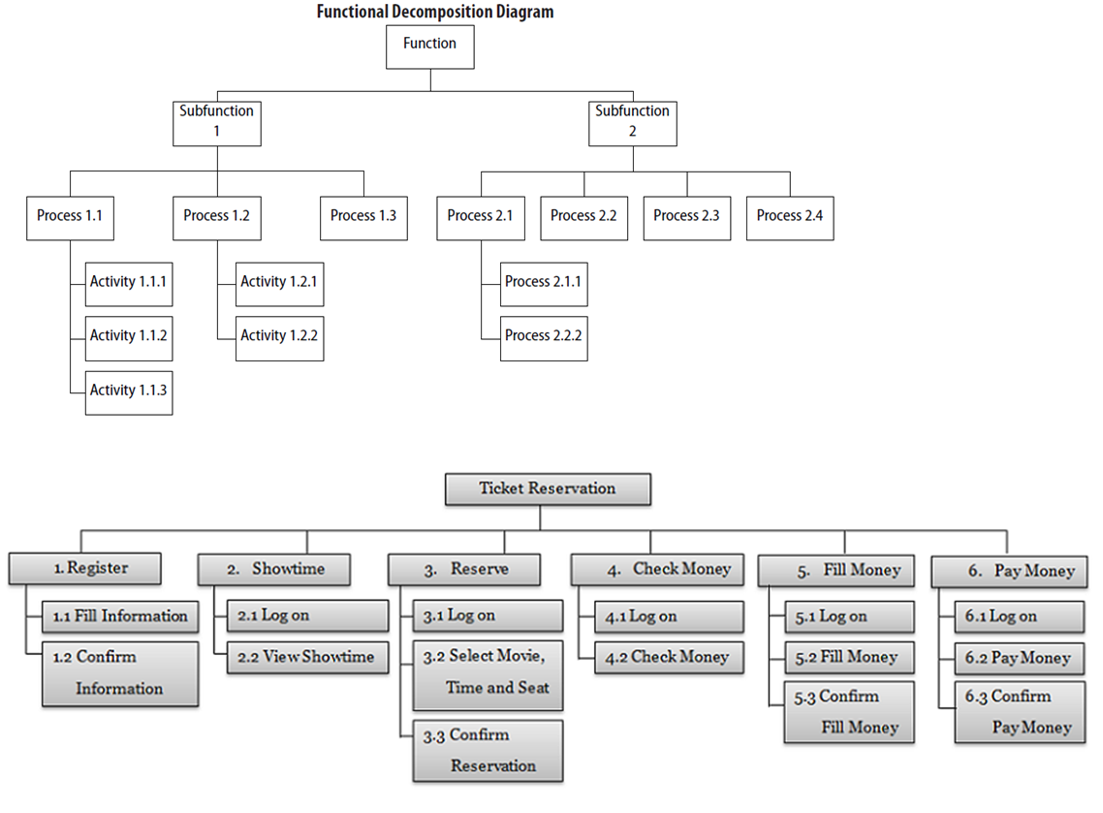
Next step?
Based on these report, can draw existing and proposed FDD (Functional Decomposition Diagram)

Slide 26
ACTIVITY
You are System Analyst at EasyJet Airline company. You are required to propose system FDD ( Functional Decomposition Diagram) to enhance EasyJet online booking system. Draw the diagram.

