Slide 1
Data Design
Week 8

Slide 2

Data Design Concepts
Data Structures
  Each file or table contains data about people, places, things or events that interact with the information system
  File-oriented system
  Database management system (DBMS)

Slide 3
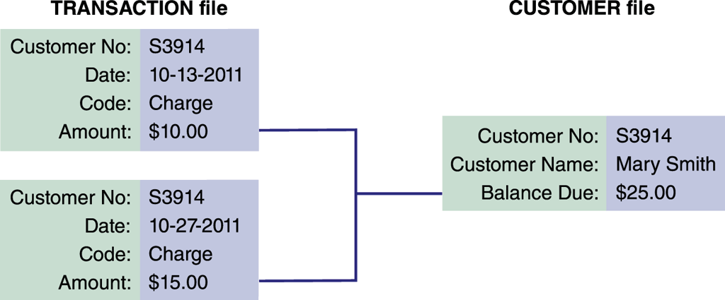
Data Design Concepts
Overview of File Processing
  File processing can be efficient and cost-effective in certain situations
  Potential problems
    Data redundancy
    Data integrity
    Rigid data structure

Slide 4
Data Design Concepts
Overview of File Processing
  Various types of files
    Master file
    Table file
    Transaction file
    Work file
    Security file
    History file

Slide 5
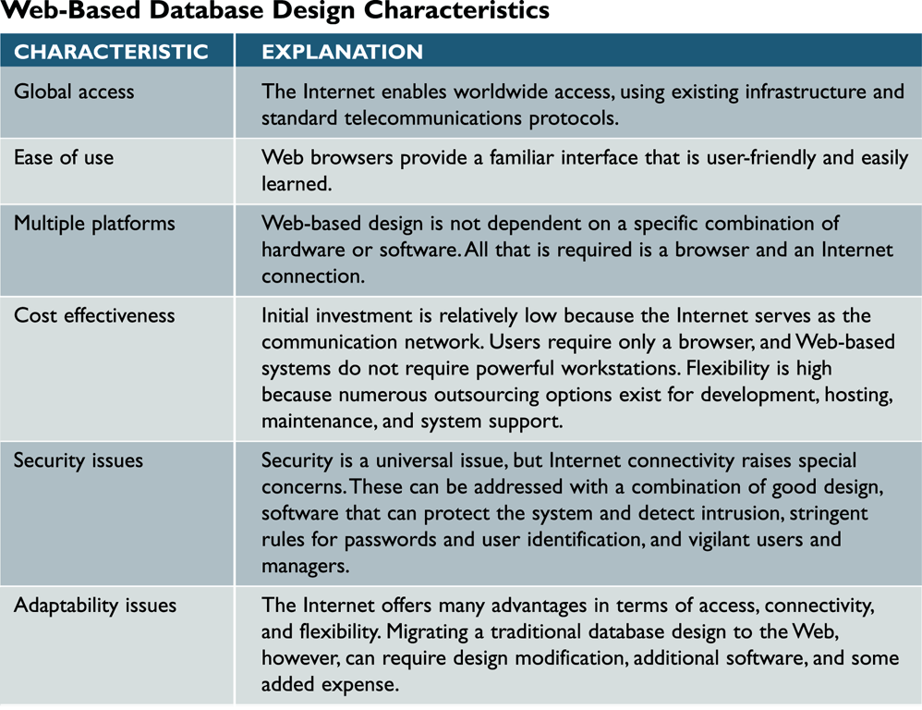
Web-Based Database Design
Characteristics of Web-Based Design

Slide 6
Web-Based Database Design
Internet Terminology
  Web browser
  Web page
  HTML (Hypertext Markup Language)
  Tags
  Web server
  Web site

Slide 7
Web-Based Database Design
Connecting a Database to the Web
  Database must be connected to the Internet or intranet
  Middleware
    Adobe ColdFusion
Data Security
  Well-designed systems provide security at three levels: the database itself, the Web server, and the telecommunication links that connect the components of the system

Slide 8
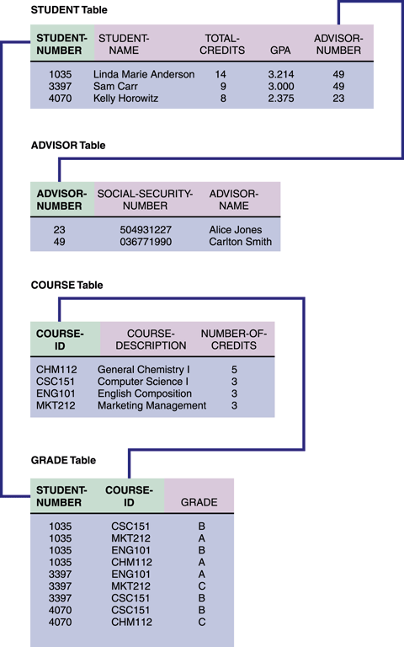
Data Design Terminology
Definitions
  Entity
  Table or file
  Field
  Record
    Tuple

Slide 9
Data Design Terminology
Key Fields
  Primary key
  Candidate key
  Foreign key
  Secondary key

Slide 10
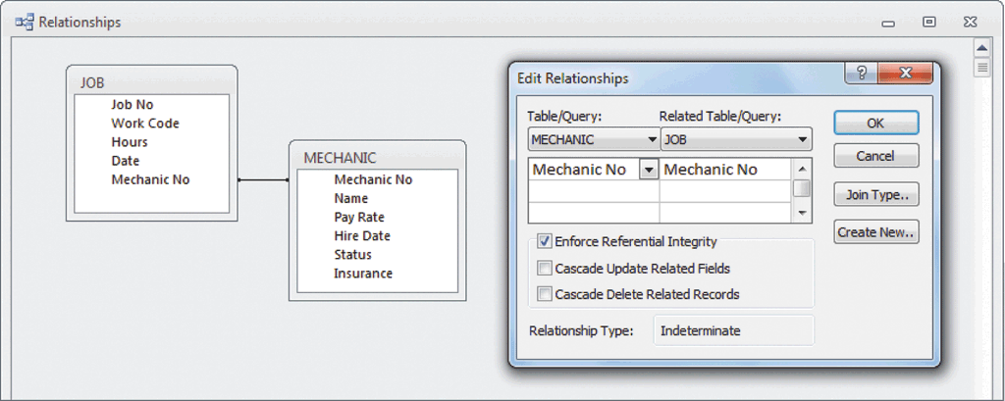
Data Design Terminology
Referential Integrity
  Validity checks can help avoid data input errors
  In a relational database, referential integrity means that a foreign key value cannot be entered in one table unless it matches an existing primary key in another table
  Orphan

Slide 11
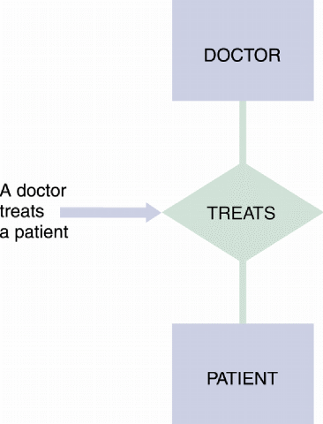
Entity-Relationship Diagrams
Drawing an ERD
  The first step is to list the entities that you identified during the fact-finding process and to consider the nature of the relationships that link them
  A popular method is to represent entities as rectangles and relationships as diamond shapes

Slide 12
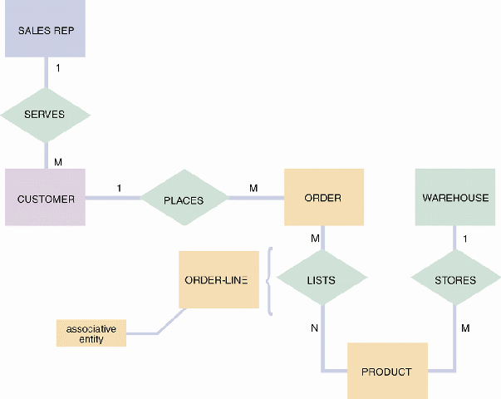
Entity-Relationship Diagrams
Types of Relationships
  Three types of relationships can exist between entities
  One-to-one relationship (1:1)
  One-to-many relationship (1:M)
  Many-to-many relationship (M:N)

Slide 13
Using Codes During Data Design
Overview of Codes
  Because codes often are used to represent data, you encounter them constantly in your everyday life
  They save storage space and costs, reduce data transmission time, and decrease data entry time
  Can reduce data input errors

Slide 14
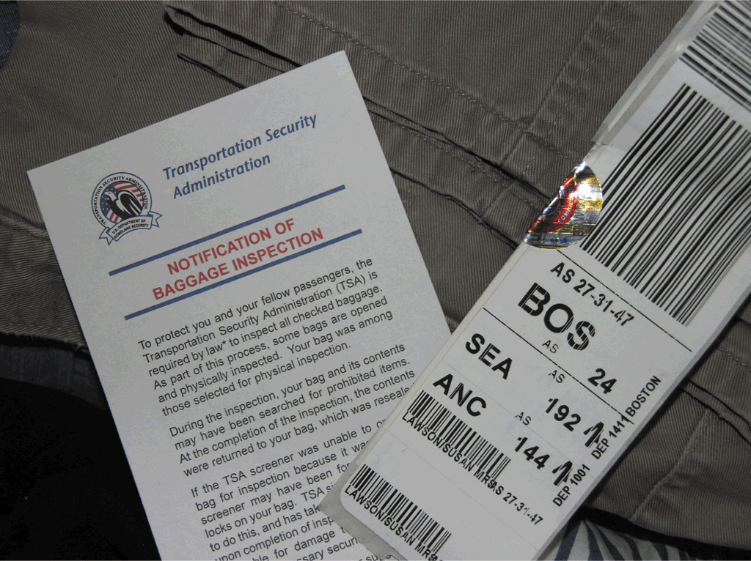
Using Codes During Data Design
Types of Codes
  Sequence codes
  Block sequence codes
  Alphabetic codes
  Significant digit codes
  Derivation codes
  Cipher codes
  Action codes

Slide 15
Using Codes During Data Design
Developing a Code
  Keep codes concise
  Allow for expansion
  Keep codes stable
  Make codes unique
  Use sortable codes

Slide 16
Using Codes During Data Design
Developing a Code
  Avoid confusing codes
  Make codes meaningful
  Use a code for a single purpose
  Keep codes consistent

Slide 17
Database Design: One Step At a Time
Create an initial ERD
Review all the data elements
Double-check all data dictionary entries

Slide 18
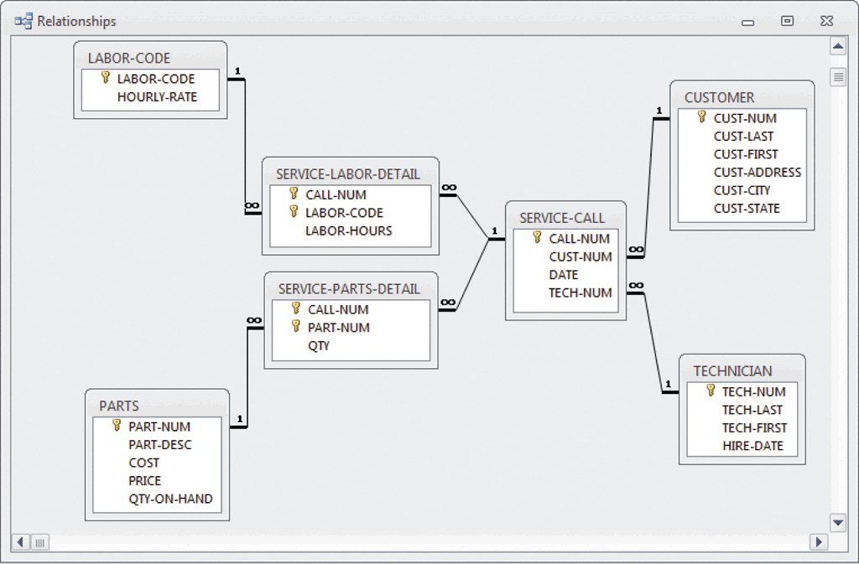
Database Models
A Real-World Business Example
  Imagine a company that provides on-site service for electronic equipment, including parts and labor

Slide 19
Chapter Summary
An entity-relationship (ERD) is a graphic representation of all system entities and the relationships among them
A code is a set of letters or numbers used to represent data in a system
The most common database models are relational and object-oriented

