Slide 1
Week 7
Structured System Process Requirements

Slide 2
Process Modeling
Process modeling – graphically representing functions, processes that capture, manipulate, store, and distribute data between a system and components within a system
Data flow diagram (DFD) – picture of the movement of data between external entities and the processes and data stores within a system.

Slide 3
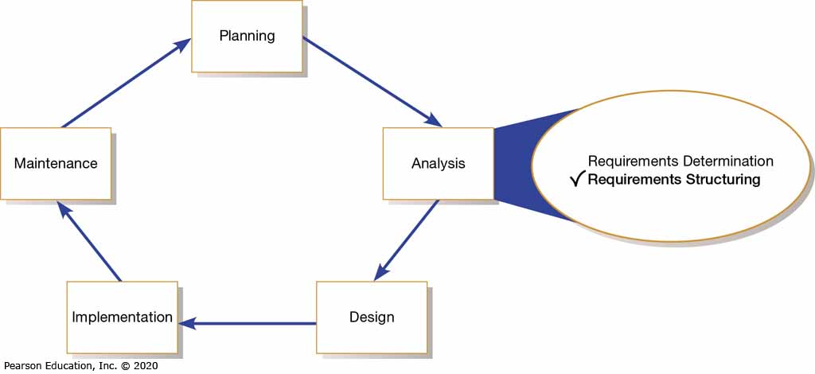
Figure 1: Systems Development Life Cycle with the Analysis Phase Highlighted
Used Data and Process Modeling Tools

Slide 4
Overview of Data and Process Modeling Tools
Systems analysts use many graphical techniques to describe an information system
One of popular method data and modeling
Data and modeling process involves three tools:
Data Flow Diagrams
Data Dictionary
Process Descriptions
Other graphical tools: object models and Entity-relationship Diagrams

Slide 5
Overview of Data and Process Modeling Tools
Data Flow Diagrams
Diagrams that shows how the systems stores, processes and transforms data into useful information
Data Dictionary
A central storehouse of information about a system’s data.
Process Descriptions
A documentation of a functional primitive's details, which represents a specific set of processing steps and business logic
Notes:
4

Slide 6
Data Flow Diagrams
A data flow diagram (DFD) shows how data moves through an information system but does not show program logic or processing steps
A set of DFDs provides a logical model that shows what the system does, not how it does it
A DFD uses various symbols to show how the system transforms input data into useful information

Slide 7
Data Flow Diagrams
DFD Symbols
Four basic symbols that represents processes, data flows, data stores, and entities.
There are several versions of DFD symbols exists, but they all serve the same purpose.
Examples: Gane and Sarson and Yourdon

Slide 8
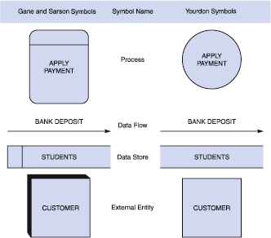
Data Flow Diagrams
DFD Symbols

Slide 9
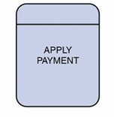
Data Flow Diagrams
DFD Symbols: Process Symbol
  A rectangle with rounded corners
  The name of the process appears inside the rectangle.
  The process name identifies a specific function
  Examples: APPLY RENT PAYMENT, CALCULATE COMMISION, VERIFY ORDER

Slide 10
Data Flow Diagrams
DFD Symbols: Process Symbol
    Receives input data and produces output that has a different content, form, or both
    A process can be procedure or algorithm
    Contain the business logic, also called business rules
    Referred to as a black box (because the underlying details and logic of the process are hidden)
    To show additional levels of detail, can zoom in on a process symbol and create a more in-depth DFD

Slide 11

Data Flow Diagrams
DFD Symbols: Data Flow Symbol
    A data flow is a path for data to move from one path of the IS to another
    It represents data movement among processes, data stores and external entities.
    A line with a single or double arrowhead
    Data flow name appears above, below, or alongside the line
    Examples: DEPOSIT, INVOICE, PAYMENT, STUDENT GRADE, ORDER

Slide 12
Data Flow Diagrams
DFD Symbols: Data Flow Symbol
    Represents one or more data items. Example: single data item (student ID Number) or include a set of data (such as class roster with student ID numbers and names)
    Does not show the detailed content (included in data dictionary)
    At least one data flow must enter and one data flow must exit each process symbol
    Must have a process symbol on at least one end

Slide 13
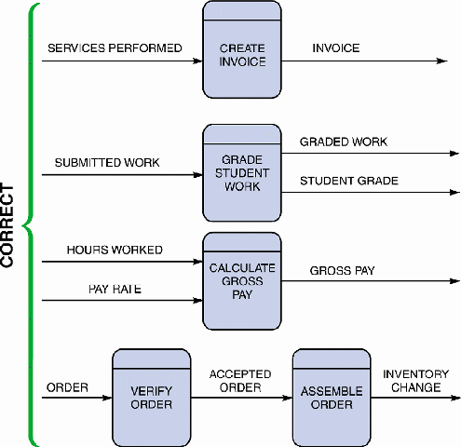
DFD

Slide 14
Data Flow Diagrams
DFD Symbols: Data Flow Symbol
  Three data flow and process combinations you must AVOID (p153):
    Spontaneous generation
    No input data flow
    Black hole
    Produces no output data flow
    Gray hole
    Has at least one input and one output but the input obviously is insufficient to generate the output shown

Slide 15

Data Flow Diagrams
DFD Symbols: Data Store Symbol
  A flat rectangle that is open on the right side and closed on the left side.
  The name appear between the lines and identifies the data it contains
  Examples: STUDENTS, PRODUCTS, DAILY PAYMENTS, PURCHASE ORDERS

Slide 16
Data Flow Diagrams
DFD Symbols: Data Store Symbol
    A data store is used to represent data that the system stores because one or more processes need to use the data at a later time
    Represents a file or part of database
    Does not show the detailed content (included in data dictionary)
    Data store must be connected to a process with data flow
    Must have at least one incoming and one outgoing data flow

Slide 17
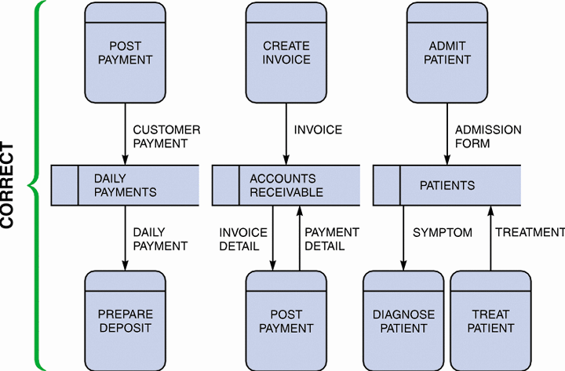
Data Flow Diagrams
DFD Symbols: Data Store Symbol

Slide 18

Data Flow Diagrams
DFD Symbols: Entity Symbol
    Rectangle, which may be shaded to make it look three-dimensional
    The name of the entity appears inside the symbol
    Examples: Patient, Customer

Slide 19
Data Flow Diagrams
DFD Symbols: Entity Symbol
    Shows only external entities that provide data to the system or receive output from the system
    Entity names can be a department, outside organization, other IS or a person
    Reminder:
    Entity: A person, place, thing, or event for which data is collected and maintained
    External Entity: is outside the system boundary but supplies input or accepts output.

Slide 20
Data Flow Diagrams
DFD Symbols: Entity Symbol
Entity Symbol also are called
    Terminators: Data origins or final destinations
    Source: Entity that supplies data to the system
    Sink: Entity that receives data from the system
    Rules: An external entity can be a source or a sink or both, but each entity must be connected to a process by a data flow to a process, and not directly to a data store or to another external entity.

Slide 21
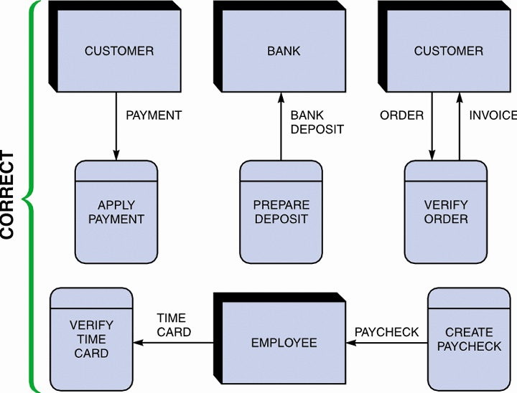
Data Flow Diagrams
DFD Symbols: Entity Symbol

Slide 22
Data Flow Diagrams
DFD Symbols
Rules in a DFD
A process -> Another process Yes
A process -> An entity Yes
A process -> A data store Yes
An entity -> Another entity /data store No
A data store -> Another entity /data store No

Slide 23
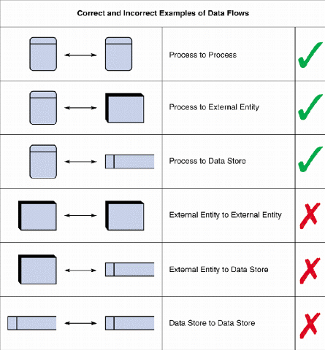
DFD

Slide 24
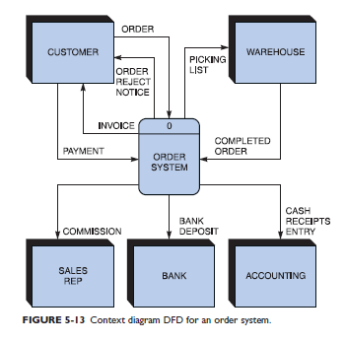
Data Flow Diagrams
Exercises
Review the order system context diagram Answer the following questions:
How many external entities are shown in each diagram?
In each diagram, how many data flows connect to the external entities?
Could the data store have been shown in the context diagram? Why or why not?

Slide 25
Data Flow Diagrams
Answers:
(a) There are five entities in each diagram.
(b) Nine data flows connect to the external entities in each diagram.
(c) The data store could not have been shown in the context diagram because a data store cannot connect to an external entity. The data store can connect to one or more processes, and it is shown in the diagram 0 DFD.

Slide 26
Creating a Set of DFDs
Create a graphical model of the information system based on your fact-finding results
First, you will review a set of guidelines for drawing DFDs. Then you will learn how to apply these guidelines and create a set of DFDs using a three-step process
Three-step process
  Step 1: Draw a context diagram
  Step 2: Draw a diagram 0 DFD
  Step 3: Draw the lower-level diagrams

Slide 27
Creating a Set of DFDs
Guidelines for Drawing DFDs
  Draw the context diagram so that it fits on one page
  Use the name of the information system as the process name in the context diagram (example: GRADING SYSTEM)
  Use unique names within each set of symbols
  (example: only one entity named STUDENT)

Slide 28
Creating a Set of DFDs
Guidelines for Drawing DFDs
  Do not cross lines. How?
  Restrict the number of symbol (Have no more than 9 process symbols)
  Duplicate an entity or data store
  Provide a unique name and reference number for each process
  Obtain as much user input and feedback as possible

Slide 29
Creating a Set of DFDs
Before creating DFDs, identify all the entities, the name and content of the data flows and the direction of the data flows
Three-step process
  Step 1: Draw a context diagram
  Represents the entire information system but does not show the internal workings
  Step 2: Draw a diagram 0 DFD
  Describe the next level of detail inside process 0 which will reveal additional processes
  Step 3: Draw the lower-level diagrams
  Describe the next level of detail inside process in diagram 0

Slide 30
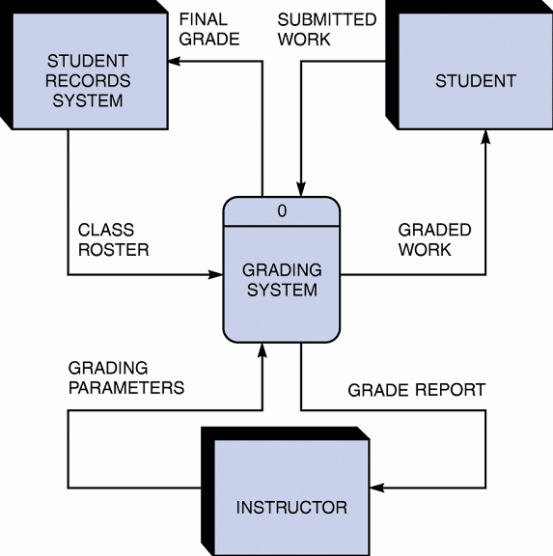
Creating a Set of DFDs
Step 1: Draw a Context Diagram
Context diagram
  is a top level view of an information system that shows the system’s boundaries and scope
  Symbolizes all processing activity within a system with a single process symbol: Process 0

Slide 31
Creating a Set of DFDs
Step 1: Draw a Context Diagram
The rules for creating a context diagram.
  Start by placing a single process symbol in the center of the page. The symbol represents the entire information system, and you identify it as process 0.
  Next, place the external entities around the perimeter of the page, and use data flows to connect the entities to the central process.
  Do not show any data stores in a context diagram because data stores are internal to the system.
  Place the external entities around the central process and label them.
  Create labeled input and output data flows between the external entities and the central system.

Slide 32
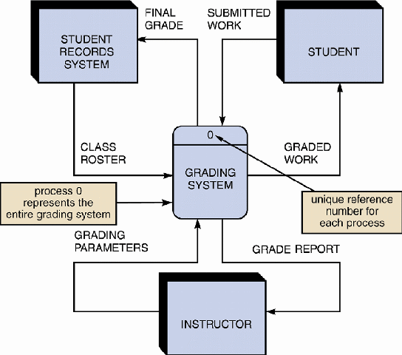
Creating a Set of DFDs
Step 1: Draw a Context Diagram

Slide 33
Creating a Set of DFDs
Step 2: Draw a Diagram 0 DFD
Diagram 0 zooms in on the system and shows major internal processes, data flows, and data stores
Diagram 0 also repeats the entities and data flows that appear in context diagram
Must retain all the connections that flow into and out of process 0

Slide 34
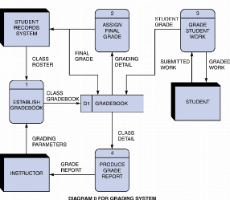
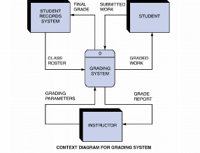
Creating a Set of DFDs
Step 2: Draw a Diagram 0 DFD

Slide 35
Creating a Set of DFDs
Step 2: Draw a Diagram 0 DFD
  Each process has a reference number: To identify the series of DFDs
  The process number do not suggest that the process are in a sequential order
  Diverging data flow: A data flow in which the same data travels to two or more different locations
  If same data flows in both directions, you can use a double-headed arrow

Slide 36
Creating a Set of DFDs
Step 2: Draw a Diagram 0 DFD
  Diagram 0 is an exploded view of process 0
  Parent diagram: Higher level diagram
  Child diagram: Lower level diagram
  Functional primitive:
  is a process that consists of a single function that is not exploded further
  Document the logic in the data dictionary

Slide 37
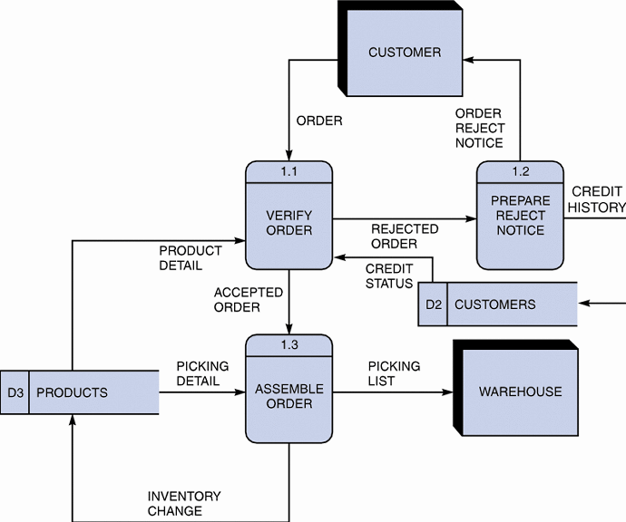
Creating a Set of DFDs
Step 3: Draw the Lower-Level Diagrams
  Must use leveling and balancing techniques

Slide 38
Creating a Set of DFDs
Step 3: Draw the Lower-Level Diagrams
Leveling examples
    Also called exploding, partitioning, or decomposing
    Uses a series of increasingly detailed DFDs until all process are identified as functional primitives.
    All process are numbered using a decimal notation (1 -> 1.1 -> 1..1.1)

Slide 39
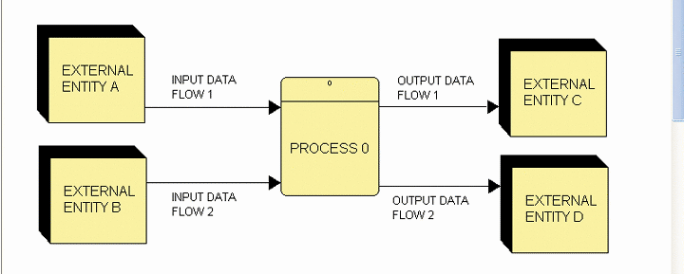
Creating a Set of DFDs
Step 3: Draw the Lower-Level Diagrams
Balancing
    Ensures that the input and output data flows of the parent DFD are maintained on the child DFD

Slide 40
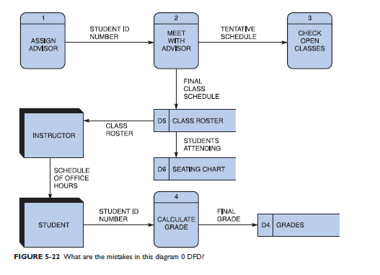
CASE IN POINT 4.1
What is the mistakes in this diagram 0 DFD?
Answer?

Slide 41
CASE IN POINT 4.1
Answer
ASSIGN ADVISOR, process 1 is a miracle
CHECK OPEN CLASSES process 3 is a black hole
CALCULATE GRADE, process 4, is a gray hole
INSTRUCTOR and STUDENT Entity cannot be connected with a data flow
INSTRUCTOR Entity does not connect to a process
GRADES and SEATING CHART data stores are black holes
CLASS ROASTER and SEATING CHART data stores cannot be connected with a data flow

Slide 42
CASE IN POINT 4.1
Answer
black hole - – A process is said to be a “ black hole” if has no output
gray hole – A process is said to be a “ gray hole” if an input is obviously insufficient to generate the shown output

Slide 43
Data Dictionary
A data dictionary, or data repository, is a central storehouse of information about the system’s data
An analyst uses the data dictionary to collect, document, and organize specific facts about the system
Also defines and describes all data elements and meaningful combinations of data elements

Slide 44
Data Dictionary
A data element, also called a data item or field, is the smallest piece of data that has meaning
Examples: student grade, salary, IC Number
Data elements are combined into records, also called data structures
A record is a meaningful combination of related data elements that is included in a data flow or retained in a data store
Examples: Student record might include student number, name, course, grade

Slide 45
Data Dictionary
Documenting the Data Elements
  You must document every data element in the data dictionary
  The objective is the same: to provide clear, comprehensive information about the data and processes that make up the system
  Online or manual form or enter the information directly into a CASE tool
  CASE tools? Visible Analyst, Visio Professional

Slide 46
Data Dictionary
Documenting the Data Elements
The following attributes usually are recorded and described:
    Data element name and label
    Alias: Alternate name
    Type and length
    Default value
    Acceptable values - Domain and validity rules
    Source
    Security
    Responsible user(s)
    Description and comments

Slide 47
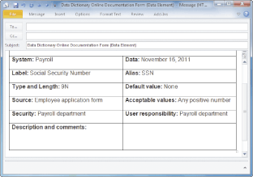
Data Dictionary
Documenting the Data Elements

Slide 48
Data Dictionary
Documenting the Data Flows
  The typical attributes are as follows
    Data flow name or label
    Description
    Alternate name(s)
    Origin
    Destination
    Record
    Volume and frequency

Slide 49
Data Dictionary
Documenting the Data Stores
  Typical characteristics of a data store are
    Data store name or label
    Description
    Alternate name(s)
    Attributes
    Volume and frequency

Slide 50
Data Dictionary
Documenting the Processes
  Typical characteristics of a process
    Process name or label
    Description
    Process number
    Process description

Slide 51
Data Dictionary
Documenting the Entities
  Typical characteristics of an entity include
    Entity name
    Description
    Alternate name(s)
    Input data flows
    Output data flows

Slide 52
Data Dictionary
Documenting the Records
  Typical characteristics of a record include
    Record or data structure name
    Definition or description
    Alternate name(s)
    Attributes

Slide 53
Data Dictionary
Data Dictionary Reports
Data dictionary documents not only components but also relationships between the components
  Many valuable reports
    An alphabetized list of all data elements by name
    A report describing each data element and indicating the user or department that is responsible for data entry, updating, or deletion
    A report of all data flows and data stores that use a particular data element

Slide 54
Process Description Tools
A process description documents the details of a functional primitive, which represents a specific set of processing steps and business logic
Typical process description tools:
Structured English
Decision tables
Decision Trees

Slide 55
Process Description Tools
When analyze a functional primitive, break the processing steps down into smaller units in a process called modular design.
Modular Design
Based on combinations of three logical structures, sometimes called control structures which serve as building blocks for the process
    Sequence
    Selection
    Iteration – looping
    Only have a single entry and exit point

Slide 56
Process Description Tools
Modular Design
    Sequence
    The completion of steps in sequential order
    Selection
    The completion of one or two or more steps based on the results of a test or condition (if-then-else/case)
    Iteration – looping
    The completion of a process step that is repeated until a specific condition changes (do-while/do-until)
    Can be combined to describe processing logic

Slide 57
Process Description Tools
Typical process description tools:
Structured English
Decision tables
Decision Trees

Slide 58
Process Description Tools
Structured English
Describes logical processes clearly and accurately
    To ensure that your process description are understandable to users who must confirm that the process is correct.
    Might look familiar to programming students because it resembles pseudo code

Slide 59
Process Description Tools
Structured English
  Must conform to the following rules
    Use only the three building blocks of sequence, selection, and iteration
    Use indentation for readability
    Use a limited vocabulary, including standard terms used in the data dictionary and specific words that describe the processing rules

Slide 60
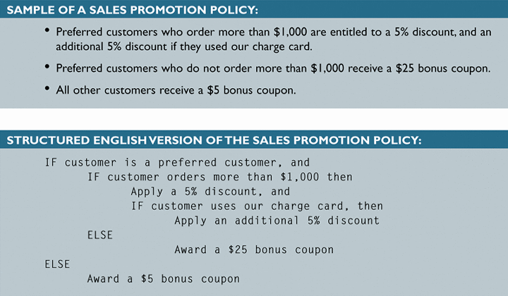
Process Description Tools
Structured English

Slide 61
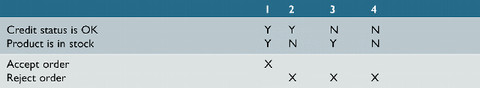
Process Description Tools
Decision Tables
  Shows a logical structure, with all possible combinations of conditions and resulting actions
  It is important to consider every possible outcome to ensure that you have overlooked nothing

Slide 62
Process Description Tools
2. Decision Tables
  Shows a logical structure, with all possible combinations of conditions and resulting actions
  The best way to describe a complex of conditions.

Slide 63
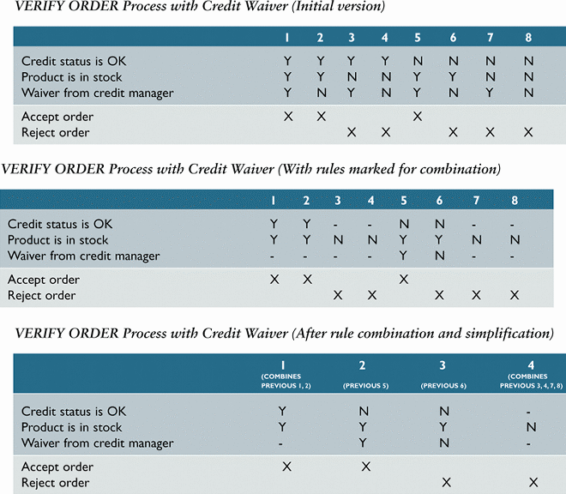
Process Description Tools
Decision Tables

Slide 64
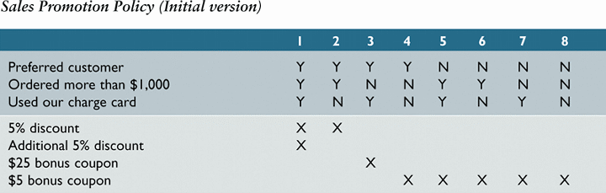
Process Description Tools
Decision Tables

Slide 65
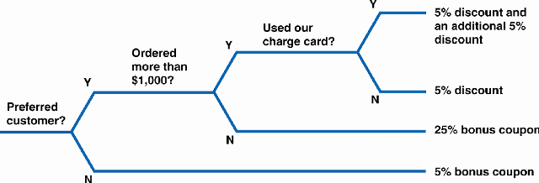
Process Description Tools
3. Decision Trees
A graphical representation of decision table

Slide 66
Chapter Summary
During data and process modeling, a systems analyst develops graphical models to show how the system transforms data into useful information
The end product of data and process modeling is a logical model that will support business operations and meet user needs
Data and process modeling involves three main tools: data flow diagrams, a data dictionary, and process descriptions

Slide 67
Chapter Summary
Data flow diagrams (DFDs) graphically show the movement and transformation of data in the information system
DFDs use four symbols
A set of DFDs is like a pyramid with the context diagram at the top

Slide 68
Chapter Summary
The data dictionary is the central documentation tool for structured analysis
Each functional primitive process is documented using structured English, decision tables, and decision trees

