Slide 1
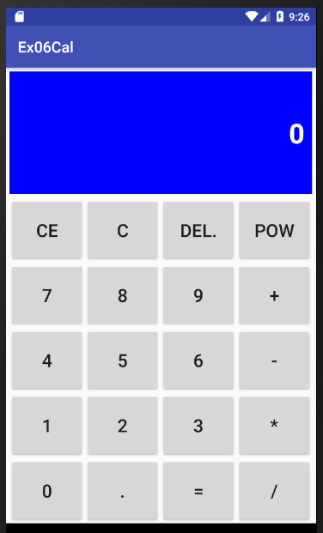
tvResult
btnCE
btnC
btnDel
btnPow
btnNum7
btnNum8
btnNum9
btnAdd
btnNum4
btnNum5
btnNum6
btnSub
btnNum1
btnNum2
btnNum3
btnMul
btnNum0
btnPoint
btnResult
btnDiv

Slide 2
3+6-1
0
“”
0
n1
op
n2

Slide 3
3+6-1
0
“”
3
n1
op
n2

Slide 4
3+6-1
3
“+”
0
n1
op
n2

Slide 5
3+6-1
3
“+”
6
n1
op
n2

Slide 6
3+6-1
9
“-”
0
n1
op
n2

Slide 7
3+6-1
9
“-”
1
n1
op
n2

Slide 8
3+6-1=
8
“”
0
n1
op
n2
result

