Slide 1
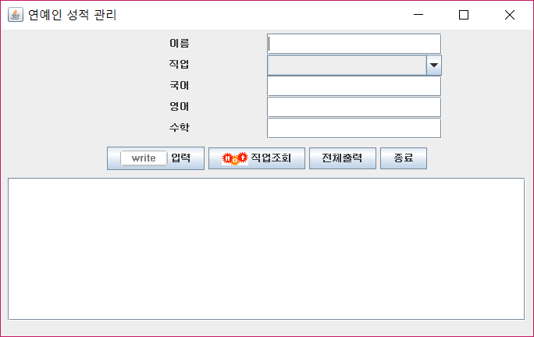
contenPane
txtName
jpup
comJob
txtKor
txtEng
txtMat
jpbtn
btnInput
btnOutput
btnSearch
btnExit
scrollPane
txtPool

