Slide 1


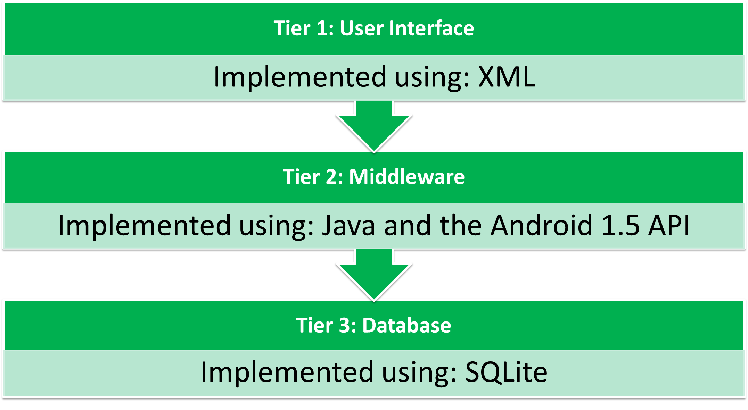

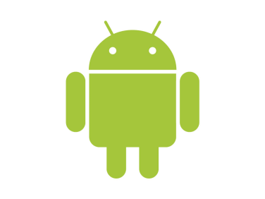

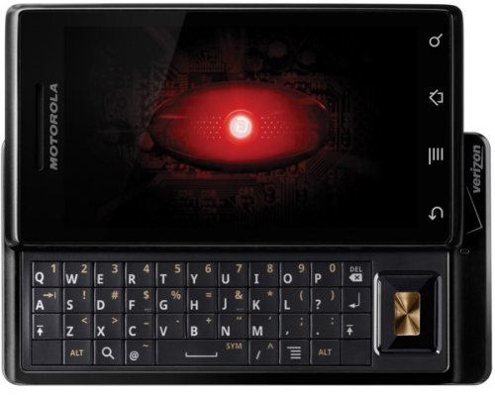
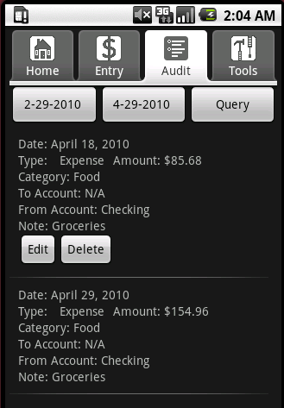
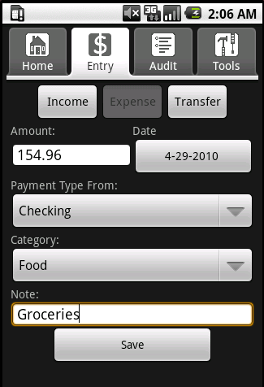

MintTrack
Christopher Wilkins, Jeff Titus, Stephan Krach, Pablo BajoLaso
Merrimack College
Project Description
MintTrack is a mobile application built for the Android OS that will help keep track of where a user’s money is being spent via expense categorization. The user will have the ability to create personalized accounts and categories that relate to their spending habits. MintTrack takes full advantage of the Android platform’s SQLite database to store its data. The database includes tables for Accounts, Categories, and Transactions. Finally, the MintTrack application provides a summary of each transaction entered into the application based on a date range. The summary provides a history of income, expenses, and transfers between accounts. Additionally, it provides the ability to edit and delete transactions. MintTrack is a complete financial suite that allows a user to keep a close eye on their daily spending habits.
Android API
The Android API was developed by Google to be used by the general public to develop applications for mobile devices running the Android OS. Using this API was a brand new experience for the group and was ultimately a difficult task due to the fact that we found many inconsistencies in the available documentation, and even some bad code examples published by Google. Overall, however, this immense collection of JavaDoc-style classes and methods proved to be a useful reference utility to all members of the group.
Documentation for the Android API can be found here: http://developer.android.com/reference/packages.html
SQLite
SQLite is the database system that Android systems use because of the fact that is has a very small memory footprint, which is highly useful for embedded devices such as cellular phones. SQLite, unlike other versions of SQL, uses a single flat file with dynamic typing (more than one type per column). Data is accessed through the use of an object called a cursor. This database system was also a new experience for all members of the group.
System Architecture Overview
As denoted by the graphic above, MintTrack was designed to utilize a 3-tier architecture. Through integration with XML, GUI construction and code and logic construction are kept separate in the development process, which results in cleaner code and a more aesthetically pleasing user interface.
Since MintTrack is a Java-based application built using the Android 1.5 API, all Android mobile devices version 1.5 or higher can run this application.
The SQLite database in this project is a perfect fit for the Android mobile device. The database has most of the functionality of a regular database but a much smaller memory footprint, which results in less memory used and faster data access times.
Tabs, Navigation, & Functionality
Navigation in MintTrack is accomplished through a tabbed architecture. The tabbed system allows users to quickly and easily switch between tasks.
There are a total of four tabs as displayed in the above graphic. Here is a brief description of each of their functionalities:
Home: The Home tab displays the income, expense, and grand totals as well as the four most recent transactions completed by the user.
Entry: Here is where the user enters his or her transactions to be saved to the database.
Audit: A history of past transactions lies at the user’s fingertips with a built-in query system.
Tools: The Tools tab gives the user three different functionalities including the abilities to manage accounts and categories, and a small tip calculator application.
Future Goals
MintTrack is a project that is still in development and will continue to be worked on in the future. Our future goals include completely error-proofing user input, adding more query functionality, possibly adding graphical analysis, improving tab layouts, providing an online help feature, and ultimately releasing the application to the general public.

