Slide 1


Presented by
Christopher Wilkins
Jeff Titus
Stephan Krach
Pablo Bajo

Slide 2
The Question: Where is my money going?
Tracking spending on a daily basis can be a tedious and grueling process
  No one has time to sit down everyday and write down what they spent their money on.
  People often times forget what they spend their money on before they can log it
It’s time to let go of the stone age methods of tracking our spending!
  Spending needs to be logged the moment we make a purchase
  The one device we almost always have with us is our cell phone

Slide 3
The Cure: MintTrack! Exclusively for Android
Keep track of your daily spending quickly and easily on your Android powered device
Control: Take back control of where your money is going with MintTrack’s ability to track your spending by categories
Visualize: Visualize your spending habits easily using MintTrack’s graphing abilities
Sanity: Take your sanity back with the comfort of knowing where you more is being spent.

Slide 4
Goals
Product Goals:
  Provide a tool that effectively allows users to track personal spending habits
  Allow users to see where their money is going
Group Goals:
  Become familiar with the Android framework
  Become proficient Android developers

Slide 5
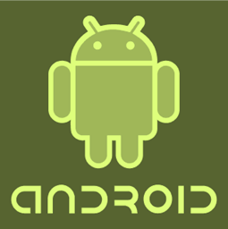
Android Mobile Framework
Mobile devices are a prevalent aspect of our lives
Android Mobile Devices provide one of the most advanced open source mobile platforms available
Open source Mobile Framework means no constraints for developers

Slide 6
Android Hardware
Motorola DROID
Features:
  Touch screen and Qwerty keyboard
  Accelerometer
  GPS
  Camera
  256 MB Ram
  Android 2.1 OS

Slide 7
Hardware Constraints
Screen Size
  Small screen space requires smart interface design
Touch Interface
  Interface must be big enough to interact via touch
Memory
  Application Memory footprint must be minimized
Performance Requirement
  If it takes to long for an application responds it fails

Slide 8
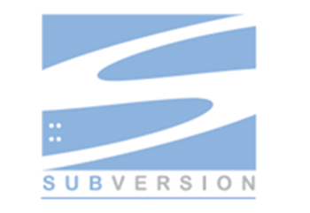
Source Management
Subversion hosted by Google Code
Group Development requires a central storage place
Provides developer accountability
Rollbacks made easy through versioning

Slide 9
Development Environment
Eclipse
  IDE used for development
Android SDK
  http://developer.android.com/sdk/index.html
Android ADT Eclipse Plug-in
  http://developer.android.com/sdk/eclipse-adt.html
Phone Emulator
  Included with the SDK

Slide 10
System Architecture
Tier 1: User Interface
  Developed with XML
  Keeps interface design out of source code
Tier 2: Middleware
  Developed with Java using the Android API, version 1.5
  All Android mobile devices running 1.5 or greater can use this application
Tier 3: Database
  Developed using SQLite, a flat file database system for mobile devices

Slide 11
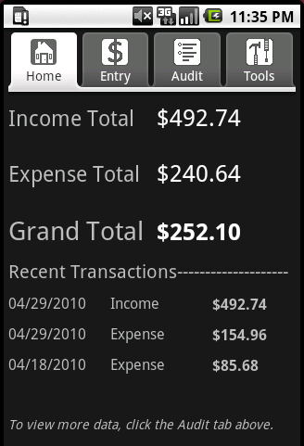
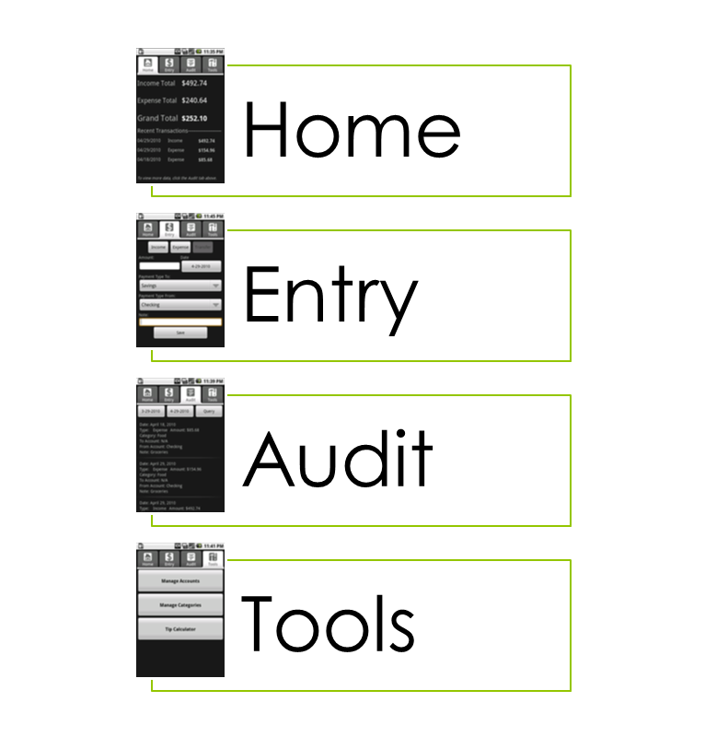
Tab Structure – Home Tab

Slide 12
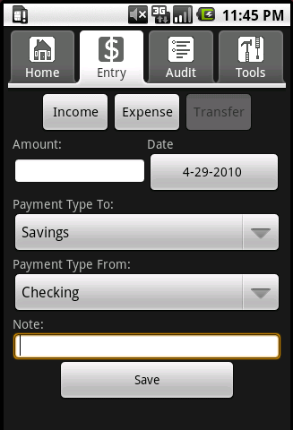
Tab Structure – Entry Tab

Slide 13
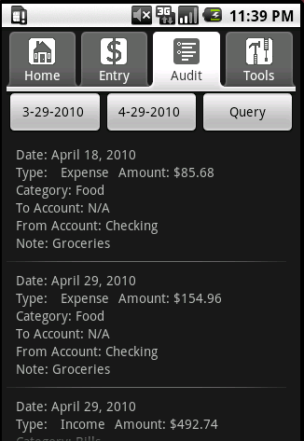
Tab Structure – Audit Tab

Slide 14
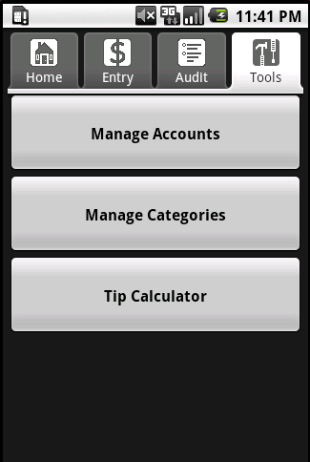
Tab Structure – Tools Tab

Slide 15

Data Storage
SQLite
  Dynamically Typed Storage
  Database stored in single file
  Serverless Database System
  Small memory footprint
  Great for embedded devices like Mobile Devices
  http://www.sqlite.org/

Slide 16
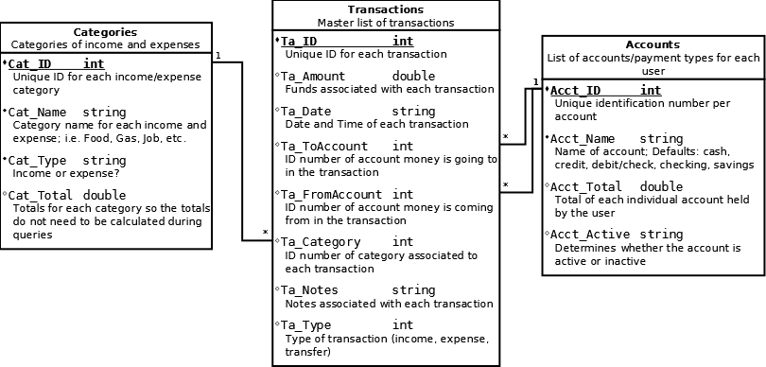
MintTrack Database Design

Slide 17
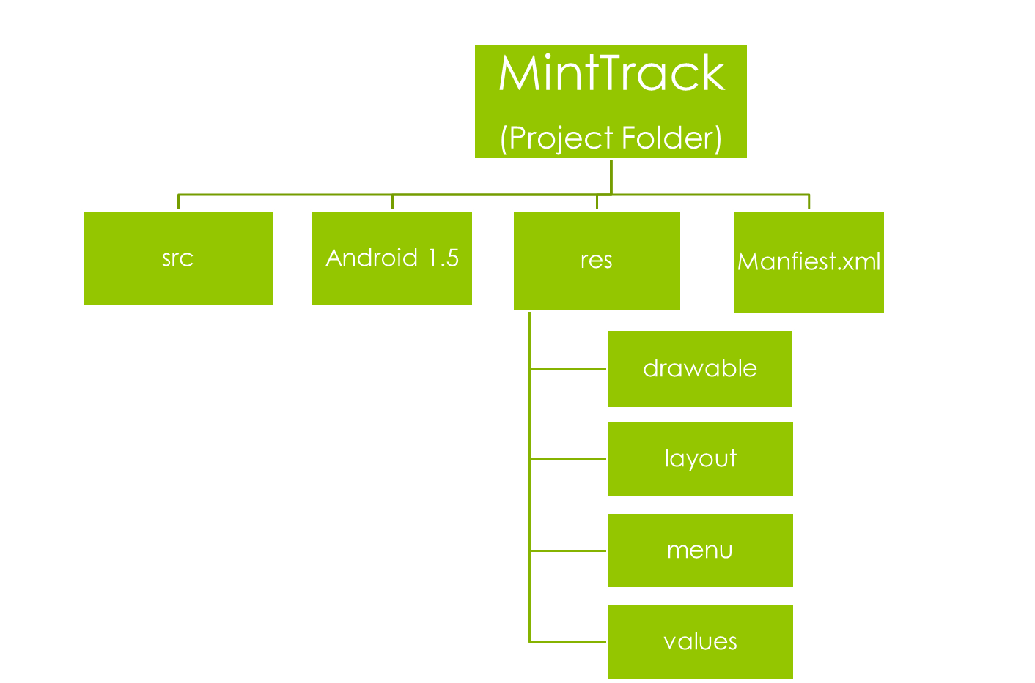
File Structure
src: A common abbreviation for source code. All the java code files are here.
res: Resources. This folder contains the xml files for the layout, menus and strings.
drawable : is folder contains the pictures and icons used in the program.
Manifest.xml: all the java classes are declared in this file.

Slide 18
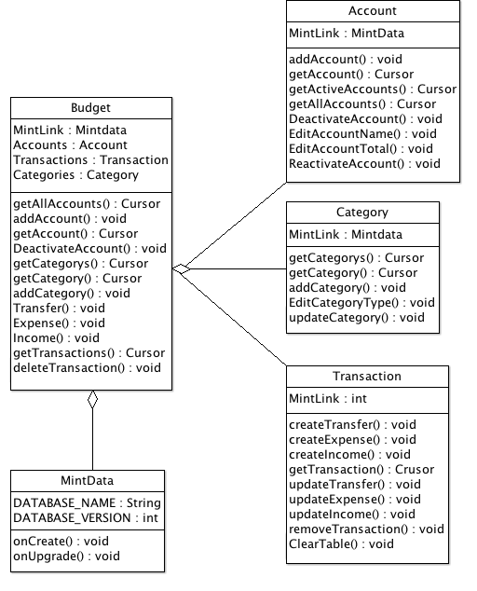
Middleware DB
Interface

Slide 19
Documentation
Project Proposal
  Initial project idea and planning
Meeting Minutes
  Weekly updates on progress
RAD – Requirements Analysis Document
  Functional, Non-functional requirements, system models
SDD – System Design Document
  Design goals, system architecture, software control and subsystems
ODD – Object Design Document
  Generated JavaDoc

Slide 20
Future Goals
Completely error proofing user input
Add more query functionality
Graphical analysis
Improvement of tab layouts
Online help feature
Releasing application to general public

