Slide 1
A Simple Message
Intro to Android Studio

Slide 2
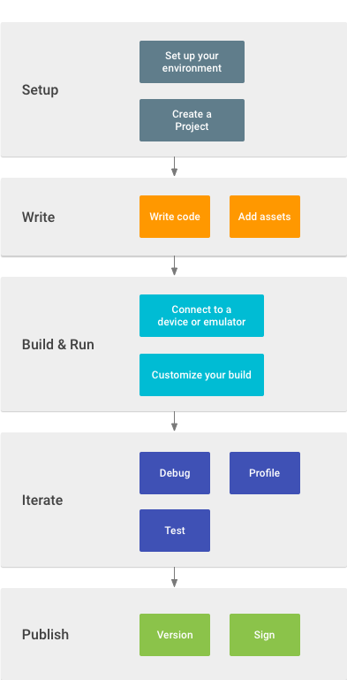
Work Flow
This is the general work flow for android app dev in Android Studio.

Slide 3
Setup
Android Studio can be downloaded from :
https://developer.android.com/studio/index.html
If you are having trouble with linux this is the link to my repo:
https://github.com/zeroBitOfDiff/androidAppShop
I also included the slides and some other helpful docs
https://github.com/zeroBitOfDiff/MyApplication
If you’re testing on a device, make sure that you have usb debugging enabled.
If you’re testing on an emulator, make sure you have virtualization turned on and have kvm or haxm installed.

Slide 4
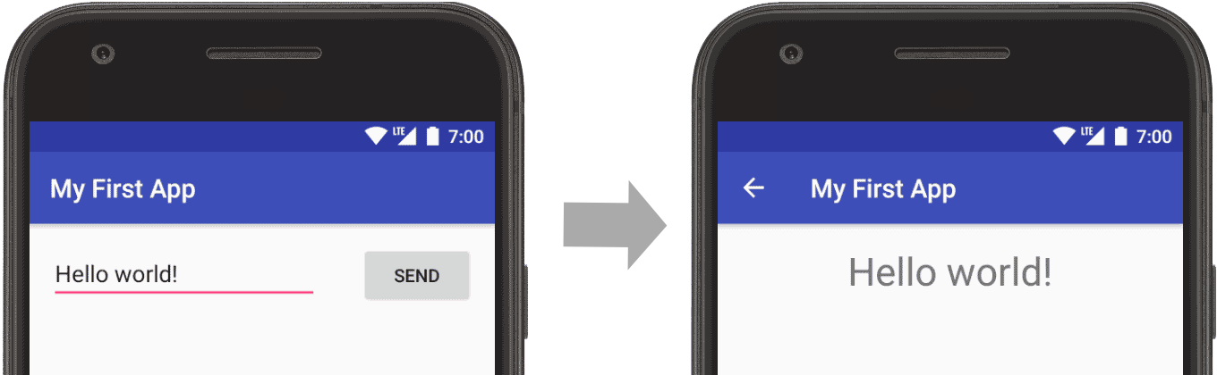
Activity to Activity messaging
In this project we will send a message from one Activity to another
Basically one UI to another
https://developer.android.com/training/basics/firstapp/index.html

Slide 5
Create a new Project
Start with Empty Activity
MainActivity.Java
This the main entry point into you app
Activity_main.xml
app>res>layout>
This defines the layout for activities UI

Slide 6
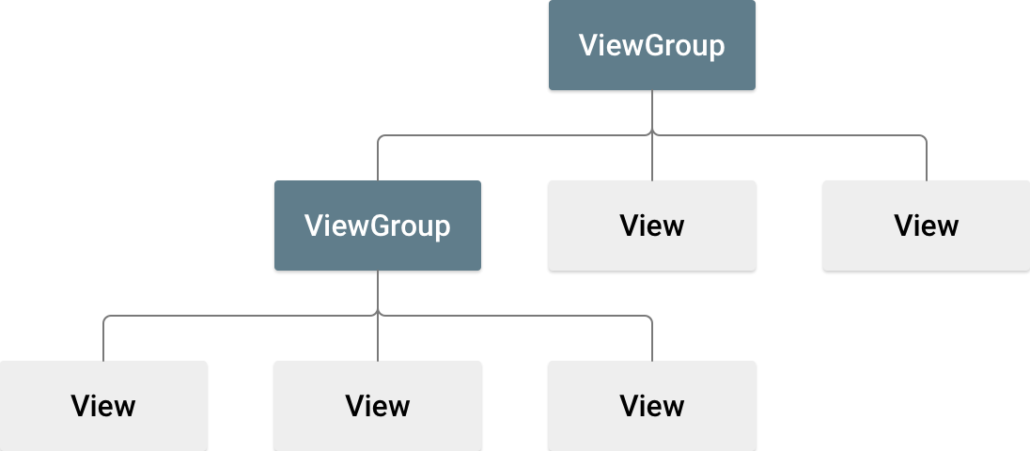
Build Simple UI
viewGroup: basically layout
View : thats the widgets, textboxes, and other UI components

Slide 7
Layout Editor
app>res>layout>activity_main.xml
If your editor shows xml source click the design tab at bottom
Component Tree:
Constraint Layout: layout that derives the position for each view based on constraints
You will see: they look like anchors

Slide 8
Add a text box
In component Tree lets delete the old text view
Go to palette window on the left and click the text box and drag to the design UI
Anchor the constraints at 16dp

Slide 9
Add Button
Pallet Widget
Anchor the button left to the text box and right
Constrain views in horizontal alignment
Click on baseline constraint anchor the baseline button to the text box
This is an easy way to chain together widgets

Slide 10
Change UI strings
[Show Design] in toolbar
Next Project Window
app>res>values>strings.xml
Open editor
Add key
“edit_message”
“Enter a message”
Add key
“button_send”
Send
Go back to activity_main.xml
Hint
Pick Resource [...]
Delete text

Slide 11
Start Another Activity
Add a method to MainActivity.java
sendMessage
Public access
Void return value
View object that was clicked is its sole parameter

Slide 12
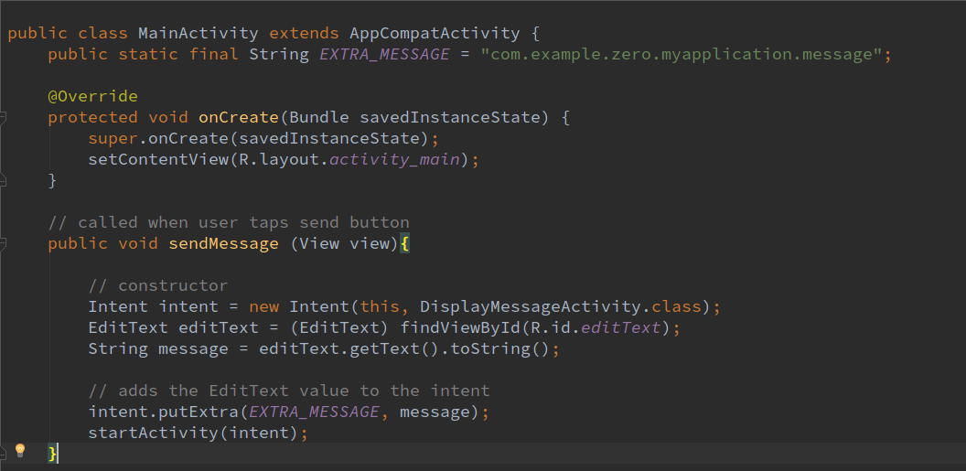

Slide 13
Build an Intent
An intent is an object that provides runtime binding between separate components like tow activities.
[this app intends to]
Also add EXTRA_MESSAGE
Intent constructor takes two params
Context (which activity is a subclass of context)
Class of app component to which the system should deliver intent
EXTRA are basically key value pairs which intent can carry
The start Activity method starts an instance of the DisplayMessageActivity specified by the intent
Alt-enter will import your needed libraries

Slide 14
Create DisplayMessageActivity
Now we must create the second activity
Project Window
app>new>empty activity
Configure Activity
Name it “DisplayMessageActivity”
A.S. creates
DisplayMessageActivity.java
Activity_display_message.xml
Adds the required <activity> element in AndroidManifest.xml

Slide 15
Add a text view
app>res>layout>activity_display_message.xml
Turn on auto connect in tool bar

Slide 16
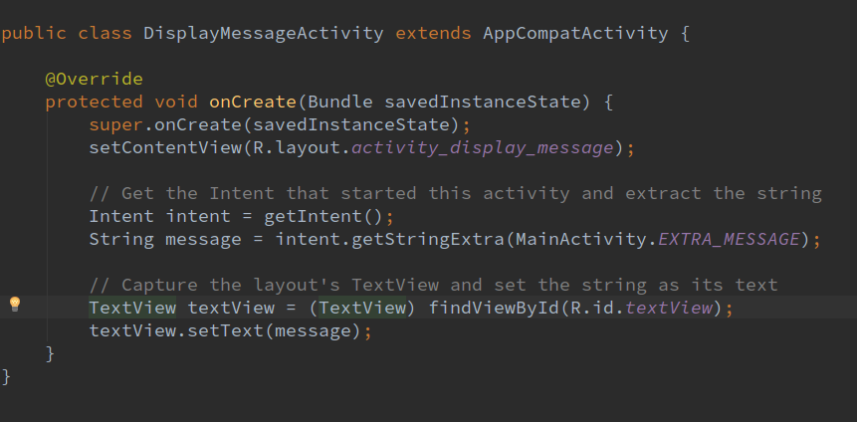
In DisplayMessageActivity.java
Basically this is getting the message from intent and setting it to text view

Slide 17
Add up Navigation
Before we have the user moving around our app, we should have a way for them to get back.
Android auto adds up button
Add code to app>Manifests>AndroidManifest.xml

Slide 18
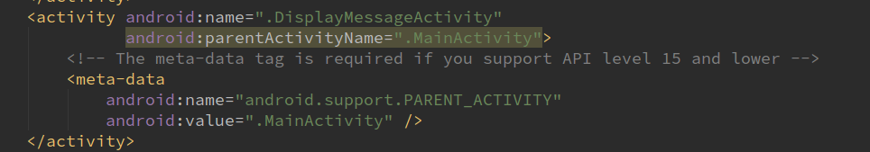

Slide 19
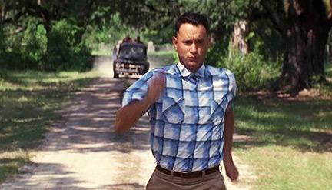
Now Run

