Slide 1

A3 Thinking AF Certification Rubric

Slide 2

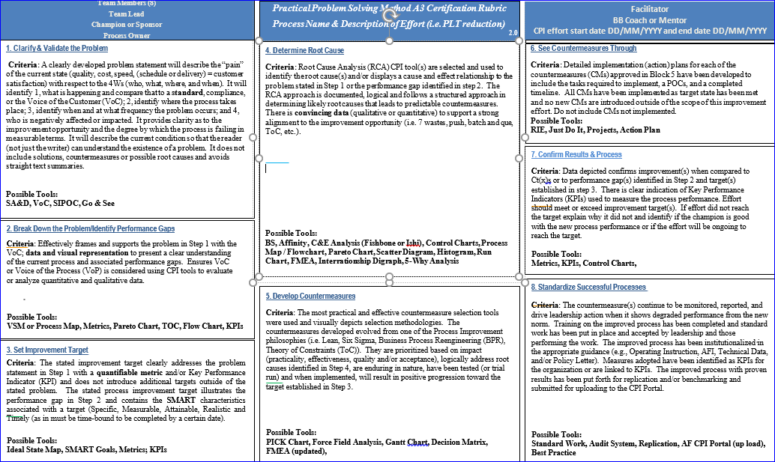
A3 Rubric

Slide 3
A3 Rubric - Headings
Process Owner:
Champion:
CPI effort Start date DD/MMM/YYYY and End date DD/MMM/YYYY
Team Lead: May or may not be process owner
Team Members: Must be at least 8 members for BB (6 members for GB)
Facilitator: Mentor: Must list as GB, BB or MBB
CPI Title (the phrase “CPI Title” is not required)
Must include Process name and clear description of effort
i.e., Hospital Y, Base X, Medical Patient In processing PLT Reduction

Slide 4
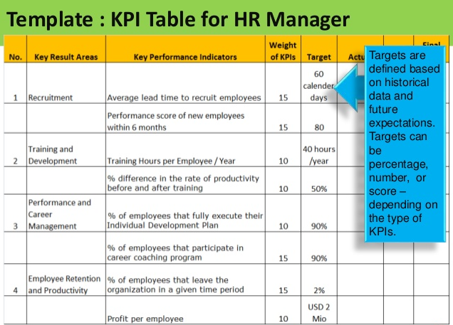
should have positive impact on Customer Satisfaction.
1. Clarify & Validate the Problem
Criteria: A clearly developed problem statement will describe the “pain” of the current state (quality, cost, speed, schedule or delivery, or customer satisfaction) with respect to the 4Ws (who, what, where, and when). It will identify 1, what is happening and compare that to a standard, compliance, or the Voice of the Customer (VoC); 2, identify where the process takes place; 3, identify when and at what frequency the problem occurs; and 4, who is negatively affected or impacted. It provides clarity as to the improvement opportunity and the degree by which the process is failing in measurable terms. It will describe the current condition so that the reader (not just the writer) can understand the existence of a problem. It does not include solutions, countermeasures or possible root causes and avoids straight text summaries.
Possible Tools:
SA&D, VoC, SIPOC, Go & See, Inspection Findings

Slide 5
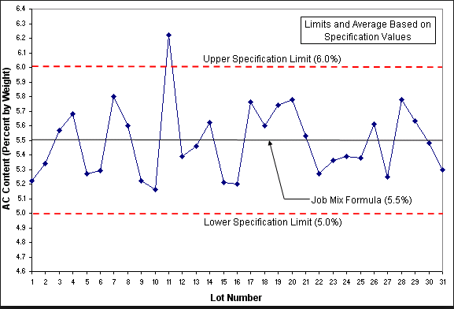
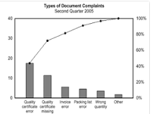
should have positive impact on Customer Satisfaction.
2. Break Down the Problem/Identify Performance Gaps
Criteria: Effectively frames and supports the problem in Step 1 with the VoC; data and visual representation to present a clear understanding of the current process and associated performance gaps. Ensures VoC or Voice of the Process (VoP) is considered using CPI tools to evaluate quantitative and qualitative data.
“Graphs and Charts”
“A picture is worth a thousand words”
Possible Tools:
VSM, Process Map, Metrics, Pareto Chart, TOC, Flow Chart, KPIs

Slide 6
should have positive impact on Customer Satisfaction.
3. Set Improvement Target
Criteria: The stated improvement target clearly addresses the problem statement in Step 1 with a quantifiable metric and or Key Performance Indicator (KPI) and does not introduce additional targets outside of the stated problem. The stated process improvement target illustrates the performance gap in Step 2 and contains the SMART characteristics associated with a target (Specific, Measurable, Attainable, Realistic and Timely (as in must be time-bound to be completed by a certain date).
Possible Tools:
Ideal State Map, SMART Goals, Metrics; KPIs

Slide 7
should have positive impact on Customer Satisfaction.
4. Determine Root Causes
Criteria: Root Cause Analysis (RCA) CPI tool(s) are selected and used to identify the root cause(s) and displays a cause and effect relationship to the problem stated in Step 1 or the performance gap identified in step 2. The RCA approach is documented, logical and follows a structured approach in determining likely root causes that lead to predictable countermeasures. There is convincing data to support a strong alignment to the improvement opportunity (i.e. 7 wastes, push, batch and que, etc.).
Possible Tools:
Brainstroming, Affinity, C&E Analysis (Fishbone or Ishi), Control Charts, Process Map / Flowchart, Pareto Chart, Scatter Diagram, Histogram, Run Chart, FMEA, Pie Chart, Interrationship Digraph, 5-Why Analysis

Slide 8
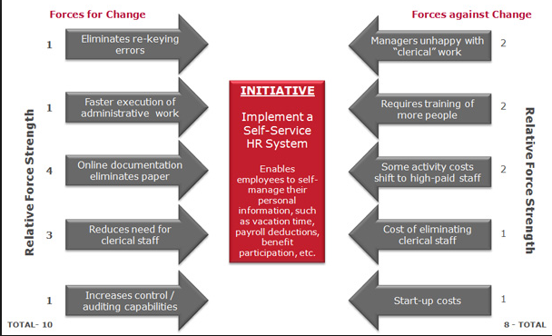
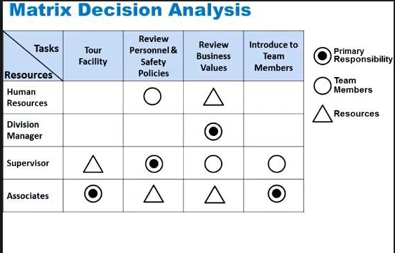
should have positive impact on Customer Satisfaction.
5. Develop Countermeasures
Criteria: The most practical and effective countermeasure selection tools were used and visually depicts selection methodologies. The countermeasures developed evolved from one of the Process Improvement philosophies (i.e. Lean, Six Sigma, Business Process Reengineering (BPR), Theory of Constraints (ToC)). They are prioritized based on impact (practicality, effectiveness, quality and/or acceptance), logically address root causes identified in Step 4, are enduring in nature, and when implemented, will result in positive progression toward the target established in Step 3.
Possible Tools:
PICK Chart, Force Field Analysis, Gantt Chart, Decision Matrix, FMEA (updated),
Force Field Analysis
Decision Matrix

Slide 9
should have positive impact on Customer Satisfaction.
6. See Countermeasures Through
Criteria: Detailed implementation plans for each of the countermeasures (CMs) approved in Block 5 have been developed to include tasks, POCs, and a completed timeline. All CMs have been implemented as target state has been met and no new CMs are introduced outside of the scope of this improvement effort. Do not include CMs not implemented.
Possible Tools:
RIE, Just Do It, Projects, Action Plan

Slide 10
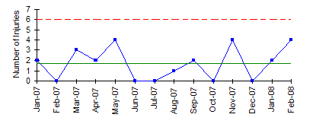
should have positive impact on Customer Satisfaction.
7. Confirm Results & Process
Criteria: Data depicted confirms improvement(s) when compared to Ct(x)s or to performance gap(s) identified in Step 2 and target(s) established in step 3. There is clear indication of Key Performance Indicators (KPIs) used to measure the process performance. Effort should meet or exceed improvement target(s). If effort did not reach the target explain why it did not and identify if the champion is good with the new process performance or if the effort will be ongoing to reach the target.
Possible Tools:
Metrics, KPIs, Control Charts,

Slide 11
should have positive impact on Customer Satisfaction.
8. Standardize Successful Processes
Criteria: The countermeasure(s) continue to be monitored, reported, and drive leadership action when it shows degraded performance from the new norm. Training on the improved process has been completed and standard work has been put in place and accepted by leadership and those performing the work. The improved process has been institutionalized in the appropriate guidance (e.g., Operating Instruction, AFI, Technical Data, and/or Policy Letter). Measures adopted have been identified as KPIs for the organization or are linked to KPIs. The improved process with proven results has been put forth for replication and/or benchmarking and submitted for uploading to the CPI Portal.
Possible Tools:
Standard Work, Audit System, Replication, AF CPI Portal (up load), Best Practice

