Slide 1
MINI-PROJECT · IRONHACK
🤖
Reinforcement
Learning
Grid World Navigation with Q-Learning
DNL · Ironhack Data Science Bootcamp · 2026

Slide 2
What is Reinforcement Learning?
The Idea
The 5 Key Concepts
An agent interacts with an environment.
It tries actions, receives rewards or penalties — and learns over time to get better and better.
No labeled data. No teacher. Just: try → get feedback → improve.
🧠 Agent
The learner — makes decisions
🌍 Environment
The system the agent operates in
📍 State
Where is the agent right now?
🎮 Action
What does it do next?
🏆 Reward
How good was the decision?
Slide 1 / 11

Slide 3
The Problem: Grid World
S
Agent's Task
🚀 Start
(top left) → Goal (bottom right)
🧱 Obstacles
Walls = forbidden (penalty: -10)
👣 Each step
costs -1 point (find shortest path!)
🏆 Goal reached
+50 points reward
G
Start
Ziel
Learned Path
🔁 5,000 episodes
to learn the optimal path
Wand
Slide 2 / 11

Slide 4
Q-Learning: Wie funktioniert es?
🎮 Analogie:
Like a video game newbie — first pressing random buttons, then learning from mistakes, eventually playing the level in your sleep.
1. Observe
2. Act
3. Feedback
4. Learn
👁
🎯
⚡
📊
Agent sees its
current state
Picks an action
(ε-greedy)
Receives reward
or penalty
Updates the
Q-table
Bellman:
Q(s,a) = Q(s,a) + α·[r + γ·maxQ(s',a') − Q(s,a)]
Slide 3 / 11

Slide 5
Key Parameters & ε-Greedy Strategy
Parameter
ε-Greedy Strategy
Parameter
Wert
Bedeutung
🎲 EXPLORATION
α (alpha)
0.1
Learning rate — how much new info overrides old
Random action
Agent explores unknown cells
γ (gamma)
0.9
Discount factor — future rewards count almost as much as immediate
with prob. ε vs (1-ε)
ε (epsilon)
Exploration decays each episode
🧠 EXPLOITATION
0.5 → 0.01
Beste bekannte Aktion
Agent nutzt sein Wissen
Episodes
5.000
Number of complete runs through the maze
Slide 4 / 11

Slide 6
Implementation: Code Overview
● ● ● Q-Learning Core
7 Steps in the Notebook
# Q-Learning Update Rule
old_value = Q[state][action]
next_max = np.max(Q[next_state])
Q[state][action] = old_value + alpha \
* (reward + gamma * next_max
- old_value)
# Epsilon Decay
epsilon = max(0.01,
epsilon * 0.995)
1
Libraries & Maze
2
RL Parameters & Q-Table
3
Validity Check & Action Selection
4
Train Agent (5,000 Episodes)
5
Extract Optimal Path
6
Visualize Maze & Path
7
Plot Learning Curve
Slide 5 / 11

Slide 7
Optimal Path: How the Agent Navigates
● ● ● get_optimal_path()
How It Works
def get_optimal_path(Q, start, goal,
actions, maze):
path = [start]
state = start
visited = set()
for _ in range(max_steps):
if state == goal: break
visited.add(state)
# Pick highest Q-value action
best_action = argmax(Q[state])
move = actions[best_action]
state = next(state, move)
path.append(state)
return path
1
Start at (0,0)
2
Look up Q-values for all 4 directions
3
Pick the action with highest Q-value
4
Move to next cell
5
Repeat until goal reached
6
visited set prevents loops
Slide 6 / 11

Slide 8
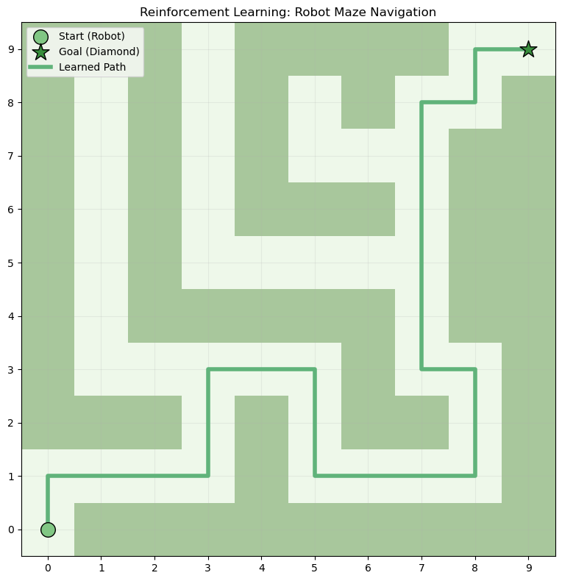
Optimal Path: The Result
What We See
🟢 Start
Agent begins top-left
⭐ Goal
Target bottom-right
〰️ Path
Route learned by Q-table
🟫 Walls
Avoided by the agent
Slide 7 / 11

Slide 9
Learning Progress: Tracking Improvement
● ● ● plot_rewards()
Why Track Rewards?
# Collect total reward each episode
rewards_all_episodes = []
for episode in range(num_episodes):
total_rewards = 0
# ... run episode ...
rewards_all_episodes.append(
total_rewards)
# Plot the learning curve
def plot_rewards(rewards):
plt.plot(rewards)
plt.title('Total Rewards per Episode')
plt.xlabel('Episode')
plt.ylabel('Total Reward')
plt.grid(True)
plt.show()
Each episode the agent collects a total reward — the sum of all individual rewards in that run. Early episodes: mostly negative — agent hits walls and wanders. Later episodes: rewards increase as the agent learns the optimal path. This curve is proof that learning is happening.
Slide 8 / 11

Slide 10
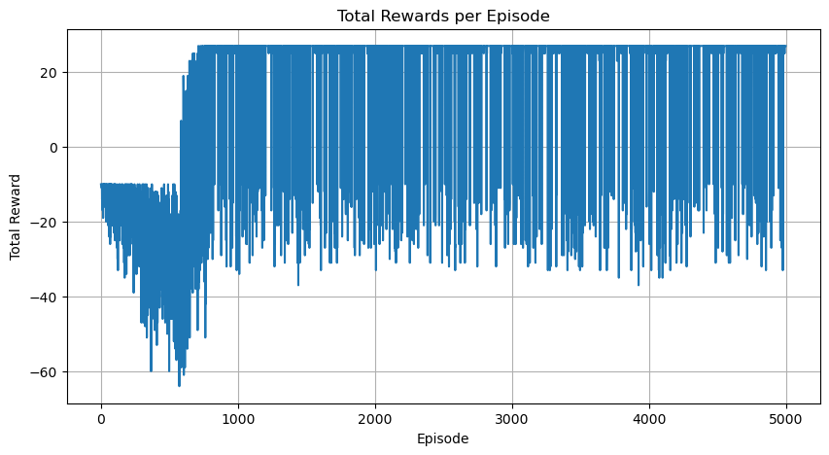
Learning Progress: The Curve
Reading the Chart
Episodes 0–800
High variance — agent is exploring randomly, frequently hitting walls
Episodes 800–2000
Transition — epsilon decays, agent starts exploiting learned paths
Episodes 2000–5000
Stabilization — agent consistently finds the goal, rewards level out
💡 The upward trend confirms the agent is learning — even with noise from ongoing exploration.
Slide 9 / 11

Slide 11
Results & Analysis
✅ Agent Finds the Path
After 5,000 episodes it reliably navigates from start to goal.
📈 Clear Learning Curve
Rewards rise from ~-85 to ~+44 — clear learning progress.
⚠️ Challenge
Epsilon decay too fast → agent gets stuck in suboptimal paths.
💡 What would I do differently? Train more episodes + compare different epsilon decay rates.
Slide 10 / 11

Slide 12
Key Takeaways
RL = Agent learns through trial & error — no labeled data needed
Q-Learning stores experience in a table and learns the optimal path
The Exploration-Exploitation dilemma is the core of RL — and applies to real life too
Grid World is perfect for learning: simple, visual, intuitive
Resources:
GeeksForGeeks · What is Reinforcement Learning | Sutton & Barto: Reinforcement Learning — An Introduction
DNL · Ironhack Data Science Bootcamp · 2026 Thank You!

