Slide 1
Principles of Communication Systems
J Bapat

Slide 2
Course Outline
Course Description: Communication systems are basic workhorses behind the information age. This course aims to provide an introduction to the basic principles behind the design of these systems and get an insight into the underlying principles behind the design and analysis of communication systems.
Class Timings: Tuesday-Thursday 1100 AM-1230 PM
Instructor: Prof. Jyotsna Bapat
Text:
[1] Upamanyu Madhow, Introduction to Communication Systems, Cambridge University Press
References:
[1] Taub and Schilling, Principles of Communication Systems, McGrawHill
[2] Simon Haykin, Communication Systems, Wiley, 5th Edition

Slide 3
List of topics Covered (weekly): Tentative, subject to change
Date | Topic | Text
Week 1 | Introduction to the course. Introduction to communication systems | Ch 1
Weeks 2-4 | Signal and Systems: Review. Fourier Transform and Series. Complex Baseband representation (Quiz 1) | Ch 2
Week 5-7 , 10 | Analog Communication, AM, FM Receivers, PLL (Quiz 2) | Ch 3
Week 8-9 | Midterm, Break
Week 11-14 | Digital Modulation (QPSK, QAM), Orthogonal Signalling. Nyquist Criterion for ISI (Quiz 3) | Ch 4
Week 15 | Review of Basic probability and random variables | Ch 5
Week 16-17 | Optimum Demodulation for AWGN | Ch 6
Week 18 | Review
Week 19 | Final

Slide 4
Course Outline
Assessment:
Midterm: 30%
Final: 35%
Quizzes: 30%
Class Participation: 5%

Slide 5
Introduction
We define communication as the process of information transfer across space or time.
Communication across space:
Radio waves carrying our phone conversation from cell phone to the base station
coaxial cables delivering television from a remote location to our home.
Across time:
communication across time, or storage of information, DVDs, hard drives and memory sticks etc.
Conversion of information into a signal, termed the transmitted signal, compatible with the physical medium of interest.
Propagation of the signal through the physical medium (termed the channel) in space or time;
Extraction of information from the signal (termed the received signal) obtained after propagation through the medium.

Slide 6
Analog Communication

Slide 7
Analog Communication
Given the analog nature of both the message signal and the communication medium, a natural design choice is to map the analog message signal (e.g., an audio signal) to an analog transmitted signal that is compatible with the physical medium over which we wish to communicate (e.g., broadcasting over the air from an FM radio station). This approach is termed analog communication.
Early communication systems were all analog: AM (amplitude modulation) and FM (frequency modulation) radio, analog television, first generation cellular phone technology (based on FM), vinyl records, audio cassettes, and VHS or beta videocassettes
While analog communication might seem like the most natural option, it is in fact obsolete.
Cellular phone technologies ➔ Digital
vinyl records and audio cassettes ➔ CDs, videocassettes ➔ DVDs.
Broadcast radio and television ➔ Digital radio and television broadcast.

Slide 8
Digital Communication
The conceptual basis for digital communication was established in 1948 by Claude Shannon, when he founded the field of information theory. There are two main threads to this theory:
Source coding and compression: Any information-bearing signal can be represented efficiently, to within a desired accuracy of reproduction, by a digital signa;, which in its simplest form is just a sequence of binary digits or bits. This is true whether the information source is text, speech, audio or video.
Techniques for performing the mapping from the original source signal to a bit sequence are generically termed source coding. They often involve compression, or removal of redundancy, in a manner that exploits the properties of the source signal .

Slide 9
Digital Communication
Digital information transfer: Once the source encoding is done, we need to reliably transfer the bit sequence at the output of the source encoder across space or time. The performance of any communication system depends on the relative strengths of the signal and noise or interference, and the distortions imposed by the channel.
Shannon showed that, once we fix these operational parameters for any communication channel, there exists a maximum possible rate of reliable communication, termed the channel capacity. Thus, given the information bits at the output of the source encoder, in principle, we can transmit them reliably over a given link as long as the information rate is smaller than the channel capacity,
This sharp transition between reliable and unreliable communication differs fundamentally from analog communication, where the quality of the reproduced source signal typically degrades gradually as the channel conditions get worse.

Slide 10
Digital Communication System

Slide 11
Why Digital?
Comparing the block diagrams for analog and digital communication, we see that the digital communication system involves far more processing.
This is not an obstacle for modern transceiver design, due to the exponential increase in the computational power of low-cost silicon integrated circuits.
Digital communication offers several advantages.

Slide 12
Why Digital?
Optimality: For a point-to-point link, it is possible to separately optimize source coding and channel coding, as long as delay and processing incurred is acceptable. Due to this source-channel separation principle, we can leverage the best available source codes and the best available channel codes in designing a digital communication system, independently of each other. The design of a digital communication link is source-independent and channel-optimized.
In contrast, the waveform transmitted in an analog communication system depends on the message signal, which is beyond the control of the link designer, hence we do not have the freedom to optimize link performance over all possible communication schemes. In practice, huge performance gains are obtained from switching from analog to digital communication.

Slide 13
Why Digital?
Scalability: Digital communication allows ideal regeneration of the information bits, hence we can focus on communicating reliably one link, not the whole system. Since information bits are transported without interpretation, the same link can be used to carry multiple kinds of messages. The information bits can be chopped up into discrete chunks, or packets, which can then be processed independently on each link.
These properties of digital communication enable massively scalable, general purpose, communication networks such as the Internet. Messages of various kinds are reduced to packets, and these packets are switched along different paths along the network, depending on the identities of the source and destination nodes, and the loads on different links in the network.
None of this would be possible with analog communication: link performance in an analog communication system depends on message properties, and successive links incur noise accumulation, which limits the number of links which can be cascaded.

Slide 14
Why Analog then?
The physical links over which the bits are sent are almost always analog.
Digital-to-analog converters, mixers, amplifiers and antennas are required to translate bits to physical waveforms to be emitted by the transmitter.
At the receiver, antennas, amplifiers, mixers and analog-to-digital converters are required to translate the physical received waveforms to digital signals that are amenable to the digital signal processing.

Slide 15
Technology story 1: The Internet
Some of the key ingredients that contributed to its growth and popularity are:
Any message can be broken into packets and routed across the network, using an Internet Protocol (IP).
Advances in optical fiber communication and high-speed digital hardware enable a super-fast “core” of routers connected by very high-speed, long-range links, that enable world-wide coverage;
The World Wide Web, or web, makes it easy to organize information into interlinked hypertext documents which can be browsed from anywhere in the world;
The digitization of content (audio, video, books) means that ultimately “all” information is expected to be available on the web;

Slide 16
Technology story 2: Wireless
Cellular mobile networks provide ubiquitous tetherless connectivity. Base stations serve mobiles in their cells, and hand them off to adjacent base stations when the mobile moves to another cell, providing mobility.
WiFi or standardized wireless local area network (WLAN) technologies based on the IEEE 802.11 family of standards is another contributor to the huge success of the internet. WiFi networks use unlicensed spectrum in the 2.4 and 5 GHz bands.

Slide 17
WiFi vs. Cellular
Cellular transceivers and networks employ spectrum that is licensed. Due to costs involved in licensing, the systems are tightly engineered. Cellular networks must provide robust wide-area coverage in the face of rapid mobility (e.g., automobiles at highway speeds).
WiFi uses unlicensed spectrum, must only provide local coverage, and typically handles much slower mobility (e.g., pedestrian motion through a home or building). As a result, WiFi can be more loosely engineered than cellular.

Slide 18
Technology story 3: Moore’s law
Moore’s “law” is actually an empirical observation attributed to Gordon Moore, one of the founders of Intel Corporation. “The density of transistors in an integrated circuit, and hence the amount of computation per unit cost, can be expected to increase exponentially over time.”
Moore’s law has had a huge impact on the communications industry by drastically lowering the cost and increasing the speed of digital computation. By converting analog signals to the digital domain as soon as possible, advanced transceiver algorithms can be implemented in digital signal processing (DSP) using low-cost integrated circuits.
Economies of scale have been critical to the growth of mass market products in both wireless (e.g., cellular and WiFi) and wireline (e.g., cable modems and DSL) communication

Slide 19
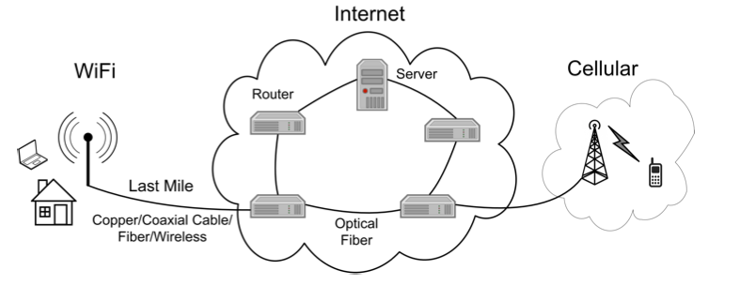
The Internet
Applications
Room for innovation
Transport layer
Network layer
“Thin waist” (packet switching using IP)
MAC/Link layer
(This course)
Room for innovation
Physical layer

Slide 20
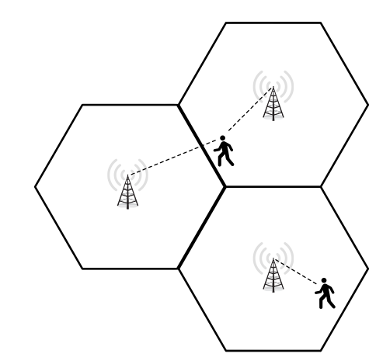
Cellular
Big Idea: Spatial Reuse
Key challenges
--Interference management
--Mobility

Slide 21
Ingredients of a Communication System
Business: Identify target customer/market, acquire funding
Network design: network architecture, router design, protocols
and their implementation
Physical link design: channel and interference modeling,
transceiver design, signal processing algorithms
This Course
Transceiver implementation: Integrated circuit implementation
of signal processing, RF; antenna design

Slide 22
Key Concepts
Structure of communication signals (Chapter 2)
Signals and systems review
Baseband and passband signals
How to send information with radio signals (Chapter 3)
Amplitude modulation, Angle modulation
Spectrum occupancy
Important analog techniques (Chapter 3)
Superheterodyne reception, phase locked loop
Legacy analog communication systems used to provide examples: AM radio, FM radio

Slide 23
Key Concepts
Digital modulation (Chapter 4)
Nyquist criterion for signaling over a bandlimited channel
Modulation techniques: QAM, PSK, orthogonal modulation
Statistical models for signals and noise (Chapter 5)
Review of probability and random variables
Random processes
Signal-to-noise ratio computations
Demodulation (Chapter 6)
Gaussian noise model
Detection theory basics
Signal space techniques: geometric approach to optimal detection
Optimal receiver design
Performance analysis

