Slide 1
Chapter 2: Signals and Systems
Principles of Communication Systems

Slide 2
Signals and Systems
A communication link involves several stages of signal manipulation:
Transmitter transforms the message into a signal that can be sent over a communication channel;
Channel distorts the signal and adds noise to it;
Receiver processes the noisy received signal to extract the message.
Communication system design must be based on a sound understanding of signals, and the systems that shape them.
Next, we will discuss concepts and terminology from signals and systems, with a focus on communication systems.

Slide 3
Signals and Systems: Goals
Review of basics: convolution, Fourier transform
Baseband and passband signals and systems:
Messages are typically baseband, while signals sent over channels (especially radio channels) are typically passband.
WiFi signals are passband (e.g., a 20 MHz band at 2.4 GHz; away from DC)
Wired communication (e.g., USB, modem) often use baseband signals

Slide 4
Passband vs. Baseband
A real-valued pass-band signal is equivalent (in a mathematically convenient and physically meaningful sense) to a complex-valued baseband signal, called the complex baseband representation, or complex envelope, of the pass-band signal.
The information carried by a pass-band signal resides in its complex envelope, so that modulation (or the process of encoding messages in waveforms that can be sent over physical channels) consists of mapping information into a complex envelope, and then converting this complex envelope into a passband signal.
Unified treatment of baseband and passband signals
Enabled by complex baseband representation for passband signals

Slide 5
Signals and Systems Review: Outline
Complex numbers
Euler’s identity
Inner product
Norm, energy
Fourier transform
Formula
Time-frequency duality
Properties: Convolution/multiplication, Parseval’s Theorem, linearity, time/freq shift
Pairs: Delta function/constant, sinc function/boxcar
Bandwidth
Baseband and passband signals
Complex baseband representation
Role of complex baseband in DSP-centric transceiver design

Slide 6
Complex numbers
Complex numbers provide a compact way of describing amplitude and phase (and the operations that affect them, such as filtering)
Complex number
(x and y real-valued, )

Slide 7


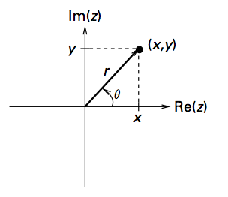
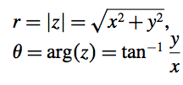

Complex numbers
Often useful to interpret a complex number as a point in 2-D plane
Cartesian (rectangular) coordinates:
Polar coordinates
But a complex number is more than just a 2D real vector:
mainly because of complex multiplication (one complex multiply
requires four real multiplies, and corresponds to adding phases)
Euler’s identity

Slide 8
Signals
A signal s(t) is a function of time (or some other independent variable, such as frequency, or spatial coordinates) which has an interesting physical interpretation. E.g., signal is generated by a transmitter, and/or processed by a receiver.
Physically realizable signals such as those sent over a wire or over the air must take real values.
It is extremely useful (and physically meaningful) to consider a pair of real-valued signals, interpreted as the real and imaginary parts of a complex-valued signal.
Thus, in general, we allow signals to take complex values.

Slide 9
Discrete vs. Continuous
Notation x(t) is used to denote continuous time signals (t taking real values), and x[n] to denote discrete time signals (n taking integer values).
A continuous time signal x(t) sampled at rate T_{s} produces discrete time samples x(nT_{s}+t₀) (t₀ an arbitrary offset), which we often denote as a discrete time signal x[n].
Signals sent over a physical communication channel are inherently continuous time, implementations at both the transmitter and receiver make heavy use of discrete time implementations on digitized samples corresponding to the analog continuous time waveforms of interest.

Slide 10
Sinusoid

Slide 11
Sinusoids
Sinusoids with known amplitude, phase and frequency are perfectly predictable, and cannot carry any information. Information can be transmitted by making the complex number Ae^{jθ} = A_{c} + jA_{s} associated with the parameters of sinusoid vary in a way that depends on the message to be conveyed.
The resulting signal is no longer a pure sinusoid, and communication system designer must decide what shape such a signal should take in the frequency domain.
Complex exponential: A complex exponential at a frequency f₀ is defined as
s(t) = Ae^{j(2πf0t+θ)} = αe^{j2πf0t}
A > 0 is the amplitude, f₀ is the frequency, θ ∈ [0, 2π] is the phase, and α = Ae^{jθ} is a complex number that contains both the amplitude and phase information.

Slide 12
Complex Exponential
Amplitude and phase for complex exponentials can be easily combined into a complex number that factors out of the complex exponential.
Using Euler’s formula,
Re (Ae^{j(2πf0t+ θ)}) = Acos(2πf₀t + θ)
Real-valued sinusoids are “contained in” complex exponentials.
The set of complex exponentials {e^{j2πft}}, where f takes values in (−∞,∞), form a “basis” for a large class of signals, and the Fourier transform of a signal is simply its expansion with respect to this basis.

Slide 13
Other Important Signals
Basic signals that are useful building blocks for more complex signals
Impulse function, or Delta function
Indicator function
Sinc function

Slide 14
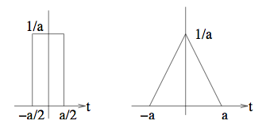
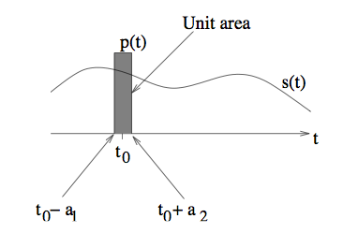

Delta (Impulse) function
Limit of “tall, thin” pulse with unit area
Multiplying a signal by a tall thin pulse at t₀ selects
its value at t₀. Now integrate to get sifting property.
Sifting Property of the Impulse

Slide 15
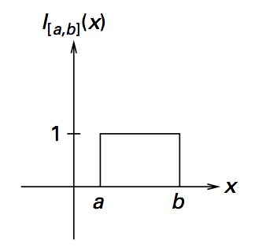

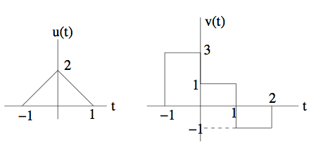


Indicator and Boxcar Functions
Indicator function of a set A
Boxcar (indicator function of an interval)
(very useful for compact notation)
Using the indicator function for compact descriptions:

Slide 16

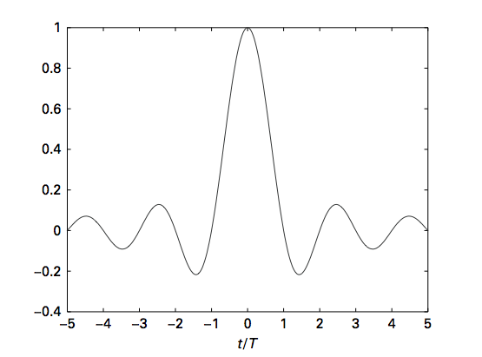
Sinc Function
(sinc(0) = 1, defined as the limit)
sinc(x), decays as 1/|x| with sinusoidal fluctuations
sinc(x)
x
The boxcar and sinc are Fourier transform pairs

Slide 17
Signals and Vectors
Euclidean geometry is important for communication system designers
Continuous-time signals are just like vectors
standard ideas from Euclidean geometry apply
We typically transform continuous-time signals into discrete-time vectors (filtering and sampling) before signal processing
Vector manipulation therefore important for both theory and algorithms

Slide 18



Signals and Vectors
Inner product is the key concept in defining signal geometry
continuous time
discrete time
(Complex-valued signals needed for our unified framework)
(note that constants
in second argument
get conjugated when
pulled out)
Linearity

Slide 19

Energy and Power
Energy and power are important concepts in communication
--How much power is needed to transmit a signal?
--What is the signal-to-noise ratio?
--How much interference do signals create for each other?
Energy = Inner product of a signal with itself

Slide 20
Energy of the Signal

Slide 21
Solution

Slide 22




Energy and Power
Power = time average of energy, computed over a large interval
Example: Power of a sinusoid
Average
value
Integrates to zero over each period
(averages to zero over large interval)

Slide 23
DC Value
DC value: The DC value of s(t) is defined as ~s(t) (time averaged value).

Slide 24
Power and DC value of Sinusoid
For a real-valued sinusoid s(t) = Acos(2πf₀t + θ), the DC value or time average is 0
Power:

Slide 25
Linear Time-invariant Systems
System: A system takes as input one or more signals, and produces as output one or more signals. A system is characterized by its input-output relationship.
Linear Time Invariant (LTI) systems provide good models for filters at the transmitter and receiver, as well as for the distortion induced by a variety of channels. The input-output relationship is particularly easy to characterize for such systems.

Slide 26
LTI
Linearity:
Let x1(t) and x2(t) denote arbitrary input signals, and let y1(t) and y2(t) denote the corresponding system outputs, respectively. Then, for arbitrary scalars a1 and a2, the response of the system to input a1x1(t) + a2x2(t) is a1y1(t) + a2y2(t).
Time Invariance:
Let y(t) denote the system response to an input x(t). Then the system response to a time-shifted version of the input, x1(t) = x(t−t0) is y1(t) = y(t−t0). A time shift in the input causes an identical time shift in the output.

Slide 27
Example
Determine whether following systems are
Linear
Time invariant
y(t) = 2x(t − 1) − jx(t − 2)
y(t) = (3 − 2j)x(1 − t)
y(t) = x(t) cos(100πt) − x(t − 1) sin(100πt)
y(t) = e^{2x(t−1)}

Slide 28


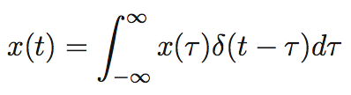
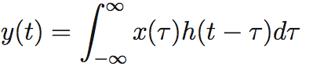
Linear Time-Invariant (LTI) Systems
Completely characterized by their impulse response
--Any signal can be expressed as a linear combination of shifted impulses
--Use LTI property to get the convolution formula
s
LTI property
s
Sifting property of impulse
Convolution

Slide 29

Convolution
Communications channels often modeled as LTI systems, so convolution is a key
modeling tool: modulated signal convolved with an LTI system, then noise added
Recall the basic definition:
Linearity and shift invariance
(notational abuse in not distinguishing dummy variable is often convenient)

Slide 30
LTI Systems

Slide 31
Convolution

Slide 32
Convolution

Slide 33
Convolution

Slide 35
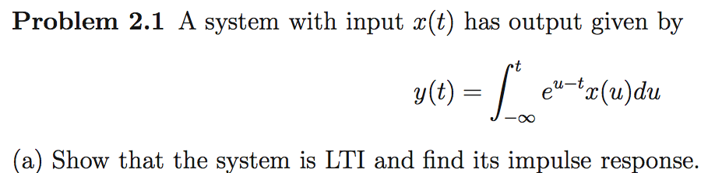
Exercise: LTI concept

Slide 36
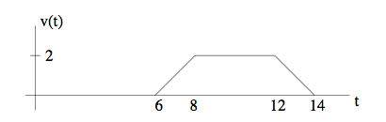
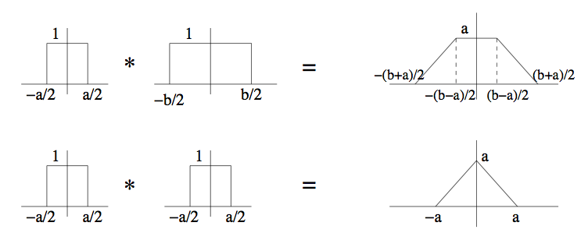
Convolution of two boxes = trapezoid
In general, useful to keep in mind the following:
Use linearity and time invariance to build convolutions of shifted boxes,
linear combinations of shifted boxes, etc.

Slide 37
Exercise: convolution computation
3
1
3
6
*
2
-4
-3
-1
Find the convolution using the convolution of two boxes as building block.
Use linearity to decompose into multiple boxes
Use time invariance: need not worry about where the signals start
(can make them start from origin, and add in delays later)

Slide 38
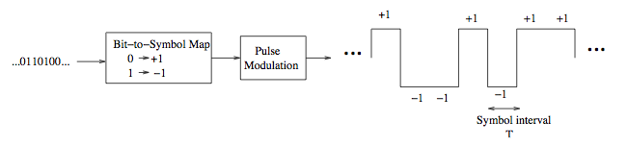

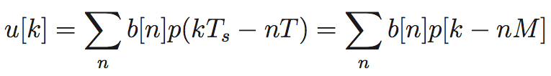
Digital modulation as convolution
Symbols at rate 1/T
Sample at rate 1/T_{s} = M/T. Symbols are spaced by M samples.
Can view as convolution between p[n] and upsampled version of b, inserting M-1 zeros
between successive entries.

Slide 39

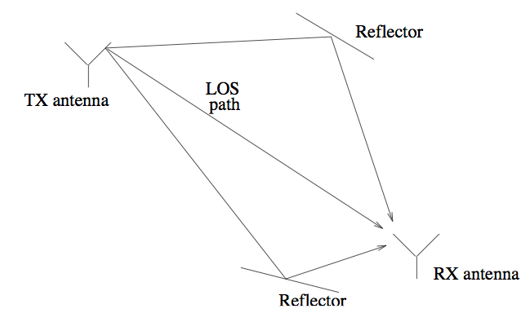
Convolving with the delta function
Convolving with the shifted delta function inserts a time shift:
(use the sifting property to see this)
So we can use the delta function to model wireless multipath channels

Slide 40
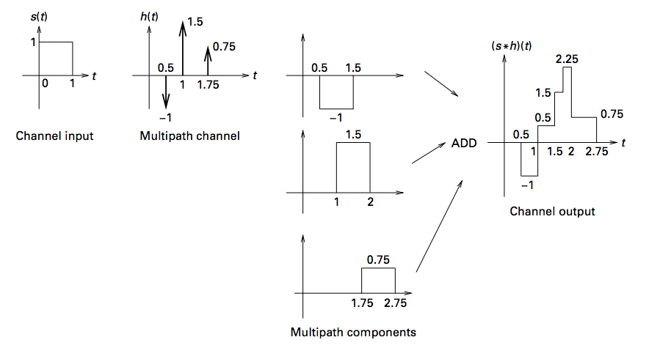

Modeling a multipath channel
Output of multipath channel
(before adding receiver noise)
Group exercise
Multipath channel impulse response

