Slide 1
EG 301 Operating Systems

Slide 2
Agenda
1
Introduction to Linux Kernel Architecture
2
File Management
3
Process Management

Slide 3
Name History
UNIX
The multitasking operating system PDP-7 supported two simultaneous users and Brian Kernighan humorously called it UNICS for the uniplexed Information and computing system. The name was changed to UNIX in 1970.
Linux
Started in 1991 by Linux Torvalds as a personal project to create a free OS Kernel.
Published under GPL
You can download the kernel sources code from kernel.org.
You can check your running kernel version in Linux system by executing the command: $ uname -r
Notes:
In 1960 , MIT, AT&T Bell Labs and GE worked on an experimental Operating system called MULTICS. MULTICS (multiplexed information and computing system) was an OS for the GE 645 mainframe computer. It allowed information sharing and security.
Thomson, Ritchie and their colleagues created a multitasking OS, with file system, shell and some features for the PDP-7.
Since the new multitasking OS for the PDP-7 supported two simultaneous users it was called UNICS.

Slide 4
Unix features
Written in a high level language
Provides a simple user interface
Uses hierarchical file system
Gives File protection
Provides a simple and consistent interface to peripheral devices.
Is a multi-user, multi-process system.
Notes:
Written in a high level language (portability) - easy to read,understand, change and move to other operating systems.
Provides a simple user interface for example shell
Uses hierarchical file system: easy maintenance and efficient implementation.
Provides a simple and consistent interface to peripheral devices. User need not to worry about the intricacies of hardware details. The user can use the device as a file and perform all the file operations on a device. It hides the machine architecture from the user making it easier to write programs that run on different hardware implementations.

Slide 5
Kernel Types and Functionality
Provides facilities like
Basic kernel services
System start up and shutdown
File, Process, Memory, Signals, IPC and Network Managements.
Interrupt and trap handling
Separation between user and system space - System calls
Scheduling
Timer and clock handling
Types of Kernel
Monolithic
Micro Kernel
Monolithic
Suitable for Desktop (UNIX, MS-Windows)
Less run time overhead
Less extensibility
Micro Kernel
Suitable for Embedded (RTOS)
Run time overhead
Highly extensible

Slide 6
Kernel Source Code
The kernel code contains architecture dependent as well as architecture independent code
Machine-independent code deals with
System call handling
The file system: files, directories, pathname translation, file locking, and I/O buffer management
Terminal handling support: the terminal-interface driver and terminal line disciplines
IPC facilities
Network communication support
Machine-dependent code deals with
Low-level system startup functions
Trap and fault handling
Low-level manipulation of runtime context of a process
Configuration and initialization of hardware devices
Runtime support for I/O devices

Slide 7
Booting Procedure
Boot Loader
Extract & decompress kernel
image
Power on
Boot Loader / MBR
Loaded into Physical Memory and uncompressed
Execute Kernel
Mount File Systems (/etc/fstab)
Choose Run Level (/etc/inittab)
Spawn systemd process
Shell / login prompt
Execute kernel
Initialize memory & h/w
Initialize device drivers
Mount root file system
Run systemd script
User programs
login-prompt
Start services
Start X-Windows

Slide 8
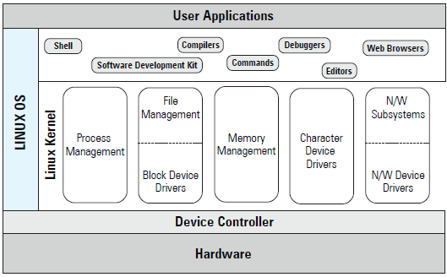
Introduction – Linux OS

Slide 9
Linux Kernel Architecture
System Call Interface
Process
Subsystem
Memory
Subsystem
File
Systems
Device
Control
Network
Subsystem
Concurrency
Virtual
Memory
VFS
tty
access
Connectivity
FS types
Network
layers
Arch
code
Memory
manager
Character
devices
Block devs
Network
drivers
HARDWARE

Slide 10
File Management
Different Types of Files
File and File System
Types of File Systems
Device Special Files
Mounting and Un mounting Devices and File systems
Buffer Cache

Slide 11
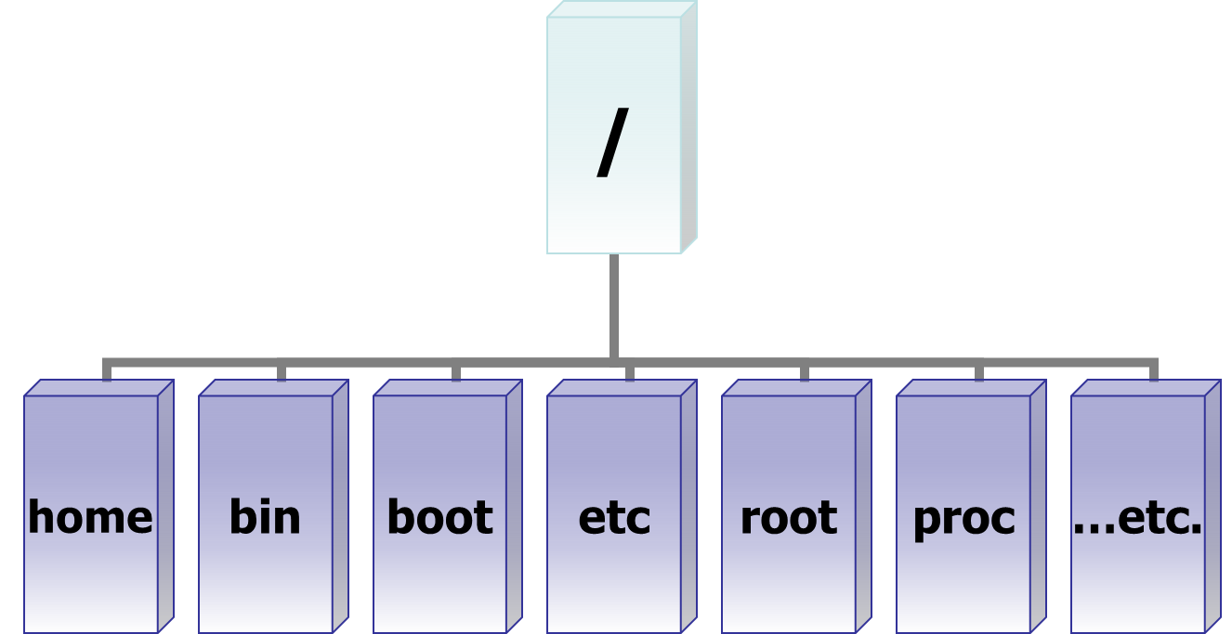
Inverted Tree Structure

Slide 12
File Types
File Types
$lsof /bin/vi - List open files
regular
Directory
Special
Device
Link
Socket
FIFO
Character
Soft
Block
Hard

Slide 13
$ ls -l
Identification of File types
? r w - r- - r- -
?-specifies a type of a file
Regular (-)
Directory (d)
Special Files
Special Files
FIFO (p)
Socket (S)
Link File
Soft Link (l)
Hard Link (inode numbers are same)
Device File
Character (c)
Example: Monitor, Keyboard, Mouse, Tape
Block (b)
Example: Hard disk, CDROM, Floppy

Slide 14
File System
VFS
XFS
ext4
UFS
proc
msdos
iso9660
Vfat
Aufs
…….
Facilitates persistent storage and data management
Facilitates file related system calls.
Different types of file system for different needs –depends on implementation
A logical file system appears as a single entity to the user process, but it may be composed of a number of physical file systems.

Slide 15
File System Architecture
open
write
read
lseek
ioctl
close
0
1
2
fd -> 3
fd Table
Virtual File System (VFS)
XFS
UFS
/ proc
Buffer Cache
UNIX Files
Regular
Directory
Link (Soft and Hard)
FIFO
Socket
Character Device
Block Device
Device Drivers
Physical Devices

Slide 16
XFS File System

Slide 17
XFS File System
When you create a file system, Linux creates a number of blocks on that device.
Boot Block
Super-block
I-node table
Data Blocks
Linux also creates an entry for the “/” (root) directory in the I-node table, and allocates data block to store the contents of the “/” directory.
The super-block contains info. such as
a bitmap of blocks on the device, each bit specifies whether a block is free or in use.
the size of a data block
the count of entries in the I-node table
the date and time when the file system was last checked
the date and time when the file system was last backed up
B
S
inode table
Data blocks

Slide 18
XFS File System
Each device also contains more than one copy of the super-block.
Linux maintains multiple copies of super-block, as the super-block contains information that must be available to use the device.
If the original super-block is corrupted, an alternate super-block can be used to mount the file system.
The I-node table contains an entry for each file stored in the file system. The total number of I-nodes in a file system determine the number of files that a file system can contain.
When a file system is created, the I-node for the root directory of the file system is automatically created.
Each I-node entry describes one file.

Slide 19
XFS File System
Each I-node contains following info
file owner UID and GID
file type and access permissions
date/time the file was created, last modified, last accessed
the size of the file
the number of hard links to the file
Each I-node entry can track a very large file
Ordinary file creation
The kernel allocates space in the hard disk. The text in the file is stored one character per byte of memory.
The file holds these characters and nothing more. It does not contain any information about its beginning or ending.
An inode entry is created on a section of the disk set aside for this purpose.

Slide 20
Device Special File
A device special file describes following characteristics of a device
Device name
Device type (block device or character device)
Major device number (for example ‘2” for floppy, “3” for hard-disk )
Minor device number (such as “1” for “hda1”)
Switch Table - Unix kernel maintains a set of tables using the major device numbers.
The switch table is used to find out which device driver should be invoked
For example : fd –> file table –> inode table –> switch table –> device drivers

Slide 21
$mount Command
Each file is located on a file system.
Each file system is created on a device, and associated with a device special file.
Therefore, when you use a file, Unix can find out which device special file is associated with that file and send your request to corresponding device driver.
Each file system must be mounted before it can be used. Normally, all file systems are mounted during system startup depending on /etc/fstab entry
root file system is mounted by default
It is possible to mount a file system at any time using the “mount” command.

Slide 22
$mount Command
The “dev” directory contains names of each device special file.
Each file system has a “/” (root) directory. However, once a file system is mounted, it’s the root directory that is accessed through mount point.
A file system is mounted typically under an empty directory. This directory is called the “mount point” for the file system.
When a file system is mounted, the system reads the I-node table and the super-block into memory.
The in-memory I-node table is used when a process tries to access a file.
If kernel does not find an entry in this I-node table, it reads the I-node from the on-disk I-node table into in-memory I-node table.
File system can be unmounted using umount cmd
You can use mount command to find how many file systems are mounted, and what is the mount point for each file system :
Screen shot of mount command
$ mount
/dev/hda2 on / type ext2 (rw)
none on /proc type proc (rw)

Slide 23
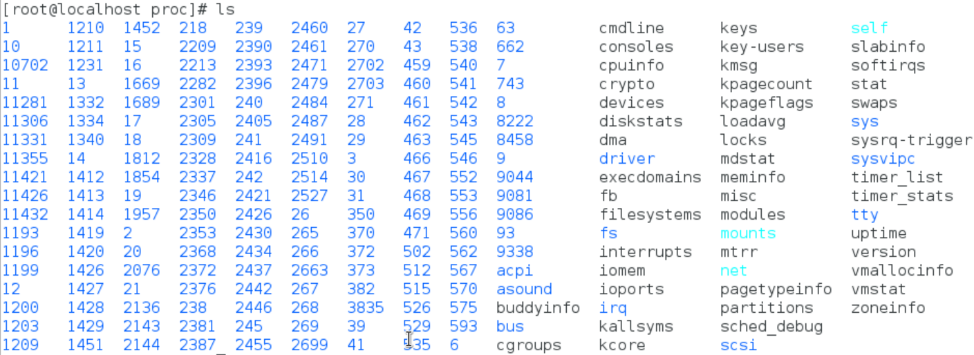
procfs
To store necessary information about currently running processes, system information and limitations. Size of /proc is zero. Created on the fly.

Slide 24
Buffer Cache
The file system also maintains a buffer cache.
The buffer cache is stored in physical memory (non-paged memory).
The buffer cache is used to store any data that is read from or written to a block-device such as a hard-disk, floppy disk or CD-ROM.
It reduces disk traffic and access time
If data is not present in buffer cache
the system allocates a free buffer in buffer cache
reads the data from the disk
stores the data in the buffer cache.
If there is no free buffer in the buffer cache
the system selects a used buffer
writes it to the disk
marks the buffer as free
allocates it for the requesting process.
While all this is going on, the requesting process is put to wait state.
Once a free buffer is allocated and data is read from disk into buffer cache, the process is resumed.
A process can use the sync() system call to tell the system that any changes made by itself in the buffer cache must be written to the disk.

Slide 25
I/O Handling
overview
fd table
System Calls
Opening a file
Duplicating a file descriptor
Random Access
File control
Get file status
select system call

Slide 26
Overview –I/O
The basic model of I/O system is a sequence of bytes that can be accessed either randomly, or sequentially.
There are no file formats (sequential, indexed etc.) and no control blocks (such as a file control block) in a typical user process.
The I/O system is visible to a user process as a stream of bytes (I/O stream). A Unix process uses descriptors (small unsigned integers) to refer to I/O streams.
The system calls related to the Input-Output operations take a descriptor as an argument.
Each process has a separate File Descriptor (FD) Table.
Valid file descriptor ranges from 0 to a maximum descriptor number that is configurable.
Kernel assigns descriptors for standard input (0), standard output (1) and standard error (2) of the FD table as part of process creation.
Kernel always assign minimum possible value from the fd table to any new file descriptors.
The system calls related to the I/O system take a descriptor as an argument to handle a file.
The descriptor is a positive integer number.
If a file open is not successful, fd returns -1.

Slide 27
fd Table
fd table
fd table Process 1
fd table Process 2
0 - stdin
0 - stdin
0 - stdin
1 - stdout
1 - stdout
1 - stdout
2 - stderr
2 - stderr
2 - stderr
3 - file1
3 - file1
File 1
3 - file1
4 - file2
4 - file2
4 - file3
File 2
File 3

Slide 28
Interaction between fd and Data Block

Slide 29
User Process Accessing Device Special File

Slide 30
System Calls
File descriptor table (fd, process specific)
File table (offset, mode,permission, pointer to inode table)
Inode Table (inode number, pointer to Data Block).
Switch table (only for device special files)
Data Block (where a file is stored)
The system call code is physically located in the kernel. The kernel itself is stored in a separate area of memory - which is normally not accessible to the process.
Therefore, the first thing that is required to execute a system call is to change to Kernel Mode - so that the kernel memory can be accessed - this is what the “int 0x80” instruction in system call wrapper function (on Intel) does.
Library Functions (Application Programs)
fopen, fwrite, fread, fclose
System Calls (System Programs)
open, write, read, close
Entry Points (Kernel Programs)
my_open, my_write, my_read, my_release

Slide 31
read(fd, &buff, sizeof(buf))
creat / open
read, write
lseek
close, unlink
dup / dup2
fcntl
stat
select
sync
Return to caller - 10
Library procedure
read
Trap to the kernel - 6
Put code for read in register
5
Increment stack pointer -11
User Space
User program calling read
Call read - 4
Push fd - 3
Push &buf - 2
Push sizeof(buf) -1
9
7
Dispatch
System call
handler
Kernel Space
8
System Call vector table

Slide 32
System Calls
int creat (char *file_name, mode_t mode)
int open(char *file_name, int flags);
int open (char *file_name, int flags,mode_t mode);
Ex: fd = open(“temp”, O_RDWR|O_CREAT, 0744);
dup or dup2 copies the oldfd into the newfd.
int new_fd = dup (old_fd);
int dup2 (int new_fd, int old_fd);
new_fd and old_fd shares: locks, file position and flags.
int write ( int fd, const void *buf, int count); it writes count bytes to the file from the buf.
On success return with: Number of bytes written
0 - indicates nothing was written or -1 on error.

Slide 33
System Calls
int write ( int fd, const void *buf, int count);
it writes count bytes to the file from the buf.
On success return with: Number of bytes written
0 - indicates nothing was written or -1 on error.
int read ( int fd, void *buf, int count);
It reads count bytes from the file and store the data into the buf.
On success return with: Number of bytes read
0 - indicates end of the file or -1 on error.
int lseek (int fd, long int offset, int whence);
whence: SEEK_SET, SEEK_CUR or SEEK_END – from the end of file
On success the system call returns with any one of the following value:
Offset value or 0 or -1

Slide 34
System Calls
int stat (“file_name”, struct stat *);
int fstat (fd, struct stat *);
int lstat (“file_name”, struct stat *);
Select is a system call used to handle more than one file descriptor in an efficient manner.
int select (int n, fd_set *readfds, fd_set *writefds, fd_set *exceptfds, struct timeval *timeout);
fd_set is the file descriptor set, which is an arrays of file descriptors.
FD_CLR (int fd, fd_set *myset); FD_ISSET (int fd, fd_set *myset);
FD_SET (int fd, fd_set *myset); FD_ZERO (fd_set *myset);

Slide 35
I/O subroutine
write modifications to the disk file - void sync (void);
Close a fd - int close (fd);
int unlink(“file_name”) - equivalent to $rm file_name;
Linux uses internal routines for accessing a file. For example
namei() (convert a “file_name” into an inode)
iget() (reads an I-node)
iput() (writes an I-node)
bread() (read a block from buffer cache/disk)
bwrite() (write a block from buffer cache to disk)
getblk() (get a free block in the buffer cache)

Slide 36
I/O Scheduling Class
ls, cp, rm, mv, touch
Page / Buffer Cache
Scheduling Class:
Idle, best effort and RT
Priority: 0-7
I/O Scheduler
Request Queue
Disk Device Driver

Slide 37
File Locking
Share data in a file
Concurrent access
Race condition
Dead Lock
Synchronization
File locking

Slide 38
Types of Locking
Two Types
Mandatory locking
Lock an entire file
Advisory (or ) Record locking
Lock to specific byte range
Granularity
Improve Performance

Slide 39
Mandatory Vs Record Locking
p1
p4
p1
p4
READ
WRITE
READ
WRITE
1 Sec
1 Sec
1 Sec
1 Sec
READ
FILE
p2
p2
READ
WRITE
Processes
Operating
on different
Records
1 Sec
WRITE
p5
1 Sec
READ
p5
READ
1 Sec
1 Sec
p3
1 Sec
p3
1 Sec
Total Time = 1 + 1 +1= 3 sec
Total Time = 1 sec

Slide 40
flock Structure
struct flock {
short l_type;
/* lock type: read, write or unlock */
short l_whence;
off_t l_start;
off_t l_len;
pid_t l_pid;
};
Read lock: allows many readers but not a single writer
Write lock: allows only one writer but not a single reader
Lock or unlock is performed by fcntl function.
int fcntl (int fd, int cmd, struct flock &);
Command may be:
F_SETLKW
F_SETLK
F_GETLK

Slide 41
Non-Shared Lock –Mandatory File Locking

Slide 42
Shared Lock – Mandatory File Locking

Slide 43
Shared Lock – Advisory or Record Locking

Slide 44
Sketch of File Locking Implementation

Slide 45
Process Management
mode and space
Context switch
Per process objects
Execution Context
Process structure
Process states
Process scheduling
Process Creation - fork
execl family of Library functions

Slide 46
Introduction
Process is a program in execution.
Processes carry out tasks in a system
A process includes program counter (PC), CPU registers and process stacks, which contains temporary data.
Linux is a multiprocessing system
The Linux kernel is reentrant
A process uses many resources like memory space, CPU, files, etc., during its lifetime.
Kernel should keep track of the processes and the usage of system resources.
Kernel should distributes resources among processes fairly.
Most important resource is CPU. In a multiprocessing environment, to attain an ideal performance of a system, the CPU utilization should be maximum.

Slide 47
Context Switch
In order to run unix, the computer hardware must provide two modes of execution
kernel mode
user mode
Some computers have more than two execution modes
eg: Intel processor. It has four modes of execution.
Each process has virtual address space , references to virtual memory are translated to physical memory locations using set of address translation maps.
Execution control is changing from one process to another.
When a current process either completes its execution or is waiting for a certain event to occur, the kernel saves the process context and removes the process from the running state.
Kernel loads next runnable process’s registers with pointers for execution.
Kernel space: a fixed part of virtual address space of each process . It maps the kernel text and data structures.

Slide 48
Execution Context
Kernel functions may execute either in process context or in system context
User code runs in user mode and process context, and can access only the process space
System calls and signals are handled in kernel mode but in process context, and may access process and system space
Interrupts and system wide tasks are handled in kernel mode and system context, and must only access system space
Every process is represented by a task_struct data structure.
This structure is quite large and complex.
When ever a new process is created a new task_struct structure is created by the kernel and the complete process information is maintained by the structure.
When a process is terminated, the corresponding structure is removed.
Uses doubly linked list data structure.

Slide 49
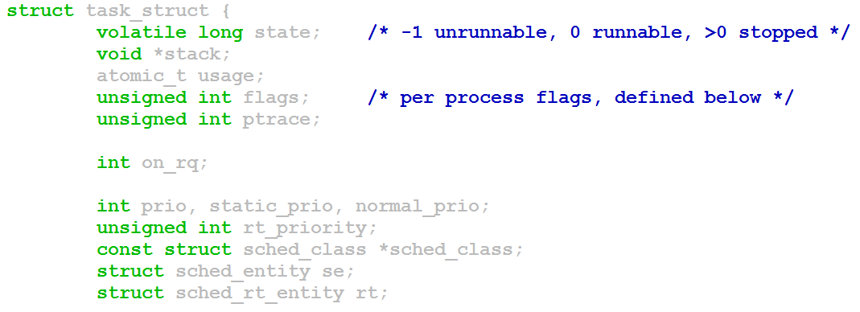
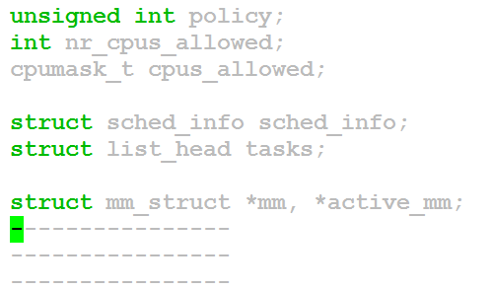
Task_struct Structure - /usr/src/linux-4.12/include/linux/sched.h

Slide 50
Process States
Running
(User Mode)
Run Queue
Running
(Kernel)
Zombie
fork ( )
exit
TASK_RUNNING
TASK_INTERRUPTIBLE
TASK_UNINTERRUPTIBLE
TASK_STOPPED
TASK_ZOMBIE
Wake up
Sleeping
or
Stopped

Slide 51
Scheduling
Every process in the system has a process identifier.
The process identifier is not an index into the task vector, it is simply a number.
Each process also has User and Group identifiers, these are used to control the process access to the files and devices in the system
The kernel keeps track of a processes creation time as well as the CPU time that it consumes during its lifetime.
This clock is the combination of software and hardware setup.
It is independent of CPU frequency.
A clock tick unit is Jiffy. System‘s interactive response depends on the clock frequency.
For example: the jiffy value may be 10ms (100Hz) or 1ms (1000Hz) depending on implementation

Slide 52
Process Scheduling
Each clock tick, the kernel updates the amount of time that the current process has spent in system and in user mode.
Linux also supports process specific interval timers, processes can use system calls to set up timers to send signals to themselves when the timers expire. These timers can be single-shot or periodic timers.
The job of a scheduler is to select the most deserving process to run out of all of the runnable processes in the run queue.
Implement fair scheduling to avoid starvation
Implement suitable scheduling policy
Updates state of the processes in every clock tick (jiffy)

Slide 53
Process Scheduling
policy - FIFO, Round Robin, Shortest Job First, FILO, Priority based etc.
priority - higher priority process will be allowed to run.
Pre-emptive and Non-preemptive scheduling
rt_priority – many UNIX variants support real time scheduling priority range.
The Linux kernel implements two separate priority ranges.
The first is the nice value, a number from -20 to 19 with a default of zero. Larger nice values correspond to a lower priority.
A process with a nice value of -20 receives the maximum time slice, whereas a process with a nice value of 19 receives the minimum time slice.
Time slice: minimum -10ms, default -150ms and maximum – 300ms

Slide 54
Process Scheduling
The second range is the real-time priority
By default, it ranges from zero to 99.
All real time processes are at a higher priority than normal processes.
Linux implements real-time priorities in accordance with POSIX.
Linux provides two real-time scheduling policies, SCHED_FIFO and SCHED_RR.
The normal non real-time scheduling policy is SCHED_OTHER.
SCHED_FIFO implements without time slices- so it can run until it blocks or explicitly yields the processor.
SCHED_RR is identical to SCHED_FIFO except that each process can only run until it exhausts a predetermined time slice.

Slide 55
Linux Scheduling Priority
Real Time
Non - Real Time
SCHED_FIFO
SCHED_RR
SCHED_OTHER
0
99
139
FIXED
DYNAMIC
Non - Real Time Process
Priority
-20
0
+19
Priority
300 ms
150 ms
10 ms
Time Slice

Slide 56
Linux Scheduling Priority
HIGER PRIORITY
LOWER PRIORITY
0
1
50
70
88
98
100
139
138
139
SYSTEM PRIORITY
99
98
3
0
REAL TIME PRIORITY
-20
0
19
NICE LEVEL
RT
-98
-80
-55
-5
0
38
39
$top OUTPUT

Slide 57
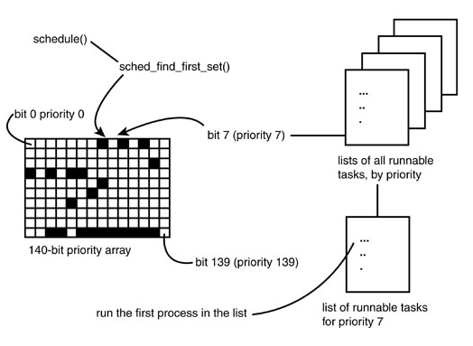
O(1) Scheduler
Ref: Linux Kernel Development by Robert Love

Slide 58
nice and chrt –Manipulate Scheduling Priorities
Command Priority nice
$nice --adjustments=-21 ./a.out 0 -20
$nice --adjustments=-20 ./a.out 0 -20
$nice --adjustments=-19 ./a.out 1 -19
$nice --adjustments=-10 ./a.out 10 -10
$nice --adjustments=-5 ./a.out 15 -5
$nice --adjustments=-1 ./a.out 19 -1
$nice --adjustments=-0/0 ./a.out 20 0
$nice --adjustments=1 ./a.out 21 1
$nice --adjustments=5 ./a.out 25 5
$nice --adjustments=19 ./a.out 39 19
$nice --adjustments=20 ./a.out 39 19
Command Priority nice
$chrt -r –p -1 <pid> < NOT VALID COMMEND>
$chrt -r –p 0 <pid> 20 0
$chrt -r –p 1 <pid> -2 0
$chrt -r –p 5 <pid> -6 0
$chrt -r –p 50 <pid> -51 0
$chrt -r –p 90 <pid> -91 0
$chrt -r –p 98 <pid> -99 0
$chrt -r –p 99 <pid> RT 0
$chrt -r –p 100 <pid> < NOT VALID COMMEND>

Slide 59
Process Scheduling Commands
$nice -19 ./***.sh; top ;
r -> pid to renice; renice value: 10
$man chrt (1)
$chrt –m
Show minimum and maximum valid priorities.
$chrt -p <pid>
To display scheduling attributes of an existing task
$chrt -r -p 99 <pid>
Set scheduling policy to SCHED_RR
$ top -p <pid>
$chrt -f -p 99 <pid>
Set scheduling policy to SCHED_FIFO
$chrt -o -p 0 <pid>
Set scheduling policy to SCHED_OTHER
man 2 sched_setscheduler

Slide 60
System Calls for Scheduling
nice() Set a process's nice value
sched_setscheduler() Set a process's scheduling policy
sched_getscheduler() Get a process's scheduling policy
sched_setparam() Set a process's real-time priority
sched_getparam() Get a process's real-time priority
sched_get_priority_max() Get the maximum real-time priority
sched_get_priority_min() Get the minimum real-time priority
sched_rr_get_interval() Get a process's timeslice value

Slide 61
Process Creation
A Command is normally executed in a shell
When you enter a command, the shell searches the corresponding command’s executable image (use PATH environment variable) and loads the image then executes.
For execution, the shell uses fork and creates a new child process and the child process’s image is replaced with the command’s executable image.
After completion of execution of the child process it gives the exit status to the parent process, i.e, shell.
Resources
Data
Resources
Text
Stack
Process Status
File
File
Linux kernel

Slide 62
Process Tree Structure
In a Linux system no process is independent of any other process.
Every process in the system, except the initial process has a parent process.
New processes are not created, they are copied, or cloned from previous processes.
Every task_struct representing a process keeps pointers to its parent process and as well as to its own child processes
$pstree – process tree structure shows the process dependency.
Parent process creates children processes, which, in turn create other processes, forming a tree of processes.
Resource sharing
Parent and children share all resources.
Children share subset of parent’s resources.
Parent and child share no resources.
Execution
Parent and children execute concurrently.
Parent waits until children terminate.
Address space
Child duplicate of parent.
Child has a program loaded into it.

Slide 63
Parent and Child
if (!fork) {
/* Child Code */
}
else {
/* parent code */
wait (0); /* or */
waitpid(pid, ….);
}
pid_t fork (void); creates a new process
All statements after the fork() system call in a program are executed by two processes - the original process that used fork(), plus the new process that is created by fork( )
main ( ) {
printf (“ Hello fork %d\n, fork ( ) ”);
}
Hello fork: 0
Hello fork: x ( > 0);
Hello fork: -1

Slide 64
COW, Zombie and Orphan Process
Instead of copying the address space of the parent, Linux uses the COW technique for economical use of the memory page.
The parent space is not copied, it can be shared by both the parent and the child process but the memory pages are marked as write protected.
if parent or child wants to modify the pages, then kernel copies the parent pages to the child process.
Advantage: Kernel can defer or prevent copying of a parent process address space.
When a child process exits, it has to give the exit status to the parent process.
If the parent process is busy or suspended then the child process will not be able to terminate.
Such state is called Zombie.
if parent exits before child, the child will become an orphan process and the init process (grand parent) will take care of the child process.

Slide 65
exec Family of Functions
To run a new program in a process, you use one of the “exec” family of calls (such as “execl”) and specify following:
the pathname of the program to run, the name of the program
each parameter to the program
(char *)0 or NULL as the last parameter to specify end of parameter list
int execl (const char *path, const char *arg, …..);
int execlp (const char *file, const char *arg);
int execle (const char *path, const char *arg, ……., char *const envp[ ]);
int execv (const char *path, char *const argv[ ]);
int execvp (const char *file, char *const argv[ ]);
All the above library functions call internally execve system call.
int execve (const char *filename, char *const argv [ ] , char *const evnp [ ]);

Slide 66
An Executable Image
The text portion of a process contains the actual machine instructions that are executed by the hardware.
When a program is executed by the OS, the text portion is read into memory from its disk file, unless the OS supports shared text and a copy of program is already being executed.
Stack
Heap
Uninitialised data
The data portion contains the program’s data. It is possible for this to be divided into 3 pieces
Initialized read only data contains elements that are initialized by the program and are read only while the process is executing.
Initialized read write data contains data elements that are initialized by the program and may have their values modified during execution of the process.
Un-initialized data contains data elements that are not initialized by the program but are set to zero before execution starts .
Initialized read-write data
Initialized Read-only data
Text
$ size a.out (man size )
text data bss dec hex filename
920 268 24 1212 4bc a.out

Slide 67
Stack Portion
The heap is used while a process is running to allocate more data space dynamically to the process.
The stack is used dynamically while the process is running to contain the stack frames that are used by many programming languages.
The stack frames contain the return address linkage for each function call and also the data elements required by a function.
A gap is shown between heap and stack to indicate that many OS leave some room between these 2 portions, so that both can grow dynamically.
The kernel context of a process is maintained and accessible only to the kernel. This area contains info that the kernel needs to keep track of the process and to stop and restart the process while other processes are allowed to execute.

Slide 68
Daemon Process
Daemon process starts during system startup
They frequently spawn other process to handle services requests
Mostly started by initialization script /etc/rc
Waits for an event to occur
perform some specified task on periodic basis (cron job)
perform the requested service and wait
Example print server
executed as the background process
Orphan process
No controlling terminal
run with super user privileges
process group leaders
session leaders

Slide 69
Daemon Process Creation
Process Types
Parent
Child
Orphan
Daemon
int init_daemon ( void ) {
if ( ! fork ( ) ) {
setsid ( ) ;
chdir ( " / " ) ;
umask ( 0 ) ;
/* Specify Your Job */
return ( 0 );
}
else
exit ( 0 );
}
Process States
Running (R)
Stopped (T)
Sleep
Interruptible (S)
Uninterruptible (D)
Zombie (Z)

