Slide 1
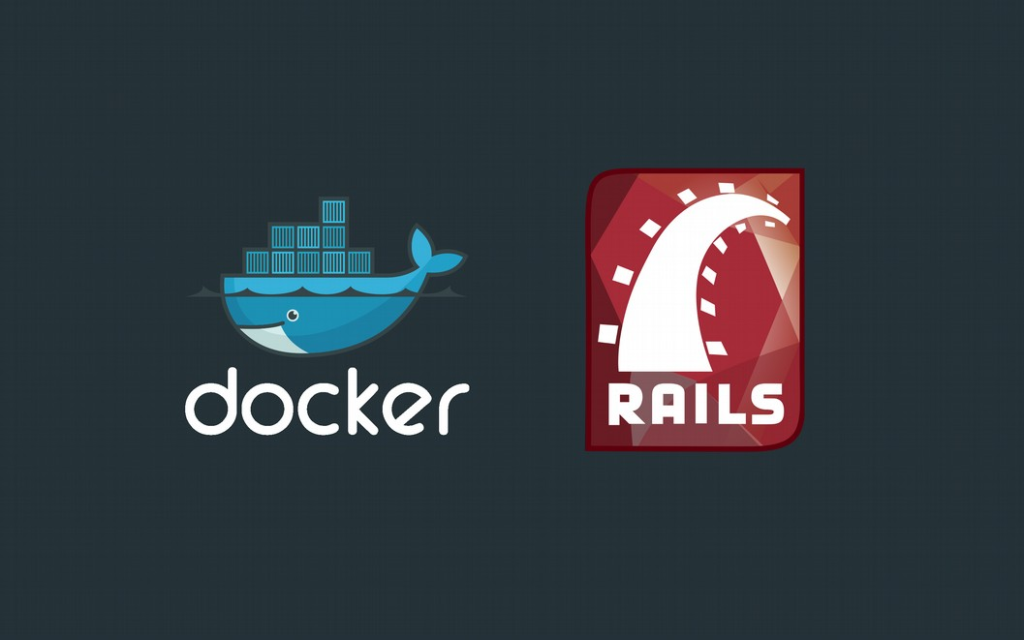
Deploy Rails With Docker
Dwi Fahni Denni (dfdenni) https://github.com/zeroc0d3

Slide 2
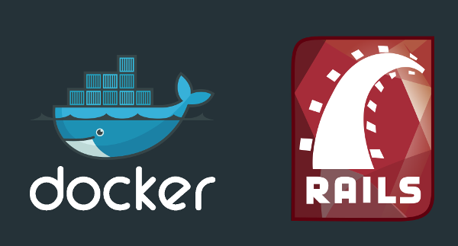
Deploy Rails With Docker
Dwi Fahni Denni (dfdenni) :: https://github.com/zeroc0d3
What’s Docker
Why Docker
Container v.s Virtualization
Docker Setup & Installation
Docker Tools
Build Simple Dockerfile
Create New Simple Rails Application
Deploy Rails Application
Test Driven Development (TDD) Dockerfile

Slide 3
Deploy Rails With Docker
Dwi Fahni Denni (dfdenni) :: https://github.com/zeroc0d3
introduction #{me}
Dwi Fahni Denni (dfdenni)
Security Researcher | Full Stack Web Developer | Archer

Slide 4
Deploy Rails With Docker
Dwi Fahni Denni (dfdenni) :: https://github.com/zeroc0d3
daily #{activity}
Full Stack Engineer @ domikado.com
(Web App, Mobile App & SEO Marketing Consultant)
System Analyst @ nfndp.com
(Architecture, Master Plan, Urban, Interior Design Consultant)

Slide 5
Deploy Rails With Docker
Dwi Fahni Denni (dfdenni) :: https://github.com/zeroc0d3
daily #{community}
Founder ZeroC0D3 Team
(Independent Security Researcher)
Contributor & Maintainer Laradock
(A Docker PHP Development Environment)
https://github.com/laradock/laradock

Slide 6
Deploy Rails With Docker
Dwi Fahni Denni (dfdenni) :: https://github.com/zeroc0d3
def #{whats}
What’s Docker

Slide 7
Deploy Rails With Docker
Dwi Fahni Denni (dfdenni) :: https://github.com/zeroc0d3
def #{why}
Why Docker

Slide 8
Deploy Rails With Docker
Dwi Fahni Denni (dfdenni) :: https://github.com/zeroc0d3
def #{compare}
Container v.s Virtualization

Slide 9
Deploy Rails With Docker
Dwi Fahni Denni (dfdenni) :: https://github.com/zeroc0d3
def #{req}
Requirements

Slide 10
Deploy Rails With Docker
Dwi Fahni Denni (dfdenni) :: https://github.com/zeroc0d3
def #{begin}
Installation & Setup

Slide 11
Deploy Rails With Docker
Dwi Fahni Denni (dfdenni) :: https://github.com/zeroc0d3
def #{tools}
Docker Tools

Slide 12
Deploy Rails With Docker
Dwi Fahni Denni (dfdenni) :: https://github.com/zeroc0d3
def #{demo1}
Create Simple Dockerfile

Slide 13
Deploy Rails With Docker
Dwi Fahni Denni (dfdenni) :: https://github.com/zeroc0d3
def #{demo2}
Build & Run
Docker Container

Slide 14
Deploy Rails With Docker
Dwi Fahni Denni (dfdenni) :: https://github.com/zeroc0d3
def #{demo3}
Create New Rails Application

Slide 15
Deploy Rails With Docker
Dwi Fahni Denni (dfdenni) :: https://github.com/zeroc0d3
def #{demo4}
Setup Configuration Rails

Slide 16
Deploy Rails With Docker
Dwi Fahni Denni (dfdenni) :: https://github.com/zeroc0d3
def #{deploy}
Deploy Rails In
Different Environments

Slide 17
Deploy Rails With Docker
Dwi Fahni Denni (dfdenni) :: https://github.com/zeroc0d3
def #{demo5}
Running Capistrano For
Deploying Environment Docker Container
(Development & Production)

Slide 18
Deploy Rails With Docker
Dwi Fahni Denni (dfdenni) :: https://github.com/zeroc0d3
def #{run}
Running Rails From
Docker Container

Slide 19
Deploy Rails With Docker
Dwi Fahni Denni (dfdenni) :: https://github.com/zeroc0d3
def #{demo6}
Restart Unicorn - Optional
(Development & Production*)
*) NO NEED to run if causing downtime

Slide 20
Deploy Rails With Docker
Dwi Fahni Denni (dfdenni) :: https://github.com/zeroc0d3
def #{evaluate}
Test Driven Development
(TDD) Dockerfile

Slide 21
Deploy Rails With Docker
Dwi Fahni Denni (dfdenni) :: https://github.com/zeroc0d3
def #{demo7}
Running TDD Dockerfile
From RSpec

Slide 22
Deploy Rails With Docker
Dwi Fahni Denni (dfdenni) :: https://github.com/zeroc0d3
def #{qa}
Questions ?

Slide 23
Deploy Rails With Docker
Dwi Fahni Denni (dfdenni) :: https://github.com/zeroc0d3
def Presentation
puts #{Thanks}
end

Slide 24
Deploy Rails With Docker
Dwi Fahni Denni (dfdenni) :: https://github.com/zeroc0d3
def #{email}
denni@domikado.com
dfdenni@nfndp.com

