Slide 1
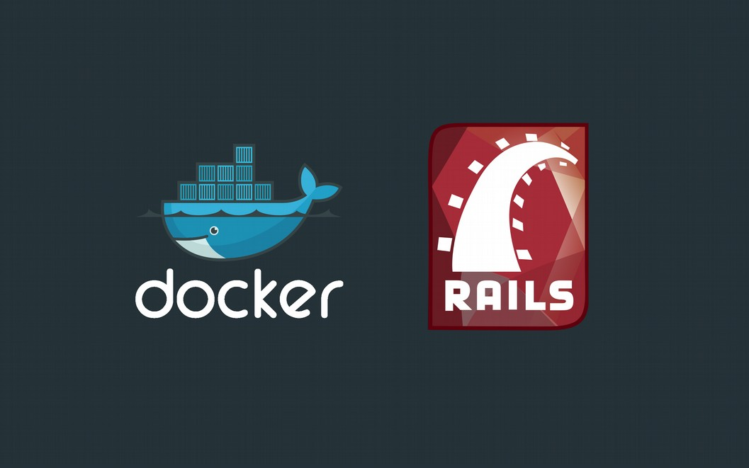
Deploy Rails With Docker
Dwi Fahni Denni (dfdenni) https://github.com/zeroc0d3

Slide 2

Deploy Rails With Docker
Dwi Fahni Denni (dfdenni) :: https://github.com/zeroc0d3
What’s Docker
Why Docker
Container v.s Virtualization
Docker Setup & Installation
Docker Tools
Build Simple Dockerfile
Create New Simple Rails Application
Deploy Rails Application
Test Driven Development (TDD) Dockerfile

Slide 3
Deploy Rails With Docker
Dwi Fahni Denni (dfdenni) :: https://github.com/zeroc0d3
daily #{activity}
Full Stack Engineer @ domikado.com
(Web App, Mobile App & SEO Marketing Consultant)
System Analyst @ nfndp.com
(Architecture, Master Plan, Urban, Interior Design Consultant)

Slide 4
Deploy Rails With Docker
Dwi Fahni Denni (dfdenni) :: https://github.com/zeroc0d3
daily #{community}
Founder ZeroC0D3 Team
(Independent Security Researcher)
Contributor & Maintainer Laradock
(A Docker PHP Development Environment)
https://github.com/laradock/laradock

Slide 5
Deploy Rails With Docker
Dwi Fahni Denni (dfdenni) :: https://github.com/zeroc0d3
def #{logs}
Real World Changes

Slide 6
Deploy Rails With Docker
Dwi Fahni Denni (dfdenni) :: https://github.com/zeroc0d3
def #{logs} :: Real World Changes
COMPARE | BEFORE | NOW
Application | Monolithic | Decouple Services (microservices)
Development Cycle | Long Cycle | Fast, Iterative improvements
Environment | Single | Multiple
Scaling Up | Slow | Fast

Slide 7
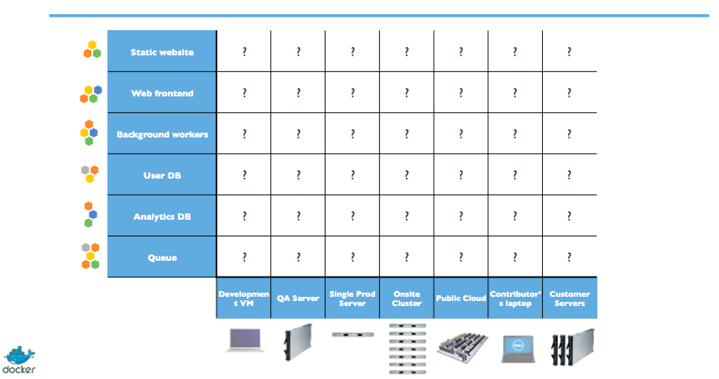
Deploy Rails With Docker
Dwi Fahni Denni (dfdenni) :: https://github.com/zeroc0d3
def #{logs} :: The Matrix from “Hell”

Slide 8
Deploy Rails With Docker
Dwi Fahni Denni (dfdenni) :: https://github.com/zeroc0d3
def #{problem}
Deployment Problems

Slide 9
Deploy Rails With Docker
Dwi Fahni Denni (dfdenni) :: https://github.com/zeroc0d3
def #{problem} :: Stacks & Targets
STACKS | TARGETS
Languanges | Individual development environments
Framework | Pre-production, QA, Staging, etc
Database | Production: on premise, cloud, hybrid

Slide 10
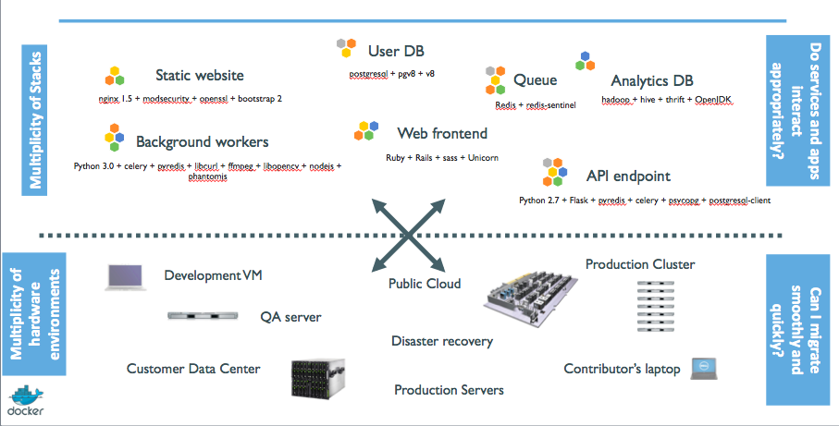
Deploy Rails With Docker
Dwi Fahni Denni (dfdenni) :: https://github.com/zeroc0d3
def #{problem} :: Deployment Problems

Slide 11
Deploy Rails With Docker
Dwi Fahni Denni (dfdenni) :: https://github.com/zeroc0d3
def #{whats}
What’s Docker

Slide 12

Deploy Rails With Docker
Dwi Fahni Denni (dfdenni) :: https://github.com/zeroc0d3
def #{whats} :: What’s Docker
Docker is an open source containerization engine, which automates the packaging, shipping, and deployment of any software applications that are presented as lightweight, portable, and self-sufficient containers, that will run virtually anywhere.
A Docker container is a software bucket comprising everything necessary to run the software independently. There can be multiple Docker containers in a single machine and containers are completely isolated from one another as well as from the host machine.
Docker container includes a software component along with all of its dependencies (binaries, libraries, configuration files, scripts, jars, and so on)
Docker is an Open Platform to Build, Ship, and Run Distributed Applications

Slide 13
Deploy Rails With Docker
Dwi Fahni Denni (dfdenni) :: https://github.com/zeroc0d3
def #{why}
Why Docker

Slide 14
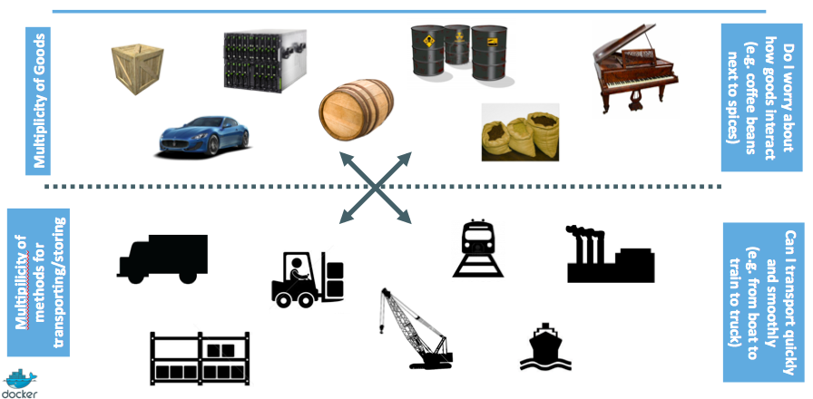
Deploy Rails With Docker
Dwi Fahni Denni (dfdenni) :: https://github.com/zeroc0d3
def #{answer1} :: Why Docker

Slide 15
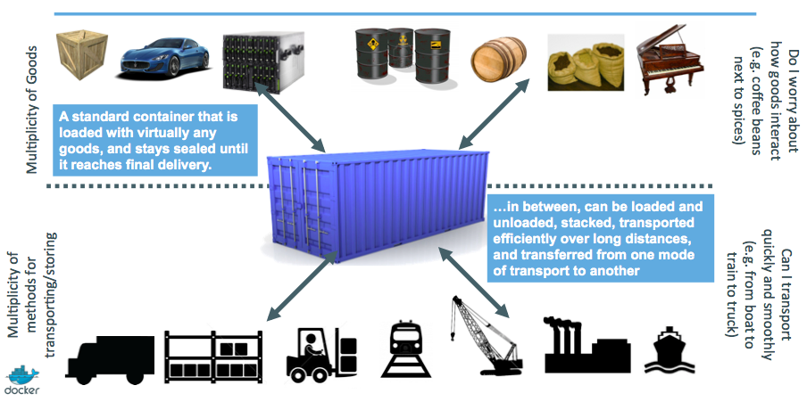
Deploy Rails With Docker
Dwi Fahni Denni (dfdenni) :: https://github.com/zeroc0d3
def #{answer2} :: Why Docker

Slide 16
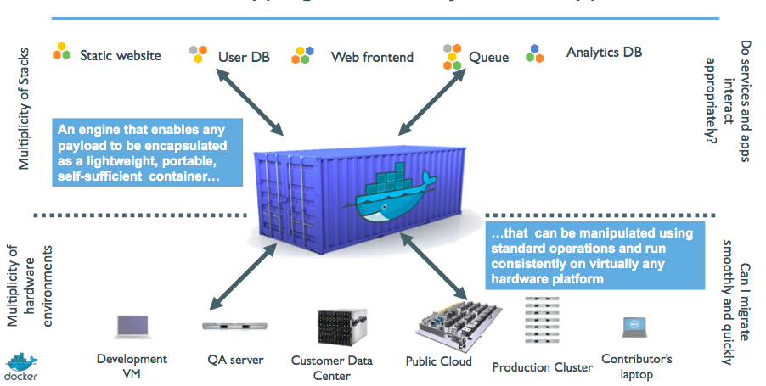
Deploy Rails With Docker
Dwi Fahni Denni (dfdenni) :: https://github.com/zeroc0d3
def #{answer3} :: Why Docker

Slide 17
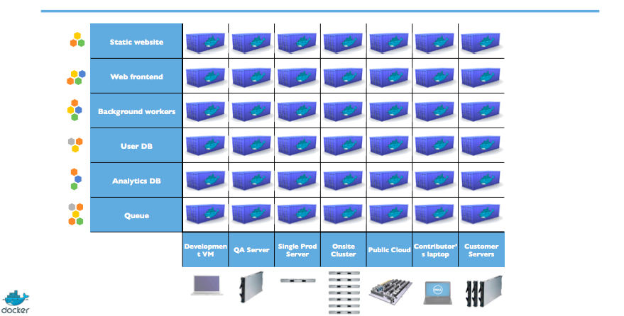
Deploy Rails With Docker
Dwi Fahni Denni (dfdenni) :: https://github.com/zeroc0d3
def #{solved} :: Eliminate The Matrix of “Hell”

Slide 18
Deploy Rails With Docker
Dwi Fahni Denni (dfdenni) :: https://github.com/zeroc0d3
def #{compare}
Container v.s Virtualization

Slide 19


Deploy Rails With Docker
Dwi Fahni Denni (dfdenni) :: https://github.com/zeroc0d3
def #{compare} :: Container v.s Virtualization

Slide 20
Deploy Rails With Docker
Dwi Fahni Denni (dfdenni) :: https://github.com/zeroc0d3
def #{req}
Requirements

Slide 21
Deploy Rails With Docker
Dwi Fahni Denni (dfdenni) :: https://github.com/zeroc0d3
def #{begin}
Installation & Setup

Slide 22
Deploy Rails With Docker
Dwi Fahni Denni (dfdenni) :: https://github.com/zeroc0d3
def #{tools}
Docker Tools

Slide 23
Deploy Rails With Docker
Dwi Fahni Denni (dfdenni) :: https://github.com/zeroc0d3
def #{demo1}
Create Simple Dockerfile

Slide 24
Deploy Rails With Docker
Dwi Fahni Denni (dfdenni) :: https://github.com/zeroc0d3
def #{demo2}
Build & Run
Docker Container

Slide 25
Deploy Rails With Docker
Dwi Fahni Denni (dfdenni) :: https://github.com/zeroc0d3
def #{demo3}
Create New Rails Application

Slide 26
Deploy Rails With Docker
Dwi Fahni Denni (dfdenni) :: https://github.com/zeroc0d3
def #{demo4}
Setup Configuration Rails

Slide 27
Deploy Rails With Docker
Dwi Fahni Denni (dfdenni) :: https://github.com/zeroc0d3
def #{deploy}
Deploy Rails In
Different Environments

Slide 28
Deploy Rails With Docker
Dwi Fahni Denni (dfdenni) :: https://github.com/zeroc0d3
def #{demo5}
Running Capistrano For
Deploying Environment Docker Container
(Development & Production)

Slide 29
Deploy Rails With Docker
Dwi Fahni Denni (dfdenni) :: https://github.com/zeroc0d3
def #{run}
Running Rails From
Docker Container

Slide 30
Deploy Rails With Docker
Dwi Fahni Denni (dfdenni) :: https://github.com/zeroc0d3
def #{demo6}
Restart Unicorn - Optional
(Development & Production*)
*) NO NEED to run if causing downtime

Slide 31
Deploy Rails With Docker
Dwi Fahni Denni (dfdenni) :: https://github.com/zeroc0d3
def #{evaluate}
Test Driven Development
(TDD) Dockerfile

Slide 32
Deploy Rails With Docker
Dwi Fahni Denni (dfdenni) :: https://github.com/zeroc0d3
def #{demo7}
Running TDD Dockerfile
From RSpec

Slide 33
Deploy Rails With Docker
Dwi Fahni Denni (dfdenni) :: https://github.com/zeroc0d3
def #{qa}
Questions ?

Slide 34
Deploy Rails With Docker
Dwi Fahni Denni (dfdenni) :: https://github.com/zeroc0d3
def Presentation
puts #{Thanks}
end

Slide 35
Deploy Rails With Docker
Dwi Fahni Denni (dfdenni) :: https://github.com/zeroc0d3
def #{email}
denni@domikado.com
dfdenni@nfndp.com

